Slide 1
Connecting code to data sources
Makes simple connections between code and defined data sources as specified (S4)
Explains the principles and uses of relational and non-relational (nosql) databases. (K11)
Notes:
Atomicity - Completed all transactions completed Fully
Consistency - Changes must not break it must be consistent
Isolation - Must be isolated and not interfere with other transactions
Durability - It must remain in the database even if system problem occur permanent.
SQL - Schema is the diagrammatic form Entity is a record ie customer
Attributes - ID Customer, First Name, Surname
No SQL - Document
No SQL - Graph
No SQL – Columna
Normalisation
1st Repeating attributes
2nd Partial key dependencies - ie employee name, dept ref number, dept name. Dept name depended on dept ref number.
3rd Last check Any attributes more dependant on other attributes (then create new tables)

Slide 2
Key features of databases and data stores
Relational databases
SQL and NoSQL
data files
data structures (tables, records, fields, definitions)
document
key-value

Slide 3
Relational Databases
A relational database is a set of formally described tables
Data can be accessed or reassembled in many different ways without having to reorganize the database tables.
The standard user and application programming interface (API) is SQL
SQL statements are used both for interactive queries for information from a relational database and for gathering data for reports.

Slide 4
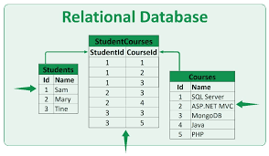
Relational Database typically uses SQL
A relational database includes tables containing rows and columns. For example, a typical business order entry database would include a table that describes a customer with columns for name, address, phone number and so forth

Slide 5
Schema
In a relational database you define tables and field types in a schema.
The schema optionally contains other information,
primary keys — unique identifiers such as an ISBN which apply to a single record
indexes — commonly queried fields indexed to aid quick searching
relationships — logical links between data fields
functionality such as triggers and stored procedures
The schema must be designed before implementation
Updates can be made later, but large changes can be complicated

Slide 6
SQL and NoSQL
 | SQL | NoSQL
Data storage | Stored in a relational model, with rows and columns. | Different data storage models. The main ones are: document, graph, key-value and columnar
Schemas and Flexibility | Each record conforms to fixed schema. The design must be decided and locked before data entry | Schemas are dynamic. Information can be added on the fly
Scalability | Scaling is vertical. In essence, more data means a bigger server, | Scaling is horizontal, more data means more servers. Many NoSQL technologies also distribute data across servers automatically.
ACID Compliancy (Atomicity, Consistency, Isolation, Durability) | The vast majority of relational databases are ACID compliant. | Many NoSQL solutions sacrifice ACID compliancy for performance and scalability

Slide 7
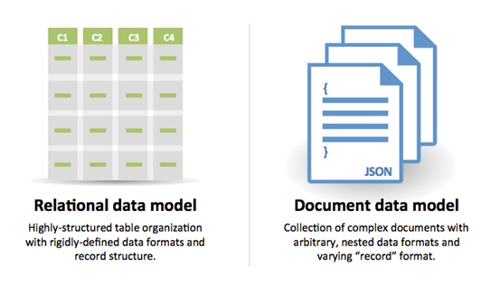
NoSQL - document
Data is stored in documents, and these documents are grouped together in collections. Each document can have a completely different structure.

Slide 8
NoSQl - graph
Data is stored in graph structures with nodes (entities), properties (information about the entities) and lines (connections between the entities)

Slide 9
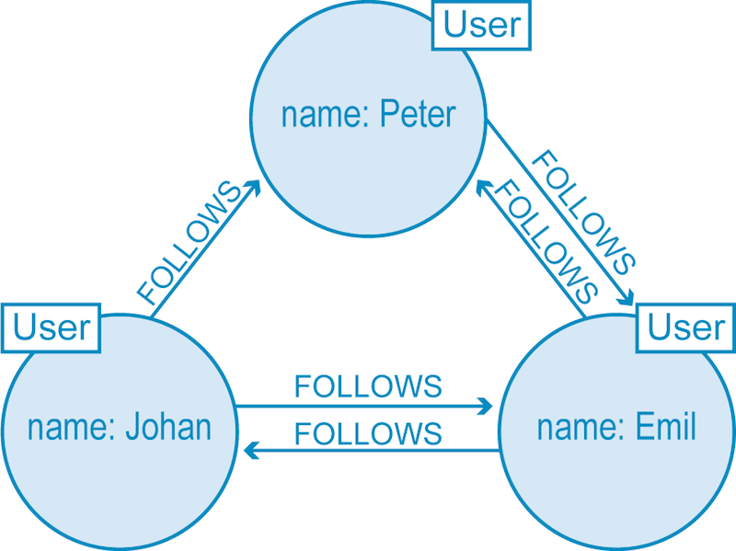
Twitter – No SQL graph
A great example: Twitter is a perfect example of a graph database connecting 330 million monthly active users.
In the illustration below, we have a small slice of Twitter users represented in a graph database. Each node (labeled User) belongs to a single person and is connected with relationships describing how each user is connected. As we see below, Peter and Emil follow each other, as do Emil and Johan, but although Johan follows Peter, Peter hasn’t (yet) reciprocated.

Slide 10
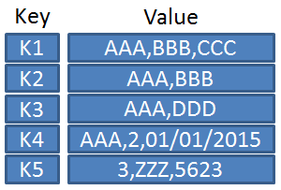
NoSQL – key value
Data is stored in an associative array of key-value pairs. The key is an attribute name, which is linked to a value
The values can be different data types or fields

Slide 11
NoSQL Columnar
In columnar databases you have column families, which are containers for rows.
No need to know all of the columns up front
Each row doesn’t have to have the same number of columns.
Columnar databases are best suited to analysing huge datasets
High performance for data analysis (read only)
Less efficient for update (read/write)

Slide 12
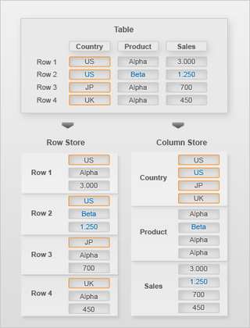
NoSQL Columnar
In a row store you have to access each row to total the sales
In a column store you have to access one column to total the sales

Slide 13
Good websites
Good tutorial mongo db - 17 mins
https://www.youtube.com/watch?v=bKjH8WhSu_E
sql vs no sql - 21 mins
https://www.youtube.com/watch?v=ZS_kXvOeQ5Y

Slide 14
Task 1
Write a definition in your own words for the 4 types of No SQL databases
Document
Graph
Key Value
Columnar
Write a definition in your own words describing key points of relational sql databases

