Slide 1
Introduction
Operating System Security & Defensive Programming
UFCFHU-30-2
Level 5
30 Credits

Slide 2
OS Security &
Defensive
Programming
Week 3
Intro
Monday
01
02
Wednesday
03
04
Tuesday
05
06
Thursday
Friday

Slide 3
Threats to operating systems
There are many sources to consider when researching threats to operating systems, here are some options to consider:
ENISA Threat Landscape – https://www.enisa.europa.eu/publications/enisa-threat-landscape-2021
Stack.watch – 2021 Security Vulnerability Statistics (stack.watch)
CISA – Known Exploited Vulnerabilities Catalog | CISA
NCSC Annual Review – https://www.ncsc.gov.uk/collection/ncsc-annual-review-2021
NCSC Weekly Threat Reports – https://www.ncsc.gov.uk/section/keep-up-to-date/threat-reports
Cybok – Knowledge Areas – https://www.cybok.org/knowledgebase1_1/

Slide 4
ENISA Threat Landscape Reports - 2021
The European Union Agency for CyberSecurity has recently produced two reports
https://www.enisa.europa.eu/publications/enisa-threat-landscape-2021 (October 2021)
https://www.enisa.europa.eu/publications/threat-landscape-for-supply-chain-attacks (July 2021)

Slide 5
ENISA Threat Landscape 2021
Exec Summary –
The time span of the ETL 2021 report is April 2020 to July 2021 and is referred to as the "reporting period" throughout the report.
During the reporting period, the prime threats identified include:
Ransomware
Malware
Cryptojacking
E-mail related threats
Threats against data
Threats against availability and integrity
Disinformation – misinformation
Non-malicious threats
Supply-chain attacks

Slide 6
ENISA Threat Landscape 2021
Exec Summary –
For each of the identified threats, attack techniques, notable incidents and trends are discussed along with proposed mitigation measures. As regards trends, during the reporting period we highlight the following:
Ransomware has been assessed as the prime threat for 2020-2021.
Governmental organisations have stepped up their game at both national and international level.
Cybercriminals are increasingly motivated by monetisation of their activities, e.g. ransomware. Cryptocurrency remains the most common pay-out method for threat actors.
Malware decline that was observed in 2020 continues during 2021. In 2021, we saw an increase in threat actors resorting to relatively new or uncommon programming languages to port their code.

Slide 7
ENISA Threat Landscape 2021
Exec Summary –
For each of the identified threats, attack techniques, notable incidents and trends are discussed along with proposed mitigation measures. As regards trends, during the reporting period we highlight the following:
The volume of cryptojacking infections attained a record high in the first quarter of 2021, compared to recent years. The financial gain associated with cryptojacking incentivised threat actors to carry out these attacks.
COVID-19 is still the dominant lure in campaigns for e-mail attacks.
There was a surge in healthcare sector related data breaches.
Traditional DDoS (Distributed Denial of Service) campaigns in 2021 are more targeted, more persistent and increasingly multivector. The IoT (Internet of Things) in conjunction with mobile networks is resulting in a new wave of DDoS attacks.
In 2020 and 2021, we observe a spike in non-malicious incidents, as the COVID-19 pandemic became a multiplier for human errors and system misconfigurations, up to the point that most of the breaches in 2020 were caused by errors

Slide 8
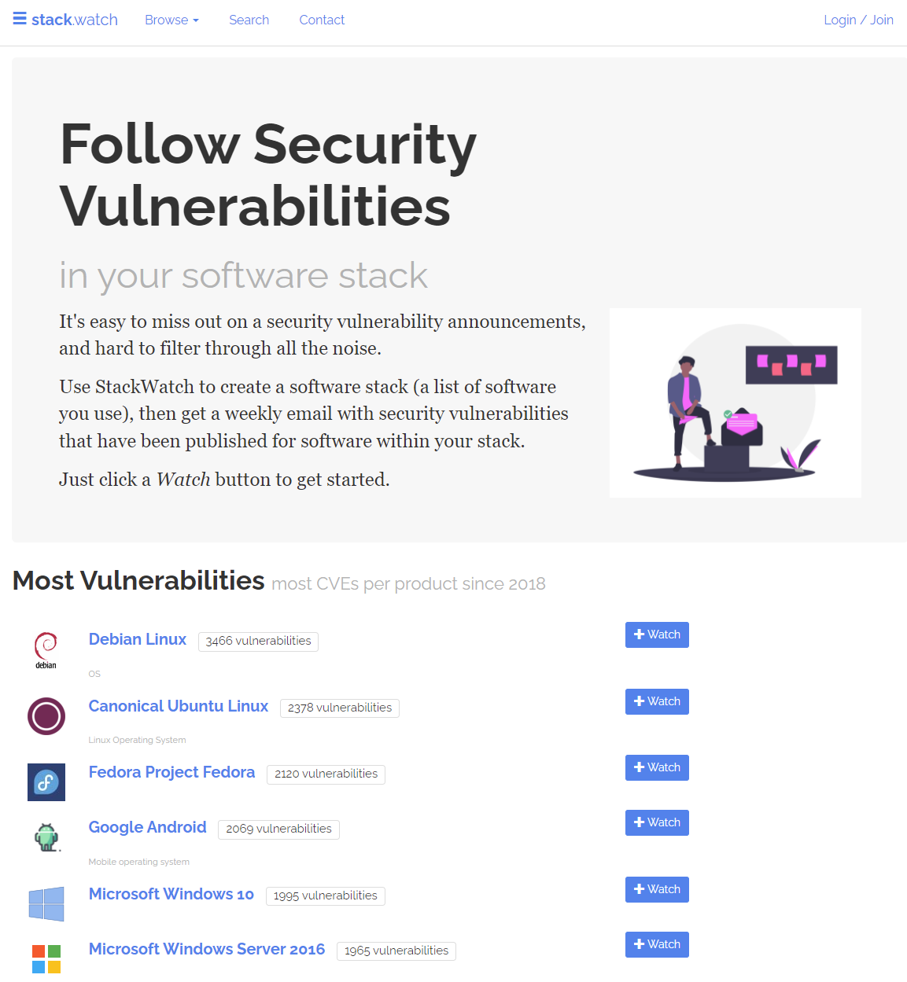
Stack Watch
Stack Watch collects security vulnerability notifications in a single, easy to follow location.
Click to “watch” projects for any security vulnerabilities
For example, on the next page you will see the latest vulnerabilities for ubuntu

Slide 9
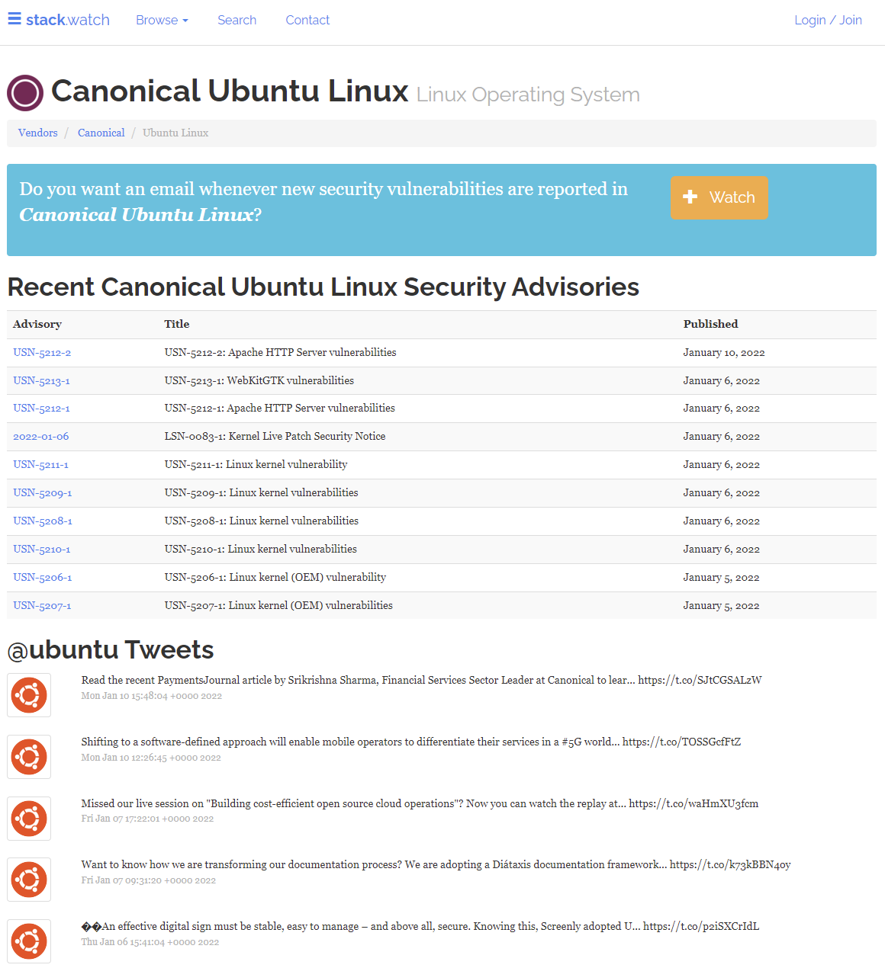
Stack Watch

Slide 10
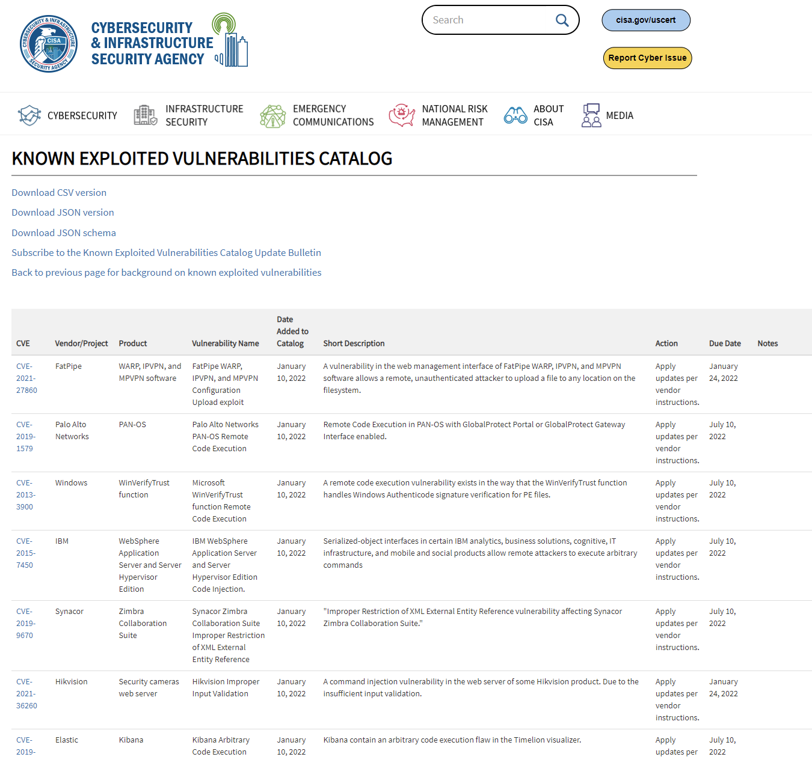
CISA – Known Exploits
https://www.cisa.gov/known-exploited-vulnerabilities-catalog

Slide 11
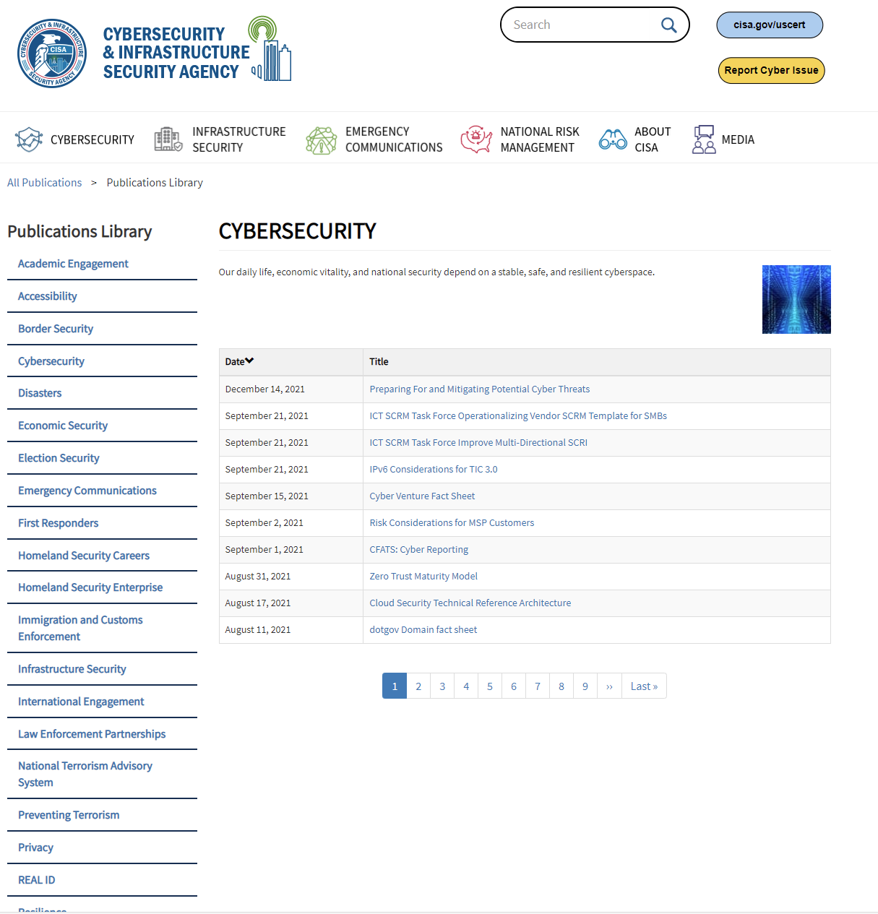
CISA – Cybersecurity Publications Library
https://www.cisa.gov/publications-library/cybersecurity?page=0

Slide 12
CyBOK Knowledgebase
https://www.cybok.org/knowledgebase1_1/
Operating System & Virtualisation
https://www.cybok.org/media/downloads/Operating_Systems_Virtualisation_Security_v1.0.1.pdf
Authentication, Authorisation & Accountability
https://www.cybok.org/media/downloads/Authentication_Authorisation_Accountability_v1.0.2.pdf
Malware and Attack Technologies
https://www.cybok.org/media/downloads/Malware_Attack_Technologies_v1.0.1.pdf
Software Security
https://www.cybok.org/media/downloads/Software_Security_v1.0.1.pdf

Slide 13
Threats to operating systems – CYBOK Knowledge Area
Malicious extensions
Bootkits
Memory errors (software)
Memory corruption (hardware)
Uninitialised data leakage
Concurrency bugs and double fetch
Side Channels (hardware) – security engineering chapter 19
Side Channels (Speculative) – security engineering chapter 19
Side Channels (Software) – security engineering chapter 19
Resource depletion (DoS)
Deadlocks/hangs (DoS)

Slide 14
Cybok - Threats to operating systems Malicious extensions
This is where an attacker manages to convince the system to load a malicious driver or kernel module (e.g.: a Trojan)

Slide 15
Cybok - Threats to operating systems Bootkits
An attacker compromises the boot process to gain control even before the operating system gets to run
https://docs.microsoft.com/en-us/windows/security/information-protection/secure-the-windows-10-boot-process

Slide 16
Cybok - Threats to operating systems Memory errors (software)
Spatial and temporal memory errors allow attackers (either local or remote) to divert control flow or leak sensitive information

Slide 17
Cybok - Threats to operating systems Memory corruption (hardware)
Vulnerabilities such as Rowhammer in DRAM allow attackers (again, local or remote) to modify data that they should not be able to access - bitflipping

Slide 18
Cybok - Threats to operating systems Uninitialized data leakage
The OS returns data to user programs that is not properly initialised and may contain sensitive data

Slide 19
Cybok - Threats to operating systems Concurrency bugs and double fetch
Example – the OS uses a value from userspace twice (e.g.: a size value is used once to allocate a buffer and later to copy into that buffer) and the value changes between the two uses.

Slide 20
Cybok - Threats to operating systems Side Channels (hardware)
Attackers use access times of shared resources such as caches and TLBs to detect that another security domain has used the resource, allowing them to leak sensitive data.
TLB – Translation Lookaside Buffer
https://en.wikipedia.org/wiki/Translation_lookaside_buffer

Slide 21
Cybok - Threats to operating systems Side Channels (Speculative)
Security checks are bypassed in speculative or out-of-order execution and while results are squashed they leave a measurable tracein the micro-architectural state of the machine.

Slide 22
Cybok - Threats to operating systems Side Channels (Software)
Example – when OS/Hypervisors use features such as memory deduplication, attackers can measure that another security domain has the same content.

Slide 23
Cybok - Threats to operating systems Resource depletion (DoS)
By hogging resources (memory, SPU, buses etc) attackers prevent other programs from making progress, leading to a denial of service.

Slide 24
Cybok - Threats to operating systems Deadlocks/hangs (DoS)
The attacker brings the system to a state where no progress can be made for some part of the software, e.g.: due to a deadlock (DoS)

Slide 25
Additional Notes
The vulnerability portal for Microsoft including the CVE and its respected patch number:
https://msrc.microsoft.com/update-guide

Slide 26
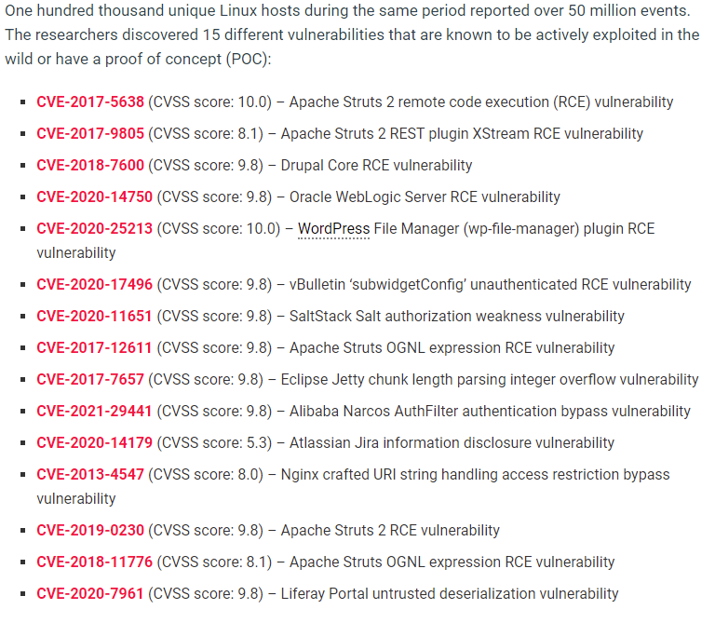
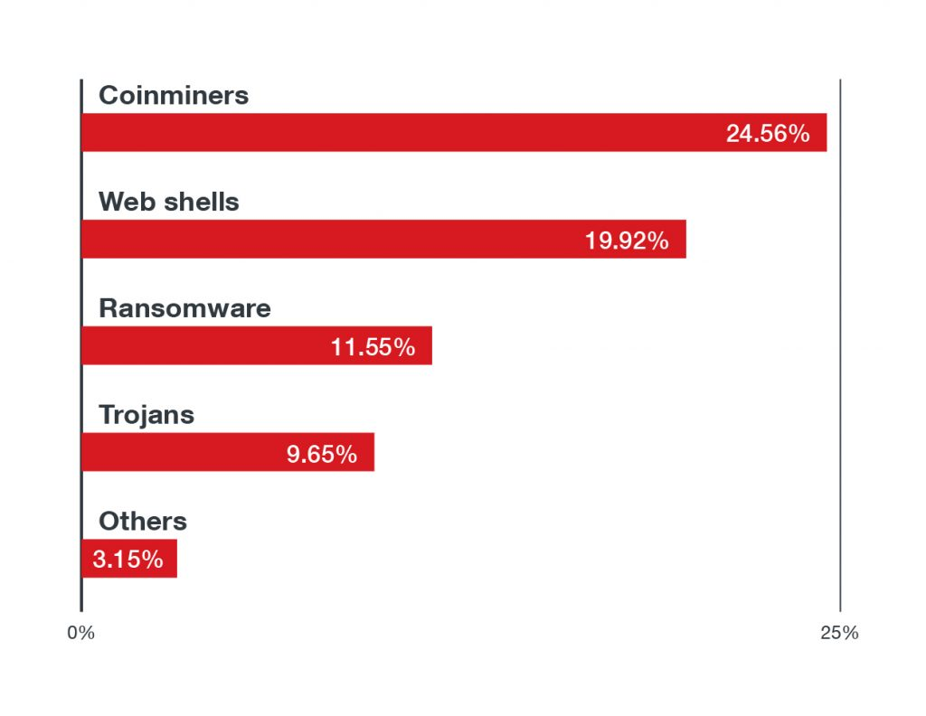
Additional Notes
15 top Linux threats, according to Trend Micro
https://cloud7.news/security/15-top-linux-threats-according-to-trend-micro/

Slide 27
Additional Notes
Linux Threat Report 2021 1H
LINUX THREATS IN THE CLOUD AND SECURITY RECOMMENDATIONS
Linux powers many cloud infrastructures today. However, it is not immune to threats and risks. We discuss several pressing security issues including malware and vulnerabilities that compromise Linux systems in the first half of 2021.
https://www.trendmicro.com/vinfo/us/security/news/cybercrime-and-digital-threats/linux-threat-report-2021-1h-linux-threats-in-the-cloud-and-security-recommendations

Slide 28
Additional Notes
https://www.smehorizon.com/linux-os-identified-as-critical-area-for-cybersecurity/

Slide 29
Additional Notes - The Role of Operating Systems in Security
https://www.companionlink.com/blog/2021/03/the-role-of-operating-systems-in-security/
For every computer system and software design, it is imperative that it should address all security concerns and implement required safeguards to enforce security policies. At the same time, it is important to keep a balance since rigorous security measures can not only increase costs but also limit the user-friendliness, usefulness and smooth performance of the system. Hence, system designers have to ensure effective performance without compromising on security. A computer’s operating system must concentrate on delivering a functionally complete and flexible set of security mechanism for security policies to be effectively enforced.

Slide 30
Additional Notes - The Role of Operating Systems in Security
An operating system’s protection and security requires all computer resources such as software, CPU, memory and others to be protected. This can be enforced by ensuring the confidentiality, integrity and availability in the operating system. It must be able to protect against all threats including malware and unauthorized access.

Slide 31
Additional Notes - The Role of Operating Systems in Security
Malware
This category includes viruses, worms, trojan horses and all kinds of malicious software. These are generally small code snippets that can corrupt files, destroy data, replicate to spread further, and even crash a system. Many times, the malware goes unnoticed by the victim user, while the cyber criminals silently extract sensitive information.
Denial of Service Attacks
Network Intrusion
Network intruders can be classified as masqueraders, misfeasors or a clandestine users. A masquerader is an unauthorized individual who penetrates into a system and exploits an authorized individual’s account. Misfeasor is a legitimate user who accesses and misuses programs, data or resources. Clandestine user takes over supervisory control and tries to evade access controls and audit collection.

Slide 32
Additional Notes - The Role of Operating Systems in Security
Buffer Overflow
Also called buffer overrun, buffer overflow is defined in the NIST Glossary of Key information security terms as “A condition at an interface under which more input can be placed into a buffer or data-holding area than the capacity allocated, overwriting other information. Attackers exploit such a condition to crash a system or to insert specially crafted code that allows them to gain control of the system”
Buffer overflow is one of the most common and dangerous security threats. To exploit a buffer overflow, attackers identify a buffer overflow vulnerability in a program and understand how the buffer will store in process memory to finally alter the execution flow of the program.

Slide 33
Task

Slide 34
Task
3 hours
In pairs, work together to research *several* threats to operating systems using the materials we have covered here, plus any others you can find.
Then create a teaching resource to help high school teachers teach students to identify and understand “Operating System Threats”
You must create learning materials - posters, quizzes, videos, blogs, etc.
You don’t need to teach it, but you do need to explain your thought process behind what you have done (the why)
You also don’t need to explain how to secure systems
Present your work back to the class on Wednesday morning in a 5 minute pair presentation

