Slide 1
Communication & Teamwork Week 1

Slide 2
Icebreaker Task

Slide 3
Outlines the principles of effective teamwork to produce software - K6
Effective team-working contributes to the effective delivery of software projects for example
decision making
conflict resolution
collaboration
communication
peer review and retrospectives

Slide 4
Teamwork
The collaborative effort of a team to achieve a common goal or to complete a task in the most effective and efficient way
Open communication to avoid conflicts
Effective coordination to avoid confusion and the overstepping of boundaries
Efficient cooperation to perform the tasks in a timely manner and produce the required results, especially in the form of workload sharing
High levels of interdependence to maintain high levels of trust, risk-taking, and performance

Slide 5
Decision making
Combine points of view, expertise, history
Avoid biased personal idiosyncrasies
Own the decisions
Accountable
Understand risks
Team communication allows members to make concrete decisions

Slide 6
Conflict resolution
Strong, productive teams understand that conflicts can pave the way for innovation
Team members must face conflicts head on in order to resolve and improve
Sharing problems
Honest communication
Trust

Slide 7
Collaboration
Buddy system
Pair of developers
Different experience
Informally review each others work
Between business development, designers, testers and customers
Collaboration tools
Slack – communication
Asana – project management
Agreedo – scrum management

Slide 8
Communication
Clear communication with one another about their
needs
the overall demands of the project
specific work processes
allows team members to be more productive
When team members feel comfortable expressing themselves among their fellow developers, they can be more confident in their introduction of new ideas, concepts and processes

Slide 9
Peer review
Code and/or documents, examined by its author and one or more colleagues, in order to evaluate its technical content and quality
Light touch – buddy review
More formal – walkthroughs, inspections
Enforced by Apple, Google – but not Microsoft

Slide 10
Retrospective – Agile process
A retrospective meeting is held at the end of every iteration
What should we start doing?
What should we stop doing?
What should we continue to do?
Retrospective meetings are useful to identify the ways of continuous improvement of an Agile team
metrics and velocity of the team
tracking tools
defect density
team dynamics
self-organization
any potential impediments that surfaced during the iteration
Managers and senior management may be barred from entering a retro meeting; the team may not speak up due to inherent fear of management

Slide 11
Task 1 – B5
Describes what elements you think make an effective team player.

Slide 12
Task 1 – B5
Revisit the previous task and discuss the following key points.
importance of working collaboratively,
keeping others informed,
recognising personal and professional limitations
seeking advice when necessary

Slide 13
Describes how they support the communication of software solutions and ideas to technical and non-technical stakeholders. (S18)
What is a stakeholder
Give an example of a technical stakeholder
Give an example of a non technical stakeholder
Discuss in groups and feedback what techniques you might use when talking to some who is non technical, what might you change or do differently.

Slide 14
Examples of technical stakeholders Other team members might include
requirements engineer
business analyst
software designer
software developer
software tester
software release engineer
managers

Slide 15
Requirements engineer
Requirements inception
Requirements analysis
System modelling (also part of design)
Requirements specification
Requirements validation

Slide 16
Business analyst
Identify the business needs and opportunities
Define an organisation’s policies and market approaches
Standardise an organisation’s workflows
Interpret the business rules and requirements for technical systems

Slide 17
Software designer
Researching and designing software
Modifying existing software designs to correct errors, allowing it to adapt to new hardware, or to improve its performance
Analysing user needs and software requirements to determine feasibility of design within time and cost constraints
Consulting with customers about software system design and maintenance

Slide 18
Software developer
Reviewing current systems
Presenting ideas for system improvements, including cost proposals
Working closely with analysts and designers
Producing detailed specifications and writing the program code
Maintaining the systems once they are up and running

Slide 19
Software tester
stress testing
performance testing
functional testing
writing and executing test scripts
running manual and automated tests
testing in different environments
writing bug reports
reviewing documentation
communicating findings to technical and non-technical colleagues

Slide 20
Software release engineer
Prepare, evaluate and maintain tools for supporting process automation for software or hardware product release
Schedule and initiate packaging and build process
Compile and assemble software
Design, manage and execute tools and scripts to develop different versions of products on wide-range operating systems
Correct build errors working with development engineers
Develop and present general releases, service packs, web products and beta products
Develop library of tools for automating manual workflows in development process

Slide 21
Tools used for communication
K4

Slide 22
COMMUNICATION TOOLS
The modern business world is evolving and so is the need of every modern workplace. With the increasing dominance of technology and automation in every industry, employees now have the freedom to stay connected to their work regardless of their actual location.
Now a key effect of this modern workplace trend is that it has shown people the importance of team communication. It has made effective team communication is an integral part of everything that we do. Furthermore, it has given rise to a range of powerful tools for communication and engagement in the workplace.

Slide 23
Tools used to communicate software solutions
Tools/software used
Remote Team collaboration
Screen Sharing Tools
Remote project management
Code repository
Video conferencing
Customer Support
Calendars and to do list
Monitoring Tools
We will look at IDE’s at a later date

Slide 24
Describes different communication methods, how to adapt in response to different audiences including collaborative technologies such as discussion threads and document collaboration. (K4)
VERBAL COMMUNICATION
Verbal communication occurs when we engage in speaking with others. It can be face-to-face, over the telephone, via Skype or Zoom, etc. Some verbal engagements are informal, such as chatting with a friend over coffee or in the office kitchen, while others are more formal, such as a scheduled meeting. Regardless of the type, it is not just about the words, it is also about the caliber and complexity of those words, how we string those words together to create an overarching message,
NON-VERBAL COMMUNICATION
What we do while we speak often says more than the actual words. Non-verbal communication includes facial expressions, posture, eye contact, hand movements. For example, if you’re engaged in a conversation with your boss about your cost-saving idea, it is important to pay attention to both their words and their non-verbal communication. Your boss might be in agreement with your idea verbally, but their nonverbal cues: avoiding eye contact, sighing, scrunched up face, might indicate something different.
WRITTEN COMMUNICATION
Whether it is an email, a memo, a report, a Facebook post, a Tweet, a contract, etc. all forms of written communication have the same goal to disseminate information in a clear and concise manner – though that objective is often not achieved. In fact, poor writing skills often lead to confusion and embarrassment, and even potential legal jeopardy. One important thing to remember about written communication, especially in the digital age, is the message lives on. Thus, there are two things to remember: first, write well – poorly constructed sentences and careless errors make you look bad; and second, ensure the content of the message is something you want to promote or be associated with for the long haul.

Slide 25
Describes different communication methods, how to adapt in response to different audiences including collaborative technologies such as discussion threads and document collaboration. (K4)
LISTENING
The act of listening does not often make its way onto the list of types of communication. Active listening, however, is perhaps one of the most important types of communication because if we cannot listen to the person sitting across from us, we cannot effectively engage with them. Think about a negotiation – part of the process is to assess what the opposition wants and needs. Without listening, it is impossible to assess that, which makes it difficult to achieve a win/win outcome.
VISUAL COMMUNICATION
We are a visual society. Think about it, televisions are running 24/7, Facebook is visual with memes, videos, images, etc., Instagram is an image-only platform, and advertisers use imagery to sell products and ideas. Think about from a personal perspective – the images we post on social media are meant to convey meaning – to communicate a message.
We communicate continually throughout each and every day. We do it without thinking – we operate on communication autopilot. However, I encourage you to think about how you communicate. How do you communicate verbally? What nonverbal cues do you use when you are disinterested? Excited? Nervous? Are you a good listener? Can you write a concise, clearly articulated message? Are there barriers to how you communicate effectively?

Slide 26
Collaboration – Microsoft teams
Microsoft Teams is a collaborative workspace within Microsoft 365/Office 365 that acts as a central hub for workplace conversations, collaborative teamwork, video chats and document sharing, all designed to aid worker productivity in a unified suite of tools. Launched in 2017 as a rival to collaboration pioneer Slack, Microsoft saw use of Teams rocket to 75 million daily active users as the COVID-19 pandemic worsened, according to stats released by Microsoft in April. The company called Teams the fastest growing business app in its history.
Microsoft Teams features collaboration software:
Teams and channels. ...
Conversations within channels and teams. ...
A chat function. ...
Document storage in SharePoint. ...
Online video calling and screen sharing. ...
Online meetings. ...
Audio conferencing. ...
Full telephony.

Slide 27
Video conferencing
Web ex - WebEx is a multi-functional desktop Video/Audio Conference call application. It allows you to meet with anyone, anywhere, in real time from your office or home, as long as you have Internet access on your computer or have the WebEx mobile app installed for your iPhone, iPad, Android, or Blackberry. Webex Meetings allow clients to join from anywhere and is easy to schedule. It's easy to use, with polling tools, breakouts, easy sharing, and most important of all, the ability to record audio.
Web ex has now creted collaborative tools to enhance web ex
Zoom
Zoom is one of the leading video conferencing software apps. It enables you to virtually interact with co-workers when in-person meetings aren't possible, and it thas been hugely successful for social events, too.
Make no mistake: Zoom is an essential tool for small-, medium-, and large-sized teams who want to keep in touch and continue their daily workflows with minimal disruption

Slide 28
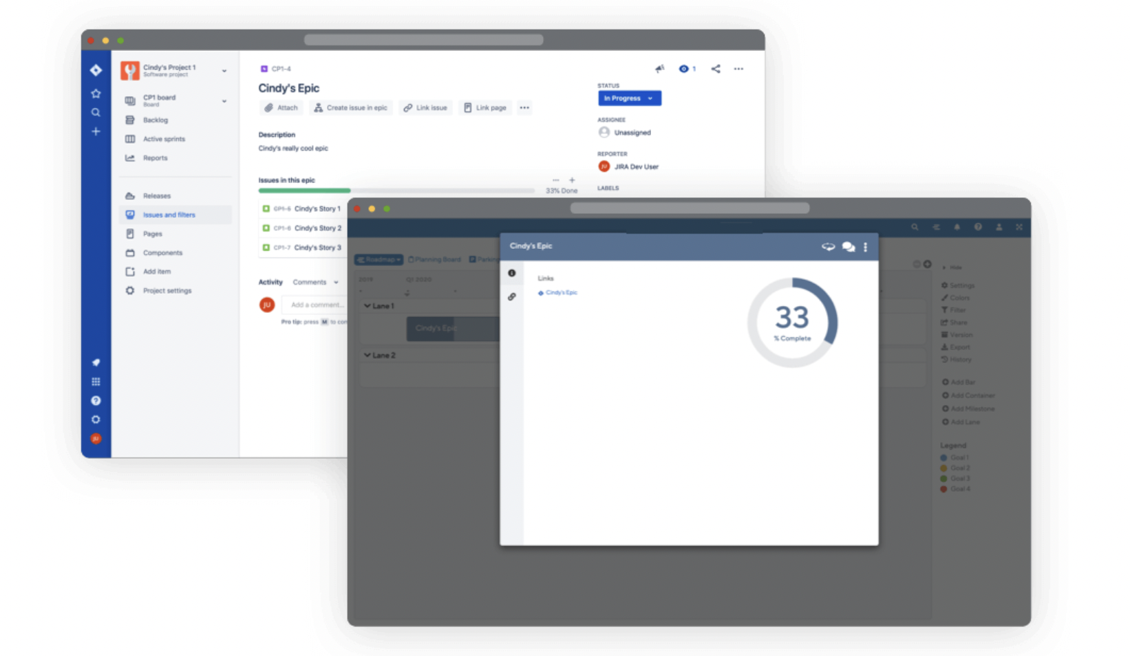
Project Management – Example Jira
What Is Jira?
Jira is a software application used for issue tracking and project management. The tool, developed by the Australian software company Atlassian, has become widely used by agile development teams to track bugs, stories, epics, and other tasks.

Slide 29
How to use Jira
https://www.youtube.com/watch?v=GWxMTvRGIpc
Follow the above online tutorial
Create a project and board ( think of a project you are part of at work)
Create a backlog and the turn it into a sprint
Research other project management software tools, identify the other popular ones used in the software development industry ?
What do you use at work for project management ?
What are the benefits of using these tools ?

Slide 30
Code repository
Git Hub
GitHub, Inc., is an Internet hosting service for software development and version control using Git. It provides the distributed version control of Git plus access control, bug tracking, software feature requests, task management, continuous integration, and wikis for every project.^{[4]}Headquartered in California, it has been a subsidiary of Microsoft since 2018.^{[5]}
It is commonly used to host open source software development projects. As of June 2022, GitHub reported having over 83 million developers and more than 200 million repositories, including at least 28 million public repositories.It is the largest source code host as of November 2021
Task create code and a repository
Handout – How to create a gut hub repo
Handout - Create hello world in visual studio - 1 Programming Structure Slides 1 -11

Slide 31
What is DevOps ?
DevOps is a combination of software developers (dev) and operations (ops). It is defined as a software engineering methodology which aims to integrate the work of software development and software operations teams by facilitating a culture of collaboration and shared responsibility
DevOps can be best explained as people working together to conceive, build and deliver secure software at top speed. DevOps practices enable software developers (devs) and operations (ops) teams to accelerate delivery through automation, collaboration, fast feedback, and iterative improvement.
Stemming from an Agile approach to software development, a DevOps delivery process expands on the cross-functional approach of building and shipping applications in a faster and more iterative manner. In adopting a DevOps development process, you are making a decision to improve the flow and value delivery of your application by encouraging a more collaborative environment at all stages of the development cycle.
DevOps represents a change in mindset for IT culture. In building on top of Agile, lean practices, and systems theory, DevOps focuses on incremental development and rapid delivery of software. Success relies on the ability to create a culture of accountability, improved collaboration, empathy, and joint responsibility for business outcomes.

Slide 32
Introduction to Dev Ops Tools - Looking at Azure Dev Ops

Slide 34
Task
Azure dev ops tutorial
https://www.youtube.com/watch?v=JhqpF-5E10I
Top 30 dev op tools to look our for in 2022
Excellent read
https://kinsta.com/blog/devops-tools/

Slide 35
Pluralsight
Communications: How to Talk, Write, Present, and Get Ahead! | Learn how to communicate effectively in your workplace to be more effective in your job and to further your career, applicable to anyone who has to communicate and wants to improve their communication skills. | 2h 29m

