Slide 1
Introduction to OOP
V1.0 October 2017

Slide 2
What you need
IDLE
Python Integrated Development Environment
Including tkinter with TcI/Tk (for GUI interface)

Slide 3
Claimed benefits of OOP
Improved productivity – modular, extensible, reusable
Improved maintenance - modular
Faster development – reuse and object libraries
Lower cost of development - reuse
Higher quality software – less coding, more verification

Slide 4
Objects
Suppose we have an object called a Turtle
We want our Turtle to do things
Position itself
Move
Draw a line
If we have more than one Turtle we would like to make them look different
Writing the code for all this would take a long time

Slide 5
Libraries
Fortunately we have a library already written for us
Start Idle
Create a new file called turtledemo and save it
We get a class called Turtle (a class has a capital first letter) from the library called turtle

Slide 6
Class
A class is a “template” or “blueprint” for making an object
It defines what the object can do (methods) and what it can contain (attributes – data we can define)
We can make many instances of an object from a class
Each instance can have different attributes

Slide 7
Instantiation

Slide 8
Making a turtle
We need to instantiate an object called len from the class
Since the name of the Turtle object len is a variable name, it must start with a letter and it cannot contain any spaces.

Slide 9
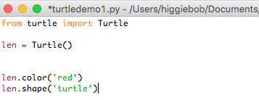
Attributes
We want to colour len and give him a shape
color and shape are attributes of the Turtle class
We can change them using dot notation

Slide 10
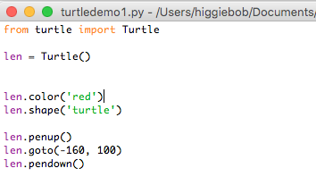
Methods
We need to make len do something
The Turtle class has methods
It can draw a line using a pen
It can move to co-ordinates (x and y: 0,0 is the centre of the canvas)
We want len to move to a given position without drawing a line

Slide 11
Run the program
You should see a red turtle appear in the centre of the canvas and move to a new position without drawing a line

Slide 12
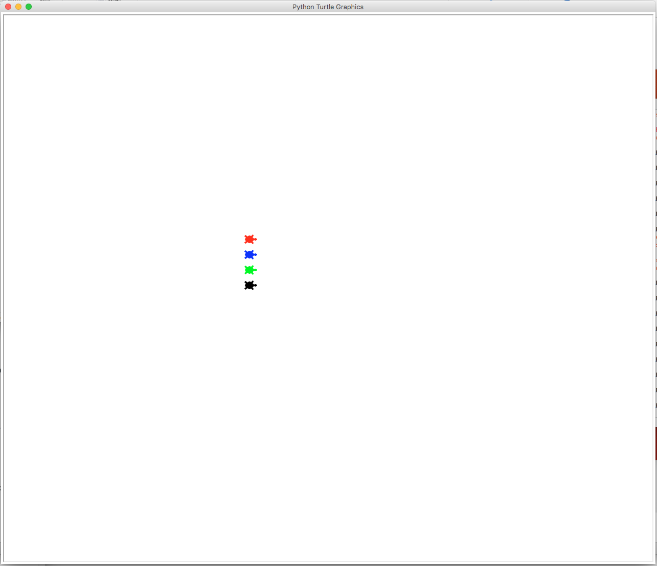
Exercise
Create three new instances of Turtle
Give them unique names
Colour them blue, green and black
Move them to an x of -160 and a y of 70, 40 and 10
Run the program and they should all line up ready for a race

Slide 13
Racing
We need to make the turtles move forward a random number of pixels
We can generate random integers by importing the randint function from the random library
Do this at the start of your code
randint(1,5) will randomly generate a number between 1 and 5

Slide 14
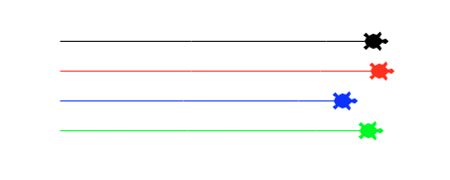
Racing
This will move len forward by 100 pixels in random amounts
Add code for your other three turtles and then run the program

Slide 15
Summary
Class – a blueprint for making an object
Object – groups together data and functions to model something in code
Instance – a specific example of an object
Method – a function called upon an object allowing interaction with that object
Attribute – a named piece of data stored within an object

