Slide 1
The Fundamentals of Web Page Development
BCS Level 3 Award in Coding and Logic

Slide 2
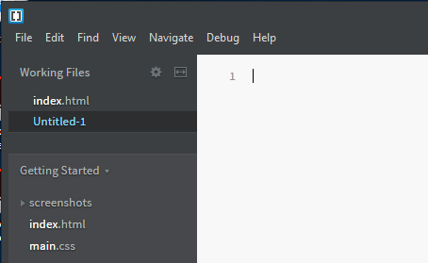
Get set up
Create the following folder structure:
Web
Images
Styles
Start Brackets
Start a new file

Slide 3
Create an HTML file
In Brackets enter:
<!DOCTYPE html>
<html>
<body>
<h1>Sample page</h1>
<p>This is a sample.</p>
<!-- this is a comment -->
</body>
</html>
Save the file as index.html in the Web folder
Notes:
Open your text editor and build this page.

Slide 4
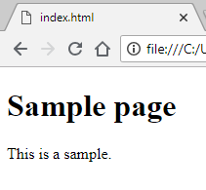
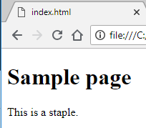
Live preview
Click the live preview icon
A Chrome browser window opens which renders the web page
Edit the file by changing sample to staple
Save the file
Note the live preview automatically updates

Slide 5
HTML file
<!DOCTYPE html> (Specifies the language and version)
<html> (Opening tag indicating start of HTML)
<body> (Opening tag start of main visible content of the page))
<h1>Sample page</h1> (Heading tags for most important heading)
<p>This is a sample.</p> (Paragraph tags)
<!-- this is a comment -->
</body> (Ending tag)
</html> (Ending tag)
Notes:
Open your text editor and build this page.

Slide 6
Common HTML elements
<h1>This is heading 1</h1> <h2>This is heading 2</h2> <h3>This is heading 3</h3> (down to level 6)
<ul> <li>A+</li> <li>Windows 10</li> <li>Cloud</li> </ul>
<ol> <li>A+</li> <li>Windows 10</li> <li>Cloud</li> </ol>
Notes:
Open your text editor and build this page.

Slide 7
Formatting
<b>This text is bold</b
<strong>This text is strong</strong>
<i>This text is italic</i>
<em>This text is emphasised</em>
<h2>HTML <small>Small</small> Formatting</h2>
<h2>HTML <mark>Marked</mark> Formatting</h2>
<p>My favorite asssesor is <del>Len</del> Andrew.</p>
<p>This is <sub>subscripted</sub> text.</p>
<p>This is <sup>superscripted</sup> text.</p>
Browsers display <strong> as <b> and <em> as <i>
<strong> and <em> mean the text is important
Notes:
Open your text editor and build this page.

Slide 8
HTML (HyperText Markup Language)
Web browsers Parse the HTML turning it into a DOM Tree.
DOM (Document Object Model)
DOM trees contain several kinds of nodes:
Document Type (<!DOCTYPE html>)
Elements (<h1>)
Text
Comments
and in some cases processing instructions

Slide 9
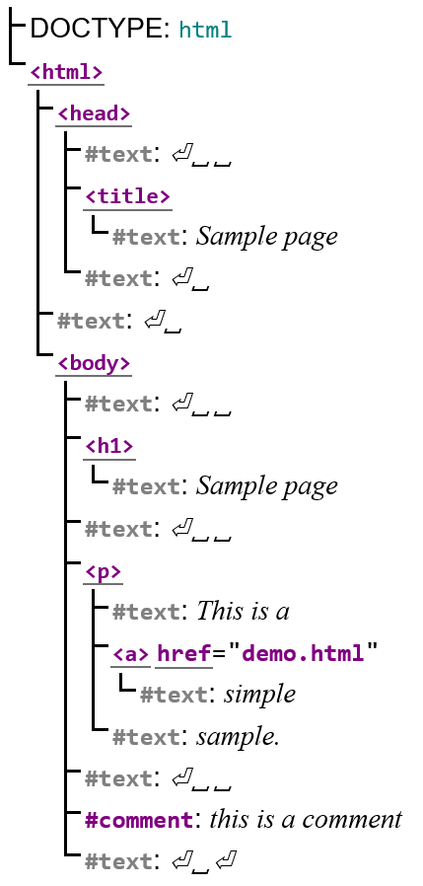
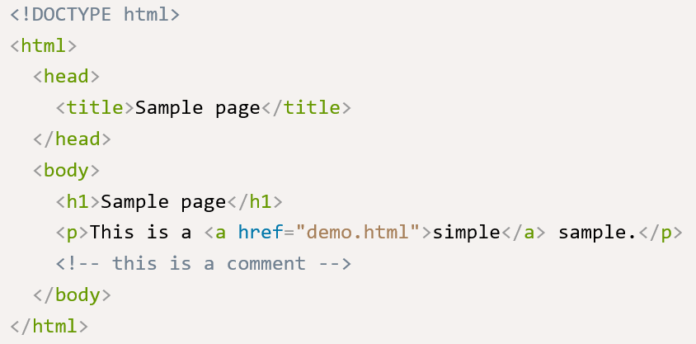
HTML (HyperText Markup Language)
A DOM tree will look like this.
There are Elements that the HTML and DOM require
The <head> element can include a title for the document, scripts, styles and meta information

Slide 10
Compliant HTML file
<!DOCTYPE html>
<html>
<head>
<title>Sample Page</title>
<!-- replaces file name with title in browser tab -->
</head>
<body>
<h1>Sample page</h1>
<p>This is a sample.</p>
<!-- this is a comment -->
</body>
</html>
Notes:
Open your text editor and build this page.

Slide 11
Links
<!DOCTYPE html>
<html>
<head>
<title>Sample Page</title>
</head>
<body>
<h1>Sample page</h1>
<p>This is a sample.</p>
<p><a href=https://www.bcs.org/>The BCS</p>
</body>
</html>
Notes:
Open your text editor and build this page.

Slide 12
New page
Create a page with title Infrastructure Technician
Heading Infrastructure Technician
Text explaining components
List of A+, Windows, Cloud, Coding, ITIL
Links to relevant CompTIA, Microsoft, BCS and ITIL pages
Save as is.html
Edit index.html
Change title and heading to Digital Apprenticeships
Update text appropriately
Link to is.html <p><a href="is.html">Infrastructure Technician</a></p>
Add a link to go back to index.html

Slide 13
Images
Save the BCS logo to the Images folder
Replace the BCS text in the BCS link in is.html with the logo
<p>
<a href="https://www.bcs.org">
<img border="0" alt="BCS" src="Images/bcsLogoTop.png">
</a>
</p>
Add images for the other companies

Slide 14
Styles
Inline style
<h1 style="color:blue;margin-left:30px;">Digital apprenticeships</h1>
This is not recommended as it mixes content with presentation

Slide 15
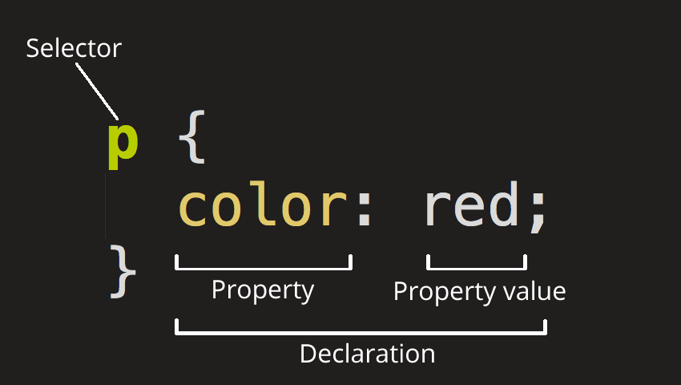
Styles
Internal style sheet
Insert into the <head>
<style>
body {
background-color: linen;
}
h1 {
color: maroon;
margin-left: 40px;
}
</style>
This is recommended when one page has a unique style

Slide 16
CSS – cascading style sheet
Create a file and save it as mystyle.css in the Styles folder
body { background-color: lightblue; } h1 { color: navy; margin-left: 20px; }
Add this line to the <head> in both pages
<link href="Styles/mystyle.css" rel="stylesheet" type="text/css">
Note how the internal style overrides the external style sheet
Remove the internal style and both pages should now look the same
External style sheets are used to make the presentation the same for all pages

Slide 17
Web site
Requires a web server at the host
Apache – open source, runs on Linux or Windows
Microsoft IIS (Internet Information Services)
HTTP (Hyper Text Transfer Protocol)
takes requests on port 80
delivers index.html as default page
HTTPS (Hyper Text Transfer Protocol Secure)
as HTTP, but communication is encrypted
takes requests on port 443
uses Secure Sockets Layer (SSL) or TLS (Transport Layer Security)
when a page is requested
a public key is sent in an SSL trusted certificate
private key is held at the web server
padlock shown in the address bar when a trusted SSL certificate is used

Slide 18
File transfer
FTP – File Transfer protocol
Used to exchange files between clients and web servers
Uses port 21 (command channel – used initially) and port 20 (data channel)
Clients can do the following to files on a server
Upload
Download
Delete
Rename
Move
copy
A user typically needs to log on to the FTP server
Content can also be available without login, also known as aonymous FTP
FTP can be initiated from:
Specific clients (Cyberduck, Transmit, FileZilla)
Web browsers – slower

Slide 19
Secure FTP
FTPS
uses SSL or TLS for encryption
uses two connections – a command channel and a data channel
either both channels are encrypted or only the data channel
SFTP
uses Secure Shell or SSH network protocol to securely exchange data
is only a draft specification
uses only one connection and encrypts both authentication information and data files being transferred

Slide 20
OWASP - Open Web Application Security Project
Core Purpose
Be the thriving global community that drives visibility and evolution in the safety and security of the world’s software
Principles
Free & Open
Governed by rough consensus & running code
Abide by a code of ethics
Not-for-profit
Not driven by commercial interests
Risk based approach

Slide 21
OWASP - Code of Ethics
Perform all professional activities and duties in accordance with all applicable laws and the highest ethical principles
Promote the implementation of and promote compliance with standards, procedures, controls for application security
Maintain appropriate confidentiality of proprietary or otherwise sensitive information encountered in the course of professional activities
Discharge professional responsibilities with diligence and honesty
To communicate openly and honestly
Refrain from any activities which might constitute a conflict of interest or otherwise damage the reputation of employers, the information security profession, or the Association
To maintain and affirm objectivity and independence
To reject inappropriate pressure from industry or others
Not intentionally injure or impugn the professional reputation of practice of colleagues, clients, or employers
Treat everyone with respect and dignity
Avoid relationships that impair — or may appear to impair — OWASP's objectivity and independence

Slide 22
OWASP Top 10 project
OWASP Top 10 Most Critical Web Application Security Risks
The OWASP Top 10 is a powerful awareness document for web application security
A broad consensus about the most critical security risks to web applications
Produced by security experts from around the world
Injection
Broken authentication
Sensitive data exposure
XML external entities
Broken access control
Security misconfiguration
Cross site scripting – XSS
Insecure deserialization
Using components with known vulnerabilities
Insufficient logging and monitoring
https://www.owasp.org/images/7/72/OWASP_Top_10-2017_%28en%29.pdf.pdf

Slide 23
Summary
6 The Fundamentals of Web Page Development
6.1
Recognise HTML (Hypertext Mark-Up Language)
Basic tags <html> <body> <head> <h1> <h2> <A>
6.2
Explain how basic Cascading Style Sheets (CSS) is used to provide common look across pages
6.3
Describe the components, methods and protocols used to host a web site
FTP / FTPS (File Transfer Protocol)
HTTP / HTTPS
6.4
Recognise the purpose of the OWASP Top 10

