Slide 1
Programming
^{<Cyber Security>}
Arrays & Lists Data Structures Cont

Slide 2
What is an array
An array is simply a collection of data that are normally related to each other. Suppose we want to store the ages of 5 users. Instead of storing them as user1Age, user2Age, user3Age, user4Age, user5Age,
An array can be declared and initialized as follows:
Int[] userAge = {21,22,23,24,25};
[]indicates it is an array instead of a normal variable

Slide 3
Arrays
In addition to declaring and initialising n array at the point of declaration we can declare an array first and initialize it later to do that we use the “NEW” operator
Declare
Int [] userage2;
Initialize later
userAge2 = new [] {21,22,23,24,25};
Or declare and initialize default array then the array will default with(0,0,0,0,0)
Int [] userAge2 = new int [5];

Slide 4
Arrays
Copy
The copy() method allows you to copy the contents of one array into another array, starting from the first element.
Whenever we use a method we need to put a pair of parenthesis() after the method name.
Some methods require certain data for it to work. These data are known as arguments.
Suppose you have
Int [] source = {12,1,5,-2,16,14};
and
Int[] dest = {1,2,3,4};
You can copy the first three elements of the source by using the statement below
Array.Copy(source,dest,3);
In this example the our dest array becomes = {12,1,5,4}

Slide 5
Arrays
Sort()
The sort() method allows you to sort our arrays. It takes an array as the argument.
Suppose you have
Int [] numbers = {12,1,5,-2,16,14};
You can sort this array by writing
Array.Sort(numbers);
The array will be sorted in ascending order. Thus, numbers becomes {-2,1,5,12,14,16}

Slide 6
Task – Array Exercise
Practice Copy and Sorting an array
Print the arrays to the screen using writeline
Extension Task
Complete the Array _Exercise in the Practical Programming Exercise Folder

Slide 7
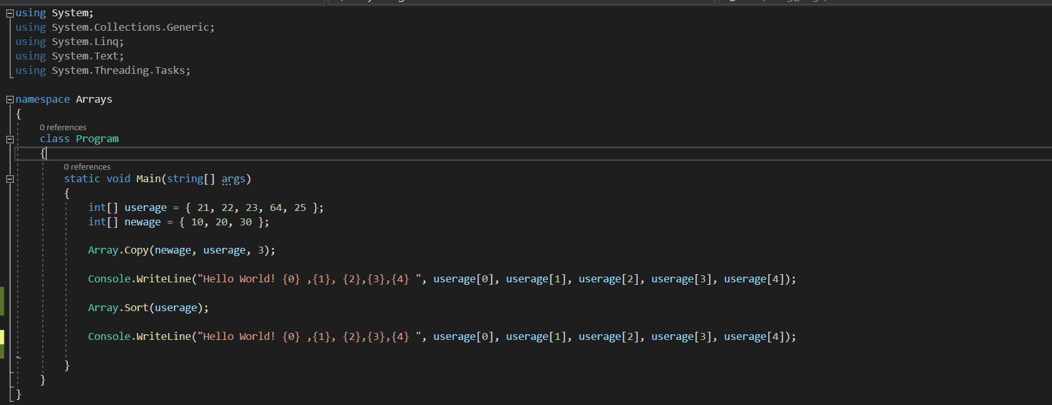
An example to help you write it to the screen to see if you are doing it correctly, however it is not efficient

Slide 8
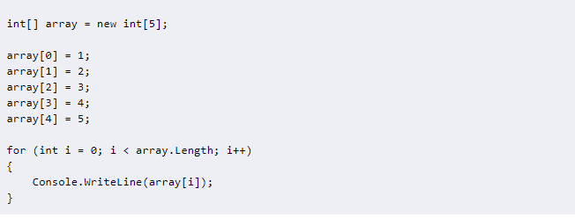
An example to help you

Slide 9
Lists - A list is a collection of items that can be accessed by index and provides functionality to search, sort and manipulate list items.
An array can hold a fixed numbers of values . If you declare
Int [] myArray = new int [10];
The myArray can only hold 10 values - just REMEMBER index starts at zero
To declare a list of integers we write
List<int> userAgeList = new List <int>();
userAgeList is the name of the list
List is a keyword to indicate you are declaring a list.
The datatype is enclosed in the < >
List<int> userAgeList = new List <int> {11,21,31,41};
To access the individual elements in a list we use the same notation as when we access elements in an array. For instance, to access the first element you write userAgeList[0]. To access the third element you would write userAgeList [2].

Slide 10
Lists - Add
Add()
So we have declared a list
List<int> userAgeList = new List <int> {11,21,31,41};
You can add members to a list using the Add() method.
userAgeList.Add(51);
userAgeList.Add(61);
userAgeList now has 6 members : {11,21,31,41,51,61}.

Slide 11
Lists – Insert() & Remove()
To insert members at a specific position use the Insert() method
To insert at 3rd position you write
userAgeList.Insert(2,51);
Where 2 is the index and 51 is the value you want to insert
It now becomes {11,21,51,31,41,51,61}
To remove members from the list use the Remove() method
If we write
userAgeList.Remove(51);
Only the first 51 is removed, it now becomes {11,21,31,41,51,61}
Then if we write
userAgeList.RemoveAt(3); Where 3 is the index (4th item)
It now becomes {11,21,31,51,61}

Slide 12
Lists
Practice Adding, Inserting and removing a list
Print the arrays to the screen using writeline

