Slide 1
Operating Systems and Architecture
^{<digital logic>}
(UFCFCU-30-1)

Slide 2
^{<outcomes>}
After completing this section of the module you will be able to:
Describe and explain computer architecture, digital logic and machine level representation of data (number systems)
digital logic
static and dynamic digital systems

Slide 3
^{<logic>}
At the end of the last session we looked at logic functions
In this session we see how these are implemented in hardware and used for arithmetic and logic
OR
A | B | Output
0 | 0 | 0
1 | 0 | 1
0 | 1 | 1
1 | 1 | 1
AND
A | B | Output
0 | 0 | 0
1 | 0 | 0
0 | 1 | 0
1 | 1 | 1
NOT
A | Output
0 | 1
1 | 0
XOR
A | B | Output
0 | 0 | 0
1 | 0 | 1
0 | 1 | 1
1 | 1 | 0

Slide 4
^{<not gate>}
The components are called gates, their output value depends on the input values
This is a one transistor NOT gate
NOT
A | Output Q
0 | 1
1 | 0
Notes:
We forget about transistors now (this isn’t an electronics course) and introduce our first example of abstraction – the logic gate diagram. Abstraction – making a model that can be reused without having to rewrite all the detail.

Slide 5
^{<and gate>}
This is an AND gate
AND
A | B | Output Q
0 | 0 | 0
1 | 0 | 0
0 | 1 | 0
1 | 1 | 1

Slide 6
^{<or gate>}
This is an OR gate
OR
A | B | Output Q
0 | 0 | 0
1 | 0 | 1
0 | 1 | 1
1 | 1 | 1

Slide 7
^{<xor gate>}
This is an XOR (exclusive or) gate
XOR
A | B | Output Q
0 | 0 | 0
1 | 0 | 1
0 | 1 | 1
1 | 1 | 0

Slide 8
^{<half adder>}
Rule of addition
0+0 = 0
1+0 = 1
1 +1 = 0 and carry 1 The XOR gate handles the addition
The AND gate handles the carry
This is only a half adder as it does not handle a carry in

Slide 9
^{<full adder>}
Rule of addition
0+0 = 0
1+0 = 1
1 +1 = 0 and carry 1
Notes:
Get the students to come up to the board and draw the inputs and outputs to each gate to show how it works.

Slide 10
^{<full adder>}
Simplify the diagram
Cin
Full adder
A
S
B
Carry out

Slide 11
^{<4 bit adder>}
Chain 4 full adders to make a 4 bit adder
Similarly, chain 32 full adders to make a 32 bit adder
If the last adder produces a carry out of 1, then we have run out of bits!
Cin
A₀
Full adder
S₀
B₀
A₁
Full adder
S₁
B₁
A₂
Full adder
S₂
B₂
A₃
Full adder
S₃
B₃
Cout
Notes:
Ask them what do we do when we get a final carry out bit?

Slide 12
^{<4 bit subtraction>}
For subtraction we need to flip the bits and add 1
We could build a separate unit for subtraction
But there is a way to use the full adder
To add 1 we can just force the first Cin to be 1
To flip the bits we could use a NOT gate
But we need to control whether we are adding or subtracting
Cin
A₀
Full adder
S₀
B₀
A₁
Full adder
S₁
B₁
A₂
Full adder
S₂
B₂
A₃
Full adder
S₃
B₃
Cout

Slide 13
^{<1 bit subtraction>}
Use an XOR gate and a control signal
The XOR gate is added to all B inputs on a multibit adder
This is the first stage
Control
0 = +
1 = -
Full adder
A
Result
B
Carry out
Notes:
Again, get them to come to the white board and show how this works with the combination of inputs

Slide 14
^{<progress>}
So far:
We have a unit that can add and subtract
We have introduced the concept of control
Where do the inputs come from and where does the output go?
We need to store data

Slide 15
^{<flip flop>}
Gates can be connected to form flip flops
Devices which retain a state until flipped into another state
The D type flip flop
Data appears on input D
CK is a clock input
The value on D will only change when the clock value is 1
Therefore the value of D is stored until there is a clock signal
Notes:
Another white board challenge!

Slide 16
^{<registers>}
Series of D type flip flops can form registers
The fastest form of storage
Integrated into the CPU
Used to:
Hold data values
Hold addresses
Hold status
Hold instructions

Slide 17
^{<registers>}
Two bit adder
Both numbers to be added appear on D₀ - D₃
When CP is 1, the data is clocked into the adders and the result is available at the output
The clock is required to time and control all the functions
Full adder
Full adder

Slide 18
^{<sRAM>}
Arrays of D type flip flops are called SRAM
RAM for Random Access Memory
S for static
So long as power is applied, SRAM will retain its value, it does not need to be refreshed
This means all accesses are for required functions, and are not overhead

Slide 19
^{<bitwise AND OR>}
A bitwise AND takes two equal-length binary values and performs the logical AND operation on each pair of the corresponding bits
A bitwise OR takes two equal-length binary values and performs the logical OR operation on each pair of the corresponding bits
 | 0 | 0 | 1 | 1
AND | 0 | 0 | 1 | 0
 | 0 | 0 | 1 | 0
 | 0 | 0 | 1 | 0
OR | 1 | 0 | 0 | 0
 | 1 | 0 | 1 | 0

Slide 20
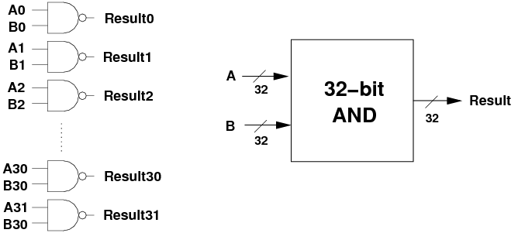
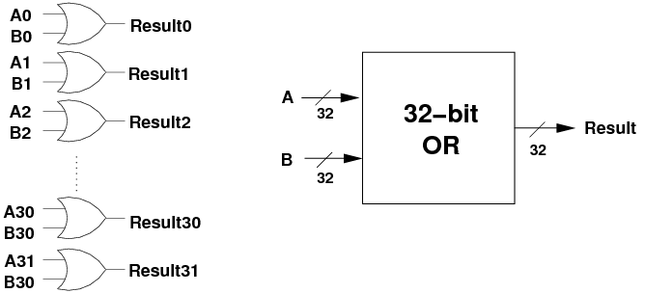
^{<bitwise AND OR hardware>}
Bitwise operations are very common and implemented in hardware
A collection of AND and OR gates
These examples are for 32 bits

Slide 21
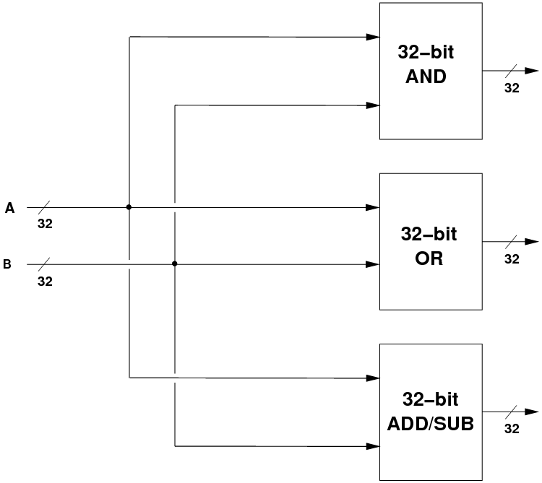
^{<ALU>}
These units are combined with the adder to form a 32 bit ALU Arithmetic Logic Unit

Slide 22
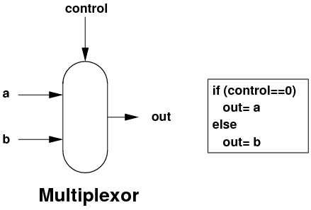
^{<multiplexor>}
We need one more component – the multiplexor
Selects an input to go to the output depending on the value of the control

Slide 23
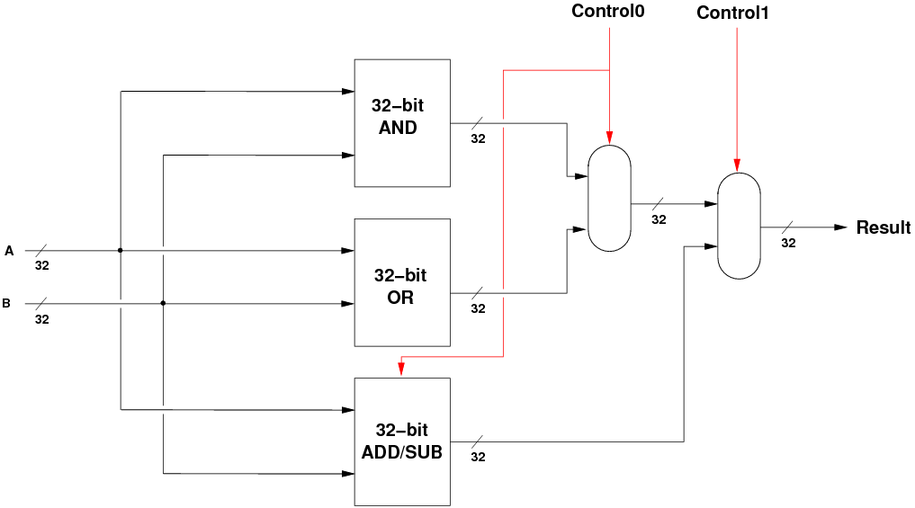
^{<ALU>}
We use two multiplexors to select the outputs from the 3 units
When c₀=0, the AND OR result is A AND B, and the ADDSUB result is A + B.
When c₀=1, the AND OR result is A OR B, and the ADDSUB result is A - B.
Notes:
Last whiteboard challenge

Slide 24
^{<bus>}
The 32 bit ALU has 32 wires in parallel coming from the registers and leaving the unit.
This is shown in shorthand as:
These wires are called a bus, as they transport data
32

Slide 25
^{<DRAM>}
The values in the registers are constantly changing as operations occur
Inputs and results have to be stored
A data bus connects the registers to DRAM
A special register, the program counter, holds the address of the next value to be retrieved from memory and transfers it on the address bus
RAM
Registers
ALU
32
32
32
16
32
PC

Slide 26
^{<DRAM v SRAM>}
DRAM - dynamic random access memory
SRAM - static random access memory
Refresh needs the stored values to be read and rewritten frequently
Characteristic | SRAM | DRAM
Speed | Faster | Slower
Size | Small | Large
Cost | Expensive | Cheap
Use | Registers, cache | Main memory
Density | Less dense | Highly dense
Construction | Complex | Simple
Transistors per bit | 6 | 1
Charge leakage | None | Exists, requires refresh
Power consumption | Low | High
Notes:
More on this on day 4.

Slide 27
^{<Conclusion>}
Transistors can be used to form gates
AND, OR, XOR and multiplexors can be used to form units capable of mathematical and logical operations on bits
Date can be moved around units on buses
A clock signal can control operations
Data can be stored in SRAM and DRAM

