Slide 1
Unit 51 – Software Design Fundamentals
Design

Slide 2
Developmental tools and techniques
Design
Flow chart
Pseudocode
Data dictionary
Structure diagram
Wire frames

Slide 3
Requirement
A program to calculate the penalty points, fine and potential disqualification for speeding offences and prepare a print out.
Speed over limit | Motorway | Points | Fine | Disqualify
Up to 10 | No | 3 | 100 | No
10 to 19 | No | 3 | 250 | No
20 to 29 | No | 6 | 750 | No
30 or over | No | 6 | 1000 | Yes
Up to 10 | Yes | 3 | 250 | No
10 to 19 | Yes | 3 | 750 | No
20 to 29 | Yes | 6 | 1500 | No
30 or over | Yes | 6 | 2500 | Yes

Slide 4
Inputs

Slide 5
Outputs

Slide 6
Flow chart

Slide 7
Flowchart

Slide 8
Pseudocode

Slide 9
Structure diagram
Condition
Function
Condition
Condition
Process
Data
Data

Slide 10
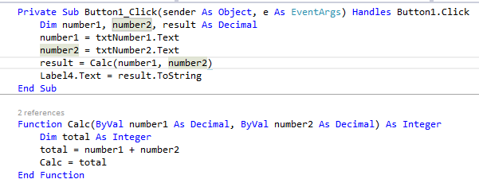
VB procedures

Slide 11
Structure diagram

Slide 12
Data dictionary
Control | Variable | Data type | Description
Variable | strSurname | string | Holds customer’s surname
Variable | sngPrice | decimal | Holds price of an item
Variable | sngTotalCost | decimal | Holds the total cost of an order
Function | vat | decimal | Will return a number after doing a calculation

Slide 13
Data dictionary

Slide 14
Wireframe
Presents the main information group
Draw the outline of structure and layout
Vision and description of the user interface
Input
Input
Input
Output
Process

Slide 15
Wireframe

