Slide 1
Developing software (15%, K2)
Functional and non-functional requirements

Slide 2
Outcomes
Distinguish between a functional and a non-functional requirement
Identify the different types of non-functional requirements and the reasons they are important to the end-product of software development
Recognise common ways in which software requirements can be expressed
Describe the qualities of good requirements and the impact of poor requirements
Explain how to determine the correct types of test coverage based on a requirement

Slide 3
3.3
Identify the different types of non-functional requirements, and the reasons they are important to the end-product of software development

Slide 4
Non Functional Requirements
DEFINITION
A non-functional requirement is that it essentially specifies how the system should behave and that it is a constraint upon the system's behaviour

Slide 5
Attributes
Attributes such as performance, security, usability, compatibility aren't a "feature" of the system, but are a required characteristic

Slide 6
Reviewing requirements
Assessing their validity
Inputs to software design
Ensure adequate test coverage during testing

Slide 7
Important to the end-product
Availability
Capacity
Performance
Scalability
Reliability
Maintainability
Recoverability

Slide 8
Availability
Availability indicates when a system is operational as well as how reliable it is during operational periods

Slide 9
Capacity
The ability to handle transactional volumes is a very important characteristic for a system

Slide 10
Performance
Response Time
Throughput
Utilization
Static Volumetric

Slide 11
Scalability
Scalability is a non-functional property of a system that describes the ability to appropriately handle increasing (and decreasing) workloads
Scalability competes with and complements other non-functional requirements such as availability, reliability and performance

Slide 12
Reliability
Requirements about how often the software fails.
The measurement is often expressed in MTBF (mean time between failures).
The definition of a failure must be clear.
Also, don't confuse reliability with availability which is quite a different kind of requirement.
Be sure to specify the consequences of software failure, how to protect from failure, a strategy for error detection, and a strategy for correction.

Slide 13
Maintainability
Maintainability is the measure of ability to successfully repair or fix the product after manufacturing, usually in the field, and over time

Slide 14
Recoverability
Recovery process – how do recoveries work, what is the process?
Recovery time scales – how quickly should a recovery take to perform?
Backup frequencies – how often is the transaction data, set-up data, and system (code) backed-up?
Backup generations - what are the requirements for restoring to previous instance(s)?

Slide 15
3.4
Recognise common ways in which software requirements can be expressed

Slide 16
Software Requirements
Can be expressed in a number of ways
requirements documents
user stories
use case diagrams
process models / flow diagrams
class diagrams
UML diagrams

Slide 17
Requirements Documents
Need to be – clear, unambiguous
Example on wiki

Slide 18
User stories
Finding out how the users use the current system
Finding out what it is that they expect the new system to do
Shadowing

Slide 19
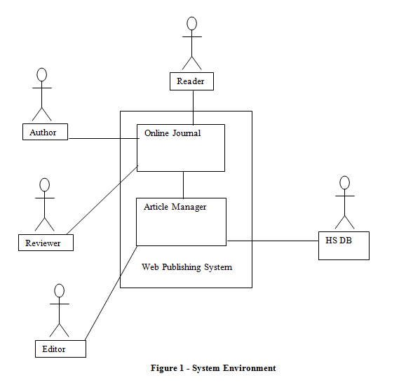
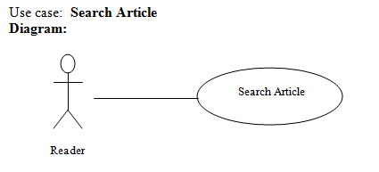
Use Case Diagrams

Slide 20
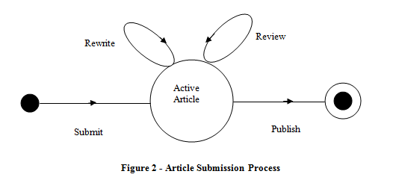
Process models/Flow Diagrams

Slide 21
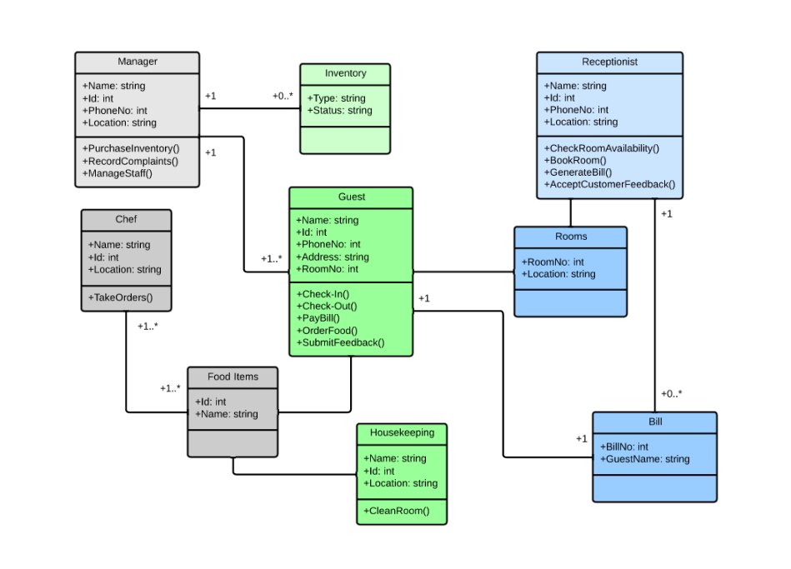
Class diagrams

Slide 22
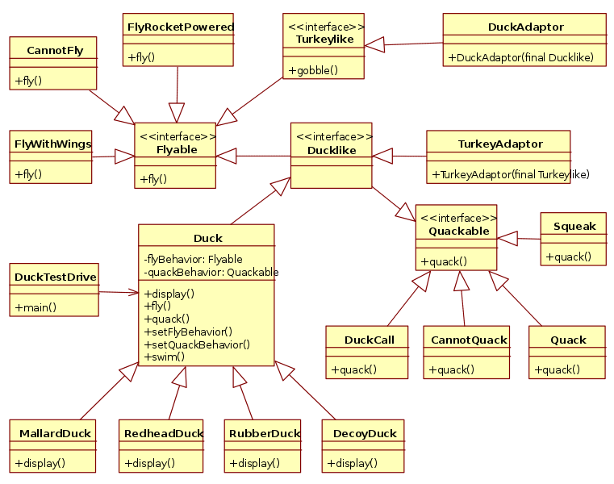
UML diagrams

Slide 23
3.5
Describe the qualities of good requirements and the impact of poor requirements

Slide 24
Characteristics of a Good Requirement
A requirement needs to meet several criteria to be considered a “good requirement”
Good requirements should have the following characteristics:
Unambiguous
Testable (verifiable)
Clear (concise, terse, simple, precise)
Correct
Understandable
Feasible (realistic, possible)
Independent
Atomic
Necessary
Implementation-free (abstract)
Zielczynski, Peter. 2007. Requirements Management Using IBM Rational RequisitePro. IBM press

Slide 25
TASK
Looking at the previous slide, describe each of the concepts
You may not find all of them but find at least six

