Slide 1
Operating Systems and Architecture
^{<assembler>}
(UFCFCU-30-1)

Slide 2
After completing this section of the module you will be able to:
Describe and explain Memory systems and storage architecture

Slide 3
End of last section we looked at

Slide 4
Memory Management
^{<Memory Management>}
Requirements for memory management
Relocation
Protection
Sharing
Logical organization
Physical organization
Frame | A fixed-length block of main memory
Page | A fixed-length block of data that resides in secondary memory (such as a disk). A page of data may temporarily be copied into a frame of main memory
Segment | A Variable-length block of data that resides in secondary memory. An entire segment may temporarily be copied into an available region of main memory (segmentation) or the segment may be divided into pages. Which can be individually copied into main memory (combined segmentation and paging)
Notes:
Main memory is divided into two parts, one part for the operating system (resident monitor and kernel) and the other for program currently running.

Slide 5
Relocation
^{<Relocation>}
The CPU takes instructions from the memory; however, we don’t know what other programs will be in main memory at the time of execution
Process control information
Process control Block
Entry point to program
Branch Instruction
Program
Increasing address values
Reference to data
Data
Current top of stack
Stack
Notes:
Once a program has been swapped out to disk we can’t really place it back in to the same memory region as before.
We need to relocate the process to a different area of memory.
We cannot know ahead of time where a program will be placed
We must allow the possibility that the program may be moved around in main memory due to swapping.
The table depicts a process image, in this case we will assume the process image occupies a contiguous region of main memory.

Slide 6
^{<Protection>}
Each process should be protected against unwanted interference by other processes.
All memory references generated by a process must be checked at runtime to ensure they refer only to memory space allocation to that process.
Memory protection must be satisfied by the processor and not the operating system.
Notes:
Each process should be protected against unwanted interference by other processes.
Programs in other processes should not be able to reference memory locations in a process for reading or writing purposes without permission.
The satisfaction of the relocation requirement also increases the difficulty of the protection requirement. Why? Because the location of a program in the main memory is unpredictable.
The reason the Hardware must protect the requirement is because the software (OS) can not anticipate all of the memory references that a program will make.
It’s only possible to access the permissibility if a memory reference at the time of execution of the instruction making the reference. For OS to do this

Slide 7
^{<Sharing>}
Any protection mechanism must have the flexibility to allow several processes to access the same portion of main memory.
If several processes are executing the same program it would be advantageous to allow each process to access the same copy of the program.
Notes:
Protection allows for relocation and the mechanism used to support relocation also support sharing capabilities.

Slide 8
^{<Logical Organisation>}
Most programs are organized into modules, some are unmodifiable (Read only, execute only) and some can be modified
Modules can be written and compiled independently with all references from one modules to another resolved by the system at run time
With modest additional overhead, different degrees of protection can be given to different modules (Read only, etc.)
It is possible to introduce mechanism by which modules can be shared among processes
Notes:
The advantage of providing sharing on a module level is that this corresponds to the users way of viewing the problem, hence why it is easy for the user to specify the sharing that is desired.

Slide 9
^{<Physical Organisation>}
Memory is organized into two different levels, Main memory and secondary memory.
Main memory is volatile and secondary is usually non volatile.
Might require overlaying
Notes:
Secondary memory is slower that main memory.
Main memory holds programs and data currently in use, and secondary is used for long term storage of programs and data.
Moving form secondary to main memory is important as main is faster.
In this two level system the flow of information between main and secondary memory is a major system concern. The responsibility for this flow could be assigned to the individual programmer, but this is impractical and undesirable for two reasons.
Main memory available for a program and its data may be insufficient. In that case, the programmer must engage in a practise known as overlaying, in which the program and data are organized in such a way that various modules can be assigned the same region of memory, with a main program responsible for switching the modules in and out as needed. Even with the aid of compiler tools, overlay programming wastes a programmers time.
In a multiprogramming environment, the programmer does not know at the time of coding how much space will be available or where that space will be, it is clear then that the task of moving information between the two levels of memory should be a system responsibility. This task is the essence of memory management.
I.e. Moving information/data from storage (secondary memory) to Main memory (RAM)

Slide 10
^{<Memory Partitioning>}
The principle operation of memory management is to bring processes into the main memory for execution by the processor
In almost all multiprogramming systems this is known as virtual memory
These are based off of two key features;
Segmentation
Paging
Firstly though we need to lay the groundwork of how we got to virtual memory.

Slide 11
^{<Memory Partitioning>}

Slide 12
Placement algorithm Fixed
^{<Fixed algorithm placement>}
Operating system 8M
8M
8M
8M
8M
8M
8M
8M
Operating system 8M
2M
4M
6M
8M
8M
12M
16M
With equal size partitions the placement process in memory is trivial.
If a partition is available a process can be loaded into it.
If all partitions are occupied with process that are not ready to run, we swap one out.
With unequal size partitions there are two possible ways to assign processes
Simple way is to assign each process to the smallest partition it will fit.
Notes:
Simple way is to assign each process to the smallest partition it will fit. - The advantage of this is that it will minimize wasted memory within a partition (internal fragmentation)
This is not optimum for a whole system though as is only good as a single application

Slide 13
Placement algorithm Fixed
^{<Fixed algorithm placement>}
Operating system 8M
2M
4M
6M
8M
8M
12M
16M
Operating system 8M
2M
4M
6M
8M
8M
12M
16M
New processes
New processes
Notes:
Lets say in this diagram on the left we don’t have any processes with a size between 12M and 16M.
The 16M will never be used and it will be wasted even though smaller processes could be assigned to it they are not. This is because we are allocating one process per partition.
A preferable approach would be to employ a single queue system for all processes (image on the right)
When its time to load a process into main memory the smallest available partition that will hold the process is then selected. If all partitions are occupied, then a swapping decision must be made.
What could we swap out? The smallest parttion – Priority - Blocked processes - Ready processes
The use of unequal size partitions provides a degree of flexibility over fixed.
There are some disadvantages though – As partition sizes are pre-set at system generation time small jobs will not utilize partition size efficiently. In most cases this is an inefficient technique unless we know before hand the main storage requirements.
Fixed partition is not really used today.

Slide 14
Dynamic Partitioning
^{<Dynamic Partitioning>}
Operating system
Operating system
Process 1
Operating system
Process 1
Process 2
Operating system
Process 1
Process 2
Process 3
Operating system
Process 1
Process 4
Process 3
8M
20M
20M
20M
20M
14M
14M
8M
56M
6M
36M
18M
18M
22M
4M
4M
Notes:
To overcome some of the issues with fixed partitioning, dynamic partitioning was developed. This has been supplanted by more sophisticated memory management techniques, but they build upon these concepts.
With Dynamic partitioning the partitions are of variable length and number
When a process is brought into main memory it is allocated exactly as much memory it requires and no more.
As we start to swap out processes we start to leave small holes where the partition is not big enough for a process, this causes external fragmentation.

Slide 15
Memory before and after allocation
^{<Memory allocation>}
Last allocated block (14M)
8M
12M
22M
18M
8M
6M
14M
36M
Before
8M
12M
6M
2M
6M
8M
14M
20M
After
Allocated | Free | Possible new allocation
Notes:
Memory compaction is time consuming
We must be clever when deciding how the OS assigns and processes memory (Plug the holes)
We must decide what block of memory of sufficient size to allocate.
Placement algorithms
Best fit – closest in size
First fit – First available block that is big enough
Next-fit – Scans from the location of the last allocation and choses the next available block
Get them to research into each algorithm and rank them in order of best performance.

Slide 16
^{<paging>}
Fixed size and variable size partitions are inefficient in memory management
Partition Main Memory into equal sized chunks
Each process is also divided into the same size equal size chunks
The Chunks of process known as Pages could be assigned to available chunks of memory known as Frames.
Notes:
Fixed results in internal fragmentation
Variable results in external fragmentation
Internal Fragmentation
Memory block assigned to process is bigger. Some portion of memory is left unused, as it cannot be used by another process. The internal fragmentation can be reduced by effectively assigning the smallest partition but large enough for the process.
External Fragmentation
Total memory space is enough to satisfy a request or to reside a process in it, but it is not contiguous, so it cannot be used. External fragmentation can be reduced by compaction or shuffle memory contents to place all free memory together in one large block. To make compaction feasible, relocation should be dynamic.

Slide 17
^{<paging>}
There will be free frames and frames that are in use
Free frames list is maintained by the OS
Process A stored on disk has four pages
When its time to load the process the OS finds four free frames and loads the four frames in.
What will the Page tables look like for each of these?
Notes:
At any given time there will be free and in use frames
As we start to load in new processes we fill up the memory.
As you can see with Process C we have no room for Process D to load in.
Each block is a page
How does the computer know how to access D with it scattered? The Base address register will not suffice, we need a page table

Slide 18
Page Tables
^{<paging>}

Slide 19
^{<paging>}
Extract the page number as the leftmost n bits of the logical address
Use the page number as an index into the process page table to find the frame number k
The starting physical address of the frame is k X 2 and the physical address of the referenced byte is that number plus the offset.
Notes:
The address does not need to be calculated it is constructed by appending the fram number to the offset

Slide 20
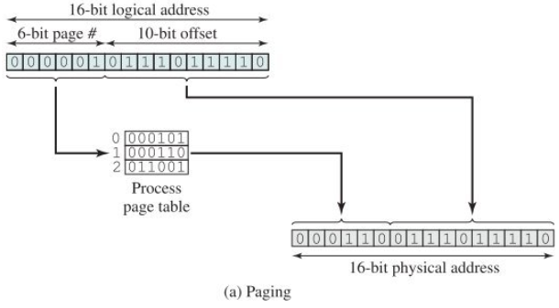
^{<paging>}
Notes:
The address does not need to be calculated it is constructed by appending the fram number to the offset

Slide 21
^{<Segmentation>}
A program can be subdivided using segmentation.
The program and its data are divided into a number of segments
They don’t all have to be the same length although there is a maximum segment length
Segmentation is similar to dynamic partitioning
Segmentation is visible to the programmer at the start unlike paging.
The complier will assign programmes and data to different segments

Slide 22
Virtual Memory
^{<Virtual Memory>}
All memory references within a process are logical address that are dynamically translated into physical address at run time.
A process may be broken up into a number of pieces (Page or segments) and these pieces need not be contiguously located in main memory during execution. The combination of dynamic run-time address translation and the use of a page or segment table permits this.
Notes:
All memory references within a process are logical address that are dynamically translated into physical address at run time.
This means that a process may be swapped in and out of main memory such that it occupies different regions of main memory at different times during the course of execution.

Slide 23
Two characteristics fundamental to memory management:
1) all memory references are logical addresses that are dynamically translated into physical addresses at run time
2) a process may be broken up into a number of pieces that don’t need to be contiguously located in main memory during execution
If these two characteristics are present, it is not necessary that all of the pages or segments of a process be in main memory during execution

Slide 24
^{<Key Terms>}
Virtual Memory | A storage allocation scheme where secondary memory can be addressed as if it was main memory.
Virtual Address | The address assigned to a location in virtual memory to allow that location to be accessed as though it were part of main memory
Virtual Address space | The virtual storage assigned to a process
Address space | The range of memory addresses available to a process
Real address | The address of a storage location in main memory

Slide 25
^{<Virtual Memory>}
Is virtual memory efficient?
There are two implications we can lead to.
More process may be maintained in main memory
A Process may be larger than all of main memory
Notes:
What if we have to interrupt a execution to fetch a page from secondary storage when the rest is in main?
But it can be efficient – we will cover later
More processes – Because we are only going to load some of the pieces of any particular process there is room for more processes. This leads to more efficient utilization of the processor, because it is more likely that at least one of the more numerous processes will be in a ready state at any particular time.
Process being larger – The most fundamental restrictions in programming is lifted. If the programmer is creating a program too big for main memory the programmer doesn’t need to worry about the size of main memory or the locations as the OS can deal with virtual pages and segments

Slide 26
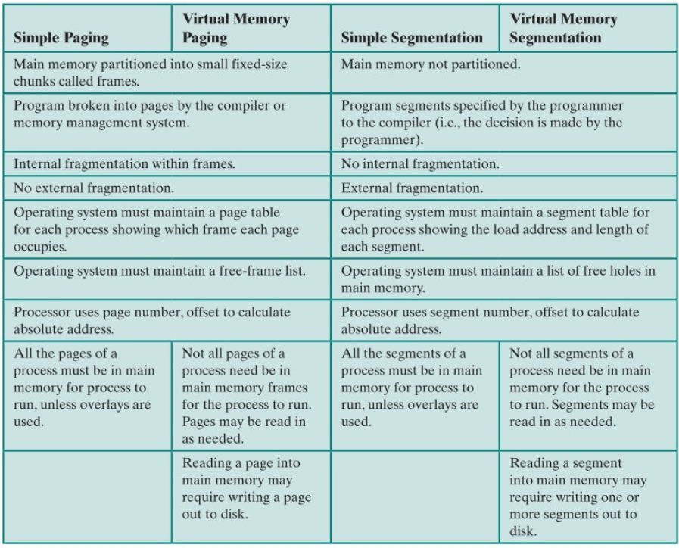
^{<Virtual Memory>}

Slide 27
^{<Virtual Memory>}
Too much swapping in Memory can cause Thrashing
Principle of locality is part of the solution, the principles of locality states that program and data references within a process tend to cluster.
The OS uses this idea and through algorithms guesses based on recent history what pieces are least likely to be used in the future.
Notes:
In a process consisting of a long program and arrays of data the execution may be confined to a small section of the programe Like a subroutine
It would be a waste to have all of the programme process loaded into memory if when the subroutine is called the rest of the programme is suspened and swapped.
If the programme branches and cant find the required piece of memory it will be feteched

Slide 28
^{<Virtual Memory paging>}
Like paging, in Virtual memory paging each process is divided into a number of equal sized pages of the same length frames
However not all pages need to be loaded into main memory frames for execution

Slide 29
^{<Virtual Memory paging>}
The page table becomes a bit different now
Why is this needed?
Notes:
A page table needs to indicate wherher the corresponding page is Present (P) in main memory or not. As not all the pages of a process will be in main memory.
If the bit indicates that the page is in memory then the entry also includes the frame number.
The page table entry also includes (m) modify to indicate if the content of the corresponding page have been altered since the page was last loaded in main memory
Other bits are used for protection sharing etc..

Slide 30
^{<Virtual Memory paging>}
The page table becomes a bit different now
Why is this needed?

Slide 31
^{<Translation lookaside buffer>}
In principle a virtual memory scheme would have the effect of doubling memory access time
Why is that?
To overcome this most virtual memory schemes make use of a special high-speed cache for page table entries.
This functions the same way as memory cache and it contains the most recently used page tables
Notes:
We have to theoretically fetch a page table entry and then fetch the desired data.

Slide 32
^{<Translation lookaside buffer>}
Notes:
The CPU will check the TLB of the table entry is present we get a (hit) then the frame number is retrieved and the real address is formed.
If the entry is not found (miss) the CPU uses the page number to index the process page table and examine corresponding page table entry. If the present bit is set then the page is in main memory, and the CPU can retrieve the frame number from the page table to form a real address.
If the present Bit is not set then the desired page is not in main memory and the memory access fault called Page fault is issues and the leave the hardware and invoke the OS which loads the needed page and updates the page table.

Slide 33
^{<Translation lookaside buffer>}
Notes:
The CPU will check the TLB of the table entry is present we get a (hit) then the frame number is retrieved and the real address is formed.
If the entry is not found (miss) the CPU uses the page number to index the process page table and examine corresponding page table entry. If the present bit is set then the page is in main memory, and the CPU can retrieve the frame number from the page table to form a real address.
If the present Bit is not set then the desired page is not in main memory and the memory access fault called Page fault is issues and the leave the hardware and invoke the OS which loads the needed page and updates the page table.

Slide 34
^{<Virtual Memory>}
The OS needs to make a few decisions when it comes to memory management
To use virtual memory techniques or not
The use of segmentation, paging or both
The algorithms employed for various aspects of memory management
Notes:
Old UNIX systems did not support virtual memory as the processor did not support Paging or segmentation

Slide 35
^{<Basic Algorithms>}
Optimal
Least recently used (LRU)
First in First out (FIFO)
Clock

Slide 36
^{<Page sizes>}
Find out the page sizes for;
Intel core i7
Pentium
IBM AS/400
Notes:
I7 – 4 kb to 1GB
Pentium – 4 kb or 4Mb
IBM – 512 bytes

Slide 37
Tasks
Research and create a table of the strengths and weaknesses of these different memory techniques.
Fixed partitioning
Dynamic partitioning
Simple paging
Simple segmentation
Virtual memory paging
Virtual memory segmentation

