Slide 1
Day 2

Slide 2
Recap
Module 1 - Fundamentals of Testing
1.1 Why is Testing Necessary?
Causes of Software Defects
The Role of Testing
Quality and Testing
How Much Testing is Enough?
1.2 What is Testing?
Testing Objectives
Testing and Debugging
1.3 Seven Testing Principles
1.4 Fundamental Test Process
1.5 The Psychology of Testing
Test Independence
Testers and Developers
Tester-Developer Communication
1.6 Code of Ethics

Slide 3
Recap
Module 2 - Testing Throughout the Software Lifecycle
2.1 Software Development Models
Life Cycle Models
Waterfall Model
V-Model
Iterative-Incremental (Agile) Models
Testing Within an Iterative-Incremental Life Cycle
Verification and Validation
Good Testing Within a Life Cycle Model
2.2 Test Levels
Component (Unit) Testing
Component Integration Testing
System Testing
System Integration Testing
Acceptance Testing
Types of Acceptance Testing
2.3 Test Types
Functional Testing
Non-functional Testing
Structural Testing
Change-Related Testing
2.4 Maintenance Testing
Scale of Maintenance Testing

Slide 4
Answers to Homework

Slide 5
Module 3
Static Techniques

Slide 6
Topics
Static Techniques and the Test Process
Review Process
Static Analysis by Tools

Slide 7
3.1 Static Techniques and the Test Process
Learning Objectives
Recognise software work products that can be examined by the different static techniques (K1)
Describe the importance and value of considering static techniques for the assessment of software work products (K2)
Explain the difference between static and dynamic techniques, considering objectives, types of defects to be identified, and the role of these techniques within the software life cycle (K2)

Slide 8
Static Testing
Static Testing is the examination of program source code or other project documentation, without the execution of the code, to find defects
There are two types of static testing:
Reviews
Static Analysis

Slide 9
Reviews
Reviews are manual examination of documents
done by humans

Slide 10
Static Analysis
Static Analysis is automated analysis of source code and software models
done by tools

Slide 11
Static Techniques
Reviews and static analysis have the same objective as dynamic testing- identifying defects
They are complementary techniques
Static techniques find causes of failures (defects) directly, while dynamic testing finds failures which may be caused by defects

Slide 12
Static Testing v Dynamic Testing
Static Testing | Dynamic Testing
Performed early in the lifecycle, before software is executed | Performed late in the lifecycle, after software is written
Analyse code or documents without running software | Execute software and analyse results
Find defects in code or documents directly | Observe failures in system which could identify defects in code
Defects are cheap to fix | Defects are expensive to fix
Add quality into software | Check quality of software

Slide 13
Reviews
Any written project document or software product can be reviewed. Typical documents include:
Business requirements
Functional specifications
System and database designs
Source code
Test plans, test cases and scripts
User guides, help text
Web pages
And others

Slide 14
Benefits of Conducting Reviews
Studies have shown that defects found early in a project are easier and cheaper to fix than those found later
Benefits of conducting reviews include:
Early defect detection and correction
Increased development productivity
Reduced development cost and timescales
Fewer defects in code
Reduced time and cost of dynamic testing
Improved communication between testers, analysts, developers and users
Conformance to standards leading to improved maintainability of code and documents

Slide 15
Goals of the Review Process
The aim of reviews is to check and improve the quality of project products, including:
Verification and validation of documents against specifications and standards
Consistency with predecessor documents
Completeness and conformance to standards

Slide 16
Goals of the Review Process
Reviews should be used by testers to identify defects such as errors, omissions, additions, inconsistencies, ambiguities, readability, terminology, spelling, grammar, layout, and structure
A good review will also include causal analysis to learn from issues and bring about process improvement
By involving a number of reviewers in a controlled manner consensus can be reached on subjects such as best design practice
Reviews are better than dynamic testing at finding some types of defect, such as:
checking standards
identifying inconsistencies in requirements and designs
assessing maintainability
checking interface specifications

Slide 17
3.2 Review Process
Learning Objectives
Recall the activities, roles and responsibilities of a typical formal review (K1)
Explain the differences between different types of reviews: informal review, technical review, walkthrough and inspection (K2)
Explain the factors for successful performance of reviews (K2)

Slide 18
Review Process
Different types of reviews:
vary from informal
characterised by no structure or written instructions
to formal or systematic
characterised by:
team participation
documented procedures
documented results
The formality of a review process is related to factors such as the maturity of the development process, any legal or regulatory requirements or the need for an audit trail

Slide 19
Review Process
The way a review is carried out depends on the agreed objectives of the review
e.g.
find defects
gain understanding
educate testers and new team members
discussion and decision by consensus

Slide 20
Formal Review
A 'formal review' is defined as any review with documented procedures and requirements
A typical formal review has the following main activities:

Slide 21
Planning
The moderator and document author define the review criteria and select which parts of documents to review
They select the review team, ensuring the right personnel are selected to add value, and allocate roles
For formal review types, they define the entry and exit criteria

Slide 22
Kick-off
Documents are distributed to the reviewers, often about 3 days in advance
The objectives, process and documents are explained to the participants

Slide 23
Individual Preparation
Reviewers read the documents and note any potential defects, questions and comments
They may compare product to predecessor products, standards, guidelines, and best practices as well as architecture strategies
Reviewers may be required to report readiness to the moderator after reviewing the document(s) or the meeting cannot be held

Slide 24
Review meeting
The participants discuss the document, defects, and log findings, with documented results or minutes
The meeting is managed by the moderator, who ensures discussions are kept on track and remain objective
In some review types, only defects are identified and agreed; in others, there may be discussions on alternatives and solutions

Slide 25
Rework
Following the meeting:
the author corrects the document based on the defects found (typically done by the author)
and updates the status of defects (in formal reviews)

Slide 26
Follow-up
The moderator ensures that document has been corrected and collects metrics such as time spent by reviewers on checking, defect density in reviewed document, and breakdown of defects by business area or severity
This will be used for causal analysis to find recurring issues

Slide 27
Roles and Responsibilities
A typical formal review will include the following roles:
Manager
Moderator (or Leader)
Author
Reviewers (aka Checkers or Inspectors)
Scribe (or Recorder)

Slide 28
Roles and Responsibilities - Manager
Manager
Decides on the execution of reviews but may not participate directly
The manager allocates time in project schedules (if not scheduled, preparation won't be thorough enough), and determines whether review objectives have been met

Slide 29
Roles and Responsibilities - Moderator
Moderator (or Leader)
Is responsible for managing all review team activities
The duties include planning, motivating, facilitating meetings, training reviewers and monitoring the whole review process
The moderator should be trained in review process, so they can lead the review meeting, set the agenda and control the pace
The moderator also records summary results for quality management and follow-up action

Slide 30
Roles and Responsibilities - Author
Author
Prepares the material to be reviewed, participates in discussions during the review meeting and incorporates the agreed changes afterwards.

Slide 31
Roles and Responsibilities - Reviewers
Reviewers (aka Checkers or Inspectors)
Are responsible for finding defects in the product under review
They should have specific relevant technical or business background and may include stakeholders (predecessor and successor owners)
Reviewers from different areas will have different focus such as:
Business users
Developers
Analysts
IT Operations
Testers
Compliance officers

Slide 32
Roles and Responsibilities - Scribe
Scribe (or Recorder)
Documents all the issues, problems and open points that were identified during the meeting

Slide 33
Roles and Responsibilities
Note that these are roles, not job titles - in some review types, one person could play a number of roles within the process, particularly the leader who may serve as recorder and reviewer too

Slide 34
Types of Review
Different review types vary in the formality of their procedures and results
A single document or product may go through different types of reviews
For example, an informal review could be carried out before it is completed to make sure it is in the right format before going through a technical review; or depending on the level of risk, an inspection may be followed by a walkthrough with the customer

Slide 35
Types of Review
All of these review types may be termed a 'peer review' if conducted by reviewers at the same organisational level without management participation
Any review with managers present is a 'management review'

Slide 36
Types of Review

Slide 37
Types of Review
The main characteristics, options and purposes of common review types are:
Informal Review
Walkthrough
Technical Review
Inspection

Slide 38
Types of Review - Informal
One-to-one discussions with no formal process, roles or documented record of findings
Typical examples include:
'buddy reviews'
desk-checking of program code
pair programming
technical team leader reviewing designs and code of team members
They are an inexpensive way to get some benefit
Common in most business areas, with senior staff helping and advising more junior staff, or peers assessing each other's work

Slide 39
Types of Review - Walkthrough
Walkthroughs are review meeting led by the author of the document being reviewed
They may take the form of scenarios, dry runs and peer group participation. Ideally, reviewers should prepare their comments before the meeting
A scribe (who is not the author but may be a reviewer) should produce a report with a list of findings
Walkthroughs should allow enough time for discussion, even if that means scheduling another meeting
Walkthroughs are very useful for highly visual products via storyboarding, workflow tools and such like

Slide 40
Types of Review - Walkthrough
Walkthroughs should find defects but not propose solutions - that is the author's task after the meeting
Walkthroughs are probably the most common review type in many organisations
They are often seen primarily as a means of presenting information and learning, e.g. a business analyst presenting a requirements document to other project personnel
Many attendees will therefore see their role as 'passive' - to learn rather than provide input
However, testers should see them as an opportunity to analyse and query the document, to find defects and improve its quality

Slide 41
Types of Review – Technical review
Technical reviews are a documented, defined defect-detection process involving both peers and technical experts
Ideally led by a trained moderator (not the author)
May vary from quite informal to very formal, with the use of guidelines and checklists

Slide 42
Types of Review – Technical review
The main purpose is to review a document from a particular technical or specialist viewpoint, to discuss, make decisions, evaluate alternatives, find defects, solve technical problems and check conformance to specifications, plans, regulations and standards
Reviewers will include technical specialists or domain experts (e.g. technical architect, data designer, compliance officer, system administrator) who should prepare comments and recommendations before the meeting
At the end of the meeting, a review report should be produced with a list of findings, the verdict whether the software product meets its requirements, and recommendations

Slide 43
Types of Review – Inspection
The inspection process is a very thorough, formal process designed to detect defects in documents and program source code, using rules, checklists and entry/exit – criteria
It was developed by Michael Fagan of IBM in the mid -1970s and it has since been extended and modified
The process should have entry criteria to determine if the inspection process is ready to begin
This prevents unfinished work products from entering the inspection process

Slide 44
Types of Review – Inspection
The inspection meeting is led by a trained moderator: (not the author) and is usually conducted as a peer review without management involvement
To be most effective, reviewers have defined roles and must submit a list of issues before the meeting
The scribe should produce a formal inspection report including a list of findings, and there is a formal follow-up process which is conducted by the author and confirmed by the moderator.
Inspections also involve causal analysis which collects metrics on defect information from each inspection, looks at common causes of defects and provides feedback to improve future development and inspection processes

Slide 45
Success Factors for Reviews
For any type of review to be successful it must have clear, predefined objective and must involve the right people for the review objectives
This includes testers who are valued reviewers and can contribute to the review and also learn about the product which enables them to prepare tests earlier

Slide 46
Success Factors for Reviews
People issues and psychological aspects must be dealt with and defects found are welcomed and expressed objectively
It is important that reviews are conducted in an atmosphere of trust
the outcome must not be used for the evaluation of the participants

Slide 47
Success Factors for Reviews - Summary
Each review has clear predefined objectives
The right people for the review objectives are involved
Testers are valued reviewers who contribute to the review and also learn about the product which enables them to prepare tests earlier
Defects found are welcomed and expressed objectively
People issues and psychological aspects are dealt with (e.g., making it a positive experience for the author)
The review is conducted in an atmosphere of trust; the outcome will not be used for the evaluation of the participants
Review techniques are applied that are suitable to achieve the objectives and to the type and level of software work products and reviewers
Checklists or roles are used if appropriate to increase effectiveness of defect identification
Training is given in review techniques, especially the more formal techniques such as inspection
Management supports a good review process (e.g., by incorporating adequate time for review activities in project schedules)
There is an emphasis on learning and process improvement

Slide 48
Use of Checklists in Reviews
Using checklists can make reviews more effective and help to find defects
Checklists can be based on various perspectives, e.g.
User, developer, tester or operations
List of typical requirements problems

Slide 49
Example checklist for inspecting requirements
Correctness
Do any requirements conflict with or duplicate other requirements?
Is each requirement written in clear, concise, unambiguous language?
Is each requirement verifiable by testing, demonstration, review, or analysis?
Is any necessary information missing from a requirement? If so, is it identified as TBD?
Can all of the requirements be implemented within known constraints and in scope for the project?
Are any specified error messages unique and meaningful?
Quality Attributes
Are all performance objectives properly specified?
Are all security and safety considerations properly specified?
Are other pertinent quality attribute goals explicitly documented and quantified, with the acceptable trade-offs specified?

Slide 50
Break

Slide 51
3.3 Static Analysis by Tools
Learning Objectives
Recall typical defects and errors identified by static analysis and compare them to reviews and dynamic testing (K1)
Describe, using examples, the typical benefits of static analysis (K2)
List typical code and design defects that may be identified by static analysis tools (K1)

Slide 52
Static Analysis by Tools
The objective of static analysis is to find defects in software source code and software models, but not written documents
It requires the use of tools and is performed without actually executing the software being examined by the tool (whereas dynamic testing does execute the software code.)
As with reviews, static analysis finds defects rather than failures

Slide 53
Static Analysis by Tools
Static analysis does not test functionality but can locate structural defects that are hard to find in dynamic testing
Subtle coding errors and fault-prone code can often be found far more quickly using these tools than by visual inspection or testing

Slide 54
Static Analysis by Tools - Value
The value of static analysis is:
Early detection of defects prior to test execution
Early warning about suspicious aspects of the code or design by the calculation of metrics, such as a high complexity measure
Identification of defects not easily found by dynamic testing
Detecting dependencies and inconsistencies in software models such as links
Improved maintainability of code and design
Prevention of defects, if lessons are learned in development

Slide 55
Benefits of Static Analysis
Static analysis can provide early detection of defects prior to test execution, and early warning about complex code
It can identify structural defects not easily found by dynamic testing, as well as dependencies and inconsistencies in software models, such as links between modules

Slide 56
Benefits of Static Analysis
It can also help to prevent further defects, if lessons are learned in development
Static analysers are usually customisable, so they can check coding standards and improve maintainability of code and design
Generally, it is much quicker to find and fix these types of defects before setting up data and running dynamic tests
For example, discovering high complexity might result in a major redesign

Slide 57
Benefits of Static Analysis
Typical defects discovered by static analysis tools include:
Referencing a variable with an undefined value
Variables that are not used or improperly declared
Inconsistent component interfaces
Unreachable (dead) code, including uncalled functions and procedures
Missing and erroneous logic, e.g. infinite loops
Overly complicated constructs
Syntax violations
Programming standards violations
Security vulnerabilities

Slide 58
Benefits of Static Analysis
Many of these faults, such as syntax checking and undeclared variables, can be detected by compilers
Procedure and variable cross-references produced by the compiler will show up uncalled functions and procedures and where variables are used
Compilers can also calculate metrics and complexity measures

Slide 59
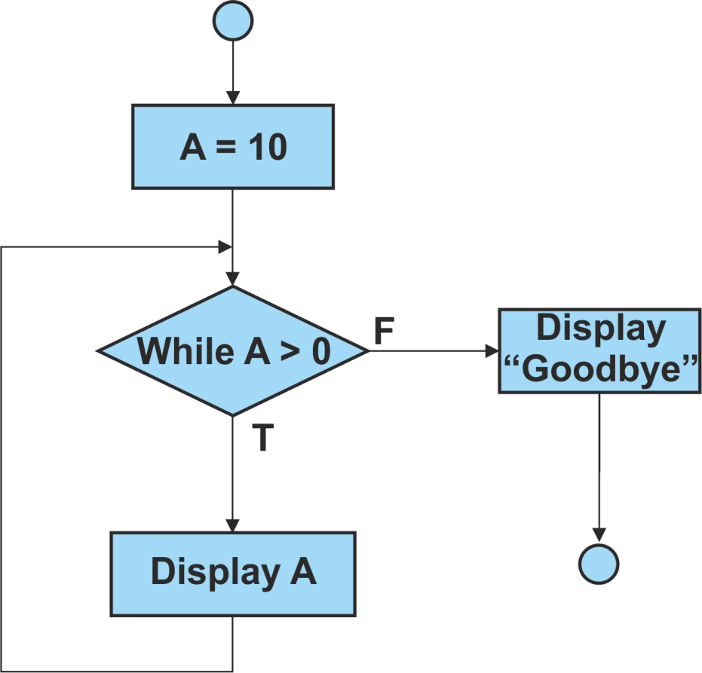
Benefits of Static Analysis – Example 1
This will loop forever as the condition 'While A > 0' will always be True

Slide 60
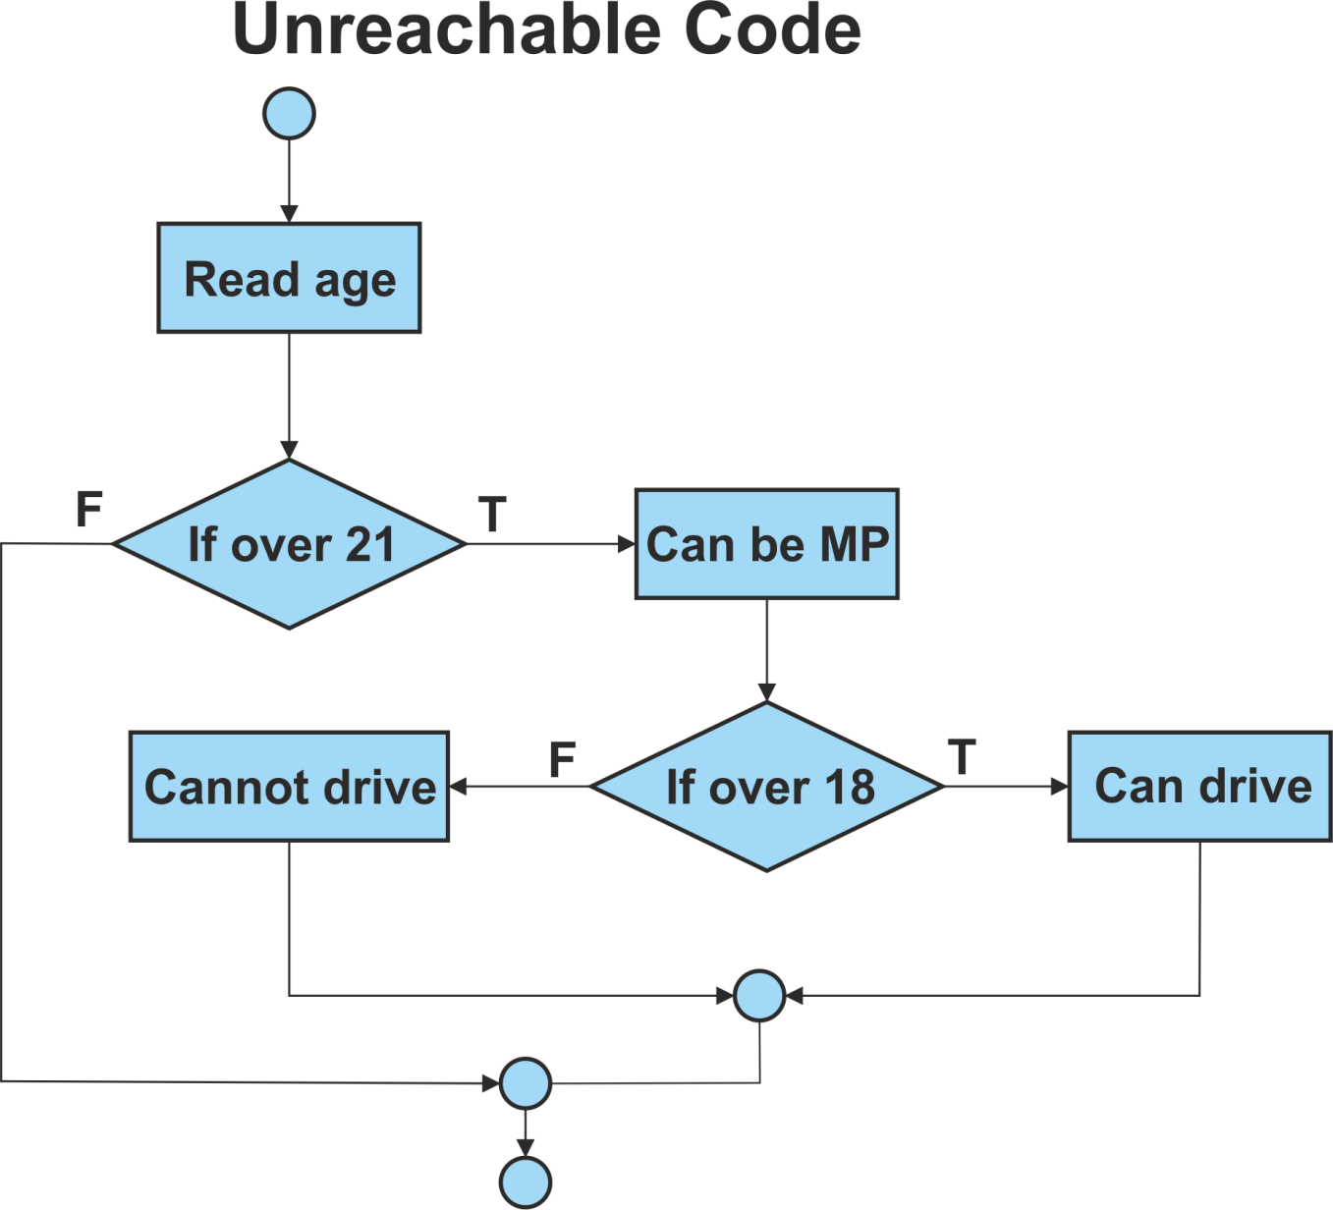
Benefits of Static Analysis – Example 2
The statement 'Cannot drive' will never be executed as the condition 'If over 18' will always be True

Slide 61
Data Flow Analysis
Examples of the typical problems that a data flow analyser would detect are shown below (assume a standalone section)
a = 10
b = 2
e = 50
f = 40
If b = x Then
do this
do that
y = a * b
Else
do other
e=10
.
.
.
End if
a is defined
b is defined
e is defined
f is defined
f is defined but not used
b is used
x is not defined
y is defined
a is used
b is used
e is redefined without use

Slide 62
Use of Static Analysis Tools
Static analysis tools are typically used by developers
Static analysis tools may produce a large number of warning messages, which need to be well-managed and filtered to allow the most effective use of the tool
Many of these tools provide a graphical view of the layout of the code
This can be useful for testers to:
Locate complex source code, which might indicate possible defect clustering and a focus for dynamic tests
Produce graphical output (e.g. control flow graphs)
Design structural (white box) tests based on control flow, data flow or other criteria
Examine source code from a number of perspectives based on industry accepted measures

Slide 63
Questions
Questions 14 to 16

Slide 64
Lunch

Slide 65
Module 4
Test Design Techniques

Slide 66
Topics
The Test Development Process
Categories of Test Design Techniques
Specification-based or Black-box Techniques
Structure-based or White-box Techniques
Experience-based Techniques
Choosing Test Techniques

Slide 67
4.1 The Test Development Process
Learning Objectives
Differentiate between a test design specification, test case specification and test procedure specification (K2)
Compare the terms test condition, test case and test procedure (K2)
Evaluate the quality of test cases in terms of clear traceability to the requirements and expected results (K2)
Translate test cases into a well-structured test procedure specification at a level of detail relevant to the knowledge of the testers (K3)

Slide 68
The Test Development Process
The formal test development process comprises three main steps:
Analyse the test basis, identify the test conditions and document them in the Test Design Specification
Design the test cases required to test the test conditions and document them in the Test Case Specification
Implement the test procedures for executing the test cases and document them in the Test Procedure Specification

Slide 69
The Process

Slide 70
IEEE529- Standard for Software Test Documentation
Describes the content of eight documents to be produced during software testing
1. Test Plan 5. Test Item Transmittal Report
2. Test Design Specification 6. Test Log
3. Test Case Specification 7. Test Incident Report
4. Test Procedure Specification 8. Test Summary Report

Slide 71
3 Documents
We are concerned with the Specification documents only in this section
Test Design Specification - documents the test conditions (coverage items) for a test item, the detailed test approach and the associated high level test cases.
Test Case Specification - documents a set of test cases (objective, inputs, test actions, expected results, and execution preconditions) for a test item.
Test Procedure Specification - documents the sequence of actions for the execution of a test. If the test is to be executed manually, it is called a test procedure; if executed by automated tools it is called a test script

Slide 72
Test Condition
Test Condition - An item or event of a component or system that could be verified by one or more test cases, e.g. a function, transaction, feature, quality attribute, or structural element - ISTQB Glossary
The test conditions are Identified from the test basis, and documented in Test Design Specification
The Test Design Specification contains:
Test conditions, and
High-level test cases

Slide 73
Test Conditions
Test conditions are the lowest-level testable elements that can be derived from the test basis. These are then combined into meaningful business combinations, called high-level test cases.
For example, suppose a requirement states: "User enters customer code which must be in valid format AA999. If customer is registered on database, customer details are displayed." This would give test conditions such as:
Valid customer code, invalid customer code, registered customer, non-registered customer
These are then combined into high-level test cases, such as:
The input of a valid registered customer code
The input of an valid format but not registered customer code

Slide 74
Test Case
Test Case - A set of input values, execution pre-conditions, expected results and execution post-conditions, developed for a particular objective or test condition, such as to exercise a particular program path or to verify compliance with a specific requirement­ ISTQB Glossary

Slide 75
Test Case
Test Cases are documented in the Test Case Specification and can be thought of as a combination of elements:
Input values- one or more test conditions (already grouped into high-level test cases)
Execution pre-conditions - state of the system prior to test execution
Data requirements - both input and already on system
Expected results- such as screen display, error message, data storage
Execution post-conditions- state of system after test execution

Slide 76
A test case based on the example above might contain:
Test condition: | The input of a valid registered customer code
Input value: | AD015
Pre-condition: | Customer AD015 on database
Expected result: | Customer details displays
Post-condition: | No change

Slide 77
Traceability
Test conditions and cases should be linked directly to the test basis (e.g. requirements) to provide traceability
A Dewey numbering system may be used (e.g. 1.1, 2.6.3, etc.)
However, when conditions are spread across multiple cases and vice versa traceability becomes much more difficult
A Traceability Matrix can be created in Excel or using test tools, linking test cases directly to requirements, or via test conditions

Slide 78
Traceability Matrix
Ensures that:
Each requirement is adequately covered by tests
Each test has a purpose related to requirements

Slide 79
Test Procedure
Test Procedure- A document specifying a sequence of actions for the execution of a test. Also known as test script or manual test script - ISTQB Glossary.
The test procedure (Documented in the Test Procedure Specification) contains all instructions for running the test cases, such as:
Where the test data is and how to load it
Login to test system
Step by step instructions to run the test cases
Where and how to record and check the test results
Action to take to finish test, e.g. backup data
If tests are run using a test execution tool, the sequence of actions is specified in a test script (which is an automated test procedure)

Slide 80
Example
Step | Action | Expected Result
1 | Login with user id "A1234" password "P@sswOrd" | Main menu displayed
2 | Double click "Customer Inquiry" | Customer Inquiry screen displayed
3 | Enter Customer ID "AD015" | Customer AD015 details displayed
4 | Click "Account" button | Customer Account screen displayed

Slide 81
Test Execution Schedule
The various test procedures and automated test scripts are subsequently formed into a Test Execution Schedule that defines the order in which they are executed.
The order of execution may be based on:
Logical or technical dependencies of test cases (matching pre and post conditions)
Order of business functions or related activities
Prioritisation due to risk analysis
Test cycles or phases (e.g. regression testing)
Availability of test environment or hardware

Slide 82
Test Execution Schedule
The Test Execution Schedule is not part of the IEEE 829 standard, but is widely used by testers.

Slide 83
Break

Slide 84
4.2 Categories of Test Design Techniques
Learning Objectives
Recall reasons that both specification-based (black-box) and structure-based (white box) test design techniques are useful and list the common techniques for each (K1)
Explain the characteristics, commonalities, and differences between specification based testing, structure-based testing and experience-based testing (K2)

Slide 85
Purpose
The purpose of a test design technique is to identify test conditions, test cases and test data. It is a classic distinction to denote test techniques as black-box (also called specification-based techniques) or white-box (also called structure-based techniques.)

Slide 86
Specification-Based / Black-Box Test Design Techniques
Black-box test design techniques are a way to derive and select test conditions, test cases, or test data based on an analysis of the test basis documentation
This includes both functional and non-functional testing
Black-box testing takes an external view of the software and does not use any information regarding the internal structure of the component or system to be tested
Specification-based tests will show if the software meets specified requirements, but will not discover if the specification is incorrect (i.e. does not match user needs.)

Slide 87
Structure-Based / White-Box Test Design Techniques
White-box test design techniques are based on an analysis of the internal structure of the component or system
Tests are designed to assess coverage of the structure of the program code or system. The extent of coverage of the software can be measured for existing test cases, and further test cases can be derived systematically to increase coverage

Slide 88
Experience-Based Test Design Techniques
Experience-based test design techniques use the knowledge, skill and expertise of testers to derive the test cases
The experience of testers, developers, users and other stakeholders about the software, its usage and its environment can be used to help design appropriate tests for known systems
Testers can use their knowledge about likely defects and their distribution to focus and prioritise tests

Slide 89
4.3 Specification-based or Black-box Techniques
Learning Objectives
Write test cases from given software models using equivalence partitioning, boundary value analysis, decision tables and state transition diagrams/tables (K3)
Explain the main purpose of each of the four testing techniques, what level and type of testing could use the technique, and how coverage may be measured (K2)
Explain the concept of use case testing and its benefits (K2)

Slide 90
All dynamic test levels will include black-box testing
functional and non-functional testing based on analysis of business requirements, designs or specifications

Slide 91
Techniques
Five specification-based test design techniques will be described:
Equivalence Partitioning
Boundary Value Analysis
Decision Tables
State Transition Diagrams/Tables
Use Case Testing

Slide 92
Equivalence Partitioning
In equivalence partitioning, inputs to the software or system are divided into groups or ranges of values that are expected to exhibit similar behaviour, so they are likely to be processed in the same way, i.e. have the same output
The groups are called equivalence partitions or classes. Instead of testing every value in the partition, one value can be chosen to represent all, and used to test the whole partition

Slide 93
Equivalence Partitioning
Partitions can be identified for ranges or sets of values, outputs, time-related values, status values, interface parameters, etc.
Equivalence partitions can be for valid data, i.e. values that should be accepted; and invalid data, i.e. values that should be rejected
Tests can be designed to cover all valid and invalid partitions
Equivalence partitioning is applicable at all levels of testing and can be used to achieve input and output coverage goals

Slide 94
Equivalence Partitioning Example
An application is used to assign grades to students taking exams, as follows:
To pass a student must score at least 40
To gain a merit a student must score at least 60
To gain distinction a student must score at least 80
Any score less than 0 or greater than 100 is invalid

Slide 95
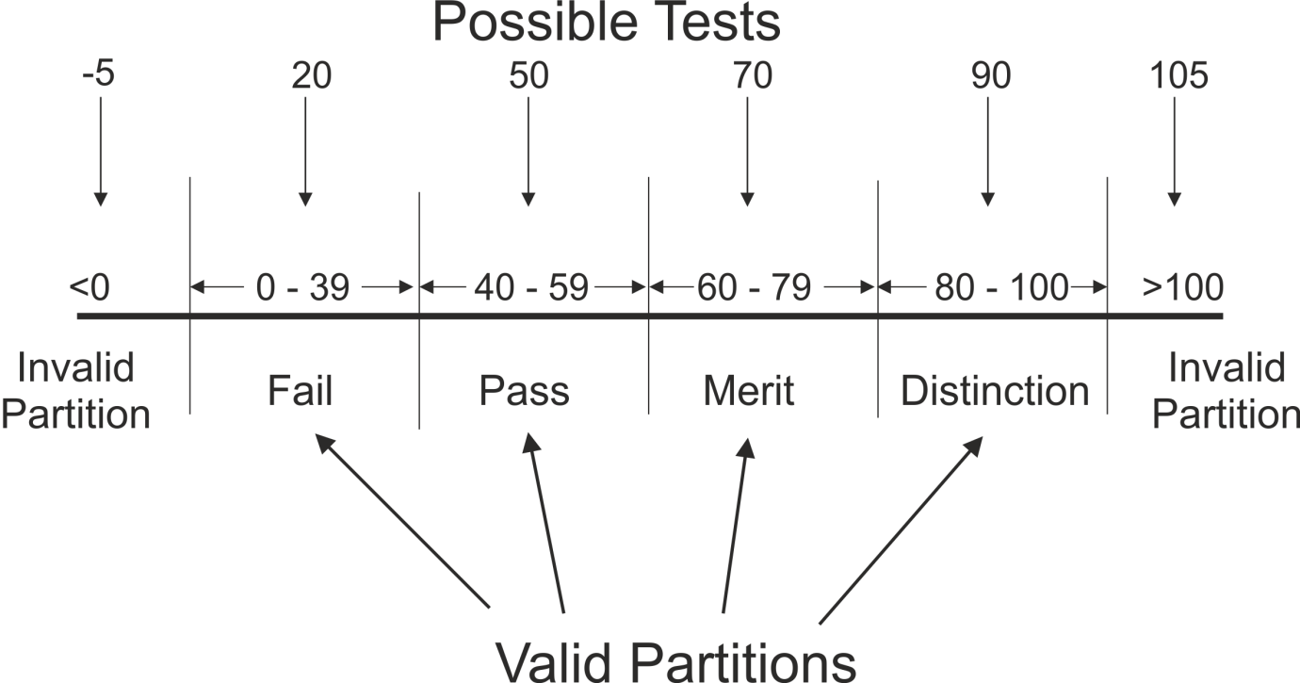
Solution
At a minimum we should test one fail, one pass, one merit and one distinction, rather than every possible score. Drawing a simple line chart can help identify the partitions, as shown below

Slide 96
Solution
In this example, there are 4 valid partitions and 2 invalid partitions, giving a total of 6 tests to cover the whole specification
The diagram also helps to clarify the specification, and identify gaps, e.g. upper/lower boundaries
In this case, the specification did not explicitly state what the output value is for an input less than 40 - we have assumed it is 'Fail'

Slide 97
Boundary Value Analysis
Boundaries are the dividing lines between equivalence partitions
Behaviour at the edge of a partition is more likely to be incorrect than behaviour within the partition, so boundaries are an area where testing is likely to yield defects
The minimum and maximum values of a partition are its boundary values.
A boundary value in a valid partition is a valid boundary value; a boundary value in an invalid partition is an invalid boundary value
Tests can be designed to cover both valid and invalid boundary values

Slide 98
Boundary Value Analysis
Boundary value analysis can be applied at all test levels. It is relatively easy to apply and its defect finding capability is high
This technique (aka Boundary Analysis) is often considered as an extension of equivalence partitioning or other black-box test design techniques

Slide 99
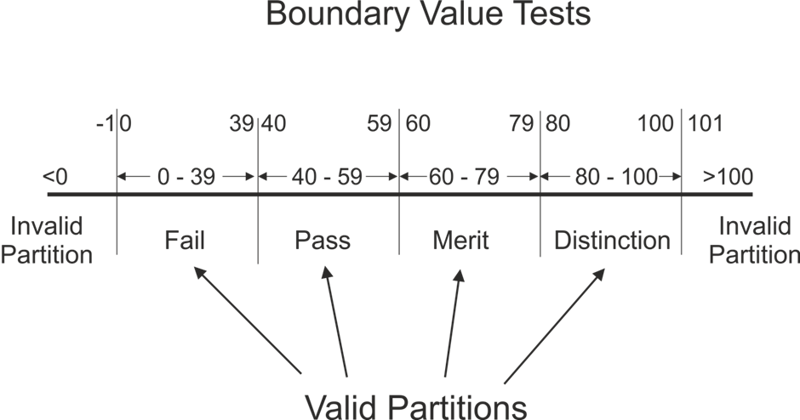
Boundary Value Analysis
In this example, there are 5 boundaries, giving a total of 10 tests to cover the whole specification. The diagram also helps to clarify the minimum increment between values, e.g. should we test 39 or 39.9 or 39.99?

Slide 100
EP and BVA Exercise
An application will calculate tax automatically for employees in the organisation.
The application should only allow input values below £200,000. If a value of this magnitude or greater is attempted, an error message is returned. Salaries are recorded in whole pounds (not pence).
Employees begin paying tax at a £5,000 threshold.
This first band is charged at 10% and this rate applies to the next £10,000 earned. 20% applies above this until at £40,000 a rate of 40% begins.
Employees may earn zero but there is no concept of negative salary.

Slide 101
Exercise
Draw a line diagram and mark the boundaries
How many valid and invalid partitions are there? What values would you use for boundary tests?

Slide 102
Decision Tables
Decision Tables represent the behaviour of a system that depends on the outcome of multiple decisions
They may be used to record complex business rules that a system is to implement

Slide 103
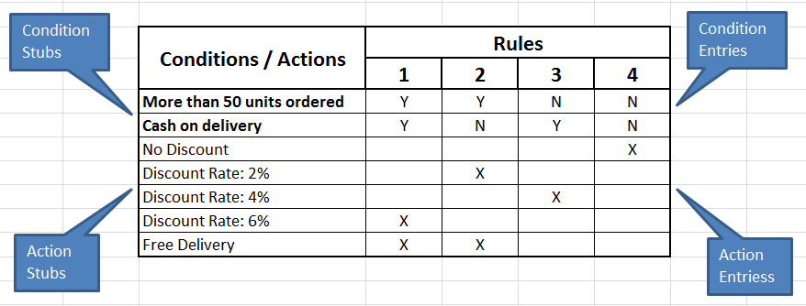
Decision Tables
The table specifies the possible combination of conditions and the resulting actions, according the business rules
Each column of the table corresponds to a business rule that defines a unique combination of conditions and which result in the execution of the actions associated with that rule
Conditions are usually stated in Boolean form (True/False or Yes/No).

Slide 104
Decision Tables
The process for creating a decision table is as follows:
Identify the condition stubs (descriptions) from the test basis.
Identify the action stubs (descriptions) from the test basis.
Establish the condition entries - all the possible combination of conditions.
List the rules from the test basis and work out the action entries for each rule - the outcomes associated with each combination.
Each column corresponds to a test case, in which the condition entries are the test conditions, and the action entries are the expected results
If there are two conditions, then there are a maximum 4 possible combinations; and for 3 conditions, there can be up to 8 possible combinations. If n is the number of conditions, then:
Number of possible combinations = 2^{n}

Slide 105
Decision Table Example
Requirement: Delivering goods from warehouse to shops
For each shop's delivery schedule we look to see how far away the shop is from the warehouse then we go through each item on the schedule
If the shop is further than 10 miles away we add the item to the next weekly delivery for that area, unless it's a rush order in which case we send it by overnight carrier
When we have an item to be delivered locally (i.e. less than or equal to 10 miles) we add it to the next day's delivery unless it's a rush order in which case Joe delivers it with an estate car immediately

Slide 106
Decision Table Example
Notes:
In this example each combination of conditions has a specified action and every combination is tested. Often however, there will be combinations of conditions for which there is no specified action, or an exception (error) generated. Then the tester will have to decide how many to test based on risk.
When faced with complex requirements, it is often easier to understand the logic using a diagrammatic technique, in this case a decision table. Like EP and BVA, it also helps to clarify the rules and establish any omissions or ambiguities.
The strength of decision table testing is that it creates combinations of conditions that might not otherwise have been exercised during testing.
If the example is extended to include a third condition, then the number of action columns should expand to eight. However, there are shortcuts which allow columns to be combined if they have the same outcome.

Slide 107
State Transition Diagrams/Tables
Some systems can be described in terms of 'states' or modes that the system can assume, the transition from one state to another because of some input condition, which leads to an event and results in an action which will finally give an output

Slide 108
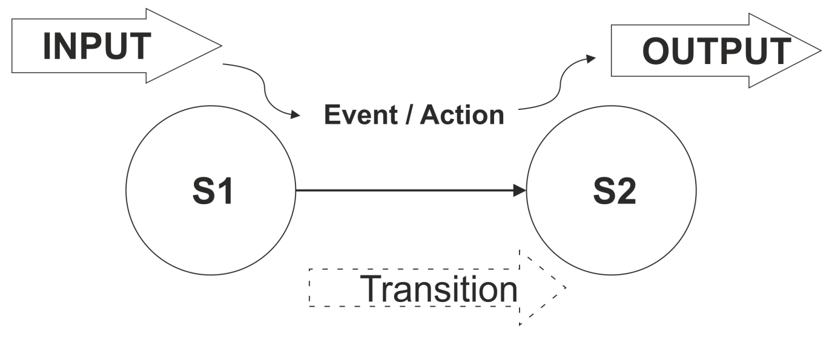
State Transition Diagrams/Tables
These systems can be represented by a state diagram showing:
The states a component or system may be in
The transitions or changes form one state to another
The events or circumstances that cause transitions
The actions as a result from the transition, for example an error message

Slide 109
State Transition Diagrams/Tables
The states of the system or object under test are separate, identifiable and finite in number.
State diagrams are often used for digital systems, embedded software or technical automation in general
However, the technique is also suitable for modelling a business object having specific states or testing screen-dialogue flows (e.g. for internet applications or business scenarios.)

Slide 110
State Transition Diagrams/Tables
State Transition Testing is a test design technique in which test cases are designed to execute valid and invalid state transitions, by creating a state table showing the resulting transitions for each state combined with each possible event, showing both valid and invalid transitions

Slide 111
State Transition Diagrams/Tables
The diagram shows the operation of a digital clock.
States are shown by a box or circle with the name of the state
Transitions are shown by arrows indicating the change of state
Events which cause transitions are shown by text on the arrows

Slide 112
State Transition Test Cases
Test cases can be derived from the State Transition Diagram to exercise each of the possible transitions, by creating a State Matrix for every valid transition (or arrow.)
The start state and event represent test conditions, and the finish state is the expected result
Test Case | 1 | 2 | 3 | 4 | 5 | 6
Start state | 81 | 81 | S3 | 82 | 82 | S4
Event/input | CM | R | TS | CM | R | DS
Finish state | S2 | S3 | S1 | 81 | 84 | S2

Slide 113
State Transition Test Cases
Creating a test case to cover each possible valid single transition in the model is known as 0-switch coverage.
It provides the ability to detect the most obvious faults but will not detect more subtle ones which would only be detectable by exercising sequences of transitions
N-switch (or Chow-switch) testing is a form of state transition testing in which test cases are designed to execute all valid sequences of N+1 transitions.
Therefore 0-switch testing means covering 0+1 (or single) transitions

Slide 114
State Transition Test Cases
The State Matrix in the previous slide shows only valid transitions
However, if we want to show both valid and invalid transitions, we will need to create the State Table:
Notes:
The table is filled in with the outcome of performing each transition from each start state. If this result is unknown or not shown on the state diagram, the corresponding cell is left blank or marked 'null' to indicate an invalid transition.
State tables are therefore a useful testing aid to derive the invalid "null" transitions directly. The decision whether to test invalid as well as valid transitions will depend on context and risk.

Slide 115
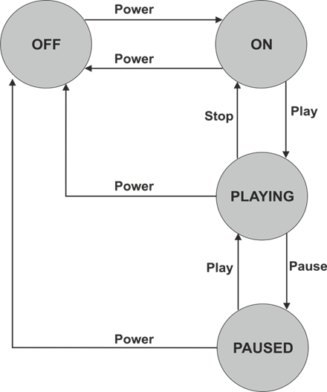
State Transition Exercise
Draw a state table using this State Transition Diagram which represents the states an MP3 player can assume:

Slide 116
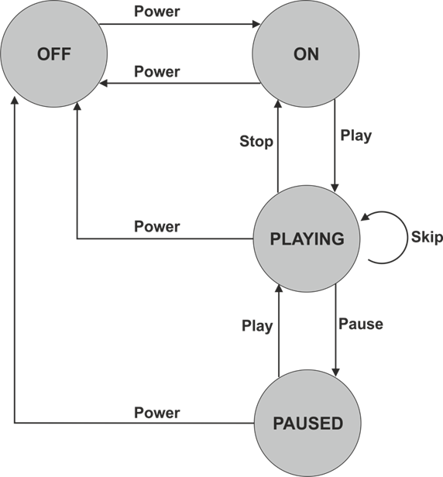
Same State Transition
Events that cause a system to remain in the same state are shown with a recursive arrow
These state transitions must also be included when defining test cases
For example, if you press the "skip" button on the MP3 player while it is playing it will start playing the next track
Notes:
When testing valid transitions (0-switch transitions) on a state transition diagram, a same-state transitions counts as one, just like any other arrow.
This illustrates that State diagrams do NOT show all system functionality, only transitions between states. Sometimes, outcomes are shown on diagrams under the arrows. Or there may be a separate text description accompanying the state diagram, which should also be used as a test basis

Slide 117
Use Case Testing
Use Case Testing is a black-box test design technique in which test cases are designed to execute scenarios of use cases
Use Case: A sequence of transactions in a dialogue between an actor and a component or system with a tangible result, where an actor can be a user or anything that can exchange information with the system - ISTQB® Glossary
Use cases are a way of defining high-level requirements or business processes viewed from a user perspective
They may be described at the abstract level (business use case, technology-free, business process level) or at the system level (system use case on the system functionality level).

Slide 118
Use Case Testing
Contents of a Use Case:
Actor List
Pre conditions
Main process flow (i.e. most likely path)
Alternate flow(s)
Exception flow(s)
Post conditions

Slide 119
Use Case Example Main Flow
'Create Policy' Use Case
User selects 'Create Policy' from the 'Maintain Policies' menu
The system displays a Quote ID input field
User enters a valid Quote ID
The system displays the quote details (name, address, customer ID, policy type, term, cost)
User checks the details, enters the start date and clicks on 'Setup DO' button
The System displays the 'Create Direct Debit' screen
User enters the customer's bank details and premium collection amount and clicks on 'Setup'
The system generates the policy and displays 'Policy No xxxxxx created'
Notes:
This structure is very similar to a test procedure (script), so is ideal for designing test cases, particularly UAT with customer or user participation.
Process flows in a Use Case are written based on intended use which makes them very useful for designing acceptance testing by end users. The descriptions could act as the test procedure thus minimising test development costs. However, they are detailed enough to test properly and therefore uncover errors.
Use cases can also uncover integration defects which individual component testing would miss (similar to functional integration testing).

Slide 120
4.4 Structure-Based or White-Box Techniques
Learning Objectives
Describe the concept and value of code coverage (K2)
Explain the concepts of statement and decision coverag e, and give reasons why these concepts can also be used at test levels other than component testing (e.g., on business procedures at system level) (K2)
Write test cases from given control flows using statement and decision test design techniques (K3)
Assess statement and decision coverage for completeness with respect to defined- exit criteria. (K4)

Slide 121
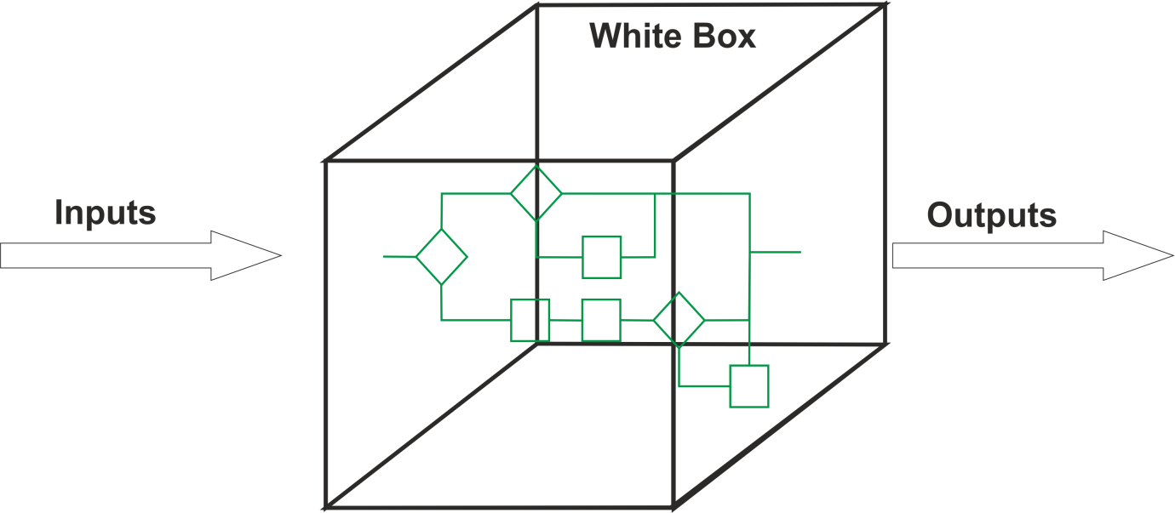
White-Box Techniques
Structure-based or white-box testing is based on an identified structure of the software or system
It does not require an analysis of business requirements or specifications and does not assess the functionality of software
It ensures that a structure, or specific parts of a structure, is adequately covered by tests

Slide 122
White-Box Techniques
Structural testing can apply at all test levels, wherever the system can be represented in a structural or architectural diagram, e.g.
Component level: the structure of a software component, i.e. statements, decisions, branches or even distinct paths
Integration level: the structure may be a call tree (a diagram in which modules call other modules)
System level: the structure may be a menu structure, business process or web page structure

Slide 123
White-box Techniques
We will focus on designing white-box tests to measure internal structure of software code
This would normally be done by developers or designers as part of component testing
White-box testing, particularly measurement of code structures, is a very comprehensive form of testing but can be complex, time­ consuming and resource-intensive, and may be too detailed for many businesses
It is often carried out using specialist tools
It is most likely to be conducted where extremely thorough testing is required, such as:
safety-critical systems
defence control systems
medical equipment software

Slide 124
White-box Techniques
Typically, white-box testing would be done after black-box testing, to ensure adequate coverage
Dynamic coverage measurement tools would be used to measure actual coverage achieved during functional and non-functional black-box testing, then further white­ box tests would be designed to complete the coverage required

Slide 125
Coverage
The key concept in structural testing is coverage. Coverage is expressed as a percentage of a structure covered by tests, and all white-box testing can be used to measure coverage of structure.
There are different coverage measures of software code structure:

Slide 126
Coverage
We only need to know techniques for statement and decision coverage at Foundation level
Be aware that stronger techniques exist
Two code-related structural test design techniques for code coverage, based on statements and decisions, are discussed
For decision testing, a control flow diagram or the simplified control flow graphs (CFGs), may be used to visualize the alternatives for each decision

Slide 127
Statement Testing and Coverage
A statement is an atomic action, i.e. a single instruction to the computer, for example:
Gross_Amount = Net_Amount + Tax
Test cases are devised to execute specific executable statements at least once
This approach does not ensure complete coverage of functionality, but it does provide a level of confidence that simple coding errors have been detected

Slide 128
Decision Testing and Coverage
A decision has two possible outcomes: True and False, for example:
If Value between 50 and 60 Then
Do Action A
Else
Do Action B
End If

Slide 129
Test cases
Test cases are devised to execute specific decision outcomes or branches
$$Decision Coverage= \frac{no. of decision outcomes expected}{total no. of decision outcomes} ×100$$
All decisions are statements, so 100% decision coverage guarantees 100% statement coverage (but not vice versa.) Decision testing is a form of control flow testing as it generates a specific flow of control through the decision points.
Notes:
Note that in the above example, it is not necessary to test equivalence partitions or boundaries for this level of structural testing. Just one value in the range (True) and one outside (False) would be enough to achieve 100% decision coverage, so 100% coverage doesn't necessarily mean exhaustive testing!

Slide 130
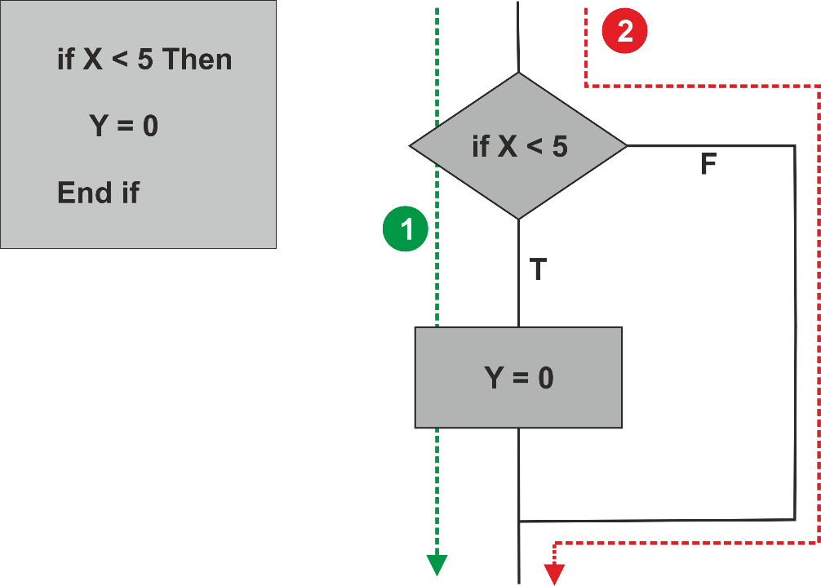
Statement and Decision Coverage Example
Software source code and flowcharts can both be used to assess coverage:

Slide 131
Statement and Decision Coverage Example
Test 1: Using a value of 3 for X will cause the condition 'If x < 5 ' to evaluate to True, so executing the statement 'y = 0’. This test executes all the statements, so has achieved 100% statement coverage
Test 2: Using a value of 8 for X will cause the condition to evaluate to False, so the system will jump directly to the 'End If’ statement, skipping the line 'Y = 0’ Both tests are required to achieve 100% decision coverage
So full statement coverage can be achieved without exercising all the software structure
This is why statement coverage is considered the weakest coverage measure, and decision coverage is a stronger measure

Slide 132
White-Box Exercise
What is the minimum number of tests needed to achieve
100% statement coverage?
100% decision coverage?

Slide 133
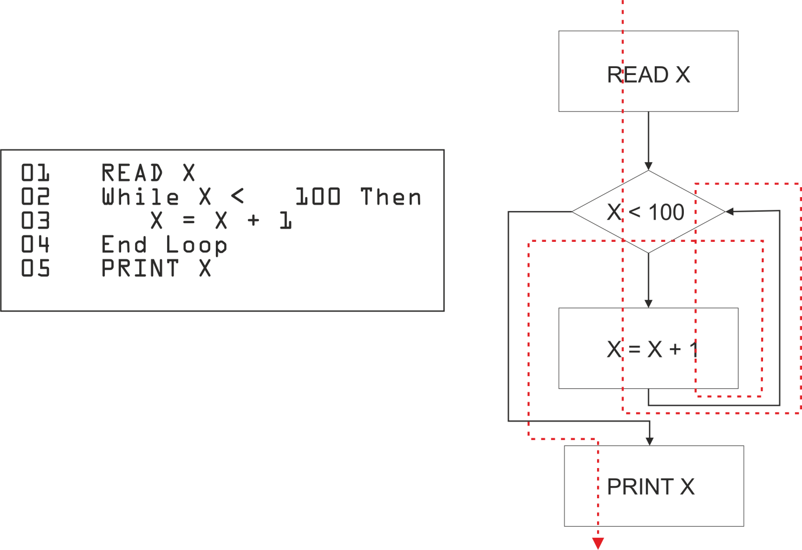
Loops
Loops are an important software construct, but counting paths for white-box testing doesn't work quite the same way for loops as for simple IF decisions.
For example:

Slide 134
Loops
If the WHILE decision outcome is True when it is evaluated the first time, then control passes through the True branch and loops back to the decision, where it is re-evaluated.
As long as it remains True, the loop will continue
When the decision outcome becomes False, control passes out of the loop to the statements after it
This means that both the True and False branches can be covered by a single test, which can never happen with an IF decision
Notes:
Note that this assumes the loop is not infinite, i.e. if the decision is
True the first time, it will eventually become False.
If the WHILE decision outcome is False when it is evaluated the first time, then the loop is never entered.
The flowchart for loops looks slightly different from IF decisions as the decision diamond has two control lines flowing into it, one from the preceding statement and one from the end of the loop.

Slide 135
White-Box Exercise
What is the minimum number of tests needed to achieve
100% statement coverage?
100% decision coverage?

Slide 136
4.5 Experience-based Techniques
Learning Objectives
Recall reasons for writing test cases based on intuition, experience and knowledge about common defects (K1)
Compare experience-based techniques with specification based testing techniques (K2)

Slide 137
Experience-based Techniques
Experience-based testing is where tests are derived from the tester's skill or intuition, and their experience of similar applications and technologies
It is not based on analysis of specifications or structure
It is generally less thorough than systematic techniques (black-box and white-box), but it can be more effective if there is a lack of testing time or resources, and it can identify special tests not easily captured by formal techniques
Testers use their expertise to identify key areas to test, such as:
Critical or most-used functions
Areas most likely to fail (e.g. defect clusters or complex code)
Experienced test designers are best suited to this approach, which if possible, should be used to augment the systematic techniques
It may be much less effective for inexperienced testers

Slide 138
Error Guessing
In error guessing, testers use their knowledge of systems and testing to anticipate possible defects
They design tests to target known or suspected weaknesses, or address aspects of the system that have caused problems in the past
Error guessing can often be used after black-box testing to cover specific problem areas more thoroughly
Notes:
In error guessing, testers use their knowledge of systems and testing to anticipate possible defects. They design tests to target known or suspected weaknesses, or address aspects of the system that have caused problems in the past. Testers should think laterally and consider how users could use the system, not just how they should use it (which is the aim in specification-based testing.)
Error guessing can often be used after black-box testing to cover specific problem areas more thoroughly.
The success of error guessing depends on the knowledge and skill of the tester. But the effectiveness can be improved if several testers, users or developers contribute to identifying possible errors.

Slide 139
Fault Attack
A structured approach to error guessing, called a Fault Attack, is to enumerate a list of possible defects and then design tests to force each one in turn
These defect and failure lists can be based on:
Experience
Available defect and failure data
Common knowledge about why software fails
List of error messages from program specification
Ideas from groups of testers, users and developers

Slide 140
Exploratory Testing
Exploratory testing combines tester experience with a structured approach. Testers explore the software and learn about it by testing
The technique involves concurrent test design, test execution, test logging and learning, based on a test charter containing test objectives, scope and tasks, and carried out within time-boxes
It is an approach that is most useful where there are few or inadequate specifications and severe time pressure, or in order to augment or complement other, more formal testing
It can serve as a check on the test process, to help ensure that the most serious defects are found
Notes:
Exploratory testing is not purely random or ad-hoc, as it involves a high-level plan, and all test activities (design, execution log, incidents) must be documented. But unlike specification-based testing, exploratory testing deviates from the plan to 'explore' areas of interest and learn more about the system.
It may be used on its own, or in conjunction with other techniques to ensure that testing is focused on the most important areas and identify possible problems.

Slide 141
Exploratory Testing
Exploratory testing is common within agile methodologies, which often incorporate limited specification documents with short development timescales.

Slide 142
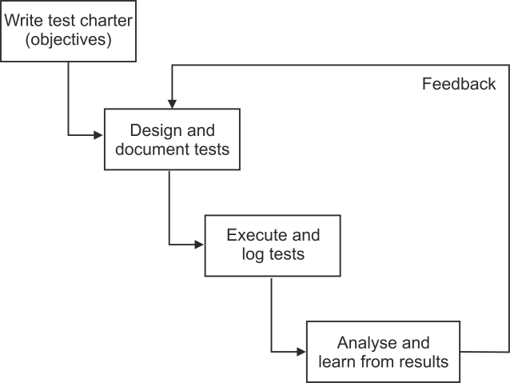
Exploratory Testing
The process is:
Start with a high-level test design. As there is limited or no specification, this may be just to explore basic functions (such as user input) or to follow the 'happy path' processing, where no error conditions are met
Execute the tests and log the outcomes
Investigate any unexpected results. In standard black-box testing, these would be recorded as incidents, and the rest of the scripted tests would be executed as planned. But in exploratory testing, the plan is suspended and new tests are designed to explore the anomalies and learn about their cause. Deviating from the plan to explore areas of interest is sometimes called the 'tour bus principle'
Document just enough to ensure that all tests are repeatable, typically in an Exploratory Test Session Sheet. This also increases the documented knowledge about the system

Slide 143
4.6 Choosing Test Techniques
Learning Objectives
Classify test design techniques according to their fitness to a given context, for the test basis, respective models and software characteristics (K2)

Slide 144
Choosing Test Techniques
Studies have been unable to prove conclusively that one type of testing is better than another, so it is important to select the most appropriate depending on circumstances

Slide 145
Choosing Test Techniques
The choice of which test techniques to use depends on a number of factors, such as:
Type of system
Regulatory standards
Customer or contractual requirements
Level and type of risk
Test objective
Documentation available
Knowledge of the testers
Time and budget
Development life cycle and test level
Use case models
Previous experience of types of defects found

Slide 146
Choosing Test Techniques
For example:
Factor | Appropriate Test Technique
Web-based system | State transition testing
Rules-based requirements | Decision tables
High-risk or safety-critical | White-box testing
Detailed specifications | Black-box testing
Unavailable specifications | Exploratory testing
Availability of source code | White-box testing
Agile methodology or limited time | Experience-based techniques

Slide 147
Choosing the Best Technique
Some techniques are more applicable to certain situations and test levels; others are applicable to all test levels

Slide 148
Choosing the Best Technique
In general:
Specification-based techniques are used
In sequential development models
At all levels of testing
For business-critical systems
Structure-based techniques are used
Mostly at lower test levels (component testing, component integration testing)
For safety-critical systems
Experience-based techniques are used
To augment systematic techniques
In iterative I agile development models
When creating test cases, testers generally use a combination of test techniques to ensure adequate coverage of the object under test

Slide 149
Homework
Questions 17 to 28

Slide 150
End of Day 2
Questions

