Slide 1
Cloud Computing Basics
Infrastructure Technician

Slide 2
Characteristics of cloud computing
On-demand self-service
provisioning or de-provisioning of computing resources as needed in an automated fashion without human intervention
Ubiquitous network access
computing facilities can be accessed from anywhere over the network using any sort of thin or thick client
Resource pooling
resources (physical or virtual) can be dynamically assigned, reassigned or de-allocated
Rapid elasticity
resources can be elastically provisioned or released according to demand
Measured service
pay only for what is used

Slide 3
Amazon AWS
10 minute tutorial
Launch a Windows Virtual Machine
https://aws.amazon.com/getting-started/tutorials/launch-windows-vm/

Slide 4
Benefits of cloud computing
Increased operational efficiency through cost-effective use of expensive infrastructure
Drives up economies of scale through shared resourcing
Rapid and agile deployment of customer environments or applications
Improved service quality and accelerated delivery through standardisation
Promotes green computing by maximizing efficient use of shared resources, lowering energy consumption

Slide 5
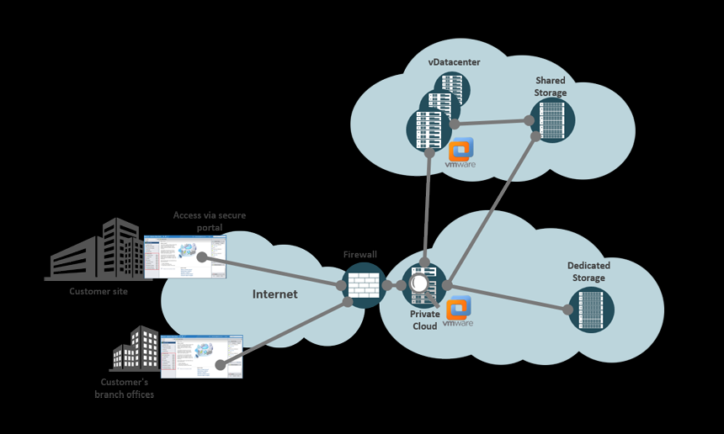
Private Cloud
The cloud infrastructure is operated solely for an organization. It may be managed by the organization or a third party and may exist on premise or off premise
Computing resources are behind the company firewall

Slide 6
Public Cloud
The cloud infrastructure is made available to the general public or a large industry group and is owned by an organization selling cloud services

Slide 7
Cloud Infrastructure as a Service (IaaS)
Provides processing, storage and networks
The consumer is able to deploy and run arbitrary software, which can include operating systems and applications
The consumer does not manage or control the underlying cloud infrastructure, but has control over
operating systems
storage
deployed applications
selected networking components (e.g., host firewalls)
Examples are:
Microsoft Azure
Amazon Web Services
Google Cloud

Slide 8
Cloud Infrastructure as a Service (IaaS)

Slide 9
Cloud Platform as a Service (PaaS)
The consumer deploys onto the cloud infrastructure consumer-created or acquired applications created using programming languages and tools supported by the provider
The consumer does not manage or control the underlying cloud infrastructure but has control over the deployed applications
Examples are:
server space for web pages such as Rackspace or GoDaddy
Google App engine

Slide 10
Cloud Platform as a Service (PaaS)

Slide 11
Cloud Software as a Service (Saas)
The ability to use the provider’s applications running on a cloud infrastructure
The applications are accessible from various client devices through a thin client interface, such as a Web browser
The consumer does not manage or control the underlying cloud infrastructure including network, servers, operating systems, storage, or even individual application capabilities
Examples are: Google Docs, Office365, Gmail, Dropbox, Slack

Slide 12
Cloud Software as a Service (Saas)

Slide 13
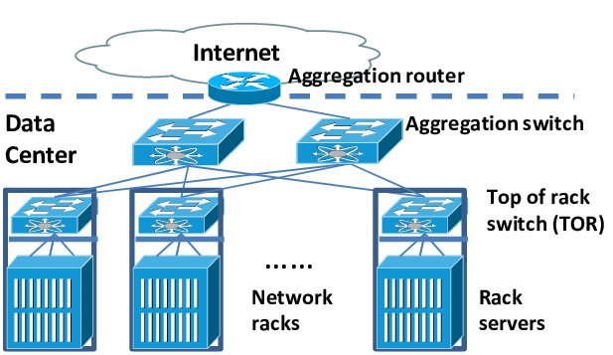
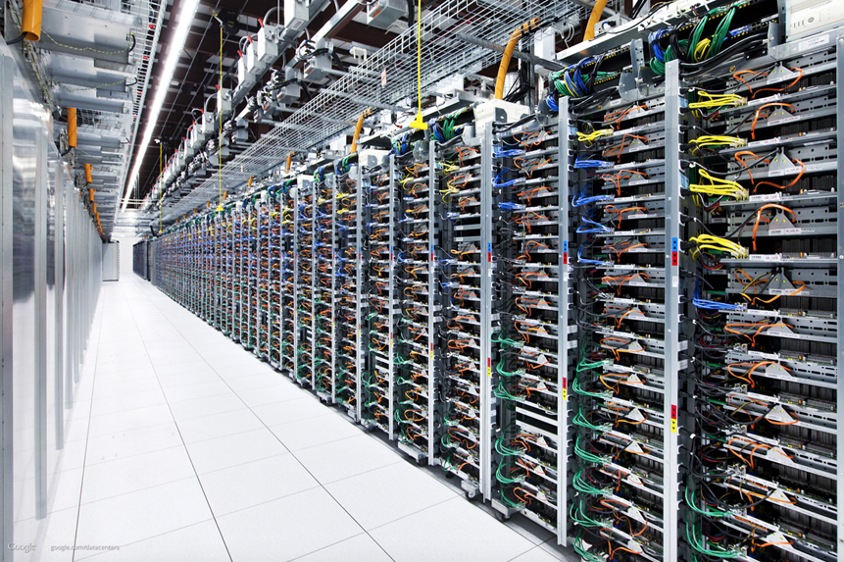
Data centres

Slide 14
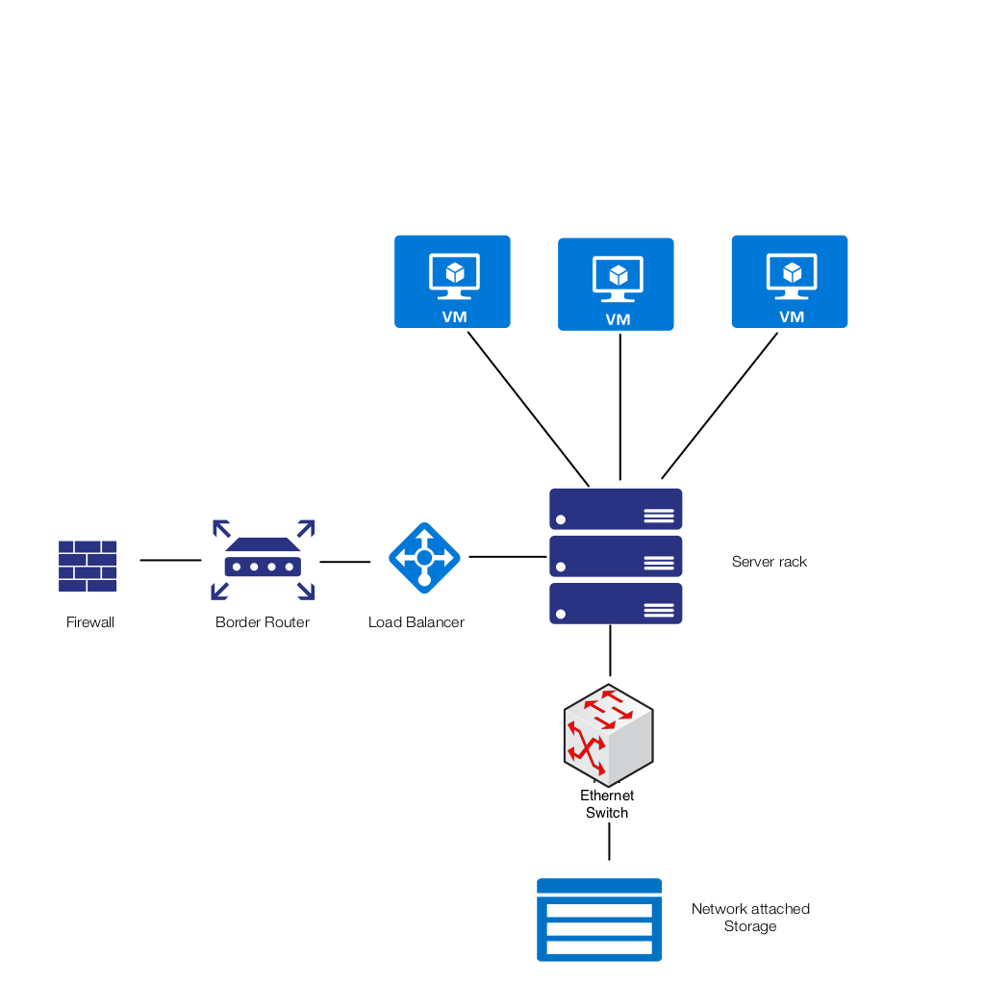
Data centre architecture
Load balancer distributes work across the physical servers
Physical servers host virtual machines with the users software stack
Storage is on a Storage area network (SAN)

Slide 15
Data centre tenancy
Single tenant
Physical separation by customer (dedicated hosts, network, and storage)
Multi tenancies
Logical separation by customer (shared physical infrastructure with logical segmentation)
Data separation (such as dedicated databases and storage)
Network separation (VLANs or private VLANs)
Performance separation by customer (shared infrastructure but guaranteed capacity or Quality of Service)

Slide 16
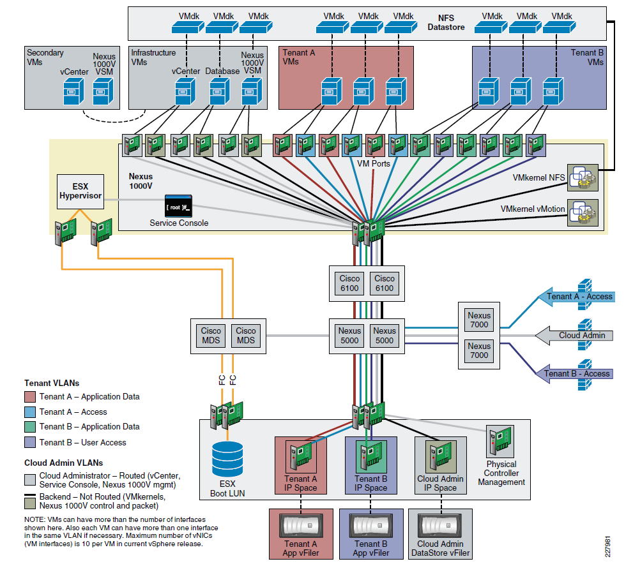
Multi tenancy data centre

Slide 17
Remote desktop virtualisation
Application execution takes place on a remote operating system
All applications and data used remain on the remote system
Display, keyboard, and mouse information are communicated with the local client device
conventional PC/laptop
thin client device
Tablet
Smartphone
Multiple desktop operating system instances (VMs) run on a server running a hypervisor

Slide 18
Remote desktop virtualisation
Advantages
Provides access to Windows applications on non-Windows endpoints (including tablets, smartphones, and non-Windows-based desktop PCs and laptops).
Provides low-cost desktop computing services where providing every user with a dedicated desktop PC is either too expensive or otherwise unnecessary.
Provides a more centralized, efficient client environment
easier to maintain
easier to upgrade, add software
Eg: Citrix

Slide 19
Cloud email
Benefits
No server maintenance
IT departments can focus more useful activities for the business
Save on energy and hardware investments by removing email servers
Disaster recovery responsibility with cloud provider
Anywhere access
Collaboration
Real-time project collaboration and document editing
Video and voice conferencing
Instant project updates
High storage capacity for sending and storing multimedia-rich emails, including video messages
Concerns
Security
Privacy
Longevity of supplier

Slide 20
Summary
1.2 Explain and summarise the key purposes of hosted applications
Email
Servers
Storage
Desktops
1.3 Summarise and explain how multi-tenant cloud platforms allow for separately provisioned tenants (i.e. multiple customers to operate on the same service, but not share or interfere with each other)

