Slide 1
Coding and Logic - Windows
Infrastructure Technician

Slide 2
Command line
Most of the things we do with Windows in this section will be in the command line
This is so that you can:
administer Windows Server Core (non GUI)
automate tasks
Start Windows Command Prompt as an administrator
X

Slide 3
Directories
Type dir
This lists the directories and files in the WINDOWS\system32 directory
Type dir /p
This pauses after each screen full (any key to continue)
Press Ctrl and c to quit
Type dir /b
This lists the files without details

Slide 4
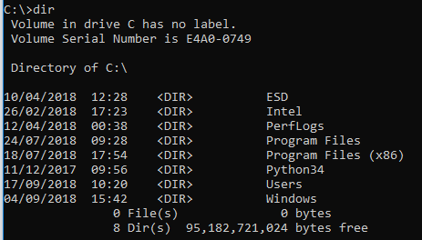
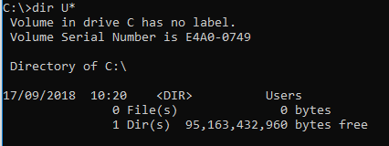
Navigation
Type cd ..\..\
This takes you to the root (known as C:\ in Windows)
Type dir U*
* is a wild card
Type cd \Windows\system32\
Type dir /b \ takes you back to root
Navigate back to system32
Type dir *.exe
List all the executable files

Slide 5
Help
Type dir /?
You get all the information about the options
Type cls any time you want to clear the screen

Slide 6
dir sorting
Type dir /o /p – sorts directories first
Type dir /od – sort by date and time, latest first
Type dir /o-d – sort by date and time, earliest first
Type dir /os – sorts by size, smallest first
Type dir /o-s – sorts by size, largest first
Type dir /on – sorts by name, alphabetical
Type dir /o-n – sorts by name, reverse alphabetical

Slide 7
Editing
There is no built in command line editor in Windows since Windows 8
You can create files in Notepad
Navigate to your Documents directory
Type mkdir Examples
cd Examples

Slide 8
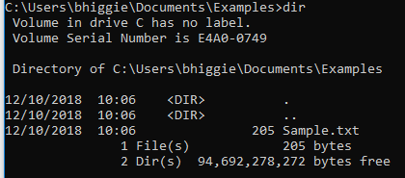
Create a sample file
Use Notepad to create a Sample file in your Examples folder with the following contents:
Fred apples 20
Susy oranges 5
Mark watermelons 12
Robert pears 4
Terry oranges 9
Lisa peaches 7
Susy oranges 12
Mark grapes 39
Anne mangoes 7
Greg pineapples 3
Oliver melons 2
Betty limes 14

Slide 9
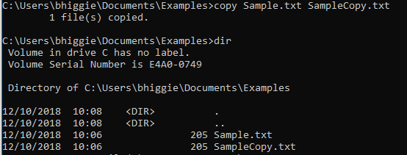
File and directory manipulation
Type copy Sample.txt SampleCopy.txt
Type ren SampleCopy.txt Sample1.txt
Type rename Sample1.txt Example.txt
Type move Example.txt .. (back one directory)
Navigate to Documents
mkdir DeleteMe
copy Example.txt c:\Users\yourname\Documents\DeleteMe\ExampleCopy.txt
del DeleteMe (try to delete the directory)
rmdir DeleteMe (try to delete the directory)
rmdir /s DeleteMe (will prompt)
Say n to the prompt
rmdir /s /q DeleteMe (will not prompt)
Caution – there is no Recycle Bin in command line

Slide 10
Searching a file
Type find /c “apples” Example.txt – count the number of lines containing apples
Type find /c /v “wombat” Example.txt – count the number of lines containing wombat (gives total lines in file)
Type find “apples” Example.txt
find is useful for searching log files (although most Windows log files are binary)

Slide 11
Commands
Use this site to review the following commands, switches and attributes
https://www.computerhope.com/msdos.htm
dir
mkdir
cd
del/delete
ren/rename
copy
move

Slide 12
File attributes
Type attrib +h Example.txt – sets the hidden attribute
Type dir Example.txt – file not found
Type dir /A:h Example.txt – lists hidden files
Type attrib -h Example.txt – removes the hidden attribute
Other file attributes
R – read only
A – archive (indicates a file has been modified, used by backup programs)
S - system

Slide 13
Your first batch file
Open notepad
Type @echo off echo Hello this a test batch file pause
Save as Hallo.bat (type All files)
In command window type Hello
(or double click in file explorer)

Slide 14
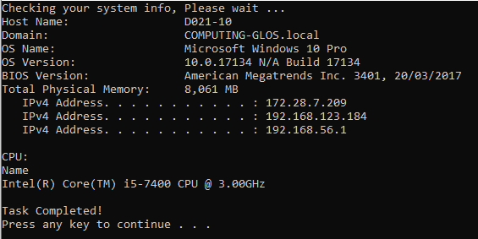
A useful batch file
Open notepad
Type then save as sysinfo.bat @echo off
echo Checking your system info, Please wait ...
systeminfo | findstr /c:"Host Name"
systeminfo | findstr /c:"Domain"
systeminfo | findstr /c:"OS Name"
systeminfo | findstr /c:"OS Version"
systeminfo | findstr /c:"Total Physical Memory"
ipconfig | findstr IPv4
echo.
echo CPU:
wmic cpu get name
echo Task Completed!
pause

Slide 15
batch file – user input, variables, loop and pipe
Open notepad
Type then save as count.bat @echo off
set /p filename= Enter the output file name?
set /a counter=0
:numbers
set /a counter=%counter%+1
if %counter% ==100 (goto :eof) else (echo %counter% >> %filename%.txt) All on one line
goto :numbers
Set /p prompts for input and assigns it to the
variable filename
Set /a says the assignment is arithmetic
:numbers is a label for the subsequent goto
Goto :eof automatically exits
>> says take the value in %counter% and pipe
it to the filename entered from the prompt

Slide 16
Access control - icacls
The icacls command enables a user to view and modify an access control list (ACL)
An ACL is a list of access control entries (ACE)
Each ACE in an ACL identifies a user account or group account and specifies the access rights allowed or denied for that user
Rights
N - no access
F - full access
M - modify access
RX - read and execute access
R - read-only access
W - write-only access
D - delete access

Slide 17
icacls examples
Grant full rights to the user carol

