Slide 1
BCS Level 3 Certificate in Programming
QAN 603/1192/7

Slide 2
Learning Outcomes
Understand the importance of building security in to software at the development stage.
9.1 Describe the following types of security issues and the scale and nature of threats that can impact software development
9.2 Explain what is meant by 'building security in', in terms of secure software development and creating a secure end-product, and why it is important.
9.3 Describe proactive security approaches during software design and development.
9.4 Explain approaches to make software more secure.

Slide 3
9.1 Describe the following types of security issues and the scale and nature of threats that can impact software development
In this section we will be looking at:
common security attacks;
security versus resilience;
social engineering

Slide 4
Developers are not trained to write secure code, nor are they incentivized to write secure code

Slide 5
Common Security Attacks
Security attacks do not just occur on the web
Prevalent in operating system software and desktop applications

Slide 6
Security Versus Resilience
Security
Concerned with the physical
Not how to mitigate, but how to fix
Resilience
Can you continue?
How to continue?
How long before a fix is available

Slide 7
Social Engineering

Slide 8
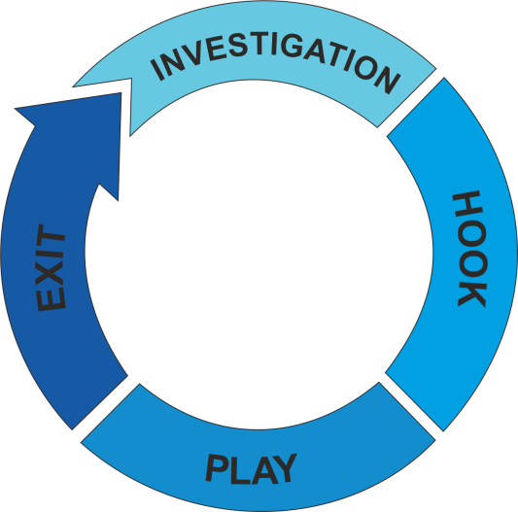
How it is done
Preparing the ground for attack:
Identifying the victim(s)
Gathering background information
Selecting attack method(s)
Closing the interaction, ideally without arousing suspicion:
Bringing the charade to a natural end
Removing all traces of malware
Covering tracks
Deceiving the victim(s) to gain a foothold:
Spinning a story
Taking control of the interaction
Obtaining the information over a period of time:
Expanding foothold
Executing the attack

Slide 9
Five most common forms of digital social engineering assaults
Baiting attacks
Use a false promise to pique a victim’s greed or curiosity
The most reviled form of baiting uses physical media to disperse malware.
Baiting scams don’t necessarily have to be carried out in the physical world
Scareware attacks
Scareware involves victims being bombarded with false alarms and fictitious threats
Scareware is also referred to as deception software, rogue scanner software and fraudware.
Scareware is also distributed via spam email that doles out bogus warnings, or makes offers for users to buy worthless/harmful services.
Pretexting
Obtains information through a series of cleverly crafted lies
Phishing
One of the most popular social engineering attack types
Spear phishing
A more targeted version of the phishing scam whereby an attacker chooses specific individuals or enterprises

Slide 10
9.2 Explain what is meant by 'building security in', in terms of secure software development and creating a secure end-product, and why it is important.
We will cover:
the role coders play in determining a secure software end-product
the impact they can have on security by not building security in
why building security in at the start is better than trying to retrofit later
“People often represent the weakest link in the security chain and are chronically responsible for the failure of security systems.”

Slide 11
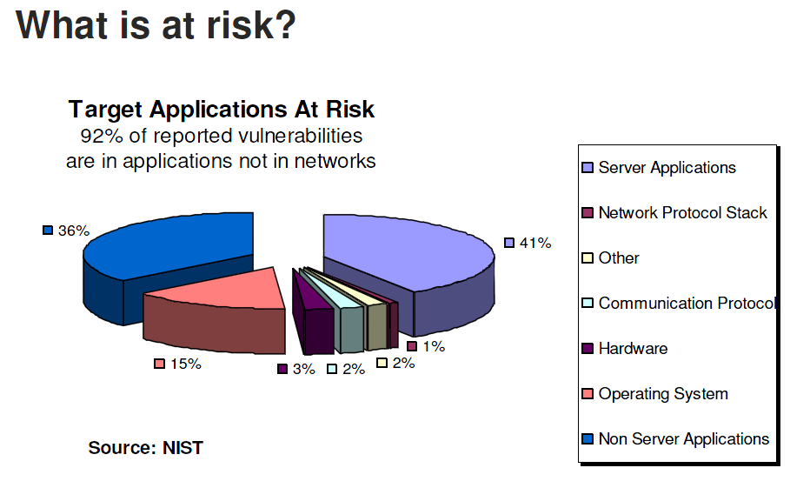
Building Security In

Slide 12
Building Security In
How we approach risk?
Application Security
Issue-based, short-term approach
Penetrate and Patch
Threat Modelling
Code Reviews

Slide 13
Building Security In
How we approach risk?
Software Security
Holistic, long-term approach
Root Cause Analysis
Organizational Change

Slide 14
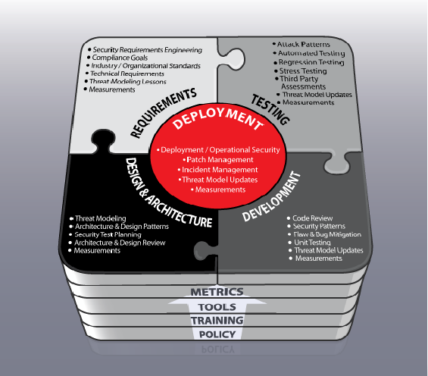
Software Risk Management and Secure Software Development Life Cycles (S-SDLC)

Slide 15
Role Coders Play
Coders traditionally have not worried too much about security
To be most effective, secure coding training for developers needs to be an integral part of the overall software development process
Everyone who touches an application – from development through testing and into production – needs to be driving toward a set of shared security goals
For the application developer, it starts with a good understanding of the major components of the software development lifecycle (SDLC)
You then need to decide what secure coding principles should apply at each stage in the process

Slide 16
Impact of not building in Security - What are the costs?
Application Security Costs:
Software Security Costs:
Defect Management: 5 defects/KLOC, $ 30,000/KLOC (Business week)
Patch Management: 1000 servers, $ 300,000 to test and deploy a patch (Gartner)
Loss of productivity due of loss of service: $ 500 ML lost from DoS attack (Microsoft)
Unbudgeted time to fix security problems:1000 man-hours (Microsoft)
Cost of training software developers in security: $100 Million (Microsoft)
Inadequate software testing costs: $3.3 billion (NIST)

Slide 17
Building Security In At The Start Is Better Than Trying To Retrofit Later
The science of software security concerns constructing secure software
This entails providing the software with a structure and design that ensures it is secure
Involves teaching software developers, constructors and end users the way to construct secure software

Slide 18
Building Security In At The Start Is Better Than Trying To Retrofit Later
“The cost of removing an application security vulnerability during the design phase ranges from 30-60 times less than if removed during production.” - NIST, IBM, and Gartner Group

Slide 19
9.3 Describe proactive security approaches during software design and development
Items to be discussed in this section:
security development lifecycle (SDLC)
defensive design / defensive programming
test creation and execution
permission setting and role based access
physical infrastructure and security

Slide 20
Security Development Lifecycle (SDLC);

Slide 21
SDLC Introduction
Requirements Analysis
Design
Implementation
Testing
Release

Slide 22
Requirements Analysis
Work closely with customer(s)
Identify the problem to be solved
Focus on ‘what’ not ‘how’
End result: functional specification
Reviewed by customer and designers
Requirements exist to define the functional security requirements implemented in the product, and include all the activities of the SDL. They are used as an enforcement point to ensure that all pieces are properly considered.

Slide 23
Design
Focus on the ‘how’
Break up the problem into smaller pieces
Decide on how each component works and how they will work together
End result: design specification
Reviewed by designers and implementers
The design phase of the SDL consists of activities that occur (hopefully) prior to writing code
Secure design is about quantifying an architecture (for a single feature or the entire product) and then searching for problems

Slide 24
Implementation or coding
Write code according to the design
Often the shortest phase
End result: program code
Reviewed by designers, coders, testers
For security we use implementation tools for testing
Static application security testing (SAST)
Dynamic application security testing (DAST)

Slide 25
SAST and DAST
SAST
DAST
SAST is like a spell-checker for code, identifying potential vulnerabilities in the source code
SAST runs against a nightly build or may be integrated into your IDE
It may find and open new bugs in the bug management system nightly or prompt the developer to pause while coding to fix a problem in real time
DAST checks the application's runtime instantiation
It spiders through an application to find all possible interfaces and then attempts to exploit common vulnerabilities in the application
These tools are primarily used on web interfaces.

Slide 26
Testing
Verify the code works according to the functional requirements
Look for corner cases
problem or situation that occurs only outside of normal operating parameters
End result: test plan, program that works
Reviewed by designers, coders, testers
Formal test activities include security functional test plans, vulnerability scanning, and penetration testing

Slide 27
Release Phase
Work closely with customer(s)
Validate customer expectations
Get feedback for next version
Maintenance of this program
End result: happy customer(s) , ££££
Release occurs when all the security activities are confirmed against the final build and the software is sent to customers (or made available for download)

Slide 28
Defensive Design / Defensive Programming
Anticipating failures by adding supporting code to detect, isolate, and if possible recover from the failure.
Application software often requires a user to input information into a system which might include:
Username/password
Contact details
Current date
Input into a search box
Building up a shopping cart
Entering data into a database

Slide 29
Common element???
People!!!

Slide 30
Defensive design
Defensive design is the practice of anticipating every possible way that an end-user could misuse a system or device
During the defensive design process, methods are put in place to eliminate misuse. If this is not completely possible then it will aim to minimise the negative consequences
Defensive design has not been good enough when
The program crashes
The program behaves in an unintended fashion
Data security has been compromised
.

Slide 31
Test Creation and Execution
The Most Important Phase of Testing
Test Plan is a dynamic document
The success of a testing project depends upon a well-written test plan document that is current at all times
Test Plan is more or less like a blueprint of how the testing activity is going to take place in a project

Slide 32
Permission Setting and Role Based Access
Permissions are granted to minimise risk
Users are granted permissions at the authorisation layer of any software – login system
Roles conceptually represent a named collection of permissions
Usually reserved for administrators (who have certain permissions)

Slide 33
Physical Infrastructure and Security
Effective physical security of an asset is achieved by multi-layering the different measures, what is commonly referred to as ‘defence-in-depth’
The concept is based on the principle that the security of an asset is not significantly reduced with the loss of any single layer
Layers could include:
Perimeter
Entry controls
Delivery and isolation areas

Slide 34
Physical Infrastructure and Security
Security of equipment should also be a priority
Items would include:
Power to the equipment and facility
Backup power supply
UPS
Multiple feeds
Fuel for backup generator
Cabling security
Equipment maintenance
Off-site equipment security
Secure disposal or re-use of equipment

Slide 35
9.4 Explain approaches to make software more secure
Here we will cover:
security scanning
penetration testing
fuzzing
load testing

Slide 36
Security Scanning
Also termed vulnerability scanners
Helps to determine an organisation’s exposure to attack from the internet or desktop applications
Is an inspection of the potential points of exploit on a computer or network to identify security holes
A vulnerability scan detects and classifies system weaknesses in computers, networks and communications equipment and predicts the effectiveness of countermeasures

Slide 37
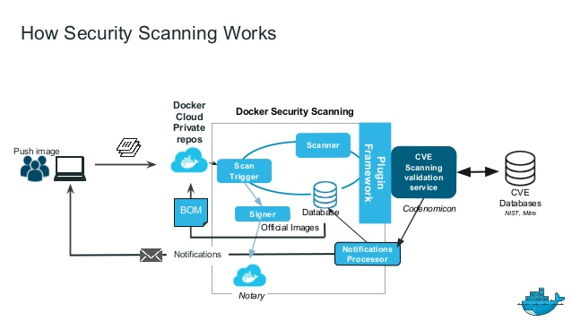
Security Scanners

Slide 38
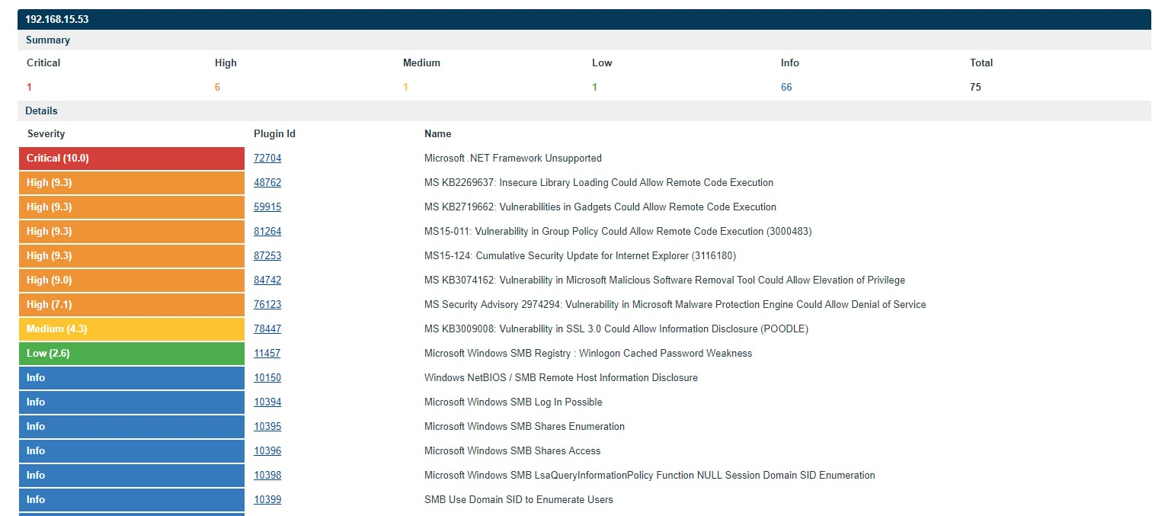
Security Scanners

Slide 39
Penetration Testing
Penetration testing (also referred to as 'pen testing') is an effective method of determining the security of networks and web applications, helping organisations identify the best way of protecting its assets
Penetration testing is a core tool for analysing the security of IT systems, but it's not a magic bullet
Definition: "A method for gaining assurance in the security of an IT system by attempting to breach some or all of that system's security, using the same tools and techniques as an adversary might."

Slide 40
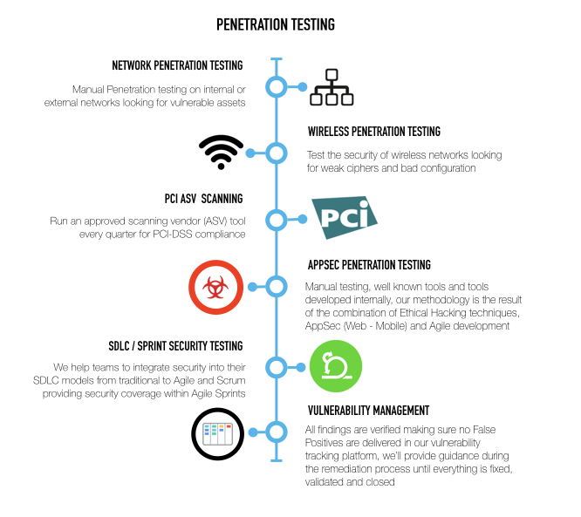
Penetration Testing

Slide 41
Fuzzing
Fuzzing or fuzz testing is an automated software testing technique that involves providing invalid, unexpected, or random data as inputs to a computer program
The program is then monitored for exceptions such as crashes, or failing built-in code assertions or for finding potential memory leaks
Is a black box testing technique
Requires no access to source code

Slide 42
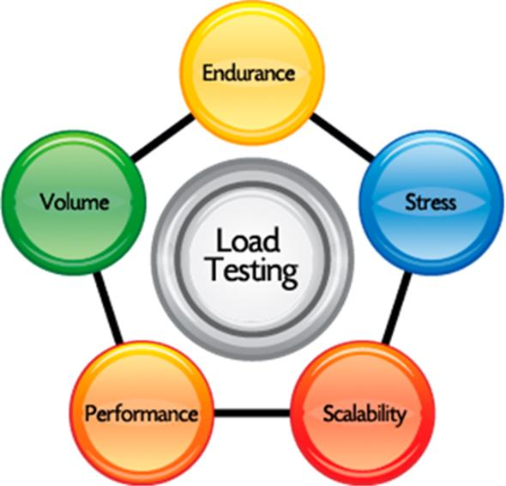
Load Testing
Load testing is performed to determine a system's behaviour under both normal and anticipated peak load conditions
It helps to identify the maximum operating capacity of an application as well as any bottlenecks and determine which element is causing degradation
Ensures that a given function, program, or system can simply handle what it’s designed to handle
Related to its bigger, more brutal cousin, stress testing

