Slide 1
CSS Selectors

Slide 2
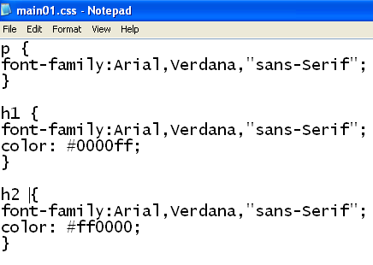
CSS Selectors
CSS Selector
CSS Declaration Block
CSS Property
CSS Value
CSS Syntax
The property has a colon after it : the value has a semi-colon after it;
The declaration block has curly brackets around it {}

Slide 3
CSS Selectors
Tag selector
Both <p> tags will apply the style.
Use tag selectors when you want to apply styles across all HTML tags.
Class selector
Only the <p> tags with the “bodytext” value will apply the style.
Use class selectors when you only want to apply styles to precise areas.

Slide 4
CSS Selectors
ID selector
Use ID selectors when you only want to apply styles to unique parts of the page. Do not use the name of an ID more than once on the same page.

Slide 5
Whats the difference
In the CSS, a class selector is a name preceded by a full stop (“.”) and an ID selector is a name preceded by a hash character (“#”).
The difference between an ID and a class is that an ID can be used to identify one element, whereas a class can be used to identify more than one.

Slide 6
Inserting a style sheet
There are three ways of inserting a style sheet:
External CSS
Internal CSS
Inline CSS

Slide 7
External CSS
With an external style sheet, you can change the look of an entire website by changing just one file!
Each HTML page must include a reference to the external style sheet file inside the <link> element, inside the head section.
Example
External styles are defined within the <link> element, inside the <head> section of an HTML page:
<!DOCTYPE html> <html> <head> <link rel="stylesheet" href="mystyle.css"> </head> <body> <h1>This is a heading</h1> <p>This is a paragraph.</p> </body> </html>
An external style sheet can be written in any text editor, and must be saved with a .css extension.
The external .css file should not contain any HTML tags.
Here is how the "mystyle.css" file looks:
"mystyle.css"
body { background-color: lightblue; } h1 { color: navy; margin-left: 20px; }

Slide 8
Internal CSS
An internal style sheet may be used if one single HTML page has a unique style.
The internal style is defined inside the <style> element, inside the head section.
Example
Internal styles are defined within the <style> element, inside the <head> section of an HTML page:
<!DOCTYPE html> <html> <head> <style> body { background-color: linen; } h1 { color: maroon; margin-left: 40px; } </style> </head> <body> <h1>This is a heading</h1> <p>This is a paragraph.</p> </body> </html>

Slide 9
Inline CSS
An inline style may be used to apply a unique style for a single element.
To use inline styles, add the style attribute to the relevant element. The style attribute can contain any CSS property.
Example
Inline styles are defined within the "style" attribute of the relevant element:
<!DOCTYPE html> <html> <body> <h1 style="color:blue;text-align:center;">This is a heading</h1> <p style="color:red;">This is a paragraph.</p> </body> </html>

