Slide 1
Developing software)
Functional and non-functional requirements
S11
7 Tasks

Slide 2
Outcomes
Distinguish between a functional and a non-functional requirement
Identify the different types of non-functional requirements and the reasons they are important to the end-product of software development
Recognise common ways in which software requirements can be expressed
Describe the qualities of good requirements and the impact of poor requirements
Explain how to determine the correct types of test coverage based on a requirement

Slide 3
Functional vs non functional
The difference is non-functional requirements describe how the system works, while functional requirements describe what the system should do. ........

Slide 4
Non Functional Requirements
DEFINITION
A non-functional requirement essentially specifies how the system should behave and ca be a constraint upon the system's behaviour
SEE LIST FOR EXAMPLES

Slide 5
Availability
Availability indicates when a system is operational as well as how reliable it is during operational periods

Slide 6
Capacity
The ability to handle transactional volumes is a very important characteristic for a system

Slide 7
Performance
Response Time
Response time is the total amount of time it takes to respond to a request for service. That service can be anything from a memory fetch,, to a complex database query, or loading a full web page.
Throughput
Flow rate / throughput: The number of flow units (e.g. customers, money, produced goods/services) going through the business process per unit time, e.g served customers per hour or produced parts per minute
Utilization
A measure of how intensively a machine is being used. Machine utilization compares the actual machine time (setup and run time) to available time.

Slide 8
Scalability
Scalability is a non-functional property of a system that describes the ability to appropriately handle increasing (and decreasing) workloads
Scalability competes with and complements other non-functional requirements such as availability, reliability and performance

Slide 9
Reliability
Requirements about how often the software fails.
The measurement is often expressed in MTBF (mean (average)time between failures).
The definition of a failure must be clear.
Also, don't confuse reliability with availability which is quite a different kind of requirement.
Be sure to specify the consequences of software failure, how to protect from failure, a strategy for error detection, and a strategy for correction.

Slide 10
Maintainability
Maintainability is the measure of ability to successfully repair or fix the product after manufacturing, usually in the field, and over time

Slide 11
Recoverability
Recovery process – how do recoveries work, what is the process?
Recovery time scales – how quickly should a recovery take to perform?
Backup frequencies – how often is the transaction data, set-up data, and system (code) backed-up?
Backup generations - what are the requirements for restoring to previous instance(s)?

Slide 12
Other non functional requirements
Performance
Security
Usability
Compatibility
Attributes such as performance, security, usability, compatibility aren't a "feature" of the system, but are a required characteristic
why they are a required characteristic and not a feature ?

Slide 13
Task 1
Firstly list examples of non functional and functional requirements including a description.
Functional | Non Functional
Including brief description……

Slide 14
Task 2
Revisit your list and discuss
How you could review these requirements and check validity?
How you they could be used as an input to software design ?
Also why are they are important to the end-product of software development?

Slide 15
3.4
Recognise common ways in which software requirements can be expressed S11

Slide 16
Software Requirements
Can be expressed in a number of ways
requirements documents
user stories
use case diagrams
process models / flow diagrams
class diagrams
UML diagrams

Slide 17
Requirements Documents
Need to be – clear, unambiguous
Example on wiki -Requirements Statement - example requirements for a computer game.

Slide 18
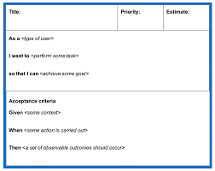
User stories
Finding out how the users use the current system
Finding out what it is that they expect the new system to do
https://www.youtube.com/watch?v=tKSUokG3Y0w

Slide 19
There are 3 others ways that requirements can be expressed………………….
Process Models/Flow Diagrams
UML Diagrams
Case diagrams

Slide 20
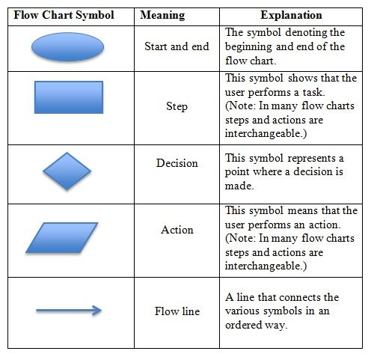
Flow Diagrams

Slide 21
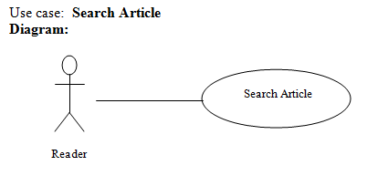
Use Case Diagrams -
A use case diagram at its simplest is a representation of a user's interaction with the system that shows the relationship between the user and the different use cases in which the user is involved

Slide 22
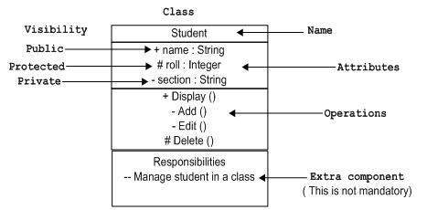
UML diagrams

Slide 23
User Story
User stories help us fit our user personas into the context of the product we’re designing. While the bio of a user persona describes their life and woes, the user story describes how they use a feature of your product – in layman’s terms!

Slide 24
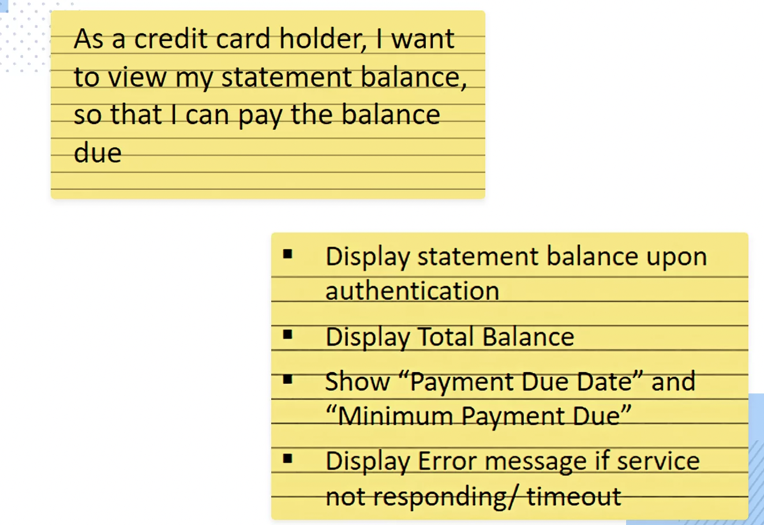
User Stories
Banking app user story example
This banking app user story example is a great way of explaining a required feature and why the user needs it in a specific way.
It gets straight to the point about who the user is and what they need to accomplish. In fact, one of the things that’s great about it is that it even hints at one of the pains the user of a banking app (in this case the credit card holder) might typically feel, such as worrying about their outstanding credit card balance, keeping a good credit score and staying out of the red

Slide 25
Task 4
Research use case diagrams or user persona and prepare a presentation for the group
1) Explain the model/diagram and how it works ?
2) What is the purpose ?
3)List any advantages and disadvantages it may have ?

Slide 26
Task 5
Research Flow Diagrams/Process Models and prepare a presentation for the group
1) Explain the model/diagram and how it works ?
2) What is the purpose ?
3)List any advantages and disadvantages it may have ?

Slide 27
Task 6
Research what user story is in Software Development and prepare a presentation for the group
1) Explain the model/diagram and how it works ?
2) What is the purpose ?
3)List any advantages and disadvantages it may have ?

Slide 28
Task7
Research user story and prepare a presentation for the group
1) Explain the model/diagram and how it works ?
2) What is the purpose ?
3)List any advantages and disadvantages it may have ?

Slide 29
Describe the qualities of good requirements and the impact of poor requirements

Slide 30
Characteristics of a Good Requirement
A requirement needs to meet several criteria to be considered a “good requirement”
Good requirements should have the following characteristics:
Unambiguous
Testable (verifiable)
Clear (concise, terse, simple, precise)
Correct
Understandable
Feasible (realistic, possible)
Independent
Atomic
Necessary
Implementation-free (abstract)
Zielczynski, Peter. 2007. Requirements Management Using IBM Rational RequisitePro. IBM press

Slide 31
TASK 7
Looking at the previous slide, describe what each of the characteristics mean.
Now find at least 3 impacts of poor software requirements
https://forms.office.com/pages/designpagev2.aspx?lang=en-GB&origin=OfficeDotCom&route=Start&subpage=design&id=fd3z5z4JJUuJnxRhvsd5l2_xne0M4wZOuZHw-ZSHDKNURVlSWkQ5Q0JTVEtBNU9EVjhBN0tPT0VSVi4u

