Slide 1
Network Engineer L4 COMPTIA NETWORK+
N10-007 Day 2

Slide 2
Hubs, bridges and switches
Layer 1 Devices
Physical layer devices such as repeaters and hubs operate only on Layer 1 of the OSI model

Slide 3
Repeaters
A repeater, sometimes also called an extender, is a device made to enable connections over longer distances.
Degraded Signal
Strong Signal
LAN
LAN
Building
Building
Repeater

Slide 4
Hubs
A hub is a Layer 1 device that connects multiple nodes into a star configuration.
Hub
Notes:
A HUB is an unsophisticated device in comparison with a switch.
It works by repeating transmissions received from one of its ports to all other ports

Slide 5
Collision domains
In the original Ethernet specification, a segment was a single coaxial cable
This meant three things:
The segment had a maximum total length, governed by the cable's attenuation.
Since a node contributes to attenuation, the segment could support a fixed number of total nodes.
The segment is a single collision domain - any two nodes on the segment transmitting at once causes a collision.
Notes:
The term network segment usually refers to a small part of a larger network, but it can mean different things depending on context. In the original Ethernet specification, a segment was a single coaxial cable. This meant three things.
The segment had a maximum total length, governed by the cable's attenuation.
Since a node contributes to attenuation, the segment could support a fixed number of total nodes.
The segment is a single collision domain - any two nodes on the segment transmitting at once causes a collision.

Slide 6
Layer 2 devices
A Layer 2 device doesn't pass data on blindly
It must be able to read the Data Link Layer frames that reach it to determine how to handle them
It must also be able to create new ones

Slide 7
Bridges
A bridge is a bit like a repeater
Creates a single aggregate network from multiple communication networks or network segments
STOP
Packet
Packet
Bridge
Hub
Notes:
Except, instead of linking two electrical segments, it links two or more Layer 1 segments, or collision domains, into a larger network

Slide 8
Bridges
A bridge has a MAC table in memory
Bridges only forward frames that are required to cross the bridge
Additionally, bridges reduce collisions by creating a separate collision domain on either side of the bridge
#2
#1
A
B
C
Bridge
#3
#4
Notes:
A bridge has a MAC table in memory: A list of MAC addresses on the network, and which side of the bridge they're on.
Bridges only forward frames that are required to cross the bridge
Additionally, bridges reduce collisions by creating a separate collision domain on either side of the bridge

Slide 9
Translating bridges
A translating bridge can even join segments using different layer 2 protocols, by translating frames from one format into the other.
W
E
E
Hub
W
Notes:
A type of bridge that interconnects two different types of LAN protocols, such as Ethernet and Token Ring. Translating bridges are generally very complicated devices

Slide 10
Switches
A Layer 2 switch is nothing more than a bridge with three or more ports, just like a hub is to a repeater.
Notes:
A type of network switch or device that works on the data link layer (OSI Layer 2) and utilizes MAC Address to determine the path through where the frames are to be forwarded
Can also be referred to as a multiport bridge

Slide 11
Broadcast domains
Switches transparently forward frames
Therefore any node on the network can still communicate directly to any other node using its MAC address
Can broadcast to the entire bridged network at once by using a broadcast address (FF:FF:FF:FF:FF:FF in MAC-based networks)
since bridges and switches automatically flood broadcast frames
This defines a Layer 2 segment, also known as the broadcast domain
Notes:
Since switches transparently forward frames, any node on the network can still communicate directly to any other node using its MAC address.
It can even broadcast to the entire bridged network at once by using a broadcast address (FF:FF:FF:FF:FF:FF in MAC-based networks), since bridges and switches automatically flood broadcast frames.
This defines a Layer 2 segment, also known as the broadcast domain.

Slide 12
Discussion: Comparing Layer 2 devices

Slide 13
Layer 3 devices
Layer 3 devices, such as gateways, routers, and multilevel switches are designed to overcome problems and link far larger, more complex networks than switches alone
They segment the larger network into multiple broadcast domains, and govern traffic between them
They have more advanced routing protocols
They also use logical addresses
Notes:
Layer 3 devices, such as gateways, routers, and multilevel switches are designed to overcome problems and link far larger, more complex networks than switches alone.
They segment the larger network into multiple broadcast domains, and govern traffic between them.
They have more advanced routing protocols, letting them find paths and share network information in ways Layer 2 switches cannot.
They also use logical addresses, which are tied to the network's structure; this means they can more easily pass data in the right direction without knowing the whole network.

Slide 14
Routers
A router is a networking device that forwards data packets between computer networks
Can be a physical or virtual appliance
Inspects a given data packet's destination Internet Protocol address (IP address), calculates the best way for it to reach its destination and then forwards it accordingly
192.168.1.200
192.168.1.214
MAC: 22:33:55:44
MAC: 22:35:55:65
192.168.1.159
192.168.1.156
Server
MAC: 22:33:30:84
192.168.1.153
192.168.1.137
Notes:
Routers sit at the boundaries between broadcast domains.
Using both physical and logical address information, they gather and store information about their surrounding network topology, use it to determine the best route between any two nodes, and then forward network layer packets along it.
Routers perform the traffic directing functions on the Internet
Data sent through the internet, such as a web page or email, is in the form of data packets

Slide 15
Routers (Cont.)
A packet is typically forwarded from one router to another router through the networks that constitute an internetwork
A router is connected to two or more data lines from different IP networks
When a data packet comes in on one of the lines, the router reads the network address information in the packet header to determine the ultimate destination
Using that information in its routing table or routing policy, it directs the packet to the next network on its journey.
Notes:
To keep the network running smoothly, those routers each have to know their surroundings and the quickest path to any particular subnet, so they constantly exchange information about changes in network conditions.
A packet is typically forwarded from one router to another router through the networks that constitute an internetwork (e.g. the Internet) until it reaches its destination node
A router is connected to two or more data lines from different IP networks
When a data packet comes in on one of the lines, the router reads the network address information in the packet header to determine the ultimate destination
Then, using information in its routing table or routing policy, it directs the packet to the next network on its journey.

Slide 16
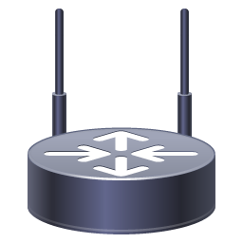
Gateways
A gateway is a node (router) in a computer network
A key stopping point for data on its way to or from other networks
With gateways, we can communicate and send data back and forth
The Internet wouldn't be any use to us without gateways
Internet
81.0.110.1
Router
192.0.2.1/24
198.51.100.1
192.0.2.2/24
198.51.100.0/24
192.0.2.104
192.0.2.148
198.51.100.104
198.51.100.10
My default gateway is
192.0.2.1
My default gateway is
198.51.100.1
Notes:
Joining two networks that use the same protocol but different addressing schemes.
Joining a LAN to a WAN, often along with related non-routing features in the same hardware device.
We could also be joining two networks that use different protocols.

Slide 17
Multilayer switches
A multilayer switch is a network device that has the ability to operate at higher layers of the OSI reference model, unlike the Data Link Layer (DLL) traditionally used by switches
A multilayer switch can perform the functions of a switch as well as that of a router at incredibly fast speeds
VLAN 3
VLAN 2
VLAN 1
VLANs 1, 2 3
Trunk
VLAN 3
VLAN 2
Multilayer
Switch
VLAN 1
Notes:
Switches that operate at higher levels of the stack are fairly common, and are called Layer 3 switches or multilayer switches depending on their exact function.
They filter and forward frames like a switch, but they can also look inside frames like a router to read network layer packets, and forward them between subnets like a router.
Some even have functions on higher levels of the stack. In short, a Layer 3 switch is one that can take over most of a router's duties.

Slide 18
Media
Electrical interference
Twisted-pair network cable standards
Twisted-pair connectors
Coaxial cable standards and connectors
How to troubleshoot physical connectivity on copper networks

Slide 19
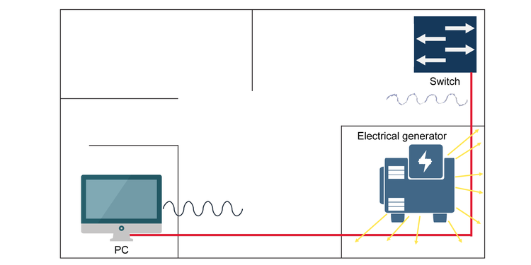
Electrical interference
Electromagnetic interference (EMI). Electrical currents, especially high-frequency, low-power signals such as those used in data networks, are subject to noise from electromagnetic sources in their environment, such as radio transmitters, electrical motors, or power cables

Slide 20
Electrical interference (Cont.)
Two signal cables alongside each other can even interfere with each other to cause crosstalk, which is especially a problem in large and complex networks when you might want to string many cables together
The second challenge is attenuation, which means the longer the line is, the weaker the signal becomes

Slide 21
Twisted-pair cables

Slide 22
Twisted-pair cable properties

Slide 23
Twisted-pair cable properties (Cont.)
Unshielded twisted-pair (UTP) is just like it sounds: It has no additional shielding and relies entirely on the twisted-pair effect to combat interference
Foil shielding uses a grounded foil wrap to provide additional electromagnetic shielding
Braided screening uses a braided copper jacket around the cable to provide shielding
Notes:
Unshielded twisted-pair (UTP) is just like it sounds: It has no additional shielding and relies entirely on the twisted-pair effect to combat interference.
Foil shielding uses a grounded foil wrap to provide additional electromagnetic shielding. The foil can be placed around each individual pair (U/FTP), around the outer cable (F/UTP), or both (F/FTP)
Braided screening uses a braided copper jacket around the cable to provide shielding. It can be used around otherwise unshielded cable (S/UTP) or in conjunction with foil shielding (S/FTP and SF/FTP).

Slide 24
F/UTP cable with the foil shielding unwrapped

Slide 25
Twisted-pair standards
The ISO/IEC 11801 standard defines several classes of cable
Each is able to support a given maximum transmission frequency over the distances used in most LAN installations
In practice, you usually hear these standards called by numbered categories, with a given category called "Cat" for short: Cat3, Cat5, Cat5e, etc.
Notes:
The ISO/IEC 11801 standard defines several classes of cable, each able to support a given maximum transmission frequency over the distances used in most LAN installations
In practice, you usually hear these standards called by numbered categories, with a given category called "Cat" for short: Cat3, Cat5, Cat5e, etc.

Slide 26
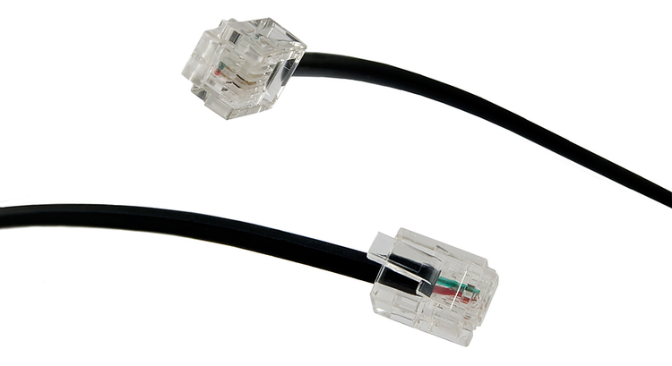
Twisted-pair connectors
Modular connectors are described by the number of positions (P) and contacts (C) they use. The number of positions determines the size of the connector, while the number of contacts determines how many wires can be connected.

Slide 27
Wiring standards

Slide 28
Wiring standards
Pin | T568A Pair | T568A Color | T568B Pair | T568B Color
1 | 3 | White/Green | 2 | White/Orange
2 | 3 | Green | 2 | Orange
3 | 2 | White/Orange | 3 | White/Green
4 | 1 | Blue | 1 | Blue
5 | 1 | White/Blue | 1 | White/Blue
6 | 2 | Orange | 3 | Green
7 | 4 | White/Brown | 4 | White/Brown
8 | 4 | Brown | 4 | Brown

Slide 29
Straight-through and crossover cables

Slide 30
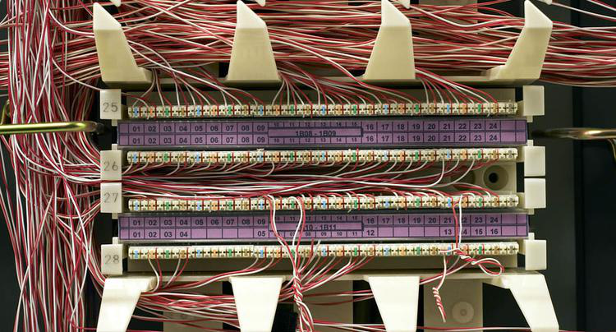
Centralized connections
All network and telephone cables are terminated to a common distribution frame
Usually on a device called a punchdown block
The block is so-named because a special tool is used to punch each wire down onto a bladed contact that punctures its insulation and holds it into place
Notes:
All network and telephone cables are terminated not with modular connectors, but to a common distribution frame, usually on a device called a punchdown block. The block is so-named because a special tool is used to punch each wire down onto a bladed contact that punctures its insulation and holds it into place.

Slide 31
Punch down Block

Slide 32
A patch panel alongside a switch
https://www.racksolutions.com/news/data-center-trends/cable-management/cable-management-strategies/

Slide 33
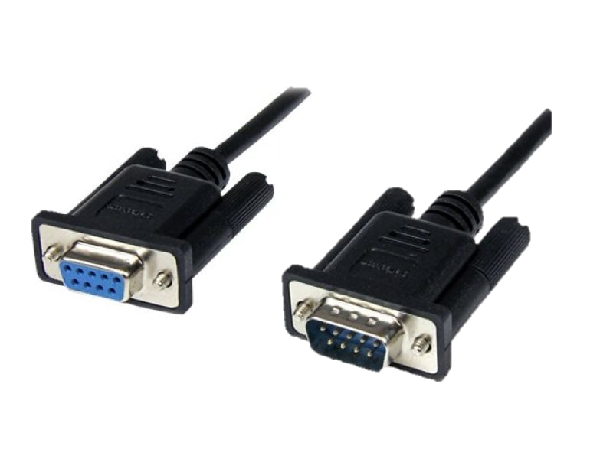
RS-232 connectors
On older PCs, RS-232 connections were simply called "serial ports"
Used for all sorts of peripheral devices like modems, printers, and mice.
RS-232 connectors use D-sub ports
Notes:
On older PCs, RS-232 connections were simply called "serial ports" and would be used for all sorts of peripheral devices like modems, printers, and mice.
RS-232 connectors use D-sub ports, easily recognizable by their D shape and metal shields.

Slide 34
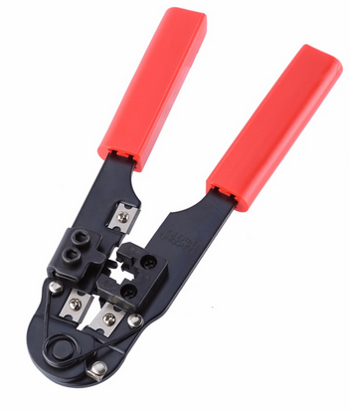
Termination tools
Snip
Crimp
Notes:
Snips
Wire stripper
Crimper
Punch down tool
A crimper with built-in snips and wire stripper.

Slide 35
Terminating twisted-pair cables
One of the most important things for you to know is how to terminate Cat5, Cat5e or Cat6 network cables with RJ45 connectors
Link to video: https://www.youtube.com/watch?v=UFlqNQsjYCs
Notes:
When you terminate a twisted-pair cable, the most important thing is that the wires are in the right order on both ends: otherwise, it won't work properly.
https://www.cableorganizer.com/learning-center/how-to/how-to-terminate-RJ45.htm

Slide 36
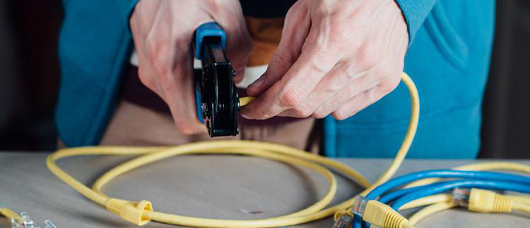
Terminating twisted-pair cables
One of the most important things for you to know is how to terminate Cat5, Cat5e or Cat6 network cables with RJ45 connectors
Notes:
When you terminate a twisted-pair cable, the most important thing is that the wires are in the right order on both ends: otherwise, it won't work properly.
https://www.cableorganizer.com/learning-center/how-to/how-to-terminate-RJ45.htm

Slide 37
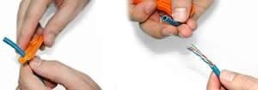
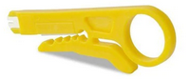
Terminating twisted-pair cables (Cont.)
Using a Crimping Tool, trim the end of the cable you're terminating, to ensure that the ends of the conducting wires are even
Being careful not to damage the inner conducting wires, strip off approximately 1 inch of the cable's jacket, using a modular crimping tool or a UTP cable stripper.

Slide 38
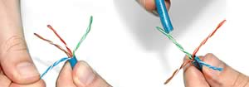
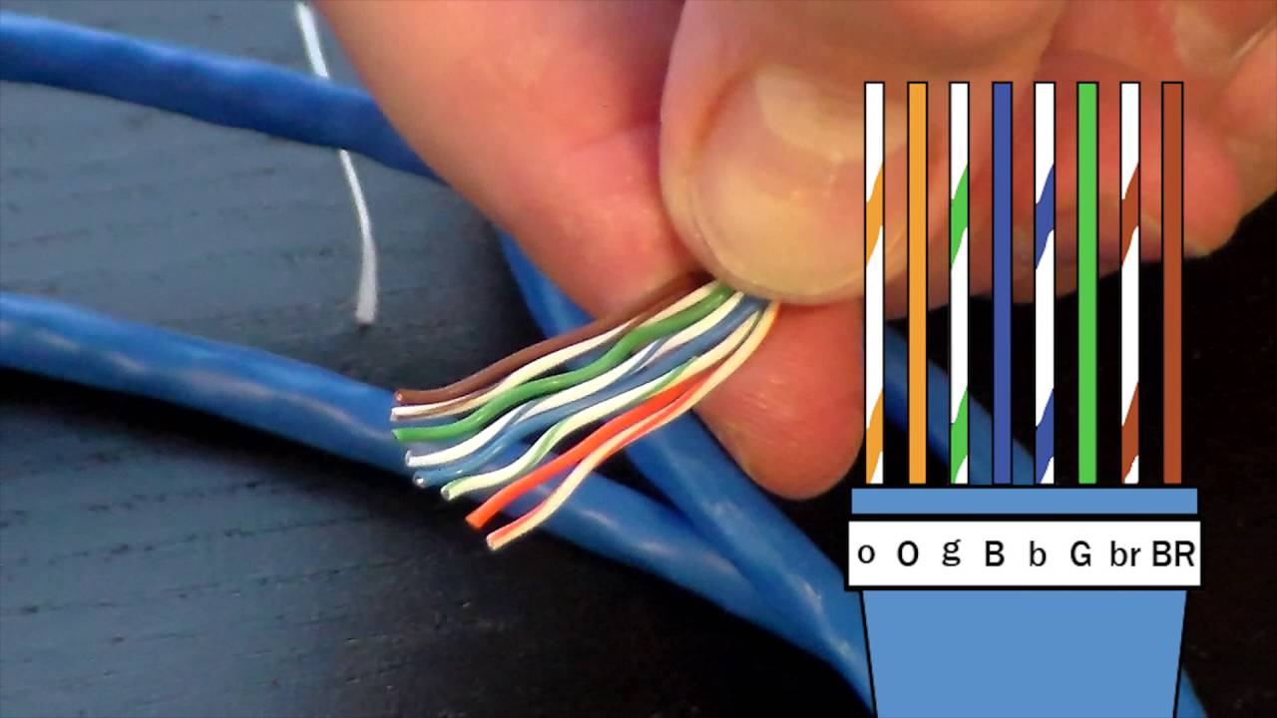
Terminating twisted-pair cables (Cont.)
Separate the 4 twisted wire pairs from each other, and then unwind each pair, so that you end up with 8 individual wires. Flatten the wires out as much as possible, since they'll need to be very straight for proper insertion into the connector.
Holding the cable with the wire ends facing away from you. Moving from left to right, arrange the wires in a flat, side-by-side ribbon formation, placing them in the following order: white/orange, solid orange, white/green, solid blue, white/blue, solid green, white/brown, solid brown.

Slide 39
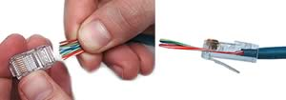
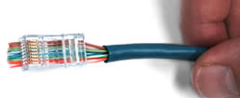
Terminating twisted-pair cables (Cont.)
Holding the RJ45 connector so that its pins are facing away from you and the plug-clip side is facing down, carefully insert the flattened, arranged wires into the connector, pushing through until the wire ends emerge from the pins. For strength of connection, also push as much of the cable jacket as possible into the connector.
Check to make sure that the wire ends coming out of the connector's pin side are in the correct order; if not, remove them from the connector, rearrange into proper formation, and re-insert. Remember, once the connector is crimped onto the cable, it's permanent. If you realize that a mistake has been made in wire order after termination, you'll have to cut the connector off and start all over again!If you're adding a cable boot, slide it on now and keep it out of the way.

Slide 40
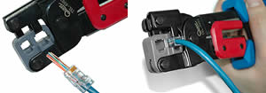
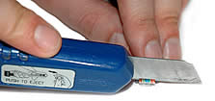
Terminating twisted-pair cables (Cont.)
Insert the prepared connector/cable assembly into the RJ45 slot in your crimping tool. Firmly squeeze the crimper's handles together until you can't go any further. Release the handles and repeat this step to ensure a proper crimp.
If your crimper doesn't automatically trim the wire ends upon termination, carefully cut wire ends to make them as flush with the connector's surface as possible. The closer the wire ends are trimmed, the better your final plug-in connection will be.

Slide 41
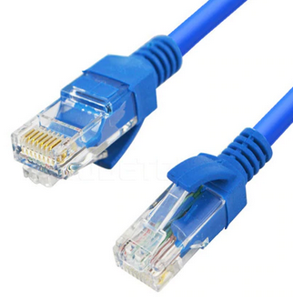
Terminating twisted-pair cables (Cont.)
After the first termination is complete, repeat process on the opposite end of your cable

Slide 42
Discussion: Twisted-pair connectors

Slide 43
Coaxial cables
An electrical cable which transmits radio frequency (RF) signals from one point to another
Mainly used to connect satellite antenna facilities to homes and businesses thanks to their durability and ease of installation
Notes:
Coaxial cable, sometimes known as coax cable, is an electrical cable which transmits radio frequency (RF) signals from one point to another.
The technology has been around since the early 20th century, with these cables mainly being used to connect satellite antenna facilities to homes and businesses thanks to their durability and ease of installation.

Slide 44
RG standards
Name | Core diameter | Outside diameter | Impedance | Uses
RG-59 | 0.64 mm | 6.1 mm | 75 ohms | Common for baseband video and older cable television systems. Not reliable for broadband network connections.
RG-6 | 1 mm | 6.86 mm | 75 ohms | Standard for newer digital cable, satellite, and cable modem connections. Essentially a higher-grade RG-59.
RG-11 | 1.63 mm | 10.5 mm | 75 ohms | Used for the same purposes as RG-6, but usually only for long distance drops and underground cables. Low loss for video
RG-8 | 2.17 mm | 10.3 mm | 50 ohms | Used by 10BASE5 "Thicknet" Ethernet, the first Ethernet standard. Now obsolete.
RG-58 | 0.81 mm | 5.0 mm | 50 ohms | Used by 10BASE2 "Thinnet" Ethernet, a cheaper but more limited alternative to Thicknet. Also obsolete.

Slide 45
RG Standards
RG-6 cables have larger conductors, so they provide better signal quality. They have thicker dielectric insulation
RG-59 cable is similar to the RG-6, but it has an even thinner centre conductor – domestic
RG-11 cable thicker than other types of coaxial cable. It offers a lower attenuation level than RG-6 or RG-59, meaning it can carry data for longer distances.
Notes:
Coaxial cable has a distinct thick, round shape because of its interior insulation layer. Its size makes it look very different to other types of cable, such as twisted pair or Ethernet cable. The most commons sizes of coaxial cable are RG-6, RG-11 and RG-59 – some of the size differences are demonstrated in the image.
Coaxial cables are available in a variety of colours including black, brown and white.
RG-6 cables have larger conductors, so they provide better signal quality. They have thicker dielectric insulation
RG-59 cable is similar to the RG-6, but it has an even thinner centre conductor mainly used in domestic
RG-11 cable is easily identifiable as it’s thicker than other types of coaxial cable, which can make it more difficult to work with. However, it offers a lower attenuation level than RG-6 or RG-59, meaning it can carry data for longer distances.

Slide 46
ISO/IEC 11801 standard
Common name | ISO/IEC 11801 name | Frequency | Description/Use
Cat 1 | Class A | 100 kHz | Low-speed cable used for older voice telephone installations. Not for use in data networks.
Cat 2 | Class B | 1 MHz | Used in older data networks like ARCnet and early Token Ring.
Cat 3 | Class C | 16 MHz | Used in early Ethernet; unsuitable for faster networks, but still used for voice telephone cables.
Cat 4 | Not standard | 20 MHz | Used by early Ethernet and some Token Ring networks but was never common.
Cat 5 | Class D | 100MHz | Widely used for Fast Ethernet and Gigabit Ethernet networks, also used for telephone and video. Superseded by Cat5e.

Slide 47
ISO/IEC 11801 standard (Cont.)
Common name | ISO/IEC 11801 name | Frequency | Description/Use
Cat 5e | Class D | 100 MHz | Category 5 Enhanced. Same overall properties as Cat5, but higher testing standards.
Cat 6 | Class E | 250 MHz | Stronger crosstalk specifications than Cat 5e. Popular for new Gigabit Ethernet installations and short distance 10 Gigabit Ethernet networks. Frequently shielded for additional EMI protection; if so, the shielding needs a grounded connection.
Cat 6a | Class Ea | 500 MHz | Augmented Category 6. Shielded and allows full distance 10 Gigabit Ethernet operation.
Cat 7 | Class F | 600 MHz | Similar to Cat6a but screened and shielded for higher noise resistance.
Cat 7a | Class Fa | 1000 MHz | Augmented Category 7. May be suitable for emerging 40 Gigabit Ethernet.

Slide 48
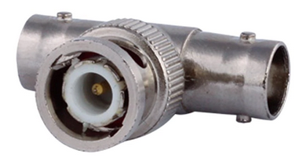
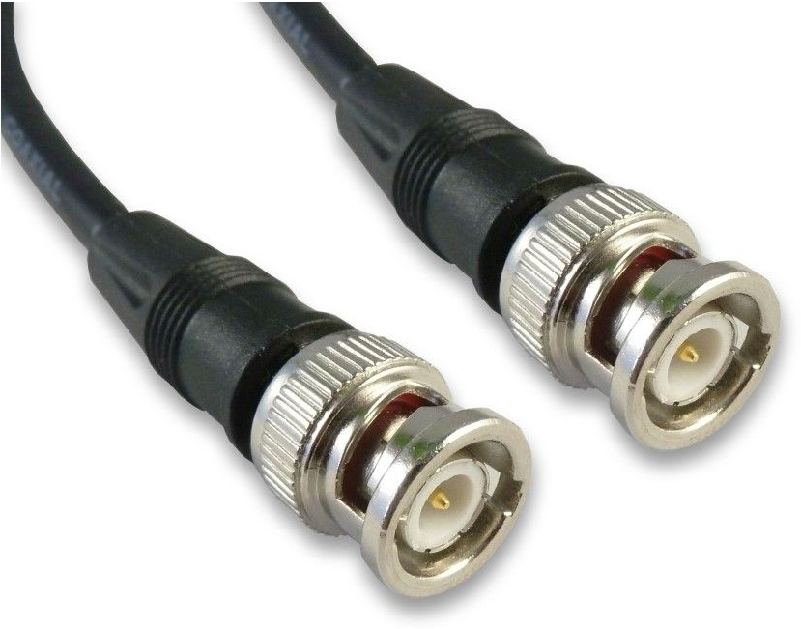
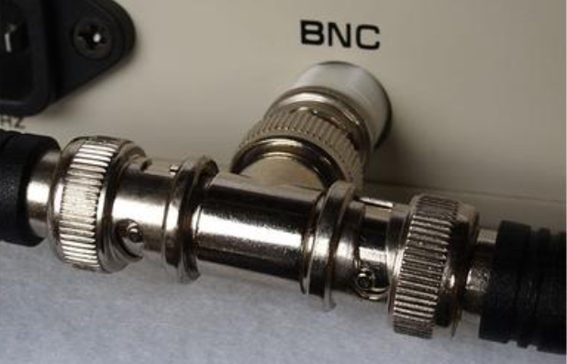
Coaxial connectors
A BNC connector, along with a T connector used for legacy Ethernet

Slide 49
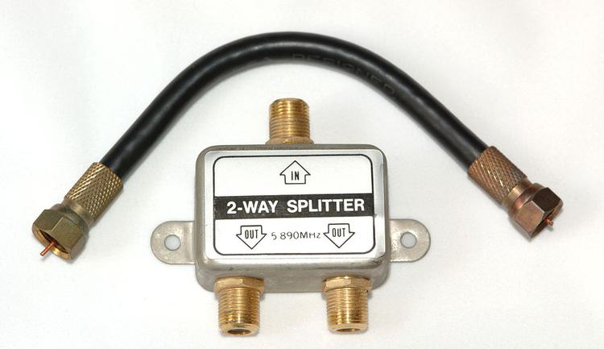
Coaxial connectors (Cont.)
A cable with F connectors, along with a splitter

Slide 50
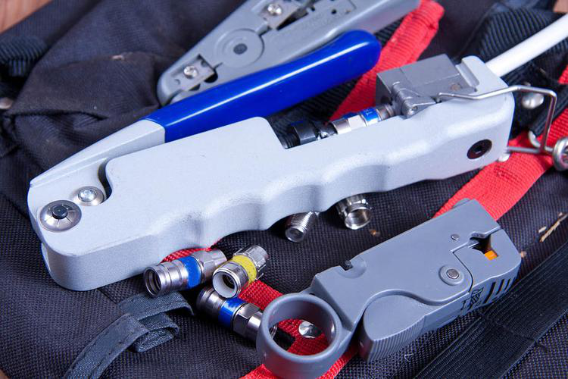
Terminating coaxial cables
Coaxial termination tools

Slide 51
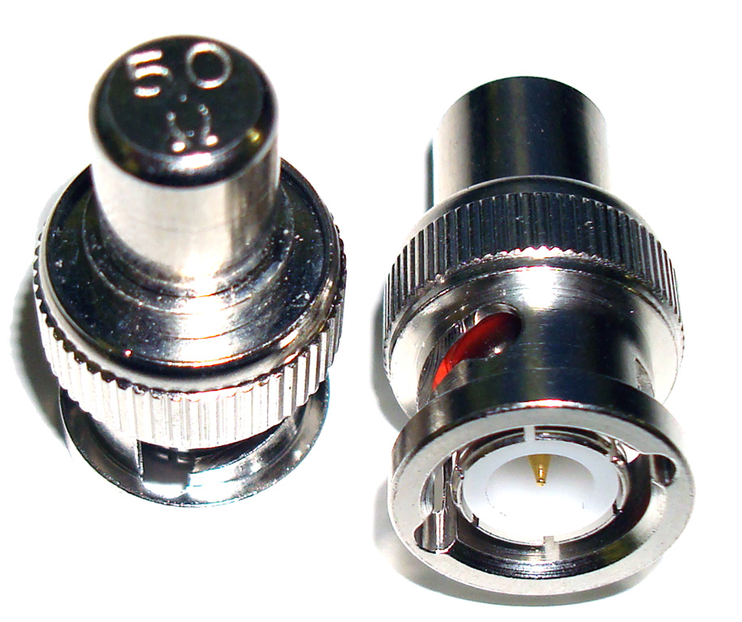
BNC Terminator
Usually 50 Ohm or 75 Ohm
The practice of ending a transmission line with a device that matches the characteristic impedance of the line
Notes:
Terminators are simple devices that electrically terminate RF coaxial ports. BNC terminator absorbs the electrical energy of the signal as it reaches the ends of cable and avoids reflection of signals.
The practice of ending a transmission line with a device that matches the characteristic impedance of the line. This is intended to prevent signals from reflecting off the end of the transmission line. Reflections at the ends of unterminated transmission lines cause distortion

Slide 52
Discussion: Coaxial media

Slide 53
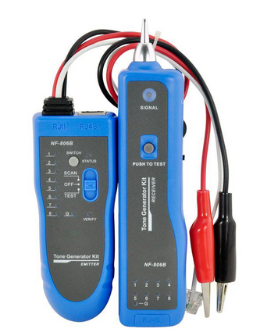
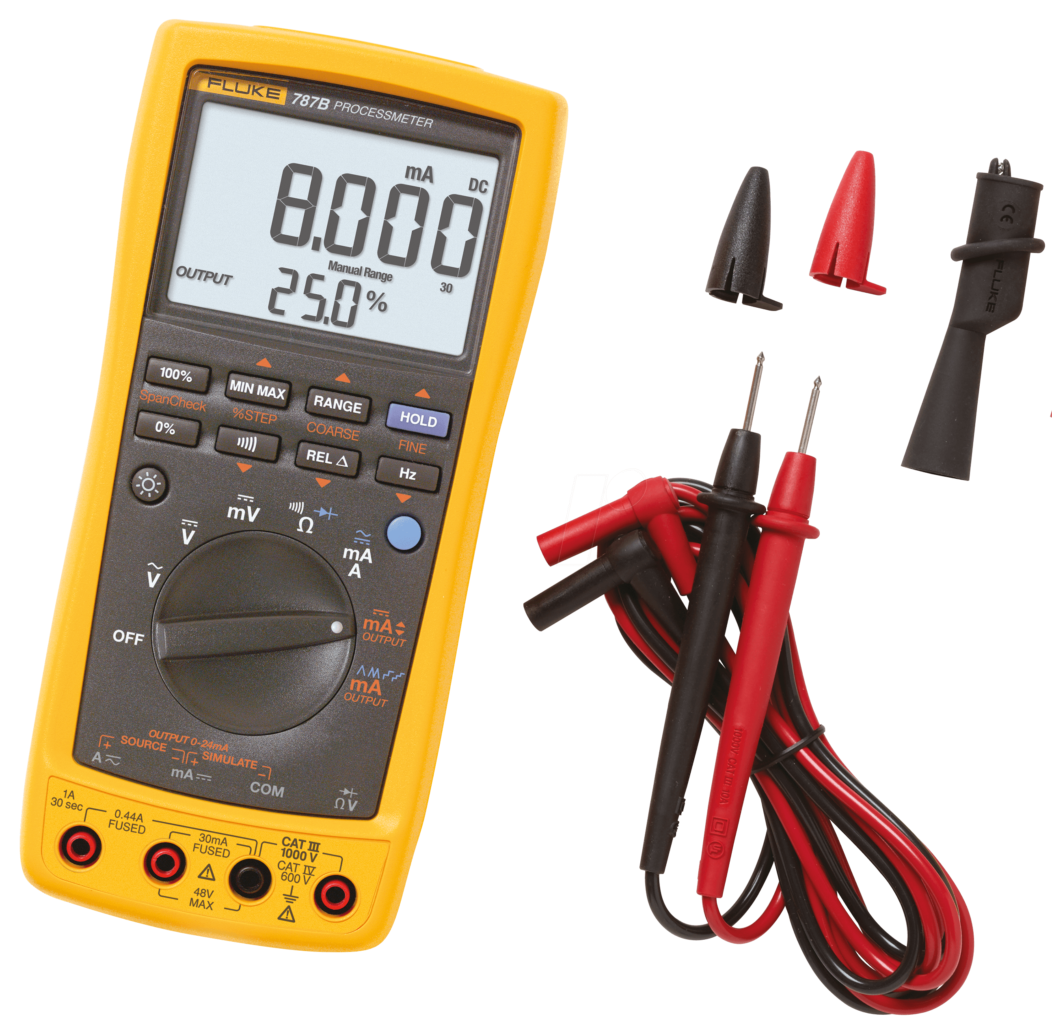
Cable testing tools
Multimeter
Tone generator

Slide 54
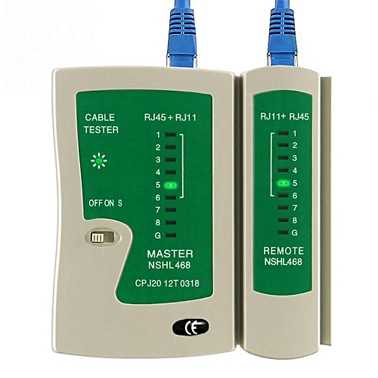
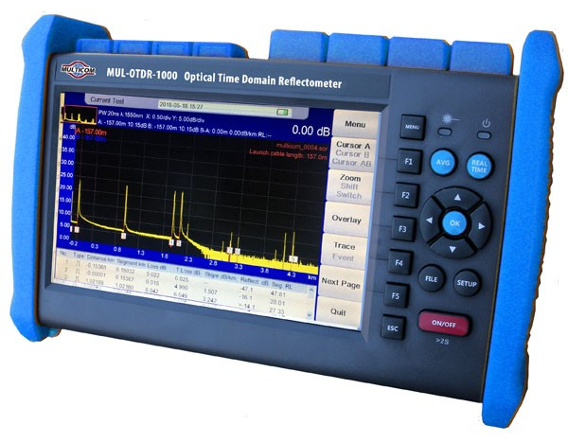
Cable testing tools (Cont.)
Cable tester
Time-domain reflectometer
Notes:
Cable tester
Network Cable Tester is a device designed to measure and test existing LAN connection or a network cable.
A time-domain reflectometer (TDR) is an electronic instrument used to determine the characteristics of electrical lines by observing reflected waveforms. It can be used to characterize and locate faults in metallic cables (for example, twisted pair wire or coaxial cable). It can also be used to locate discontinuities in a connector, printed circuit board, or any other electrical path.

Slide 55
Cable testing tools (Cont.)
Spectrum analyzer
Cable certifier
Loopback plug

Slide 56
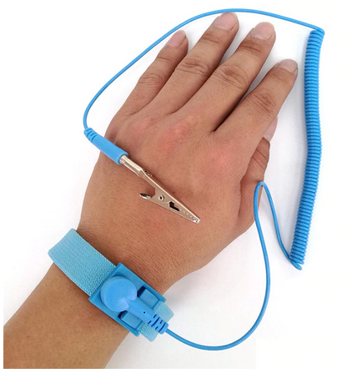
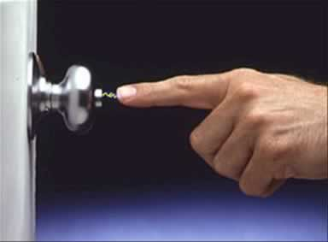
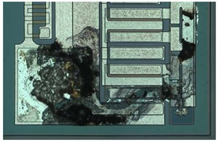
Electrical hazards
Static electricity is an imbalance of electric charges within or on the surface of a material
Notes:
Electrostatic shock can do permanent damage to sensitive electronics, even when it's not strong enough for a human to notice it. When you handle circuit boards or sensitive electronic connectors, especially in cool dry environments where it's easy for static to build, consider wearing an anti-static wrist strap to prevent damage.

Slide 57
Using multimeters
Multimeters may be analog or digital; either can measure current, voltage, or resistance.
Make sure the device is properly configured.
Set the multimeter to the appropriate test type.
If testing resistance, zero the meter by touching the leads directly together.
Touch the leads to either side of the circuit you're testing and read the display.

Slide 58
Using toner probes
Notes:
Turn on the tone generator
Bring the probe's tip over the generator's leads to verify that it's working
Connect the leads to the wire you're testing or plug in the modular jack
Move the probe closely over the cable bundle, patch panel, or punch down block you want to test
https://www.youtube.com/watch?v=Jz-gHbJz8sw

Slide 59
Copper connection troubleshooting
Breaks in cable continuity interrupt a signal
Internal or external interference cause noise, introducing errors
Cables terminated with the wrong wire order on one end carry the wrong signals and prevent a successful connection.
The same termination error made on both ends can cause noise if there are split pairs
Physical interfaces can fail too
Notes:
Breaks in cable continuity interrupt a signal. This can include damage along cables themselves, termination errors, or bent pins in a connector.
Internal or external interference cause noise, introducing errors that can make the connection slow or entirely unusable.
Cables terminated with the wrong wire order on one end carry the wrong signals and prevent a successful connection.
The same termination error made on both ends can cause noise if there are split pairs, where the wire pairs on the termination don't match the physical twisted pairs in the cable.
Physical interfaces can fail too: Not only does a jack or patch panel give another opportunity for improper termination, but a NIC, hub, or switch transceiver can fail.

Slide 60
Optical media
About optical fibers
About optical connector standards
How to troubleshoot optical networks

Slide 61
Optical fibers

Slide 62
Fiber types
Notes:
SMF – Single mode Fibre
MMF – Multi-mode Fibre

Slide 63
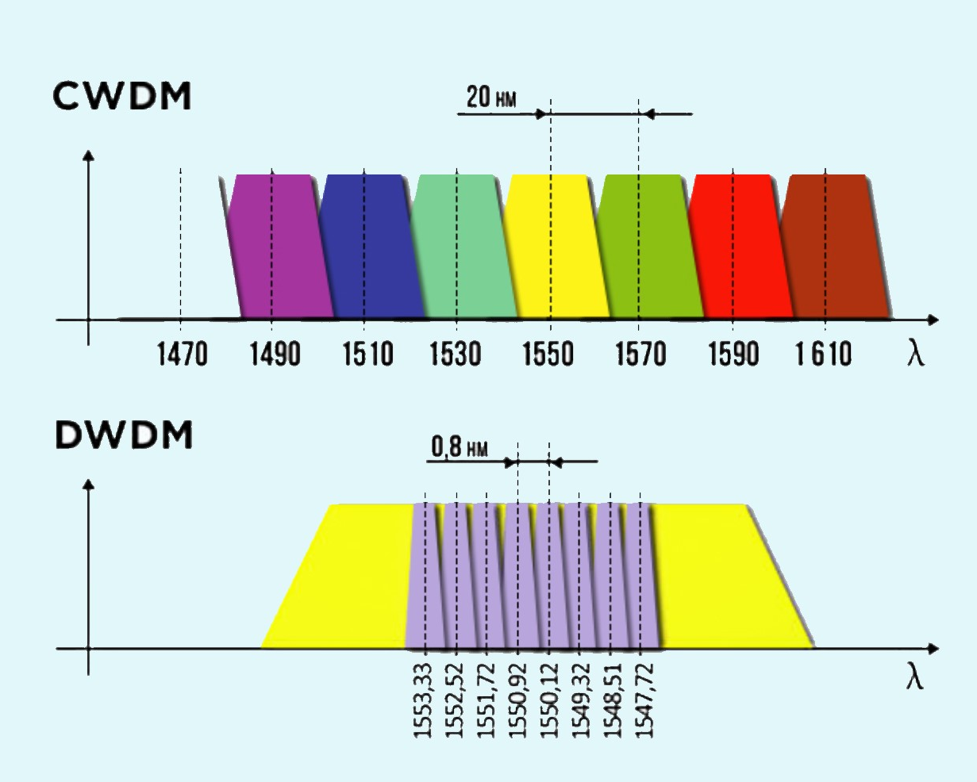
Wavelength-division multiplexing
Notes:
The two key WDM technologies are Coarse Wavelength Division Multiplexing, CWDM and Dense Wavelength Division Multiplexing, DWDM. Which solution is best suited to a given environment depends on the network and user requirements.
Coarse wavelength division multiplexing (CWDM) is a wavelength division multiplexing (WDM) technology that combines multiple signals at various wavelengths for simultaneous transmission over fibre cables.
CWDM supports up to 18 wavelength channels transmitted through a fibre at the same time. To achieve this, the different wavelengths of each channel are 20nm apart. DWDM, supports up to 80 simultaneous wavelength channels, with each of the channels only 0.8nm apart. CWDM technology offers a convenient and cost-efficient solution for shorter distances of up to 70 kilometres. For distances between 40 and 70 kilometres, CWDM tends to be limited to supporting eight channels.

Slide 64
CWDM and DWDM Statistics
 | DWDM | CWDM
Distance | 70km unamplified | 80km unamplified
 | 1000km+ amplified | Not applicable
Channels | 88 (Using interleaver) | 18 (Distances limited in the water peak)
Spacing | 0.8nm | 20nm
Protocols | All including 100G and beyond: 1/10/40/100GE and 8/16/32GFC | Up to 10GE and 8GFC (40G using 4x10G CWDM)

Slide 65
Optical fiber connectors
The industry standard connectors are rigid ferrule connectors and can be broken down into four categories:
Flat
PC
UPC
APC
Notes:
Fiber Optics Flat: Flat polish connector. These connectors are polished by the manufacturer typically have an attenuation of -30dB. Flat polish connectors control back reflection fairly well
Fiber Optics PC: Physical contact polish. These connectors are hand polished and typically have an attenuation of -30dB. PC refers to how the ferrule of the connector is polished. These connectors can cause back reflection into the ferrule and into the transmitter.
Fiber Optics SPC/UPC: SUPER POLISH CONTACT
Done by the manufacturer. -40db ULTRA POLISH CONTACT, done by the manufacturer. -50db These finishes are to help prevent back reflection into the transmitter.
Fiber Optics APC: Angled physical contact. This is done by the manufacturer, they cut the ferrule to an 8 degree angle to reduce back reflection. These connectors have an attenuation of -60dB and are used by CATV and Phone companies.

Slide 66
Optical Cable Assembly

Slide 67
Couplers and splitters
A fiber coupler is a type of splitter, where multiple fibers on one end are fused to join at a single core.
An optical coupler can be used just like a coaxial splitter, to send a single input to multiple outputs.
One thing you can't do is combine multiple inputs of the same wavelength to a single output, since they'll only interfere with each other.

Slide 68
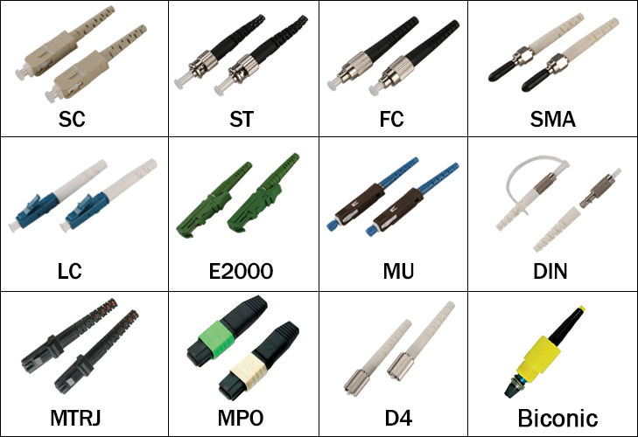
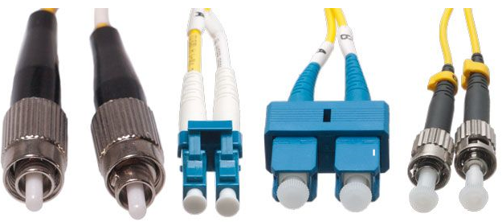
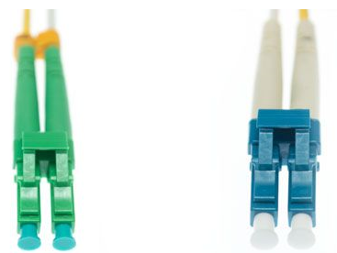
Optical connector standards
Notes:
From left to right: FC, LC, SC, and ST
A green color-coded APC connector (left) vs. a UPC connector (right)

Slide 69
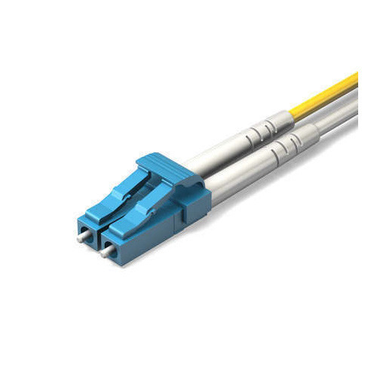
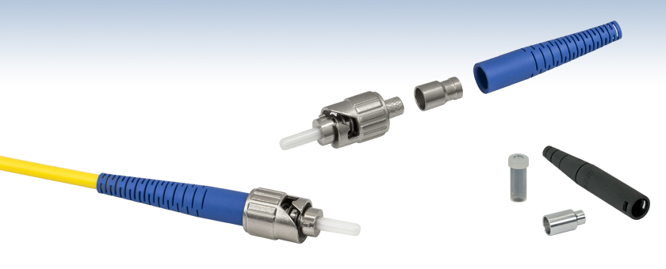
Most Common Connectors
ST
LC
SC
Notes:
SC – Subscriber Connector
The ST (straight tip connector) historically has been the most commonly used connector in the industry up to several years ago, it was not originally recognized by the standards but was added because of it’s prevalence in the industry.
The duplex SC (subscriber connector) was the first connector to be recognized by the TIA/EIA fibre standards because of it’s ease of inter-connectability and it represents a complete link (1 connector for TX the other for RX).
The new standard in fibre connectors is the LC (Lucent connector). These are small form factor (SFF) connectors that take up less space in a fibre panel.

Slide 70
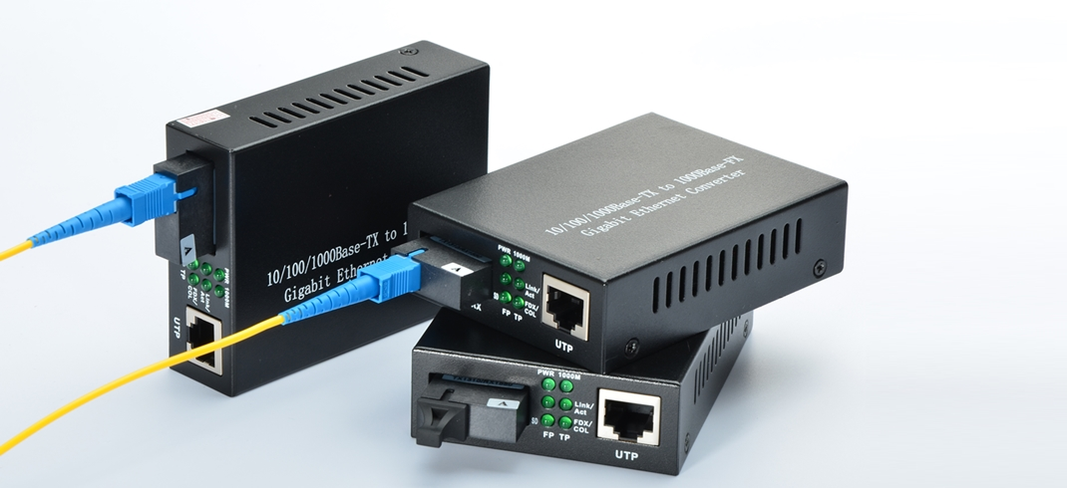
Media converters

Slide 71
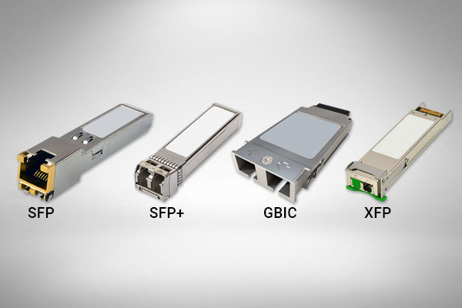
Modular transceivers
GBIC transceivers are visibly larger than those in the SFP family
GBIC
SFP
XFP
SFP+
QSFP
Notes:
A gigabit interface converter (GBIC) is a transceiver that converts electric currents (digital highs and lows) to optical signals, and optical signals to digital electric currents.
The GBIC is typically employed in fibre optic and Ethernet systems as an interface for high-speed networking.
A smaller variation of the GBIC called the small form-factor pluggable transceiver (SFP), also known as mini-GBIC, has the same functionality but in a smaller form factor. It largely made the GBIC obsolete.

Slide 72
Exercise: Identifying optical media

