Slide 1
Week 1

Slide 2
Day 1
Introduction
Programming Languages
Build a website

Slide 3
BCS Level 3 Award in Principles of Coding
QAN 603/0762/6

Slide 4
Introduction
Hi
Leonard Shand – Team Lead for Digital Apprenticeships
In the computing field for over 30 years
Cybersecurity expert
leonard.shand@gloscol.ac.uk

Slide 5
Where to find stuff
Wiki – gloscolapprenticeships.co.uk/appWiki/doku.php
You will need a password to access certain areas:
Username: apprentice
Password: ApprenticE
Email: leonard.shand@gloscol.ac.uk
Telephone: 07714437164

Slide 6
Syllabus
Completed over two weeks
25 to 29 January
22 to 26 February
Appreciation of Logic (10%, K2)
Programming Languages (10%, K1)
Interaction and Compatibility of Code on Different Platforms (25%, K2)
Web components (55%, K2)

Slide 7
2. Programming Languages (10%, K1)
In this topic, learners will become aware of programming languages and how they apply in building digital products. The successful Apprentice should be able to:
2.1 Identify the key characteristics and applications of the following programming languages:
Hypertext Markup Language (HTML)
JavaScript (JS)
Java

Slide 8
Hypertext Markup Language (HTML)
HTML stands for Hyper Text Markup Language
HTML describes the structure of Web pages using markup
HTML elements are the building blocks of HTML pages
HTML elements are represented by tags
HTML tags label pieces of content such as "heading", "paragraph", "table", and so on
Browsers do not display the HTML tags, but use them to render the content of the page

Slide 9
Example
<!DOCTYPE html>
<html lang="en">
<head>
<meta charset="UTF-8">
<meta name="viewport" content="width=device-width, initial-scale=1.0">
<title>Welcome</title>
</head>
<body>
<h1>
Welcome
</h1>
<p>If you can see this, you have successfully found Kristen's website</p>
</body>
</html>

Slide 10
JavaScript (JS)
JavaScript is used to provide interactive features to a web page
It is a dynamic programming language
It adds behaviour to your web page
It is embedded within the HTML code
Some things we can do the in JavaScript:
Form validation
Calculations
Animations
Load images

Slide 11
Java
Java is NOT the same as JavaScript
Is a full on Object Oriented Programming language

Slide 12
JavaScript (JS)
JavaScript is a scripting or programming language that allows you to implement complex features on web pages
Displays timely content updates, interactive maps, animated 2D/3D graphics, scrolling video jukeboxes, etc. — you can bet that JavaScript is probably involved
Runs in the browser

Slide 13
Java
Java is NOT the same as JavaScript
Is a full on Object Oriented Programming language

Slide 14
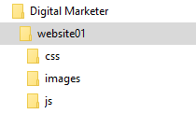
Create a folder on your computer called Digital Marketer
Open it and add another folder called website01
Within the website01 folder add three more folders as per the image below

Slide 15
Filezilla
Notes:
Follow along with me.
Share the screen with filezilla.
Open Filezilla and enter the following:

Slide 16
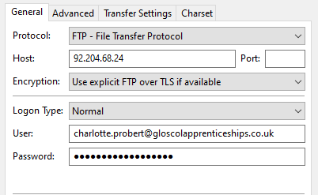

Slide 17
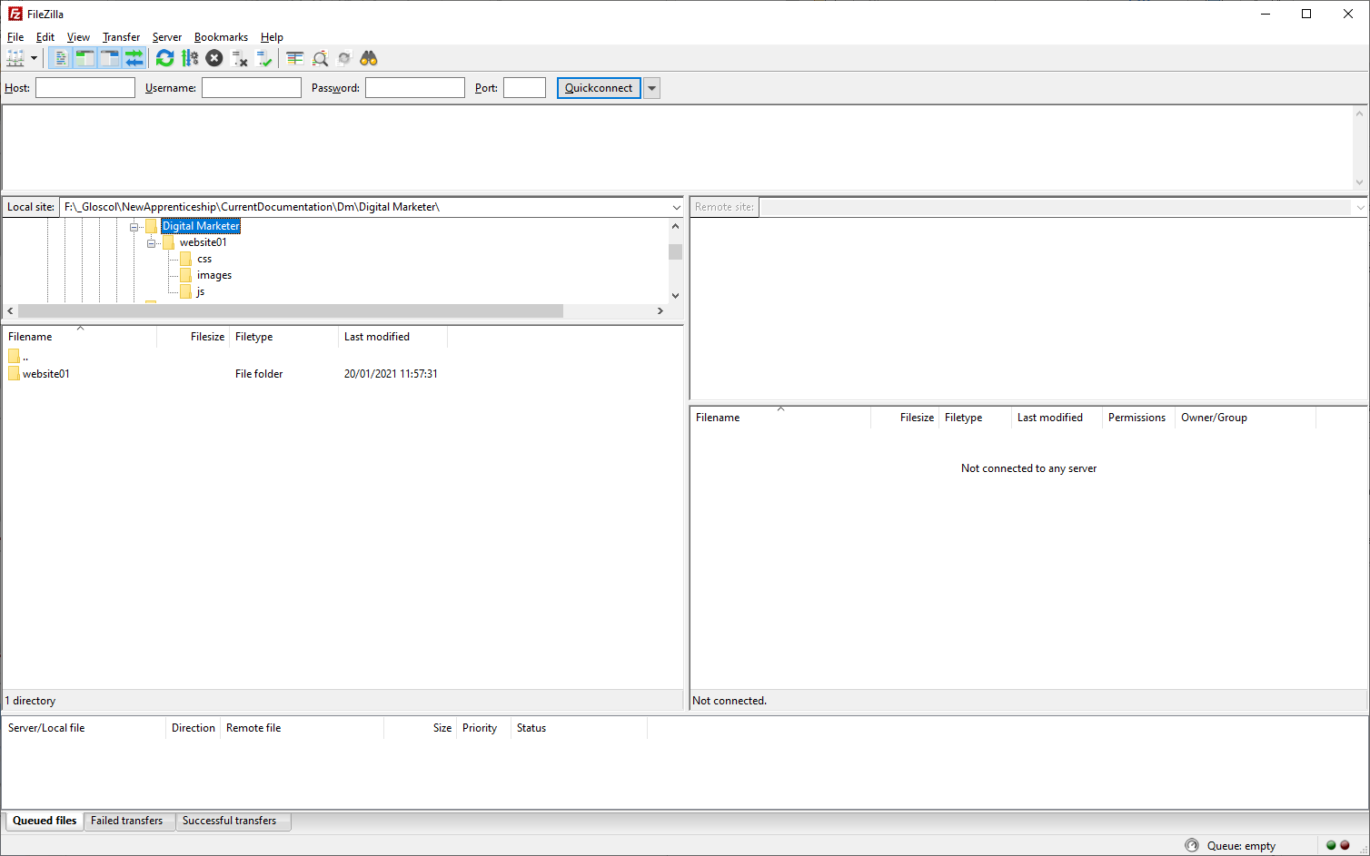

Slide 18
Day 2
Client-Server
Terminology
Security
Fix a website
Add pages
Links
Forms

Slide 19
4. Web components (55%, K2)
In this topic, learners will understand the components involved to make the Web work.
4.1 Define the terminology for the following key internet protocols that enable the web to work:
Hypertext Transfer Protocol (HTTP)
Hypertext Transfer Protocol Secure (HTTPS)
Transport Layer Security and Secure Sockets Layer (TLS / SSL)
4.2 Discuss the purpose of the following:
Web and application server
Hosting and serving
Relational database management systems
Content management systems

Slide 20
4. Web components (55%, K2)
4.3 Describe the purpose of a web client
Browsers
Applications
4.4 Describe how Search Engines operate in regard to the following:
How mark-up languages render hyperlinks
How the web crawler work
Displaying of search results
Factors that affect search engine optimization (SEO)
4.5 Explain the differences between a static and dynamic website.
Written in code
Written scripting language

Slide 21
4. Web components (55%, K2)
4.6 Describe how local (cookies) or session data storage is utilised to share information for standard digital features.
Forms
Checkout
Registration
4.7 Identify the key roles of the following Web technologies governance groups.
World Wide Web Consortium (W3C);
Internet Engineering Task Force (IETF).

Slide 22
4.1 Define the terminology for the following key internet protocols that enable the web to work
Hypertext Transfer Protocol (HTTP)
Hypertext Transfer Protocol Secure (HTTPS)
Transport Layer Security and Secure Sockets Layer (TLS / SSL)

Slide 23
The Internet and WWW
WWW
WWW = World Wide Web
The pages you see when you use a device and you are ‘online’
Need a browser
Internet
An internetwork of computers across the globe and even using space
Consists of networked computers and other devices
Hardware

Slide 24
Hypertext Transfer Protocol (HTTP)
WWW is about communication between web clients and servers
Communication between client computers and web servers is done by sending HTTP Requests and receiving HTTP Responses
Foundation of data communication for the World Wide Web
NOT secure
i
Not secure
|
http://example.com

Slide 25
Hypertext Transfer Protocol Secure (HTTPS)
Hypertext Transfer Protocol Secure (https) is a combination of the Hypertext Transfer Protocol with an added layer of security
Requires a certificate
Protects the integrity and confidentiality of data between the user's computer and the website
|
https://example.com

Slide 26
Encryption
Before encryption:
This is a string of text that is completely readable
After encryption:
ITM0IRyiEhVpa6VnKyExMiEgNveroyWBPlgGyfkflYjDaaFf/Kn3bo3OfghBPDWo6AfSHlNtL8N7ITEwIXc1gU5X73xMs

Slide 27
Transport Layer Security and Secure Sockets Layer (TLS / SSL)
SSL refers to Secure Sockets Layer whereas TLS refers to Transport Layer Security
Basically, they are one and the same, but, entirely different
SSL and TLS are cryptographic protocols that authenticate data transfer between servers, systems, applications and users
TLS has replaced SSL (but we still say “I need an SSL certificate”)

Slide 28
Organisations
IETF (https://www.ietf.org/)
The Internet Engineering Task Force (IETF) develops and promotes voluntary Internet standards, in particular the standards that comprise the Internet protocol suite (TCP/IP)
W3C (www.w3.org)
The World Wide Web Consortium (W3C) is the main international standards organisation for the World Wide Web
Founded and currently led by Tim Berners-Lee

Slide 29
Day 3
Web and application server
Hosting and serving

Slide 30
4.2 Discuss the purpose of the following
Web and application server
Hosting and serving
Relational database management systems
Content management systems

Slide 31
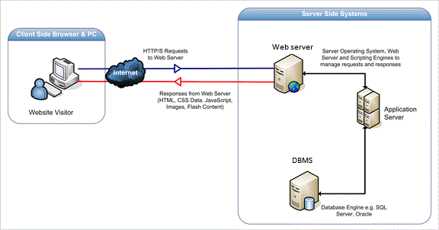
Web and Application Server
Web server serves web content over HTTP
Displays site content
Application server serves business logic to application programs through any number of protocols

Slide 32
Hosting and Serving
Hosting
A web host, or web hosting service provider, is a business that provides the technologies and services needed for the website or webpage to be viewed on the Internet
Websites are hosted, or stored, on special computers called servers
Web servers
Hardware dedicated to running web server software

Slide 33
Relational Database Management Systems
Complex database software
Make use of relationships between entities
Examples:
MariaDB
MySQL
Microsoft SQL Server
Microsoft Access (Desktop)

Slide 34
Example database system
Database Name
Table name

Slide 35
Database
A database is just a different kind of spreadsheet

Slide 36
Content Management Systems
Manages the creation and modification of digital content
Support the separation of content and presentation
A web content management system (WCM or WCMS) is a CMS designed to support the management of the content of Web pages
Most popular CMSs are also WCMSs
Web content includes text and embedded graphics, photos, video, audio, maps, and program code (e.g., for applications) that displays content or interacts with the user.

Slide 37
Content Management Systems
Such a content management system (CMS) typically has two major components:
A content management application (CMA) is the front-end user interface that allows a user, even with limited expertise, to add, modify, and remove content from a website without the intervention of a webmaster.
A content delivery application (CDA) compiles that information and updates the website.
Is a backend system

Slide 38
Example CMS

Slide 39
Example CMS - WordPress

Slide 40
4.3 Describe the purpose of a web client
Browsers
Applications

Slide 41
Browsers
All browsers display web pages
Not all browsers behave the same
Internet Explorer does not follow web standards

Slide 42
Browsers
Over 100 browsers available
Can install more than one
Top 6:
Chrome
Safari
Firefox
Internet Explorer
Opera
Edge (Windows 10 only)

Slide 43
Applications
A web application (or web app) is application software that runs on a web server, unlike computer-based software programs that are run locally on the operating system
Any computer program that performs a specific function by using a web browser as its client
Example: online forms, shopping carts, word processors, spreadsheets, video and photo editing, file conversion, file scanning, and email programs such as Gmail

Slide 44
Web and application server
Hosting and serving
Web and application server
Hosting and serving

Slide 45
Day 4
Search Engines

Slide 46
4.4 Describe how Search Engines operate
How mark-up languages render hyperlinks.
How the web crawler work.
Displaying of search results.
Factors that affect search engine optimization (SEO).

Slide 47
How mark-up languages render hyperlinks
Hyperlinks are one of the most exciting innovations the Web has to offer
They've been a feature of the Web since the beginning, and are what makes the Web a web
Hyperlinks allow us to link documents to other documents or resources, link to specific parts of documents, or make apps available at a web address
A basic link is created by wrapping the text or other content inside an <a> element and using the href attribute, also known as a Hypertext Reference, or target, that contains the web address
<p>I'm creating a link to <a href="https://www.mozilla.org/en-US/">the Mozilla homepage</a>. </p>

Slide 48
Search Engines
A search engine is a software system that is designed to carry out web searches, which means to search the World Wide Web in a systematic way for particular information specified in a textual web search query
Familiar search engines
Google
DuckDuckGo
Yahoo
Amazon
Pinterest

Slide 49
How the web crawlers work
Also called web spiders
A search engine bot
A web crawler copies webpages so that they can be processed later by the search engine, which indexes the downloaded pages
This allows users of the search engine to find webpages quickly
The web crawler also validates links and HTML code, and sometimes it extracts other information from the website

Slide 50
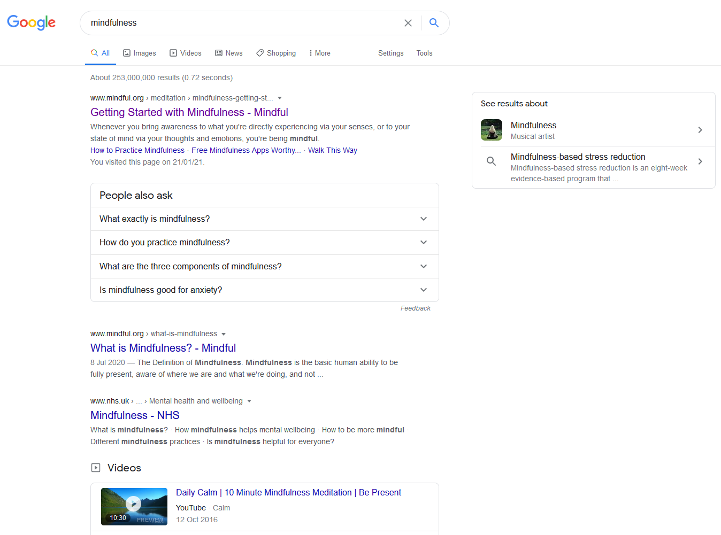
Displaying of search results
Some are pretty

Slide 51
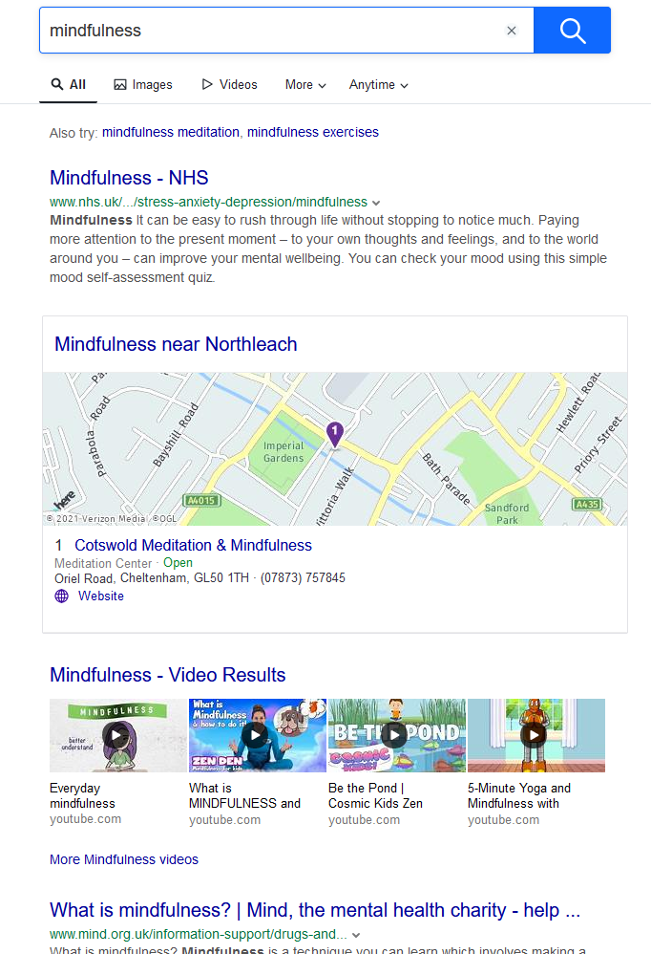
Displaying of search results
Some not so much

Slide 52
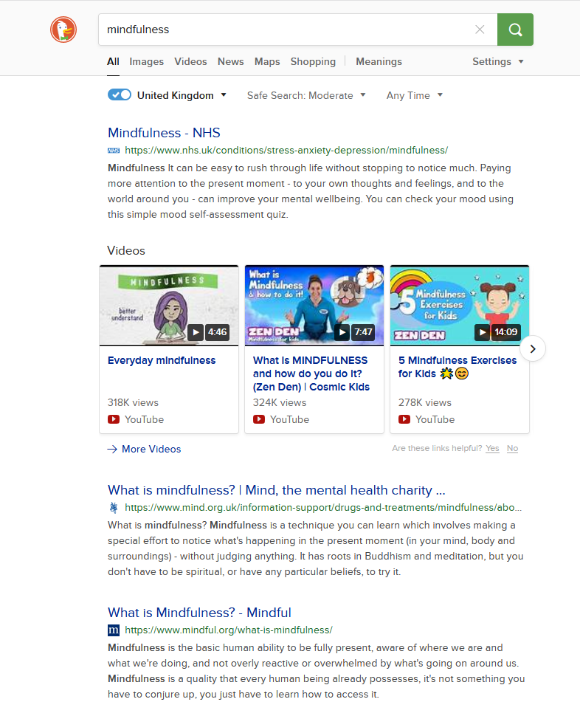
Displaying of search results
Some don’t track you

Slide 53
Factors that affect search engine optimization (SEO)
What Are the Most Important SEO Ranking Factors?
A Secure and Accessible Website
Page Speed (Including Mobile Page Speed)
Mobile Friendliness
Domain Age, URL, and Authority
Optimized Content
Technical SEO
User Experience (RankBrain)
Links
Social Signals
Real Business Information
Notes:
Question…: which is more important, pleasing Google or pleasing your audience?
Is it mobile friendly? https://search.google.com/test/mobile-friendly

Slide 54
4.5 Explain the differences between a static and dynamic website
Written in code
Written scripting language

Slide 55
Web client; Browsers and Applications
Web client
A user interface through which messages are sent to a web server
A web client usually operates within a web browser
Browser
Used to access the World Wide Web
Applications
Any computer program that performs a specific function by using a web browser as its client
Example: contact form

Slide 56
Static
Pages coded in HTML only
Content needs to be changed manually
Static and Dynamic Websites
Dynamic
Pages coded in HTML and other languages such as PHP, JavaScript, VB.net, C#
Pages content changes when user requests a piece of content or upon input into the page

Slide 57
Static Pages - Code
<!DOCTYPE html>
<html lang="en">
<head>
<meta charset="UTF-8">
<title>Len's Cakes | Home</title>
<link rel="stylesheet" href="css/styles.css">
</head>
<body>
<div class="header">
<div class="nav"><img src="images/cherryCupCake.png" alt="Cherry cup cake logo" width="100px" >
<ul>
<li><a href="index.html">Home</a></li>
<li><a href="about.html">About</a></li>
<li><a href="cakes.html">Our Cakes</a></li>
<li><a href="contact.html">Contact</a></li>
<li><a href="faq.html">FAQ</a></li>
</ul>
</div>

Slide 58
Dynamic Pages – Code (JavaScript)
Use Worksheet 5 to create a new web page

Slide 59
Dynamic Pages – Code (PHP)
Use Worksheet 6 to create a new web page

Slide 60
4.6 Describe how local (cookies) or session data storage is utilised to share information for standard digital features
Forms
Checkout
Registration

Slide 61
4.6 - Cookies
A cookie is often used to identify a user
A cookie is a small file that the server embeds on the user's computer
Each time the same computer requests a page with a browser, it will send the cookie too
With PHP, you can both create and retrieve cookie values.

Slide 62
Written in code
>>> from http import cookies
>>> C = cookies.SimpleCookie()
>>> C["fig"] = "newton"
>>> C["sugar"] = "wafer"
>>> print(C) # generate HTTP headers
Set-Cookie: fig=newton
Set-Cookie: sugar=wafer
>>> print(C.output()) # same thing
Set-Cookie: fig=newton
Set-Cookie: sugar=wafer
>>> C = cookies.SimpleCookie()
>>> C["rocky"] = "road"
>>> C["rocky"]["path"] = "/cookie"
>>> print(C.output(header="Cookie:"))
Cookie: rocky=road; Path=/cookie
>>> print(C.output(attrs=[], header="Cookie:"))
Cookie: rocky=road

Slide 63
Written scripting language
<?php
$value = 'something from somewhere';
setcookie("TestCookie", $value);
setcookie("TestCookie", $value, time()+3600); /* expire in 1 hour */
setcookie("TestCookie", $value, time()+3600, "/~rasmus/", "example.com", 1);
?>

Slide 64
Forms
Used to allow a user to enter data into a web page
Form.html
<html> <body> <form action="welcome.php" method=“post"> Name: <input type="text" name="name"><br> E-mail: <input type="text" name="email"><br> <input type="submit"> </form> </body> </html>

Slide 65
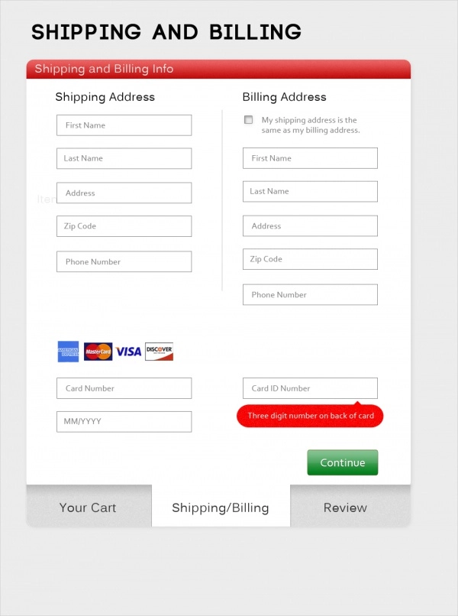
Checkout
Part of the process of online shopping in which the customer enters delivery information and pays for the item
Example:
Amazon

Slide 66
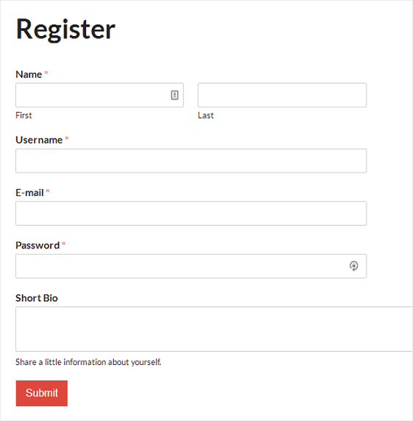
Registration
A registration form allows user data to be stored in a database
Good for making email lists or setting up access rights to allow a user to login to a site

Slide 67
Day 5
Web Technologies

Slide 68
4.7 Identify the key roles of the following Web technologies governance groups
World Wide Web Consortium (W3C)
Internet Engineering Task Force (IETF).

Slide 69
World Wide Web Consortium (W3C)
The World Wide Web Consortium is the main international standards organization for the World Wide Web
Founded in 1994 and currently led by Tim Berners-Lee, the consortium is made up of member organizations that maintain full-time staff working together in the development of standards for the World Wide Web
Full-time staff, and the public work together to develop Web standards
W3C's primary activity is to develop protocols and guidelines that ensure long-term growth for the Web
W3C's standards define key parts of what makes the World Wide Web work

Slide 70
Internet Engineering Task Force (IETF)
The IETF is a large open international community of network designers, operators, vendors, and researchers concerned with the evolution of the Internet architecture and the smooth operation of the Internet

Slide 71
Internet Assigned Numbers Authority
The Internet Assigned Numbers Authority (IANA) is the central coordinator for the assignment of unique parameter values for Internet protocols
Performs global coordination of the DNS Root, IP addressing, and other Internet protocol resources
This role means assigning the operators of top-level domains, such as .uk and .com, and maintaining their technical and administrative details.

