Slide 1
BCS Level 4 Certificate in Network Systems and Architecture
NSaA-QAN_60305472
2 – Storage Protocol Failures

Slide 2
2. Storage Protocol Failures

Slide 3
What is a storage protocol?
A protocol specific to a technology
Mainly used in cloud applications
Most storage networks use the SCSI protocol for communication between servers and disk drive devices

Slide 4
Small Computer System Interface (SCSI)
In use since the early 1980’s and was originally used to move data within a single server
Dominant block level access method for disk in the data centre
Still widely used in its native format but it has also been encapsulated into other protocols for use within storage networks for consolidated storage

Slide 5
Fibre Channel (FC)
Designed to extend the functionality of SCSI into point-to-point, loop, and switched topologies
FC encapsulates SCSI data and Command Descriptor Blocks (CDB) into the payload of Fibre Channel frames
Fibre Channel networks provided the addressing, routing, and flow-control required to support SCSI data
Designed to meet the needs of SCSI by providing ‘lossless’ in order delivery
This means that in a stable network FC frames will not be dropped
Delivered in order ensuring that the Upper Layer Protocols (ULP) will not be forced to reorder or resend frames
Typically carried over fiber-optic links on dedicated infrastructures
Traditionally built-in pairs as exact mirrors of one another
FC networks come in 1/2/4/8 Gbps speeds with 16/32 Gbps in the works

Slide 6
internet/IP Small Computer System Interface (iSCSI)
Typically uses TCP ports 860 and 3260
iSCSI takes SCSI data and CDBs and places it in the payload of IP packets
Allows the SCSI protocol to be extended across existing IP infrastructure
Has not gained the required market share
The problem with iSCSI from a protocol standpoint is that it takes the SCSI protocol which expects lossless, in-order delivery, and places it in TCP/IP packets which are designed to support heterogeneous WAN networks and experience packet loss and out-of-order delivery frequently

Slide 7
Fibre Channel over Ethernet (FCoE)
Ratified in 2009 and provides the functionality for moving native Fibre Channel across consolidated Ethernet networks
FCoE encapsulates full Fibre Channel frames inside Ethernet Jumbo Frame payloads
FCoE does not modify the existing Fibre Channel protocol suite

Slide 8
Common Internet File System (CIFS)
CIFS is a file based storage system based on Server Message Block (SMB)
This is a shared storage protocol typically used in Microsoft environments for file sharing
Windows-based file shares rely on CIFS as the transfer protocol of the file level data
File based storage relies on an underlying files system such as FAT32, XFS, NTFS
block based storage does not

Slide 9
Network File System (NFS)
File based storage protocol
NFS is traditionally used in Linux and Unix environments
NFS is also a widely used protocol for VMware environments and can offer several benefits for virtual machine storage
As a file based storage protocol NFS experiences many of the same limitations as stated for CIFS

Slide 10
Hyper Text Transfer Protocol (HTTP) and others
When the cloud discussion leaves the data centre (private/internal cloud) and moves up to the service provider level such as Google, Amazon, or the TelCos, the protocols listed above may not have the necessary scalability
Protocols such as HTTP based storage are being used to simplify storage configuration and increase its scalability

Slide 11
Failures
Disk failure
This type of failure is triggered by failure mechanisms of disks
Imperfect media, media scratches caused by loose particles, rotational vibration, and many other factors internal to a disk can lead to this type of failures
Sometimes, the storage layer proactively fails disks based on statistics collected by on-disk health monitoring mechanisms - e.g., a disk has experienced too many sector errors
Physical interconnect failure
This type of failure is triggered by errors in the networks connecting disks and storage heads
It can be caused by host adapter failures, broken cables, shelf enclosure power outage, shelf backplanes errors, and/or errors in shelf FC drivers
When physical interconnect failures happen, affected disks appear to be missing from the system

Slide 12
Failures
Protocol failure
This type of failure is caused by incompatibility between protocols in disk drivers or shelf enclosures and storage heads and software bugs in the disk drivers
When this type of failure happens, disks are visible to the storage layer but I/O requests are not correctly responded by disks
Performance failure
This type of failure happens when the storage layer detects that a disk cannot serve I/O requests in a timely manner while none of previous three types of failures are detected
It is mainly caused by partial failures, such as unstable connectivity or when disks are heavily loaded with disk-level recovery (e.g., broken sector remapping)

Slide 13
Locally Attached Storage Protocol Failures
Storage protocol failures
SATA
SCSI
SAS
hardware failure - loss of access to local disk(s) and / or corruption of data

Slide 14
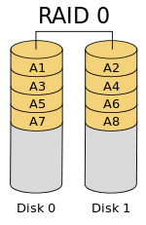
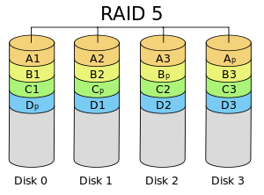
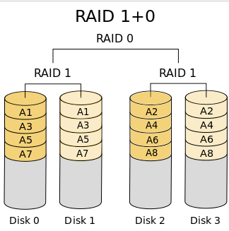
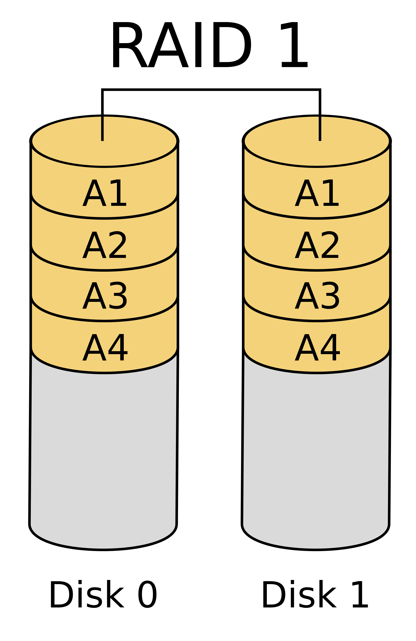
Causes and Impact of Failures of RAID
Raid 0
Uses striping
Maximise parallelism
No redundancy
No error correction
No fault tolerance
Only use 50%
NO drive can fail
RAID 1
Uses mirroring
Redundant data
Fault tolerant
Most common form
One drive can fail
Raid 5
Uses block-level striping
Rotating parity array
Error correction takes place in same disks as data storage
Parallelism, better performance than RAID 4
Single drive failure
RAID 10
Mirroring AND striping at same time
Minimum of 4 disks (have to be even amount)
Fault tolerance
Very high performance
Only use 50%
2 drives can fail (one in each mirrored pair)

Slide 15
Causes and Impact of Failures of RAID
Loss of single / multiple disks
reduced throughput
loss of data depending on RAID
Level and number of disk failures
See previous slide
Loss of RAID controller
permanent / temporary loss of access to data

Slide 16
Failures of network shares
Usually caused by network card drivers
Use proprietary driver, not windows version
Anti-virus programs
ACL issues
DNS issues in AD
Misconfigured firewall or protocols (NFS, SMB, TCP/IP, AFS)
complete loss of access to NAS
Misconfigured NFS
loss of access for Linux / NAS network shares
Misconfigured SMB
loss of access to Windows network shares
Misconfigured AFS
loss of access for Apple systems shares
Misconfigured authentication and/or authorisation
loss of access to some / all NAS / network shares

Slide 17
Storage Area Network (SAN) failures
A Storage Area Network (SAN) is a specialized, high-speed network that provides block-level network access to storage
SANs are typically composed of hosts, switches, storage elements, and storage devices that are interconnected using a variety of technologies, topologies, and protocols
SANs may also span multiple sites
SANs are often used to:
Improve application availability (e.g., multiple data paths)
Enhance application performance (e.g., off-load storage functions, segregate networks, etc.)
Increase storage utilization and effectiveness (e.g., consolidate storage resources, provide tiered storage, etc.), and improve data protection and security
SANs also typically play an important role in an organization's Business Continuity Management (BCM) activities

Slide 18
Storage Area Network (SAN) failures
SANs are commonly based on Fibre Channel (FC) technology that utilizes the Fibre Channel Protocol (FCP) for open systems and proprietary variants for mainframes
The use of Fibre Channel over Ethernet (FCoE) makes it possible to move FC traffic across existing high speed Ethernet infrastructures and converge storage and IP protocols onto a single cable
Single misconfigured or failed Fibre switch
Increased load on remaining switches and possible reduced throughput and/or storage outage
The standard data network is unaffected;
Loss of all Fibre switches
Complete loss of access to storage
The standard data network is unaffected
Failure of a single host bus adapter (HBA)
Increased load on remaining HBA on a single node and possible reduced throughput for this node or complete outage if this is the only on-board HBA

Slide 19
Failures of network shares
2.4 Explain causes and consequences of storage area network (SAN) failures over the Fibre Channel protocol and summarise the appropriate response for each.
single misconfigured or failed Fibre switch - increased load on remaining switches and possible reduced throughput and/or storage outage. The standard data network is unaffected;
loss of all Fibre switches - complete loss of access to storage. The standard data network is unaffected;
failure of a single host bus adapter (HBA) - increased load on remaining HBA on a single node and possible reduced throughput for this node or complete outage if this is the only onboard HBA.

Slide 20
Fibre Channel

Slide 21
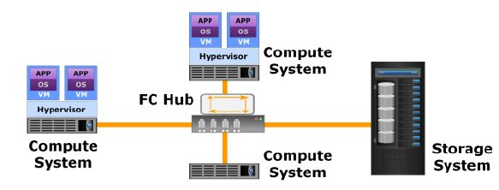
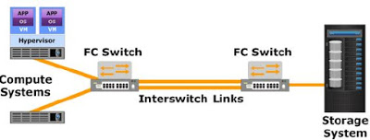
Fibre Channel over Ethernet (FCoE)
The FC SAN physical components such as network cables network adapters and hubs or switches can be used to design a Fibre channel Storage Area Network
The different types of FC architecture which can be designed are:
Point-to-point
two nodes are connected directly to each other
Fibre channel arbitrated loop (FC-AL)
the devices are attached to a shared loop
Fibre channel switched fabric (FC-SW)
a single FC switch or a network of FC switches (including FC directors) to interconnect the nodes

Slide 22
Basic troubleshooting tips for Fibre Channel (FC) SAN issues
Always take backup of Switch Configurations
Troubleshooting Connectivity Issues
Fcping - an FC version of the popular IP ping tool
Fctrace - traces a route/path to an N_Port
Things to check while troubleshooting Zoning
Are your aliases correct ?
If using port zoning, have your switch domain IDs changed ?
If using WWPN zoning, have any of the HBA/WWPNs been changed ?
Is your zone in the active zone set?
Rescan the SCSI Bus if required
Understanding Switch Configuration Dumps
Use Port Error Counters

Slide 23
SAN failures over Fibre Channel over Ethernet (FCoE)
Single misconfiguration or failed standard switch
Increased load on remaining switches and possible reduced throughput or storage outage
The standard data network may also be impacted
TCP/IP misconfiguration
Inability for some / all nodes to access storage
Failure of a single network interface controller (NIC)
Increased load on remaining NIC on a single node and possible reduced throughput for this node or complete outage if this is the only on-board NIC
Incorrect / invalid logical unit number (LUN)
Inability to access logical storage device
Loss of network
Total outage

Slide 24
SAN failures over the iSCSI
Single misconfiguration or failed standard switch
Increased load on remaining switches and possible reduced throughput or storage outage
Standard data network may also be impacted
TCP/IP misconfiguration
Inability for some / all nodes to access storage
Failure of a single NIC
Increased load on remaining NIC on a single node and possible reduced throughput for this node or complete outage if this is the only on-board NIC
Incorrect / invalid iSCSI qualified name (IQN) address
Inability to access logical storage device

Slide 25
Cloud Storage Failures
Router / ISP failure
Complete loss of access
TCP/IP misconfiguration
Inability for some / all nodes to access storage
Misconfigured authentication / authorisation
Loss of access to some / all cloud storage
Cloud service provider failure
Loss of access to data and / or loss of data
Data read, disk, or server failures
Basically corrupt data or failing hardware

