Slide 1
Digital Marketer
Certificate in Principles of Coding
1.Appreciation of logic
3. Interaction and Compatibility of Code on Different Platforms

Slide 2
Syllabus
Completed over two weeks
Appreciation of Logic (10%, K2)
Programming Languages (10%, K1)
Interaction and Compatibility of Code on Different Platforms (25%, K2)
Web components (55%, K2)

Slide 3
Syllabus
Appreciation of Logic (10%, K2)
In this topic, learners will understand and develop an appreciation of logic. The successful Apprentice should be able to:
1.1 Understand the basics of logic in computation and of logic gates.
And
Or
Not

Slide 4
Syllabus
3. Interaction and Compatibility of Code on Different Platforms (25%, K2)
In this topic, learners will gain an understanding of code compatibility on different platforms. The successful Apprentice should be able to:
3.1 Memorise the LAMP (Linux, Apache, MySQL, and PHP) and XAMPP stack. Describe the associated code compatibility with using alternative proprietary web stacks.
3.2 Discuss how the following file formats that can be shared across multiple digital platforms and issues that arise around compatibility:
PDF
HTML
Image (GIF, JPG, PNG)
Video; Mpeg
Audio; MP3
3.3 Describe each stage required to generate or commission code. What considerations will be required to ensure code capability across multiple devices and the associated infrastructure limitations.
Social media platforms feeds (called widgets) used on a new digital solution.
Creating and protecting feeds (using API keys) for use by other organisations.

Slide 5
Appreciation of Logic (10%, K2)

Slide 6
Binary
Binary is used in a computer because it has a definite state
On
Off
Represented by ones and zeros
1001 – represents the number 9
01100101 - represents the letter e
All data that we want a computer to process needs to be converted into this binary format.

Slide 7
Binary
Denary | Binary |  | Denary | Binary
0 | 0000 |  | 5 | 0101
1 | 0001 |  | 6 | 0110
2 | 0010 |  | 7 | 0111
3 | 0011 |  | 8 | 1000
4 | 0100 |  | 9 | 1001

Slide 8
Converting from Binary to Denary
Thousands | Hundreds | Tens | Units
(1000s) | (100s) | (10s) | (1s)
Thousands | Hundreds | Tens | Units
1 | 0 | 2 | 4
1 x 1000 | 0 x 100 | 2 x 10 | 4 x 1

Slide 9
Converting from Binary to Denary
512 | 256 | 128 | 64 | 32 | 16 | 8 | 4 | 2 | 1
2⁹ | 2⁸ | 2⁷ | 2⁶ | 2⁵ | 2⁴ | 2³ | 2² | 2¹ | 2⁰
1 | 0 | 0 | 1 | 1 | 1 | 0 | 1 | 0 | 1
1 x 512 | 0 x 256 | 0 x 128 | 1 x 64 | 1 x 32 | 1 x 16 | 0 x 8 | 1 x 4 | 0 x 2 | 1 x 1
512 | 0 | 0 | 64 | 32 | 16 | 0 | 4 | 0 | 1
This gives us a denary value of….
629

Slide 10
Converting from Denary to Binary
Convert 354 from denary to binary
Start at left and ask "Can 512 be taken away from 354?"
No, place 0 in the first column
Now ask "Can 256 be taken away from 354?"
Yes, once. So now place 1 in the second column
354 – 256 = 98
Now ask "Can 128 be taken away from 98?"
No, place 0 in the third column
Continue this process until you reach zero
512 | 256 | 128 | 64 | 32 | 16 | 8 | 4 | 2 | 1
0
1
0
1
1
0
0
0
1
0

Slide 11
Adding Binary Numbers
There are four rules that need to be followed when adding two binary numbers. These are:
0 + 0 = 0
1 + 0 = 1
1 + 1 = 10 (binary for 2)
1 + 1 + 1 = 11 (binary for 3)

Slide 12
Let’s try adding together two binary numbers: 0101 0011 and 0111 0110.
When we have 2 ones, group them
1
1
1
1
1
This ring looks
like a zero
0101 0011
+
0111 0110
'Carry' a one to the next column and place a zero below the line
100 1001
1

Slide 13
Understand the basics of logic in computation and of logic gates
Logic gates are used in computers to perform certain functions
There are three main logic gates to consider:
AND
OR
NOT

Slide 14
AND
Go to the store and buy me an apple AND a pear
Apple | Pear | T/F
No | No | False
No | Yes | False
Yes | No | False
Yes | Yes | True
Apple | Pear | T/F
0 | 0 | 0
0 | 1 | 0
1 | 0 | 0
1 | 1 | 1

Slide 15
OR
Go to the store and buy me an apple OR a pear
Apple | Pear | T/F
No | No | False
No | Yes | True
Yes | No | True
Yes | Yes | True
Apple | Pear | T/F
0 | 0 | 0
0 | 1 | 1
1 | 0 | 1
1 | 1 | 1

Slide 16
NOT
Go to the store and don’t buy me an apple or a pear
Apple or Pear | T/F
0 | 1
1 | 0

Slide 17
Programming Languages
A web page (also written as webpage) is a document that is suitable for the World Wide Web and web browsers.
A web browser displays a web page on a monitor or mobile device.

Slide 18
Browsers
All browsers display web pages
Not all browsers behave the same
Internet Explorer does not follow web standards

Slide 19
Browsers
Over 100 browsers available
Can install more than one
Top 6:
Chrome
Safari
Firefox
Internet Explorer
Opera
Edge (Windows 10 only)

Slide 20
Web pages
But that is what we see
There are many other aspects hidden to the user that makes up a web page

Slide 21
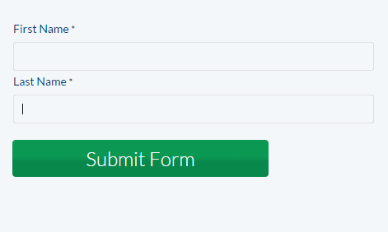
Hidden Elements
JavaScript, jQuery and Ajax
Allows the user to 'interact' with the web page

Slide 22
Server Code
PHP, ASP.Net, C#
Allows the server to do some processing before returning the web page to the browser

Slide 23
Server processes content
Processed content is returned to web server
Server returns the html page
Server returns the html page
User requests a web page
If page requires processing, sent to processing server
Server finds file and reads contents

Slide 24
A web page's construction…

Slide 25
Anatomy of a Web Page
<!DOCTYPE html>
<html lang="en">
<head>
<meta charset="UTF-8">
<title>Document</title>
<script></script>
<style></style>
</head>
<body>
</body>
</html>
What type of page am I?
What language am I written in?
What the rest of the page needs to know about me to function correctly
What the search engine looks for
What am I called?
Do I use scripts to function?
How will I look?
Most of the stuff the visitor sees and interacts with is known as the content, stuff like pictures, videos, Flash, links, forms, etc.
This indicates the end of my content
This is the end of everything

Slide 26
Anatomy of a Web Page
Courtesy: http://www.agenius-marketing.com/websites/web-site-design-anatomy/

Slide 27
Lets have a recap

Slide 28
HTML Code
<!DOCTYPE html>
<html lang="en">
<head>
<meta charset="UTF-8">
<title>Document</title>
</head>
<body>
<div><h1></h1></div>
<div><ul><li></li></ul><div>
<div></div>
</body>
</html>

Slide 29
Hypertext Markup Language (HTML)
HTML stands for Hyper Text Markup Language
HTML describes the structure of Web pages using markup
HTML elements are the building blocks of HTML pages
HTML elements are represented by tags
HTML tags label pieces of content such as "heading", "paragraph", "table", and so on
Browsers do not display the HTML tags, but use them to render the content of the page

Slide 30
Elements
An HTML element usually consists of a start tag and end tag, with the content inserted in between:
<tagname>Content goes here...</tagname>
The HTML element is everything from the start tag to the end tag:
<p>My first paragraph.</p>

Slide 31
Nested Elements
Elements can be nested, i.e. they can contain elements
<ul>
<li></li>
<li></li>
<li></li>
</ul>

Slide 32
HTML Attributes
Attributes provide additional information about HTML elements.
All HTML elements can have attributes
Attributes provide additional information about an element
Attributes are always specified in the start tag
Attributes usually come in name/value pairs like: name="value"

Slide 33
Links
Different types of links:
Navigation
Standard
Image

Slide 34
Navigation Links
Usually ordered in a list

Slide 35
Standard Link
HTML links are defined with the <a> tag. The link address is specified in the href attribute:
<a href="http://gloscol.ac.uk">This is a link</a>
The 'a' is called the anchor tag

Slide 36
Image Links
HTML images are defined with the <img> tag.
The filename of the image source is specified in the src attribute:
<img src="logo.jpg">
Image tags should have an 'alt' attribute in the event the image cannot be displayed, or for people with vision impairment
<img src="logo.jpg" alt = "Gloscol logo">

Slide 37
Attributes
Attribute | Description
alt | Specifies an alternative text for an image, when the image cannot be displayed
disabled | Specifies that an input element should be disabled
href | Specifies the URL (web address) for a link
id | Specifies a unique id for an element
src | Specifies the URL (web address) for an image
style | Specifies an inline CSS style for an element
title | Specifies extra information about an element (displayed as a tool tip)

Slide 38
Headings
Headings are defined with the <h1> to <h6> tags
<h1>Heading 1</h1> <h2>Heading 2</h2> <h3>Heading 3</h3> <h4>Heading 4</h4> <h5>Heading 5</h5> <h6>Heading 6</h6>

Slide 39
<head> Element
The HTML <head> element has nothing to do with HTML headings.
The <head> element is a container for metadata. HTML metadata is data about the HTML document. Metadata is not displayed.
The <head> element is placed between the <html> tag and the <body> tag

Slide 40
Add JavaScript to Web Pages
JavaScript needs to be placed within the script tag
<script> code </script>
Scripts can be placed in the head section

Slide 41
Task
Follow worksheets 2, 3 and 4 on the Wiki

Slide 42
Java
Java is NOT the same as JavaScript
Is a full on Object Oriented Programming language
Example of Code

Slide 43
Day ?
3. Interaction and Compatibility of Code on Different Platforms (25%, K2)
In this topic, learners will gain an understanding of code compatibility on different platforms. The successful Apprentice should be able to:
3.1 Memorise the LAMP (Linux, Apache, MySQL, and PHP) and XAMPP stack. Describe the associated code compatibility with using alternative proprietary web stacks.
3.2 Discuss how the following file formats that can be shared across multiple digital platforms and issues that arise around compatibility:
PDF
HTML
Image (GIF, JPG, PNG)
Video; Mpeg
Audio; MP3
3.3 Describe each stage required to generate or commission code. What considerations will be required to ensure code capability across multiple devices and the associated infrastructure limitations.
Social media platforms feeds (called widgets) used on a new digital solution.
Creating and protecting feeds (using API keys) for use by other organisations.

Slide 44
3.1 - Different Platforms
Two main platforms:
Windows
Linux

Slide 45
Windows
We have a Windows ‘stack’
WAMP
Windows
Apache
MySQL
PHP
Operating system
A web server
Database system
For processing code

Slide 46
Linux
We have a Linux ‘stack’
LAMP
Linux
Apache
MySQL
PHP
Operating system
A web server
Database system
For processing code

Slide 47
Alternatives
MAMP – works on Mac (Apple)
SAMP – works on Sun Microsystems
FAMP – works on FreeBSD
XAMPP – works on any operating system
You need to download the correct version

Slide 48
3.2 - File Formats
All files have a specific format
Types of files
Images
png, jpg, gif, svg, dwg, cdr, psd
Documents
doc, docx, odt, wpd, pdf
Scripts
html, php, sql, py, aspx,
Audio
mpeg, mp3, wav, ogg, flac
Video
avi, flv, mov, mp4, wmv

Slide 49
Portability
Not all files work on all platforms
Some formats are proprietary
Some formats need to die (Flash)

Slide 50
Problems
What happens when you want to play a specific file?

Slide 51
Resources
Video - https://www.motionelements.com/blog/articles/what-you-need-to-know-about-the-5-most-common-video-file-formats
Audio - https://www.toptenreviews.com/software/articles/audio-file-types/
https://www.falmouth.ac.uk/content/6-common-audio-file-types

Slide 52
3.3 - Generating or Commissioning Code
Five main ingredients in the programming process:
Defining the problem
Planning the solution
Coding the program
Testing the program
Documenting the program

Slide 53
The Process

Slide 54
Requirements
The task of defining the problem consists of:
identifying what it is you know (input-given data)
what it is you want to obtain (output-the result)
Eventually, you produce a written agreement that, among other things, specifies the kind of input, processing, and output required
This is not a simple process

Slide 55
Design
Two common ways of planning the solution to a problem are:
draw a flowchart
write pseudocode
or possibly both

Slide 56
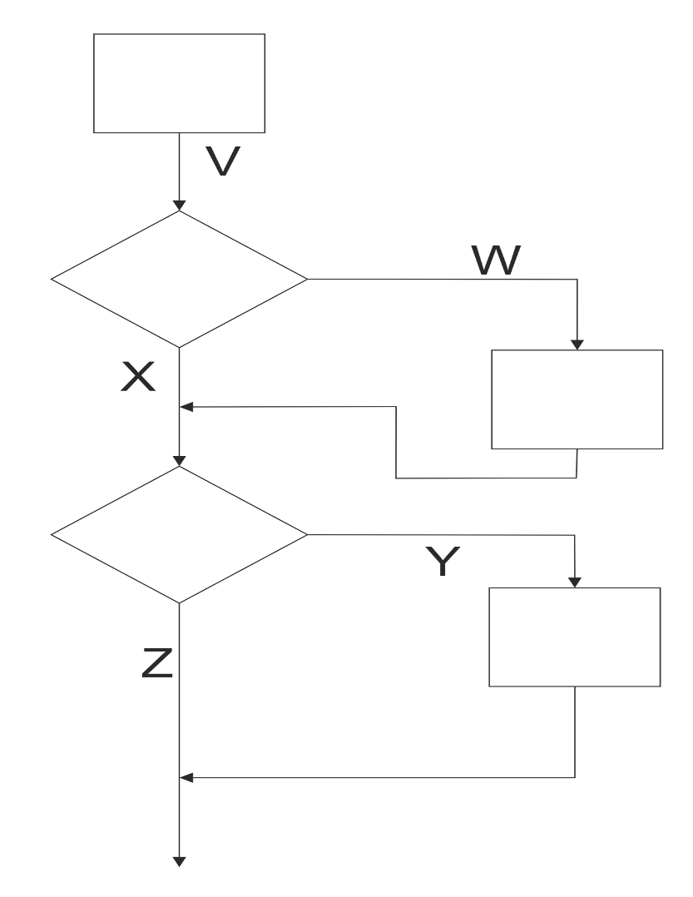
Flowchart

Slide 57
Psuedocode
Get the radius
Is radius larger than 10?
Error message (“Choose smaller radius”)
Calculate area of circle

Slide 58
Implementation
This is where the actual coding is done
Similar to what you did when coding up a web page

Slide 59
Testing
A crucial component of the lifecycle
Not everything can be tested

Slide 60
Maintenance
This is where specific releases are introduced
Could be regulatory, mandatory or functional
Non-functional components could be introduced here

Slide 61
Social media platforms feeds
A Web feed or RSS feed is a format that provides users with frequently updated content
Content distributors syndicate a Web feed, enabling users to subscribe to a site's latest content

Slide 62
API’s
An API is a set of functions and procedures that allow the creation of applications which access the features or data of an operating system, application, or other service
Application Programming Interface

Slide 63
API

Slide 64
API - Example
If you want to capture photos or video from the iPhone’s camera, you don’t have to write your own camera interface
You use the camera API to embed the iPhone’s built-in camera in your app.

