Slide 1
Final pieces
Coding and Logic

Slide 2
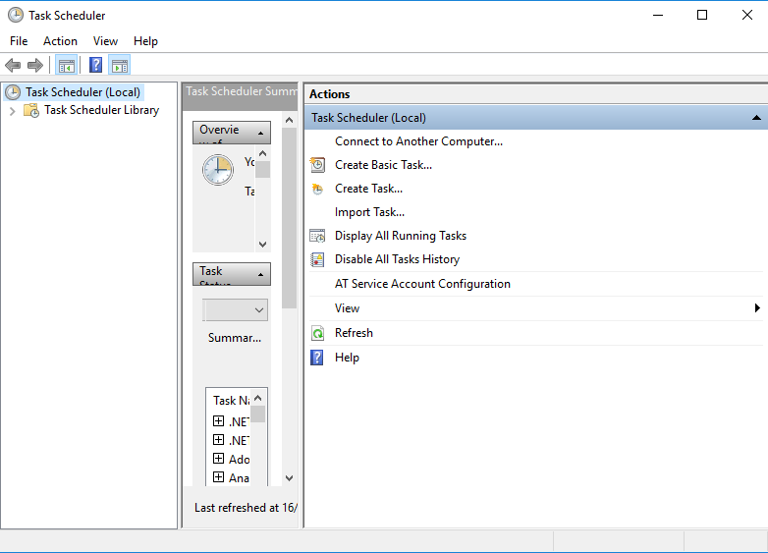
Scheduling - Windows
Start Task Scheduler
Click Create Basic Task
Follow the steps to schedule a one time run of a batch file in 5 minutes time
Make sure it works

Slide 3
Scheduling - Linux
Crontab
The cron utility runs based on commands specified in a cron table: crontab
The crontab command is used to view or edit the cron files
A cron file contains the commands to run a cron job
Example of job definition: .---------------- minute (0 - 59) | .------------- hour (0 - 23) | | .---------- day of month (1 - 31) | | | .------- month (1 - 12) OR jan,feb,mar,apr ... | | | | .---- day of week (0 - 6) (Sunday=0 or 7) OR sun,mon,tue,wed,thu,fri,sat | | | | | * * * * * user-name command to be executed
00 15 * * Thu /usr/local/bin/mycronjob.sh
This line runs mycronjob.sh every Thursday at 3 p.m.

Slide 4
Compression
ZIP is a compress-archive file format that supports lossless data compression
A ZIP file may contain one or more files or directories that may have been compressed
File extension .zip
In Windows
Right click, Send to Compressed (zip) folder
zip.ps1 – a PowerShell zip utility (not built in)
In Linux
gzip normally used to compress just single files
compressed archives are typically created by assembling collections of files into a single tar archive, and then compressing that archive with gzip.
the final .tar.gz or .tgz file is usually called a tarball

Slide 5
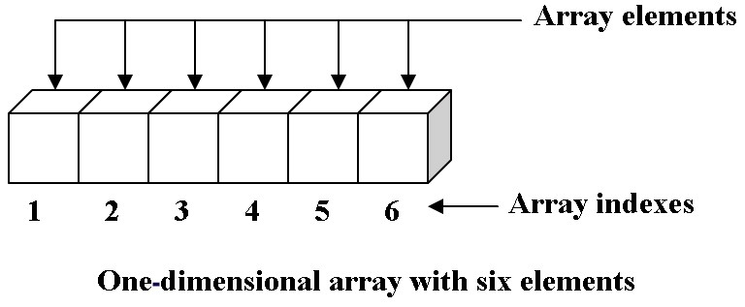
Data types
String - can contain any sequence of characters
Integer – whole numbers
Floating point – decimal numbers
Array - a data structure of the same data type that stores a sequence of consecutively numbered objects
Unix[0]='Debian'
Unix[1]='Red hat'
Unix[2]='Ubuntu'
Unix[3]='Suse'
echo ${Unix[1]}
Red hat

Slide 6
Functions
Used when you need to perform the same commands several times in a script
An example function in bash
#!/bin/bash
# Basic function
print_something () {
echo Hello I am a function
}
print_something
When the function is called it will print Hello I am a function
Functions can receive and return parameters

Slide 7
loops
For
#!/bin/bash
for i in `seq 1 10`;
do
echo $i
done
While
#!/bin/bash
COUNTER=0
while [ $COUNTER -lt 10 ]; do
echo The counter is $COUNTER
let COUNTER=COUNTER+1
done

Slide 8
loops
Until
#!/bin/bash
COUNTER=20
Until [ $COUNTER –lt 10 ]; do
echo COUNTER $COUNTER
let COUNTER-=1
done

Slide 9
Data structures
CSV – comma separated variable
a common data exchange format
plain text
records (typically one record per line),
records divided into fields separated by delimiters: comma, semicolon, or tab
every record has the same sequence of fields
XML
Null

Slide 10
Data structures
XML stands for eXtensible Markup Language
a markup language much like HTML
designed to store and transport data
stores data in plain text format.
It is software- and hardware-independent
<note> <to>Jamie</to> <from>Matt</from> <heading>Question</heading> <body>How do I get this helmet off my head?</body> </note>

Slide 11
Null
A value that indicates there is no value
Not a zero
Not a space

Slide 12
Math
Operation | Linux | Windows (normal) | Windows PS
Equal
Not Equal
Greater than
Less than
+
/
*
-

