Slide 1
PHP: Login

Slide 2
Tasks
We will go through a worked example
You will write your own scripts for the criteria which will be assessed by witness statement

Slide 3
Example
We will create a login page that asks the user to enter a username and password.
If the credentials entered by the user match those hard-coded into the script, a session variable called login will be set to "OK", and the user will be directed to the protected page.
The protected page will check login is "OK",
If it is not OK, the user is redirected to the login screen.

Slide 4
PHP Sessions
A session is the time spent by a user browsing a particular website.
When a session is created, a unique Session ID is set up for the user that is subsequently made available to each page the user visits.
The Session ID is stored in a PHP system variable called PHPSESSID.
This allows information to be shared across pages (it can also be stored in cookies)

Slide 5
Uses for Sessions
When a user starts a shopping cart the items added to the cart could be contained in session data
In our case we will use session data to say if a user is logged in and able to view protected pages

Slide 6
Session Initiation
<?php
session_start();
?>
The session_start() function checks for an existing session. If one is not found, it creates a new session and gives it a Session ID.

Slide 7
Storing a Simple Counter Value
Session information stored in session variables using the $_SESSION array.
A simple counter variable is created for the session and is set to 1
<?php
session_start();
$_SESSION['count'] = 1;
?>

Slide 8
session01.php
Create a folder called login
Place session01.php into it
<?php
session_start();
$_SESSION['count'] = 1;
?>

Slide 9
session01.php
<html>
<head>
<title>Some web page</title>
</head>
<body>
<?php
echo "Counter value = ".$_SESSION['count'];
?>
</body>
</html>

Slide 10
Checking if a Session Exists
To check whether a variable exists and has been assigned use the isset() function
It returns true if the variable has been set (given a value) and false otherwise.
We will use the isset() function to check whether the count variable exists and has been set.
If it has, the code will increment the value of count.
Else, the count variable will be created and set to 1.

Slide 11
session02.php
<?php
session_start();
if(isset($_SESSION['count'])) $_SESSION['count'] = $_SESSION['count'] + 1;
else $_SESSION['count'] = 1;
?>

Slide 12
session02.php
<html>
<head>
<title>Some web page</title>
</head>
<body>
<?php
echo "Counter value = ".$_SESSION['count'];
?>
</body>
</html>

Slide 13
Session Checker
The result is initially the same, but each time the page is refreshed the counter increases by one

Slide 14
Clearing a Session
Clear the contents of a particular session variable using the unset() function
The following script will clear the count variable when it reaches 10
The page will then say the count does not have a value and then start again

Slide 15
session03.php
<?php
session_start();
if(isset($_SESSION['count'])) { $_SESSION['count'] = $_SESSION['count'] + 1; if($_SESSION['count'] > 5) unset($_SESSION['count']);
} else
$_SESSION['count'] = 1;
?>

Slide 16
session03.php
<html>
<head>
<title>Some web page</title>
</head>
<body>
<?php
if(isset($_SESSION['count']))
echo "Counter value = ".$_SESSION['count'];
else echo "The counter does not currently have a value!";
?>
</body>
</html>

Slide 17
Login
For this example the user name and password will be stored in the script
Later we will use multiple user names and passwords stored in a database table

Slide 18
Pages
Login page:
establishes a session and asks the user to enter a username and password.
if the credentials match, a session variable called login will be set to "OK",
the user will be directed to:
Protected page:
checks $_SESSION value is "OK",
if true the user is redirected to the login screen

Slide 19
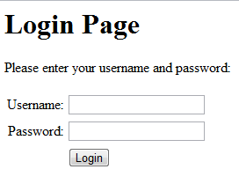
login01.php
Displays a form to enter the user name and password
If they match it calls protected.php
If they are blank or don’t match, it calls itself

Slide 20
login01.php (part 1)
<?php
$user = $_POST["username"];
$pass = $_POST["password"];
$validated = false;
session_start();
if($user!=""&&$pass!="") { if($user=="jsmith"&&$pass=="letmein") $validated = true;
if($validated) {
$_SESSION['login'] = "OK";
$_SESSION['username'] = $user;
$_SESSION['password'] = $pass;
header('Location: protected.php');
}

Slide 21
login01.php (part 2)
else {
$_SESSION['login'] = "";
echo "Invalid username or password.";
}
}
else $_SESSION['login'] = "";
?>

Slide 22
login01.php (part 3)
<html>
<body>
<h1>Login Page</h1>
<p>Please enter your username and password:</p> <form action="login01.php" method="post">
<table> <tr>
<td align="right">Username: </td>
<td>
<input size=\"20\" type="text" size="20" maxlength="15" name="username">
</td> </tr>

Slide 23
login01.php (part 4)
<tr>
<td align="right">Password: </td>
<td>
<input size=\"20\" type="password" size="20" maxlength="15" name="password">
</td>
</tr>
<tr>
<td>
</td>
<td colspan="2" align="left">
<input type="submit" value="Login">
</td>
</tr>
</table>
</form>
</body>
</html>

Slide 24
protected.php (part 1)
<?php
session_start();
if($_SESSION['login'] != "OK") {
header('Location: login01.php');
//Send user back to login page
exit();
}
?>
<html>
<head> <title>Protected Web Page</title>
</head>

Slide 25
protected.php (part 2)
<body>
<h1>Protected Web Page</h1>
<?php
echo "<p>You have successfully logged in!</p>";
echo "<p>Your username is: ";
echo $_SESSION['username'];
echo "<br/>";
echo "Your password is: ";
echo $_SESSION['password'];
echo "</p>"
?>
</body>
</html>

Slide 26
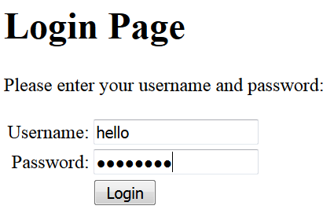
Login Result
If the user name and password are entered incorrectly, then the user is referred back to the login page with a message

Slide 27
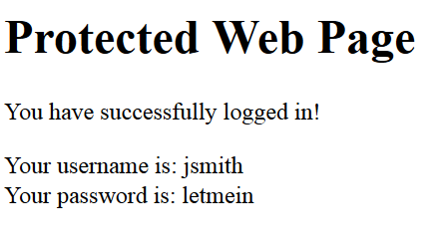
Login Result
If the user name “jsmith” and password “letmein” are entered correctly, then the protected page is displayed
If the protected page is accessed without being logged in, then the login page is displayed

Slide 28
Summary
P4 Implement, test and document a simple login system using web server scripting

Slide 29
Task
Write a simple login system for your BTEC application.
Have this witnessed to meet criteria P4.
Note: You will have to submit code listings to pass the criteria as well as having it witnessed!

Slide 30
Next Time
Creating Database Login pages

