Slide 1
Week 1 – Day 2
Cyber Threats
UFCFFU-30-1

Slide 2
Cyber Threats
Week 1
Intro
Monday
01
02
Tuesday
03
04
Wednesday
05
06
Thursday
Friday

Slide 3
Recap Session

Slide 4
Syllabus – Week 1
Foundations of cyber security, its significance, concepts, threats, vulnerabilities and assurance
Application of cyber security concepts to IT infrastructure
Fundamental building blocks and typical architectures of IT infrastructure
Common vulnerabilities in networks and systems
Vulnerabilities in computer networks, applications and systems (e.g., Insecure coding and unprotected networks) and how they can be exploited

Slide 5
Syllabus – Week 1
Network-based attacks e.g.: Eavesdropping/sniffing, man-in-the-middle, spoofing, session hijacking, denial of service, traffic redirection, routing attacks, traffic analysis
Impact of vulnerabilities in an organisational context
Human dimension of cyber security and adversarial thinking applied to system development
How an employee may enable a successful attack chain without realising it

Slide 6
Week 1 - Tuesday
Fundamental building blocks and typical architectures of IT infrastructure
Common vulnerabilities in networks and systems

Slide 7
Fundamental building blocks and typical architectures of IT infrastructure

Slide 8
Infrastructure Elements Firewalls Routers Switches Hubs Storage Transmission

Slide 9
Firewalls
A network security system that monitors and controls incoming and outgoing network traffic based on predetermined security rules
A firewall typically establishes a barrier between a trusted internal network and untrusted external network, such as the Internet

Slide 10
Firewalls - stateful, stateless and deep packet inspection
Stateful – monitors incoming and outgoing packets and the connection (Transport layer 4)
Was this connection made legitimately?
Significantly better at detecting and identifying unauthorized or forged connections
More useful to corporations more likely subject to cyber attack
Looks at connection data (TCP/UDP) as well as packet headers
Stateless Firewalls contain rules about which traffic to allow or block depending on (Network layer 3)
Source IP,
Destination IP,
Port numbers,
Network Protocols
Have no knowledge of whether the connection was initiated by the client
Faster than stateful as only looks at the packet header

Slide 11
Firewalls - stateful, stateless and deep packet inspection
Stateful
# Generic rule to allow clients to connect to any
# webserver on the internet
Allow traffic going out to port 80
Allow traffic related to connections initiated by any internal client back to the same client
Deny any other traffic coming in to the client.
Stateless
Allow traffic going out to port 80 on www.example.com
Allow traffic coming from host www.example.com and port 80
Deny any other traffic coming in to the client

Slide 12
Firewalls - stateful, stateless and deep packet inspection
Deep packet inspection (DPI)
Firewalls cannot distinguish between permissible and forbidden data traffic between legitimate application
DPI looks at the the packet for:
virus signatures
worms
payload pattern matching
payload size
port numbers
IP matching
Can block, reroute or log infractions

Slide 13
Activity – 15Mins
Individually, find out about Virus Signatures and what they look like
We’ll discuss your finding and any observations as a group

Slide 14
Intrusion detection systems (IDS)
A device or software to monitor a network for malicious activity or policy violations
Events can be reported to administrators or collected in an event management system
Differs from a firewall as it monitors internal events
Works by inspecting network traffic and looking for:
known patterns (signature based)
deviations from regular activity (anomaly based)

Slide 15
Intrusion prevention systems (IPS)
Incorporates an IDS, but as an inline device so that it can attempt to block or stop malicious activity
An IPS can:
sending an alarm,
drop detected malicious packets
reset a connection
block traffic from an offending IP address
correct cyclic redundancy check (CRC) errors
defragment packet streams
mitigate TCP sequencing issues

Slide 16
Activity – 15Mins
Find out more about CRC errors
and…
How the correction takes place?
We’ll discuss your finding and any observations as a group
Notes:
Resources & Notes:

Slide 17
Honeypot
A computer used to detect, deflect or counteract unauthorised use
Replicates legitimate parts of an IT system to attract and fool attackers
Production honeypots used by corporations as security devices
Research honeypots used to gather information and develop countermeasures
Spam honeypot
Catches open relay test messages from spammers
Returns the email to the spammer, but blocks all subsequent emails from the spammer
Notifies spammer’s ISP

Slide 18
Routers
A router is a device that analyzes the contents of data packets transmitted within a network or to another network
Routers determine whether the source and destination are on the same network
It can also determine whether data must be transferred from one network type to another, which requires encapsulating the data packet with routing protocol header information for the new network type

Slide 19
Router
Forwards data packets between computer networks
Connected to two or more data lines (Ethernet, WAN etc) from different networks
Reads the network (IP) address information in the packet to determine the ultimate destination
Uses information in its routing table or routing policy to direct the packet to the next network on its journey
Is a layer 3 (network) device

Slide 20
Hops
A hop occurs each time packets are passed to the next network device
The “hop count” is the number of intermediate devices the packet has to pass through from source to destination
The “hop count” can be used as a metric by routing protocols to determine the optimum path for a packet

Slide 21
Routing table
Contains the destination subnet
The metric (indicates best path)
Next hop or gateway
In the example (for a home router)
0.0.0.0 is for an address not found in the table
127.0.0.0 is localhost
Default gateway is 192.168.0.1 and reached through the local network card 192.168.0.100
Network Destination | Netmask | Gateway | Interface | Metric
0.0.0.0 | 0.0.0.0 | 192.168.0.1 | 192.168.0.100 | 10
127.0.0.0 | 255.0.0.0 | 127.0.0.1 | 127.0.0.1 | 1
192.168.0.0 | 255.255.255.0 | 192.168.0.100 | 192.168.0.100 | 10
192.168.0.100 | 255.255.255.255 | 127.0.0.1 | 127.0.0.1 | 10
192.168.0.1 | 255.255.255.255 | 192.168.0.100 | 192.168.0.100 | 10

Slide 22
Routing protocols
Used by routers to exchange information about routes between network nodes
Routing algorithms determine the choice of routes directly attached to router
This information is then shared, such that routers gain knowledge of the network topology
The results are stored as a metric in the routing table
Routing Information Protocol (RIP) counts hop (maximum 15)
Open Shortest Path First (OSPF) measures the cost – bandwidth, delay and load

Slide 23
Static routing
The network administrator adds entries in the routing table
Used for:
For a default node when no other nodes are available
In a small network with only one or two routes
As a backup if dynamic routing is not available
Good for:
Full control over the network
Very little CPU load and no traffic to other routers
Problems:
Human error
Not fault tolerant if a route becomes unavailable

Slide 24
Dynamic routing
The entries in the routing table are made by the routing protocols
Entries are updated according to the conditions of the network
Failing nodes can be routed around
The paths can be adjusted based on traffic load, delays
Traffic can be switched to idle paths

Slide 25
Routers

Slide 26
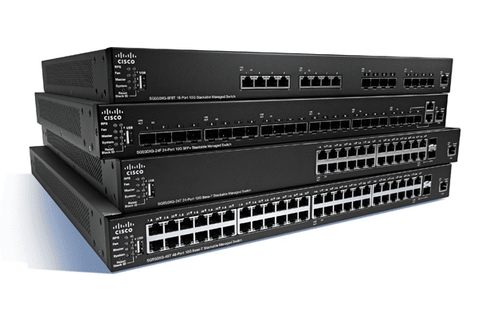
Switches
A network switch is a central communication device for local area Ethernet networks
Also called switching hub, bridging hub, officially MAC bridge

Slide 27
Switches – layer 2
Transports data on the data link layer
Operates on MAC addresses
Creates a LAN
Removes the collision domain
All ports are in a broadcast domain

Slide 28
Switches – layer 3
Inspect the incoming/outgoing network traffic – IP addressing (network layer 3)
Support of all major routing protocols and most of the routing of data/traffic to the next hop/router
Include switching abilities, and can forward data according to a device's physical address (layer 2)
Uses hardware routing, whereas typical routers use software routing
Use of hardware leads to higher performance
Very useful for VLANs

Slide 29
Switches – Layer 3

Slide 30
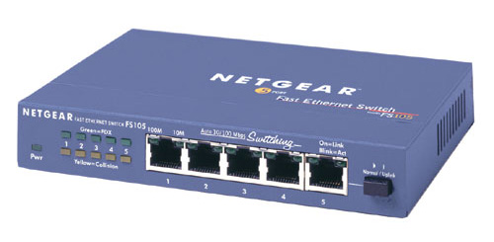
Hubs
Still in use but not used in the business world as switches have better performance
A hub is the most basic networking device that connects multiple computers or other network devices together
Unlike a network switch or router, a network hub has no routing tables or intelligence on where to send information
Broadcasts all network data across each connection!

Slide 31
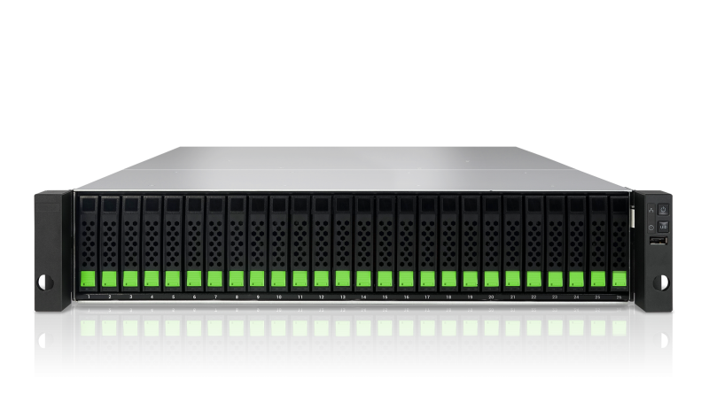
Storage
Network-Attached Storage (NAS) is a file-level computer data storage server connected to a computer network providing data access to a heterogeneous group of clients
NAS is specialized for serving files either by its hardware, software, or configuration

Slide 32
Transmission
Data transmission is the process of sending digital or analogue data over a communication medium to one or more computing, network, communication or electronic devices
It enables the transfer and communication of devices in a point-to-point, point-to-multipoint and multipoint-to-multipoint environment

Slide 33
Common vulnerabilities in networks, systems and applications
Missing data encryption
OS command injection
SQL injection
Buffer overflow
Missing authentication for critical function
Missing authorization
Unrestricted upload of dangerous file types
Reliance on untrusted inputs in a security decision
Cross-site scripting and forgery
Download of codes without integrity checks
Use of broken algorithms
URL redirection to untrusted sites
Path traversal
Bugs
Weak passwords
Software that is already infected with virus

Slide 34
Activity – 45Mins
Choose 5 Vulnerabilities
and…
Find out more about each of them
We’ll discuss your finding and any observations as a group

Slide 35
How to Detect and Prevent Network Vulnerabilities
Organisations Employee and Client data is important for so many reasons
User software and services for transferring large data sets can find weaknesses in IT Infrastructure
Important to stay actively monitor network traffic
Prevention includes:
Monitoring bandwidth
Blocking users from visiting unsafe sites
Filtering internet activity
Setting white lists and black lists
Applying bandwidth checks

Slide 36
Cyber Threats
Week 1
Intro
Monday
01
02
Tuesday
03
04
Wednesday
05
06
Thursday
Friday

Slide 37
Recap Session (15 Mins)
Xxx
Xxx
Xxx
Xxx
Xxx

Slide 38
If you see a slide with this background…
Recap Session

Slide 39
If you see a slide with this background…
Exercises & Labs =

Slide 40
If you see a slide with this background…
Important Information =

