Slide 1
Configure

Slide 2
Revision document
Look through the slides in this section.
Not down how to do key elements of customization in windows.
When we are next in college we will spend a hour going through these and you will need to be ready on how to do them.
Take this time to familiarise yourself with the settings and options ready.

Slide 3
Configure Windows Desktop
Customize Windows 10 Start
Configure the Actin Centre taskbar

Slide 4
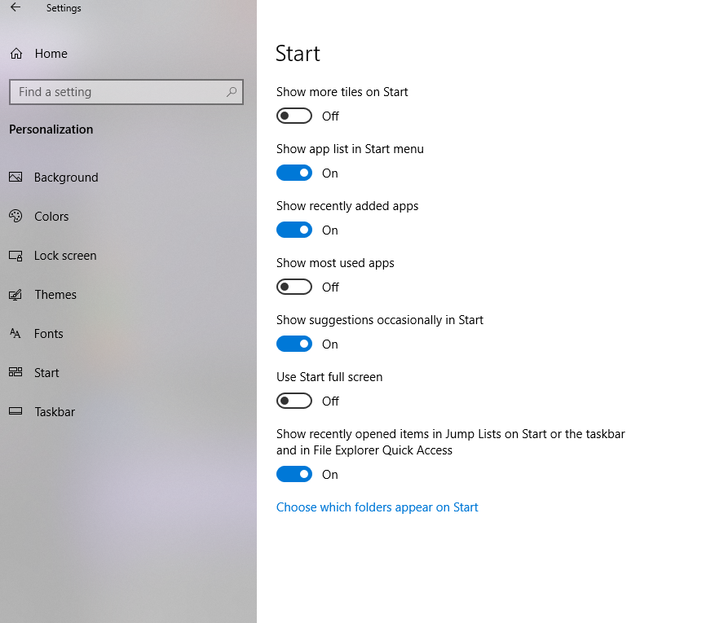
Customize Windows 10 Start
You can change the start menu behaviour via the settings app, go to personalisation then click the start tab then you can change the start menu settings.

Slide 5
Windows 10 start settings
Go though each setting in the previous slide and create a document that will be useful for revision later.
Take note of each of these settings:
Show more tiles on start
Show app list in start menu
Show recently added apps
Show most used apps
Show suggestions occasionally in start
Use start full screen
Show recently opened items in jump lists on start or the taskbar
Choose which folder appear on start

Slide 6
Windows 10 Start layout
You can export out start layouts in 2 modes
Full start layout
Partial start layout
The start layout is exported out as a .xml file it can then be deployed via:
Group policy
Windows Configuration designer provisioning package
Mobile device management (MDM)

Slide 7
Windows 10 start layout
You can customise the layout prior to exporting the layout this can include:
Pin apps to start
Unpin the apps you don’t want to display
Drag the tiles on the start to reorder or group apps
Resize tiles
Create your own app groups
Name groups
Once you have a desired layout you can export your settings

Slide 8
Windows 10 start layout
Open up powershell
Run this:
Export-StartLayout –path <path><file name>.xml
Transfer the file to the shared network folder of StartMenus
Download a random start menu and import it in via Group policy
User Configuration\Policies\Administrative Templates\Start Menu And Taskbar folder and open the Start Layout GPO.
Enter the full folder and name of the xml file to your Policy \\Wbl-digi\iso\...

Slide 9
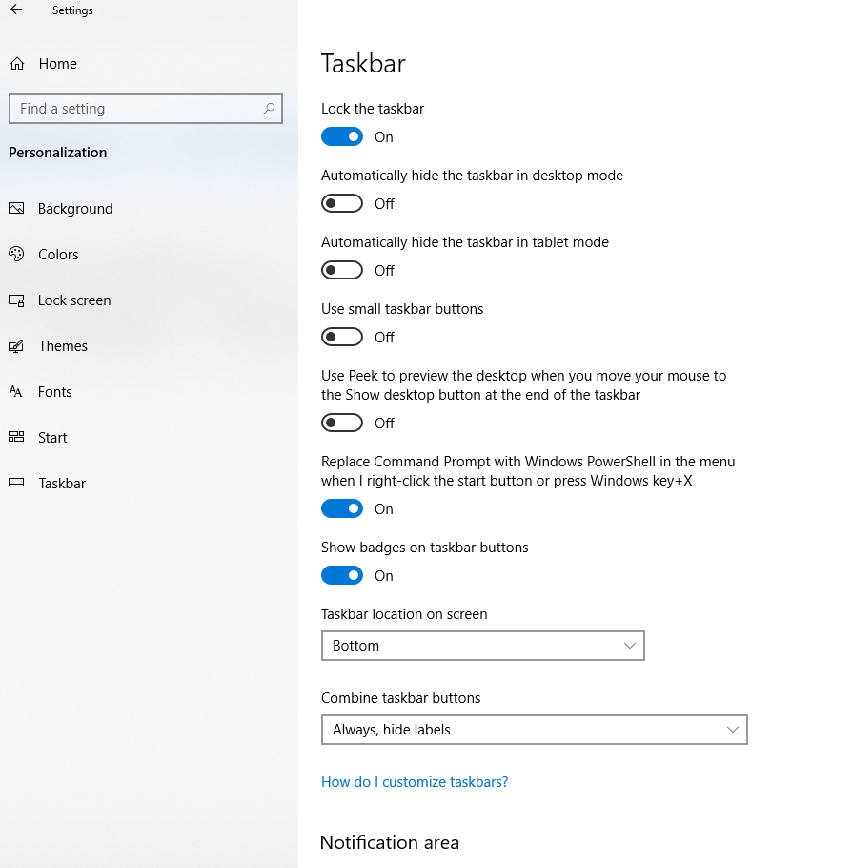
Windows 10 Desktop
Change the Windows 10 desktop via:
Start > Settings > Personalization

Slide 10
Multiple Desktops
Windows 10 has support for multiple desktops, this allows for easier multitasking and can be sued to separate work and leisure apps
Access this by pressing the windows key + Tab or the task view button

Slide 11
Windows 10 Action Centre
The Windows 10 Action Centre can be accessed by swiping right on touch screen devices or by clicking the notification icon bottom right of the screen.
Action centre has:
Quick Action Tiles
Notification area

Slide 12
Configure the quick action tiles
Tablet Mode – Switch from table to desktop mode
Rotation lock – Enable or disable rotation lock, normally the device should auto rotate
Airplane mode – disable all internal radios in the device
All settings – provides a shortcut to settings
Connect – Find and connect to media servers, includes Xbox and other devices running windows
Project – link your device to an external monitor or wireless display
Battery saver – only available when the device is running low on battery
VPN – switches to the VPN tab in the network settings

Slide 13
Configure the quick action tiles
Bluetooth - Enable or disable the Bluetooth radio.
Brightness - Enables you to control display brightness. Click this tile to step through brightness levels in 25 percent increments.
Wi-Fi - Enables or disables the Wi-Fi connection.
Focus Assist - (Called Quiet Hours in earlier versions of Windows 10) allows you to avoid distracting notifications when you need to stay focused by reducing the notifications you receive.
Night Light - Toggles your display to remove white light. You can configure Night Light in the Settings app.
Location - Enables or disables location services. Many services use location to customize services, such as mapping apps, for your device.

Slide 14
Configure the quick action tiles
Change the settings yourself and get familiar with how you do this.
Go to settings then System and configure the notification and actions centre
Record the steps and put this in your document – questions about these might pop up

Slide 15
Windows Taskbar
You can modify the taskbar via right clicking it and going to taskbar settings
You can also do this in the XML file by adding <TaskbarLayout>
You can specify the apps by using the Application User Model ID
Or desktop application path (the local application path)

Slide 16
Windows Taskbar
<CustomTaskbarLayoutCollection>
Enter the AUMID
Add: xmlns:taskbar=“http://schemas.microsoft.com/Start/2014/TaskbarLayo ut” to the first line of the file, before the closing >.
Use <taskbar:UWA> and AUMID to pin Universal Windows Platform apps.
Use <taskbar:DesktopApp> and the Desktop Application Link Path to pin desktop applications.
Get this working and document the process and save the Xml file someplace safe for revision later (Microsoft like scripts)

Slide 17
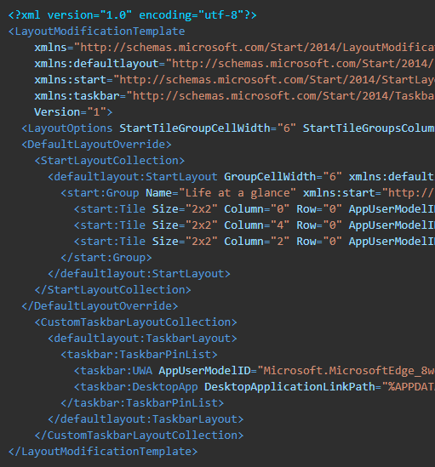
Windows Taskbar

Slide 18
Microsoft Edge
Default web browser in Windows 10
Offers these feature that Internet explorer can not:
Reading Mode
Kiosk Mode – Full screen mode for public use or digital signage
The Hub in Microsoft edge offers:
Favourites
Reading List
Books
Extensions
History
Downloads
Web Notes, which enable you to use tools to make notes, draw, write, and highlight webpages.

Slide 19
Microsoft Edge
Go through all the settings you can change and give a detailed description of where the setting is and what it does. And add these to your revision document.
Edge takes up about 5% of the exam
Firstly list the main settings you have from the (…) in Microsoft edge
Give a sentence on what each setting does. E.g.
History – opens your webpage history

Slide 20
Microsoft Edge
Add what settings there are and what they do in the More Tools section
From the Settings Cog at the bottom of the window, you can access four submenus: General, Privacy and Security, Passwords and Autofill, and Advanced:
Add what each of these sections has like you have before to your revision document

Slide 21
Microsoft Edge
As mentioned, there is a Kiosk mode in Edge
Learn how to configure accounts and Edge through your local group policy to get this working.
Document the steps to get Kiosk mode with Microsoft edge working for your revision document

Slide 22
Internet explorer 11
List and document the settings in each area of IE11
These areas are:
General
Security
Privacy
Content
Connections
Programmes
Advanced
You can configure IE11 through GPO however there are around 1600 options
Computer Configuration\Policies\Administrative Templates\Windows Components\Internet Explorer node.

Slide 23
Configure mobility settings
This section will cover how to:
Configure basic power options
Configure power plans
Configure presentation settings

Slide 24
Configure basic power settings
On the Power & Sleep tab, you can configure the following options.
Screen Available options are
On Battery Power, Turn Off After
Select a value or choose Never.
When Plugged In, Turn Off After
Select a value or choose Never.
Sleep Available options are
On Battery Power, PC Goes To Sleep After Select a value or choose Never.
When Plugged In, PC Goes To Sleep After Select a value or choose Never.
Network Connection Available options are
When My PC Is Is Asleep And On Battery Power, Disconnect From The Network Select Always, Managed By Windows, or Never.

Slide 25
Power Plans
Plan | Power Consumption | Screen | System Activity
Power Saver | Low | By default, the display is powered off after five minutes of inactivity | Saves energy by reducing system performance whenever possible
Balanced | Medium | You can configure the plan to turn off the display after a specified amount of time | Measures computer activity and continues to use full power to all system components currently in use
High Performance | High | This sets the screen to 100% brightness | Keeps the computer’s drives, memory, and processors continuously supplied with power
Ultimate Performance | High | This sets the screen to 100% brightness | Keeps the computer’s drives, memory, and processors continuously supplied with power Forces processor state to be 100% Not available on battery powered devices

Slide 26
Power configuration
Use Powercfg.exe /?
Note down each of these commands and document what they do along side a screenshot in your document.
If some of them are not working because of a battery or lack of, complete some of these at work over next week.

