Slide 1
Week 1

Slide 2
Day 1 & 2
Introduction
Programming Languages
Build a website

Slide 3
BCS Level 3 Award in Principles of Coding
QAN 603/0762/6

Slide 4
Introduction
Hi
Emma Littlefair –Lead for Software Digital Apprenticeships
In the computing field for over 20 years
emma.littlefair@gloscol.ac.uk

Slide 5
Where to find stuff
Wiki – gloscolapprenticeships.co.uk/appWiki/doku.php
You will need a password to access certain areas:
Username: ApprenticE
Password: ApprenticE
Email: emma.littlefair@gloscol.ac.uk

Slide 6
Syllabus
Completed over two weeks
Appreciation of Logic (10%, K2)
Programming Languages (10%, K1)
Interaction and Compatibility of Code on Different Platforms (25%, K2)
Web components (55%, K2)

Slide 7
Week 1
2.Web components (55%, K2)
4.Programming Languages (10%, K1)

Slide 8
Week 2
Interaction and Compatibility of Code on Different Platforms including web recap (25%, K2)
Appreciation of Logic (10%, K2)

Slide 9
2. Programming Languages (10%, K1)
In this topic, learners will become aware of programming languages and how they apply in building digital products. The successful Apprentice should be able to:
2.1 Identify the key characteristics and applications of the following programming languages:
Hypertext Markup Language (HTML)
JavaScript (JS)
Java

Slide 10
Hypertext Markup Language (HTML)
HTML stands for Hyper Text Markup Language
HTML describes the structure of Web pages using markup
HTML elements are the building blocks of HTML pages
HTML elements are represented by tags
HTML tags label pieces of content such as "heading", "paragraph", "table", and so on
Browsers do not display the HTML tags, but use them to render the content of the page

Slide 11
Example
<!DOCTYPE html>
<html lang="en">
<head>
<meta charset="UTF-8">
<meta name="viewport" content="width=device-width, initial-scale=1.0">
<title>Welcome</title>
</head>
<body>
<h1>
Welcome
</h1>
<p>If you can see this, you have successfully found Kristen's website</p>
</body>
</html>

Slide 12
JavaScript (JS)
JavaScript is used to provide interactive features to a web page
It is a dynamic programming language
It adds behaviour to your web page
It is embedded within the HTML code
Some things we can do the in JavaScript:
Form validation
Calculations
Animations
Load images

Slide 13
JavaScript (JS)
JavaScript is a scripting or programming language that allows you to implement complex features on web pages
Displays timely content updates, interactive maps, animated 2D/3D graphics, scrolling video jukeboxes, etc. — you can bet that JavaScript is probably involved
Runs in the browser

Slide 14
Java
Java is NOT the same as JavaScript
Is a full on Object Oriented Programming language

Slide 15
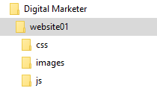
Create a folder on your computer called Digital Marketer
Open it and add another folder called website01
Within the website01 folder add three more folders as per the image below

Slide 16
A webpage – A HTML Basic Document
Start HTML
<html>
<head>
<title>Document name goes here</title>
</head>
<body>
Visible text goes here
</body>
</html>
Header information
Page information
Notes:
http://www.w3schools.com/html/html_elements.asp

Slide 17
HTML tags
Tag | Description | Nested in
<html></html> | Start of HTML section | N/A
<head></head> | Document header. Includes information about the document. | <html></html>
<title></title> | Displays a title in the Browsers title bar. Identifies the web content | <head></head>
<body></body> | Main body of the HTML document. Contains the websites content | <html></html>
<b></b> | Bold formatter | <body></body>
<p></p> | Paragraph of text. Add extra lines before and after paragraph. | <body></body>
<br> | Single carriage return | <body></body>
<h1></h1> | Heading style (largest heading) | <body></body>
<h6></h6> | Heading style (smallest heading) | <body></body>
<i></i> | Defines italic text | <body></body>
HTML tags normally come in pairs

Slide 18
Notepad
Create your first webpage using Notepad
The body text should include your name in bold
Save the file as "mypage.html".
Press F12 to preview in browser

Slide 19
W3C rules
HTML not case sensitive
W3C recommend lowercase
Tags should have closing tags
<p></p>
<br />

Slide 20
HTML Basic Formatting
<html>
<head>
<title>Document name goes here</title>
</head>
<body>
<b>My first Webpage</b> by Joe Blogs
</body>
</html>
Add Italic here
Add Bold
Notes:
http://www.w3schools.com/html/html_elements.asp

Slide 21
Headings
Headings are defined with the <h1> to <h6> tags.
<h1>This is a large heading</h1>
<h2>This is a heading</h2>
<h3>This is a heading</h3>
<h4>This is a heading</h4>
<h5>This is a heading</h5>
<h6>This is a small heading</h6>
HTML automatically adds an extra blank line before and after a heading.

Slide 22
HTML Basic Formatting
<html>
<head>
<title>Document name goes here</title>
</head>
<body>
<h1>This is a large heading</h1>
<h2>This is a heading</h2>
<h3>This is a heading</h3>
<h4>This is a heading</h4>
<h5>This is a heading</h5>
<h6>This is a small heading</h6>
</body>
</html>
Notes:
http://www.w3schools.com/html/html_elements.asp

Slide 23
HTML Basic Paragraphing
<html>
<head>
<title>Document name goes here</title>
</head>
<body>
<hr>
<p>Paragraphs have a blank space before and after the text</p>
<p>This is useful to distinguish section of text</p>
<b>Sometimes extra <i>line breaks</i> are not needed</b>
<br />A simple <i>Line Break</i> can be used here
<br />Note it does not need a closing tag
</body>
</html>
Notes:
http://www.w3schools.com/html/html_elements.asp

Slide 24
Tags and Attributes
Some tags can have extra parameters (attributes)
An attribute provides extra formatting functionality
Not all tags allow attributes
<tag attribute=“parameter”></tag>

Slide 25
Alignment (Horizontal)
Alignment defines the positioning of text
<html>
<head>
<title>Document name goes here</title>
</head>
<body>
<h1 align=‘center’>This is a large heading</h1>
<h2 align=‘left’>This is an h2 heading</h2>
<h3 align=‘right’>This is an h3 heading</h3>
<h4 align=‘justify’ >This is an h4 heading</h4>
</body>
</html>

Slide 26
Paragraph alignment
<p align=“center”></p>

Slide 27
Background attribute
Defining a background colour in the body tag
<body bgcolor=‘#000000’> (This is deprecated)
<body bgcolor=‘rgb(0,0,0)’>
<body bgcolor=‘black’>
Defining a background image
<body background="www.images.com/clouds.gif">
Note W3C has deprecated bgcolor, background attribute in latest versions of HTML (HTML 4 and XHTML) – use CSS instead.

Slide 28
Colours
256 * 256 * 256 = 16 777 216
Colour | Colour HEX | Colour RGB
 | #000000 | rgb(0,0,0)
 | #FF0000 | rgb(255,0,0)
 | #00FF00 | rgb(0,255,0)
 | #0000FF | rgb(0,0,255)
 | #FFFF00 | rgb(255,255,0)
 | #00FFFF | rgb(0,255,255)
 | #FF00FF | rgb(255,0,255)
 | #C0C0C0 | rgb(192,192,192)
 | #FFFFFF | rgb(255,255,255)
http://www.computerhope.com/htmcolor.htm
Notes:
http://www.w3schools.com/html/html_colors.asp
Initially web sites could only use web safe colours. These were 216 colours for VGA displays. With x11 came the opportunity to expand into 16 bit (high colour) and 24 bit (True Colour). Each hex value corresponds to the red, green and blue shades. Can use a shortcut if the values are similar, e.g. #C0C0C0 can be represented as #C0.

Slide 29
Font tag
Format font
<font face="Verdana">text</font>
Format font and size (size is 0-7, not scaled in points)
<font size="2" face="Verdana">text</font>
Format colour
<font color="#c0c0c0">text</font>
Note W3C has deprecated the font attribute in latest versions of HTML (HTML 4 and XHTML).– use CSS instead.
Notes:
W3C has deprecated font attribute in latest versions of HTML (HTML 4 and XHTML) – use CSS instead.

Slide 30
DIV tag
Generic block element
Facilitates styling attributes
Heavily used in CSS
<div></div>

Slide 31
DIV examples
<div
align="center“ style="color:#FF0000; " class="menu">
</div>
We will comeback to this in CSS !

Slide 32
Positioning content
Only three ways available to position content
Left Centre Right
Tables provide more flexibility for arranging items on page
HOWEVER NOT ideal

Slide 33
Task - Tables
Change this number
<table border="1">
<tr>
<td>row 1, cell 1</td>
<td>row 1, cell 2</td>
</tr>
<tr>
<td>row 2, cell 1</td>
<td>row 2, cell 2</td>
</tr>
</table>
row 1, cell 1
row 1, cell 2
row 2, cell 1
row 2, cell 2
Table>(tr>(td*2)) *2

Slide 34
Task - Tables
Add a preceding row for column headings
Heading A
Heading B
row 1, cell 1
row 1, cell 2
row 2, cell 1
row 2, cell 2
Optionally, use the heading tag <th></th> tag instead of <td></td> for heading cells

Slide 35
Sizing Cells
Cells can have specific sizes by defining the
Height
Width
Browsers use the sizing units:
Percentage of screen width (%)
Pixels (width & height)

Slide 36
Sizing Cells
300px
75%
25%
Heading A
Heading B
row 1, cell 1
row 1,
cell 2
row 2, cell 1
row 2,
cell 2

Slide 37
Task – Sizing table
<table border="1" width="300">
<tr>
<th>Heading A</th>
<th>Heading B</th>
</tr>
<tr>
<td>row 1, cell 1</td>
<td>row 1, cell 2</td>
</tr>
<tr>
<td>row 2, cell 1</td>
<td>row 2, cell 2</td>
</tr>
</table>
Change to 50%

Slide 38
Task – Sizing Cells
<table border="1" width="300">
<tr>
<th width="25%">Heading A</th>
<th width="75%">Heading B</th>
</tr>
<tr>
<td>row 1, cell 1</td>
<td>row 1, cell 2</td>
</tr>
<tr>
<td>row 2, cell 1</td>
<td>row 2, cell 2</td>
</tr>
</table>
Heading
A
Heading B
row 1, cell 1
row 1, cell 2
row 2, cell 1
row 2, cell 2
25%
75%

Slide 39
Merging Cells
Merging allows several cells to become one
Merge Rows
Merge Columns
Merged Cell
row 1, cell 1
row 1, cell 2
row 2, cell 1
row 2, cell 2

Slide 40
Task – Merged Columns
<table border="1" width="75%">
<tr>
<th colspan="2">Merged Cell</th>
</tr>
<tr>
<td width="25%">row 1, cell 1</td>
<td width="75%">row 1, cell 2</td>
</tr>
<tr>
<td>row 2, cell 1</td>
<td>row 2, cell 2</td>
</tr>
</table>
Merged Cell
row 1, cell 1
row 1, cell 2
row 2, cell 1
row 2, cell 2

Slide 41
Task – Merged Rows
75% of screen width
<table border="1" width="75%">
<tr>
<th colspan="2">Merged Cell</th>
</tr>
<tr>
<td width="25%"> row 1, cell 1</td>
<td rowspan="2" width="50%">Merged Rows</td>
</tr>
<tr>
<td>row 2, cell 1</td>
</tr>
</table>
Merged Cell
row 1, cell 1
Merged Rows
row 2, cell 1
50% of table width

Slide 42
Cell colours
Change the entire table to red
<table bgcolor="#FF0000“>
Change the row to red
<tr bgcolor="#FF0000“>
Change a cell to red
<td bgcolor="#FF0000“>

Slide 43
Tables and Images
To insert an image into a document use
<img src="url">
<img src="file:///c:/ski.gif">
Insert an image into the tables
Resize image using the width and height parameters
<img src="url" width="105" height="89“ >
Alt attribute. Display text if browser fails to display image
<img src="url" alt="Big Boat“>

Slide 44
Task – Simple table
Publish the following sales on the companies website
Use tables and Notepad

Slide 45
Inserting Hyperlinks
The HTML <a> tag defines a hyperlink. It has the following syntax:
<a href="url">link text</a>
The most important attribute of the <a> element is the href attribute, which indicates the link's destination.
The link text is the part that will be visible to the reader.
Clicking on the link text, will send the reader to the specified URL address.
Examples
This example shows how to create a link to W3Schools.com:
<a href="https://www.w3schools.com/">Visit W3Schools.com!</a>
You can also link to internal pages
<a href=“homepage.html”>Home</a>
Add an external link to you practice page !

Slide 46
Lets pull all the skills together Practical Task – Click on website task Mindfulness

Slide 47
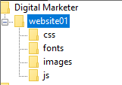
Your Files
Open up the wellbeing powerpoint to see what we are building today
Add the necessary images and tags to make the files display nicely
Open up the word document and copy the text
Copy any of the images on the wiki digital marketing page
Add the necessary images and tags to make the files display nicely
Visit W3C schools for additional tags
Your pictures are in here
Your index.html file is in here

Slide 48
CSS

Slide 49
Objectives
Understand:
Basic CSS features
Implementing CSS

Slide 50
Online resources
http://www.w3schools.com/css/

Slide 51
What is CSS
CSS stands for Cascading Style Sheets
CSS
Applies styles to a document
Styles define how to display HTML elements
Easy to update an entire webpage and website
Control the layout of multiple pages at once
Expandability
Improved formatting

Slide 52
Why not still use HTML
HTML was originally used to define context
Netscape and Internet Explorer evolved HTML
Difficult to separate context from presentation
HTML is limited for presentation techniques
Organisation is limited to table structure

Slide 53
Implementing CSS
CSS attributes can be placed either:
Inline – CSS code mixed into the HTML code
Internal/embedded – CSS code is within a HTML document
External (linked) - a separate imported CSS file

Slide 54
Inline
CSS code mixed into the HTML code
Simple to update CSS
Useful to override some other style definition by embedded or external CSS
Simple changes have to be reciprocated through each occurrence
<p style="color: sienna; margin-left: 20px">This is a paragraph</p>

Slide 55
Internal/embedded
CSS code is within a HTML document
No separate file
Written as part of the <head> tag
Only affects one page
<html>
<head>
<style type="text/css">
hr {color: blue}
p {margin-left: 20px}
</style>
</head>
<body>
<p>My paragraph</p>
</body>
</html>

Slide 56
External
A separate imported CSS file
One change modifies all pages
Most powerful type of style sheet
Single style sheet formats many pages
CSS file
Home webpage
Contact webpage
Products webpage
Notes:
0

Slide 57
Cascading Order
Styles can be implemented in multiple places – external, internal, inline
Which style will take priority?
Browser default (highest priority)
External style sheet
Internal style sheet (inside the <head> tag)
Inline style (inside an HTML element) (NEXT Highest priority)
Inline will override all other CSS styles

Slide 58
CSS selector implementation
Type
Redefine all instances of a specific HTML tag
Class
Redefine specific HTML tags that contain this attribute
Greater flexibility over styles
More combination of styles per HTML tag
ID
Creating your own specific styling
Defines a specific element
Unique ID names
syntax

Slide 59
CSS Selector Syntax
selector {property: value}
Selector - relates to the HTML tag to be defined
Property – attribute to change
Value – new attributes value
Declaration
p {font-family: "Arial";}
Selector
Property
Value

Slide 60
Type selector format
p {font-family: "sans serif";}
p {text-align:center; color:red;}
p {
text-align: center;
color: black;
font-family: "arial";
}
Better code formatting

Slide 61
Type selector in use
p {font-family: "Comic"; color: blue;}
</head>
<body>
<p>This text will have the CSS attributes applied</p>
<p>This text will also be formatted using CSS</p>
</body>

Slide 62
Class selector in use
p.smallprint {font-family: "Comic"; font-size: 10px;}
p.mainprint {font-family: "Arial"; font-size: 16px;}
</head>
<body>
<p>this text will have no CSS formatting applied</p>
<p class= "smallprint">text will be formatted using class selector</p>
<p class= "mainprint">text formatted differently</p>
</body>

Slide 63
TASK External CSS file – Lets create it !!!!
CSS file – "mystyle.css"
p {font-family: "Comic"; color: blue;}
Home webpage
<head>
<link rel="stylesheet" type="text/css" href="mystyle.css" />
</head>
<body>
<p>this text will have the CSS attributes applied</p>
<p>this text will also be formatted using CSS</p>
</body>

Slide 64
Grouped elements
Many tags can be grouped to minimise coding
h1,h2,h3,b,p
{
color: green;
}
Heading tags 1-3, bold and paragraph all coloured green

Slide 65
CSS background
body {
background-image: url(Images/bg.jpg);
background-repeat: repeat-x;
background-color: #FFFFFF;
}
Notes:
http://www.w3schools.com/css/tryit.asp?filename=trycss_background-repeaty

Slide 66
Wellness website
Lets practice all these skills with the wellness slides
We are going to add more pages and create and external css page
Open up Mindfulness part 2 powerpoint

Slide 67
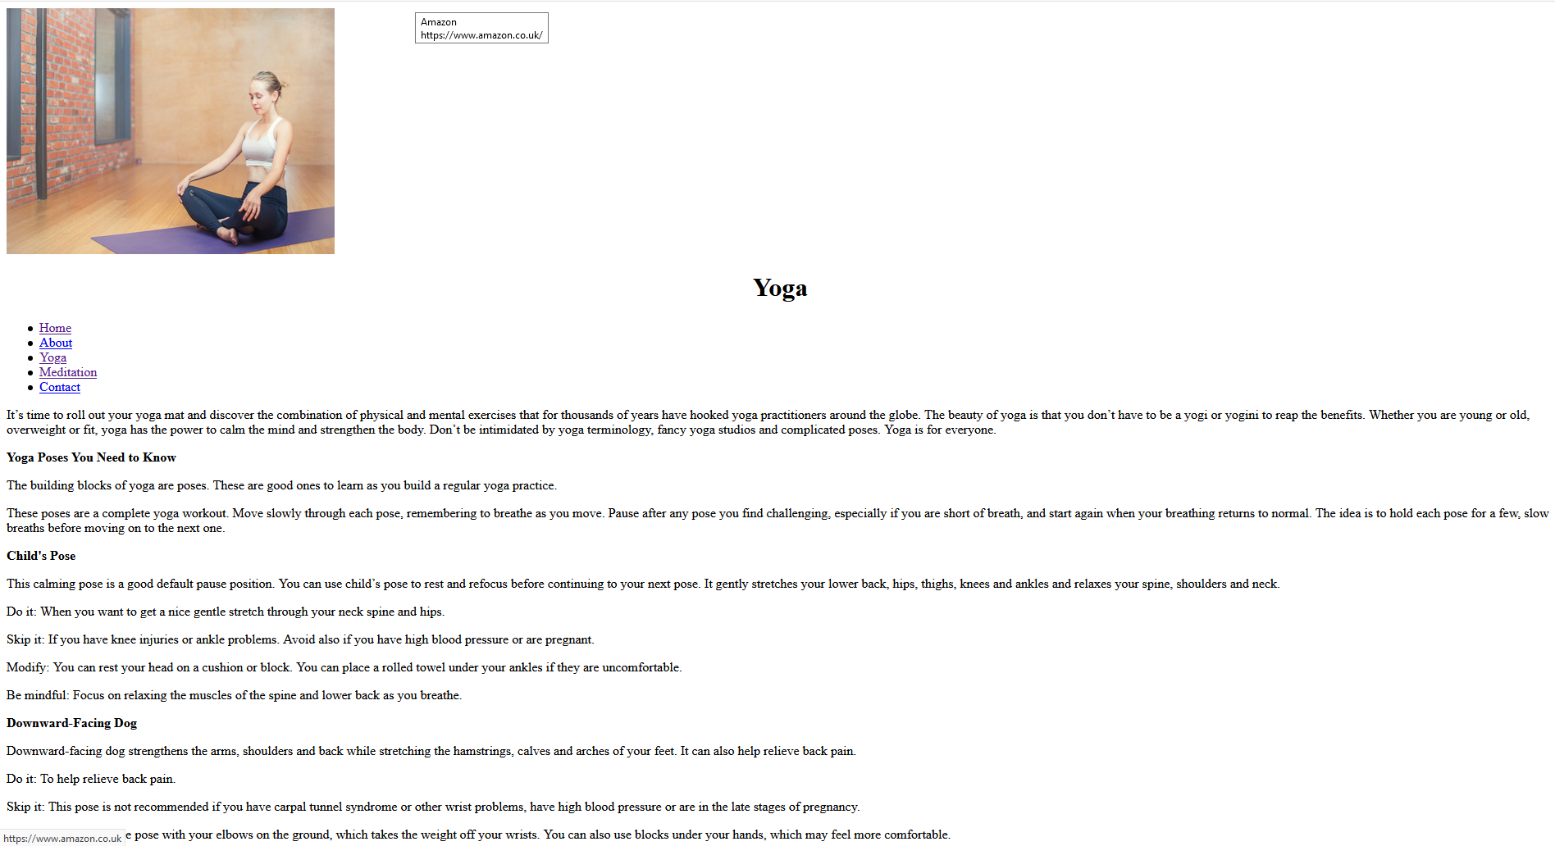
The pages should start to look something like this

Slide 68
Filezilla
When you have done, upload using FileZilla

Slide 69
Filezilla
Notes:
Follow along with me.
Share the screen with filezilla.
Open Filezilla and enter the following:

Slide 70
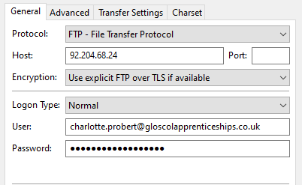

Slide 71
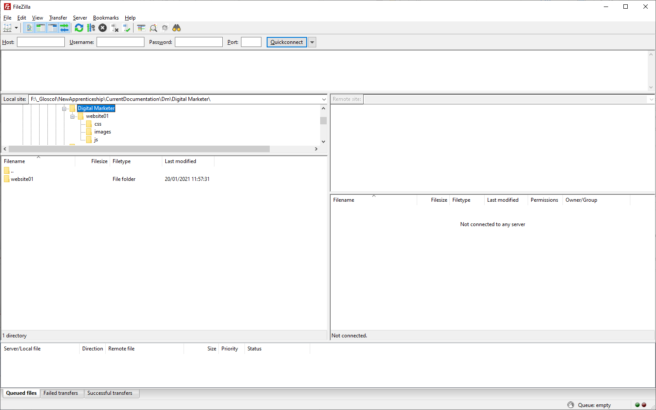

Slide 72
Javascript Day 3

Slide 73
JavaScript
JavaScript is the world's most popular programming language.
JavaScript is the programming language of the Web.
JavaScript is easy to learn
Javascript can also be accessed from a file similar to external CSS files
<script src="file.js" type="text/javascript"></script>

Slide 74
JavaScript
Why Study JavaScript?
JavaScript is one of the 3 languages all web developers must learn:
1. HTML to define the content of web pages
2. CSS to specify the layout of web pages
3. JavaScript to program the behavior of web page

Slide 75
JavaScript
http://www.w3schools.com/js/
http://www.w3schools.com/jsref/

Slide 76
JavaScript – Try this in notepad and save as js.html
<!DOCTYPE html>
<html>
<body>
<h2>My First JavaScript</h2>
<button type="button"
onclick="document.getElementById('demo').innerHTML = Date()">
Click me to display Date and Time.</button>
<p id="demo"></p>
</body>
</html>

Slide 77
getElementById()
JavaScript Can Change HTML Content
One of many JavaScript HTML methods is getElementById().
The example before "finds" an HTML element (with id="demo"), and changes the element content (innerHTML) to the date
https://www.w3schools.com/js/tryit.asp?filename=tryjs_intro_lightbulb

Slide 78
Noscript -
<script type="text/javascript">
document.write("hello, world");
</script>
<noscript>
goodbye, world
</noscript>
Definition and Usage
The <noscript> tag defines an alternate content to be displayed to users that have disabled scripts in their browser or have a browser that doesn't support script.
The <noscript> element can be used in both <head> and <body>.

Slide 79
Manipulating Data in JavaScript
You can use JavaScript to achieve much more than popping up dialog boxes.
JavaScript gives you the opportunity to define and use variables and arrays, work with date and time arithmetic, and control program flow with loops and conditional branches.

Slide 80
Variables
Variables can be numeric
var speedlimit = 55;
var speed = 73;
Variables need not be numeric
var firstname = 'Peter'
var lastname = 'Smith';

Slide 81
Variables
JavaScript Identifiers
All JavaScript variables must be identified with unique names.
These unique names are called identifiers.
Identifiers can be short names (like x and y) or more descriptive names (age, sum, totalVolume).
The general rules for constructing names for variables (unique identifiers) are:
Names can contain letters, digits, underscores, and dollar signs.
Names must begin with a letter
Names can also begin with $ and _ (but we will not use it in this tutorial)
Names are case sensitive (y and Y are different variables)
Reserved words (like JavaScript keywords) cannot be used as name

Slide 82
Variables
We may now use these variables in other statements
var overLimit = speed – speedLimit;
var fullname = firstname + lastname;
OR
document.writeln('Hello, '+ firstname + ' ' + lastname);

Slide 83
You can do arithmetic with JavaScript variables, using operators like = and + Try this..................
<!DOCTYPE html>
<html>
<body>
<h2>JavaScript Variables</h2>
<p>The result of adding 5 + 2 + 3:</p>
<p id="demo"></p>
<script>
var x = 5 + 2 + 3;
document.getElementById("demo").innerHTML = x;
</script>
</body>
</html>

Slide 84
Arrays
What is an Array?
An array is a special variable, which can hold more than one value at a time.
If you have a list of items (a list of car names, for example), storing the cars in single variables could look like this:
var car1 = "Saab"; var car2 = "Volvo"; var car3 = "BMW";
However, what if you want to loop through the cars and find a specific one? And what if you had not 3 cars, but 300?
The solution is an array!
An array can hold many values under a single name, and you can access the values by referring to an index number.

Slide 85
Arrays
<!DOCTYPE html>
<html>
<body>
<h2>JavaScript Arrays</h2>
<p id="demo"></p>
<script>
var cars = ["Saab", "Volvo", "BMW"];
document.getElementById("demo").innerHTML = cars;
</script>
</body>
</html>

Slide 86
Access the Elements of an Array
You access an array element by referring to the index number.
The statement accesses the value of the first element in cars
Note: Array indexes start with 0.
[0] is the first element. [1] is the second element

Slide 87
Arrays – Try this
<!DOCTYPE html>
<html>
<body>
<h2>JavaScript Arrays</h2>
<p>JavaScript array elements are accessed using numeric indexes (starting from 0).</p>
<p id="demo"></p>
<script>
var cars = ["Saab", "Volvo", "BMW"];
document.getElementById("demo").innerHTML = cars[0];
</script>
</body>
</html>

Slide 88
Boolean - JavaScript booleans can have one of two values: true or false – Try this
<!DOCTYPE html>
<html>
<body>
<p>Display the value of Boolean(10 > 9)</p>
<button onclick="myFunction()">Try it</button>
<p id="demo"></p>
<script>
function myFunction() {
document.getElementById("demo").innerHTML = Boolean(10 > 9);
}
</script>
</body>
</html>

Slide 89
Statements
JavaScript Statement Identifiers
JavaScript statements often start with a statement identifier to identify the JavaScript action to be performed.
Statement identifiers are reserved words and cannot be used as variable names (or any other things).
The following table lists all JavaScript statements:
Keyword | Description
break | Terminates a switch or a loop
continue | Jumps out of a loop and starts at the top
debugger | Stops the execution of JavaScript, and calls (if available) the debugging function
do ... while | Executes a block of statements, and repeats the block, while a condition is true
for | Marks a block of statements to be executed, as long as a condition is true
function | Declares a function
if ... else | Marks a block of statements to be executed, depending on a condition
return | Exits a function
switch | Marks a block of statements to be executed, depending on different cases
try ... catch | Implements error handling to a block of statements
var | Declares a variable

Slide 90
Validation

Slide 91
JavaScript Can Validate Numeric Input
Try this.....
<!DOCTYPE html>
<html>
<body>
<h2>JavaScript Can Validate Input</h2>
<p>Please input a number between 1 and 10:</p>
<input id="numb">
<button type="button" onclick="myFunction()">Submit</button>
<p id="demo"></p>
<script>
function myFunction() {
var x, text;
// Get the value of the input field with id="numb"
x = document.getElementById("numb").value;
// If x is Not a Number or less than one or greater than 10
if (isNaN(x) || x < 1 || x > 10) {
text = "Input not valid";
} else {
text = "Input OK";
}
document.getElementById("demo").innerHTML = text;
}
</script>
</body>
</html>

Slide 92
Event Handlers
Often you want your JavaScript code to be executed because something specific has occurred
To achieve these effects you use special interfaces provided by the browser and known as event handlers.
Event handlers allow you to call JavaScript methods automatically when certain types of events occur.

Slide 93
Event Handlers
Consider the following code:
<form>
<input type=”button” value=”Click Here” onClick=”alert(‘Thanks for clicking!’)”>
</form>
Here we capture the action of the user clicking the button, using the onClick event handler. When the user’s click is detected, the script carries out the instructions listed in the onClick attribute of the input tag:
onClick=”alert(‘Thanks for clicking!’)”

Slide 94
Other Event Handlers
EVENT HANDLER | COMMENTS
onChange | Occurs when the value in an input field changes
onClick | Occurs when a user clicks the mouse on the element in question
onLoad | Occurs when the page has finished loading
onMouseOver | Occurs when the mouse pointer enters the screen area occupied by the element in question …
onMouseOut | … and when it leaves
onSubmit | Occurs at the point a form is submitted

Slide 95
Concatenation
Joining of two or more items
var userName;
userName = prompt("What is your name?");
document.write("Hi, " + userName + "!");

Slide 96
Including JavaScript in HTML Pages
We can include as many <script>…</script> tags in our page as we need. However, we must pay some attention to where in the document they are placed.
JavaScript commands are executed in the order in which they appear in the page.
JavaScript can also be added to the head section of the HTML page.
This is a popular place to keep JavaScript functions

Slide 97
Including JavaScript in HTML Pages
Placing JavaScript functions into external files allows them to be made available to a number of different web pages without having to retype any code. It also makes them easier to maintain because the latest version is automatically linked into the calling HTML page each time that page is requested.
It is possible to build up substantial JavaScript libraries in this way, linking them into web pages when their particular functions are required.

Slide 98
Passing Arguments to Functions
Wouldn’t it be good if we could tell the function what message to display so that we could have different alert messages for different circumstances?
We can achieve this by passing the message to our function as an argument: Try this ...
<!DOCTYPE html>
<html>
<body>
<p>Click the button to display an alert box.</p>
<button onclick="myFunction()">Try it</button>
<script>
function myFunction() {
alert("Hello! I am an alert box!");
}
</script>
</body>
</html>

Slide 99
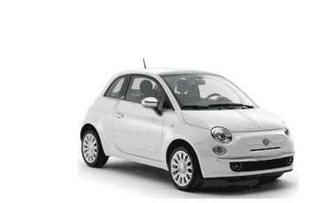
Objects
Object | Properties | Methods
 | car.name = Fiat car.model = 500 car.weight = 850kg car.color = white | car.start() car.drive() car.brake() car.stop()
Real Life Objects, Properties, and Methods
In real life, a car is an object.
A car has properties like weight and color, and methods like start and stop:
All cars have the same properties, but the property values differ from car to car.
All cars have the same methods, but the methods are performed at different times.
You have already learned that JavaScript variables are containers for data values.
This code assigns a simple value (Fiat) to a variable named car:
var car = "Fiat";

Slide 100
Objects – Try this – Add model and colour to the output
<!DOCTYPE html>
<html>
<body>
<h2>JavaScript Objects</h2>
<p id="demo"></p>
<script>
// Create an object:
var car = {type:"Fiat", model:"500", color:"white"};
// Display some data from the object:
document.getElementById("demo").innerHTML = "The car type is " + car.type;
</script>
</body>
</html>

Slide 101
Theory of Web Components
Client-Server
Terminology
Security
Fix a website
Add pages
Links
Forms

Slide 102
4. Web components (55%, K2)
In this topic, learners will understand the components involved to make the Web work.
4.1 Define the terminology for the following key internet protocols that enable the web to work:
Hypertext Transfer Protocol (HTTP)
Hypertext Transfer Protocol Secure (HTTPS)
Transport Layer Security and Secure Sockets Layer (TLS / SSL)
4.2 Discuss the purpose of the following:
Web and application server
Hosting and serving
Relational database management systems
Content management systems

Slide 103
4. Web components (55%, K2)
4.3 Describe the purpose of a web client
Browsers
Applications
4.4 Describe how Search Engines operate in regard to the following:
How mark-up languages render hyperlinks
How the web crawler work
Displaying of search results
Factors that affect search engine optimization (SEO)
4.5 Explain the differences between a static and dynamic website.
Written in code
Written scripting language

Slide 104
4. Web components (55%, K2)
4.6 Describe how local (cookies) or session data storage is utilised to share information for standard digital features.
Forms
Checkout
Registration
4.7 Identify the key roles of the following Web technologies governance groups.
World Wide Web Consortium (W3C);
Internet Engineering Task Force (IETF).

Slide 105
4.1 Define the terminology for the following key internet protocols that enable the web to work
Hypertext Transfer Protocol (HTTP)
Hypertext Transfer Protocol Secure (HTTPS)
Transport Layer Security and Secure Sockets Layer (TLS / SSL)

Slide 106
The Internet and WWW
WWW
WWW = World Wide Web
The pages you see when you use a device and you are ‘online’
Need a browser
Internet
An internetwork of computers across the globe and even using space
Consists of networked computers and other devices
Hardware

Slide 107
Hypertext Transfer Protocol (HTTP)
WWW is about communication between web clients and servers
Communication between client computers and web servers is done by sending HTTP Requests and receiving HTTP Responses
Foundation of data communication for the World Wide Web
NOT secure
i
Not secure
|
http://example.com

Slide 108
Hypertext Transfer Protocol Secure (HTTPS)
Hypertext Transfer Protocol Secure (https) is a combination of the Hypertext Transfer Protocol with an added layer of security
Requires a certificate
Protects the integrity and confidentiality of data between the user's computer and the website
|
https://example.com

Slide 109
Encryption
Before encryption:
This is a string of text that is completely readable
After encryption:
ITM0IRyiEhVpa6VnKyExMiEgNveroyWBPlgGyfkflYjDaaFf/Kn3bo3OfghBPDWo6AfSHlNtL8N7ITEwIXc1gU5X73xMs

Slide 110
Transport Layer Security and Secure Sockets Layer (TLS / SSL)
SSL refers to Secure Sockets Layer whereas TLS refers to Transport Layer Security
Basically, they are one and the same, but, entirely different
SSL and TLS are cryptographic protocols that authenticate data transfer between servers, systems, applications and users
TLS has replaced SSL (but we still say “I need an SSL certificate”)

Slide 111
Organisations
IETF (https://www.ietf.org/)
The Internet Engineering Task Force (IETF) develops and promotes voluntary Internet standards, in particular the standards that comprise the Internet protocol suite (TCP/IP)
W3C (www.w3.org)
The World Wide Web Consortium (W3C) is the main international standards organisation for the World Wide Web
Founded and currently led by Tim Berners-Lee

Slide 112
4.2 Discuss the purpose of the following
Web and application server
Hosting and serving
Relational database management systems
Content management systems

Slide 113
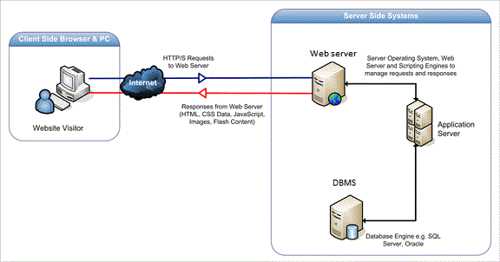
Web and Application Server
Web server serves web content over HTTP
Displays site content
Application server serves business logic to application programs through any number of protocols

Slide 114
Hosting and Serving
Hosting
A web host, or web hosting service provider, is a business that provides the technologies and services needed for the website or webpage to be viewed on the Internet
Websites are hosted, or stored, on special computers called servers
Web servers
Hardware dedicated to running web server software

Slide 115
Relational Database Management Systems
Complex database software
Make use of relationships between entities
Examples:
MariaDB
MySQL
Microsoft SQL Server
Microsoft Access (Desktop)

Slide 116
Example database system
Database Name
Table name

Slide 117
Database
A database is just a different kind of spreadsheet

Slide 118
Content Management Systems
Manages the creation and modification of digital content
Support the separation of content and presentation
A web content management system (WCM or WCMS) is a CMS designed to support the management of the content of Web pages
Most popular CMSs are also WCMSs
Web content includes text and embedded graphics, photos, video, audio, maps, and program code (e.g., for applications) that displays content or interacts with the user.

Slide 119
Content Management Systems
Such a content management system (CMS) typically has two major components:
A content management application (CMA) is the front-end user interface that allows a user, even with limited expertise, to add, modify, and remove content from a website without the intervention of a webmaster.
A content delivery application (CDA) compiles that information and updates the website.
Is a backend system

Slide 120
Example CMS

Slide 121
Example CMS - WordPress

Slide 122
4.3 Describe the purpose of a web client
Browsers
Applications

Slide 123
Browsers
All browsers display web pages
Not all browsers behave the same
Internet Explorer does not follow web standards

Slide 124
Browsers
Over 100 browsers available
Can install more than one
Top 6:
Chrome
Safari
Firefox
Internet Explorer
Opera
Edge (Windows 10 only)

Slide 125
Applications
A web application (or web app) is application software that runs on a web server, unlike computer-based software programs that are run locally on the operating system
Any computer program that performs a specific function by using a web browser as its client
Example: online forms, shopping carts, word processors, spreadsheets, video and photo editing, file conversion, file scanning, and email programs such as Gmail

Slide 126
Web and application server
Hosting and serving
Web and application server
Hosting and serving

Slide 127
4.4 Describe how Search Engines operate
How mark-up languages render hyperlinks.
How the web crawler work.
Displaying of search results.
Factors that affect search engine optimization (SEO).

Slide 128
How mark-up languages render hyperlinks
Hyperlinks are one of the most exciting innovations the Web has to offer
They've been a feature of the Web since the beginning, and are what makes the Web a web
Hyperlinks allow us to link documents to other documents or resources, link to specific parts of documents, or make apps available at a web address
A basic link is created by wrapping the text or other content inside an <a> element and using the href attribute, also known as a Hypertext Reference, or target, that contains the web address

Slide 129
Search Engines
A search engine is a software system that is designed to carry out web searches, which means to search the World Wide Web in a systematic way for particular information specified in a textual web search query
Familiar search engines
Google
DuckDuckGo
Yahoo
Amazon
Pinterest

Slide 130
How the web crawlers work
Also called web spiders
A search engine bot
A web crawler copies webpages so that they can be processed later by the search engine, which indexes the downloaded pages
This allows users of the search engine to find webpages quickly
The web crawler also validates links and HTML code, and sometimes it extracts other information from the website

Slide 131
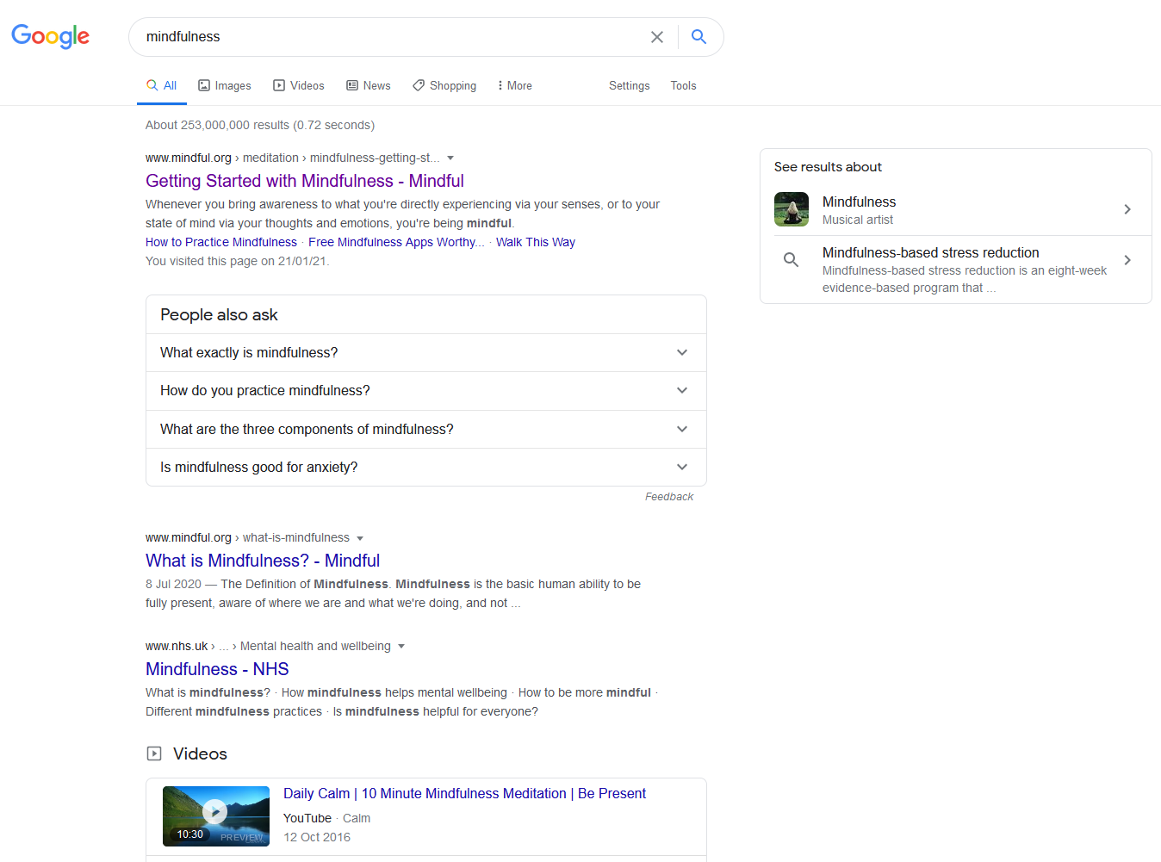
Displaying of search results
Some are pretty

Slide 132
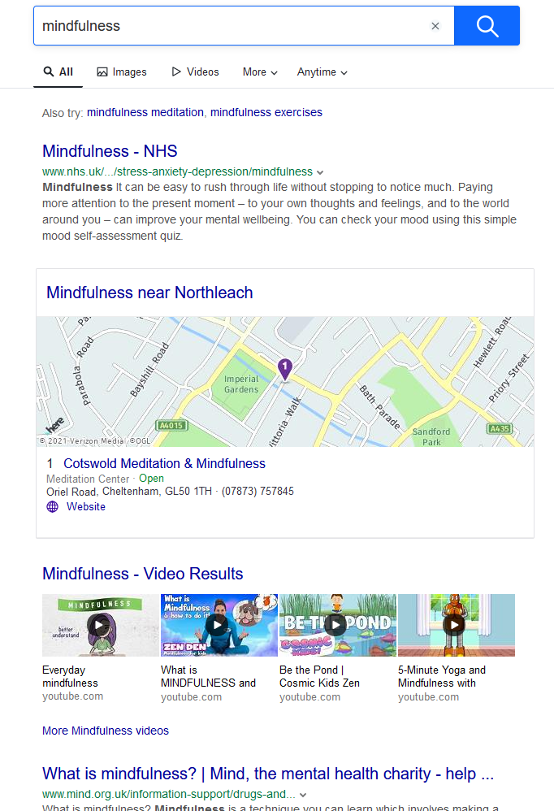
Displaying of search results
Some not so much

Slide 133
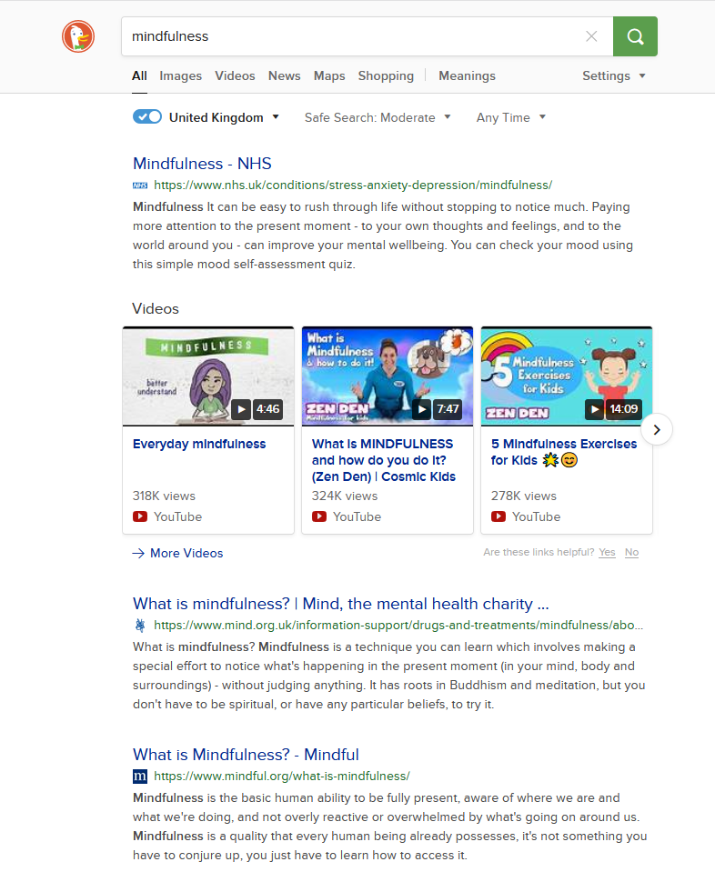
Displaying of search results
Some don’t track you

Slide 134
Factors that affect search engine optimization (SEO)
What Are the Most Important SEO Ranking Factors?
A Secure and Accessible Website
Page Speed (Including Mobile Page Speed)
Mobile Friendliness
Domain Age, URL, and Authority
Optimized Content
Technical SEO
User Experience (RankBrain)
Links
Social Signals
Real Business Information
Notes:
Question…: which is more important, pleasing Google or pleasing your audience?
Is it mobile friendly? https://search.google.com/test/mobile-friendly

Slide 135
SEO
Search Engine Optimisation

Slide 136
What is SEO?
Position
Keywords
Optimise
SEO
Rank
Links
Pages
Content

Slide 137
Two views
Basic
Increasing rankings
Complex
Managing the programming
Managing the content
Managing the visibility
Managing the success

Slide 138
Search Engines
You need a search engine to achieve all of the above
You need to remain up to date with the latest search engine trends
Old ways of doing SEO could actually hinder your SEO visibility
You need to understand the search engine’s algorithms

Slide 139
How Search Engines Work
How the search engine results are produced
What factors influence rankings
How algorithms (the maths) works
How a search engine ‘views’ your website
How search results are designed for human behaviour

Slide 140
Human Factors for Search
How do we ‘read’ the search results?
What factors make us click?
What factors help us decide which results are relevant?
What is the importance of WORDS?

Slide 141
Keyword Research
Keywords – THE most important SEO element for every search engine

Slide 142
Keyword Research
These are the words that people type into the search engine
Why is the keyword the foundation of all online marketing and not just SEO?
PPC, Social, Ads, Content, Multimedia
What is keyword research based on?
Behaviour, intent, and activity of a searcher.
How does searcher’s intent help us develop content around the searcher’s need?
How are keyword tools used to gather and evaluate keywords?

Slide 143
On-Page Optimisation
How to implement keywords in your content?
What are the key page elements?
Space
Navigation
About Us
Contact
CTA or sign up
Search
Informational footer
Great images and style for buttons
Web fonts
How to structure your content?
What is navigation?
Explain page and content types:
Ecommerce
Publisher
Blogs
Others
How to avoid penalties?
Don’t buy links
Don’t overuse keywords
Make original, quality content

Slide 144
Off-Page Optimisation
What is the importance of link building?
Helps to promote your brand
It can help to show that you are an authority in your field through links to relevant content
It can also help to promote the expertise of your company as well as the strengths of its goods and services
What are the types of links?
Natural links
Manual outreach links
Self-created links

Slide 145
Strategies to get other pages to link to you
When you reach out to other entities to create links to your site, try some of these tried and true strategies
Create compelling content that people will want to link to and reference
Submit your news for press releases and submit your site to directories
Put your products and services where influential people will see them
Get links from friends, partners, and other people you know

Slide 146
On-Page SEO
Meta tags
Internal linking
Keyword research and placement

Slide 147
Meta Tags
Meta tags are snippets of text that describe a page’s content
The meta tags don’t appear on the page itself, but only in the page’s code
Usually in the ‘HEAD’ section of the HTML

Slide 148
Internal Linking
Internal links are links that go from one page on a domain to a different page on the same domain. They are commonly used in main navigation.
These type of links are useful for three reasons:
They allow users to navigate a website.
They help establish information hierarchy for the given website.
They help spread link equity (ranking power) around websites.

Slide 149
Keyword Research and Placement
Keyword research: find popular keywords people use when they look for information related to data visualization
Keyword placement: embed selected SEO keywords at places where search engines pay more attention to when examining web page contents

Slide 150
Use the following guidelines to place the keywords:
Place keyword(s) in article headline and in subheads.
Place keyword(s) in the first 25 words of your page.
Place keyword(s) in the last 25 words of your page.
Bold keyword(s) at least once on your page.

Slide 151
Off-Page SEO
Directory Submission
Article Submission
Forms Posting
Social Media marketing
Link Building including backlinks
Press Release Submission

Slide 152
Ranking Factors
Domain Factors
Page-Level Factors
Site-Level Factors
Backlink Factors
User Interaction
Special Google Algorithm Rules
Brand Signals
On-Site Webspam Factors
Off-Site Webspam Factors
https://backlinko.com/google-ranking-factors#domain

Slide 153
4.5 Explain the differences between a static and dynamic website
Written in code
Written scripting language

Slide 154
Web client; Browsers and Applications
Web client
A user interface through which messages are sent to a web server
A web client usually operates within a web browser
Browser
Used to access the World Wide Web
Applications
Any computer program that performs a specific function by using a web browser as its client
Example: contact form

Slide 155
Static
Pages coded in HTML only
Content needs to be changed manually
Static and Dynamic Websites
Dynamic
Pages coded in HTML and other languages such as PHP, JavaScript, VB.net, C#
Pages content changes when user requests a piece of content or upon input into the page

Slide 156
4.6 Describe how local (cookies) or session data storage is utilised to share information for standard digital features
Forms
Checkout
Registration

Slide 157
4.6 - Cookies
A cookie is often used to identify a user
A cookie is a small file that the server embeds on the user's computer
Each time the same computer requests a page with a browser, it will send the cookie too
With PHP, you can both create and retrieve cookie values.

Slide 158
Written in code
>>> from http import cookies
>>> C = cookies.SimpleCookie()
>>> C["fig"] = "newton"
>>> C["sugar"] = "wafer"
>>> print(C) # generate HTTP headers
Set-Cookie: fig=newton
Set-Cookie: sugar=wafer
>>> print(C.output()) # same thing
Set-Cookie: fig=newton
Set-Cookie: sugar=wafer
>>> C = cookies.SimpleCookie()
>>> C["rocky"] = "road"
>>> C["rocky"]["path"] = "/cookie"
>>> print(C.output(header="Cookie:"))
Cookie: rocky=road; Path=/cookie
>>> print(C.output(attrs=[], header="Cookie:"))
Cookie: rocky=road

Slide 159
Written scripting language
<?php
$value = 'something from somewhere';
setcookie("TestCookie", $value);
setcookie("TestCookie", $value, time()+3600); /* expire in 1 hour */
setcookie("TestCookie", $value, time()+3600, "/~rasmus/", "example.com", 1);
?>

Slide 160
Forms
Used to allow a user to enter data into a web page
Form.html
<html> <body> <form action="welcome.php" method=“post"> Name: <input type="text" name="name"><br> E-mail: <input type="text" name="email"><br> <input type="submit"> </form> </body> </html>

Slide 161
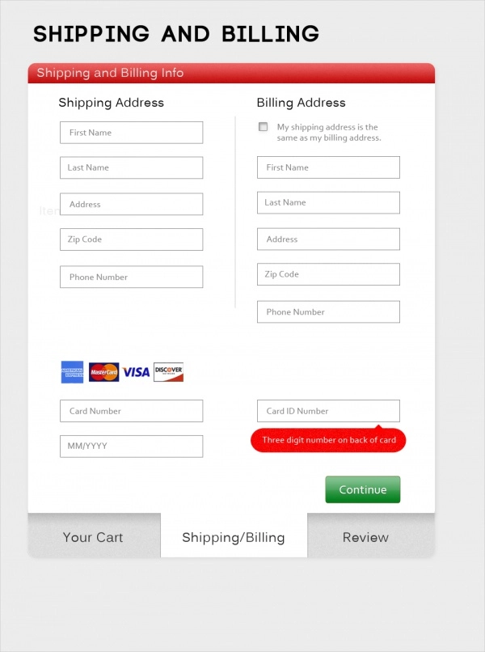
Checkout
Part of the process of online shopping in which the customer enters delivery information and pays for the item
Example:
Amazon

Slide 162
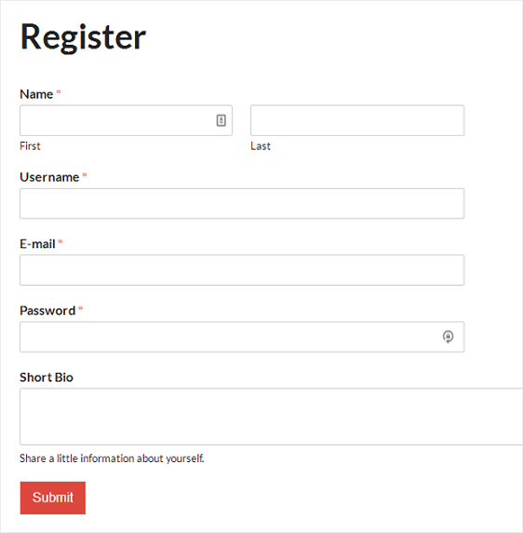
Registration
A registration form allows user data to be stored in a database
Good for making email lists or setting up access rights to allow a user to login to a site

Slide 163
4.7 Identify the key roles of the following Web technologies governance groups
World Wide Web Consortium (W3C)
Internet Engineering Task Force (IETF).

Slide 164
World Wide Web Consortium (W3C)
The World Wide Web Consortium is the main international standards organization for the World Wide Web
Founded in 1994 and currently led by Tim Berners-Lee, the consortium is made up of member organizations that maintain full-time staff working together in the development of standards for the World Wide Web
Full-time staff, and the public work together to develop Web standards
W3C's primary activity is to develop protocols and guidelines that ensure long-term growth for the Web
W3C's standards define key parts of what makes the World Wide Web work

Slide 165
Internet Engineering Task Force (IETF)
The IETF is a large open international community of network designers, operators, vendors, and researchers concerned with the evolution of the Internet architecture and the smooth operation of the Internet

Slide 166
Internet Assigned Numbers Authority
The Internet Assigned Numbers Authority (IANA) is the central coordinator for the assignment of unique parameter values for Internet protocols
Performs global coordination of the DNS Root, IP addressing, and other Internet protocol resources
This role means assigning the operators of top-level domains, such as .uk and .com, and maintaining their technical and administrative details.

