Slide 1
Operating Systems and Architecture
^{<virtualisation basics>}
(UFCFCU-30-1)

Slide 2
Virtual machines
^{<virtualisation basics>}
This is an introductory session. Full details of virtualisation will be covered later.
The purpose of this is to introduce you to Hyper-V so that you can use it for your assignment work later in the week

Slide 3
Virtual machines
^{<virtual machines>}
A virtual machine is a computer file
typically called an image
behaves like an actual computer
It runs in a window as a guest on a host operating system
The VM is sandboxed from the rest of the system
the VM software inside a virtual machine cannot
escape outside of its allocated memory
interfere with the host OS or physical hardware

Slide 4
Multiple Virtual machines
^{<virtual machines>}
Multiple virtual machines can run simultaneously on the same physical computer
For servers, the multiple operating systems run on a hypervisor
Desktop computers run one host operating system to run the guests within the host’s program windows
Each virtual machine provides its own virtual hardware:
CPUs
Memory
Hard drives
Network interfaces
other devices
The host maps the virtual hardware to the real physical hardware

Slide 5
Hypervisors
^{<hypervisors>}
Type 1, native, bare-metal hypervisors
Run directly on the physical hardware
Guests run on top of the hypervisor
Examples are VMware ESXi, Microsoft Hyper-V
Type 2 hosted hypervisors
Run on top of a conventional OS
Examples are VMware workstation, Parallels Desktop for Mac

Slide 6
Hypervisors
^{<hypervisors>}

Slide 7
Hyper-V is Type 1
^{<Hyper-V>}
It looks like a type 2!
When you install Hyper-V, Windows appears like a host OS
Hyper-V setup converts the original Windows OS into a root partition puts the hypervisor below
Guests are in child partitions

Slide 8
Prepare for Hyper-V
^{<practical>}
Open Disk Management
If there are only 2 volumes (C: and G:) then:
Shrink G to ~500GB
In the unallocated space make a new simple volume
200,000 MB drive letter V, NTFS, Volume label: Hyper-V
If Hyper-V is not in the list of available programs then:
Run Turn Windows Feature on or off
Tick the check box for Hyper-V, click OK, click Restart Now

Slide 9
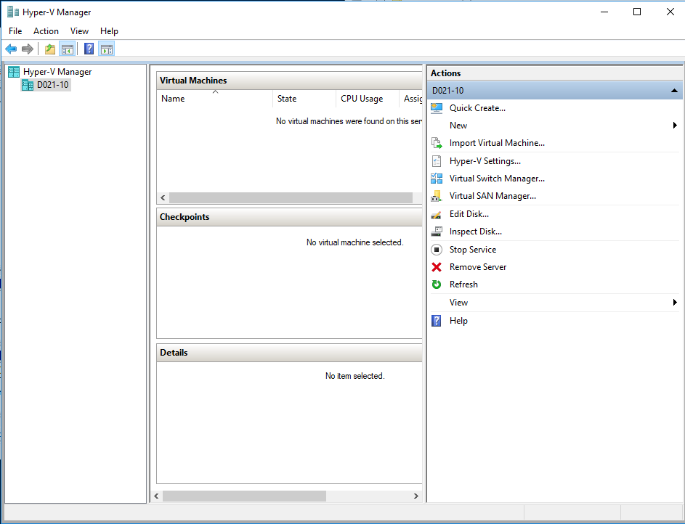
Start Hyper-V and create a VM
^{< practical >}
As administrator
Click New > Virtual Machine
Click Next for custom
Name the VM after the OS, either WinServer or W10Client
Store in V:\VirtualMachines
Click Next
Select Generation 2
Click Next

Slide 10
VM creation
^{< practical >}
Use 2048 MB of memory for a WinServer
Use 1024 MB of memory for a W10Client
Click Next
Connect to to the default switch
Click Next
Create a VHDX of 100GB for WinServer, 50GB for W10Client
Use the default location (on the V: drive)
Click Next
Install the OS later and click Next
Click Finish

Slide 11
Install an OS on Hyper-V
^{< practical >}
Click Settings for the VM (eg Win10Client)
Click on SCSI Controller
Add a DVD drive: Click on Image file and browse to location of Windows.iso See next slide for location (You may need to copy the ISO to the desktop)
Click Open, then Apply and OK
Start the VM
Windows Setup will boot

Slide 12
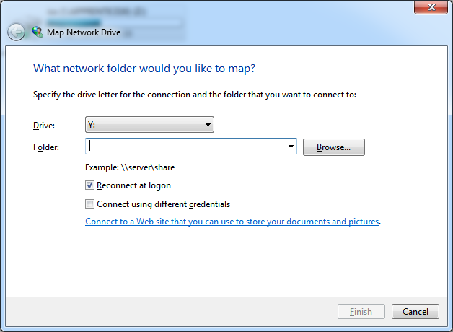
Map network drive
^{< practical >}
Map a network drive to access the share
Folder is \\APPRENTICE16\iso
Tick reconnect at logon
Credentials are:
Username - ShareManager
Password - Computing123

Slide 13
W10Client Settings
^{< practical >}
UK
Customise and turn off all options
Create a user account Apprentice
Password Apprentice01
Password hint ApprenticeXX
Not now Cortana
Not now Updates
No to network discovery

Slide 14
Export a VM
^{< practical >}
Using Hyper-V Manager
In Hyper-V Manager, right-click the virtual machine and select Export.
Choose where to store the exported files, and click Export.
When the export is done, you can see all exported files under the export location.
Using PowerShell
Open a session as Administrator and run a command like the following, after replacing <vm name> and <path>:
Export-VM -Name \<vm name\> -Path \<path\>

Slide 15
Import a VM
^{< practical >}
Importing depends on where you saved the export files
See : https://docs.microsoft.com/en-us/windows-server/virtualization/hyper-v/deploy/export-and-import-virtual-machines for details

Slide 16
Usage
^{< practical >}
Use the VM Windows Client for all the practicals
If you need to revert to an original state you can delete the VM and import the original exported version

Slide 17
Server 2012
^{< practical >}
Repeat the installation for Server2012
You will now have 2 Virtual Machines which can communicate via the virtual switch
Configure networking
Properties of local area connection
Properties of IPV4
Set static address and subnet mask (eg 192.168.1.100)

Slide 18
Configure Server 2012
^{< practical >}
Add roles
Select Active Directory Domain roles
Install it
Run dcpromo.exe
Create a new domain
You may need to set a stronger password eg Passw0rd123456
Use local users in control panel
Use your name eg me.co.uk

Slide 19
Configure Server 2012
^{< practical >}
Set the functional level to Windows Server 2012
Select DNS server
Click yes to continue
Accept default file settings
Use the same strong password
Click next to install
Restart

Slide 20
Configure Server 2012
^{< practical >}
Add roles
DHCP
File services
Print services
Research and apply these yourselves

Slide 21
Configure Server 2012
^{< practical >}
Add a user – John Doe etc
Assign permissions
Allocate file space to the users (folder structure)
Login to the domain (from your Client VM) and map the allocated network drive
Congratulations, you have created a virtual data centre

