Slide 1
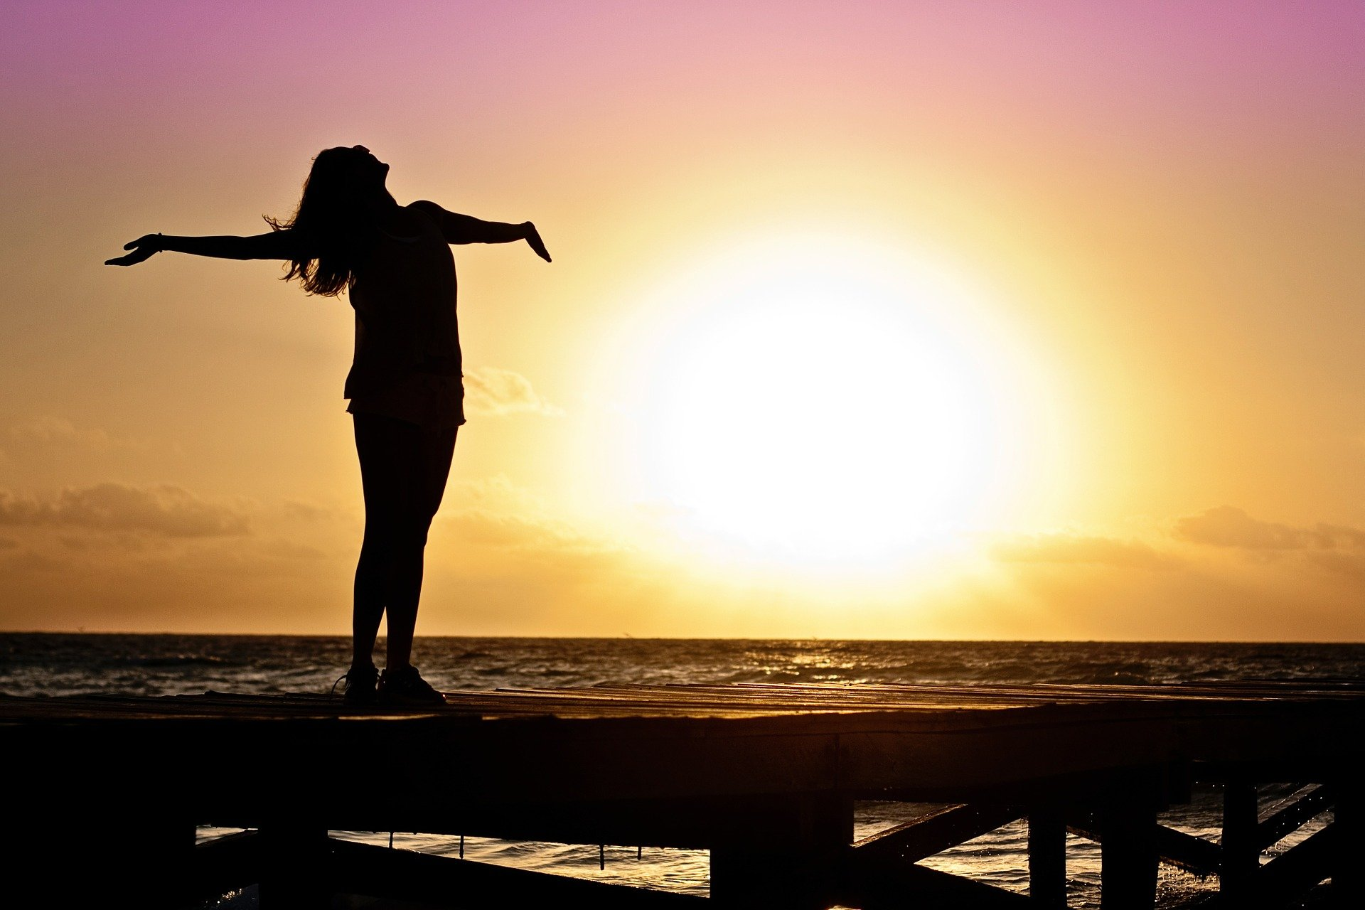
Make a Website

Slide 2
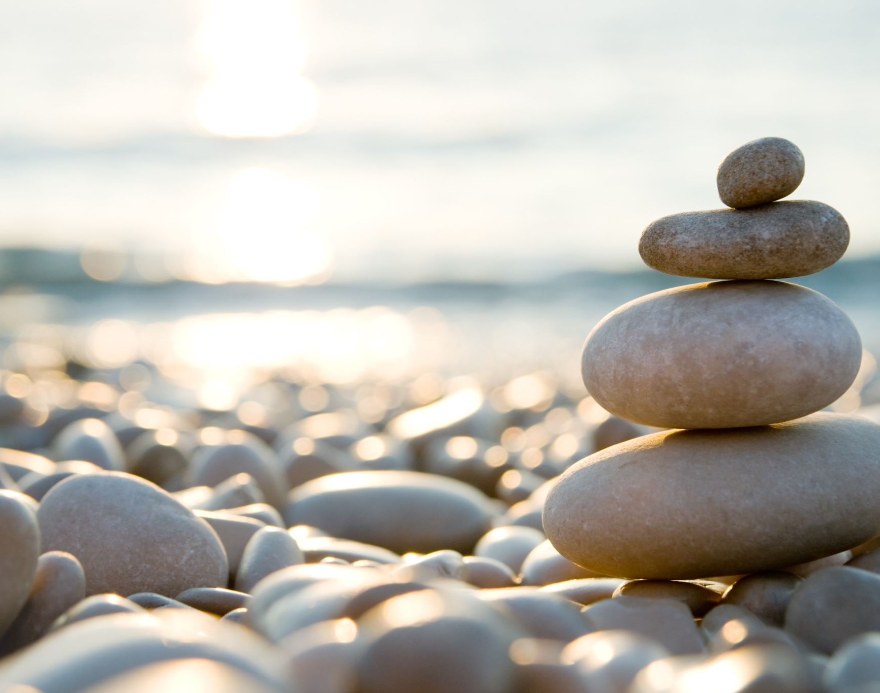
The website
6 pages in total
Home
About
Meditation
Yoga
Contact
Yoga class

Slide 3
All Pages (except yogaclass.html)
One image at top of the page
A second image as a supplementary image
All content must be in the centre of the page
All content must be 1000px wide
The site must have a background colour
The header, nav, content and footer must not be the same colour as the background
Every page must have navigation
There must be NO navigation to the yogaclass.html page

Slide 4
All Pages
Change this for the page name i.e. Document to Home
Hero Image
800px wide
<!DOCTYPE html>
<html lang="en">
<head>
<meta charset="UTF-8">
<meta name="viewport" content="width=device-width, initial-scale=1.0">
<title>Document</title>
</head>
<body>
<div><!--site wrapper -->
<div><!--content wrapper -->
<div>This is the header</div>
<div>This is the navigation</div>
<div>This is the content
</div> <!--End of content -->
<div>This is the footer</div>
</div><!— end of site wrapper -- >
</body>
</html>
Navigation, horizontal 800px wide
Content
800px wide
image
Footer 100% wide
You can copy this code to your editor

Slide 5
Home
(index.html)
Yoga
(yoga.html)
Meditation
(meditation.html)
About
(about.html)
Contact
(contact.html)
Yoga Class
(yogaclass.html)

Slide 6
External Stylesheet
There must be one external stylesheet
Link it to all the documents except the yogaclass.html

Slide 7
All Pages
Your hero image must cover the entire 800 width
Your second image:
Make it float right 430px from the top of the page
Make all paragraph text 260px from the left
Navigation links must be horizontal across the page, centred
All <h1> headings must have the following style:
Font = Helvetica
Height = 24px
Padding 5px all sides
All <h2> headings must be 260px from the left
Font = Arial
Height = 18px
Padding = 5px all sides
All <p> text must be 260px from the left

Slide 8
Home Page – index.html
Change the style sheet to:
Have the following unordered listing:
#ul{ margin:50px;
width:100px;
background‐image:url(images/background‐repeatx.jpg);
background‐repeat:repeat‐x;
border‐top‐width: thin;
border‐right‐width: thin;
border‐bottom‐width: thin;
border‐left‐width: thin;
border‐top‐style: solid;
border‐right‐style: solid;
border‐bottom‐style: solid;
border‐left‐style: solid;
}

Slide 9
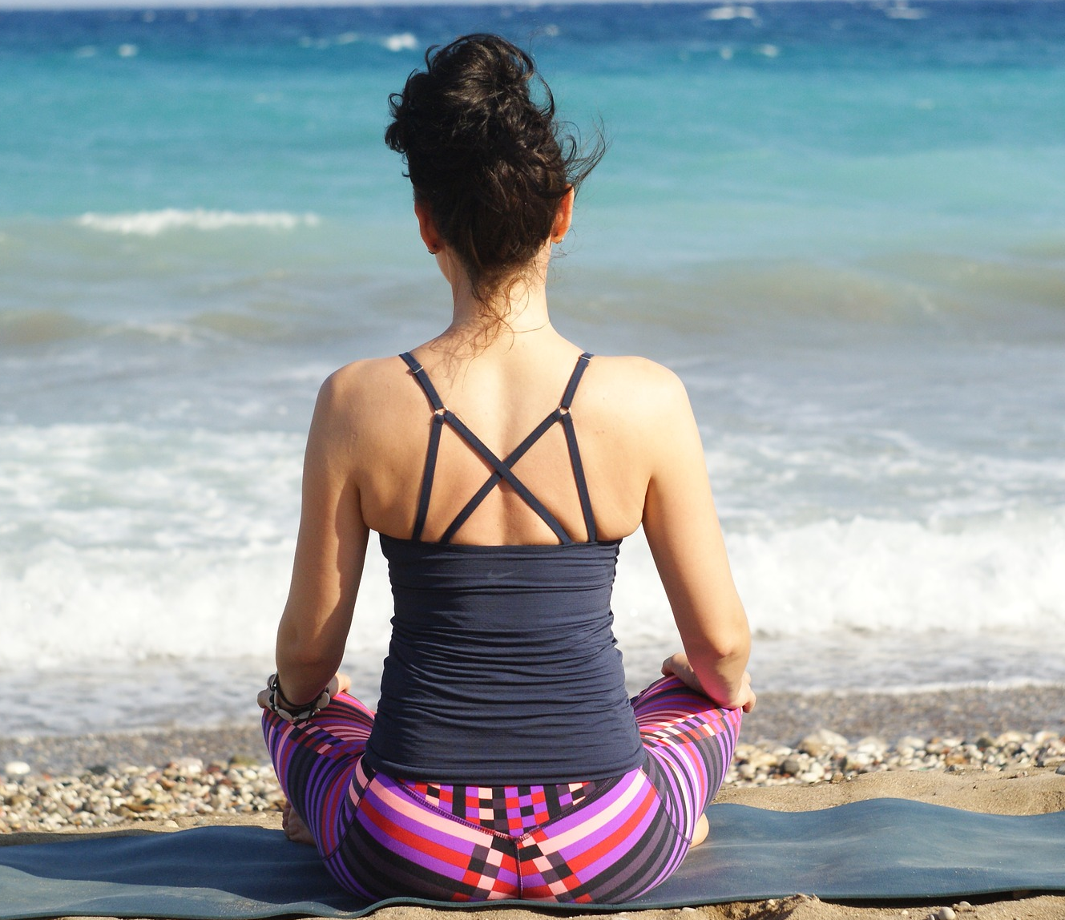
Home Page – index.html
Your hero image must cover the entire 800 width
Add the following to your stylesheet:
a:link{ color: red; }
a:visited{ color: blue; }
a:hover{ color: yellow; }
a:active{ color: lime; }

Slide 10
Index Page – index.html
Add the correct styles to:
ul
body
Set the navigation
Home to index.html
Yoga to yoga.html
Meditation to meditation.html
About to about.html
Contact to contact.html

Slide 11
All Other Pages
Add the menu to all the other pages
Add the following to the title on each page:
Mindfulness – (page name)
Mindfulness | Home
Mindfulness | Yoga
And so on…..

Slide 12
Add content to the List
Add the following:
<div id="nav">
<ul>
<li><a href="#">Home</a></li>
<li><a href="#">Yoga</a></li>
<li><a href="#">Meditationg</a></li>
<li><a href="#">About</a></li>
<li><a href="#">Contact</a></li>
</ul>
Where we have the <a href=“#”> correct that to link to the respective pages

Slide 13
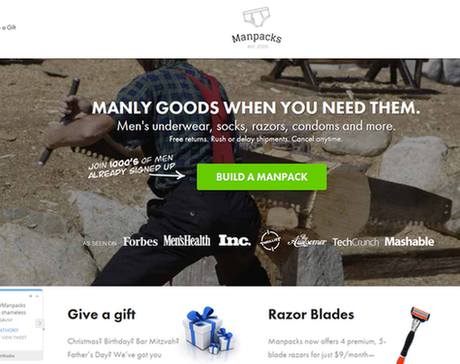
Yoga Page
Use the hero image section to create a call to action
Example:

Slide 14
Yoga Page
It must promote a yoga class – Call To Action!!!
https://adespresso.com/blog/call-to-action-examples/
https://www.wordstream.com/blog/ws/2014/10/20/call-to-action-examples
It must have a button that links the user to the yogaclass.html

Slide 15
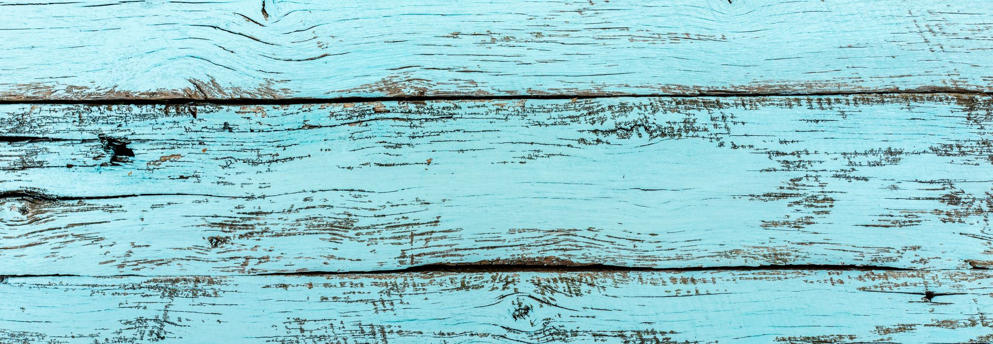
The Main Containers
We are now going to give the content area a width and centre it horizontally
Specify the width and margins of the main container, #wrap. Give it a background colour to make it show up on the page as follows:
body {
min-width:1200px;
}
.wrap {
margin:0 auto;
width:1000px;
}
The method we use to centre the content is based on the fact that when an element’s left and right margins are set to auto, they will share whatever is left when the element’s width has been subtracted from that of its container.
The width of #wrap will be subtracted from the width of the browser window.

Slide 16
Getting a Horizontal Navigation Bar
At present the navigation bar is vertical
The navigation contains a regular unordered list of links
Since we don’t want it to look like an unordered list we could restyle it like this:
#menu{
height:60px;
background-color: #666;
clear:left;
}
#menu ul{
margin:0;
padding:0;
}
#menu li{
list-style-type:none;
float:left;
display:block;
width:150px;
height:60px;
}

Slide 18
Yoga Class Page – yogaclass.html
Here you can do what you want
Show your creativity!!
This is what is known as a landing page

Slide 19
Your landing page
https://unbounce.com/landing-page-articles/what-is-a-landing-page/
Think about the 'sales funnel'

Slide 20
A Sales Funnel

Slide 21
Extra
For those that finish quickly, add another page that links from the 'BUY' button on the yogaclass.html page
Use your imagination here
Create an 'upsell' on this page

