Slide 1
Operating Systems and Architecture
^{<representation of data>}
(UFCFCU-30-1)

Slide 2
^{<outcomes>}
After completing this section of the module you will be able to:
Describe and explain computer architecture, digital logic and machine level representation of data (number systems)
boolean, byte, decimal, double, float, int, long etc
ASCII, Unicode, UTF
instructions
file formats
metadata

Slide 3
^{<data types>}
The computer works on bits and has no knowledge of what they mean
Declare data types in programs, e.g. C#
Type | Represents | Range
bool | Boolean value | True or false
byte | 8-bit unsigned integer | 0-255
char | 16-bit Unicode character | U +0000 to U +ffff
decimal | 128-bit precise decimal values with 28-29 significant digits | ±1.0 x 10⁻²⁸ to ±7.9228 x 10²⁸
double | 64-bit double-precision floating point type | ±5.0 × 10⁻³²⁴ to ±1.7 × 10³⁰⁸
float | 32-bit single-precision floating point type | ±1.5 x 10⁻⁴⁵ to ±3.4 x 10³⁸
int | 32-bit signed integer type | -2,147,483,648 to 2,147,483,647
long | 64-bit signed integer type | -9,223,372,036,854,775,808 to 9,223,372,036,854,775,807
Notes:
This just shows how programs need to declare what the bits mean.

Slide 4
^{<character sets>}
There is no algorithmic way of converting characters into bits
There have to be codes for allocating characters to bit patterns
ASCII
7 bit patterns stored in bytes with leading zero
128 characters
Alphanumeric
Punctuation
Control characters
CPU just sees bits, so comparisons can be made (eg =, >= etc)
Also arithmetic (eg “A” + 3 = D)
ASCII does not have the range to handle multiple languages
Eg Greek, Cyrillic

Slide 5
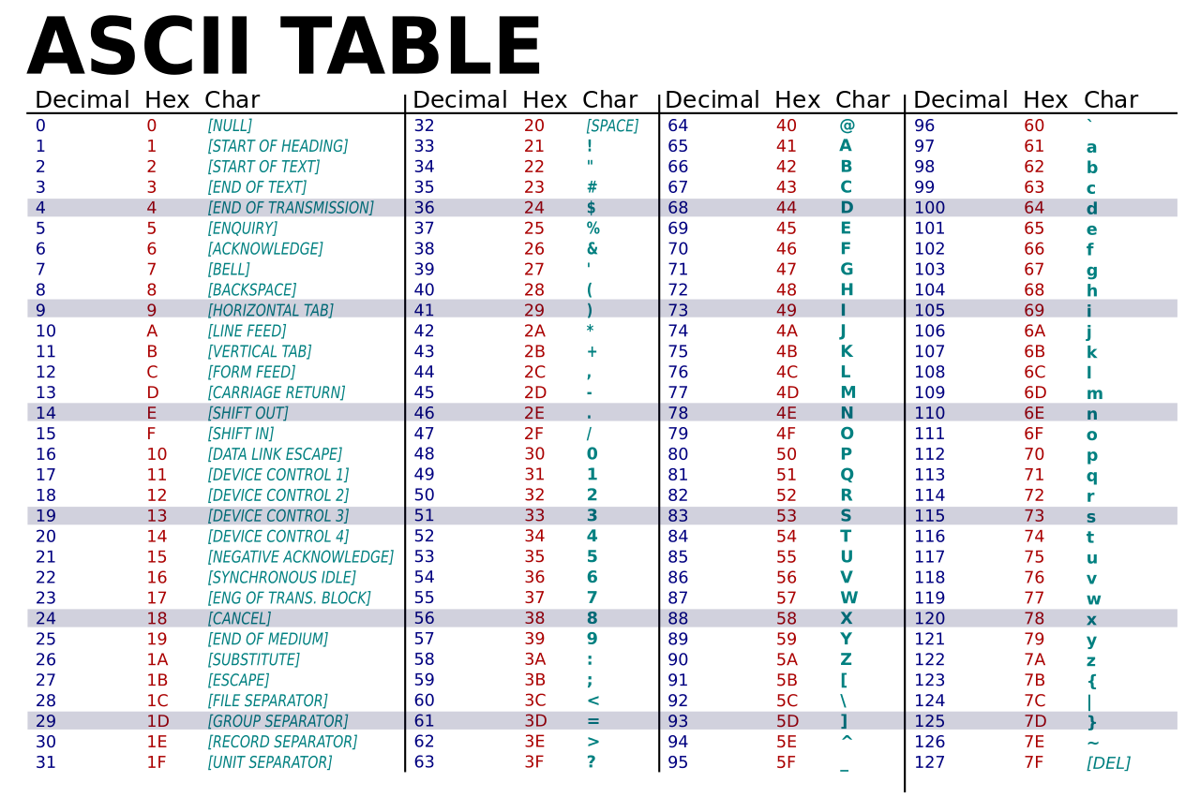
^{<ASCII>}

Slide 6
^{<character sets>}
Unicode (UTF – Unicode transformation format)
143,859 characters
154 modern and historic scripts
(eg Cyrillic, hieroglyphics)
Symbol sets and emojis
music notation, mathematical symbols
Unicode characters are encoded into binary
UTF-8 for the web
UTF-16 in operating systems

Slide 7
^{<UTF>}
UTF-8
1-4 bytes long
backwards compatible with ASCII
<meta charset="utf-8">
UTF-16
Variable length
Handles all possible Unicode
Windows from NT onwards
macOS
KDE
Java
.NET

Slide 8
^{<instructions>}
Specific binary values are defined to instruct the CPU what to do
These are called instruction sets
Three types of instructions
Data handling
Arithmetic and logic operations
Control flow operations
Sequences of instructions form machine language – op codes
Examples of instruction sets
8080 – 8 bit
x86 – 16 -> 32 -> 64 bit
ARM and ARM 64 – 32 and 64 bit
Instructions are usually referenced by three character mnemonics

Slide 9
^{<data handling>}
Data handling
Set a register to a value
MOV Rd, #immediate
Fetch data from a memory location into a register – load
LDR Rd, direct
Send data from a register to a memory location – store
STR Rs, direct
Read and write data from hardware devices
INP Rd, address
OUT Rs, address
Note: d = destination, s = source
The actual byte code for these instructions will be different for each instruction set
We will look at this in detail on day 7 – assembler language
Notes:
These are from the instruction set for the R|ISC simulator we use later on

Slide 10
^{<operations>}
Arithmetic and logic operations
Add, subtract, multiply or divide the values of 2 registers, placing the result in a register
ADD Rd, Rs, Rb
SUB Rd, Rs, Rb
MUL Rd, #immediate
Do bitwise operations (AND, OR, XOR etc)
AND Rd, Rs, Rb
ORR Rd, Rs, Rb
XOR Rd, Rs, Rb
Compare values
CMP Rb, #immediate
Notes:
# immediate is an exact value to be loaded, eg 3

Slide 11
^{<control>}
Control flow operations
Branch to another location in the program and execute instructions there
BRA Branch Always
Branch to another location on a condition
BEQ Branch if Equal
BGT Branch if Greater Than
Indirectly branch to another location (address in register)
BRA Rs
Call another block of code (address in register)
JMS Rs Jump to Subroutine
Notes:
This is just a few branches – they could see what other ones there are.

Slide 12
^{<file formats>}
In the computer a file is just a sequence of bits
A file format specifies how the bits are encoded to have meaning
Type of file format in use:
Filename extension
Internal metadata
External metadata

Slide 13
^{<file extensions>}
Filename extension
Used by most operating systems
Format based on the characters after the last period in the filename
E.g.
.exe (executable program)
.txt (any characters)
.htm/html (script language for web browsers)
.dmg (mountable disk image for OSX)
.png (portable network graphics)
.ogg (multimedia container)
Notes:
Hundreds of these.

Slide 14
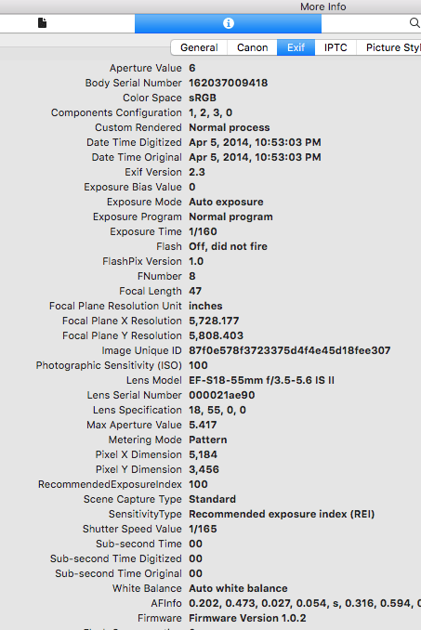
^{<metadata>}
Internal metadata
Data about the file is contained inside the file itself
Usually stored at the beginning
Can be plain text or binary
For images:
Format
Size
Resolution
Colour space

Slide 15
^{<metadata>}
Magic number
A defined number at the start of a file indicating the type
Originally 2 bytes
.jpeg FF D8
Now longer
.pdf 25 50 44 46 or %PDF in plain text
.doc D0 CF 11 E0 A1 B1 1A E1
.html <!DOCTYPE html>
Notes:
Lots of these as well

Slide 16
^{<conclusion>}
Multiple methods to indicate how a sequence of bits should be interpreted
Determines what actions operating systems and applications should take

