Slide 1
Digital Marketer
Certificate in Principles of Coding

Slide 2
Syllabus
Completed over two weeks
2 to 6 July
16 to 20 July
Appreciation of Logic (10%, K2)
Programming Languages (10%, K1)
Interaction and Compatibility of Code on Different Platforms (25%, K2)
Web components (55%, K2)

Slide 3
First Session
Appreciation of Logic (10%, K2)
Programming Languages (10%, K1)

Slide 4
Second Session
Interaction and Compatibility of Code on Different Platforms (25%, K2)
Web components (55%, K2)

Slide 5
Introduction
Hi
Leonard Shand
In the computing field for over 30 years
Cybersecurity expert

Slide 6
First Session
Appreciation of Logic (10%, K2)
Programming Languages (10%, K1)

Slide 7
Session 1
Appreciation of Logic (10%, K2)
In this topic, learners will understand and develop an appreciation of logic. The successful Apprentice should be able to:
1.1 Understand the basics of logic in computation and of logic gates.
And
Or
Not
Programming Languages (10%, K1)
In this topic, learners will become aware of programming languages and how they apply in building digital products. The successful Apprentice should be able to:
2.1 Identify the key characteristics and applications of the following programming languages:
Hypertext Markup Language (HTML)
JavaScript (JS)
Java

Slide 8
Session 1
3. Interaction and Compatibility of Code on Different Platforms (25%, K2)
In this topic, learners will gain an understanding of code compatibility on different platforms. The successful Apprentice should be able to:
3.1 Memorise the LAMP (Linux, Apache, MySQL, and PHP) and XAMPP stack. Describe the associated code compatibility with using alternative proprietary web stacks.
3.2 Discuss how the following file formats that can be shared across multiple digital platforms and issues that arise around compatibility:
PDF
HTML
Image (GIF, JPG, PNG)
Video; Mpeg
Audio; MP3
3.3 Describe each stage required to generate or commission code. What considerations will be required to ensure code capability across multiple devices and the associated infrastructure limitations.
Social media platforms feeds (called widgets) used on a new digital solution.
Creating and protecting feeds (using API keys) for use by other organisations.

Slide 9
Binary
Binary is used in a computer because it has a definite state
On
Off
Represented by ones and zeros
1001 – represents the number 9
01100101 - represents the letter e
All data that we want a computer to process needs to be converted into this binary format.

Slide 10
Binary
Denary | Binary |  | Denary | Binary
0 | 0000 |  | 5 | 0101
1 | 0001 |  | 6 | 0110
2 | 0010 |  | 7 | 0111
3 | 0011 |  | 8 | 1000
4 | 0100 |  | 9 | 1001

Slide 11
Converting from Binary to Denary
Thousands | Hundreds | Tens | Units
(1000s) | (100s) | (10s) | (1s)
Thousands | Hundreds | Tens | Units
1 | 0 | 2 | 4
1 x 1000 | 0 x 100 | 2 x 10 | 4 x 1

Slide 12
Converting from Binary to Denary
512 | 256 | 128 | 64 | 32 | 16 | 8 | 4 | 2 | 1
2⁹ | 2⁸ | 2⁷ | 2⁶ | 2⁵ | 2⁴ | 2³ | 2² | 2¹ | 2⁰
1 | 0 | 0 | 1 | 1 | 1 | 0 | 1 | 0 | 1
1 x 512 | 0 x 256 | 0 x 128 | 1 x 64 | 1 x 32 | 1 x 16 | 0 x 8 | 1 x 4 | 0 x 2 | 1 x 1
512 | 0 | 0 | 64 | 32 | 16 | 0 | 4 | 0 | 1
This gives us a denary value of….
629

Slide 13
Converting from Denary to Binary
Convert 354 from denary to binary
Start at left and ask "Can 512 be taken away from 354?"
No, place 0 in the first column
Now ask "Can 256 be taken away from 354?"
Yes, once. So now place 1 in the second column
354 – 256 = 98
Now ask "Can 128 be taken away from 98?"
No, place 0 in the third column
Continue this process until you reach zero
512 | 256 | 128 | 64 | 32 | 16 | 8 | 4 | 2 | 1
0
1
0
1
1
0
0
0
1
0

Slide 14
Adding Binary Numbers
There are four rules that need to be followed when adding two binary numbers. These are:
0 + 0 = 0
1 + 0 = 1
1 + 1 = 10 (binary for 2)
1 + 1 + 1 = 11 (binary for 3)

Slide 15
Let’s try adding together two binary numbers: 0101 0011 and 0111 0110.
When we have 2 ones, group them
1
1
1
1
1
This ring looks
like a zero
0101 0011
+
0111 0110
'Carry' a one to the next column and place a zero below the line
100 1001
1

Slide 16
Understand the basics of logic in computation and of logic gates
Logic gates are used in computers to perform certain functions
There are three main logic gates to consider:
AND
OR
NOT

Slide 17
AND
Go to the store and buy me an apple AND a pear
Apple | Pear | T/F
No | No | False
No | Yes | False
Yes | No | False
Yes | Yes | True
Apple | Pear | T/F
0 | 0 | 0
0 | 1 | 0
1 | 0 | 0
1 | 1 | 1

Slide 18
Programming Languages
A web page (also written as webpage) is a document that is suitable for the World Wide Web and web browsers.
A web browser displays a web page on a monitor or mobile device.

Slide 19
Browsers
All browsers display web pages
Not all browsers behave the same
Internet Explorer does not follow web standards

Slide 20
Browsers
Over 100 browsers available
Can install more than one
Top 6:
Chrome
Safari
Firefox
Internet Explorer
Opera
Edge (Windows 10 only)

Slide 21
Web pages
But that is what we see
There are many other aspects hidden to the user that makes up a web page

Slide 22
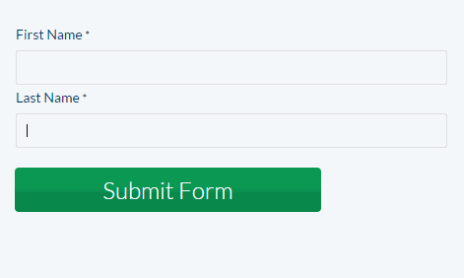
Hidden Elements
JavaScript, jQuery and Ajax
Allows the user to 'interact' with the web page

Slide 23
Server Code
PHP, ASP.Net, C#
Allows the server to do some processing before returning the web page to the browser

Slide 24
Server processes content
Processed content is returned to web server
Server returns the html page
Server returns the html page
User requests a web page
If page requires processing, sent to processing server
Server finds file and reads contents

Slide 25
A web page's construction…

Slide 26
Anatomy of a Web Page
<!DOCTYPE html>
<html lang="en">
<head>
<meta charset="UTF-8">
<title>Document</title>
<script></script>
<style></style>
</head>
<body>
</body>
</html>
What type of page am I?
What language am I written in?
What the rest of the page needs to know about me to function correctly
What the search engine looks for
What am I called?
Do I use scripts to function?
How will I look?
Most of the stuff the visitor sees and interacts with is known as the content, stuff like pictures, videos, Flash, links, forms, etc.
This indicates the end of my content
This is the end of everything

Slide 27
Anatomy of a Web Page
Courtesy: http://www.agenius-marketing.com/websites/web-site-design-anatomy/

Slide 28
HTML Code
<!DOCTYPE html>
<html lang="en">
<head>
<meta charset="UTF-8">
<title>Document</title>
</head>
<body>
<div><h1></h1></div>
<div><ul><li></li></ul><div>
<div></div>
</body>
</html>

Slide 29
Hypertext Markup Language (HTML)
HTML stands for Hyper Text Markup Language
HTML describes the structure of Web pages using markup
HTML elements are the building blocks of HTML pages
HTML elements are represented by tags
HTML tags label pieces of content such as "heading", "paragraph", "table", and so on
Browsers do not display the HTML tags, but use them to render the content of the page

Slide 30
Elements
An HTML element usually consists of a start tag and end tag, with the content inserted in between:
<tagname>Content goes here...</tagname>
The HTML element is everything from the start tag to the end tag:
<p>My first paragraph.</p>

Slide 31
Nested Elements
Elements can be nested, i.e. they can contain elements
<ul>
<li></li>
<li></li>
<li></li>
</ul>

Slide 32
HTML Attributes
Attributes provide additional information about HTML elements.
All HTML elements can have attributes
Attributes provide additional information about an element
Attributes are always specified in the start tag
Attributes usually come in name/value pairs like: name="value"

Slide 33
Links
Different types of links:
Navigation
Standard
Image

Slide 34
Navigation Links
Usually ordered in a list

Slide 35
Standard Link
HTML links are defined with the <a> tag. The link address is specified in the href attribute:
<a href="http://gloscol.ac.uk">This is a link</a>
The 'a' is called the anchor tag

Slide 36
Image Links
HTML images are defined with the <img> tag.
The filename of the image source is specified in the src attribute:
<img src="logo.jpg">
Image tags should have an 'alt' attribute in the event the image cannot be displayed, or for people with vision impairment
<img src="logo.jpg" alt = "Gloscol logo">

Slide 37
Attributes
Attribute | Description
alt | Specifies an alternative text for an image, when the image cannot be displayed
disabled | Specifies that an input element should be disabled
href | Specifies the URL (web address) for a link
id | Specifies a unique id for an element
src | Specifies the URL (web address) for an image
style | Specifies an inline CSS style for an element
title | Specifies extra information about an element (displayed as a tool tip)

Slide 38
Headings
Headings are defined with the <h1> to <h6> tags
<h1>Heading 1</h1> <h2>Heading 2</h2> <h3>Heading 3</h3> <h4>Heading 4</h4> <h5>Heading 5</h5> <h6>Heading 6</h6>

Slide 39
<head> Element
The HTML <head> element has nothing to do with HTML headings.
The <head> element is a container for metadata. HTML metadata is data about the HTML document. Metadata is not displayed.
The <head> element is placed between the <html> tag and the <body> tag

Slide 40
Activity
Let's create a web page

Slide 41
Day 2 - Programming Languages
Aware of programming languages and how they apply in building digital products
The successful Apprentice should be able to:
Identify the key characteristics and applications of the following programming languages:
Hypertext Markup Language (HTML)
JavaScript (JS)
Java

Slide 42
JavaScript (JS)
JavaScript is used to provide interactive features to a web page
It is a dynamic programming language
It adds behaviour to your web page
It is embedded within the HTML code
Some things we can do the in JavaScript:
Form validation
Calculations
Animations
Load images

Slide 43
Add JavaScript to Web Pages
JavaScript needs to be placed within the script tag
<script> code </script>
Scripts can be placed in the head section

Slide 44
Task
Follow worksheets 2, 3 and 4 on the Wiki

Slide 45
Java
Java is NOT the same as JavaScript
Is a full on Object Oriented Programming language

Slide 46
Day 3
3. Interaction and Compatibility of Code on Different Platforms (25%, K2)
In this topic, learners will gain an understanding of code compatibility on different platforms. The successful Apprentice should be able to:
3.1 Memorise the LAMP (Linux, Apache, MySQL, and PHP) and XAMPP stack. Describe the associated code compatibility with using alternative proprietary web stacks.
3.2 Discuss how the following file formats that can be shared across multiple digital platforms and issues that arise around compatibility:
PDF
HTML
Image (GIF, JPG, PNG)
Video; Mpeg
Audio; MP3
3.3 Describe each stage required to generate or commission code. What considerations will be required to ensure code capability across multiple devices and the associated infrastructure limitations.
Social media platforms feeds (called widgets) used on a new digital solution.
Creating and protecting feeds (using API keys) for use by other organisations.

Slide 47
3.1 - Different Platforms
Two main platforms:
Windows
Linux

Slide 48
Windows
We have a Windows ‘stack’
WAMP
Windows
Apache
MySQL
PHP
Operating system
A web server
Database system
For processing code

Slide 49
Linux
We have a Linux ‘stack’
LAMP
Linux
Apache
MySQL
PHP
Operating system
A web server
Database system
For processing code

Slide 50
Alternatives
MAMP – works on Mac (Apple)
SAMP – works on Sun Microsystems
FAMP – works on FreeBSD
XAMPP – works on any operating system
You need to download the correct version

Slide 51
3.2 - File Formats
All files have a specific format
Types of files
Images
png, jpg, gif, svg, dwg, cdr, psd
Documents
doc, docx, odt, wpd, pdf
Scripts
html, php, sql, py, aspx,
Audio
mpeg, mp3, wav, ogg, flac
Video
avi, flv, mov, mp4, wmv

Slide 52
Portability
Not all files work on all platforms
Some formats are proprietary
Some formats need to die (Flash)

Slide 53
Problems
What happens when you want to play a specific file?

Slide 54
Resources
Video - https://www.motionelements.com/blog/articles/what-you-need-to-know-about-the-5-most-common-video-file-formats
Audio - https://www.toptenreviews.com/software/articles/audio-file-types/
https://www.falmouth.ac.uk/content/6-common-audio-file-types

Slide 55
3.3 - Generating or Commissioning Code
Five main ingredients in the programming process:
Defining the problem
Planning the solution
Coding the program
Testing the program
Documenting the program

Slide 56
The Process

Slide 57
Requirements
The task of defining the problem consists of:
identifying what it is you know (input-given data)
what it is you want to obtain (output-the result)
Eventually, you produce a written agreement that, among other things, specifies the kind of input, processing, and output required
This is not a simple process

Slide 58
Design
Two common ways of planning the solution to a problem are:
draw a flowchart
write pseudocode
or possibly both

Slide 59
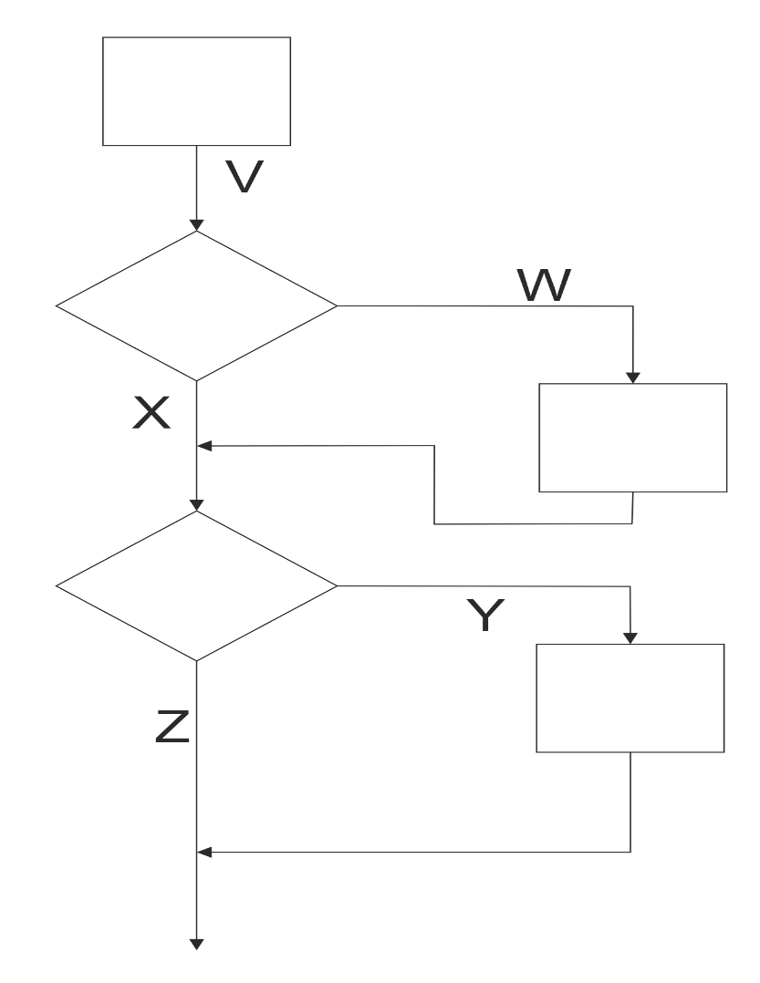
Flowchart

Slide 60
Psuedocode
Get the radius
Is radius larger than 10?
Error message (“Choose smaller radius”)
Calculate area of circle

Slide 61
Implementation
This is where the actual coding is done
Similar to what you did when coding up a web page

Slide 62
Testing
A crucial component of the lifecycle
Not everything can be tested

Slide 63
Maintenance
This is where specific releases are introduced
Could be regulatory, mandatory or functional
Non-functional components could be introduced here

Slide 64
Social media platforms feeds
A Web feed or RSS feed is a format that provides users with frequently updated content
Content distributors syndicate a Web feed, enabling users to subscribe to a site's latest content

Slide 65
API’s
An API is a set of functions and procedures that allow the creation of applications which access the features or data of an operating system, application, or other service
Application Programming Interface

Slide 67
API - Example
If you want to capture photos or video from the iPhone’s camera, you don’t have to write your own camera interface
You use the camera API to embed the iPhone’s built-in camera in your app.

Slide 68
Day 7
4. Web components (55%, K2)
In this topic, learners will understand the components involved to make the Web work. The successful Apprentice should be able to:
4.1 Define the terminology for the following key internet protocols that enable the web to work:
Hypertext Transfer Protocol (HTTP)
Hypertext Transfer Protocol Secure (HTTPS)
Transport Layer Security and Secure Sockets Layer (TLS / SSL)
4.2 Discuss the purpose of the following:
Web and application server
Hosting and serving
Relational database management systems
Content management systems

Slide 69
4.3 Describe the purpose of a web client; browsers and applications.
4.4 Describe how Search Engines operate in regard to the following:
How mark-up languages render hyperlinks.
How the web crawler work.
Displaying of search results.
Factors that affect search engine optimization (SEO).

Slide 70
4.5 Explain the differences between a static and dynamic website.
Written in code
Written scripting language
4.6 Describe how local (cookies) or session data storage is utilised to share information for standard digital features
forms
checkout
registration
4.7 Identify the key roles of the following Web technologies governance groups:
World Wide Web Consortium (W3C)
Internet Engineering Task Force (IETF).

Slide 71
Terminology for Key Internet Protocols
Hypertext Transfer Protocol (HTTP)
Foundation of data communication for the World Wide Web
NOT secure
Hypertext Transfer Protocol Secure (HTTPS)
An extension of the Hypertext Transfer Protocol
Secure
Look for the padlock
Uses Transport Layer Security (TLS)
Transport Layer Security and Secure Sockets Layer (TLS / SSL)
TLS replaced SSL
Cryptographic protocols that provide communications security over a computer network

Slide 72
Organisations
IETF (https://www.ietf.org/)
The Internet Engineering Task Force (IETF) develops and promotes voluntary Internet standards, in particular the standards that comprise the Internet protocol suite (TCP/IP)
W3C (www.w3.org)
The World Wide Web Consortium (W3C) is the main international standards organisation for the World Wide Web
Founded and currently led by Tim Berners-Lee

Slide 73
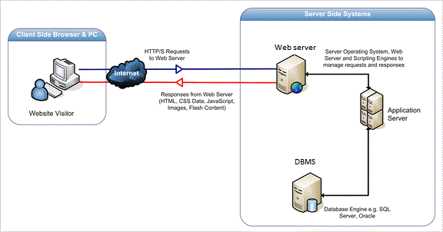
Web and Application Server
Web server serves web content over HTTP
Displays site content
Application server serves business logic to application programs through any number of protocols

Slide 74
Hosting and Serving
Hosting
A web host, or web hosting service provider, is a business that provides the technologies and services needed for the website or webpage to be viewed in the Internet
Websites are hosted, or stored, on special computers called servers
Web servers
Hardware dedicated to running web server software

Slide 75
Relational Database Management Systems
Complex database software
Make use of relationships between entities
Examples:
MariaDB
MySQL
SQL Server
Access (Desktop)

Slide 76
Example database system

Slide 77
Content Management Systems
Manages the creation and modification of digital content
Support the separation of content and presentation
A web content management system (WCM or WCMS) is a CMS designed to support the management of the content of Web pages
Most popular CMSs are also WCMSs
Web content includes text and embedded graphics, photos, video, audio, maps, and program code (e.g., for applications) that displays content or interacts with the user.

Slide 78
Content Management Systems
Such a content management system (CMS) typically has two major components:
A content management application (CMA) is the front-end user interface that allows a user, even with limited expertise, to add, modify, and remove content from a website without the intervention of a webmaster.
A content delivery application (CDA) compiles that information and updates the website.
Is a backend system

Slide 79
Example CMS

Slide 80
Web client; Browsers and Applications
Web client
A user interface through which messages are sent to a web server
A web client usually operates within a web browser
Browser
Used to access the World Wide Web
Applications
Any computer program that performs a specific function by using a web browser as its client
Example: contact form

Slide 81
Static and Dynamic Website
Static
Pages coded in HTML only
Content needs to be changed manually
Dynamic
Pages coded in HTML and other languages such as PHP, JavaScript, VB.net, C#
Pages content changes when user requests a piece of content or upon input into the page

Slide 82
Static Pages - Code
<!DOCTYPE html>
<html lang="en">
<head>
<meta charset="UTF-8">
<title>Len's Cakes | Home</title>
<link rel="stylesheet" href="css/styles.css">
</head>
<body>
<div class="header">
<div class="nav"><img src="images/cherryCupCake.png" alt="Cherry cup cake logo" width="100px" >
<ul>
<li><a href="index.html">Home</a></li>
<li><a href="about.html">About</a></li>
<li><a href="cakes.html">Our Cakes</a></li>
<li><a href="contact.html">Contact</a></li>
<li><a href="faq.html">FAQ</a></li>
</ul>
</div>

Slide 83
Dynamic Pages – Code (JavaScript)
Use Worksheet 5 to create a new web page

Slide 84
Dynamic Pages – Code (PHP)
Use Worksheet 6 to create a new web page

Slide 85
4.6 - Cookies
A cookie is often used to identify a user
A cookie is a small file that the server embeds on the user's computer
Each time the same computer requests a page with a browser, it will send the cookie too
With PHP, you can both create and retrieve cookie values.

Slide 86
Session Data
The session_start() function checks for an existing session
If one is not found, it creates a new session and gives it a Session ID

Slide 87
Storing a Simple Counter Value
Session information stored in session variables using the $_SESSION array.
A simple counter variable is created for the session and is set to 1
<?php
session_start();
$_SESSION['count'] = 1;
?>

Slide 88
session01.php
Create a folder called login
Place session01.php into it
<?php
session_start();
$_SESSION['count'] = 1;
?>

Slide 89
session01.php
<html>
<head>
<title>Some web page</title>
</head>
<body>
<?php
echo "Counter value = ".$_SESSION['count'];
?>
</body>
</html>

Slide 90
Checking if a Session Exists
To check whether a variable exists and has been assigned use the isset() function
It returns true if the variable has been set (given a value) and false otherwise.
We will use the isset() function to check whether the count variable exists and has been set.
If it has, the code will increment the value of count.
Else, the count variable will be created and set to 1.

Slide 91
session02.php
<?php
session_start();
if(isset($_SESSION['count'])) $_SESSION['count'] = $_SESSION['count'] + 1;
else $_SESSION['count'] = 1;
?>

Slide 92
session02.php
<html>
<head>
<title>Some web page</title>
</head>
<body>
<?php
echo "Counter value = ".$_SESSION['count'];
?>
</body>
</html>

Slide 93
Session Checker
The result is initially the same, but each time the page is refreshed the counter increases by one

Slide 94
Clearing a Session
Clear the contents of a particular session variable using the unset() function
The following script will clear the count variable when it reaches 10
The page will then say the count does not have a value and then start again

Slide 95
session03.php
<?php
session_start();
if(isset($_SESSION['count'])) { $_SESSION['count'] = $_SESSION['count'] + 1; if($_SESSION['count'] > 5) unset($_SESSION['count']);
} else
$_SESSION['count'] = 1;
?>

Slide 96
session03.php
<html>
<head>
<title>Some web page</title>
</head>
<body>
<?php
if(isset($_SESSION['count']))
echo "Counter value = ".$_SESSION['count'];
else echo "The counter does not currently have a value!";
?>
</body>
</html>

Slide 97
Login
For this example the user name and password will be stored in the script
Later we will use multiple user names and passwords stored in a database table

Slide 98
Pages
Login page:
establishes a session and asks the user to enter a username and password.
if the credentials match, a session variable called login will be set to "OK",
the user will be directed to:
Protected page:
checks $_SESSION value is "OK",
if true the user is redirected to the login screen

Slide 99
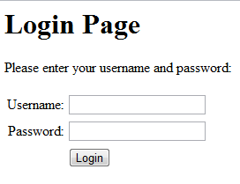
login01.php
Displays a form to enter the user name and password
If they match it calls protected.php
If they are blank or don’t match, it calls itself

Slide 100
login01.php (part 1)
<?php
$user = $_POST["username"];
$pass = $_POST["password"];
$validated = false;
session_start();
if($user!=""&&$pass!="") { if($user=="jsmith"&&$pass=="letmein") $validated = true;
if($validated) {
$_SESSION['login'] = "OK";
$_SESSION['username'] = $user;
$_SESSION['password'] = $pass;
header('Location: protected.php');
}

Slide 101
login01.php (part 2)
else {
$_SESSION['login'] = "";
echo "Invalid username or password.";
}
}
else $_SESSION['login'] = "";
?>

Slide 102
login01.php (part 3)
<html>
<body>
<h1>Login Page</h1>
<p>Please enter your username and password:</p> <form action="login01.php" method="post">
<table> <tr>
<td align="right">Username: </td>
<td>
<input size=\"20\" type="text" size="20" maxlength="15" name="username">
</td> </tr>

Slide 103
login01.php (part 4)
<tr>
<td align="right">Password: </td>
<td>
<input size=\"20\" type="password" size="20" maxlength="15" name="password">
</td>
</tr>
<tr>
<td>
</td>
<td colspan="2" align="left">
<input type="submit" value="Login">
</td>
</tr>
</table>
</form>
</body>
</html>

Slide 104
protected.php (part 1)
<?php
session_start();
if($_SESSION['login'] != "OK") {
header('Location: login01.php');
//Send user back to login page
exit();
}
?>
<html>
<head> <title>Protected Web Page</title>
</head>

Slide 105
protected.php (part 2)
<body>
<h1>Protected Web Page</h1>
<?php
echo "<p>You have successfully logged in!</p>";
echo "<p>Your username is: ";
echo $_SESSION['username'];
echo "<br/>";
echo "Your password is: ";
echo $_SESSION['password'];
echo "</p>"
?>
</body>
</html>

Slide 106
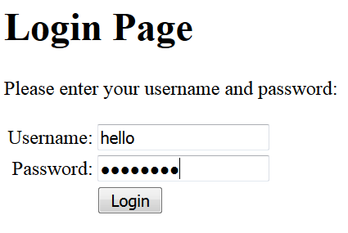
Login Result
If the user name and password are entered incorrectly, then the user is referred back to the login page with a message

Slide 107
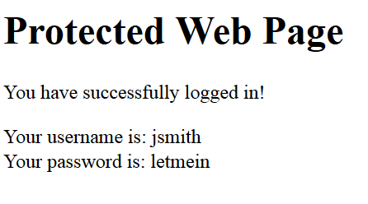
Login Result
If the user name “jsmith” and password “letmein” are entered correctly, then the protected page is displayed
If the protected page is accessed without being logged in, then the login page is displayed

Slide 108
Forms
Used to allow a user to enter data into a web page
Form.html
<html> <body> <form action="welcome.php" method="post"> Name: <input type="text" name="name"><br> E-mail: <input type="text" name="email"><br> <input type="submit"> </form> </body> </html>

Slide 109
Forms
Welcome.php
<html> <body> Welcome <?php echo $_POST["name"]; ?><br> Your email address is: <?php echo $_POST["email"]; ?> </body> </html>

Slide 110
Checkout
Part of the process of online shopping in which the customer enters delivery information and pays for the item
Example:
Amazon

Slide 111
Registration
A registration form allows user data to be stored in a database
Good for making email lists or setting up access rights to allow a user to login to a site

Slide 112
End!!!!!

