Slide 1
Cloud Networking Basics

Slide 2
No Connection
Single user
No connection
Very secure

Slide 3
Connection
Two users
Crossover cable
Full duplex
Transmit and receive at the same time
OSI layer 1 – Physical
Transmission of bits
100010100101010

Slide 4
Hub
Two or more users
A single network segment
Straight cables
OSI layer 1 – Physical
Transmission of bits
Hub
Amplifies signal
Broadcasts input on all outputs
Clients reject inputs not for them
Half duplex – transmit or receive
Poor performance
101001
101001
101001
101001

Slide 5
MAC (Media Access Control) Addressing
Uniquely identifies a network interface controller (NIC)
MAC addresses are used as a network address for Ethernet and Wi-Fi
Addresses are assigned by the manufacturer and stored in the NIC’s read-only memory or firmware
It is a 48-bit address for 281,474,976,710,656 possible MAC addresses (normally shown as 6 octets) ether 4a:00:02:00:ca:e0 (from ifconfig)
ipconfig or ifconfig commands show the MAC address

Slide 6
Packets and frames
A MAC address allows data to be directed to a specific device
The data segment is called a frame
Preamble | Start of frame delimiter | Destination | Source | Length | Data | CRC
Timing |  | MAC Addressing |  | Amount of data | Payload | Checksum
7 bytes | 1 byte | 6 bytes | 6 bytes | 2 bytes | 46-1500 bytes | 4 bytes
FRAME

Slide 7
Switch
Two or more users
A single network segment
Straight cables
OSI layer 2 – Data Link
Transmission of packets
Switch
Amplifies signal
Directs inputs to correct outputs
Full duplex
Best performance
Error checking
101001
111011
101001
111011

Slide 8
Switch operation
Works on the Layer 2 Header
Uses the source and destination MAC addresses to make its forwarding decisions.
MAC Address Table
maps the switch’s ports to MAC addresses
the source address and the port a frame was received on are entered in the MAC Address Table.
as each connected device sends a frame the table gets fully populated
the table is then used to forward frames to their intended destination

Slide 9
Local Area Network
When the area covered is small, such as an office, this is known as a Local Area Network (LAN)
Devices connected to the switches are called Hosts
The hosts are typically clients, servers or LAN attached peripherals, such as printers
A LAN can be wired or wireless
Switches can be cascaded to increase the number of hosts

Slide 10
Increasing the number of hosts
Adding switches is inefficient (inactive hosts are flushed from the MAC address table after 300s)
Adding hosts increases traffic congestion on the LAN (more collisions and failed transmissions)
Adding hosts means increased processing loads
The solution is to create additional physical networks

Slide 11
IP addresses
A MAC address is physical, it allows packets to be delivered from one NIC to another (hop to hop)
IP addresses are logical and allow delivery of packets across networks (from end to end)
IP addresses work at OSI layer 3 – Network
An address is a 32 bit binary number represented as 4 octets
E.g. 192.168.1.123 (IP v4)
Destination and source IP addresses are added to the data payload of the ethernet packet

Slide 12
Packets with IP addresses
Preamble | Start of frame delimiter | Destination | Source | Length | Data | CRC
Timing |  | MAC Addressing |  | Amount of data | Payload | Checksum
7 bytes | 1 byte | 6 bytes | 6 bytes | 2 bytes | 46-1500 bytes | 4 bytes
PACKET
Source IP address | Destination IP address
4 bytes | 4 bytes

Slide 13
Two networks
192.168.1.9
X
R1 NIC
R2 NIC
A
Router
B
192.168.1.12
192.168.2.7
Source MAC | Destination MAC | Source IP | Destination IP
Host A | Router R1 | 192.168.1.12 | 192.168.2.7
Source MAC | Destination MAC | Source IP | Destination IP
Router R2 | Host B | 192.168.1.12 | 192.168.2.7

Slide 14
ARP Address Resolution Protocol
Used to find the MAC address for a given IP
Host A (192.168.1.12) needs to send to Host B (192.168.2.7)
It knows 192.168.2.7 is in a different network
It has a default gateway of 192.168.1.1 (the router)
It sends a broadcast ARP message (MAC ff:ff:ff:ff:ff:ff) for 192.168.1.1 (this goes to all hosts on the network)
Only the router replies with its Mac and IP addresses
Host A updates its ARP table
Sends packet to 192.168.2.7 with router MAC address

Slide 15
ARP table

Slide 16
Router Table In Host A (192.168.1.12)
Contains a 0.0.0.0 entry which points to the default gateway 192.168.1.1
Contains other IP addresses on its own network and the address of its own NIC
If sending to Host X it will look in the table and send directly
If sending to Host B (192.168.2.7) will find 0.0.0.0 as the closest match in the table and send to the gateway
Network Destination | Gateway | Interface | Notes
0.0.0.0 | 192.168.1.1 | 192.168.1.12
127.0.0.1 | On-Link | 127.0.0.1 | Loopback
192.168.1.9 | On-Link | 192.168.1.12 | Host X

Slide 17
Router’s Table
Contains a list of IP addresses and interfaces
If sending to 192.168.1.n will forward via R1 NIC
If sending to 192.168.2.n will forward via R2 NIC /24 refers indirectly to the number of hosts on the network and is covered in subnetting (not in the BCS Cloud syllabus)
IP address | Interface
192.168.1.0/24 | R1 NIC
192.168.2.0/24 | R2 NIC

Slide 18
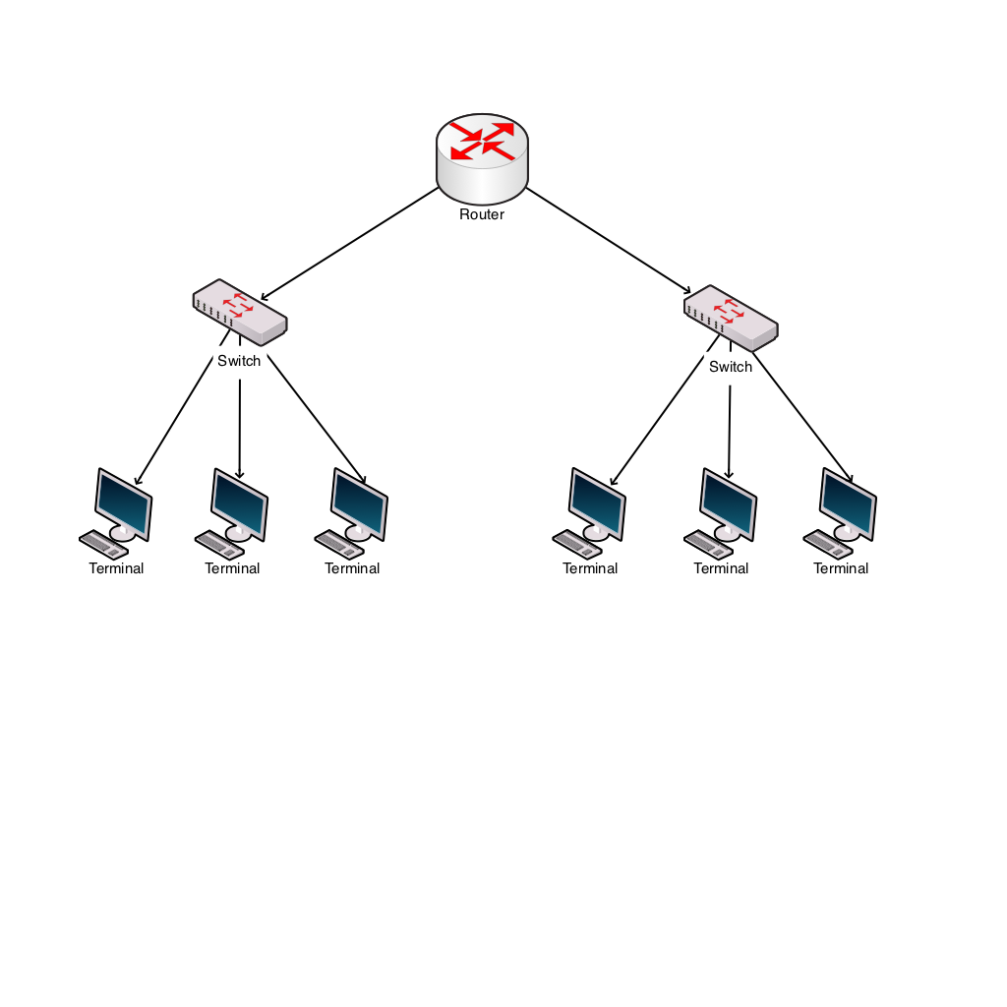
Windows Network Utilities
Ping
Tests connectivity
ping 192.168.2.7
ARP
Shows MAC addresses for IP addresses

Slide 19
IP addresses
IP address classes
Class D is used for multicast (224-239)
Class E is experimental (240-255)
One class A address is worth 16M hosts
Therefore a way is needed to allocate significantly more hosts than are available
Address class | First octet range | Number of hosts
A | 1-126 | 16M
B | 128-191 | 64k
C | 192-223 | 254

Slide 20
Private IP addresses
Address ranges allocated as private, therefore not permissible onto the general internet.
So, an organisation can have one outward facing IP address and up to 16M hosts inside
This is done using network address translation (explained later)
Address range | Number of hosts
10.0.0.0 – 10.255.255.255 | 16M
172.16.0.0 – 172.31.255.255 | 1M
192.168.0.0 – 192.168.255.255 | 64K

Slide 21
Setting IP addresses
Assume a small system with 192.168.1.n addresses
Static addresses are set on the device
Dynamic addresses are leased by a DHCP server
IP address | Host | Type
192.168.1.1 | Router | Static
192.168.1.10 | Server | Static
192.168.1.20 | Printer | Static
192.168.1.100 - 200 | Desktops | Dynamic

Slide 22
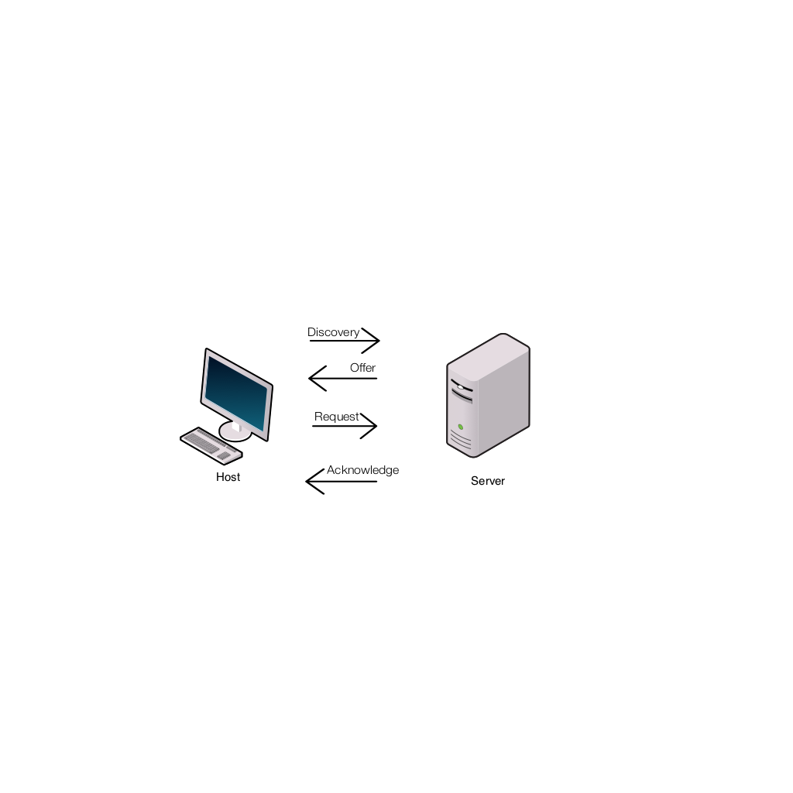
DHCP Dynamic Host Configuration Protocol
Host sends a discovery request (255.255.255.255) for a DHCP server
Server responds with a lease offer of an IP address, gateway address, duration and DNS server address (see later for DNS)
Host responds with a request to accept the offered lease
Server acknowledges the request
Host configures its network interface with the agreed parameters

Slide 23
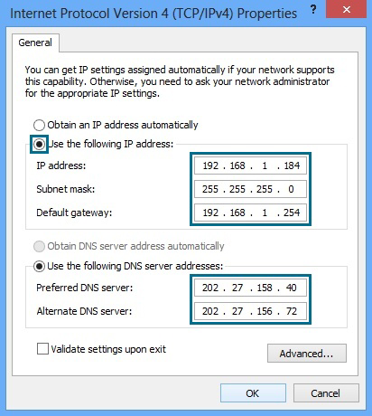
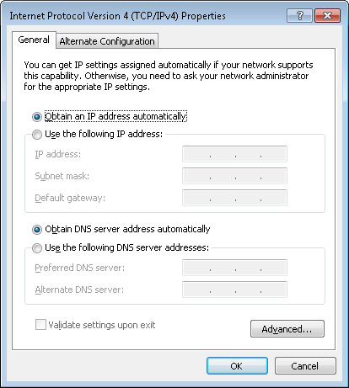
DHCP Windows Configuration
Static Dynamic

Slide 24
Recap
Hosts have MAC and IP addresses
They can communicate in the same network using switches and MAC addressing
To communicate between networks they use routers and IP addresses
Private IP addresses allow duplicate usage in different organisations, but are not allowed on the internet
IP addresses can be manually configured or obtained by DHCP

Slide 25
Internet connection
Connection to the ISP
ADSL
Cable
Satellite
Cellular
Leased line
ISP supplies:
IP address via DHCP
DNS address

Slide 26
ISP IP addresses
An ISP will allocate an IP address from a range it owns
These IP addresses are unique on the internet
Gloucester College IP address is 212.219.57.69
All internet traffic to and from Gloucester College is via the IP address 212.219.57.69
Internal IP addresses at the college will be from the private IP addresses ranges
How does traffic for a private IP address get to the right host?

Slide 27
Network and port address translation (NAT and PAT)
Implemented in the router
Allows many hosts on the internal network to connect via one public IP address
Allows many applications on one host to communicate with many services in the cloud
Uses IP and port numbers

Slide 28
Ports
An IP address and a port address make up a socket
Eg 212.219.57.69:80 (Gloucester college HTTP port)
An application, service or process uses the socket to send and receive data via the network – OSI Layer 4 Transport
The operating system
transmits the data from all application ports on to the network
directs received packets to the matching IP address and port number

Slide 29
Port allocation
Well known ports 0-1023
Examples
21 FTP
25 SMTP
80 HTTP
110 POP3
443 HTTPS
Registered ports 1024-49151
Dynamic ports 49152-65535

Slide 30
Packets with IP addresses and port numbers
Preamble | Start of frame delimiter | Destination | Source | Length | Data | CRC
Timing |  | MAC Addressing |  | Amount of data | Payload | Checksum
7 bytes | 1 byte | 6 bytes | 6 bytes | 2 bytes | 46-1500 bytes | 4 bytes
PACKET
Source IP address | Destination IP address | Source port number | Destination port number
4 bytes | 4 bytes | 2 bytes | 2 bytes

Slide 31
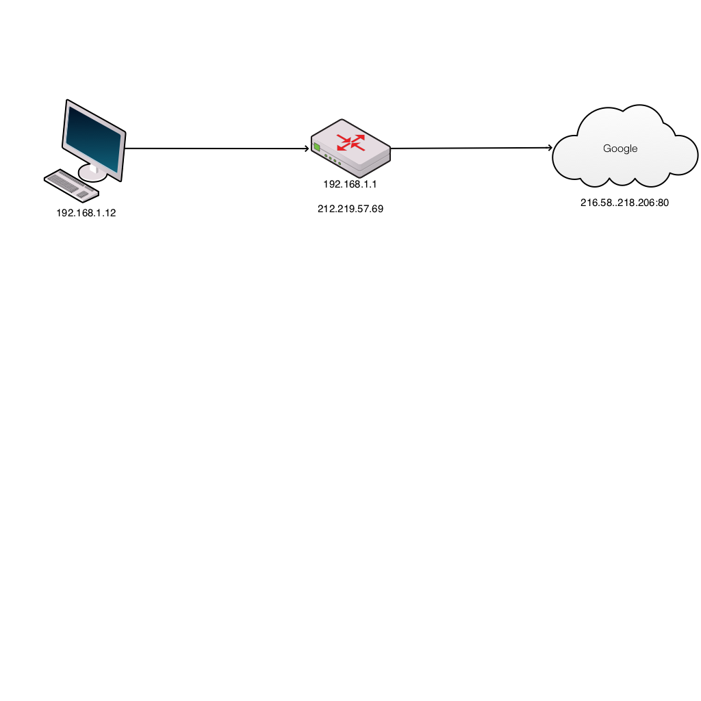
Browser request
Host | Router client side | Router ISP side | Cloud service
S 192.168.1.12:3333 D 216.58.218.206:80 | 192.168.1.12:3333 | 212.219.57.69:7777 | S 212.219.57.69:7777 D 216.58.218.206:80
Host inserts random source port number
Router translates internal network IP address to the external network address and port
Router updates translate table and records port numbers

Slide 32
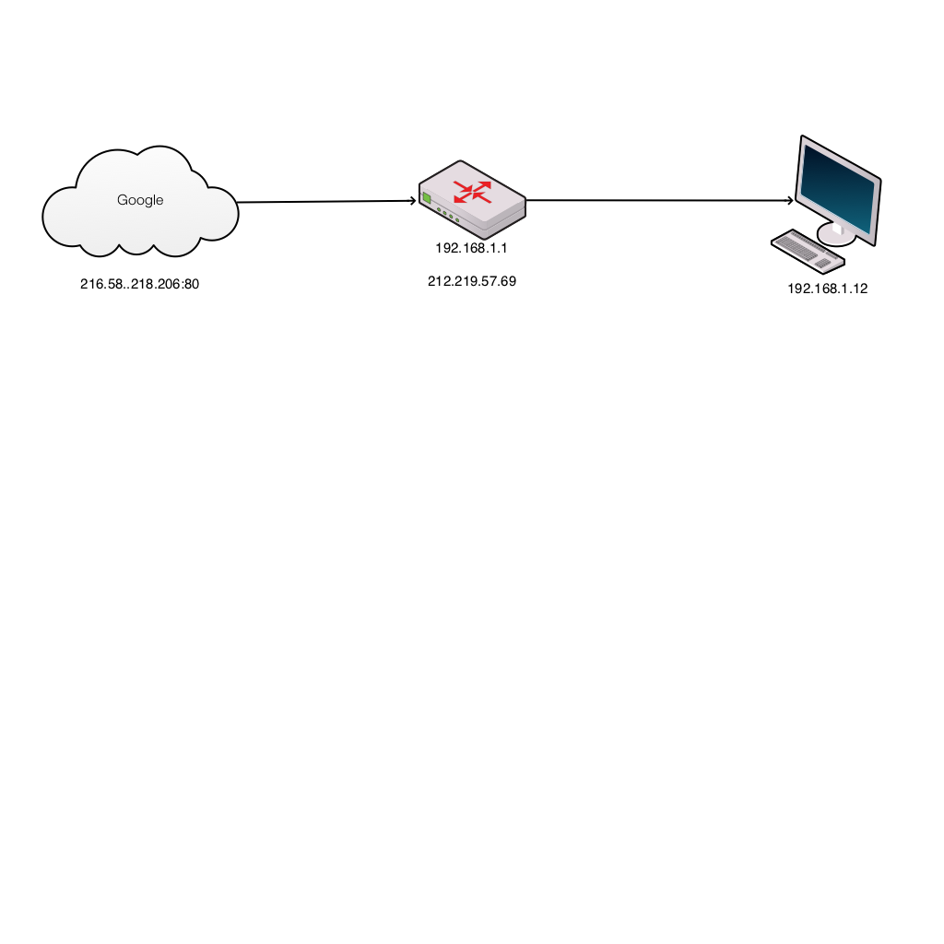
Server response
Cloud service | Router ISP side | Router client side | Host
S 216.58.218.206:80 D 212.219.57.69:7777 | 212.219.57.69:7777 | 192.168.1.12:3333 | S 216.58.218.206:80 D 192.168.1.12:3333
Server puts source address from received packet into destination address of outbound packet
Router translates external network IP address to the internal network address and port
Host receives packet and OS directs to correct application

Slide 33
Domain Name System
Translates domain names to IP addresses
A host will query a domain name server (address from DHCP) with the domain name (eg www.techrepublic.com)
DNS server returns the IP address
Windows command: nslookup

Slide 34
Data States
There are 3 main states that Data can be in.
Rest – Data that is in storage, stored on an HDD in the cloud
Transit – Data that is being sent across the network. You retrieving your data from the HDD it is stored on in the cloud.
In Use - Using the Data to make changes or Data that is currently awaiting process

Slide 35
Cloud protocols
Azure use SMB 3.0 and HTTPS to secure data at rest and in transit.
SMB used to be ran on top of NetBios on port 139
For SMB to work for cloud solutions it uses port 445
SMB (Server message block)

Slide 36
Cloud Security
All Cloud systems have security
AWS uses ACLs (Access control Lists) to make individual objects accessible to authorized users
Azure uses similar methods with Azure Active Directory. Like. AD but for Cloud

Slide 37
Recap
Internal networks connect to the internet via ISP
The ISP allocates an IP address
Network address translation (NAT) allows private IP addressing
Port address translation (PAT) allows multiple applications to connect to cloud services
DNS allows memorable names to be used for cloud resources

