Slide 1
Week 2 – Day 3
Cyber Threats
UFCFFU-30-1

Slide 2
Cyber Threats
Week 2
Monday
01
02
Tuesday
04
Links between physical, logical, personal and procedural security
03
Thursday
Wednesday
05
Friday

Slide 3
Week 2 - Wednesday
Links between physical, logical, personal and procedural security

Slide 4
Physical Security
If someone really wants to get at the information, it is not difficult if they can gain physical access to the computer or hard drive.
--Microsoft White Paper, July 1999

Slide 5
Learning Objectives
Upon completion of this section, you should be able to:
Understand the conceptual need for physical security.
Identify threats to information security that are unique to physical security.
Describe the key physical security considerations for selecting a facility site.
Identify physical security monitoring components.
Grasp the essential elements of access control within the scope of facilities management.
Understand the criticality of fire safety programs to all physical security programs.
Notes:
Learning Objectives:
Upon completion of this section you should be able to:
Understand the conceptual need for physical security.
Identify threats to information security that are unique to physical security.
Describe the key physical security considerations for selecting a facility site.
Identify physical security monitoring components.
Grasp the essential elements of access control within the scope of facilities management.
Understand the criticality of fire safety programs to all physical security programs.
Describe the components of fire detection and response.
Grasp the impact of interruptions in the service of supporting utilities.
Understand the technical details of uninterruptible power supplies and how they are used to increase availability of information assets.
Discuss critical physical environment considerations for computing facilities.
Discuss countermeasures to the physical theft of computing devices.

Slide 6
Learning Objectives:
Upon completion of this section you should be able to:
Describe the components of fire detection and response.
Grasp the impact of interruptions in the service of supporting utilities.
Understand the technical details of uninterruptible power supplies and how they are used to increase availability of information assets.
Discuss critical physical environment considerations for computing facilities.
Discuss countermeasures to the physical theft of computing devices.
Notes:
Learning Objectives:
Upon completion of this section you should be able to:
Understand the conceptual need for physical security.
Identify threats to information security that are unique to physical security.
Describe the key physical security considerations for selecting a facility site.
Identify physical security monitoring components.
Grasp the essential elements of access control within the scope of facilities management.
Understand the criticality of fire safety programs to all physical security programs.
Describe the components of fire detection and response.
Grasp the impact of interruptions in the service of supporting utilities.
Understand the technical details of uninterruptible power supplies and how they are used to increase availability of information assets.
Discuss critical physical environment considerations for computing facilities.
Discuss countermeasures to the physical theft of computing devices.

Slide 7
Seven Major Sources of Physical Loss
Temperature extremes
Gases
Liquids
Living organisms
Projectiles
Movement
Energy anomalies
Notes:
Introduction
Physical security addresses design, implementation, and maintenance of countermeasures that protect the physical resources of an organization.
Most of the technology-based controls discussed to this point can be circumvented, if an attacker gains physical access to the devices being controlled.
Some computer systems are constructed in such a way that it easy to steal the hard drive and the information it contains.
As a result, physical security should receive as much attention as logical security in the security development life cycle.
Seven Major Sources of Physical Loss
From Donn B. Parker
Extreme temperature: heat, cold
Gases: war gases, commercial vapors, humid or dry air, suspended particles
Liquids: water, chemicals
Living organisms: viruses, bacteria, people, animals, insects
Projectiles: tangible objects in motion, powered objects
Movement: collapse, shearing, shaking, vibration, liquefaction, flows waves, separation, slide
Energy anomalies: electrical surge or failure, magnetism, static electricity, aging circuitry; radiation: sound, light, radio, microwave, electromagnetic, atomic.

Slide 8
Community Roles
General management:
responsible for the security of the facility
IT management and professionals:
responsible for environmental and access security
Information security management and professionals:
perform risk assessments and implementation reviews
Notes:
Community Roles
General management: responsible for the security of the facility in which the organization is housed and the policies and standards for secure operation.
IT management and professionals: responsible for environmental and access security in technology equipment locations and for the policies and standards of secure equipment operation.
Information security management and professionals: perform risk assessments and implementation reviews for the physical security controls implemented by the other two groups.

Slide 9
Access Controls
There are a number of physical access controls that are uniquely suited to the physical entry and exit of people to and from the organisation’s facilities, including:
biometrics
smart cards
wireless enabled keycards
Notes:
Access Controls
There are a number of physical access controls that are uniquely suited to the physical entry and exit of people to and from the organisation’s facilities, including biometrics, smart cards and wireless enabled keycards.

Slide 10
Facilities Management
A secure facility is a physical location that has been engineered with controls designed to minimise the risk of attacks from physical threats
A secure facility can use the natural terrain; traffic flow, urban development, and can complement these features with protection mechanisms such as fences, gates, walls, guards, and alarms
Notes:
Facilities Management
Before examining access controls, understand the concept of a secure facility and its design.
From the point of view of facilities management, a secure facility is a physical location that has been engineered with controls designed to minimise the risk of attacks from physical threats.
A secure facility can use the natural terrain; traffic flow, urban development, and can complement these features with protection mechanisms, such as fences, gates, walls, guards, and alarms.

Slide 11
Controls for Protecting the Secure Facility
Walls, Fencing, and Gates
Guards
Dogs, ID Cards, and Badges
Locks and Keys
Mantraps
Electronic Monitoring
Alarms and Alarm Systems
Computer Rooms
Walls and Doors
Notes:
Controls for Protecting the Secure Facility
There are a number of physical security controls and issues that the organization’s communities of interest should consider together when implementing physical security:
Walls, Fencing, and Gates.
Guards to apply human reasoning.
Dogs to provide their keen sense of smell and hearing and to be placed in harm’s way in lieu of humans.
ID Cards and Badges
Locks and Keys
Mantraps
Electronic Monitoring
Alarms and Alarm Systems
Computer Rooms
Walls and Doors

Slide 12
ID Cards and Badges
Ties physical security to information access with identification cards (ID) and/or name badges
ID card is typically concealed
Name badge is visible
These devices are actually biometrics (facial recognition)
Should not be the only control as they can be easily duplicated, stolen, and modified
Tailgating occurs when unauthorised individuals follow authorised users through the control
Notes:
ID Cards and Badges
One area of access control that ties physical security with information access control is the use of identification cards (ID) and name badges. An ID card is typically worn concealed, whereas a name badge is visible.
These devices are forms of biometrics (facial recognition) to identify and authenticate an authorized individual with access to the facility.
With the addition of a magnetic strip or radio chip, the ID card can provide access control.
A name badge or ID should not be the only control for access to restricted areas, as they can be easily duplicated, stolen, and modified.
Tailgating occurs when an authorised individual presents a key and a door is opened, but other individuals, who may or may not be authorised, also enter the unlocked door.

Slide 13
Locks and Keys
There are two types of locks
mechanical and electro-mechanical
Locks can also be divided into four categories
manual, programmable, electronic, and biometric
Locks fail and facilities need alternative procedures for access
Locks fail in one of two ways:
when the lock of a door fails and the door becomes unlocked, that is a fail-safe lock
when the lock of a door fails and the door remains locked, this is a fail-secure lock
Notes:
Locks and Keys
There are two types of locks: mechanical and electro-mechanical.
The mechanical lock relies on a key of carefully shaped pieces of metal that turn tumblers to release secured loops of steel, aluminum, or brass (in brass padlocks).
The electro-mechanical lock can accept a variety of inputs including keys that are magnetic strips on ID Cards, radio signals from name badges, PINs typed into a keypad.
Locks are divided into four categories: manual, programmable, electronic, and biometric.
As part of general management’s responsibility for the physical environment, the management of keys and locks is a fundamental concern.
Sometimes locks fail and facilities need alternative procedures for access.
Locks fail in one of two ways: when the lock of a door fails and the door becomes unlocked, that is a fail-safe lock; when the lock of a door fails and the door remains locked, this is a fail-secure lock.

Slide 14
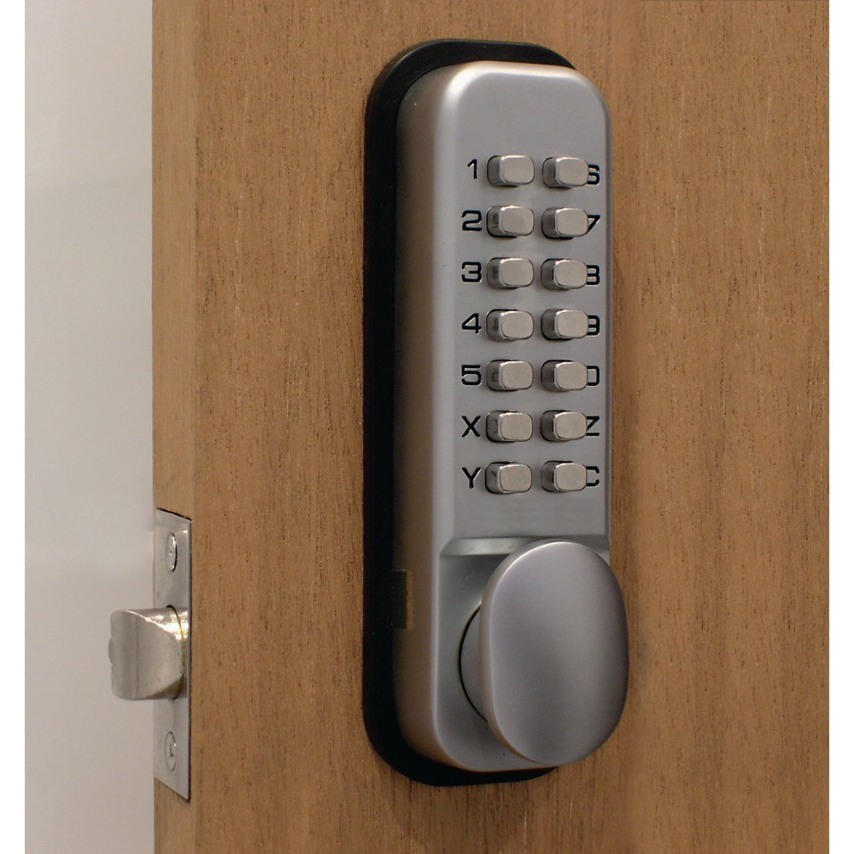
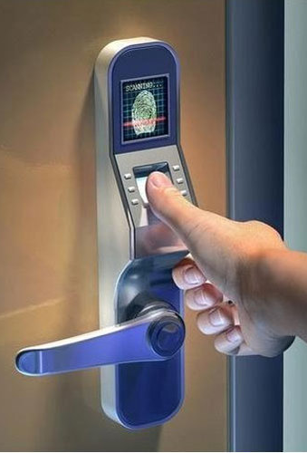
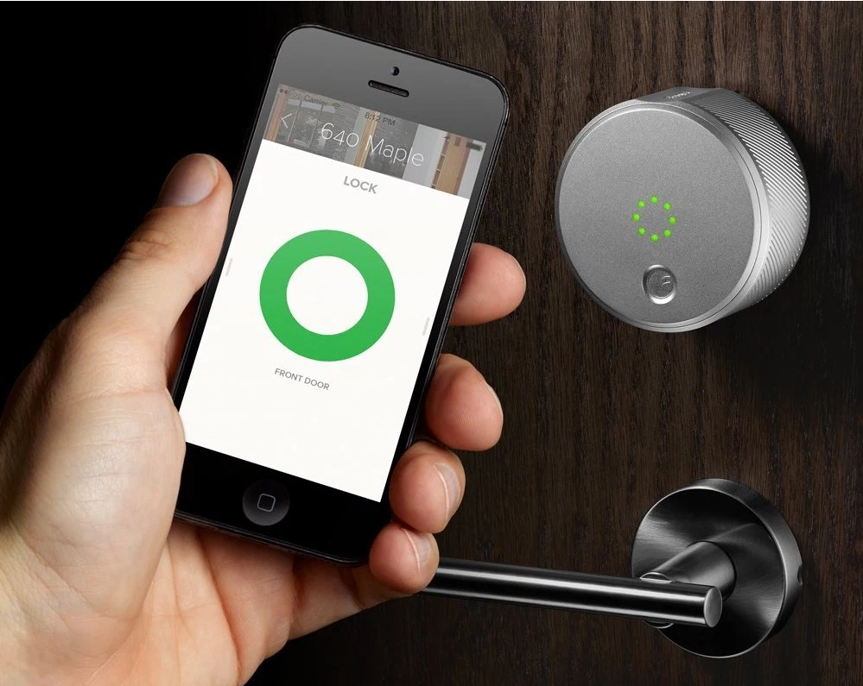
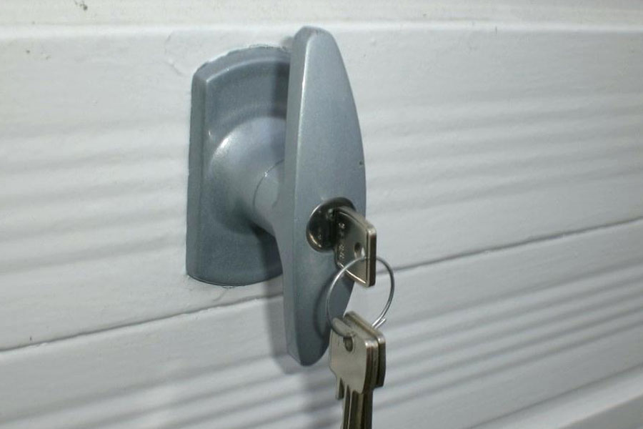
Locks

Slide 15
Mantraps
An enclosure that has an entry point and a different exit point
The individual enters the mantrap, requests access, and if verified, is allowed to exit the mantrap into the facility
If the individual is denied entry, they are not allowed to exit until a security official overrides the automatic locks of the enclosure
Notes:
Mantraps
A mantrap is a small enclosure that has an entry point and a different exit point.
The individual entering the facility, area, or room, enters the mantrap, requests access through some form of electronic or biometric lock and key, and if verified, is allowed to exit the mantrap into the facility.
This is called a mantrap, because if the individual is denied entry, the mantrap does not allow exit until a security official overrides the automatic locks of the enclosure.

Slide 16
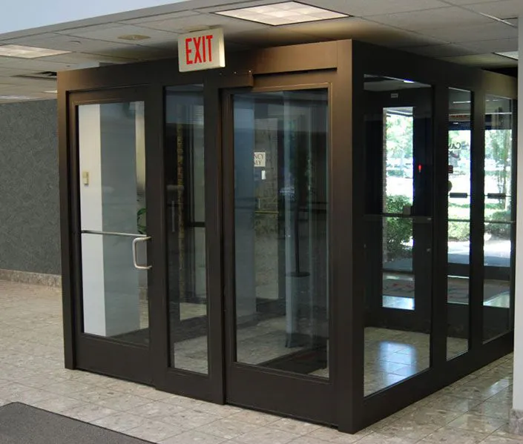
Mantraps 9-2 Mantraps

Slide 17
Electronic Monitoring
Records events where other types of physical controls are not practical
May use cameras with video recorders
Drawbacks:
reactive and do not prevent access or prohibited activity
recordings often not monitored in real time and must be reviewed to have any value
Notes:
Electronic Monitoring
Used to record events within a specific area or areas where other types of physical controls are not practical.
Monitoring frequently uses cameras viewing individuals, while on the other end of these cameras are video cassette recorders and related machinery that captures the video feed.
These systems have drawbacks as for the most part they are reactive and do not prevent access or prohibited activity.
Recorded monitoring requires an individual to review the information collected.

Slide 18
Alarms and Alarm Systems
Alarm systems notify when an event occurs
Used for fire, intrusion, environmental disturbance, or an interruption in services
These systems rely on sensors that detect the event: motion detectors, smoke detectors, thermal detectors, glass breakage detectors, weight sensors, and contact sensors
Notes:
Alarms and Alarm Systems
Alarm systems notify appropriate individuals when a predetermined event or activity occurs.
This could be a fire, a break-in or intrusion, an environmental disturbance, such as flooding, or an interruption in services, such as a loss of power.
Burglar alarm systems detect intrusions into unauthorized areas and notify either a local or remote security agency to react.
These systems rely on a number of sensors that detect the intrusion: motion detectors, thermal detectors, glass breakage detectors, weight sensors, and contact sensors.

Slide 19
Computer Rooms and Wiring Closets
Computer rooms and wiring and communications closets require special attention
Logical controls are easily defeated, if an attacker gains physical access to the computing equipment
Custodial staff are often the least scrutinised of those who have access to offices and are given the greatest degree of unsupervised access
Notes:
Computer Rooms and Wiring Closets
Computer rooms and wiring and communications closets are facilities that require special attention to ensure the confidentiality, integrity, and availability of information.
Logical access controls are easily defeated, if an attacker gains physical access to the computing equipment.
Custodial staff are often the least scrutinised of employees and non-employees who have access to offices. Yet custodians are given the greatest degree of unsupervised access.

Slide 20
Interior Walls and Doors
The walls in a facility are typically either:
standard interior
firewall
All high-security areas must have firewall grade walls to provide physical security from potential intruders and improves the facility's resistance to fires
Doors that allow access into secured rooms should also be evaluated
Computer rooms and wiring closets can have push or crash bars installed to meet building codes and provide much higher levels of security than the standard door pull handle
Notes:
Interior Walls and Doors
The security of information assets can sometimes be compromised because of the construction of the walls and doors of the facility.
The walls in a facility are typically: standard interior or firewall.
All high-security areas, such as computer rooms and wiring closets, must have firewall grade walls surrounding them.
This provides not only physical security from potential intruders but from fires as well.
The doors that allow access into these types of secured rooms should also be evaluated.
Computer rooms and wiring closets can have push or crash bars can be installed.
Such devices meet building codes, but provide much higher levels of security than the standard door pull handle.

Slide 21
Fire Safety
The most serious threat to the safety of the people who work in the organisation is the possibility of fire
Fires account for more property damage, personal injury, and death than any other threat
It is imperative that physical security plans examine and implement strong measures to detect and respond to fires and fire hazards
Notes:
Fire Safety
The most serious threat to physical security and the safety of the people who work in the organization is the possibility of fire.
Fires account for more property damage, personal injury, and death than any other threat to physical security.
As a result, it is imperative that physical security plans examine and implement strong measures to detect and respond to fires and fire hazards.

Slide 22
Fire Detection and Response
Fire suppression systems are devices installed and maintained to detect and respond to a fire
They work to deny an environment of one of the three requirements for a fire to burn: heat, fuel, and oxygen
Water and water mist systems reduce the temperature and saturate some fuels to prevent ignition
Carbon dioxide systems rob fire of its oxygen
Soda acid systems deny fire its fuel, preventing spreading
Gas-based systems disrupt the fire’s chemical reaction but leave enough oxygen for people to survive for a short time
Notes:
Fire Detection and Response
Fire suppression systems are devices installed and maintained to detect and respond to a fire, potential fire, or combustion situation.
These devices typically work to deny an environment of one of the three requirements for a fire to burn: temperature, fuel, and oxygen.
Water and water mist systems reduce the temperature of the flame to extinguish it and to saturate some categories of fuels to prevent ignition.
Carbon dioxide systems rob fire of its oxygen.
Soda acid systems deny fire its fuel, preventing spreading.
Gas-based systems disrupt the fire’s chemical reaction but leave enough oxygen for people to survive for a short time.

Slide 23
Fire Detection
Before a fire can be suppressed, it must be detected
Fire detection systems fall into two general categories:
manual and automatic
Part of a complete fire safety program includes individuals that monitor the chaos of a fire evacuation to prevent an attacker accessing offices
There are three basic types of fire detection systems: thermal detection, smoke detection, and flame detection
Smoke detectors operate in one of three ways: photoelectric, ionization, and air-aspirating
Notes:
Fire Detection
Before a fire can be suppressed, it must be detected.
Fire detection systems fall into two general categories: manual and automatic.
Manual fire detection systems include human responses, such as calling the fire department, as well as manually activated alarms, such as sprinklers and gaseous systems.
During the chaos of a fire evacuation, an attacker can easily slip into offices and obtain sensitive information. As part of a complete fire safety program, it is advisable to designate individuals as floor monitors.
There are three basic types of fire detection systems: thermal detection, smoke detection, and flame detection.
The thermal detection systems contain a sophisticated heat sensor that operates in one of two ways, fixed temperature, and rate-of-rise.
Smoke-detection systems are perhaps the most common means of detecting a potentially dangerous fire, and are required by building codes:
Smoke detectors operate in one of three ways:
1) photoelectric sensors project and detect an infrared beam, if interrupted activates alarm or suppression systems.
2) ionization sensors contains a small amount of a harmless radioactive material within a detection chamber. When certain by-products of combustion enter, a change in the level of electrical conductivity activates the detector.
3) air-aspirating detectors take in air, filtering it, and moving it through a chamber containing a laser beam. If the laser beam is diverted or refracted by smoke particles, the system is activated.
The flame detector is a sensor that detects the infrared or ultraviolet light produced by an open flame.
These systems require direct line-of-sight with the flame and compare the flame “signature” to a database to determine whether or not to activate the alarm and suppression systems.
While highly sensitive, flame detection systems are expensive and must be installed where they can scan all areas of the protected area.

Slide 24
Fire Suppression
Can be portable, manual, or automatic
Portable extinguishers are rated by the type of fire:
Class A - fires involving solid materials such as wood, paper or textiles.
Class B - fires involving flammable liquids such as petrol, diesel or oils.
Class C - fires involving gases.
Class D - fires involving metals.
Class E - fires involving live electrical apparatus. (Class E is not used, instead the symbol of an electric spark is displayed)
Class F - fires involving cooking oils such as in deep-fat fryers.
Notes:
Fire Suppression
Fire suppression systems can consist of portable, manual, or automatic apparatus. Portable extinguishers are rated by the type of fire:
Class A: fires of ordinary combustible fuels. Use water and multi-purpose, dry chemical fire extinguishers.
Class B: fires fueled by combustible liquids or gases, such as solvents, gasoline, paint, lacquer, and oil. Use carbon dioxide, multi-purpose dry chemical and halon fire extinguishers.
Class C: fires with energized electrical equipment or appliances. Use carbon dioxide, multi-purpose, dry chemical and halon fire extinguishers.
Class D: fires fueled by combustible metals, such as magnesium, lithium, and sodium. Use special extinguishing agents and techniques.
Manual and automatic fire response can include installed systems designed to apply suppressive agents. These are usually either sprinkler or gaseous systems.
All sprinkler systems are designed to apply liquid, usually water, to all areas in which a fire has been detected.
In sprinkler systems, the organization can implement wet pipe, dry pipe, or pre-action systems.
Water mist sprinklers are the newest form of sprinkler systems and rely on micro-fine mists instead of traditional shower-type systems.

Slide 25
Fire Suppression
Installed systems apply suppressive agents, either sprinkler or gaseous systems
Sprinkler systems are designed to apply liquid, usually water
In sprinkler systems, the organization can implement wet-pipe, dry-pipe, or pre-action systems
Water mist sprinklers are the newest form of sprinkler systems and rely on microfine mists

Slide 26
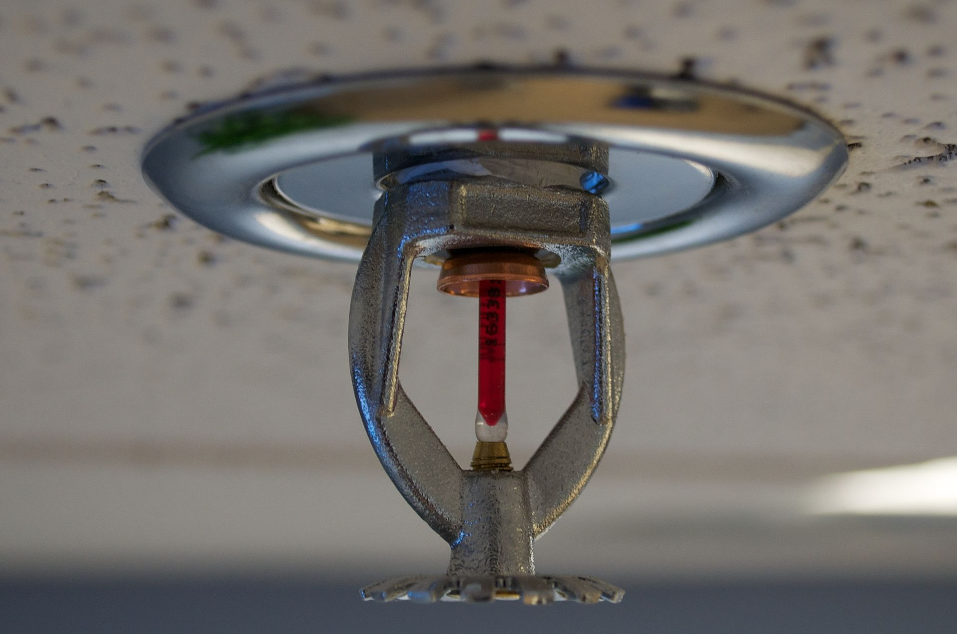
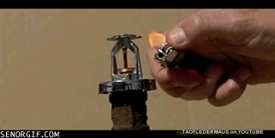
Water Sprinkler System
Notes:
When the ambient temperature reaches 140-150° F, the plastic pin melts, or in the case of a glass tube, shatters, releasing the stopper and allowing water to hit the diffuser spraying water throughout the area

Slide 27
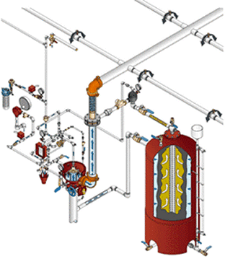
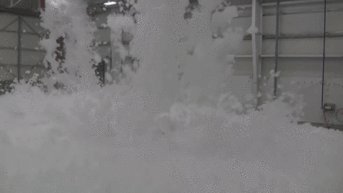
Water Foam Sprinkler System

Slide 28
Gaseous Emission Systems
Until recently there were only two types of systems
carbon dioxide and halon
Carbon dioxide robs a fire of its oxygen supply
Halon is a clean agent but has been classified as an ozone-depleting substance, and new installations are prohibited
Alternative clean agents include the following:
FM-200
Inergen
Carbon dioxide
FE-13 (trifluromethane)
Notes:
Gaseous Emission Systems
Chemical gas systems can be used in the suppression of fires.
Until recently there were only two major types of gaseous systems: carbon dioxide and halon.
Carbon dioxide robs a fire of its oxygen supply.
Halon is a clean agent, which means that it does not leave any residue when dry, nor does it interfere with the operation of electrical or electronic equipment. Unfortunately the EPA has classified halon as an ozone-depleting substance, and therefore new installations are prohibited.
Alternative clean agents include the following:
FM-200
Inergen
Carbon dioxide
FE-13 (trifluromethane)

Slide 29
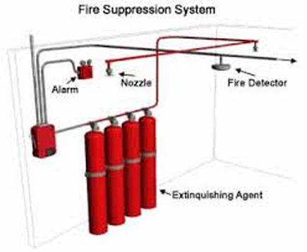
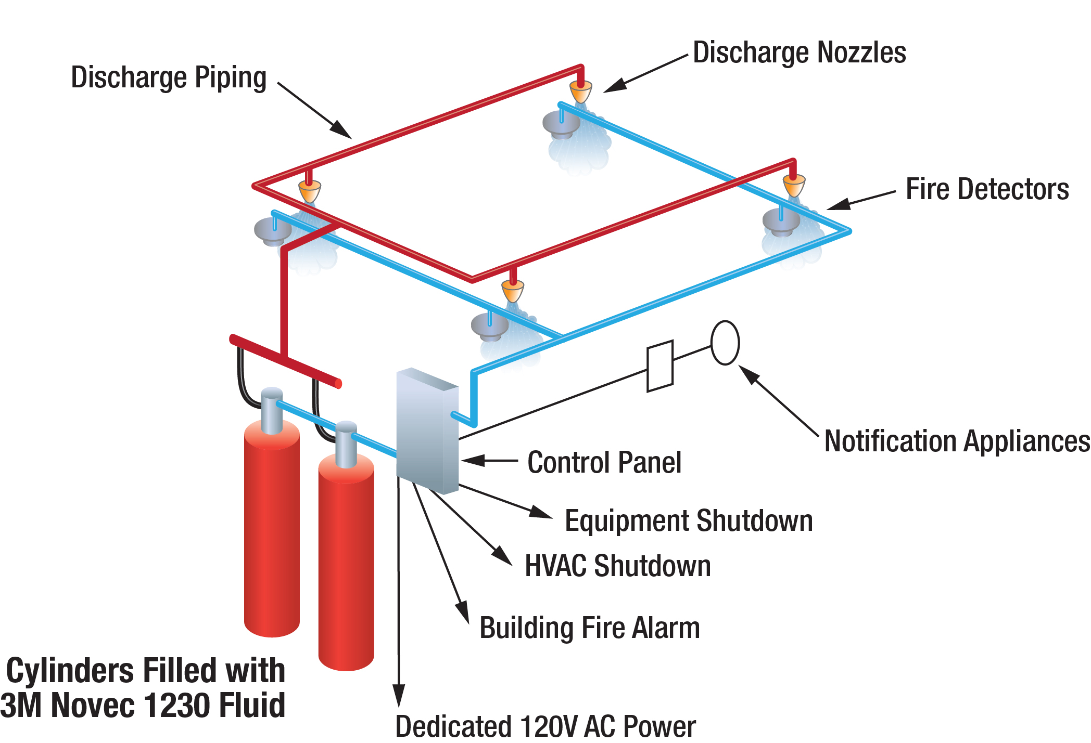
Fire Suppression System

Slide 30
Failure of Supporting Utilities and Structural Collapse
Supporting utilities, such as heating, ventilation and air conditioning, power, water, and other utilities, have a significant impact on the continued safe operation of a facility
Extreme temperatures and humidity levels, electrical fluctuations and the interruption of water, sewage, and garbage services can create conditions that inject vulnerabilities in systems designed to protect information
Notes:
Failure Of Supporting Utilities And Structural Collapse
Supporting utilities, such as heating, ventilation and air conditioning, power, water, and other utilities, have a significant impact on the continued safe operation of a facility.
Extreme temperatures and humidity levels, electrical fluctuations and the interruption of water, sewage, and garbage services can create conditions that inject vulnerabilities in systems designed to protect information.

Slide 31
Heating, Ventilation, and Air Conditioning
HVAC system areas that can cause damage to information systems:
Temperature
Computer systems are subject to damage from extreme temperature
The optimal temperature for a computing environment (and people) is between 70 and 74 degrees Fahrenheit (21 – 24°C)
Filtration
Humidity
Static
One of the leading causes of damage to sensitive circuitry is electrostatic discharge (ESD)
A person can generate up to 12,000 volts of static current by walking across a carpet
Notes:
Heating, Ventilation, and Air Conditioning
Although traditionally a facilities management responsibility, the operation of the heating, ventilation, and air conditioning (HVAC) system can have dramatic impact on information and information systems operations and protection.
Specifically, there are four areas within the HVAC system that can cause damage to information-carrying systems: temperature, filtration, humidity, and static electricity.
Temperature
Computer systems are electronic and as such are subject to damage from extreme temperature.
Rapid changes in temperature, from hot to cold, or from cold to hot can produce condensation, which can create short circuits or otherwise damage systems and components.
The optimal temperature for a computing environment (and people) is between 70 and 74 degrees Fahrenheit (21 – 24°C)
Humidity
Humidity is the amount of moisture in the air.
High humidity levels create condensation problems, and low humidity levels can increase the amount of static electricity in the environment.
With condensation comes the short-circuiting of electrical equipment and the potential for mould and rot in paper-based information storage.
Static
Static electricity is caused by a process called triboelectrification, which occurs when two materials are rubbed or touched and electrons are exchanged, resulting in one object becoming more positively changed and the other more negatively charged.
When a third object with an opposite charge or ground is encountered, electrons flow again, and a spark is produced.
One of the leading causes of damage to sensitive circuitry is electro-static discharge (ESD).
Static
Integrated circuits in a computer use between two and five volts of electricity.
Voltage levels as low as 200 can cause microchip damage.
Static electricity is not even noticeable to humans until levels approach 1,500 volts, and you can’t see the little blue spark until it approaches 4,000 volts.
A person can generate up to 12,000 volts of static current by walking across a carpet.
Static
Two types of failures can result from ESD damage to chips. Immediate failures, also known as catastrophic failures, occur right away, are usually totally destructive.
Latent failures or delayed failures can occur weeks or even months after the damage is done.
It is imperative to maintain the optimal level of humidity, which is between 40 and 60 percent, in the computing environment. Humidity levels below this range create static, and levels above create condensation.

Slide 32
Ventilation Shafts
Security of the ventilation system air ductwork:
While in residential buildings the ductwork is quite small, in large commercial buildings it can be large enough for an individual to climb through
If the vents are large, security can install wire mesh grids at various points to compartmentalise the runs
Notes:
Ventilation Shafts
One last discussion point within the topic of HVAC is the security of the ventilation system air ductwork.
While in residential buildings the ductwork is quite small, in large commercial buildings it can be large enough for an individual to climb though.
If the vents are large, security can install wire mesh grids at various points to compartmentalize the runs. In any case, the ventilation system is one more area within the HVAC that must be evaluated.

Slide 33
Power Management and Conditioning
Electrical quantity (voltage level and amperage rating) is a concern, as is the quality of the power (cleanliness and proper installation)
Any noise that interferes with the normal 50 Hertz cycle can result in inaccurate time clocks or unreliable internal clocks inside the CPU
Grounding
Grounding ensures that the returning flow of current is properly discharged
If this is not properly installed it could cause damage to equipment and injury or death to the person
Overloading a circuit not only causes problems with the circuit tripping but can also overload the power load on an electrical cable, creating the risk of fire
Notes:
Power Management and Conditioning
Not only is electrical quantity (voltage level and amperage rating) of concern, but so is the quality of the power (cleanliness and proper installation).
Interference with the normal pattern of the electrical current is referred to as noise in the current.
Any noise that interferes with the normal 50 Hertz cycle can result in inaccurate time clocks or, even worse, unreliable internal clocks inside the CPU.
Grounding
Grounding ensures that the returning flow of current is properly discharged to the ground.
If this is not properly installed, anyone touching a computer or other electrical device could be used as a ground source, causing damage to equipment and injury or death to the person.
Power should also be provided in sufficient amperage to support needed operations.
Overloading a circuit not only causes problems with the circuit tripping but can also overload the power load on an electrical cable, creating the risk of fire.

Slide 34
Uninterruptible Power Supplies (UPSs)
In case of power outage, a UPS is a backup power source for major computer systems
There are four basic configurations of UPS:
The standby
Ferro-resonant standby
Line-interactive
The true online
Notes:
Uninterruptible Power Supplies (UPSs)
In case of power outage, a UPS is a backup power source for major computer systems.
There are four basic configurations of UPS:
the standby
Ferro-resonant standby
line-interactive
the true online

Slide 35
Uninterruptible Power Supplies (UPSs)
A standby or offline UPS is an offline battery backup that detects the interruption of power to the power equipment
A ferro-resonant standby UPS is still an offline UPS
the ferro-resonant transformer reduces power problems
The line-interactive UPS is always connected to the output, so has a much faster response time and incorporates power conditioning and line filtering
The true online UPS works in the opposite fashion to a standby UPS since the primary power source is the battery, with the power feed from the utility constantly recharging the batteries
this model allows constant feed to the system, while completely eliminating power quality problems
Notes:
Uninterruptible Power Supplies (UPSs)
A standby or offline UPS is an off-line battery backup that detects the interruption of power to the power equipment.
A ferroresonant standby UPS is still an offline UPS, with the electrical service still providing the primary source of power, with the UPS serving as a battery backup. The ferroresonant transformer reduces power problems.
The line-interactive UPS is always connected to the output, so has a much faster response time and incorporates power conditioning and line filtering.
The true online UPS works in the opposite fashion to a standby UPS since the primary power source is the battery, with the power feed from the utility constantly recharging the batteries. This model allows constant feed to the system, while completely eliminating power problems.

Slide 36
Emergency Shutoff
One important aspect of power management in any environment is the need to be able to stop power immediately should the current represent a risk to human or machine safety
Most computer rooms and wiring closets are equipped with an emergency power shutoff, which is usually a large red button, prominently placed to facilitate access, with an accident-proof cover to prevent unintentional use
Notes:
Emergency Shutoff
One important aspect of power management in any environment is the need to be able to stop power immediately should the current represent a risk to human or machine safety.
Most computer rooms and wiring closets are equipped with an emergency power shutoff, which is usually a large red button, prominently placed to facilitate access, with an accident-proof cover to prevent unintentional use.

Slide 37
Electrical Terms
Fault: momentary interruption in power
Blackout: prolonged interruption in power
Sag: momentary drop in power voltage levels
Brownout: prolonged drop in power voltage levels
Spike: momentary increase in power voltage levels
Surge: prolonged increase in power voltage levels
Notes:
Electrical power influences:
Fault: momentary interruption in power
Blackout: prolonged interruption in power
Sag: momentary drop in power voltage levels
Brownout: prolonged drop in power voltage levels
Spike: momentary increase in power voltage levels
Surge: prolonged increase in power voltage levels

Slide 38
Water Problems
Lack of water poses problems to systems, including the functionality of fire suppression systems, and the ability of water chillers to provide air-conditioning
On the other hand, a surplus of water, or water pressure, poses a real threat
It is therefore important to integrate water detection systems into the alarm systems that regulate overall facilities operations
Notes:
Water Problems
Lack of water poses problem to systems, including the functionality of fire suppression systems, and the ability of water chillers to provide air-conditioning.
On the other hand, a surplus of water, or water pressure, poses a real threat.
It is therefore important to integrate water detection systems into the alarm systems that regulate overall facilities operations.

Slide 39
Structural Collapse
Unavoidable forces can cause failures of structures that house the organization
Structures are designed and constructed with specific load limits, and overloading these design limits, intentionally or unintentionally, inevitably results in structural failure and potentially loss of life or injury
Periodic inspections by qualified civil engineers assists in identifying potentially dangerous structural conditions well before they fail
Notes:
Structural Collapse
Unavoidable environmental factors or forces of nature can cause failures of structures that house the organization.
Structures are designed and constructed with specific load limits, and overloading these design limits, intentionally or unintentionally, inevitably results in structural failure and potentially loss of life or injury.
Periodic inspections by qualified civil engineers assists in identifying potentially dangerous structural conditions well before they fail.

Slide 40
Testing Facility Systems
Physical security of the facility must be constantly documented, evaluated, and tested
Documentation of the facility’s configuration, operation, and function is integrated into disaster recovery plans and standing operating procedures
Testing provides information necessary to improve the physical security in the facility and identifies weak points
Notes:
Testing Facility Systems
Just as with any phase of the security process, the physical security of the facility must be constantly documented, evaluated, and tested.
Documentation of the facilities configuration, operation, and function is integrated into disaster recovery plans and standing operating procedures.
Testing provides information necessary to improve the physical security in the facility and identifies areas weak points.

Slide 41
Interception of Data
There are three methods of data interception:
Direct observation
Data transmission
Eavesdropping on signals
TEMPEST is a technology that involves the control of devices that emit electromagnetic radiation (EMR) in such a manner that the data cannot be reconstructed
Notes:
Interception of Data
There are three methods of data interception: direct observation, interception of data transmission, and electromagnetic interception.
With direct observation, one must be close enough to information to breach confidentiality. Physical security mechanisms can restrict the possibility of an individual accessing unauthorised areas and thus directly observing information.
On the other hand, if attackers can access the transmission media, i.e. by using the Internet or tapping the LAN, they need not be anywhere near the source of information.
It is possible to eavesdrop on signals cables that emit electro-magnetic signals without actually tapping into them. TEMPEST is a technology that involves the monitoring of devices that emit electromagnetic radiation (EMR) in such a manner that the data can be reconstructed.
TEMPEST monitoring involves the following: ensuring that computers are placed as far as possible from outside perimeters; installing special shielding inside the CPU case; and implementing a host of other restrictions, including maintaining distances from plumbing and other infrastructure components that carry radio waves.

Slide 42
Mobile and Portable Systems
With the increased threat to overall information security for laptops, handhelds, and PDAs, mobile computing requires even more security than the average in-house system
Many of these mobile computing systems not only have corporate information stored within them, many are configured to facilitate the user’s access into the organisation’s secure computing facilities
Notes:
Mobile And Portable Systems
With the increased threat to overall information security for laptops, handhelds, and PDAs, mobile computing requires even more security than the average in-house system
Many of these mobile computing systems not only have corporate information stored within them, many are configured to facilitate the user’s access into the organisation’s secure computing facilities

Slide 43
Stopping Laptop Losses
Controls support the security and retrieval of lost or stolen laptops
CompuTrace is stored on a laptop’s hardware and reports to a central monitoring centre
Burglar alarms made up of a PC card that contains a motion detector
If the alarm in the laptop is armed, and the laptop is moved beyond a configured distance, the alarm triggers an audible alarm
The system also shuts down the computer and includes an encryption option to completely render the information unusable
Notes:
Mobile And Portable Systems
New technology to support the location of lost or stolen laptops can provide additional security.
The first type of new technology is CompuTrace, computer software that is stored on a laptop’s hardware and reports itself and the electronic serial number of the computer on which it is installed to a central monitoring center.
Also available for laptops are burglar alarms made up of a PC card that contains a motion detector.
If the alarm in the laptop is armed, and the laptop is moved beyond a configured distance, the alarm triggers an audible alarm.
The system also shuts down the computer and includes an encryption option to completely render the information unusable.
For maximum security, laptops should be secured at all times.
If you are traveling with a laptop, you should have it in your possession at all times.

Slide 44
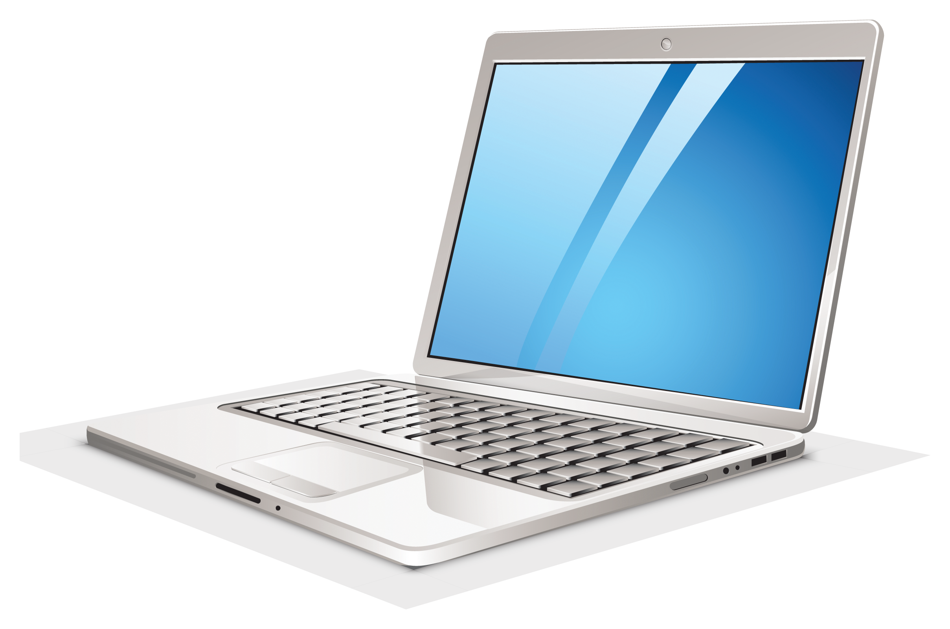
Figure 9-6 Laptop Theft Deterrence
Laptop loaded with trace software
Laptop periodically reports connection and electronic serial number
Central monitoring station verifies ownership
Stolen computer information passed to law enforcement

Slide 45
Remote Computing Security
Remote site computing - distant from the organisational facility
Telecommuting - computing using telecommunications including Internet, dial-up, or leased point-to-point links
Employees may need to access networks on business trips
Telecommuters need access from home systems or satellite offices
To provide a secure extension of the organisation’s internal networks, all external connections and systems must be secured
Notes:
Remote Computing Security
Remote site computing includes a wide variety of computing sites, which are distant from the base organisational facility, and includes the entire spectrum of telecommuters (or tele-computers).
Telecommuting involves computing using telecommunications facilities including Internet, dial-up, or leased point-to-point links.
Employees may need to access home networks on business trips, telecommuters need access from home systems, and some organizations even have satellite offices that need to be tightly integrated into the overall IT infrastructure.
Individuals telecommuting from home deserve special attention. As more individuals consider telecommuting, the risk to organisational information through these often unsecured connections is substantial.
Few organisations provide their employees with secure connections to their office networks, and even fewer provide secure systems, should the employee’s home computer be compromised.
To provide a secure extension of the organisation’s internal networks, all external connections and systems must be secured.
Although it is possible to secure remote sites, organisations cannot assume the employees invest their own funds for security.

Slide 46
Special Considerations for Physical Security Threats
Develop physical security in-house or outsource?
Many qualified and professional agencies
Benefit of outsourcing physical security includes gaining the experience and knowledge of these agencies
Downside includes high expense, loss of control over the individual components, and the level of trust that must be placed in another company
Social engineering is the use of people skills to obtain information from employees
Notes:
Special Considerations For Physical Security Threats
There are a number of special considerations for physical security threats that should be examined.
The first of these is the decision to develop physical security in-house or to outsource it.
There are a number of qualified and professional agencies that provide consulting and services in the physical security area.
The benefit of outsourcing physical security includes gaining the experience and knowledge of these agencies, many of which have been in the field for decades.
The downside includes the high expense of outsourcing physical security, the loss of control over the individual components of the physical security solution, and the level of trust that must be placed in another company.
Another area of physical security deals with social engineering.
Social engineering is the use of people skills to obtain information from employees without their knowing it.
While most social engineers prefer to use the telephone and computer to make their contacts and solicit information, there are those who brazen accessing the information more directly.
Require all individuals entering the facility display appropriate visitor’s badges and be escorted by a security individual when in restricted areas.

Slide 47
Inventory Management
Computing equipment should be inventoried and inspected on a regular basis
Classified information should also be inventoried and managed
Whenever a classified document is reproduced, a stamp should be placed on the original before it is copied
This stamp states the document’s classification level and document number for tracking
Each classified copy is issued to its receiver, who signs for the document
Notes:
Inventory Management
As with other organisational resources, computing equipment should be inventoried and inspected on a regular basis. Similarly classified information should also be inventoried and managed.
Whenever a classified document us reproduced, a stamp should be placed on the original before it is copied.
This stamp states the document’s classification level and document number for tracking.
Each classified copy is issued to its receiver, who signs for the document.

Slide 48
Logical Security
Protects computer-based data from software-based and communication-based threats
Is a subset of computer security
Consists of software safeguards for an organization's systems, including:
User identification and password access
Authenticating
Access rights and authority management

Slide 49
Elements of Logical Security
User IDs
Authentication
Token authentication
Password authentication
Two-way authentication
Biometric authentication

Slide 50
User IDs
Also known as logins, usernames, logons or accounts
Are unique personal identifiers agents of a computer program or network that is accessible by more than one agent
Based on short strings of alphanumeric characters and are either assigned or chosen by the users

Slide 51
Authentication
Is the process used by a computer program, computer, or network to attempt to confirm the identity of a user
The confirmation of identities is essential to the concept of access control, which gives access to the authorised excludes the unauthorised

Slide 52
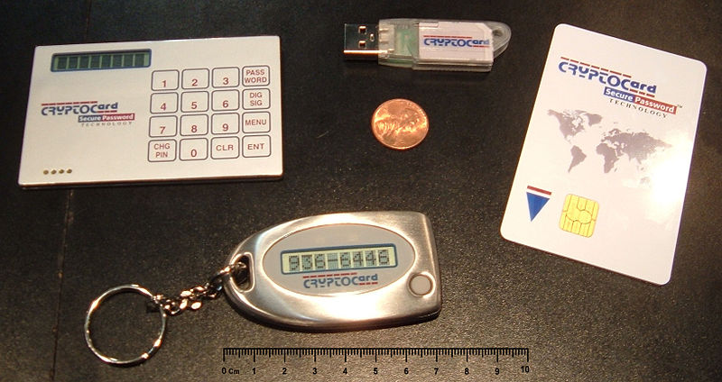
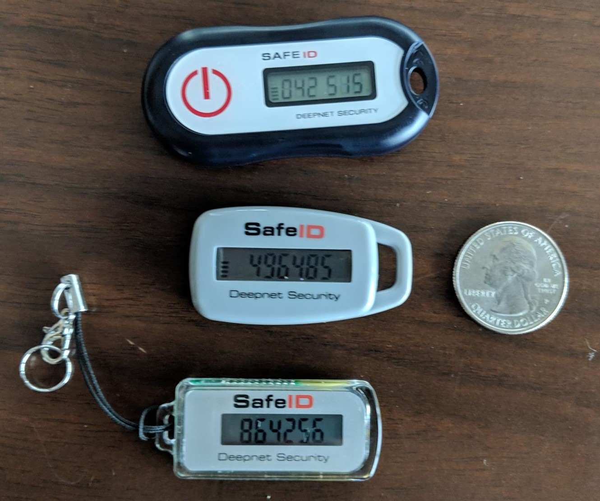
Token Authentication
Comprises security tokens which are small devices that authorised users of computer system or networks carry to assist in identifying that who is logging in to a computer or network is actually authorised
They can also store cryptographic keys and biometric data

Slide 53
Password Authentication
Uses secret data to control access to a particular resource
Usually, the user attempting to access the network, computer or computer program is queried on whether they know the password or not
Access is granted accordingly
Passwords are either created by the user or assigned, similar to usernames

Slide 54
Two-way Authentication
Involves both the user and the system or network convincing each other that they know the shared password without transmitting this password over any communication channel

Slide 55
Biometric Authentication
Is the measuring of a user's physiological or behavioural features to attempt to confirm his/her identity
Physiological aspects that are used include:
Fingerprints
Eye retinas and irises
Voice patterns
Facial patterns
Hand measurements
Behavioural aspects that are used include:
Signature recognition
Gait recognition
Speaker recognition
Mouse use characteristics
Cognitive biometrics

Slide 56
Common Setup and Access Rights
Access rights and authority levels are rights or power granted to users to create, change, delete or view data and files within a system or network
These rights vary from user to user
Can range from anonymous login (Guest) to Superuser (root) privileges
Guest and Superuser accounts are two extremes
Individual access rights can be granted or denied to any user
Only the system administrator has the ability to grant or deny these rights

Slide 57
Guest Accounts
Are set up so that multiple users can log in to the account at the same time
Users are sometimes asked to type a username
This account has very limited access
Often only allowed to access special public files

Slide 58
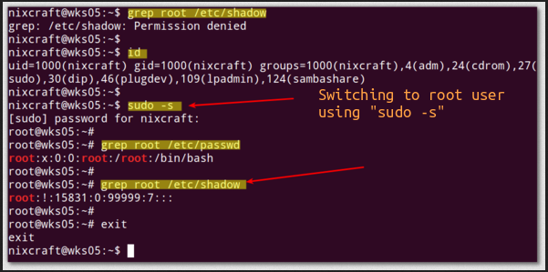
Superuser
Is an authority level assigned to system administrators on most computer operating systems
This level is also called root

Slide 59
Personal Security
Personnel and People Security is the system of policies and procedures which seek to mitigate the risk of workers (insiders) exploiting their legitimate access to an organisation’s assets for unauthorised purposes
Acceptable use policies
Segregation of duties
To limit the scope that any one individual has to attack and compromise the information security of the organisation
To limit the dependence that an organisation has upon any one individual
Security awareness
Codes of conduct

Slide 60
Procedural Security
Checking references for job applicants
Contracts of employment
Service contracts and security undertakings
Obligations on third party suppliers of goods and services

Slide 61
Cyber Threats
Week 2
Monday
01
Tuesday
02
03
Wednesday
04
Thursday
05
Friday

