Slide 1
Operating Systems and Architecture
^{<computer architecture>}
(UFCFCU-30-1)

Slide 2
^{<outcomes>}
After completing this section of the module you will be able to:
Explain the relationships between hardware components and the subsystems used in a computer system.
This section will examine hardware. Operating system I/O will be covered on day 11
Programmed I/O
Interrupt driven I/O
Direct Memory Access (DMA)
Serial and parallel buses
PCIe
Adapters
GPUs

Slide 3
^{<trends>}
Trends in I/O systems
Improving processing efficiency
Moving functions into the CPU, ultimately SOC
Moving processing power into the adapters, offloading the CPU
Replacing parallel buses with serial
Point to point replacing sharing
Continuous performance improvements

Slide 4
^{<programming I/O>}
Methods of programming I/O
Programmed I/O
CPU controls all activities
Interrupt driven I/O
CPU initiates all activities
Direct memory access
Activities offloaded to adapters
Notes:
This is part of the trend to improve processing efficiency

Slide 5
^{<programmed I/O>}
Programmed I/O
Already seen in the RISC simulator
INP R0,2
INP R1,2
ADD R2,R1,R0
OUT R2,4
HLT
Each I/O data transfer requires a CPU instruction
Used for PS/2 keyboard and mouse
Still in use where high data rates not required, such as embedded systems
PIO instructions
PIO instruction

Slide 6
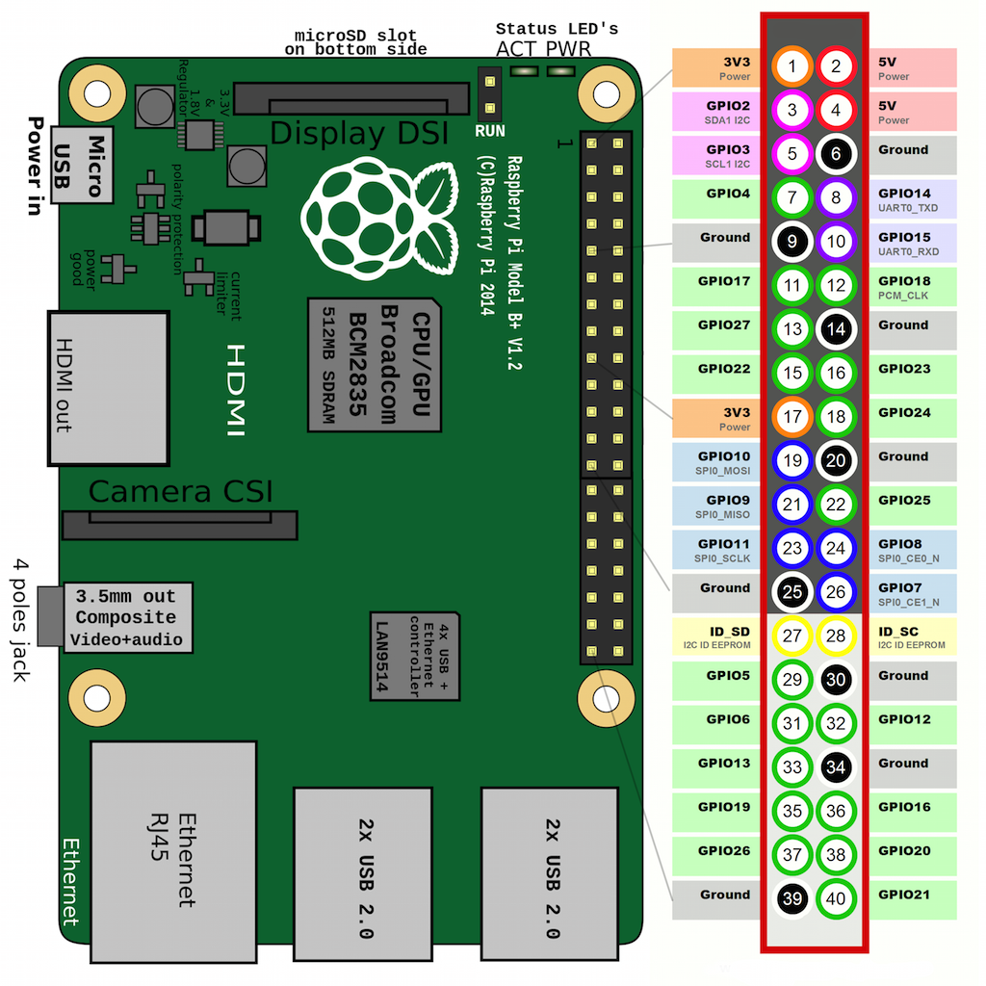
^{<programmed I/O>}
Raspberry Pi GPIO (general purpose input/output)
Example Python program for LED on pin 18
import RPi.GPIO as GPIO import time GPIO.setmode(GPIO.BCM) GPIO.setwarnings(False) GPIO.setup(18,GPIO.OUT) print "LED on" GPIO.output(18,GPIO.HIGH) time.sleep(1) print "LED off" GPIO.output(18,GPIO.LOW)

Slide 7
^{<polling>}
Code to detect button push – no interrupt
Polls the button status every 0.1 second
Why is this bad?
pressed = False
while True:
# button is pressed when pin is LOW
if not GPIO.input(BUTTON_GPIO):
if not pressed:
print("Button pressed!")
pressed = True
# button not pressed (or released)
else:
pressed = False
time.sleep(0.1)
Notes:
Nobody uses this if they can avoid it.

Slide 8
^{<interrupt>}
Code to add an interrupt and handler
Why is this better?
def button_callback(channel):
if not GPIO.input(BUTTON_GPIO):
print("Button pressed!")
else:
print("Button released!")
GPIO.add_event_detect(BUTTON_GPIO, GPIO.BOTH,
callback=button_callback, bouncetime=50)
Notes:
What is that bounce time about? Debounce in keyboards? Or is that done in hardware?
Bouncetime is the minimum time between interrupts – anything less than this e.g. a key bounce will be ignored, avoids multiple key presses when there was only one.

Slide 9
^{<DMA>}
PIO is not efficient for large or high rate data transfers
DMA (Direct Memory Access) offloads the CPU from reading and writing between devices and memory
Typically the CPU will issue
a count of the data to be transferred
the memory address
the address of the I/O device
if it is a read or a write
The DMA controller will then carry out the transfer and interrupt the CPU when it is complete, of if it needs another block of data
Used in disk controllers, network, graphics and sound adapters

Slide 10
^{<DMA>}
DMA takes control of the bus during transfer
If the CPU requires the bus, it has to wait for 1 data block (word)
This is not an interrupt
Effect is CPU executing more slowly during DMA transfers, but not much
Memory
CPU
DMA read
What is the purpose of the bridge?
What is a word?
I/O
Bridge
Notes:
This should lead to a discussion about bus speeds
Direct Memory Access
Smallest accessible unit in memory is called a word

Slide 11
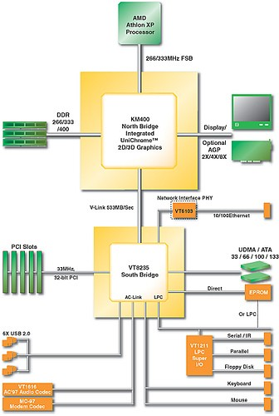
^{<Computer architecture>}
PC architecture (c 2000)
Why are there 2 bridges?
Why are the I/O devices organised this way?
What does each bus do?
Which buses are serial and which are parallel?
Notes:
More discussion about speeds and data rates.

Slide 12
^{<parallel bus>}
Parallel bus
If run at the same clock speed, it is 8 times as fast as a serial bus
Issues:
Clock skew
Crosstalk
What are these?
Transmitter
Receiver
D7
D6
D5
D4
D3
D2
D1
D0
1-byte parallel bus
8 bits transferred at once
Notes:
Also issues with reflections. Crosstalk and skew get worse with length. On motherboards if the bus has a bend, the outside path is longer than the inner path creating skew.

Slide 13
^{<serial bus>}
Serial bus
If run at the same clock speed, it is 8 times slower than a parallel bus
Advantage:
Smaller
Less crosstalk
Cheaper
Longer
Transmitter
Receiver
D7
D6
D5
D3
D2
D1
D0
D4
1-bit serial bus
1 bit transferred at a time

Slide 14
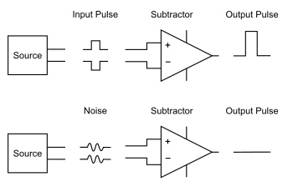
^{<differential signalling>}
Ethernet, HDMI, USB, PCIe, DMI serial buses use differential signalling
Uses 2 wires (e.g. twisted pair)
Receiver only detects difference between signals, therefore eliminating noise on both wires
Low voltage more susceptible to noise
In single ended
Vsupply – Vground = Vsupply
In differential
The low state is not ground, but – Vsupply
So difference is Vsupply – (-Vsupply) = 2Vsupply
Giving double the noise immunity
Notes:
Very important on motherboards where Vsupply less than 2V

Slide 15
^{<serial >}
Serial has become cheaper over time
Serial can be clocked faster than parallel
What has replaced these parallel interfaces?
IEEE 1284
PATA
SCSI
PCI
Why, specifically?

Slide 16
^{<current PC>}
Northbridge now in CPU
Southbridge now the PCH (platform controller hub)
DMI 3.0 (direct media interface) serial CPU – PCH bus
SATA serial disk bus
M.2 PCIe/SATA serial bus
PCIe serial bus
2.5 G Gigabit Ethernet
USB serial bus
Legacy PS/2 port (really)

Slide 17
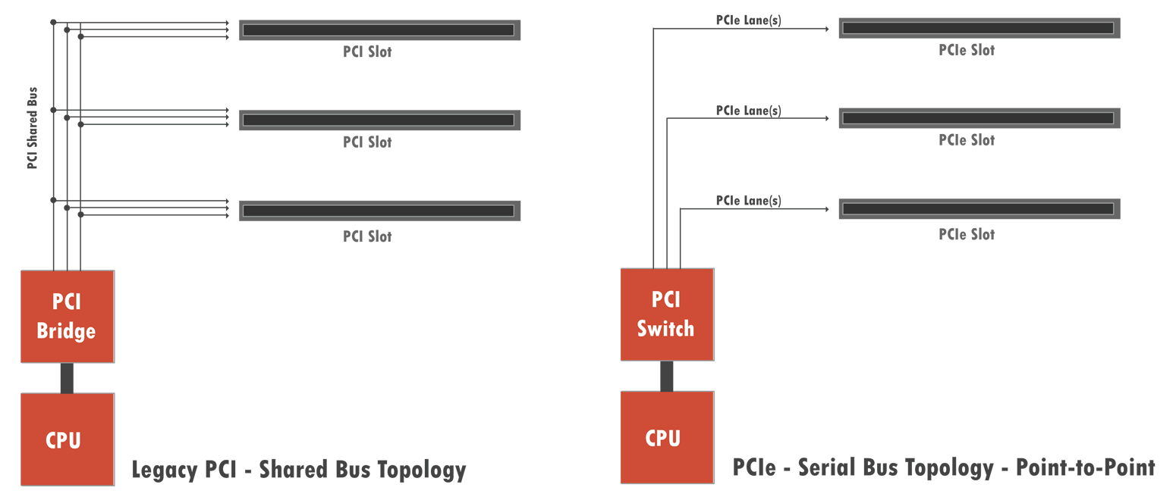
^{<PCIe>}
PCIe – express
Whereas PCI was a shared bus system, PCIe is a point to point system
Why is this better?
Notes:
PCI parallel, only one use of bus at a time and in one direction, speed limited to slowest device. PCIe full duplex between any 2 endpoints, no limit on concurrent access across multiple endpoints

Slide 18
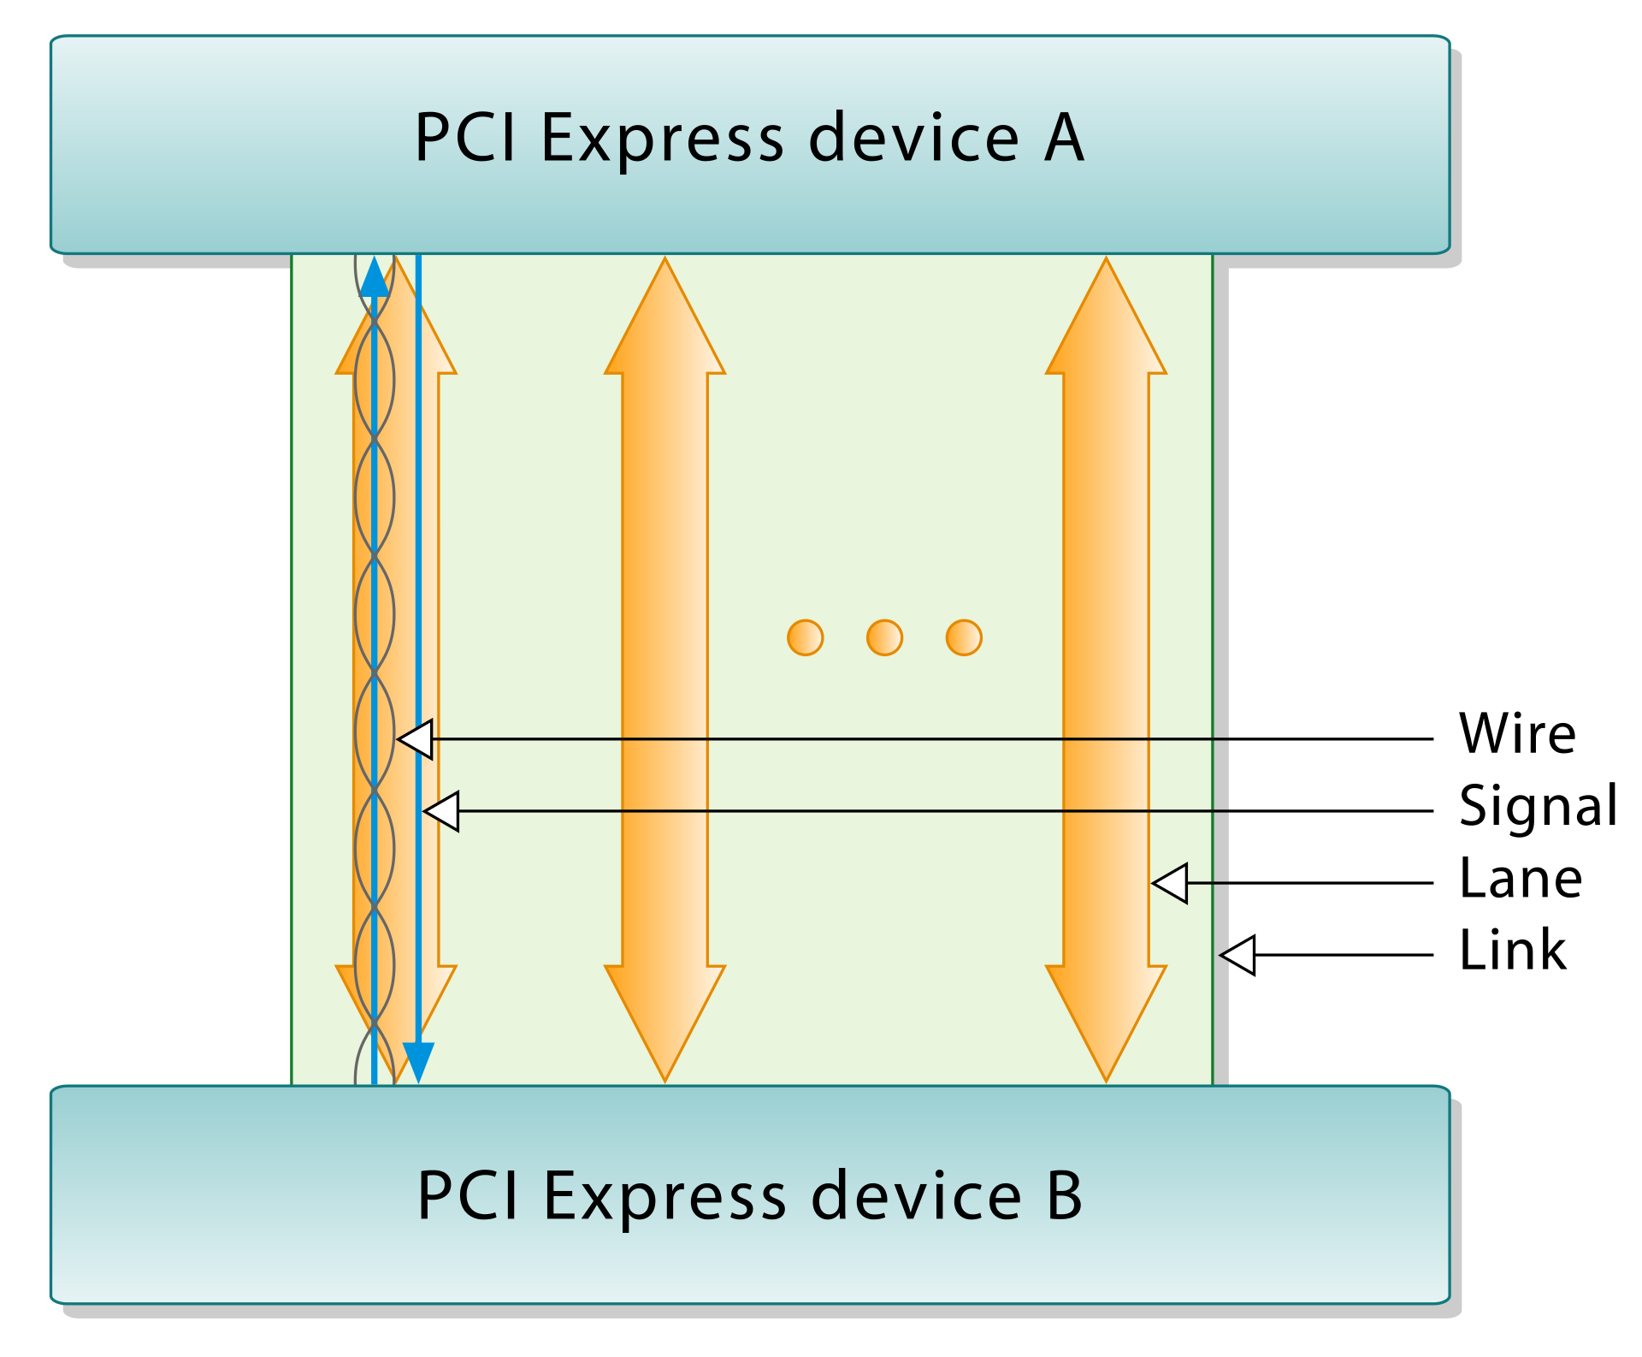
^{<lanes>}
PCIe – lanes
A lane consists of 2 differential signaling pairs, one for transmitting and one for receiving
A link can contain:
1
4
8
16
32 lanes
PCIe 3.0 8GT/s per lane
What is GT/s and what does this mean in bytes/s?
Notes:
Discuss how clocking is embedded in the signal, so no extra wires required.

Slide 19
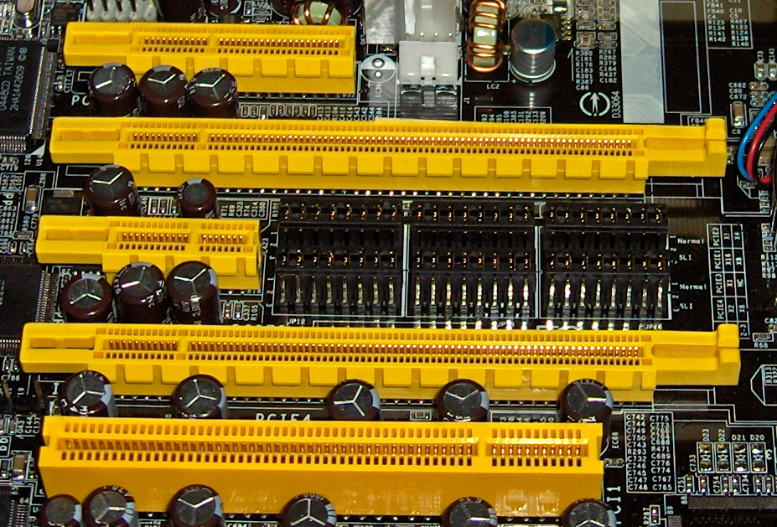
^{<lanes>}
Lane usage
1 lane
Low cost, low performance
16 lane
Graphics adapters
10 gigabit Ethernet
SAS or Fibre Channel
Using PCIe 3.0 what are the transfer rates achievable for 16 lanes?
Do CPUs and PCHs limit the number of concurrent lanes in use?
From the top:
4 lane
16 lane
1 lane
16 lane
Legacy PCI
Notes:
What are SAS and Fibre Channel? Slides coming later.

Slide 20
^{<PCIe and DMA>}
As well as DMA transfers from device to memory it is possible for:
Peer to peer DMA transfers between devices
No involvement of CPU or main memory
Notes:
Simplifies multi GPU programming – SLI and Crossfire use this. You can talk about these

Slide 21
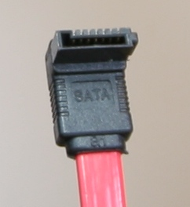
^{<SATA>}
SATA – serial ATA
Used to connect disks and SSDs
Two pairs using differential signalling
3 grounds
SATA revision 3.0
6 Gbit/s, 600 MB/s
SATA express
Supports SATA and 2 PCIe 3.0 lanes
UP to 2 GB/s
Supports NVMe for SSDs
M.2
Implementation of SATA Express in small form factor
Notes:
Get them to find out NVMe is. Non-Volatile Memory Express – specific interface to take advantage of SSDs

Slide 22
^{<SAS>}
SAS – Serial attached SCSI
Used in servers
Complete a comparison of SATA with SAS
Notes:
Get them to do the work – speeds, reliability, up time, seek times, cost, usage

Slide 23
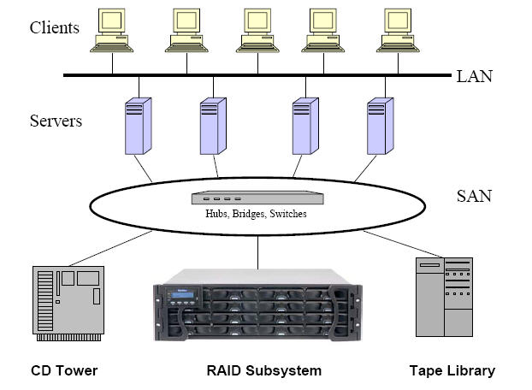
^{<SAN>}
Storage area network
Like Ethernet, but uses Fibre Channel
SCSI over fibre
Up to 128 Gb/s
Allows multiple servers to share storage
Not accessible to LAN
Can automate backups
Notes:
Ask then if they think hubs and bridges are still in use

Slide 24
^{<USB firewire thunderbolt>}
USB – Universal Serial Bus
Firewire
Thunderbolt
All are used to attach a variety of hardware
They all use differential signalling and carry power
Construct a table showing their key characteristics and usage (only compare the latest and current versions)
Notes:
Full duplex or not, speeds, length, PCIe or not, but split into two groups and let them decide what the key characteristics are. Mention DMA cyber attack vumerability

Slide 25
^{<DMI>}
DMI – direct media interface (Intel. AMD use PCIe)
DMI 3.0
Interface between CPU and PCH
Similar to PCIe
4 lanes
8 GT/s, 3.93 GB/s

Slide 26
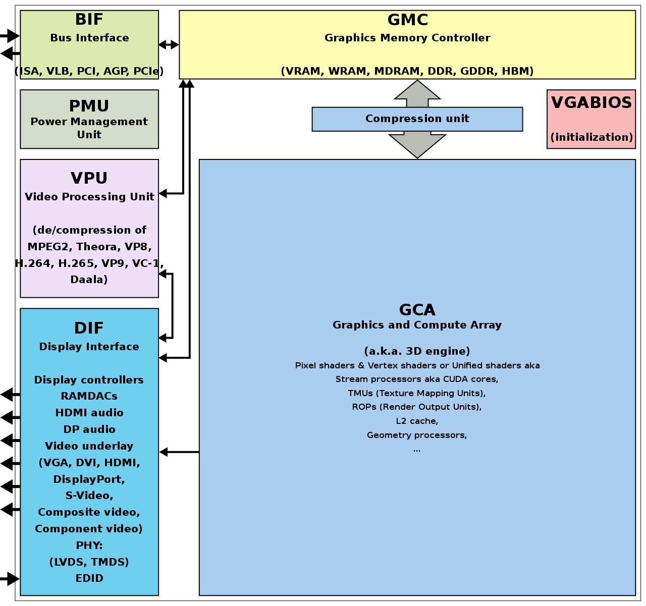
^{<graphics>}
GPUs
Significant processing power
Offload OpenGL DirectX
Can be used for non graphical purposes
What are common non-graphical uses?
Notes:
You can probably talk about these for hours

Slide 27
^{<graphics>}
Video can be:
On an adapter card
Integrated into the CPU
Compare the two approaches
Notes:
Dedicated v shared RAM, cost, size, energy consumption, offload, performance

Slide 28
^{<NIC>}
Network interface controller
Integrated on motherboard or into SOC (system on chip)
Serial connections for slower speeds 10/100/1000
PCIe connection for performance Gigabit and 10 Gigabit Ethernet
Interrupt driven to request transfer of data
DMA for transfer of data to buffers in main memory (more on this in operating systems)
Transmit and receive queues handle packets
High performance adapters can offload the complete TCP/IP stack from the CPU (more on this in module 2)
RJ45, fibre optic and wireless

Slide 29
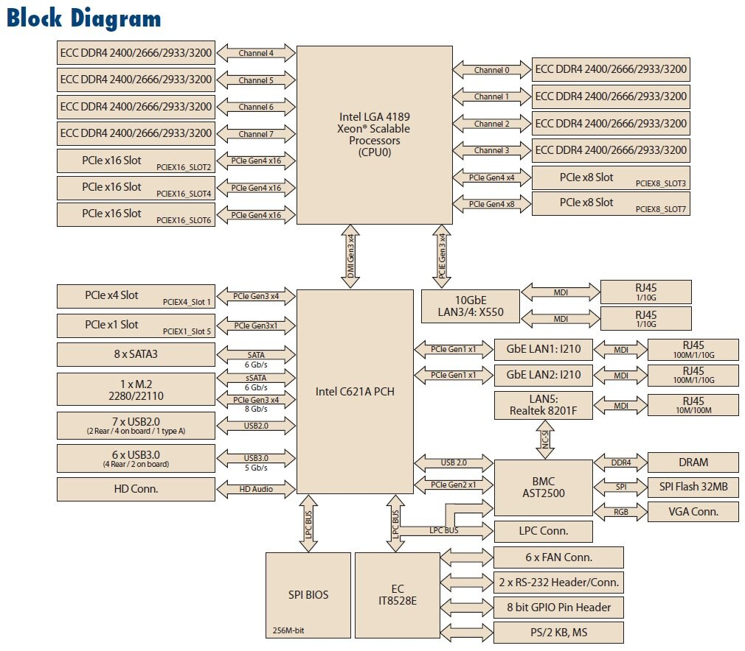
^{<servers>}
Server platform
How many PCIe lanes?
Direct to CPU
Other
Why?
How is this optimised for the required use?
What is a BMC?

Slide 30
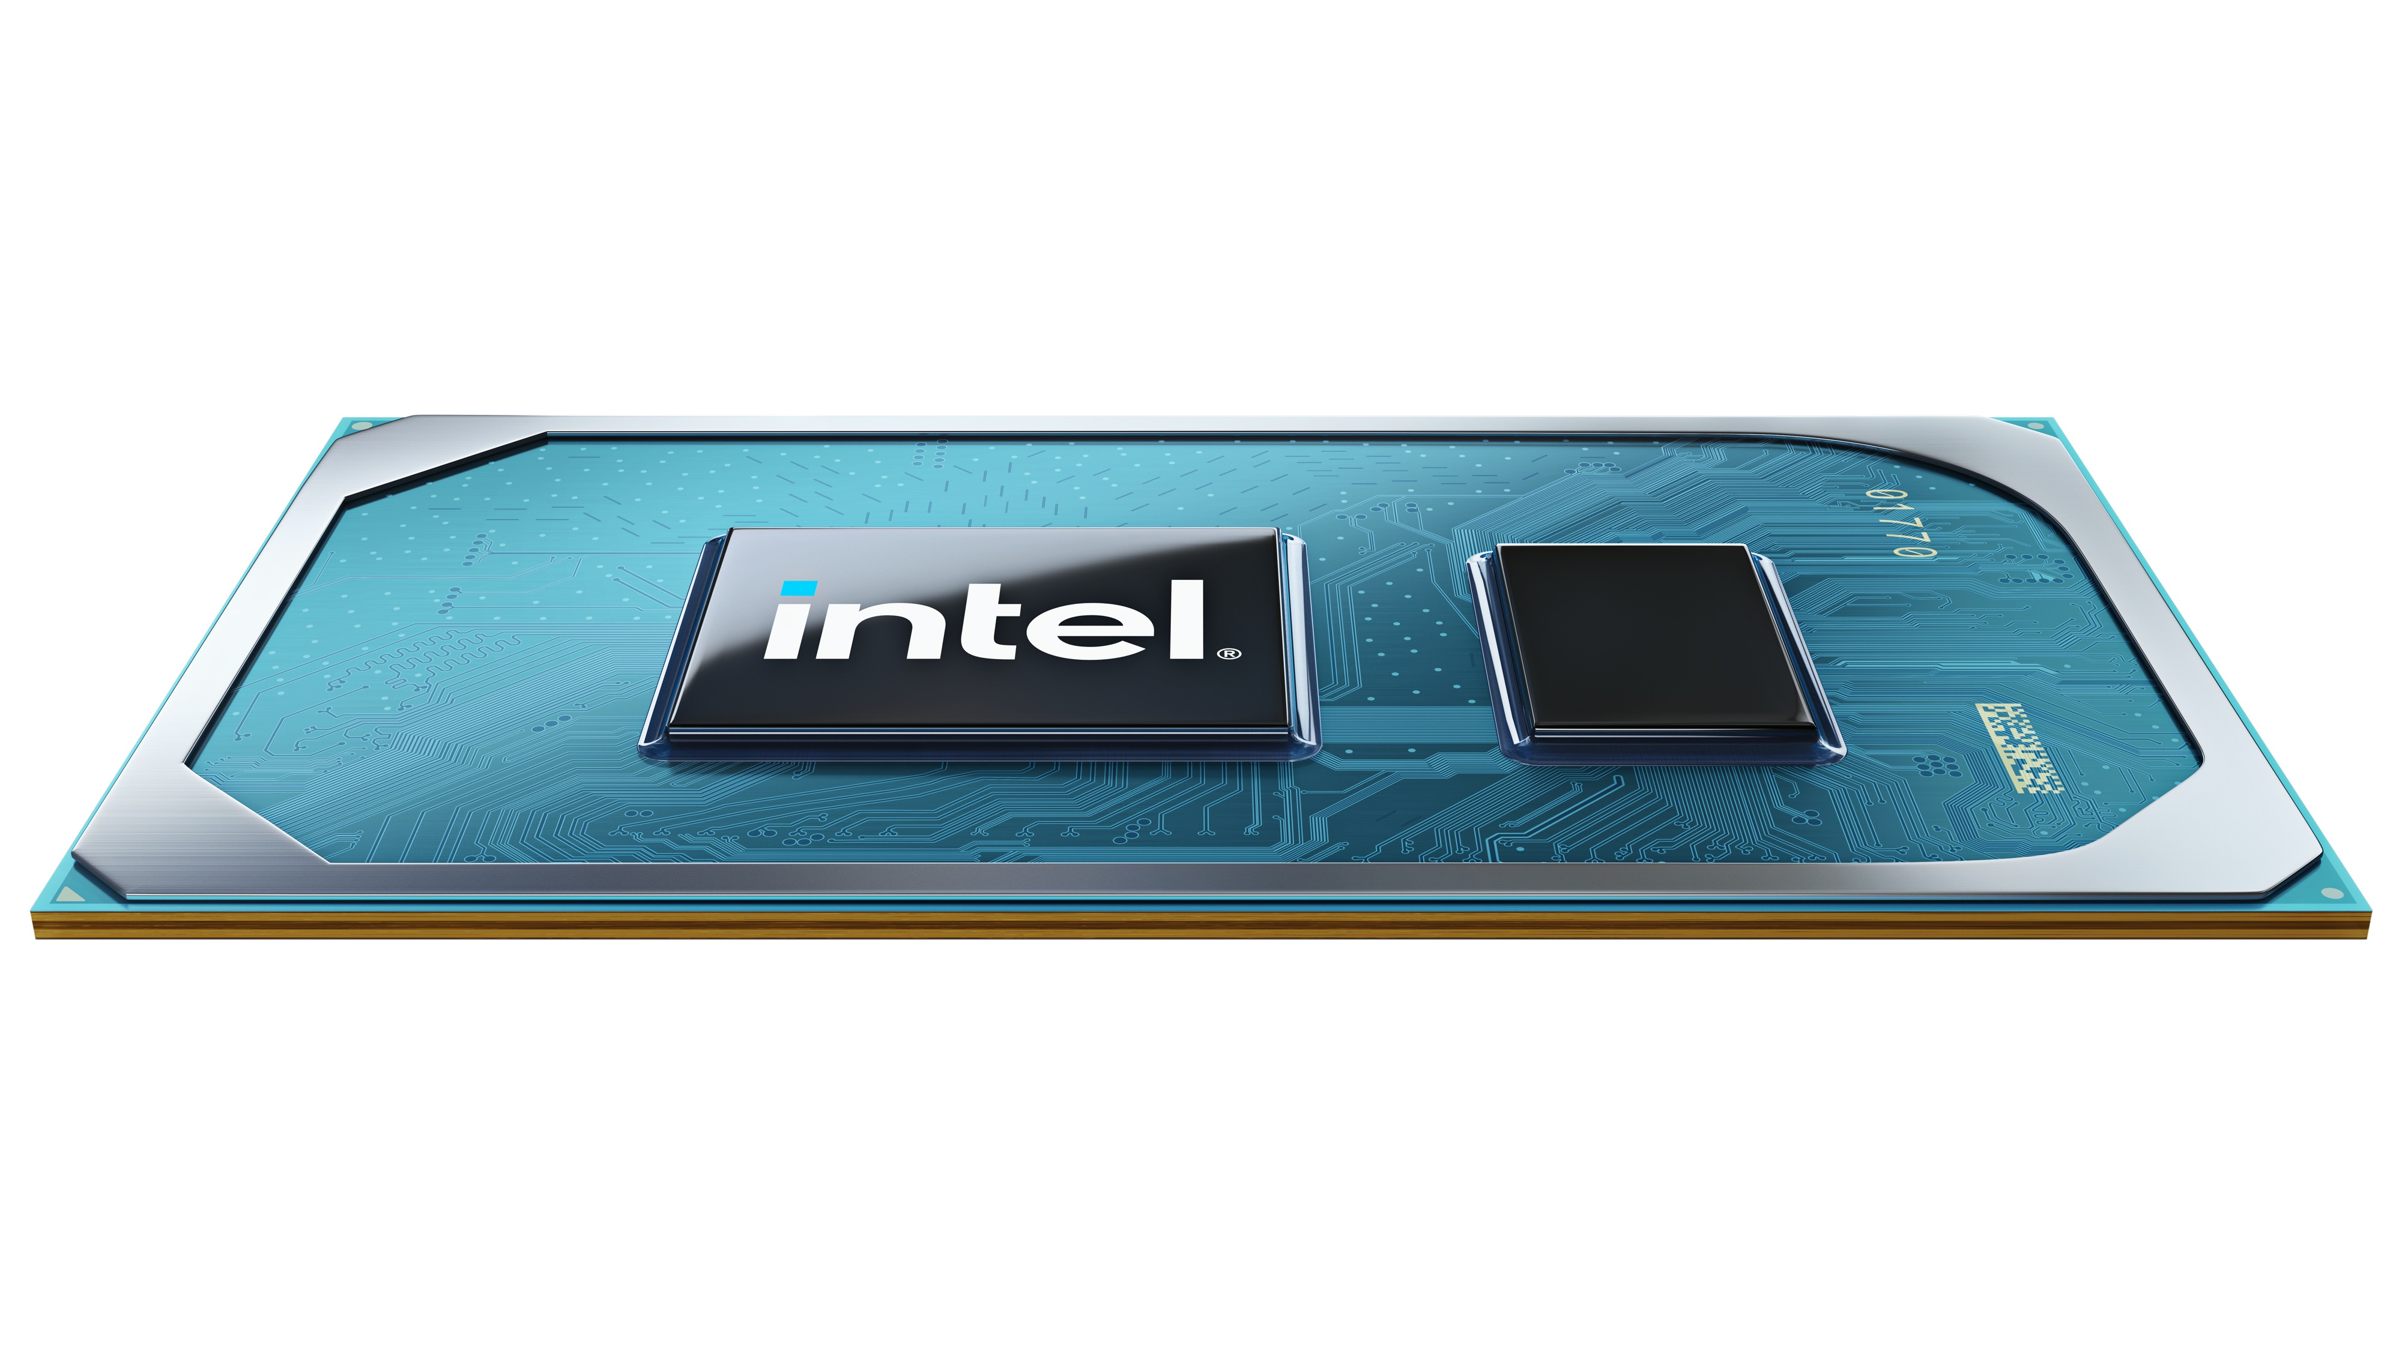
^{<Integration>}
CPU + PCH in one package
What are the advantages of this?
Intel EVO September 2020
Notes:
Matched system, shorter bus lengths, Intel EVO announced this September. Has PCIe 4.0. Get them to say what the improvements are – double the bandwidth.

Slide 31
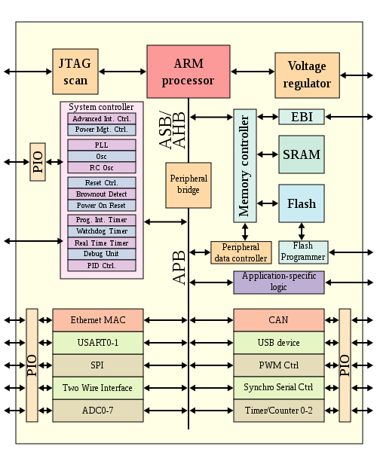
^{<soc>}
System on a chip
All I/O integrated
What are the advantages of this?
Broadcom

Slide 32
^{<phone SOC>}
Notes:
Some fun discussion points here. How many cores?

Slide 33
^{<final task>}
Construct – for your own notes – a bus speed hierarchy
Fastest at the top
Slowest at the bottom
Current versions only
Quote the performance
Include typical usage

Slide 34
^{<conclusion>}
We have covered:
All the I/O buses in current use
How signalling is performed
How the CPU is offloaded for data transfers and graphics
How the operating system handles I/O will be covered on day 11

