Slide 1
Embedded Systems
^{< introduction to the module >}
(UFCFCU-)

Slide 2
^{< PHASE >}
PHASE—Principles of High Assurance Software Engineering—prescribes a set of five principles to be used in the creation of ultra-reliable software and systems:
1. Minimal implementation
2. Component architecture
3. Least privilege
4. Secure development process
5. Independent expert validation

Slide 3
^{< Minimal Implementation >}
Most software developers do not work in an environment in which producing the absolute minimal possible solution to a problem is an unwavering requirement. Spaghetti code is the source of vulnerabilities that run rampant in software and provide the avenue of exploitation for hackers.
Notes:
As an example, let’s consider an HTML 1.1-compliant web server. Engineers at Green Hills Software developed a high-assurance web server (HAWS) that used state-driven protocol processing instead of the typical error-prone string parsing and manipulation. The result: a few hundred lines of perfect code instead of the tens of thousands of lines found in many commercial web servers. The Green Hills web server runs on the high-assurance INTEGRITY operating system. In 2008, a website running on this platform was deployed on the Internet, and Netragard, a leading white hat hacker organization, was invited to perform a vulnerability assessment of the website. Netragard CTO Adriel Desautels reported that the website had “no attack surface whatsoever.” HAWS is covered in more depth as a case study at the end of this chapter.

Slide 4
^{< Componentisation >}
An .EXE in windows is usually the most common target.
Different embedded operating systems (and microprocessors) have varying capabilities in terms of enforcing strict separation between components.
For secure systems, the embedded operating system must provide strict partitioning of applications in both time and space. A damaged application cannot exhaust system memory, operating system resources, or CPU time because the faulty software is strictly limited to an assigned quota of critical resources.
Notes:
complex software made up of multiple components should always be used in conjunction with an operating system that employs memory protection to prevent corruption of one component’s memory space by another partition. Inter-component communication is typically accomplished with standard operating system message-passing constructs.

Slide 5
^{< Least Privilege >}
Components must be given access to only those resources (e.g., communication pathways, I/O devices, system services, information) that are absolutely required.
insecure systems typically allow any program to access the file system, launch other programs, and manipulate system devices.

Slide 6
^{< Least Privilege >}
For example, browser buffer overflow vulnerabilities may enable an attacker to access any file because the web browser has the privilege to access the entire file system.
How do we secure this?
Notes:
The web browser either should have write access only to a dedicated, browser-specific directory (out of which the user can carefully decide what can leave the sandbox), or all browser write requests can require user approval via a dialog box. Read access can be limited to a whitelist of files known to be required for browser operation. The web browser’s runtime stack should not be executable.

Slide 7
< Secure Development Process >
ISO 15408
Let's take our plane that if something goes wrong, we don’t really want to be on it.
When it comes to creating the software that tells the plane to stay level in the air, we want to make sure the programmers are following secure practice and have testing in place.

Slide 8
< Secure Development Process >
What if though there is a problem with a code base and a programmer has created a system that shuts down the engines at a certain time of day?
This software may reside in all the aircraft engines the programmer was working on
What are some ways we can make sure this doesn’t happen?
Notes:
What if the programmer does send this code out into the world? What can we do then?
Redundant teams working on the same project split up so a separate team who don’t communicate to each other will work on the engine code. Therefore if one goes wrong the redundant code should keep the engine running.
Pilot could switch to backup system, or it could be automatic based on conditions.

Slide 9
^{< Change management>}
An extremely important aspect of maintaining secure software over the long term is to utilize an effective change management policy.
Notes:
A software project may be robust and reliable at the time of its first release, only to endure change rot over ensuing years as new features, not part of the original design, are hacked in, causing the code to become difficult to understand, maintain, and test.

Slide 10
^{< Expert validation >}
In the U.S. aircraft safety domain, the FAA must certify critical aircraft electronics (and their constituent software) against the RTCA/DO-178B standard.
Regulatory bodies for safety certification of industrial control, automation, and automotive systems sometimes use the IEC 61508 standard internationally.
ISO 26262
Rail and other industries utilizing IEC 61508 go through rigorous development and testing requirements.

Slide 11
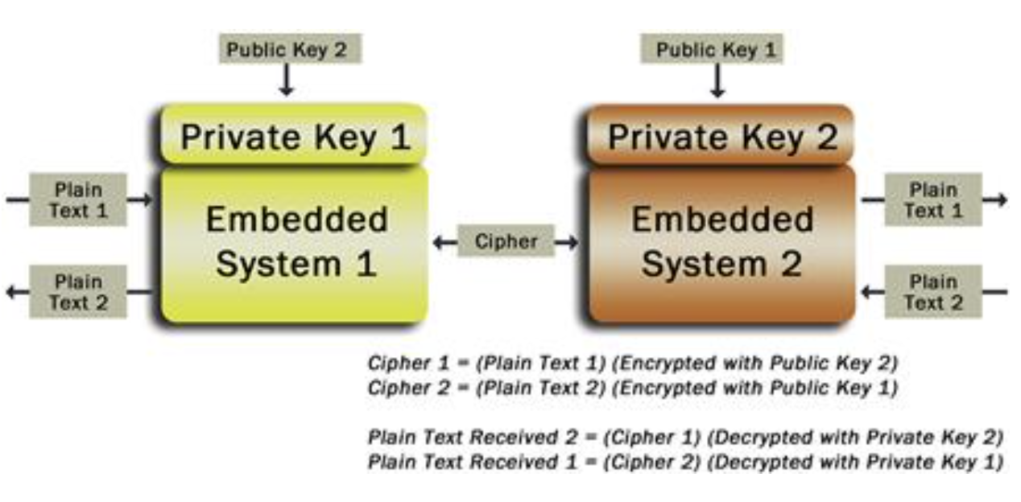
^{< Cryptography >}
RSA
Diffie-Hellman
Elliptic Curve (ECC)

Slide 12
^{< Cryptography >}
Look into Cryptography around embedded systems for the next 10 minutes and we will have a discussion about them
Is crypto more important in an embedded system?
Are there any ways the Crypto can be exploited?

Slide 13
^{< Cryptography >}
Since Alice’s and Bob’s ephemeral public keys are made public, an adversary, Mallory, who is an active eavesdropper, can intercept them and introduce his own public key for distribution to Alice and Bob

Slide 14
^{< Cryptography & Certs >}
FIPS 140-3
For embedded systems whose peers can be more directly controlled (need not interoperate with arbitrary endpoints), other certificate formats can be used. In particular, some highly memory-constrained embedded systems may find the storage requirements for a minimum set of X.509 certificates, each of which may be on the order of 1KB in size, to be prohibitive.

Slide 15
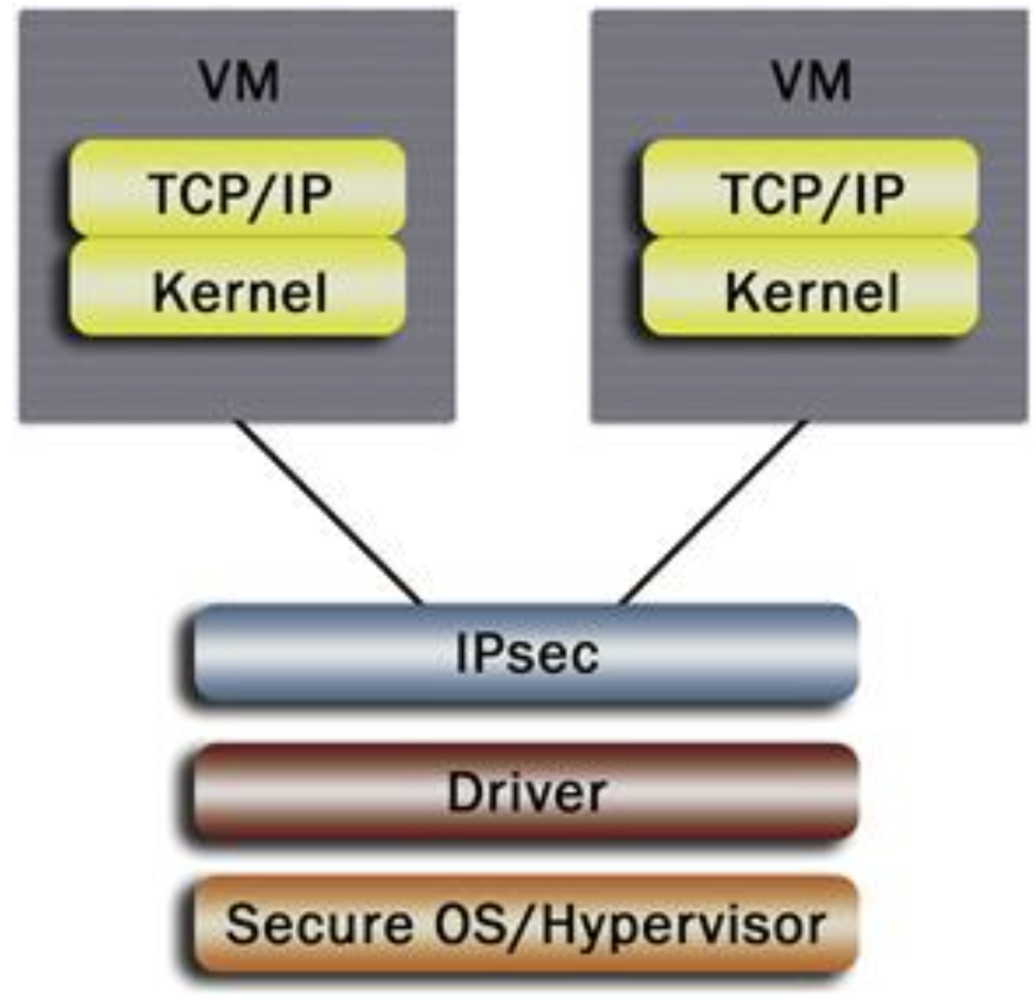
^{< Data Protection>}
Wi-Fi standards for network devices
WPA???
IPSEC & SSL
802.11??
802.1X??
Notes:
802.1x EEE 802.1 is a working group of the IEEE 802 project of the IEEE Standards Association . LAN/MAN bridging and management. Covers management and the lower sub-layers of OSI Layer 2, Wired ethernet

Slide 16
^{< Smart devices >}
Take a smart meter and find out as much information you can
How do they connect to the power company?
How much RAM, Storage etc. do they have?
What radio wave communication method do they use?
TCP or UDP?
IPV4 or 6?
Notes:
IPv6 is of enormous importance due to the desire to connect, ultimately, billions of smart energy network endpoints. However, a full-featured, RFC-conformant IKE/IPsec implementation is very sophisticated and not a good fit for a low-cost, battery-powered smart sensor armed with a microcontroller and its tens of kilobytes of flash and RAM talking to a low-rate, small-packet-size 802.15.4-based wireless network.
In fact, today’s Zigbee-based devices use rudimentary data link layer security that has proven trivial to break (e.g., private symmetric keys provisioned over the network in the clear). In essence, designers are asserting that the security perimeter is best enforced at the gateway and that the threat to the HAN or perhaps even the NAN is not worth worrying about.

Slide 17
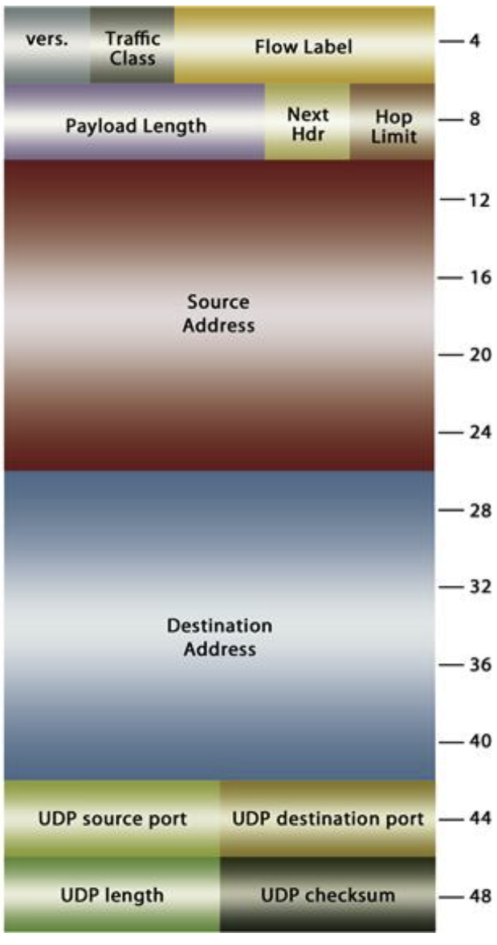
^{< Smart devices >}
IPV6 Packet for a smart meter

Slide 18
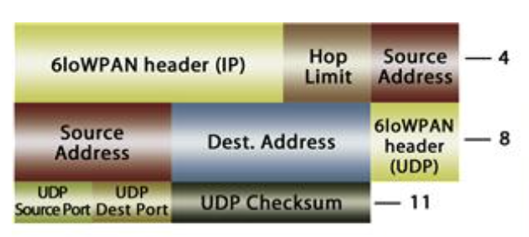
^{< Smart devices >}
6loWPAN

Slide 19
^{< Embedded systems VPN >}
OpenSwan
A modern Openswan implementation will require approximately 300 KB of code and data storage (static footprint), not including the cryptographic algorithms required by IKE.
Open VPN

Slide 20
^{< Network Attacks >}
Man-in-the-Middle and/or Eavesdropping
Phishing and Other Social Engineering Attacks
Malware Attacks
Web Application Attacks
Pharming Attacks
Notes:
In computer security, a side-channel attack is any attack based on information gained from the implementation of a computer system, rather than weaknesses in the implemented algorithm itself (e.g. cryptanalysis and software bugs). Timing information, power consumption, electromagnetic leaks or even sound can provide an extra source of information, which can be exploited.

Slide 21
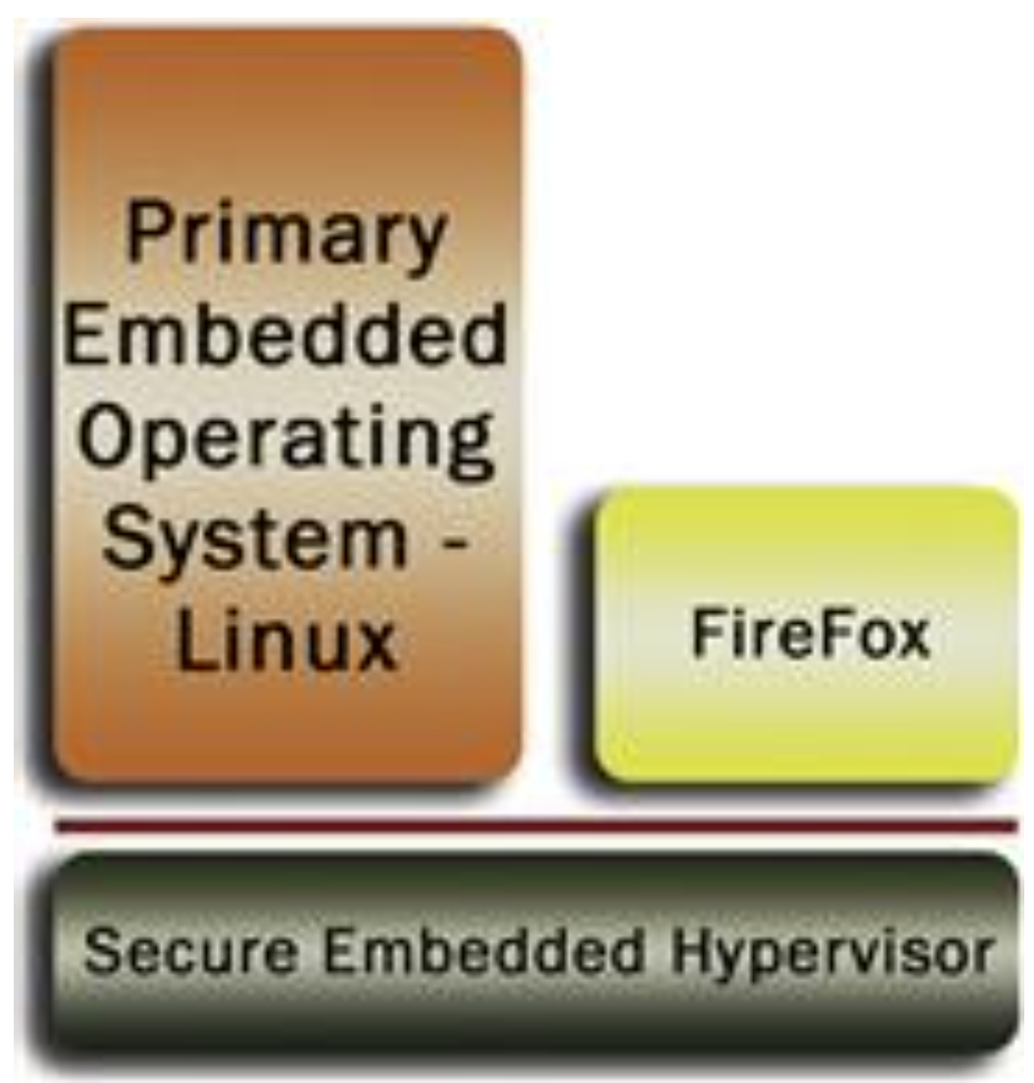
^{< Network Security >}
Virtualized Web Client

Slide 22
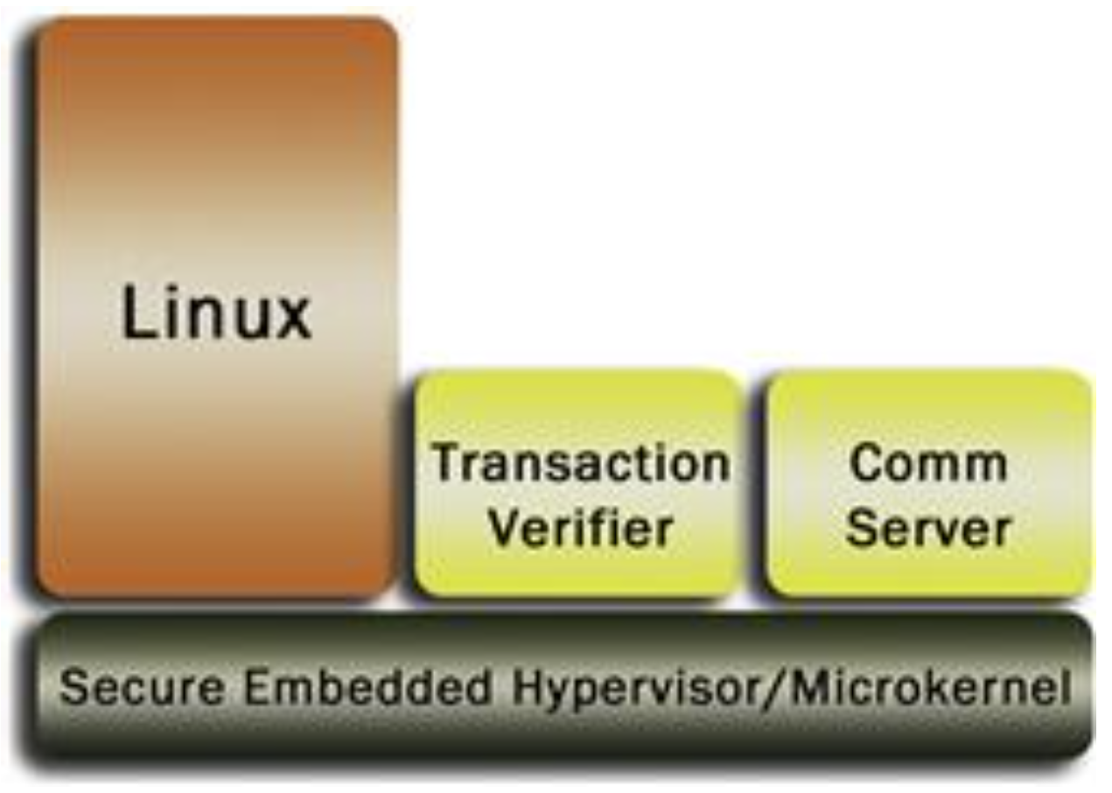
< Trustworthy Embedded Transaction Architecture >
Virtualization can be used to host the system’s guest Linux environment while employing two critical security subsystems that run in a separate virtual machine or within a native microkernel process (if applicable).
Notes:
The first subsystem, called the communications server, provides a trustworthy communications connection between the embedded system and the remote server. The second subsystem, called the transaction verifier, provides a trusted verification interface for the client

Slide 23
< Trustworthy Embedded Transaction Architecture >
End-to-end network transaction security will be improved by applying the same high-assurance methodology on the server side.

Slide 24
< Car threats and Mitigations >
Local-Physical
Examples of local-physical threat would be someone physically tapping into the drivetrain’s CAN network and disrupting communications or damaging an ECU via power surge or excessive heat application.
Noninvasive attacks can come from accessing the Private keys of a cars embedded system. Electric cars to the grid, or cars to the GPS.
Notes:
Controller area network _ embedded devices that communicate to each other.
Private keys must be kept in storage that can withstand sophisticated physical attacks, both invasive and non-invasive, because the loss of even a single private key may enable an attacker to establish connections into remote infrastructures where widespread damage and property loss can ensue.

Slide 25
< Car threats and Mitigations >
Remote
A hacker tries to probe the car’s long-range radio interfaces for vulnerabilities in network security protocols
Notes:
Whenever possible, complete physical isolation of critical automotive ECUs from network-connected vehicular infrastructure should be imposed.

Slide 26
< Car threats and Mitigations >
Internal-Electronic
While physical network isolation is desirable, touch points will inevitably exist. For example, the car’s navigation system, in some markets, must be disabled while the car is in motion, implying communication between systems of widely differing safety criticality.
Furthermore, a strong future trend toward consolidation—where more powerful multi-core microprocessors are used to host disparate systems, turning many ECUs into virtual ECUs—increases the risk of software-borne threats such as privilege escalation due to operating system vulnerabilities, side-channel attacks on cryptography, and denials of service.

Slide 27
^{< Side Channel>}
Computers give out unintended signals
We can analyze the signals such as power EMI to read data.
Signal patterns are used for identifying data
A chip on an embedded system will use more power if its generating or checking crypto keys for example.

Slide 28
^{< Side Channel >}
Use the rest of the day to look into side channel attacks and any tools that can be used to perform them.

