Slide 1
Day 2
Client-Server
Terminology
Security
Fix a website
Add pages
Links
Forms

Slide 2
4. Web components (55%, K2)
In this topic, learners will understand the components involved to make the Web work.
4.1 Define the terminology for the following key internet protocols that enable the web to work:
Hypertext Transfer Protocol (HTTP)
Hypertext Transfer Protocol Secure (HTTPS)
Transport Layer Security and Secure Sockets Layer (TLS / SSL)
4.2 Discuss the purpose of the following:
Web and application server
Hosting and serving
Relational database management systems
Content management systems

Slide 3
4. Web components (55%, K2)
4.3 Describe the purpose of a web client
Browsers
Applications
4.4 Describe how Search Engines operate in regard to the following:
How mark-up languages render hyperlinks
How the web crawler work
Displaying of search results
Factors that affect search engine optimization (SEO)
4.5 Explain the differences between a static and dynamic website.
Written in code
Written scripting language

Slide 4
4. Web components (55%, K2)
4.6 Describe how local (cookies) or session data storage is utilised to share information for standard digital features.
Forms
Checkout
Registration
4.7 Identify the key roles of the following Web technologies governance groups.
World Wide Web Consortium (W3C);
Internet Engineering Task Force (IETF).

Slide 5
4.1 Define the terminology for the following key internet protocols that enable the web to work
Hypertext Transfer Protocol (HTTP)
Hypertext Transfer Protocol Secure (HTTPS)
Transport Layer Security and Secure Sockets Layer (TLS / SSL)

Slide 6
The Internet and WWW
WWW
WWW = World Wide Web
The pages you see when you use a device and you are ‘online’
Need a browser
Internet
An internetwork of computers across the globe and even using space
Consists of networked computers and other devices
Hardware

Slide 7
Hypertext Transfer Protocol (HTTP)
WWW is about communication between web clients and servers
Communication between client computers and web servers is done by sending HTTP Requests and receiving HTTP Responses
Foundation of data communication for the World Wide Web
NOT secure
i
Not secure
|
http://example.com

Slide 8
Hypertext Transfer Protocol Secure (HTTPS)
Hypertext Transfer Protocol Secure (https) is a combination of the Hypertext Transfer Protocol with an added layer of security
Requires a certificate
Protects the integrity and confidentiality of data between the user's computer and the website
|
https://example.com

Slide 9
Encryption
Before encryption:
This is a string of text that is completely readable
After encryption:
ITM0IRyiEhVpa6VnKyExMiEgNveroyWBPlgGyfkflYjDaaFf/Kn3bo3OfghBPDWo6AfSHlNtL8N7ITEwIXc1gU5X73xMs

Slide 10
Transport Layer Security and Secure Sockets Layer (TLS / SSL)
SSL refers to Secure Sockets Layer whereas TLS refers to Transport Layer Security
Basically, they are one and the same, but, entirely different
SSL and TLS are cryptographic protocols that authenticate data transfer between servers, systems, applications and users
TLS has replaced SSL (but we still say “I need an SSL certificate”)

Slide 11
Organisations
IETF (https://www.ietf.org/)
The Internet Engineering Task Force (IETF) develops and promotes voluntary Internet standards, in particular the standards that comprise the Internet protocol suite (TCP/IP)
W3C (www.w3.org)
The World Wide Web Consortium (W3C) is the main international standards organisation for the World Wide Web
Founded and currently led by Tim Berners-Lee

Slide 12
Time for some Practical

Slide 13
Homework

Slide 14
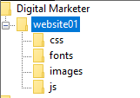
1
Your pictures are in here
Your index.html file is in here
Save your two files here
4
<!DOCTYPE html>
<html lang="en">
<head>
<meta charset="UTF-8">
<meta name="viewport“>
<title>Document</title>
</head>
<body>
</body>
</html>
<!DOCTYPE html>
<html lang="en">
<head>
<meta charset="UTF-8">
<meta name="viewport“>
<title>Document</title>
</head>
<body>
</body>
</html>
2
3
Now in your editor, create two new files
meditation.html
yoga.html

Slide 15
Your Files
Add the necessary images and tags to make the files display nicely
No markup tags used

Slide 16
Your Files
Add the necessary images and tags to make the files display nicely
Markup tags used

Slide 17
Filezilla
When you have done your two pages, upload using FileZilla

Slide 18
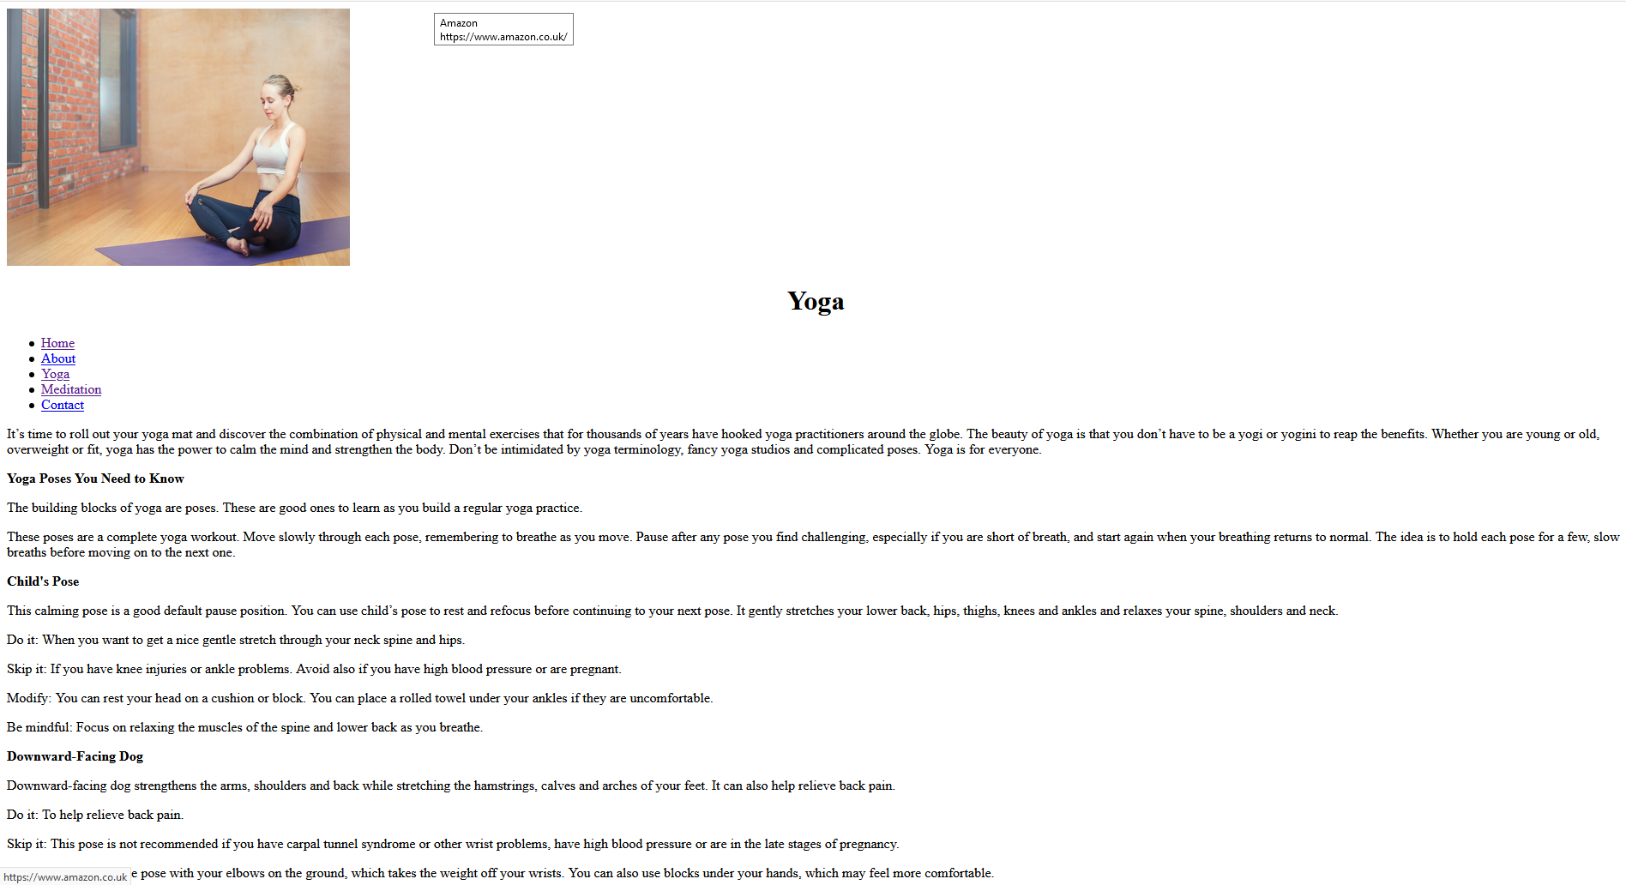
The two pages should look something like this

Slide 19
HTML tags
Tag | Description | Nested in
<html></html> | Start of HTML section | N/A
<head></head> | Document header. Includes information about the document. | <html></html>
<title></title> | Displays a title in the Browsers title bar. Identifies the web content | <head></head>
<body></body> | Main body of the HTML document. Contains the websites content | <html></html>
<b></b> | Bold formatter | <body></body>
<p></p> | Paragraph of text. Add extra lines before and after paragraph. | <body></body>
<br> | Single carriage return | <body></body>
<h1></h1> | Heading style (largest heading) | <body></body>
<h6></h6> | Heading style (smallest heading) | <body></body>
<i></i> | Defines italic text | <body></body>
HTML tags normally come in pairs

Slide 20
Lets Play
Create a folder in your Digital Marketer Folder called webtest

Slide 21
HTML Basic Document
Start HTML
<! DOCTYPE html>
<html>
<head>
<title>Document name goes here</title>
</head>
<body>
Visible text goes here
</body>
</html>
Header information
Page information
Notes:
http://www.w3schools.com/html/html_elements.asp

Slide 22
Notepad
Create your first webpage using an editor of your choice
The body text should include your name in bold
Save the file as "mypage.html".

Slide 23
W3C rules
HTML not case sensitive
W3C recommend lowercase
Tags should have closing tags
<p></p>
<br />

Slide 24
HTML Basic Formatting
<html>
<head>
<title>Document name goes here</title>
</head>
<body>
<b>My first Webpage</b> by Joe Blogs
</body>
</html>
Add Italic here
Add Bold
Notes:
http://www.w3schools.com/html/html_elements.asp

Slide 25
Headings
Headings are defined with the <h1> to <h6> tags.
<h1>This is a large heading</h1>
<h2>This is a heading</h2>
<h3>This is a heading</h3>
<h4>This is a heading</h4>
<h5>This is a heading</h5>
<h6>This is a small heading</h6>
HTML automatically adds an extra blank line before and after a heading.

Slide 26
HTML Basic Formatting
<html>
<head>
<title>Document name goes here</title>
</head>
<body>
<h1>This is a large heading</h1>
<h2>This is a heading</h2>
<h3>This is a heading</h3>
<h4>This is a heading</h4>
<h5>This is a heading</h5>
<h6>This is a small heading</h6>
</body>
</html>
Notes:
http://www.w3schools.com/html/html_elements.asp

Slide 27
HTML Basic Paragraphing
<html>
<head>
<title>Document name goes here</title>
</head>
<body>
<p>Paragraphs have a blank space before and after the text</p>
<p>This is useful to distinguish section of text</p>
<b>Sometimes extra <i>line breaks</i> are not needed</b>
<br />A simple <i>Line Break</i> can be used here
<br />Note it does not need a closing tag
</body>
</html>
Notes:
http://www.w3schools.com/html/html_elements.asp

Slide 28
Tags and Attributes
Some tags can have extra parameters (attributes)
An attribute provides extra formatting functionality
Not all tags allow attributes
<tag attribute=“parameter”></tag>

Slide 29
Alignment (Horizontal)
Alignment defines the positioning of text
<html>
<head>
<title>Document name goes here</title>
</head>
<body>
<h1 align=‘center’>This is a large heading</h1>
<h2 align=‘left’>This is an h2 heading</h2>
<h3 align=‘right’>This is an h3 heading</h3>
<h4 align=‘justify’ >This is an h4 heading</h4>
</body>
</html>

Slide 30
Paragraph alignment
<p align=“center”></p>

Slide 31
Background attribute
Defining a background colour in the body tag
<body bgcolor=‘#000000’> (This is deprecated)
<body bgcolor=‘rgb(0,0,0)’>
<body bgcolor=‘black’>
Defining a background image
<body background="www.images.com/clouds.gif">
Note W3C has deprecated bgcolor, background attribute in latest versions of HTML (HTML 4 and XHTML) – use CSS instead.

Slide 32
Colours
256 * 256 * 256 = 16 777 216
Colour | Colour HEX | Colour RGB
 | #000000 | rgb(0,0,0)
 | #FF0000 | rgb(255,0,0)
 | #00FF00 | rgb(0,255,0)
 | #0000FF | rgb(0,0,255)
 | #FFFF00 | rgb(255,255,0)
 | #00FFFF | rgb(0,255,255)
 | #FF00FF | rgb(255,0,255)
 | #C0C0C0 | rgb(192,192,192)
 | #FFFFFF | rgb(255,255,255)
http://www.computerhope.com/htmcolor.htm
Notes:
http://www.w3schools.com/html/html_colors.asp
Initially web sites could only use web safe colours. These were 216 colours for VGA displays. With x11 came the opportunity to expand into 16 bit (high colour) and 24 bit (True Colour). Each hex value corresponds to the red, green and blue shades. Can use a shortcut if the values are similar, e.g. #C0C0C0 can be represented as #C0.

Slide 33
Font tag
Format font
<font face="Verdana">text</font>
Format font and size (size is 0-7, not scaled in points)
<font size="2" face="Verdana">text</font>
Format colour
<font color="#c0c0c0">text</font>
Note W3C has deprecated font attribute in latest versions of HTML (HTML 4 and XHTML).– use CSS instead.
Notes:
W3C has deprecated font attribute in latest versions of HTML (HTML 4 and XHTML) – use CSS instead.

Slide 34
DIV tag
Generic block element
Serves no direct purpose
Facilitates styling attributes
Heavily used in CSS
<div></div>

Slide 35
DIV examples
<div align="center"></div>
<div style="color:#FF0000;">
<div class=“menu"></div>

Slide 36
Let’s go to our mindfulness web pages
In the yoga.html page, change the font of the YOGA heading
<font face="Verdana">Yoga</font>
Let’s say we had 20 pages to do, what problem do you see?
What happens if tomorrow we need to change the font in the 20 pages to ARIAL?

Slide 37
Too much work!!!!

Slide 38
There is an easier way

Slide 39
Implementing CSS
CSS attributes can be placed either:
Inline – CSS code mixed into the HTML code
Internal/embedded – CSS code is within a HTML document
External (linked) - a separate imported CSS file

Slide 40
Inline
CSS code mixed into the HTML code
Simple to update CSS
Useful to override some other style definition by embedded or external CSS
Simple changes have to be reciprocated through each occurrence
<p style="color: sienna; margin-left: 20px">This is a paragraph</p>

Slide 41
Internal/embedded
CSS code is within a HTML document
No separate file
Written as part of the <head> tag
Only affects one page
<html>
<head>
<style type="text/css">
hr {color: blue}
p {margin-left: 20px}
</style>
</head>
<body>
<p>My paragraph</p>
</body>
</html>

Slide 42
External
A separate imported CSS file
One change modifies all pages
Most powerful type of style sheet
Single style sheet formats many pages
CSS file
Home webpage
Contact webpage
Products webpage
Notes:
0

Slide 43
Cascading Order
Styles can be implemented in multiple places – external, internal, inline
Which style will take priority?
Browser default (least priority)
External style sheet
Internal style sheet (inside the <head> tag)
Inline style (inside an HTML element) (Highest priority)
Inline will override all other CSS styles

Slide 44
CSS selector implementation
Type
Redefine all instances of a specific XHTML tag
Class
Redefine specific XHTML tags that contain this attribute
Greater flexibility over styles
More combination of styles per XHTML tag
ID
Creating your own specific styling
Defines a specific element
Unique ID names
syntax

Slide 45
CSS Selector Syntax
selector {property: value}
Selector - relates to the HTML tag to be defined
Property – attribute to change
Value – new attributes value
Declaration
p {font-family: "Arial";}
Selector
Property
Value

Slide 46
Type selector format
p {font-family: "sans serif";}
p {text-align:center; color:red;}
p
{
text-align: center;
color: black;
font-family: "arial";
}
Better code formatting

Slide 47
Type selector in use
p {font-family: "Comic"; color: blue;}
</head>
<body>
<p>This text will have the CSS attributes applied</p>
<p>This text will also be formatted using CSS</p>
</body>

Slide 48
Class selector in use
p.smallprint {font-family: "Comic"; font-size: 10px;}
p.mainprint {font-family: "Arial"; font-size: 16px;}
</head>
<body>
<p>this text will have no CSS formatting applied</p>
<p class= "smallprint">text will be formatted using class selector</p>
<p class= "mainprint">text formatted differently</p>
</body>

Slide 49
External CSS file example
CSS file – "mystyle.css"
p {font-family: "Comic"; color: blue;}
Home webpage
<head>
<link rel="stylesheet" type="text/css" href="mystyle.css" />
</head>
<body>
<p>this text will have the CSS attributes applied</p>
<p>this text will also be formatted using CSS</p>
</body>

Slide 50
Grouped elements
Many tags can be grouped to minimise coding
h1,h2,h3,b,p
{
color: green;
}
Heading tags 1-3, bold and paragraph all coloured green

Slide 51
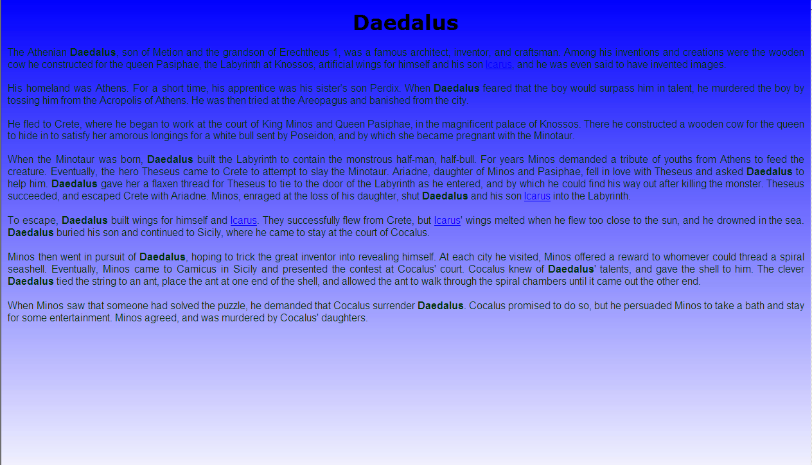
Background colour

Slide 52
CSS background
body {
background-image: url(gradient.jpg);
background-repeat: repeat-x;
background-color: #FFFFFF;
}
Notes:
http://www.w3schools.com/css/tryit.asp?filename=trycss_background-repeaty

Slide 53
Bitmap image
3x

Slide 54
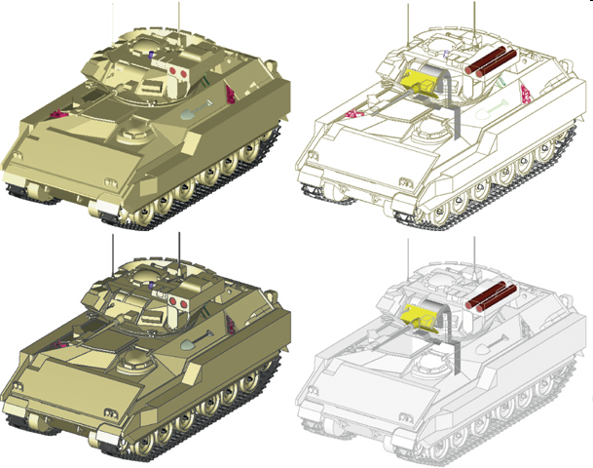
Vector image
Uses mathematical equations to represent a image
Use geometrical shapes, such as:
Points
Lines
Curves
Circles
polygons
3x

Slide 55
Background effects

Slide 56
Let’s make some css for our index.html page
Open index.html in your editor

Slide 57
<!DOCTYPE html>
<body>
<div><img src="images/dm_sunset.jpg" alt="sunset image"></div>
<ul>
<li><a href="index.html">Home</a></li>
<li><a href="#">About</a></li>
<li><a href="yoga.html">Yoga</a></li>
<li><a href="meditation.html">Meditation</a></li>
<li><a href="#">Contact</a></li>
</ul>
<div>
<p align="center" style="font-size:60px"> Mindfulness</p1>
<h3 align="center">Mind Body Soul</h3>
<img src="images/dm_logo.png" align="left" height="40px" width="60px">
<p style = "font-size:30px">With most of us living fast-paced lifestyles trying to balance work, family and social lives can take it’s toll on our mental and physical wellbeing. Learning to meditate can bring a sense of calm and inner happiness to our lives and help promote feeling of peace and tranquility that often times get lost when we are busy trying to juggle everything we have to accomplish on a daily basis. </p>
</div>
<br>
<img src="images/dm_logo.png" alt="logo" align="left" height="40px" width="60px">
<p style = "font-size:30px">The practice of meditation is a gateway into your inner consciousness, resulting in an enhanced awareness of your own existence and your overall relationship to the universe & one of the best things about meditation is it can take only minutes a day! </p>

Slide 58
After the body tag, add a div
<body>
<div class="header">img src="images/dm_sunset.jpg alt="sunset image"</div>
.
.
.

Slide 59
Run your page in the browser
What do you observe?
No change!!!!

Slide 60
Let's add a link
Below the <!DOCTYPE html> add the following:
<head>
<link rel="stylesheet" href="css/style.css">
</head>
No change!!!!

Slide 61
Run your page in the browser
What do you observe?
No change!!!!

Slide 62
Make a new webpage and call it style.css
Place it in the css folder
Make a new webpage and call it style.css
In Sublime: Ctrl N -> Ctrl S -> style.css
Place it in the css folder

Slide 63
Add the following:
.header {
color: blue;
text-align: center;
font-size:60px;
}
Save the style.css and the index.html pages
Run your page in the browser

Slide 64
BREAK
Well done
Have a 15 minute break….

