Slide 1
BCS Level 3 Certificate in Software Development Context and Methodologies
QAN 603/1191/5

Slide 2
Syllabus
1. Business Context and Market Environment (10%, K2)
2. Software Development Methodologies (20%, K3)
3. Team Roles and Relationships (10%, K2)
4. Application Structure and Development Platform Context (20%, K3)
5. The Software Development Lifecycle (SDLC) (10%, K3)
6. Software Testing (20%, K3)
7. Configuration Management and Version Control Systems (10%, K3)

Slide 3
1. Business Context and Market Environment (10%, K2)
In this topic, the apprentice will learn that a broad range of industries and markets differ in their approach to information and their rationale, whilst the software development processes and methods are similar.
The successful apprentice should be able to:

Slide 4
1.1 and 1.4
Recognise that business, market and information needs may lead to very different applications whilst using similar development processes and methods
Distinguish types of business in context of their provision and use of web and digital services

Slide 5
Market Segments

Slide 6
Meanings
Here’s what all four stand for:
B2B – business-to-business
B2C – business-to-consumer
C2C – consumer-to-consumer
C2B – consumer-to-business

Slide 7
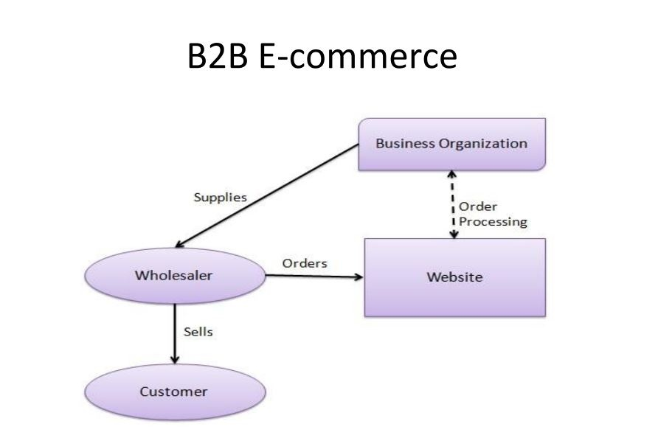
B2B
B2B refers to businesses that are focused on selling products or services to other companies are called B2B, or business-to-business

Slide 8
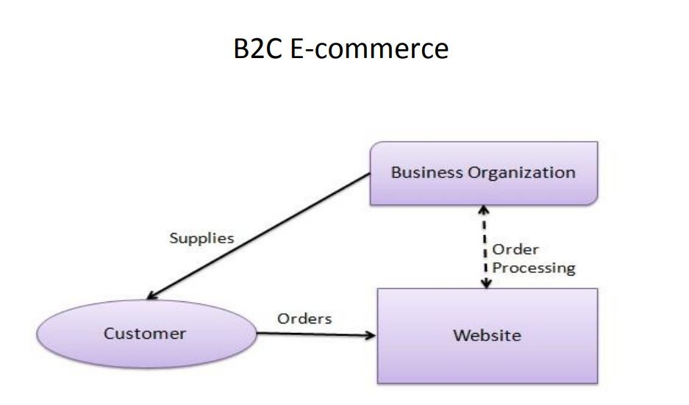
B2C
B2C is the type of commerce transaction in which businesses sell products or services to consumers
More recently, the term B2C refers to the online selling of products, or e-tailing, in which manufacturers or retailers sell their products to consumers over the Internet.

Slide 9
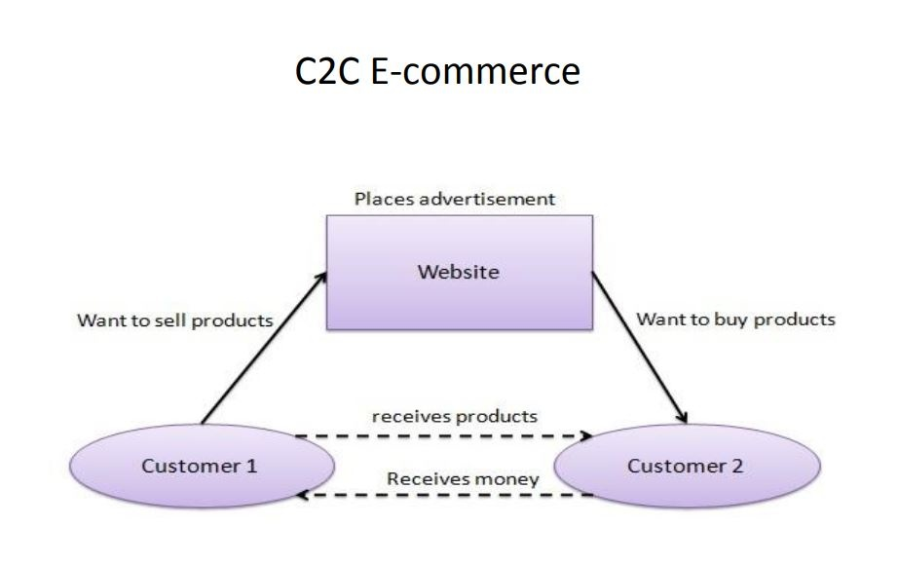
C2C
C2C is a business model that facilitates the transaction of products or services between customers
An example of C2C would be the classifieds section of a newspaper, or an auction
In both of these cases, a customer, not a business, sells goods or services to another customer

Slide 10
C2B
C2B is in contrast with the more traditional business-to-consumer model, the C2B (consumer-to-business) model allows businesses to extract value from consumers – and vice versa
In the C2B model, businesses profit from the willingness of consumers to name their own price or contribute data or marketing to the company, while consumers profit from flexibility, direct payment, or free or reduced-price products and services
Examples of C2B include customer reviews, participation in focus groups, or sharing as an influencer.

Slide 11
Task - Within pairs try to think of examples for each section.
B2C
B2B
C2C
C2B

Slide 12
Task - Now revisit this and look at how each of these examples might use digital /web services within their business i.e anything over the internet
B2C
B2B
C2C
C2B

Slide 13
Business needs
Each business will have unique requirements
These will depend on the stage of the business
Start-up
Established
Expanding

Slide 14
1.2
Explain the different business and market contexts that lead to varying approaches to software development, including but not limited to:
Characteristics of market sectors and segments
Business drivers and desired outcomes
Market risk
Operational risk
Legal and regulatory requirements

Slide 15
List all the market sectors you can think of ?

Slide 16
Examples
Market sectors:
Materials
Industrials
Financials
Energy
Consumer discretionary
Information technology
Communication services
Real estate
Health care
Consumer staples
Utilities

Slide 17
Characteristics of market sectors and segments

Slide 18
Characteristics of market sectors and segments
The target market comprises of groups of people or organizations for whom the business intends to implement its marketing strategies
The business then divides the target market into groups of buyers with distinct needs, characteristics or behaviours; these groups are called market segments
Market segments are, therefore, subsets of target markets and their characteristics bring out the characteristics of target markets

Slide 19
Identifying market segments
Market segmentation is the process of splitting a business’ target market into different groups. Businesses use these groups to make it easier for them to develop products aimed at certain people and to help them target their marketing. Small businesses generally split up their target market based on location, demographics, behaviour, lifestyle, income and age.

Slide 20
The difference between a market sector and market segment
Market sector is a broad way of categorising the kinds of market the company is aiming for. The sectors have similar characteristics such a technology, utilities, telecommunications and so on
Market sector is an area of the economy in which businesses share the same or a related product or service.
Market segment is dividing up the markets into smaller segments targeting customers that share characteristics
They interact with one another by nature of their characteristics. Technology sector would govern who the segments are targeting, i.e. early adopters, gamers, etc. This in turn could influence the direction of the companies in the sector head

Slide 21
Market Sector
Market Sector: A broad way of categorizing the kinds of market the company is aiming for
Geographical sectors, which focus on the values, culture and characteristics of purchasers in that region along with purchasing power
Consumer needs vary between climatic regions where block heaters are used in Canada which would be of little use in Egypt
Client-based sectors, which may focus on consumers, industrial, public sector and commercial.
Watchmakers target income groups such as Tissot vs Swatch vs Rolex.

Slide 22
Business Drivers
The Four Business Outcomes
Productivity
Profitability
Staff retention
Customer loyalty
A business driver is a measurable resource that drives performance to achieve maximum profits for a business
Business objectives can be seen as ‘How much’ or ‘By when’, where drivers can be seen as ‘what influences’ these objectives
Leads to a desired outcome

Slide 23
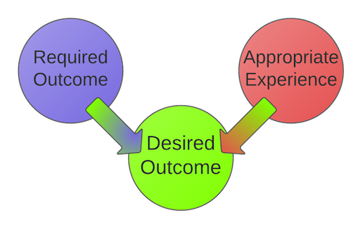
Desired Outcomes
Desired outcome = Required Action + Informed Decisions + Minimized Waste
Using the SMART model
Desired Outcome has two parts… Required Outcome and Appropriate Experience

Slide 24
1.3
Explain the reasons why businesses need to keep processes and applications up to date, and responsive to user and customer needs.

Slide 25
Keeping up to date
Patching
patch is a set of changes to a computer program or its supporting data designed to update, fix, or improve it. This includes fixing security vulnerabilities and other bugs, with such patches usually being called bugfixes or bug fixes
Legal
Regulatory

Slide 26
Responsiveness
Customer responsiveness is about being fast and right
The value of being right is obvious - customers get something that meets their needs
Using technology, including websites, email and telephone systems, to enable customers to quickly get the information they need is one aspect of customer responsiveness
Understanding your customers’ business

Slide 27
2. Software Development Methodologies (20%, K3)
In this topic, the apprentice will learn a broad range of methodologies, frameworks and how they can be applied to software development. The successful apprentice should be able to:

Slide 28
2.1
Recognise and list a variety of software development methodologies which can be broadly categorised as sequential or iterative/incremental and that there are a variety of specific methods/approaches within them.

Slide 29
Software Methodologies
There are the following methodologies:
Agile Software Development
Crystal Methods
Dynamic Systems Development Model (DSDM)
Extreme Programming (XP)
Feature Driven Development (FDD)
Joint Application Development (JAD)
Lean Development (LD)
Rapid Application Development (RAD)
Rational Unified Process (RUP) Methodology
Scrum Methodology
Spiral Methodology
Systems Development Life Cycle (SDLC) Methodology
Waterfall (a.k.a. Traditional) Methodology
Notes:
Pause here and get learner to research

Slide 30
Software Methodologies
There are the following methodologies:
Agile Software Development - Iterative
Crystal Methods - Iterative
Dynamic Systems Development Model (DSDM) – Agile therefore Iterative
Extreme Programming (XP) - Iterative
Feature Driven Development (FDD) – Iterative AND Sequential
Joint Application Development (JAD) - Iterative
Lean Development (LD) - Iterative
Rapid Application Development (RAD) - Iterative
Rational Unified Process (RUP) Methodology – almost Sequential
Scrum Methodology - Iterative
Spiral Methodology – Iterative AND Sequential
Systems Development Life Cycle (SDLC) Methodology – Iterative AND Sequential
Waterfall (a.k.a. Traditional) Methodology - Sequential

Slide 31
Waterfall
The waterfall model shows the steps in sequence where the customer requirements are progressively refined to the point where coding can take place. This type of model is often referred to as linear or sequential model. Each work product or activity is completed before moving on to the next.
In the waterfall model testing is carried out once the code has been fully developed. Once this is completed a decision can be made on whether the product can be released into the live environment.
This model for development shows how a fully tested product can be created but it has significant drawbacks, what happens if the product fails the tests.

Slide 32
2.2
Summarise the main differences between sequential and iterative/incremental methodologies.

Slide 33
Sequential Approach
It is very simple to understand and use. Each phase must be completed before the next phase can begin and there is no overlapping in the phases.
The waterfall model illustrates the software development process in a linear sequential flow. This means that any phase in the development process begins only if the previous phase is complete.

Slide 34
Iterative Approach
A design methodology based on a cyclic process of prototyping, testing, analyzing, and refining a product or process
Based on the results of testing the most recent iteration of a design, changes and refinements are made
This process is intended to ultimately improve the quality and functionality of a design
In iterative design, interaction with the designed system is used as a form of research for informing and evolving a project, as successive versions, or iterations of a design are implemented.
Incremental Approach
A method of software development where the model is designed, implemented and tested incrementally (a little more is added each time) until the product is finished
It involves both development and maintenance
The product is defined as finished when it satisfies all of its requirements

Slide 35
2.3
Explain the main principles of Agile together with the different approaches within it including but not limited to:
Scrum
Kanban
Extreme programming (XP)
Test Driven development (TDD)
Behaviour driven development (BDD)

Slide 36
Agile
Agile Development is a different way of managing software development projects
The key principles, and how Agile Development fundamentally differs from a more traditional Waterfall approach to software development

Slide 37
Key Principles of Agile Software Development
Active user involvement is imperative
The team must be empowered to make decisions
Requirements evolve but the timescale is fixed
Capture requirements at a high level; lightweight &amp; visual
Develop small, incremental releases and iterate
Focus on frequent delivery of products
Complete each feature before moving on to the next
Apply the 80/20 rule
Testing is integrated throughout the project lifecycle – test early and often
A collaborative & cooperative approach between all stakeholders is essential

Slide 38
Four VALUES of Agile
Individuals and Interactions Over Processes and Tools
Working Software Over Comprehensive Documentation
Customer Collaboration Over Contract Negotiation
Responding to Change Over Following a Plan

Slide 39
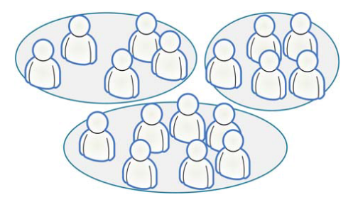
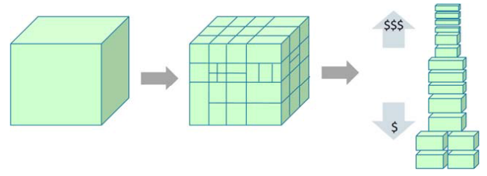
Scrum
A process tool
Split your organization into small, cross-functional, self-organizing teams
Split your work into a list of small, concrete deliverables. Sort the list by priority and estimate the relative effort of each item
Split time into short fixed-length iterations (usually 1 – 4 weeks), with potentially shippable code demonstrated after each iteration
Optimize the release plan and update priorities in collaboration with the customer, based on insights gained by inspecting the release after each iteration
Optimize the process by having a retrospective after each iteration

Slide 40
Kanban
A process tool
Literally, Kanban is a Japanese word that means “visual card”
Visualize the workflow
Split the work into pieces, write each item on a card and put on the wall
Use named columns to illustrate where each item is in the workflow
Limit Work In Progress (WIP) – assign explicit limits to how many items may be in progress at each workflow state
Measure the lead time (average time to complete one item, sometimes called “cycle time”), optimize the process to make lead time as small and predictable as possible
We collect useful Kanban links at: http://www.crisp.se/kanban

Slide 41
Kanban

Slide 42
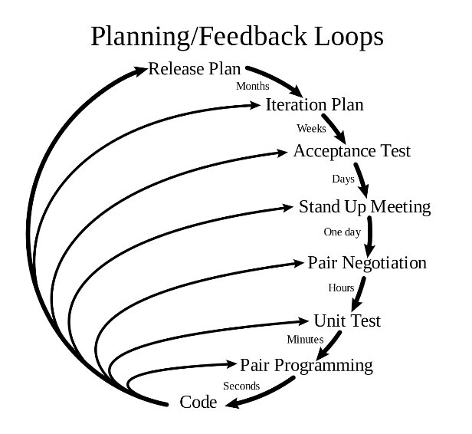
Extreme Programming
A software development methodology which is intended to improve software quality and responsiveness to changing customer requirements
A type of agile software development
Advocates frequent "releases" in short development cycles

Slide 43
Test Driven Development
Test-driven development (TDD) is a software development process that relies on the repetition of a very short development cycle
The following sequence of steps is generally followed:
Add a test
Run all tests and see if the new one fails
Write some code
Run tests
Refactor code
Repeat

Slide 44
TDD Vs. Traditional Testing
Traditional:
Write logic
Write tests
This is unit testing!!!!

Slide 45
TDD Vs. Traditional Testing
TDD:
Write tests
Write logic

Slide 46
Counter Productive?
Not necessary
We want a failing test
This means that our code is not doing something it is not supposed to
THEN we write the application logic to PASS the test
Gives focus and clarity

Slide 47
Behaviour driven development (BDD)
Behaviour Driven Development (BDD) is a synthesis and refinement of practices stemming from Test Driven Development (TDD) and Acceptance Test Driven Development (ATDD)
BDD augments TDD and ATDD with the following tactics:
Apply the "Five Why's" principle to each proposed user story, so that its purpose is clearly related to business outcomes
thinking "from the outside in", in other words implement only those behaviours which contribute most directly to these business outcomes, so as to minimize waste
describe behaviours in a single notation which is directly accessible to domain experts, testers and developers, so as to improve communication
apply these techniques all the way down to the lowest levels of abstraction of the software, paying particular attention to the distribution of behaviour, so that evolution remains cheap

Slide 48
Revision Purposes
Create a presentation describing the following
Waterfall model
Agile method
Ensure that you explain each stage of the model / what is involved
Also include an evaluation explaining key differences between the them.
Be prepared to present your work and create your own diagrams ( this will help you remember the steps and processes.)

Slide 49
Day 2.

Slide 50
2.4
Demonstrate how software development is undertaken within governance and management frameworks/methods that organisations use to control and manage projects, programmes and operations.

Slide 51
Governance
Oxford dictionary the meaning it has is:
the action or manner of governing a state, organization, etc.
rule, control
In software development life cycle we can think of governance as monitor, measure and management of software

Slide 52
Development Stage | What needs governance | How do we (or tools/techniques used for) govern?
Business Problem | The source of problem statement (real business case vs. developer’s wish) Project roadmap, timeline and resource constraints | Process exists to ensure right stakeholders are engaged, agreed upon project roadmap is defined, and resource pool, delivery timeline and risks are identified
Requirement Gathering | Use Case and Requirements Effort level and Risks | Requirement document reviewed and signed off from all major stakeholders (business, development and testing teams)
Architecture | Alignment with corporate IT Non FRs like Performance, Security | Architecture Review
Design | Design guidelines | Design review
Implementation | Code Quality Feature implementation | Code Review Code Coverage Feature Demo
Testing | Test Plan and Strategy Test Results and Coverage Score card on Non-FRs | Review of Test Plan, Strategy, Coverage, and Results Review of Non-FRs score card or compliance report
Documentation | Documents | Documentation Review
Deployment | Deployment Instructions | Deployment document review Deployment team’s feedback on ease of deployment and 1st few weeks report from production
Service / Maintenance | Ease of troubleshooting Number of Customer found defects New feature request | Tracking production defects and ensuring root cause analysis done on the same Assess and feed feature requests to next release’s project requirements Process to have regular feedback from service team’s

Slide 53
Management Frameworks
ITIL
(formerly an acronym for Information Technology Infrastructure Library) is a set of detailed practices for IT service management (ITSM) that focuses on aligning IT services with the needs of business
https://www.goodelearning.com/courses/it-service-management/itil-foundation/what-is-itil
TOGAF
The Open Group Architecture Framework (TOGAF) is a framework for enterprise architecture that provides an approach for designing, planning, implementing, and governing an enterprise information technology architecture
https://www.goodelearning.com/courses/enterprise-architecture/togaf-9-foundation/what-is-togaf

Slide 54
3. Team Roles and Relationships (10%, K2)
In this topic, the apprentice will learn the roles involved in software development and how they relate to each other within a software development team. The successful apprentice should be able to:

Slide 55
3.1
Describe the main roles within software development teams, including but not limited to:
Requirements engineer
Business analyst
Software designer
Software developer
Software tester
Software project manager
Software release engineer

Slide 56
Requirements Engineer
The requirements engineer is charged with working with the project stakeholders and end users to elicit, understand, analyse, and document the requirements for a system in order to solve a given business problem
Used interchangeably with the IT Business Analyst though many people see this role as being limited to requirements gathering and documentation
Other common titles for this role are: Requirements Analyst, Functional Architect, Business Systems Analyst, Business Analyst

Slide 57
Business Analyst
Someone who analyses an organization or business domain (real or hypothetical) and documents its business or processes or systems, assessing the business model or its integration with technology
Developing technical solutions to business problems
To advance a company's sales efforts, begins with defining, analysing and documenting requirements
Helping to manage, change and plan for the future in line with their goals
Communicating between internal departments and external parties, acting as a 'translator' where necessary to convey how information technology can support the organisation's needs

Slide 58
Software Designer
A software designer works as part of a collaborate development team to help create software that meets the management's or client's needs, and in an effective and cost-efficient manner
Involved at the requirements and design stages of the SDLC

Slide 59
Software Developer
A coder
Develops software solutions
May be called a systems/software/database/web programmer, engineer or developer, depending on the system you're developing
Responsible for using the technical requirements from the Technical Lead to create cost and timeline estimates

Slide 60
Software Tester
Ensures that the software solution meets the business requirements and that it is free of bugs, errors and defects
Tasks such as functional testing, customer scenario testing, stress testing, performance testing, scalability testing and international testing are common
Involved in identifying test conditions and creating test designs, test cases, test procedure specifications and test data, and may automate or help to automate the tests
Involved in all stages of the SDLC

Slide 61
Software Tester
Some of the Software Testers duties can include:
They often set up the test environments or assist system administration and network management staff in doing so
As test execution begins, the number of testers often increases, starting with the work required to implement tests in the test environment
Testers execute and log the tests, evaluate the results and document problems found
They monitor the testing and the test environment, often using tools for this task, and often gather performance metrics
Throughout the software testing life cycle, they review each other’s work, including test specifications, defect reports and test results

Slide 62
Software Project Manager
Has the overall responsibility for the successful initiation, planning, design, execution, monitoring, controlling and closure of a project
Must have a combination of skills including an ability to ask penetrating questions, detect unstated assumptions and resolve conflicts, as well as more general management skills

Slide 63
The role of the project manager encompasses many activities including:
Planning and Defining Scope
Activity Planning and Sequencing
Resource Planning
Developing Schedules
Time Estimating
Cost Estimating
Developing a Budget
Documentation
Creating Charts and Schedules
Risk Analysis
Managing Risks and Issues
Monitoring and Reporting Progress
Team Leadership
Strategic Influencing
Business Partnering
Working with Vendors
Scalability, Interoperability and Portability Analysis
Controlling Quality
Benefits Realisation

Slide 64
Software Release Engineer
A release engineer is an individual who is concerned with the mechanics of the development and processing of software products
Is involved in the final stages of the software
Oversee and control the proper placement and deployment of the source code
They ensure that each code is entered in the software code repository and is ready for media duplication and distribution

Slide 65
Task – Revision Create a table List all the activities for each role
Requirements Engineer | Business Analyst | Software Designer | Software Developer | Software Tester | Software Project Manager | Software Release Engineer

Slide 66
3.2
Explain how the different roles relate to each other in terms of typical interfaces and accountabilities.

Slide 68
Task
Revisit the previous task and add an extra row
Add comments on each job role and how they relate to each other in terms of typical interfaces (meet and interact) and accountabilities.

Slide 69
Task – Revision Create a table List all the activities for each role
 | Requirements Engineer | Business Analyst | Software Designer | Software Developer | Software Tester | Software Project Manager | Software Release Engineer
Interacts with /Responsibility ..

Slide 70
A good website.....
https://medium.com/@SherrieRose/software-project-team-roles-and-responsibilities-152a7d575759

Slide 71
3.3
Recognise the key roles and processes external to the software development team which interface with the software development team, including but not limited to:
Customers
Users
Operations
Service management

Slide 72
Customers - a person who buys goods or services from a shop or business
Customers make buying decisions
May or may not be users ?
Explain why a customer may not be a user of the system

Slide 73
Users -
Users - Alternatively referred to as an end user, a user is any individual who is not involved with supporting or developing a computer or service. For example, you are the end-user of the computer you are using when you call technical support for help
People who use the software
May be a customer
Explain why a user may be a customer
What are the different types of user , give examples

Slide 74
Operations
The operations department of a company is responsible for smooth and profitable production
Running efficiently
Ensuring quality
Timeliness of delivery
Management of resources
Goal setting
Communications

Slide 75
Service Management
IT service management (ITSM) refers to the entirety of activities – directed by policies, organized and structured in processes and supporting procedures – that are performed by an organization to design, plan, deliver, operate and control information technology (IT) services offered to customers

Slide 76
Day 3

Slide 77
3.4
Recognise that collaborative approaches are especially important in Agile development and DevOps practices.

Slide 78
Agile
Agile processes allow for changing requirements throughout the development cycle and stress collaboration between software developers and customers and early product delivery
4 values of Agile
In Scrum, projects progress in a series of month-long iterations called sprints
Development teams meet with the client, or product owner, before each sprint to prioritize the work to be done and select the tasks the team can complete in the upcoming sprint
During the sprint, the team stays on track by holding brief daily meetings
At the end of each sprint, the team delivers a potentially shippable product increment

Slide 79
What is Dev OPs ??
Task research what is Dev OPS
Why do you think collaborative approaches are especially important ?

Slide 80
4. Application Structure and Development Platform Context (20%, K3)
In this topic, the apprentice will learn and appreciate the underlying architecture of software applications, and the importance of linking software to databases for data storage and information presentation to users. The apprentice will recognise the different requirements for development and deployment of software across multiple platform types. The successful apprentice should be able to:

Slide 81
4.1
Illustrate the different components that contribute to the underlying architecture of software applications.

Slide 82
Software Architecture Bases
Wireless/Mobile
Cloud
Embedded systems
Desktop

Slide 83
Software Architecture
Software architecture is the structure of software
Architecture can be planned upfront and/or emerge over time
It includes elements such as services, layers, components, relationships, technologies, standards, principles, conventions and constraints
Architecture can be evaluated based on business objectives in areas such as cost, functionality, reliability, maintainability and operability
In other words, a poor architecture can be costly, unreliable and difficult to maintain, operate, change and extend

Slide 84
Component Definition
A software component is a unit of composition with contractually specified interfaces and explicit context dependencies only. A software component can be deployed independently and is subject to composition by third parties. [WCOP'96 Summary in ECOOP'96 Workshop Reader, dpunkt Verlag, 1997. ISBN 3-920993-67-5]

Slide 85
Software Components
Software components are parts of a system or application
Components are a means of breaking the complexity of software into manageable parts
Each component hides the complexity of its implementation behind an interface

Slide 86
Views
User interface components for different requests, views and scenarios
For example, difficult components can be used to display the same information in a web page and mobile app

Slide 87
Models
Components that handle requests or events including business rules and data processing
For example, a model might handle a bill payment request for an internet banking website
Exampe of new user following TOGAF

Slide 88
Controllers
A controller is a component that decides what components to call for a particular request or event
For example, a controller might dynamically load different views for a bill payment based on factors such as language, transaction status or channel

Slide 89
Data Access Objects
A data access object provides an abstract interface for databases
In theory, this allows you to switch to a different database without the application needing to know
This shows the power of a component based approach as dramatic changes can be confined to a relatively small section of a code base

Slide 92
Services
A service is a component that is deployed independently
For example, a bank might deploy a market data service to cloud infrastructure
This service would provide stock market data to a variety of stock trading systems and applications – More than one service/user
Services allow for extremely resilient applications
For example, if an application doesn't get a response from a service, it can try again and be directed to a completely different instance

Slide 93
Plugins
Components designed to extend the functionality of an application or system
For example, a plugin for a media player to visualize music

Slide 94
APIs
A component that can be reused across multiple systems and applications can be packaged and distributed as an API
For example, an open source API to connect to a particular database

Slide 95
4.2
Describe the use of data sources in software applications for storage and retrieval of information.

Slide 96
Data Sources
Computer applications can have multiple data sources defined, depending on their purpose or function
Applications such as relational database management systems and even websites use databases as primary data sources
Hardware such as input devices and sensors use the environment as the primary data source
Datasource is a name given to the connection set up to a database from a server
The name is commonly used when creating a query to the database

Slide 97
Types of Data
Primary Data
When someone refers to "primary data" they are referring to data collected by the researcher himself/herself
Secondary Data
This type of data typically comes from other studies done by other institutions or organizations

Slide 98
4.3
Explain the features of the following platforms in context of software development, deployment and underlying architecture, including but not limited to:
Web
Mobile
Desktop
Server
Cloud

Slide 99
Native applications are written for specific platforms and therefore utilise the local system features and software
Web applications are easier to develop as open source software allows the development to focus on the specific aim of the application. Code must be written separately for each platform

Slide 100
Web
Uses http on port 80
Makes use of HTML, PHP, ASP or another server side scripting language
Requires a domain name, server hosting and web space
Client requires a browser
Web applications are easier to develop as open source software allows the development to focus on the specific aim of the application

Slide 101
Mobile
Various platforms
Android – smartphone and tablet
IOS – smartphone and tablet
Blackberry - smartphone
Microsoft – smartphone and laptop
Apple - laptop
Linux – laptop
Each platform requires each own language and development environment

Slide 102
Desktop and Server
Various platforms
Microsoft Windows
Mac OS
Linux
Each has its own development environment
Desktop run a specific Operating System which provide resources to run applications including file systems, memory management and user interfaces
What is
.net
Kde/Gnome
Write a definition

Slide 103
Cloud
Cloud is basically a web app or web storage on a remote server
HTML and a specific server centric language can be used
For example:
Microsoft web apps will use ASP.net
Cloud services provide remotely accessed functions
Applications can deploy to cloud instances such as VMs and containers, but the cloud also offers many services to support application function
Apple's iCloud Drive is an example of cloud storage that stores and processes photos, videos, applications and other documents for users
Microsoft's OneDrive is another example of cloud storage as a service

Slide 104
4.4
Distinguish the characteristics of software development that are impacted by the deployment of software on multiple platforms as opposed to a single platform.

Slide 105
Cross Platform Software Deployment
Cross-platform software may be divided into two types; one requires individual building or compilation for each platform that it supports, and the other one can be directly run on any platform without special preparation, e.g., software written in an interpreted language or pre-compiled portable bytecode for which the interpreters or run-time packages are common or standard components of all platforms
For example, a cross-platform application may run on Microsoft Windows, Linux, and macOS. Cross-platform programs may run on as many as all existing platforms, or on as few as two platforms. Cross-platform frameworks (such as Qt, Xamarin, Phonegap, Ionic, and React Native) exist to aid cross-platform development

Slide 106
Cross Platform Software Deployment - Web
Unless a common interpreted language like PHP is used, each application needs to be tested separately on its own platform
A windows application needs to be tested on Windows machines
The differences between platforms need to be incorporated into tests

Slide 107
5. The Software Development Lifecycle (SDLC) (10%, K3)
In this topic, the apprentice will learn and gain an appreciation of how software development follows a structured and phased approach to different activities through the software development lifecycle.

Slide 108
5.1 and 5.3
Recognise that there are several ways to represent the terminology and phases of the SDLC (Software development lifecycle) rationalised here as follows:
Feasibility Study
Requirements Analysis
Design
Code Development
Testing
Deployment/Implementation
Maintenance
Explain the main activities of each of the phases of the SDLC (Software development lifecycle) in terms of inputs, activities and outputs.

Slide 109
A Good Resource
https://existek.com/blog/sdlc-models/

Slide 110
Software Development Cycle
Feasibility Study
Requirements
Analysis
Design
Design may change if application does not work as expected
Code Development
Testing
Deployment/
Implementation
Maintenance

Slide 111
Software Development Lifecycle
Development of a program forms part of a natural lifecycle. New solutions are designed due to:
A system failing
Users needs change over time

Slide 112
1
Determine the scope of the problem
2
8
Gathering requirements
Review and maintain
3
7
Writing the specification
Writing documentation
6
testing
4
Designing a solution
5
Coding the
design

Slide 113
Stage 1 – Determine the scope of the problem
What are the boundaries of the problem? (Scope). It is important to note what is and also what is not covered by the program, and who is affected by it.
Understanding all of these elements combined help understand the nature of the program.

Slide 114
Stage 2 – Gather requirements
What is wanted from the program off your stakeholders, so that it can specify what the program is going to do (looking at the function requirements)
A high number of commercial solutions fail because not enough research is done in this stage.
They are often collected describing individually how each task is going to be achieved.

Slide 115
Stage 3 – Writing the specification
Make a list of all the elements which cover:
Inputs and outputs
Processing
Storage
User interface
constraints

Slide 116
Stage 4: Designing the solution
Solution is built using suitable design tools (it shows a set of procedures)(pseudocode and flow diagrams)
Can be paper or electronic
Without correct planning and design a lot of time is wasted from mistakes made!

Slide 117
Stage 5 & 6 – coding & testing
Convert the design into code. It is important that stage 6 is mostly done simultaneously by the program being tested in smaller sections the same way as each broken down element is coded.
Testing is vital. Two main methods for testing are the black box and white box testing methods….

Slide 118
Stage 6 – Testing (Continued)
Black Box testing
Does it meet the list of its functional requirements?
Does it do what it is supposed to do?
e.g. Area = height * width
White Box Testing
Examines the performance of the code AFTER the functionality is working
Is there a better way to do the task?
Does it allow for flexibility?
Is it robust?
Is the use of language clear for the end user?
Is the solution displayed in a logical order?
ALL Boundaries should be tested thoroughly….

Slide 119
Stage 7 – Writing Documentation
There are three types of documentation
Internal documentation
Technical documentation
User documentation

Slide 120
Task
Explain the main activities of each of the phases of the SDLC (Software development lifecycle) in terms of inputs, activities and outputs

Slide 121
Internal Documentation
Use correct naming conventions especially when naming your variables!
Good use of comments, describing the purpose of the bits of code
Use a tidy layout, complete with indentation and blocking correctly

Slide 122
Technical Documentation
Written by developers for other developers to read
Often uses jargon and programming terminology, but it must also be backed up with a clear and concise explanation!
Should cover –
Requirements
Design
Flow charts
DFD
Data type list
Testing
Corrective actions for errors
Copy of documented code
Recommendations for future improvements/enhancements

Slide 123
User documentation
Technical terms and jargon are avoided!
Installation
How to use the program
Troubleshooting
Help
Examples of program working
This can be paper format, text files or screencast/video animations.

Slide 124
Stage 8 - Review and Maintain
Reviewing is reflective by comparing this to the original stakeholder requirements – does it do what you want it to do, how well does it work?
Maintenance is ongoing, fixing minor errors as they occur and making small adjustments as you feel they are necessary, adding extra features and extra functionality

Slide 125
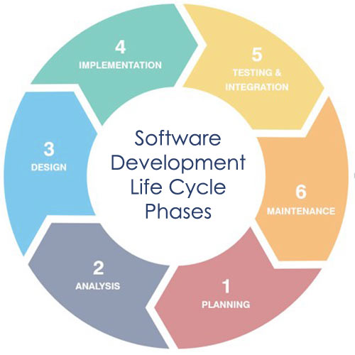
Summary of SLC
5.2 Summarise the phases of the SDLC. (Software development lifecycle)

Slide 126
Day 4

Slide 127
5.4
Show how the phases of the SDLC (Software development lifecycle) may be implemented according to the development methodology and approach adopted for a project or organisation

Slide 128
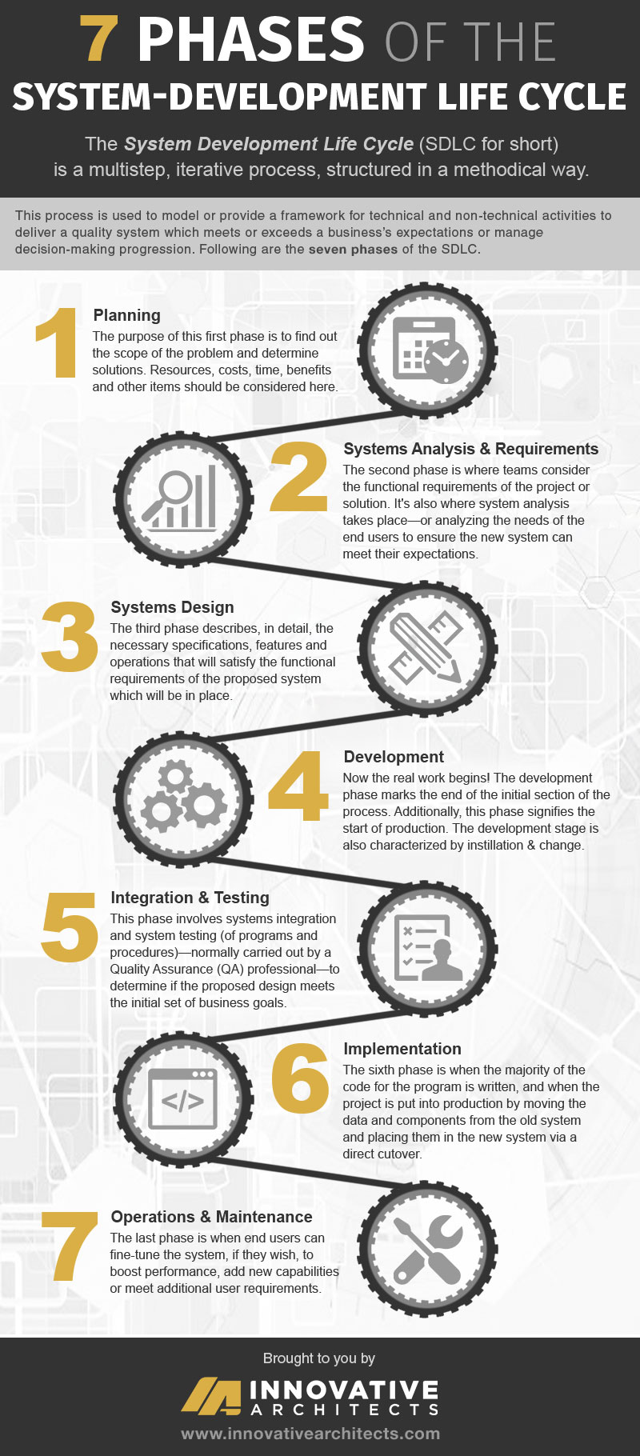
7 Phases

Slide 129
Planning and Requirements Stages

Slide 130
Design Phase

Slide 131
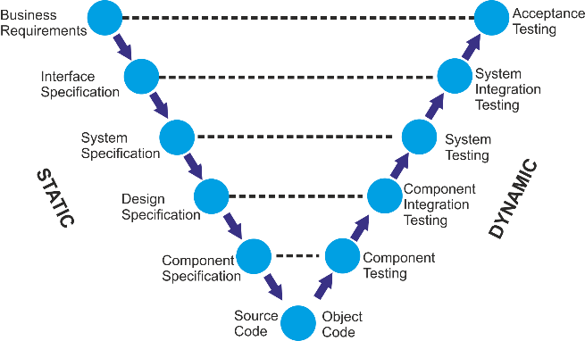
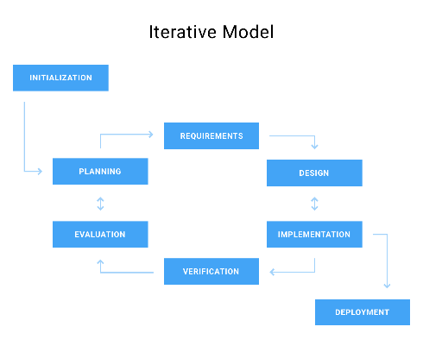
Development Phase
Using V-model
Using Waterfall
Using Iterative model

Slide 132
Integration and Testing

Slide 133
Implementation

Slide 134
Operational Testing
Operational testing refers to the evaluation of a software Prior to the production phase
Operational testing ensures system and component compliance in the application's standard operating environment (SOE)
Operational testing is applied in a specified environment during various software development life cycle (SDLC) phases for the evaluation of software system functionality
Operational testing focuses on system implementation behaviour and is preferred over verification for the following reasons:
Operational testing facilitates the consideration of environmental factors that influence system behaviour
Operational testing allows feature interaction
A key operational testing feature is error detection, which ensures correct functional implementation

Slide 135
6. Software Testing (20%, K3)
In this topic, the apprentice will learn and understand the levels and types of software testing, their purpose and examples of their application. The successful apprentice should be able to:
Explain why testing is necessary
Within the SDLC (Software development lifecycle) summarise the different levels of testing, their purposes and the generic test process that supports them all
Describe different types and techniques for software testing that are available and why they would be used
Write test cases including coverage measurement from given requirements
Tools to support software testing

Slide 136
6.1
Explain why testing is necessary, including but not limited to principles of:
Early testing
Risk reduction
Conformance to functional and non-functional requirements
Finding defects
Differentiating testing from debugging

Slide 137
Why Early Testing?
A defect can be found throughout all the phases of software development Life Cycle
It is better to start early testing in the software development life cycle so as to minimize defects in the later stages
It can be design review, unit testing or regression testing
Design phase comes early in Software Development Life Cycle
Design Testing is done at this phase.

Slide 138
Risk reduction
Risk: A factor that could result in future negative consequences; usually expressed as impact and likelihood - ISTQB Glossary
A risk-based approach to testing provides proactive opportunities to reduce the levels of product risk, starting in the initial stages of a project
It involves the identification of product risks and their use in guiding test planning and control, specification, preparation and execution of tests
In a risk-based approach, the risks identified may be used to:
Determine the test techniques to be employed
Determine the extent of testing to be carried out
Prioritise testing in an attempt to find the critical defects as early as possible
Determine whether any non-testing activities could be employed to reduce risk

Slide 139
Conformance to functional and non-functional requirements
Conformation is the degree of adherence to pre-set expectations
The degree to which a product meets its pre-specified criteria is termed as conformance in the context of software engineering
Software Developer establishes functional and non-functional requirements prior to software development
The functional requirements are those requirements that represent the core functionality provided by the system
Non-functional requirements are the additional requirements such as restriction on time, performance, availability, scalability, reliability, etc.
The degree of adherence of the software to its functional requirements is the conformance of the software to its requirements

Slide 140
Finding defects
Reviewers (aka Checkers or Inspectors) are responsible for finding defects in the product under review
Developers see finding defects as a negative process which causes delays
Testers know that software contains bugs
All defects start with a human error (for example a typo, misunderstanding, lack of capacity planning etc.)
The tester's job is to expose the defect by causing a failure before the software gets to production

Slide 141
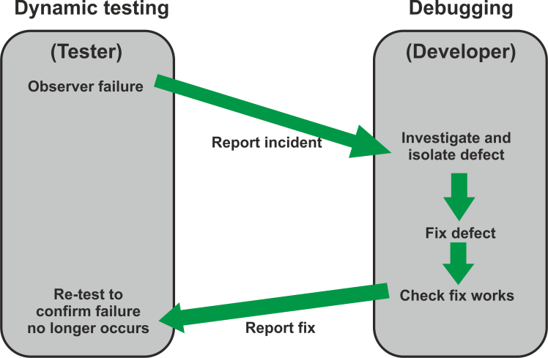
Differentiating testing from debugging
Debugging and testing are different
Testing can show failures that are caused by defects
Debugging is the development activity that identifies the cause of a defect, repairs the code and checks that the defect has been fixed correctly
Subsequent re-testing by a tester ensures that the fix does indeed resolve the failure

Slide 142
6.2
Within the SDLC (Software development lifecycle) summarise the different levels of testing, their purposes and the generic test process that supports them all:
Unit
Integration
System
Acceptance
The generic test process, activities and key deliverables, including but not limited to:
Test analysis, design, implementation, execution, reporting
Test planning, monitoring & control
Test conditions, test cases, test scripts
Information traceability between tests and requirements

Slide 143
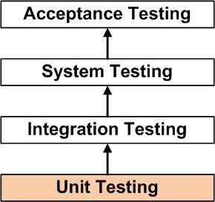
Unit Testing
Unit testing is a level of software testing where individual units/ components of a software are tested
The purpose is to validate that each unit of the software performs as designed. A unit is the smallest testable part of any software
It usually has one or a few inputs and usually a single output

Slide 144
Integration Testing
Integration testing is a level of software testing where individual units are combined and tested as a group
The purpose of this level of testing is to expose faults in the interaction between integrated units
Test drivers and test stubs are used to assist in Integration Testing

Slide 145
System Testing
System testing is a level of software testing where a complete and integrated software is tested
The purpose of this test is to evaluate the system's compliance with the specified requirements - definition by ISTQB

Slide 146
Acceptance Testing
The purpose of acceptance testing is to establish confidence in the system or specific characteristics of the system
The main focus is ensuring the system is fit for purpose, not finding defects. It may assess the system's readiness for deployment and use
The aim should literally be to 'accept' and therefore should be a test of the system under typical usage
Acceptance testing is a level of software testing where a system is tested for acceptability. The purpose of this test is to evaluate the system's compliance with the business requirements and assess whether it is acceptable for delivery - definition by ISTQB.

Slide 147
Test analysis
Test analysis is the process of looking at something that can be used to derive test information
This basis for the tests is called the test basis
The test basis is the information we need in order to start the test analysis and create our own test cases

Slide 148
Test Design
Test design is a process that describes “how” testing should be done
It includes processes for the identifying test cases by enumerating steps of the defined test conditions
The testing techniques defined in test strategy or plan is used for enumerating the steps

Slide 149
Test Implementation
Test implementation and execution is the activity where test procedures or scripts are specified by combining the test cases in a particular order and including any other information needed for test execution, the environment is set up and the tests are run
Test Implementation tasks include:
Finalise, implement and prioritise test cases
Develop and prioritise test procedures or write automated scripts
Create test suites from the test procedures for efficient execution
Create test data
Verify that the test environment has been set up correctly

Slide 150
Test Execution
Test execution is the process of executing the code and comparing the expected and actual results
Following factors are to be considered for a test execution process:
Based on a risk, select a subset of test suite to be executed for this cycle
Assign the test cases in each test suite to testers for execution
Execute tests, report bugs, and capture test status continuously
Resolve blocking issues as they arise
Report status, adjust assignments, and reconsider plans and priorities daily
Report test cycle findings and status

Slide 151
Test Reporting
Also known as a test summary report
Test Report is a document which contains
A summary of test activities and final test results
An assessment of how well the Testing is performed
Based on the test report, the stakeholders can
Evaluate the quality of the tested product
Make a decision on the software release
For example, if the test report informs that there’re many defects remaining in the product, the stakeholder can delay the release until all the defects are fixed

Slide 152
Test planning, monitoring & control
Test planning is the activity of verifying the mission of testing, defining the objectives of testing and the specification of test activities in order to meet the objectives and mission. Without a plan the detailed testing will lack direction.
Test Planning has the following major tasks:
Determine the scope and risks, and identify the objectives of testing
Implement the test policy and/or the test strategy
Determine the test approach (e.g. techniques, test items, coverage, interfaces, etc.)
Determine the required test resources
Schedule the test activities (e.g. analysis, design, implementation, execution and evaluation)
Determine the entry and exit criteria
In order to control testing, the testing activities should be monitored throughout the project and fed back to test planning.
Test Control tasks include:
Monitor testing activities and results throughout a project
Compare actual progress against the plan
Take controlling actions as required

Slide 153
Test conditions, test cases, test scripts
Test conditions can be a piece of functionality or anything you want to verify. In simple terms the goal of a test case. It is an item or event of a system that could be verified by one or more test cases. Eg; transaction, function, structural element etc.
A TEST CASE is a set of conditions or variables under which a tester will determine whether a system under test satisfies requirements or works correctly.
The process of developing test cases can also help find problems in the requirements or design of an application
A test script in software testing is a set of instructions that will be performed on the system under test to test that the system functions as expected
There are various means for executing test scripts
Manual testing
These are more commonly called test cases
Automated testing.
Short program written in a programming language used to test part of the functionality of a software system
Test scripts written as a short program can either be written using a special automated functional GUI test tool (such as HP QuickTest Professional, Borland SilkTest, IBM TPNS and Rational Robot) or in a well-known programming language (such as C++, C#, Tcl, Expect, Java, PHP, Perl, Powershell, Python, or Ruby)

Slide 155
Information traceability between tests and requirements
Requirements traceability is a sub-discipline of requirements management within software development and systems engineering
Traceability as a general term is defined by the IEEE Systems and Software Engineering Vocabulary as the degree to which a relationship can be established between two or more products of the development process, especially products having a predecessor-successor or master-subordinate relationship to one another

Slide 156
6.3
Describe different types and techniques for software testing that are available and why they would be used, including but not limited to:
Functional Testing
Non-Functional Testing
Security
Performance
Usability
Reliability
Regression testing
Reviews and static analysis
White Box testing (Structure-based)
Black Box testing (Specification-based)
Equivalence partitioning
Boundary value analysis
Decision tables
State transition diagrams
Experience-based testing

Slide 157
Functional Testing
Functional testing is concerned with WHAT the system must do to achieve its objectives, as defined in business requirements, functional specifications, Use Cases, business process models, etc.
It considers the external behaviour of the software, so is black-box testing

Slide 158
Non-Functional Testing
Non-functional testing tests the attributes of a system that do not relate to functionality. It is concerned with HOW WELL a system works
Non-functional requirements are often constraints on the functionality, e.g. constraint on how, how often, who, when or where a function can take place
Has the following parameters:
Security - The parameter defines how system is safeguarded against deliberate and sudden attacks from internal and external sources. This is tested via Security Testing
Performance - type of testing perform to determine the performance of system to major the measure, validate or verify quality attributes of the system like responsiveness, speed, scalability, stability under variety of load conditions
Usability - The ease with which the user can learn, operate, prepare inputs and outputs through interaction with a system. This is checked by Usability Testing
Reliability - The extent to which any software system continuously performs the specified functions without failure. This is tested by Reliability Testing

Slide 159
Regression testing
Testing of a previously tested program following modification, to ensure that defects have not been introduced or uncovered in unchanged areas of the software as a result of the changes made. ISQTB Glossary

Slide 160
Reviews and static analysis
Reviews are manual examination of documents - done by humans
Static Analysis is automated analysis of source code and software models - done by tools
Reviews and static analysis have the same objective as dynamic testing - identifying defects
They are complementary techniques
Static techniques find causes of failures (defects) directly, while dynamic testing finds failures which may be caused by defects

Slide 161
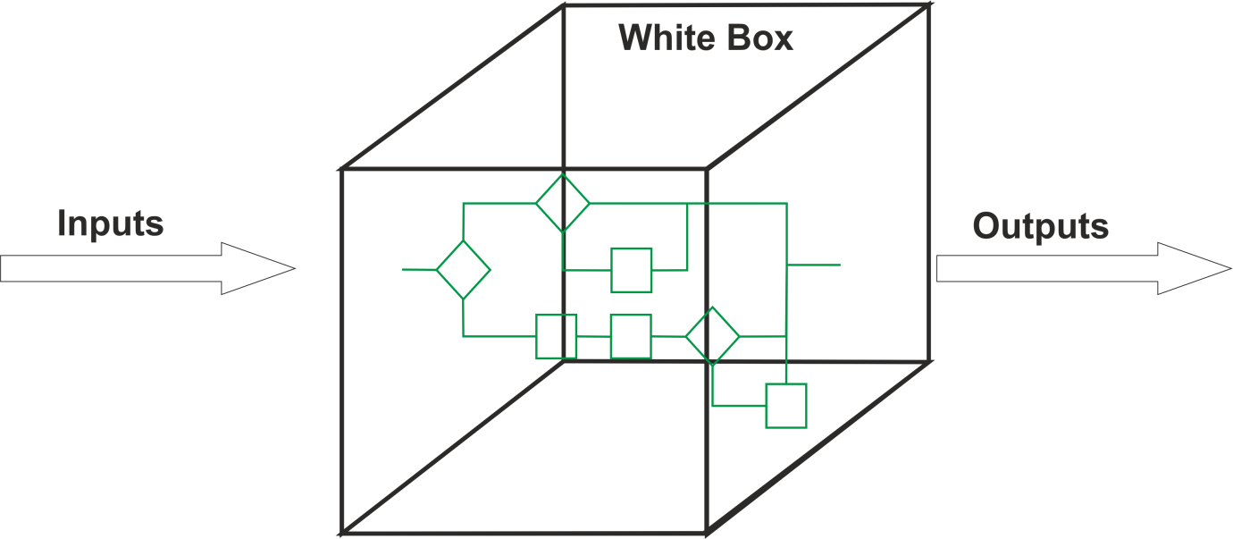
White Box testing (Structure-based)
Structure-based or white-box testing is based on an identified structure of the software or system
It does not require an analysis of business requirements or specifications and does not assess the functionality of software
It ensures that a structure, or specific parts of a structure, is adequately covered by tests

Slide 162
Black Box testing (Specification-based)
Black-box test design techniques are a way to derive and select test conditions, test cases, or test data based on an analysis of the test basis documentation
This includes both functional and non-functional testing.
Black-box testing takes an external view of the software and does not use any information regarding the internal structure of the component or system to be tested

Slide 163
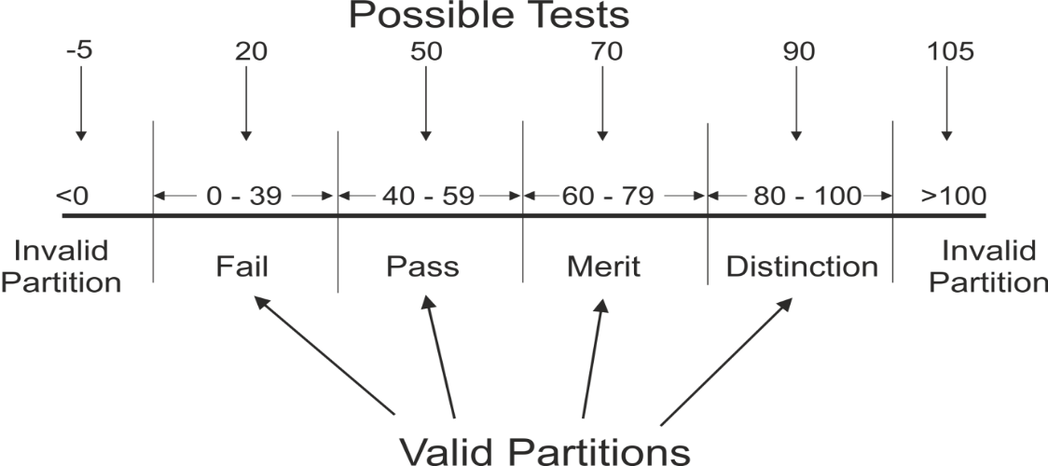
Black Box – Equivalence Partitioning
Equivalence partitioning
In equivalence partitioning, inputs to the software or system are divided into groups or ranges of values that are expected to exhibit similar behaviour, so they are likely to be processed in the same way, i.e. have the same output.
Instead of testing every value in the partition, one value can be chosen to represent all, and used to test the whole partition

Slide 164
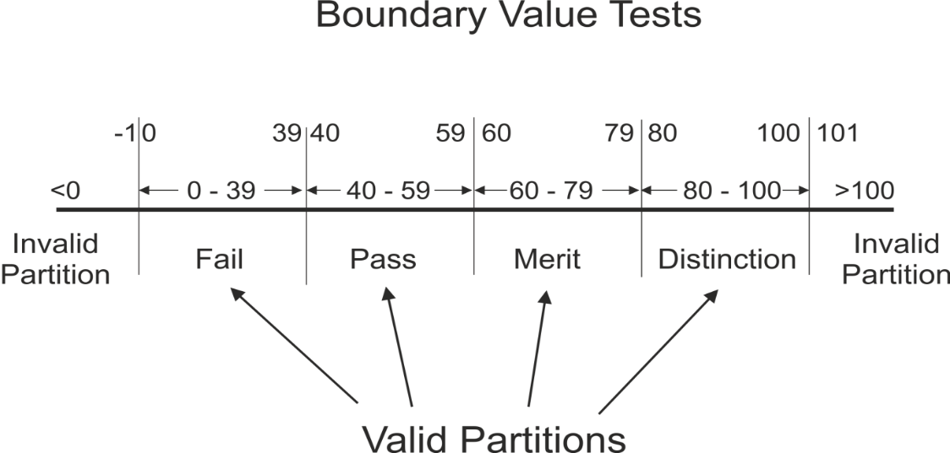
Black Box – Boundary Value Analysis
Boundary value analysis
Boundaries are the dividing lines between equivalence partitions
Behaviour at the edge of a partition is more likely to be incorrect than behaviour within the partition, so boundaries are an area where testing is likely to yield defects
The minimum and maximum values of a partition are its boundary values

Slide 165
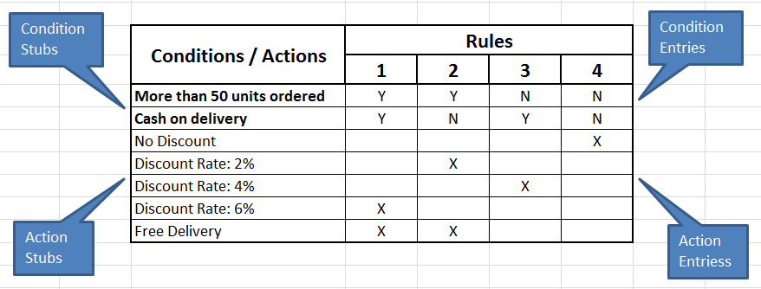
Black box – Decision Tables
Decision tables
Decision Tables represent the behaviour of a system that depends on the outcome of multiple decisions
They may be used to record complex business rules that a system is to implement
The table specifies the possible combination of conditions and the resulting actions, according the business rules
Each column of the table corresponds to a business rule that defines a unique combination of conditions and which result in the execution of the actions associated with that rule
Conditions are usually stated in Boolean form (True/False or Yes/No)

Slide 166
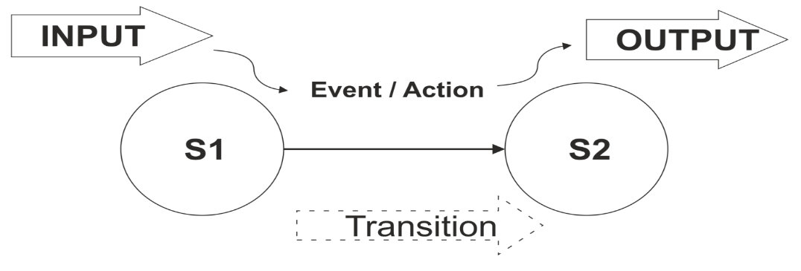
Black box - State transition diagrams
State transition diagrams
Some systems can be described in terms of 'states' or modes that the system can assume, the transition from one state to another because of some input condition, which leads to an event and results in an action which will finally give an output
These systems can be represented by a state diagram showing:
The states a component or system may be in
The transitions or changes form one state to another
The events or circumstances that cause transitions
The actions as a result from the transition, for example an error message

Slide 167
Experience-based testing
Experience-based testing is where tests are derived from the tester's skill or intuition, and their experience of similar applications and technologies
It is not based on analysis of specifications or structure
It is generally less thorough than systematic techniques (black-box and white-box), but it can be more effective if there is a lack of testing time or resources, and it can identify special tests not easily captured by formal techniques
Testers use their expertise to identify key areas to test, such as:
Critical or most-used functions
Areas most likely to fail (e.g. defect clusters or complex code)

Slide 168
6.4
Write test cases including coverage measurement from given requirements (text or model) using the following Black Box (Specification-based) techniques:
Equivalence partitioning
Boundary value analysis
Decision tables
State transition diagrams/tables

Slide 169
EP and BVA Exercise
An application will calculate tax automatically for employees in the organisation.
The application should only allow input values below £200,000. If a value of this magnitude or greater is attempted, an error message is returned. Salaries are recorded in whole pounds (not pence).
Employees begin paying tax at a £5,000 threshold.
This first band is charged at 10% and this rate applies to the next
£10,000 earned. 20% applies above this until at £40,000 a rate of 40% begins.
Draw a line diagram and mark the boundaries.
How many valid and invalid partitions are there? What values would you use for boundary tests?

Slide 170
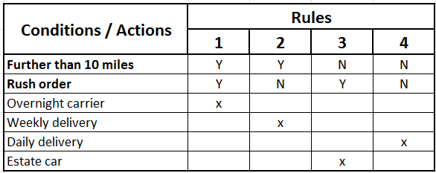
Decision Table Example
Requirement: Delivering goods from warehouse to shops
For each shop's delivery schedule we look to see how far away the shop is from the warehouse then we go through each item on the schedule.
If the shop is further than 10 miles away we add the item to the next weekly delivery for that area, unless it's a rush order in which case we send it by overnight carrier.
When we have an item to be delivered locally (i.e. less than or equal to 10 miles) we add it to the next day's delivery unless it's a rush order in which case Joe delivers it with an estate car immediately.

Slide 171
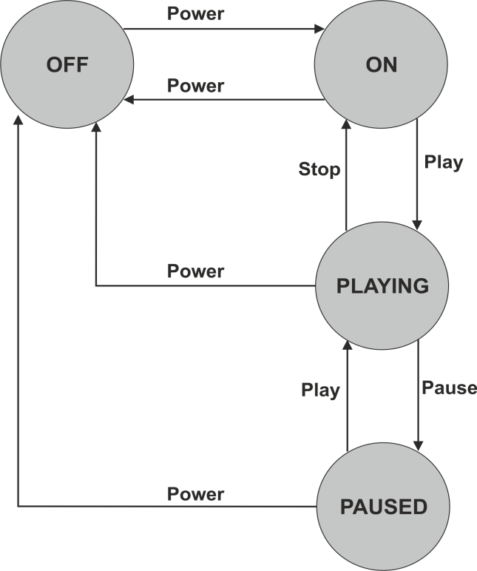
State Transition Exercise
Draw a state table using this State Transition Diagram which represents the states a music player can assume:

Slide 172
6.5
For tools to support software testing successful apprentices should be able to:
Recognise the tool types to support software testing and their main purpose
Summarise the pros and cons of test automation

Slide 173
Tools to support software testing
Test tool - A software product that supports one or more test activities, such as planning and control, specification, building initial files and data, test execution and test analysis- ISTQB Glossary
Test tools can be used for a number of activities that can support testing, including:
Tools used directly in testing tasks (e.g. test execution, data generation, result comparison)
Tools that help to manage the test process (e.g. management of tests, requirements, data, incidents)
Tools used to monitor and report activities during testing (e.g. performance, memory, file activity)
Generic tools that can be used to help testing (e.g. spreadsheets, SQL, debugging tools)

Slide 174
Why use tools
Testers may use tool support for a number of reasons, depending on the context:
Improve the efficiency of testing (e.g. scripted test execution)
Support manual activities (e.g. test planning, design or reporting)
Automate repetitive tasks (e.g. regression testing)
Automate activities that are difficult to do manually (e.g. static analysis or large scale performance testing)
Increase reliability of testing (e.g. automating large data comparisons or simulating behaviour)

Slide 175
Test Tools Classification
There are a number of tools that support different aspects of testing. Tools can be classified based on several criteria such as purpose, commercial/free/open-source/shareware, technology used and so forth
Some tools clearly support one activity; others may support more than one activity, but are classified under the activity with which they are most closely associated
One of the most important features of tools is their ability to interact and integrate with other tools

Slide 176
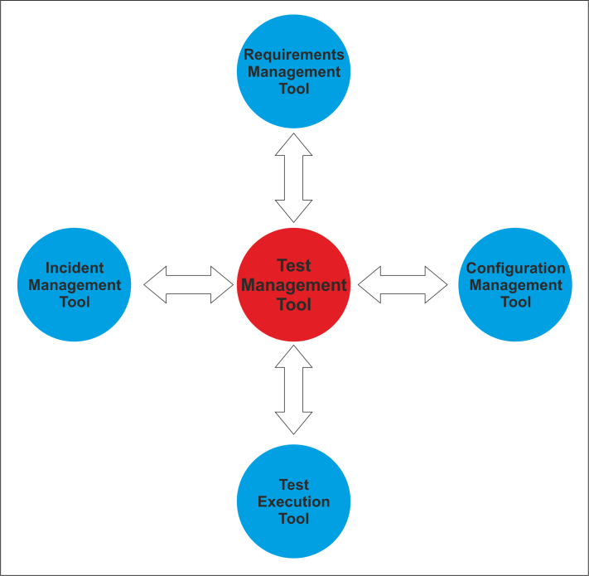
Test Management Tools
These are 'umbrella' tools which provide interfaces for executing tests, tracking defects and managing requirements
They also support traceability of test objects to requirements specifications, and might have an independent version control capability or an interface to an external configuration management tool

Slide 177
Requirements Management Tools
These tools store business requirements in a central repository which incorporates
Unique identifiers
Descriptions of functional and non-functional requirements
Attributes such as source, priority, rationale and status
Links between requirements
These tools may also help with identifying inconsistent, overlapping or missing requirements, and can support tracing the requirements to individual tests

Slide 178
Incident Management (Defect Tracking) Tools
These tools store and manage incident reports, such as defects, failures, change requests or perceived problems and anomalies, and manage the life cycle of incidents, optionally with support for statistical analysis.
They support the logging of incident characteristics (e.g. type, priority, severity) and status (e.g. rejected, ready, deferred.)

Slide 179
Tool Support for Static Testing
Static testing tools provide a cost effective way of finding more defects at an earlier stage in the development process
Review Tools
These tools (also known as Review Process Support tools) assist with review processes, checklists, review guidelines and defects
They are used to store and communicate reviewers' comments, report on defects and effort, and store metrics for causal analysis and process improvement
Static Analysis Tools
These tools help developers and testers find defects in source code prior to dynamic testing. Static analysis tools can provide complexity feedback for developers via various industry-defined metrics.
They can analyse structures and dependences and help in planning and risk analysis

Slide 180
Tool Support for Static Testing
Modelling Tools
These tools are used to validate software models (e.g., physical data model, activity model, process model), by enumerating inconsistencies and finding defects. These tools can often aid in generating some test cases based on the model
Mainly used by designers and developers, modelling tools that record state transition diagrams or use cases can also be suitable for testers

Slide 181
Tool Support for Test Specification
Test Design Tools
These tools are used to generate executable tests, test inputs (data) or test oracles (expected results ie determines if it has passed or failed) automatically from requirements, graphical user interfaces, design models (such as business rules, state diagrams or data models) or code
Data Preparation Tools
Test data preparation tools manipulate databases, files or data transmissions to set up test data to be used during the execution of tests
Test data preparation tools enable data to be selected from existing databases or created afresh

Slide 182
Tool Support for Test Execution and Logging
Test Execution Tools
These tools enable tests to be executed automatically or semi­ automatically, using stored inputs and expected outcomes, through the use of a scripting language
They can also be used to record tests, and usually support scripting language or GUI-based configuration for parameterisation of data and other customisation in the tests
Test execution tools usually provide a test log for each test run and can compare actual and expected results
Test Harness / Unit Test Frameworks Tools
A unit test harness or framework facilitates the testing of components or parts of a system by simulating the environment in which that test object will run, through the provision of mock objects as stubs or drivers
This is particularly useful for component integration testing, such as top-down or bottom-up testing

Slide 183
Tool Support for Test Execution and Logging
Test Comparator Tools
Test comparator tools are used to compare actual results and expected results by analysing differences between files, databases or test results
Standalone comparison tools normally deal with a range of file or database formats
Coverage Measurement Tools
These tools measure the percentage of specific types of code structures that have been exercised by a set of dynamic tests
They may measure coverage of statements, branches or decisions, and calls to modules or functions
They are used during white-box testing to measure actual coverage achieved by a set of structural tests
Security Tools
These tools are used to evaluate security characteristics of software such as the ability of the software to protect data confidentiality, integrity, authentication, authorisation, availability and non­repudiation
They can also check for viruses and denial-of-service attacks
Due to the nature of these tools, they are mostly focused on a particular technology, platform and purpose

Slide 184
Tool Support for Performance and Monitoring
Dynamic Analysis Tools
Dynamic analysis tools provide run-time information on the state of software under test
They find defects that are evident only when software is executing, such as time dependencies or memory leaks
Performance, Load and Stress Testing Tools
Performance testing tools monitor and report on how a system behaves under a variety of simulated usage conditions in terms of the number of concurrent users, their ramp-up pattern, frequency and relative percentage of transactions
Monitoring Tools
Monitoring tools continuously analyse, verify and report on usage of specific system resources (such as CPU, memory, disc capacity, network), and give warnings of possible service problems
Data Quality Assessment Tools
These tools assess data quality and integrity for data-centric projects such as data conversion/migration projects and data warehouse applications

Slide 185
Summarise the pros and cons of test automation
Pros
Cons

Slide 186
Pros and Cons of Test Automation
Pros
Cons
Fast and effective
Time saving
Cost effective
Transparency
Expensive
Cannot replace manual testing
Compatibility

Slide 187
7. Configuration Management and Version Control Systems (10%, K3)
In this topic, the apprentice will gain an understanding of the importance of configuration management and version control, together with the use of tools and techniques to store and manage incremental updates and versions of code. The successful apprentice should be able to:

Slide 188
7.1
Explain how configuration management tools and techniques are used to control and manage the different software development artifacts (including but not limited to) through the phases of the SDLC (Software development lifecycle) and live operation.
Requirements documentation
Code
Test scripts

Slide 189
Configuration Management
Configuration management (CM) is a systems engineering process for establishing and maintaining consistency of a product's performance, functional, and physical attributes with its requirements, design, and operational information throughout its life
Why use configuration management tools?
Configuration management tools enable changes and deployments to be faster, repeatable, scalable, predictable, and able to maintain the desired state.

Slide 190
Configuration Management Tools
CM tools are tools for automating the application of configuration states
Tools
CFEngine
Chef
Ansible
Puppet
Explain how configuration management tools and techniques are used to control and manage the different software developmen

Slide 191
CFEngine
CFEngine is one of the older CM tools
Compared to Puppet, also an established technology:
CFEngine runs on C, as opposed to Puppet’s use of Ruby
C is the more low level of the two languages, and one of the main complaints regarding CFEngine is that the learning curve is very steep
It does mean though that CFEngine has a dramatically smaller memory footprint, it runs faster and has far fewer dependencies

Slide 192
Chef
Chef is the other heavyweight in the CM and automation arena
Like Puppet, Chef is also written in Ruby, and its CLI also uses a Ruby-based DSL
Chef utilizes a master-agent model, and in addition to a master server, a Chef installation also requires a workstation to control the master
The agents can be installed from the workstation using the ‘knife’ tool that uses SSH for deployment, easing the installation burden

Slide 193
Ansible
Newer than Chef or Puppet, Ansible has gained a solid footing in the industry
It's included in popular Linux distros such as Fedora
Two offerings: Ansible and Ansible Tower, the latter featuring the platform’s UI and dashboard
Despite being a relatively new player in the arena when compared to competitors like Chef or Puppet, it’s gained quite a favourable reputation amongst DevOps professionals for its straightforward operations and simple management capabilities

Slide 194
Puppet
One of the best resources for trends in DevOps
Knowing the strengths and weaknesses of the Puppet platform is increasingly important for people in operations
It is frequently stated that Puppet is a tool that was built with sysadmins in mind
The learning curve is less imposing due to Puppet being primarily model driven
Getting your head around JSON data structures in Puppet manifests is far less daunting to a sysadmin who has spent their life at the command line than Ruby syntax is

Slide 195
7.2
Summarise the main features and benefits of version control for the development of code, including but not limited to:
Change history
Concurrent working
Tracking and preventing conflicts
Traceability
Security

Slide 196
Benefits of Version Control
Version control systems allow you to compare files, identify differences, and merge the changes if needed prior to committing any code
Versioning is also a great way to keep track of application builds by being able to identify which version is currently in development, QA, and production
When new developers join a team, they can easily download the current version of the application to their local environment using the version control system and are able to keep track of the version they’re currently running
During development, you can also have entirely independent code versions if you prefer to keep different development efforts separate
When ready, you can merge the files to create a final working version
Another great use for versioning is when troubleshooting an issue, you are able to easily compare different versions of files to track differences
You can compare the last working file with the faulty file, decreasing the time spent identifying the cause of an issue
If the user decides to roll back the changes, you can implement the last working file by using the correct version

Slide 197
Main Features of Version Control
A version control system is mostly based around one concept, tracking changes that happen within directories or files
The set of files or directories that are under version control are more commonly called a repository
Repositories may be cloned (also called checking out)
In version control, modifying, deleting files and/or directories, moving files or anything that can alter the state of a file is known as a commit
When a commit is made, the changes are recorded as a changeset and given a unique revision
A changeset will include a reference to the person who made the commit

Slide 198
Change history
As files are updated, you can leave messages explaining why the change happened (stored in the VCS, not the file). This makes it easy to see how a file is evolving over time, and why

Slide 199
Concurrent working
Where a team of people may concurrently make changes to the same files
A CVS is used to this end
Concurrent Versioning System (CVS), is a free client-server revision control system in the field of software development.
A version control system keeps track of all work and all changes in a set of files, and allows several developers (potentially widely separated in space and time) to collaborate
Several developers may work on the same project concurrently, each one editing files within their own "working copy" of the project, and sending (or checking in) their modifications to the server

Slide 200
Tracking and preventing conflicts
To avoid conflicts, the server only accepts changes made to the most recent version of a file
Developers are therefore expected to keep their working copy up-to-date by incorporating other people's changes on a regular basis
This task is mostly handled automatically by the CVS client, requiring manual intervention only when an edit conflict arises between a checked-in modification and the yet-unchecked local version of a file
If the check in operation succeeds, then the version numbers of all files involved automatically increment, and the CVS-server writes a user-supplied description line, the date and the author's name to its log files
CVS can also run external, user-specified log processing scripts following each commit
These scripts are installed by an entry in CVS's loginfo file, which can trigger email notification or convert the log data into a Web-based format.
Clients can also compare versions, request a complete history of changes, or check out a historical snapshot of the project as of a given date or as of a revision number.

Slide 201
Traceability
When creating and developing documents such as formal policies or project documents version control allows you to identify the development of the document e.g. many versions of a draft and final policy, over a prolonged period.
This allows traceability – retention of drafts and detail of changes made, often as a result of contributions from multiple collaborators within document development, the order of changes, and a record of those versions of documents regarded as final and/or approved by relevant groups or individuals

Slide 202
Security
One of the fundamental pieces of version control is a revision history
Copies of the repository, which has all the files and their history, can be stored on multiple computers
Version control also allows you to create markers that reference the state of the files at a specific point in time
These are often used to denote major changes, such as a new version
Version control forces every file change to be attributed to a user, which introduces accountability

Slide 203
7.3
Demonstrate how version control, in conjunction with configuration and release management, can be used for software that is being developed for use on multiple platforms.

Slide 204
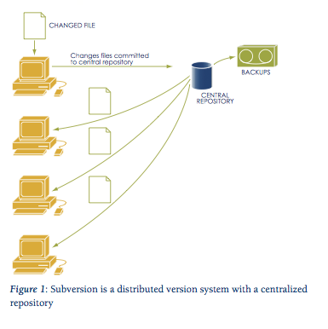
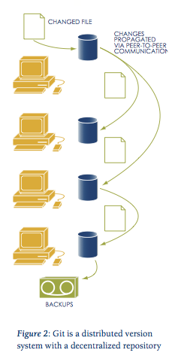

Slide 205
7.4
Discuss different version control approaches and their relative pros and cons.

Slide 206
Version Control - Why is it important

Slide 207
Approaches to Version Control
There are two general varieties of version control:
Centralized
Distributed
Distributed version control is more modern, runs faster, is less prone to errors, has more features, and is somewhat more complex to understand

Slide 208
Centralised
In centralized version control, each user gets his or her own working copy, but there is just one central repository
As soon as you commit, it is possible for your co-workers to update and to see your changes
For others to see your changes, 2 things must happen:
You commit
They update

Slide 209
Distributed
In distributed version control, each user gets his or her own repository and working copy
After you commit, others have no access to your changes until you push your changes to the central repository
When you update, you do not get others' changes unless you have first pulled those changes into your repository
For others to see your changes, 4 things must happen:
You commit
You push
They pull
They update

Slide 210
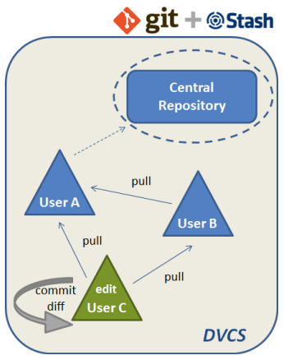
Pros and Cons of Distributed
Pros
Cons
Everyone has their own local sandbox
You can make changes and roll back, all on your local machine
No more giant checkins; your incremental history is in your repo
Works offline.
You only need to be online to share changes
Otherwise, you can happily stay on your local machine, checking in and undoing, no matter if the “server” is down or you’re on an airplane
DVCS git is fast
Diffs, commits and reverts are all done locally.
There’s no sketchy network or server to ask for old revisions from a year ago
DVCS handles changes very well
Distributed version control systems were built around sharing changes
Every change has a guid that makes it easy to track
Branching and merging is easy
Because every developer “has their own branch”, every shared change is like reverse integration
The guids make it easy to automatically combine changes and avoid duplicates
With DVCS, there is less management
DVCS systems are easy to get running since there is no “always-running” server software to install
You still need a backup.
Some claim your “backup” is the other machines that have your changes, but what if they didn’t accept them all? ** What if they’re offline and you have new changes?
You still want a machine to push changes to “just in case”
In Subversion, you usually dedicate a machine to store the main repo; do the same for a DVCS
There’s not really a “latest version”
If there’s no central location, you don’t immediately know whether to see others for the latest version.
A central location helps clarify what the latest “stable” release is
There aren’t really revision numbers
Every repo has its own revision numbers depending on the changes
Instead, people refer to change numbers that are not intuitive. But, you can tag releases with meaningful names

