Slide 1
Cloud Computing Security
Infrastructure Technician

Slide 2
What are the issues?
Data breaches
Account hijacking
Insider threats
Malware injection
Abuse of services - hosting illegal content
Insecure APIs (application programming interfaces)
Denial of service attacks
Shared vulnerabilities - who is responsible for access and passwords
Data loss
Find a real failure example for each one of these problems

Slide 3
Responsibilities
Issue | Cloud provider | Cloud user | Infrastructure Technican
Data breaches | ✓ | ✓ | ✓
Account hijacking | ✓ | ✓
Insider threats | ✓ | ✓
Malware injection | ✓ | ✓
Abuse of services | ✓ | ✓
Insecure APIs | ✓
Denial of service attacks | ✓
Shared vulnerabilities | ✓ | ✓ | ✓
Data loss | ✓ | ✓

Slide 4
Data breach countermeasures
Secure communications
HTTPS
Encrypted
Client authenticates server certificate
VPN
Secure connection to tenant’s cloud VLAN
encrypted data
sender authentication to prevent unauthorised users from accessing the VPN
message integrity to detect any instances of tampering with transmitted messages

Slide 5
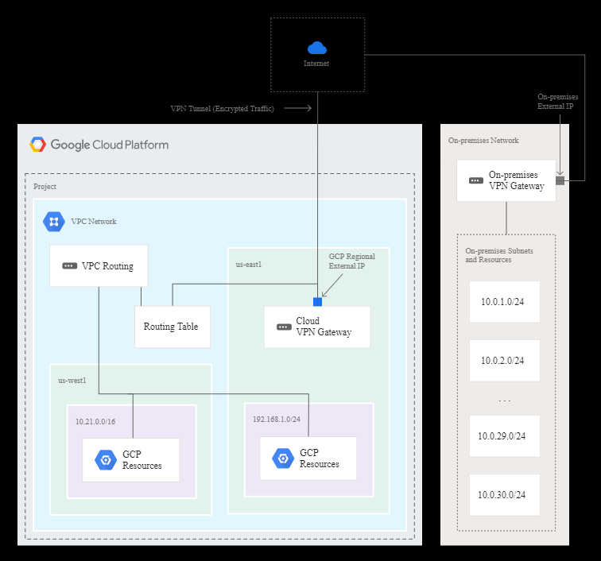
VPN example

Slide 6
Shared vulnerabilities
Passwords
Tenant controls issuing
Tenant and host control password policies
Access control
Tenant and host control user and group creation
Tenant and host control user and group access to resources

Slide 7
Passwords
Test your password security
https://howsecureismypassword.net/
Traditional
Password length
Required characters
No reuse
Better
Password manager
Passphrases,
Four random dictionary words
CVC-CVC-CVC (consonant-vowel-consonant)
System
Lock after failed attempts
Limit rate of attempts

Slide 8
Authentication
Access to secure systems based on user credentials that imply authenticity
Something the user knows
Password
Partial password
Pass phrase
Personal identification number (PIN)
Challenge response (the user must answer a question, or pattern)
Security question

Slide 9
Authentication
Something the user has
wrist band
ID card
security token
implanted device
smartphone with built-in hardware token
software token or smartphone holding a software token

Slide 10
Authentication
Something the user is or does
Fingerprint
Retinal pattern
DNA sequence (there are assorted definitions of what is sufficient)
Signature
Face
Voice
Unique bio-electric signals or other biometric identifier

Slide 11
Multi-factor authentication
Single factor
Only one required
Two factor
Two required
Research authentication requirements
Banking
Gmail
iCloud
Dropbox

Slide 12
Password managers
User IDs are often guessable
Derived from the account holder's name, email address etc
Complex passwords are difficult to remember
Many users have defaulted to passwords like
“password"
"abc123“
their pet's name
other easily guessable or breakable naming conventions
Hundreds of millions or more passwords may already be floating around the seedier corners of the internet
https://haveibeenpwned.com/

Slide 13
Password managers
The user creates a master password for access to their identity vault
If this is forgotten then passwords are not available and will have to be reset
The password manager fills in individual user IDs and passwords for the sites and apps in use
Each site or app can have a different, complex and hard to remember password
These can be generated by the password manager
Two factor authentication provides security
The vault is encrypted (on the device or in the cloud)

Slide 14
Password managers
Features
Local storage
Cloud based vault (accessible from multiple devices)
Form filling
App integration
Fingerprint authentication (IOS, Android)
Built into the OS (Apple Keychain)
Automatic password change (renders old password hacks obsolete)
Travel mode (limited set of password on mobile device)

Slide 15
Password managers
Login credentials must be stored in an encrypted form
Secure resource usage
using secure memory to prevent a decrypted password being recovered by a malicious security cracker
Should not trust the security of outside applications
they may store decrypted passwords in undeleted temp files (Google Chrome used to show passwords without authentication)

Slide 16
Summary
1.4
Understand factors required for secure password
set a strong password policy
use multifactor / two-factor authentication where available
1.5
List the pros and cons of password management tools and services
all passwords in one place
access on multiple device
password generation.

