Slide 1
Cryptography
UFCFGU-30-2 – Week 2
Level 5
30 Credits

Slide 3
Cryptography
Week 2
Intro
Monday
01
02
Wednesday
03
04
Tuesday
05
06
Thursday
Friday

Slide 4
Syllabus – Week 2
Monday
Secure Hash
Digital Signing, Certificate Authorities
Tuesday
Public Key Ciphers – Examples & Analysis
Block Ciphers – Examples & Analysis – Covered Previously
Wednesday
How cryptographic techniques are applied and to what end and their limitations
Thursday
Examples of badly applied or implemented cryptographic techniques
Friday
Review, Q&A

Slide 5
Secure Hash

Slide 6
Cryptography Principles
Integrity
Ensuring the consistency, accuracy, completeness and general trustworthiness of data is maintained, “In Transit” and “At Rest”, and throughout its lifecycle

Slide 7
Hashing
Hashing is generating a value or values from a string of text using a mathematical function
Crypto Hash, can be represented as a short string of text, provides a "message digest“
It cannot be used to recover the original message from the hash, as a result it’s commonly referred to as “One-Way Hash”
Can be used to verify that a downloaded file is identical to the original: Integrity Principle
Can also be used to store passwords in a non-plaintext form: Confidentiality principle

Slide 8
Hashing
The word “hash” just means to “chop and mix”
In the cryptographic sense, it means to take a string of data, and then in some way, chop it up into bits, and mix those bits up
Hash functions should take in a string of arbitrary length (any length)
Should always produce an output of fixed length (the “hash length”)

Slide 9
Hashing
It’s common in hashing to use hexadecimal to represent the output
It’s nothing more than representing a number in a different base
(just like binary, when we use base 2)
In this case we use base 16
(16 is two bits, commonly used in computing)
The word hexadecimal comes from the Greek, hex for 6 and decimal for 10, so 16 overall

Slide 10
Hashing
In relation to hash functions…
We take a string and convert it into a string of fixed length (often by converting the string to a number written in hexadecimal)
However, this can be done in a myriad of ways
So, what sort of functions make good cryptographic functions?

Slide 11
Hashing
The function should “appear” as random as possible, so it’s not feasible to compute a message from its hash function
Small changes in the message should result in a totally different hash function, for example “MEET ME IN THE PUB” and “MEET ME IN THE SUB” should have totally different hash functions
Two different messages should not both give the same result when the hash function is applied. If they did, an attacker could switch the original message for another message without it being detected

Slide 12
Hashing (Unencrypted Digest)

Slide 13
Hashing

Slide 14
Hashing – MD5
Ronald Rivest, founder of RSA Data Security LLC and professor at Massachusetts Institute of Technology, designed MD5 in 1991
Designed as an improvement to message-digest algorithm, MD4
Describing it in Internet Engineering Task Force (IETF) Request for Comments (RFC) 1321

Slide 15
Hashing – MD5
MD5 message-digest hashing algorithm processes data in 512-bit strings, broken down into 16 words composed of 32 bits each
Output from MD5 is a 128-bit message-digest value
Computation of the MD5 digest value is performed in separate stages that process each 512-bit block of data along with the value computed in the preceding stage

Slide 16
Hashing - MD5
First stage begins with the message-digest values initialized using consecutive hexadecimal numerical values
Each stage includes four message-digest passes, which manipulate values in the current data block and values processed from the previous block
Final value computed from the last block becomes the MD5 digest for that block

Slide 17
Hashing – MD5
IS MD5 still secure?
MD5 is considered insecure, due to the potential for an attacker to generate a hash “collision”, whereby two different files can have the same resultant hash value
MD5 hashes are no longer considered cryptographically secure methods, and should not be used for cryptographic authentication, according to IETF

Slide 18
Lab (15 Mins):
Use the MD5 Collision Finder in Cryptool2
Open Cryptool2
Look at “Templates”, under “Hash Functions”
Find and run “MD5 Collision Finder”
Add your message in “Random Seed” - top left
Press “Play” on the task bar
See how different inputs can generate the same MD5 hash value!

Slide 19
Secure Hash Algorithms - SHA
The SHA (Secure Hash Algorithm) is a collection of algorithms for hashing
The first, SHA (now usually referred to as SHA-0), was published as a US standard in 1993, intended as a replacement for a previously commonly-used algorithm MD5 (Message Digest algorithm 5)
It works on the principles of Rivest, one of the creators of the RSA public-key algorithm

Slide 20
Secure Hash Algorithms - SHA
SHA-1 has been very widely used in relatively modern applications, such as copy protection systems (as those used in the Xbox), and digital signatures
However, in 2005, certain properties in SHA-1 were shown to be theoretically insecure. Although at the time, computing power needed to break it was beyond that available
Although not computationally possible at the time it was feared that the techniques used could lead to deeper analysis and a feasible way to break it
As such, SHA-1 was superseded by improved versions

Slide 21
Secure Hash Algorithms - SHA
Examples of SHA names used are SHA-1, SHA-2, SHA-256, SHA-512, SHA-224, and SHA-384
However, in reality there are only two types: SHA-1 and SHA-2
Larger numbers, like SHA-256, are just versions of SHA-2

Slide 22
Lab (15 Mins):
Create some hash values using Cryptool2, and online services
Using MD5 & SHA-256
My name is xxx
MD5
SHA-256
My name is xxxy
MD5
SHA-256
Look at the significant differences to the resultant hash values

Slide 23
Lab Findings
What online services did you use, and what did you notice about the hashes?
Hash can be used with any type of message of any size file, image etc.
Creates a fixed length string
Also referred to as a “Message Digest”, “Checksum” or “Digital Fingerprint”
Hashes should not “collide” however examples of collision can be seen with MD5 hashing
Commonly used to check hashes are identical to that of the original file.

Slide 24
Hashes & Passwords

Slide 25
Cryptography Principles
Confidentiality
Ensuring that the sensitive information is protected from unauthorized access

Slide 26
Hashing and Passwords
Password storage:
Don’t store the plaintext password, use a hash value
To avoid password brute force attacks, additional information is included in the hash, known as “Salt”
When used for authentication hashes are compared, not passwords

Slide 27
Attacks on Passwords
Directly…
Brute force
Dictionary
Rainbow table
Indirectly…
Phishing
Man-in-the-Middle
Credential Stuffing
Keyloggers
Notes:
Resources & Notes:
Phishing – Email pretending to be from someone else to trick the recipient in providing or entering their login details
Man-in-the-Middle – Whereby an Attacker eavesdrops in network traffic to either gather or intercept and change information
Credential Stuffing – Attackers use a list of compromised credentials to try to access a system
Keyloggers – Can either be hardware or software (in the form of malware) to capture credentials as they are being used by users to access the legitimate system

Slide 28
Brute Force Attack

Slide 29
Brute Force Attacks
A brute force attack is a trial-and-error method used to obtain information such as a user password or personal identification number (PIN)

Slide 30
Brute Force Attacks

Slide 31
Brute Force Attacks
In a brute force attack, automated software is used to generate a large number of consecutive guesses as to the value of the desired data

Slide 32
Brute Force Attacks
Brute force attacks may be used by criminals to crack encrypted data, or by security analysts to test an organization’s network security

Slide 33
Brute Force Attacks
A brute force attack is also known as brute force cracking or simply brute force

Slide 34
Dictionary Attack

Slide 35
Dictionary Attacks
A dictionary attack is a method of breaking into a password-protected computer or server by systematically entering every word in a dictionary as a password
A dictionary attack can also be used in an attempt to find the key necessary to decrypt an encrypted message or document

Slide 36
Dictionary Attacks
Dictionary attacks work because many computer users and businesses insist on using ordinary words as passwords
Dictionary attacks are rarely successful against systems that employ multiple-word phrases, and unsuccessful against systems that employ random combinations of uppercase and lowercase letters mixed up with numerals

Slide 37
Tools
Can use tools such as:
Hydra
Quickly runs through a large number of password combinations, either simple brute force or dictionary-based
It can attack more than 50 protocols and multiple operating systems
Hydra is an open platform; the security community and attackers constantly develop new modules
Aircrack-ng
Can be used on Windows, Linux, iOS, and Android
It uses a dictionary of widely used passwords to attack wireless networks
L0phtCrack
A tool for cracking Windows passwords
It uses rainbow tables, dictionaries, and multiprocessor algorithms

Slide 38
Tools
Can use tools such as:
John the Ripper
Runs on 15 different platforms including Unix, Windows, and OpenVMS
Tries all possible combinations using a dictionary of possible passwords
Hashcat
Works on Windows, Linux, and Mac OS
Can perform simple brute force, rule-based, and hybrid attacks
DaveGrohl
An open-source tool for cracking Mac OS
Can be distributed across multiple computers
Ncrack
A tool for cracking network authentication
It can be used on Windows, Linux, and BSD

Slide 39
Rainbow Tables

Slide 40
Rainbow Tables
A rainbow table is a database that is used to gain authentication by cracking the password hash
It is a precomputed dictionary of plaintext passwords and their corresponding hash values that can be used to find out what plaintext password produces a particular hash

Slide 41
Rainbow Tables
Since more than one text can produce the same hash, it’s not important to know what the original password really was, as long as it produces the same hash

Slide 43
Rainbow Tables
A rainbow table attack reduces the processing power and time taken to conduct an attack by using pre-computed hashes

Slide 44
Digital Signing

Slide 45
Cryptography Principles
Integrity
Ensuring the consistency, accuracy, completeness and general trustworthiness of data is maintained, “In Transit” and “At Rest”, and throughout its lifecycle

Slide 46
Cryptography Principles
Authentication
A process for recognizing and confirming a users identity

Slide 47
Cryptography Principles
Non-Repudiation
Preventing an individual or entity from denying having performed a particular action

Slide 48
Digital Signatures
Digital Signatures Explanation:
What are Digital Signatures? - Computerphile – YouTube
10 Mins
Notes:
Resources & Notes:
https://www.youtube.com/watch?v=s22eJ1eVLTU

Slide 49
Hashes and Digital Signatures

Slide 50
Ensure you are familiar with the Hashing Function, Digital Signature process and associated calculations

Slide 51
Hashes and Digital Signatures
Hashing can be used in digital signatures to provide assurance:
Message has not changed – Principle of Integrity
Source of the message – Principle of Authentication
Signature is definitely from that person – Principle of non-repudiation
“Non-repudiation” = Person cannot deny that they sent the message
Hashes can also be referred to as the “Message Digest”

Slide 52
Digital Signature (Encrypted Digest)

Slide 53
Example
In previous examples we have seen how Alice uses Bob's public key to send him an encrypted message
When sending a message, she can claim to be Alice, but Bob has no way of verifying that the message was from Alice since anyone can use Bob's public key to send him encrypted messages
In order to verify the origin of a message, Alice’s RSA Private Key can be used to sign the message prior to it being sent

Slide 54
Example continued…
Alice also needs to provide assurance that the message hasn’t been tampered with whilst in transit, so will hash the message prior to adding her Digital Signature
For this example instead of using MD5, SHA-1 or SHA-2 Alice is going to hash the message using a simplified hashing method of her own
Once a hash value / message digest of the file has been created, Alice will add her digital signature prior to sending both to Bob

Slide 55
Stage 1 – Create a Hash Digest of the message
Alice wants to send the message “TRUE” to Bob. Alice wants to send this in plain text so does not need to encrypt it, but she wants to sign it so that Bob knows it came from her
To sign it, she first creates a hash as follows:
Convert the message “TRUE” into a hexadecimal string
(so A goes to 41, up to Z going to 5A)

Slide 56
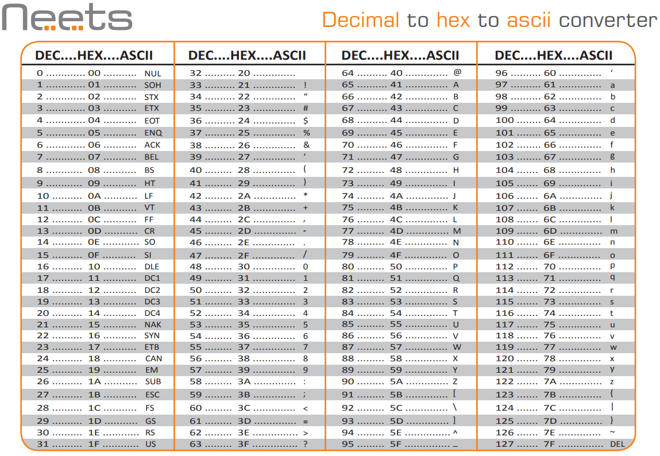
RSA Encryption – Decimal to Ascii to Hex
Notes:
Resources & Notes:
https://www.rapidtables.com/convert/number/ascii-to-hex.html

Slide 57
Stage 1 – Create a Hash Digest of the message
Write the hexadecimal strings next to each other to form an 8-digit string
Reverse the string (so e.g. 0F671E89 would go to 98E176F0)
Note: Reverse the number individually not in pairs = 54552545
T | R | U | E
54 | 52 | 55 | 45
E | U | R | T
54 | 55 | 25 | 45

Slide 58
Stage 2 – Create a Hash Digest of the message
Take the decimal equivalent of this string
= 1414866245
Convert it to a number (mod 1012345)
= 620280 Remainer
Convert it back to hexadecimal to make a fixed-length of 5 characters
= 976F8
So 976F8 is the Hash digest of the message “TRUE”
Notes:
Resources & Notes:
https://www.rapidtables.com/convert/number/hex-to-decimal.html
https://www.calculators.org/math/modulo.php

Slide 59
Alice’s Key Pair - Private Key
Alice’s Private Key for this example:
Private Key
The Pair of numbers (n, d) form the RSA Private Key
Shown as (d, n) = (29, 91)

Slide 60
Stage 3 Digitally sign the message
Alice digitally signs the message using her Private Key (d, n) = (29, 91)
Alice raises the decimal value of the hash (620280) to the power of d (modulo n) (as she does when decrypting a message)
620280 (mod n) = 620280 (mod 91) = 33
Alice then attaches it as a “Signature" to the message
d
29
Notes:
Resources & Notes:
https://www.rapidtables.com/calc/math/Exponent_Calculator.html
https://www.dcode.fr/modular-exponentiation

Slide 61
Example continued…
Alice then sends the message, hash and digital signature to Bob
Bob uses the same hash algorithm (which they have agreed previously) to recreate the message hash value
Bob compares the resultant hash value with the hash of the original message, and if they match the integrity of the file is confirmed

Slide 62
Stage 4 – Check the Hash Digest
Bob checks the Hash Digest of the message he’s calculated against the one provided by Alice:
Hash value of message sent (calculated by Alice): 976F8
Hash value of message received (calculated by Bob): 976F8
This provides assurance that the message has not been tampered with “In-Transit”
Notes:
Resources & Notes:
https://www.rapidtables.com/calc/math/Exponent_Calculator.html
https://www.dcode.fr/modular-exponentiation

Slide 63
Example continued…
Bob has confirmed that the message hasn’t changed, but he still doesn’t know for sure whether it’s really Alice who sent the message
To confirm the sender of the message is Alice, Bob will need to check the message hash in conjunction with Alice’s Public Key

Slide 64
Alice’s Key Pair - Public Key
Alice’s Public key for this example:
Public Key
The pair of numbers (n, e) form the RSA Public Key
Shown as (e, n) = (5, 91)

Slide 65
Stage 7 - Check the Digital signature of Alice
Bob now knows that the file hasn’t been tampered with in transit, but if we stop here Bob still doesn’t have any assurance that the message is actually from Alice! So he needs to check Alice’s Digital Signature
Bob first takes the Hashes Hexadecimal value and converts it to Decimal:
976F8 = 620280
Bob then raises the Hashes decimal value to the power of e (modulo n) using Alice’s Public Key (e, n) = (5, 91)
620280 (mod n) = 620280 (mod 91) = 33
e
5
Notes:
Resources & Notes:
https://www.rapidtables.com/calc/math/Exponent_Calculator.html
https://www.dcode.fr/modular-exponentiation

Slide 66
Stage 8 – Check the Digital signature of Alice
Bob checks the digital signature provided by Alice with the one calculated from the Hash and Alice’s Public Key:
Digital signature created by Alice using the message Hash and her Private Key (calculated by Alice): 33
Digital signature checked using the message Hash provided by Alice and her Public Key (calculated by Bob): 33
This provides assurance that the message has not been tampered with “In-Transit”, and that it was created by the owner of the Key Pair - Alice
Notes:
Resources & Notes:
https://www.rapidtables.com/calc/math/Exponent_Calculator.html
https://www.dcode.fr/modular-exponentiation

Slide 67
Lab (45 Mins):
Working in pairs, using the Hashing function and digital signature process we’ve just gone through:
As Alice…
Write a new short message
Create a Hash Digest
Create a Digital Signature
As Bob…
Check the Hash Digest against the original
Validate Alice’s Digital Signature

Slide 68
Certificate Authorities

Slide 69
Certificate Authorities
If you look back on how we started, with the Caesar cipher, progressing through shared key ideas… to the use of private & public Keys
We have a system that doesn’t involve any secret key sharing, because every private key never has to be distributed to anyone. Yes, we distribute the public keys, but it’s impossible (or as close to impossible as we can get) to get the private key from the public key, so what does it matter?
This has evolved into a highly secure system. Is it perfect? Sadly not – there is another security issue to consider

Slide 70
Certificate Authorities
OK, so Bob publishes his public key. But how do we know that when it gets published, this public key really did come from Bob?
We haven’t yet set up a way to stop someone pretending to be Bob, publishing their own public key, and hence being able to receive messages sent from people erroneously believing the recipient to be Bob
The idea is to somehow certify that a public key really did come from the believed sender. How do you certify something? With a certificate

Slide 71
Certificate Authorities
You create your own public key, you then get a trusted third-party (i.e. someone else that you trust) to create a file that contains your public key, your details, followed by their (the trusted third-party) digital signature. This is your digital certificate
If someone wants to send a message to you, but are worried if it really was you that issued that public key, they can first of all check with your trusted third-party that the public key really did come from you (so essentially they check your certificate) and then feel confident in sending the message, reassured that it will go to the right person

Slide 72
Certificate Authorities & Trust Hierarchies
Certificate Authorities, or CAs, issue Digital Certificates
Digital Certificates are verifiable small data files that contain identity credentials to help websites, people, and devices represent their authentic online identity (authentic because the CA has verified the identity)
CAs play a critical role in how the Internet operates and how transparent, trusted transactions can take place online
CAs issue millions of Digital Certificates each year, and these certificates are used to protect information, encrypt billions of transactions, and enable secure communication

Slide 73
SSL Certificate
An SSL Certificate is a popular type of Digital Certificate that binds the ownership details of a web server (and website) to cryptographic keys
These keys are used in the SSL/TLS protocol to activate a secure session between a browser and the web server hosting the SSL Certificate.
In order for a browser to trust an SSL Certificate, and establish an SSL/TLS session without security warnings, the SSL Certificate must contain the domain name of website using it, be issued by a trusted CA, and not have expired

Slide 74
SSL Certificate

Slide 75
Public Key Infrastructure
Not to be confused with Public Key encryption…
Public Key Infrastructure (PKI) is used to confirm the identity of end entities that include humans, computers, network devices and many other types of 'smart' devices on a network
Public Key Infrastructure (PKI) is a set of roles, policies, hardware, software and procedures needed to create, manage, distribute, use, store and revoke digital certificates and manage public-key encryption

Slide 76
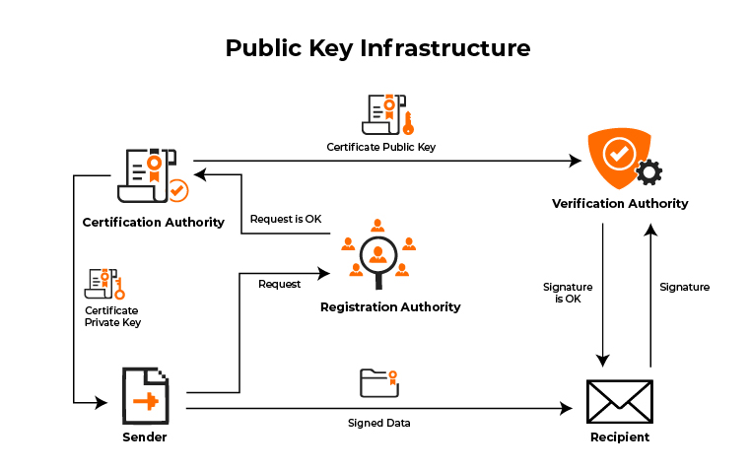
Public Key Infrastructure
Notes:
Resources & Notes:
The Sender first raises a request with the Registration Authority (RA), once the RA authorises the request the Certification Authority provides a Certificate Private Key to the Sender, and provides a Certificate Public Key to the Verification Authority.
When the Sender sends Signed Data to the Recipient, the Recipient then checks with the Verification Authority that the Signature is OK.

Slide 77
Web of Trust
An alternative approach to the problem of public authentication of public key information is the web-of-trust.
This uses self-signed certificates and third-party attestations of those certificates
The singular term "web of trust" does not imply the existence of a single web of trust, or common point of trust, but one of any number of potentially "webs of trust”

Slide 78
Web of Trust
Examples of implementations of this approach are PGP (Pretty Good Privacy) and GnuPG (an implementation of OpenPGP, the standardized specification of PGP)
Because PGP and implementations allow the use of e-mail digital signatures for self-publication of public key information, it is relatively easy to implement one's own web of trust

Slide 79
Web of Trust

Slide 80
Assessment – Reminder!
This module is assessed by a combination of:
Component A: Presentation (30 minutes)
Issued: End of block release week 1
Due: Start of block release week 3
Component B: Course Workbook
Issued: End of block release week 3
Due: Start of block release week 1 of next module

Slide 81
Component A – Presentation – Reminder!
Component A (50%):
A 30 minute demonstration where apprentices will show how they have chosen an appropriate algorithm and technique to solve a given requirement.
They will demonstrate the solution and satisfactorily explain its operation to an audience without specialised expertise.
In addition to demonstrating their grasp of the module outcomes, the demonstration will give the students the opportunity to practice their oral skills, particularly in speaking to a non-expert audience.

Slide 82
Cryptography
Week 2
Intro
Monday
01
02
Wednesday
03
04
Tuesday
05
06
Thursday
Friday

Slide 83
Syllabus – Week 2
Monday
Secure Hash
Digital Signing, Certificate Authorities
Tuesday
Public Key Ciphers – Examples & Analysis
Block Ciphers – Examples & Analysis – Covered Previously
Wednesday
How cryptographic techniques are applied and to what end and their limitations
Thursday
Examples of badly applied or implemented cryptographic techniques
Friday
Review, Q&A

Slide 84
Modulus - recap

Slide 85
Modulus
Take a modulus of 5. What is 3 + 4 (mod 5)?
With modulus 5, we wrap around when we reach 5
So the only numbers we have are 0, 1, 2, 3 and 4
When we reach 5 we go back to 0

Slide 86
Modulus
Trying to add 3 + 4, start from 3
Adding 1 gives 4
Adding another 1 gives 0 (we wrap back to 0 because we reached 5)
Adding another 1 gives 1. Adding another 1 gives 2
So overall, adding 4 gives the answer 2, and 3 + 4 ≡ 2 (mod 5)

Slide 87
Modulus
We can do multiplication as well:
What is 3 * 2 (mod 5)?
(The * symbol is commonly used for multiplication to avoid confusion with the letter x)
“Normally” 3 * 2 is 6. But 6 is the “same as” 1 (as we reset at 5)
So, we can say 3 * 2 ≡ 1 (mod 5)
This should become clearer when we consider remainders
Notes:
Test Questions
7 + 30 (Mod24) = 13
15 + 40 (Mod 12) = 7
3 * 90 (Mod 25) = 20
12 * 10 (Mod 25) = 20

Slide 88
Group: Mini-Test Questions
7 + 30 (Mod24)
Notes:
Test Questions
7 + 30 (Mod24) = 13
15 + 40 (Mod 12) = 7
3 * 90 (Mod 25) = 20
12 * 10 (Mod 25) = 20

Slide 89
Group: Mini-Test Questions
15 + 40 (Mod 12)
Notes:
Test Questions
7 + 30 (Mod24) = 13
15 + 40 (Mod 12) = 7
3 * 90 (Mod 25) = 20
12 * 10 (Mod 25) = 20

Slide 90
Group: Mini-Test Questions
3 * 90 (Mod 25)
Notes:
Test Questions
7 + 30 (Mod24) = 13
15 + 40 (Mod 12) = 7
3 * 90 (Mod 25) = 20
12 * 10 (Mod 25) = 20

Slide 91
Group: Mini-Test Questions
12 * 10 (Mod 25)
Notes:
Test Questions
7 + 30 (Mod24) = 13
15 + 40 (Mod 12) = 7
3 * 90 (Mod 25) = 20
12 * 10 (Mod 25) = 20

Slide 92
Remainders - Recap

Slide 93
Remainders
When you divide one number by another, you are probably used to the idea of quotients and remainders
For example, when you divide 27 by 4, the quotient is however many times 4 goes into 27 (in this case 6)
The remainder is what’s left over, in this case 3
This can be expressed as 27 = 6 * 4 + 3

Slide 94
Remainders
How does this relate to modular arithmetic?
Well, what is 27 (mod 4)? Start counting…
Remembering to wrap around every time we reach 4. We wrap around at 4, 8, 12, 16, 20, and 24 (so our 6 lots of 4)
Then count up to 3 to reach 27, So 27 ≡ 3 (mod 4)

Slide 95
Remainders
Hence a number x (mod n) is equivalent to the remainder when you divide x by n
Another example: What is 57 mod 5?
Well, the remainder when you divide 57 by 5 is 2 (57 = 11 * 5) + 2.
So, 57 ≡ 2 (mod 5)

Slide 96
Congruences

Slide 97
Congruences
Informally, two numbers x, y are congruent (mod n) - written x ≡ y (mod n) - if they have the same remainder when divided by n
So, for example, 6 ≡ 11 (mod 5) since both 6 and 11 have remainder 1 when divided by 5
Some other numbers that are congruent to 6 are 16, 21, 26, 31, 36, 41, …., so any number that has remainder 1 when divided by 5

Slide 98
Congruences
The “remainder” way of doing things becomes slightly trickier when dealing with negative numbers
What is the remainder when -4 is divided by 5? It’s not 4
Thinking about it, -4 = (-1)*5 + 1 and so the remainder is 1
This makes sense following our pattern above. We’d already decided that 6, 11, 16, 21, 26, 31, 36, 41, …. are all congruent mod 5

Slide 99
Congruences
Following the pattern downwards (difference of 5 between each number) we should have all of these congruent :
..., -39, -34, -29, -24, -19, -14, -9, -4, 1, 6, 11, 16, 21, 26, 31, 36, 41,…
since they all have remainder 1 when divided by 5
Just be careful with negative numbers!

Slide 100
A Note on Convention
We have used the symbol ≡ above to denote “equivalence”
So, for example, we said that 6 ≡ 11 (mod 5) because 6 and 11 are “equivalent” modulus 5 (they have the same remainder when divided by 5)
There is one and only one case where it is convention to use a normal equals sign = which is when you are asked to give the “answer” to the question of what is a single number (mod n)

Slide 101
A Note on Convention
Example: What is 17 (mod 5)?
There are many things that are congruent to 17 (mod 5), in fact any number with a remainder of 2 when divided by 5, so for example -13, -8, -3, 2, 7, 12, 22, 27, etc.
The convention is to give the smallest positive number
So in this case we would say that 17 (mod 5) = 2
The “answer” to x (mod n) will always be a number in the range 0 to (n - 1), and will just be the remainder when dividing by n.
So, for example, 26 (mod 4) = 2 and 24 (mod 4) = 0

Slide 102
Prime & Coprime Numbers - Recap

Slide 103
Prime Numbers
An integer p is said to be prime if the only integers that divide exactly into p are 1 and p
For technical reasons, 1 is not considered to be prime, so the first few prime numbers are 2, 3, 5, 7, 11, 13, 17, 19, 23, 29,…...
Numbers that divide exactly into a number n is called a “factor of n”
So for example, the factors of 16 are 1, 2, 4, 8, and 16

Slide 104
Coprime Numbers
Two numbers are said to be coprime if the only factor they have in common is 1
So for example 5 and 21 are coprime, but 6 and 21 are not, since they share a common factor 3
Another example of coprime is 21 & 22:
The factors of 21 are 1, 3, 7 and 21
The factors of 22 are 1, 2, 11 and 22

Slide 105
Coprime Numbers
Another example of NOT coprime is 21 & 24:
The factors of 21 are 1, 3, 7 and 21
The factors of 24 are 1, 2, 3, 4, 6, 8, 12 and 24
These are NOT coprime as they have the common factors 1 and 3

Slide 106
Greatest Common Divisor

Slide 107
Greatest Common Divisor - GCD
Let a and b be integers, not both zero
Then the greatest common divisor (GCD) of a and b is the largest positive integer which is a factor of both a and b
We use gcd(a,b) to denote this largest positive factor

Slide 108
Greatest Common Divisor - GCD
gcd(a, b) denotes the GCD of a and b
The GCD of any two distinct primes is 1
gcd(3, 59) = 1
The GCD of 18 and 27 is 9
gcd(18, 27) = 9

Slide 109
Euler’s totient function

Slide 110
Euler’s totient function
Euler’s totient function (named after the famous 18th century Swiss mathematician Leonhard Euler, widely regarded as one of the greatest mathematicians of all time) can be defined as follows:
Given a positive integer n, the Euler totient function φ (n) is the number of positive integers less than n which are coprime to n.
It is sometimes called the phi function (the symbol used is a lower-case Greek letter phi). It is extremely important in various branches of mathematics.

Slide 111
Euler’s totient function
As an example, what is the Euler totient function of 8?
The numbers less than 8 that are coprime to 8 are 1, 3, 5 and 7, so there are four of them
The other numbers (2, 4, and 6) are not coprime to 8 as they share a common factor of 2
So φ (8) = 4. Similarly the integers less than 12 that are coprime to 12 are 1, 5, 7, 11 and so φ (12) = 4 as well

Slide 112
Euler’s totient function
Note that for a prime number p, the only number that is not coprime to p is 1
If there was a number that was not coprime to p then it would, by definition, share a factor of p which is impossible since p is prime
Hence φ(p) = p – 1 for any prime p

Slide 113
Public Key Ciphers
Examples & Analysis (RSA)

Slide 114
Ensure you are familiar with RSA Keypair Generation, Encryption / Decryption and associated calculations

Slide 115
Asymmetric Encryption – Recap…
Private Key
Public Key
Is never shared
Only key that can decrypt the message
Used to digitally sign messages
Can create a Symmetric Key by combining the recipients Public Key with your Private Key, Recipient does this also
Can be openly shared e.g. via email or public facing website
Senders use this to send you (and you only) encrypted messages
If the “Key Pair” becomes compromised or you forget the password, a new Key Pair will need to be created and new Public Key shared

Slide 116
Public Key Encryption - RSA

Slide 117
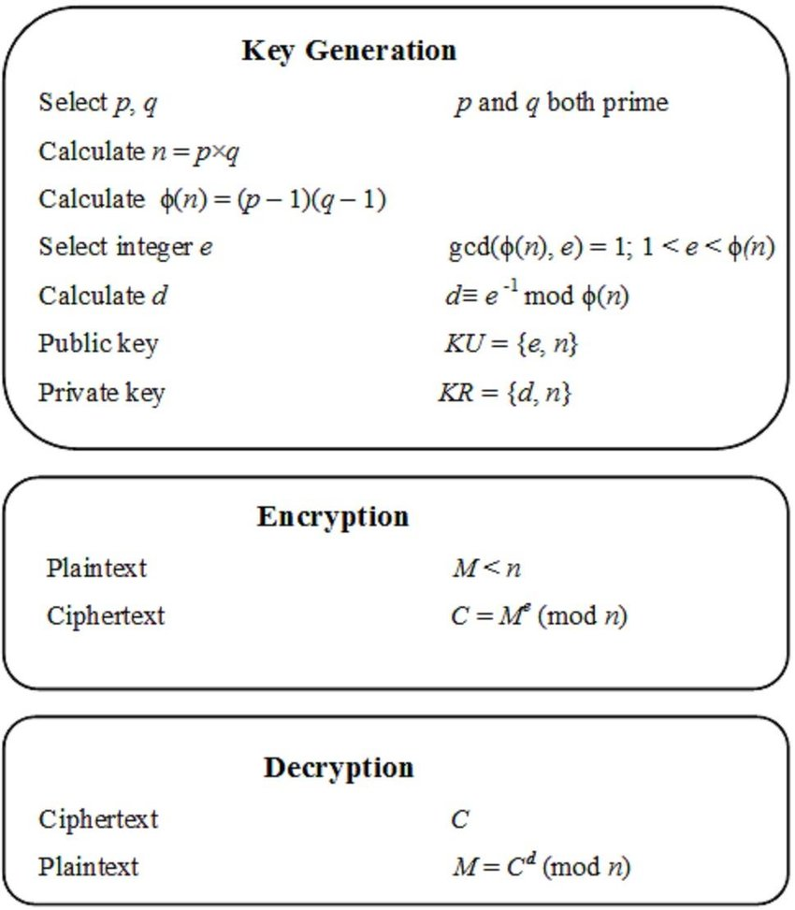
RSA – Recap…
RSA Calculation, Explanation:
RSA (Rivest, Shamir, Adleman) – YouTube
5 Min Video – watched in Week 1
Prime Numbers & RSA Encryption Algorithm - Computerphile – YouTube
15 Min Video – watched in Week 1
Notes:
Resources & Notes:
https://medium.com/hackernoon/how-does-rsa-work-f44918df914b
https://www.youtube.com/watch?v=-jSX9fNJiN8
https://www.youtube.com/watch?v=JD72Ry60eP4

Slide 118
Example
Alice wants to send Bob an encrypted file
But before Alice can do this she will need Bob’s Public Key
So first Bob needs to create his Key Pair (Public & Private Keys)

Slide 119
Generation of the RSA Key Pair - Public Key
Notes:
Resources & Notes:

Slide 120
Generation of Bob’s Public Key – Step 1
Maths: Generate n
Select two large Prime numbers:
P and Q
Calculate n:
n=p*q
Example Output: n
p = 7 and q = 13
Therefore n = pq = 7 x 13 = 91
n = 91

Slide 121
Generation of Bob’s Public Key – Step 2
Maths: Find derived number e
Number e must be greater than 1 and less than (p − 1)(q − 1)
There must be no common factor for e and (p − 1)(q − 1) except for 1
In other words two numbers e and (p – 1)(q – 1) are coprime
Example Output: e
There is no number that is common factor of 5 and (p − 1)(q − 1) = 6 × 12 = 72, except for 1
e = 5 is a valid choice for the public exponent
Notes:
Resources & Notes:
What's an acceptable public exponent e?
The public exponent in RSA should be an integer e>1 with gcd(e,p−1)=gcd(e,q−1)=1, so that e will have an inverse both (modp−1) and (modq−1); or, equivalently, such that e will have an inverse (modϕ(p⋅q)). This insures that e is odd, for we have assumed that p and q are.
Also, e must not reveal so much information (about p or q, or ϕ(p⋅q)) that it significantly simplifies factorization of N. This rules out some non-iterative constructive methods like e=max(p,q), or e=(p−1)(q−1)+1, or e=(p−1)(q−1)−1 (which do insure that gcd(e,p−1)=gcd(e,q−1)=1, assuming min(p,q)>3 for the last formula)

Slide 122
Generation of Bob’s Public Key – Step 3
Maths: Identify the Public Key
The pair of numbers (n, e) form the RSA Public Key
Generally shown as (e, n)
This key is then made public
Example Output: (e, n)
Output from Step 1
n = 91
Output from Step 2
e = 5
Public Key (n, e) = (91, 5)
Shown as (e, n) = (5, 91)

Slide 123
Generation of the RSA Key Pair - Private Key
Notes:
Resources & Notes:

Slide 124
Generation of Bob’s Private Key – Step 4
Maths: Calculate the Private Key
Private Key d is calculated from p, q, and e
Number d is the inverse of e modulo (p - 1)(q – 1).
This means that d is the number less than (p - 1)(q - 1) such that when multiplied by e, it is equal to 1 modulo (p - 1)(q - 1)
This relationship is written mathematically as follows − ed = 1 mod (p − 1)(q − 1)
Example Output: d
Select e = 5, which is a valid choice since there is no number that is common factor of 5, and
(p − 1)(q − 1) = 6 × 12 = 72, except for 1
Input p, q, and e into the Extended Euclidean Algorithm, and d will be provided as output
Notes:
Resources & Notes:
Modular Inverse Calculator: https://www.dcode.fr/modular-inverse
Using the example: Enter 5 and the inverse modulo 72 will result in 29
https://www.dcode.fr/extended-gcd
Also can use Cryptool2 – RSA Key Generator to check this

Slide 125
Generation of Bob’s Private Key – Step 5
Maths: Calculate the Private Key
Input p-1, q-1, and e into the “Extended Euclidean Algorithm”
d will be provided as output
Example Output: d
Input p = 6, q = 12, and e = 5 to the Extended Euclidean Algorithm
The output will be d = 29.
Check that the d calculated is correct by computing − de = 29 × 5 = 145 = 1 mod 72

Slide 126
Generation of Bob’s Private Key – Step 6
Maths: Calculate the Private Key
The pair of numbers (n, d) form the RSA Private Key
Generally shown as (d, n)
This key must remain private
Example Output: (d, n)
Output from Step 1
n = 91
Output from Step 5
d = 29
Public Key (n, d) = (91, 29)
Shown as (d, n) = (29, 91)

Slide 127
Generation of Bob’s Key Pair – Step 7
Public Key
The pair of numbers (n, e) form the RSA Public Key
Shown as (e, n) = (5, 91)
Which Bob will provide to Alice
Private Key
The Pair of numbers (n, d) form the RSA Private Key
Shown as (d, n) = (29, 91)
Which Bob will keep private

Slide 128
Encryption using Recipients
RSA Public Key
Notes:
Resources & Notes:

Slide 129
Example - continued…
Alice wants to send Bob the letter “P”
To do this Alice will need Bob’s Public Key (from his Key Pair)
Alice will need to convert “P” to a number
Alice will then encrypt the resultant number using Bob’s Public Key

Slide 130
RSA Encryption – Decimal to Ascii to Hex
Notes:
Resources & Notes:
https://www.rapidtables.com/convert/number/ascii-to-hex.html

Slide 131
Encryption using Bob’s Public Key – Step 8
Maths: Plaintext to Ciphertext
For this example, Plaintext “P” will be converted to the number 50 (Ref: ASCII Table)
Alice takes Bob’s Public Key (e, n) = (5, 91), and encrypts the number 50 by multiplying it by the power of e (mod n)
Example Output: Ciphertext
Multiply plaintext represented by 50 to the power of e = 5
Ciphertext = P mod n
50 (mod 91) =
312,500,000 (Mod91) = 85
Ciphertext = 85
e
5
Notes:
Resources & Notes:
Calculate the power of: https://www.rapidtables.com/calc/math/Exponent_Calculator.html
Calculate the power of: https://exponentiations.com/
Calculate the Power of and Mod: https://www.dcode.fr/modular-exponentiation

Slide 132
Decryption using Recipients RSA Private Key
Notes:
Resources & Notes:

Slide 133
Example - continued…
Alice has converted the plaintext letter to a number, and encrypted it using Bob’s Public Key
Alice sends the encrypted message or “Ciphertext” to Bob
Bob now wants to decrypt Alice’s message using his Private Key to change the Ciphertext back to Plaintext

Slide 134
Decryption using Bob’s Private Key - Step 9
Maths: Ciphertext to Plaintext
For this example, the Ciphertext “85” will be decrypted back to the Plaintext number 50
Bob takes the Ciphertext 85, and using his Private Key (d, n) = (29, 91), decrypts the number 85 by multiplying it by the power of d (mod n)
Example Output: Plaintext
Multiply ciphertext represented by 85 to the power of d = 29
Plaintext = C mod n
85 (mod 91) = 50
Ciphertext = 85 has been decrypted to Plaintext = 50 = “P”
d
29
Notes:
Resources & Notes:
https://www.dcode.fr/modular-exponentiation

Slide 135
RSA Analysis
Notes:
Resources & Notes:

Slide 136
RSA Analysis
The security of RSA depends on the strengths of two separate functions.
The RSA cryptosystem is most popular public-key cryptosystem strength of which is based on the practical difficulty of factoring the very large numbers

Slide 137
RSA Analysis
Encryption Function −
Is considered as a one-way function of converting plaintext into ciphertext and it can be reversed only with the knowledge of Private Key d
Key Generation −
The difficulty of determining a private key from an RSA public key is equivalent to factoring the modulus n
An attacker cannot use knowledge of an RSA public key to determine an RSA private key unless he can factor n, going from p & q values to modulus n is easy but reverse is not possible

Slide 138
RSA Analysis
If either of these two functions are proved non one-way, then RSA will be broken
In fact, if a technique for factoring efficiently is developed then RSA will no longer be safe
The strength of RSA encryption drastically reduces against attacks if the number p and q are not large primes and / or the chosen Public Key e is a small number

Slide 139
Lab (30 Mins):
Using Kleopatra you installed earlier
Create a Private / Public Keypair
Share your Public key with your colleague
Encrypt a file with using the RSA asymmetric cipher
Can your colleague Decrypt the file using the same or an alternative product?
Notes:
Resources & Notes:

Slide 140
Lab (30 Mins):
In Pairs…
Using the Private and Public Key in the example
Create a message and convert to ASCII
Encrypt the message using Bob’s Public Key
Decrypt the message using Bob’s Private Key
Notes:
Resources & Notes:

Slide 141
Key Management

Slide 142
Ensure you are familiar with the components of Key Management systems, and important implementation / operation considerations

Slide 143
Symmetric Key Systems
Definitions:
Data Encryption key (DEK): is an encryption key whose function it is to encrypt and decrypt the data.
Key Encryption key (KEK): is an encryption key whose function it is to encrypt and decrypt the DEK.
Key Management Application Program Interface (KM API): is an application interface that is designed to securely retrieve and pass along encryption keys from a key management server to the client requesting the keys.
Certificate Authority (CA): is an entity that creates public and private keys, creates certificates, verifies certificates and performs other PKI functions.
Transport Layer Security (TLS): is a cryptographic protocol that provides security, through mutual authentication, for data-in-motion or “data in transit” over a computer network.
Key Management System (KMS): is the system that houses the key management software

Slide 144
Symmetric Key Systems

Slide 145
Symmetric Key Systems
NOTE: Detail relating to previous slide
This a step by step example of how an authorized user accesses encrypted data:
A user requests to access encrypted data.
The database, application, file system, or storage then sends a DEK retrieval request to the client (KM API).
Next, the client (KM API) and KM verify each other’s certificates:
The client (KM API) sends a certificate to the KM for verification.
The KM then checks the certificate against the CA for authentication.
Once the client (KM API) certificate has been verified, the KM then sends its certificate to the KM API for authentication and acceptance.
Once the certificates have been accepted, a secure TLS connection is established between the client (KM API) and the KM.
The KM then decrypts the requested DEK with the KEK
The KM sends the DEK to the client (KM API) over the encrypted TLS session.
The KM API then sends the DEK to the database, application, file system, or storage.
The database (may) cache the DEK in temporary secure memory.
The database, application, file system, or storage then sends the plaintext information to the user

Slide 146
Asymmetric Key Systems

Slide 147
Asymmetric Key Systems
NOTE: Detail relating to previous slide
The Sender and Recipient verify each other’s certificates: The sender sends a certificate to the recipient for verification.
The recipient then checks the certificate against their Certificate Authority (CA) or an external Validation Authority (VA) for authentication.
Once the sender’s certificate has been verified, the recipient then sends their certificate to the sender for authentication and acceptance.
Once the sender and recipient have mutual acceptance: The sender requests the recipient’s public key.
The recipient sends their public key to the sender.
The sender creates an ephemeral symmetric key and encrypts the file to be sent. (an ephemeral symmetric key is a symmetric encryption key used only for one session) The sender encrypts the symmetric key with the public key. The sender then sends the encrypted data with the encrypted symmetric key. The recipient receives the packet and decrypts the symmetric key with the private key. The recipient decrypts the data with the symmetric key

Slide 148
Key Management Lifecycle

Slide 149
Key Creation (Generation & Pre-Activation)
The encryption key is created and stored on the key management server
The key manager creates the encryption key through the use of a cryptographically secure random bit generator and stores the key, along with all it’s attributes, into the key storage database
The attributes stored with the key include its name, activation date, size, instance, the ability for the key to be deleted, as well as its rollover, mirroring, key access, and other attributes
The key can be activated upon its creation or set to be activated automatically or manually at a later time

Slide 150
Key Creation (Generation & Pre-Activation)
The encryption key manager should track current and past instances (or versions) of the encryption key
You need to be able to choose whether or not the key can be deleted, mirrored to a failover unit, and by which users or groups it can be accessed
Your key manager should allow the administrator to change many of the key’s attributes at any time

Slide 151
Key Use and Rollover (Activation through Post-Activation)
The key manager should allow an activated key to be retrieved by authorized systems and users for encryption or decryption processes
It should also seamlessly manage current and past instances of the encryption key
For example…
If a new key is generated and the old one deactivated (or rolled) every year, then the key manager should retain previous versions of the key but dispense only the current instance and activate previous versions for decryption processes

Slide 152
Key Use and Rollover (Activation through Post-Activation)
Previous versions can still be retrieved in order to decrypt data encrypted with such versions of the key
The key manager will also roll the key either through a previously established schedule or allow an administrator to manually roll the key

Slide 153
Key Revocation
An administrator should be able to use the key manager to revoke a key so that it is no longer used for encryption and decryption requests
A revoked key can, if needed, be reactivated by an administrator so that, in certain cases the key can be used to decrypt data previously encrypted with it, like old backups
But even that can be restricted

Slide 154
Back Up (Escrow)
NIST SP800-57 Part 1 Revision 5 (Section 8.3.1) requires that an archive should be kept for deactivated keys
The archive should “protect the archived material from unauthorized [disclosure,] modification, deletion, and insertion.”
The encryption keys need “to be recoverable … after the end of its cryptoperiod” and “the system shall be designed to allow reconstruction” of the keys should they need to be reactivated for use in decrypting the data that it once encrypted

Slide 155
Key Deletion (Destruction)
If a key is no longer in use or if it has somehow been compromised, an administrator can choose to delete the key entirely from the key storage database of the encryption key manager
The key manager will remove it and all its instances, or just certain instances, completely and make the recovery of that key impossible (other than through a restore from a backup image)
This should be available as an option if sensitive data is compromised in its encrypted state
If the key is deleted, the compromised data will be completely secure and unrecoverable since it would be impossible to recreate the encryption key for that data

Slide 156
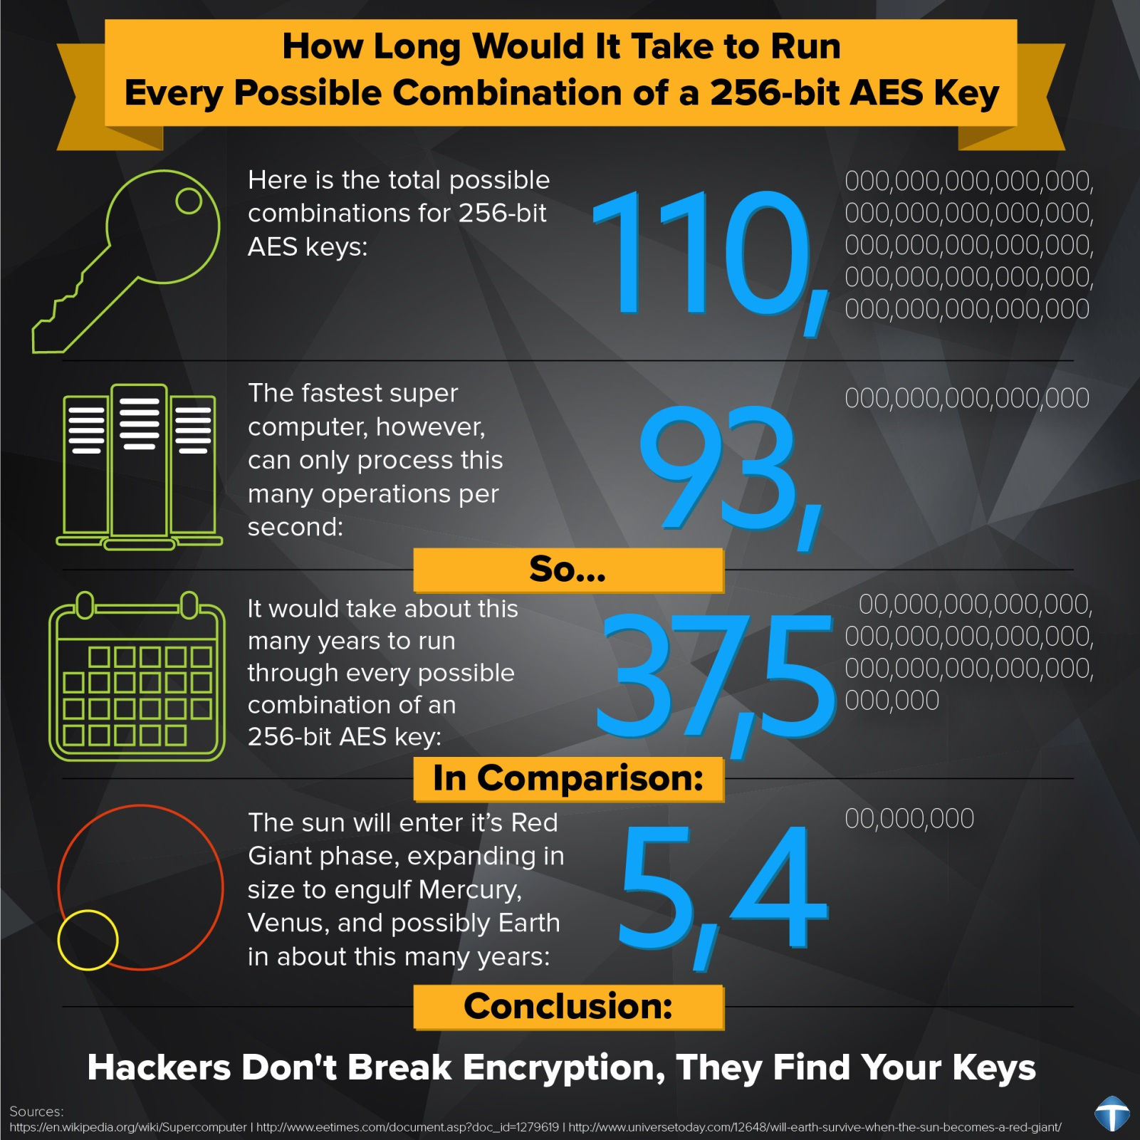
Why is Key Management important?
Pick a “Strong” encryption algorithm and key
Very few attackers that would attempt to break encryption algorithms and ciphertext
Instead, they would focus on weaknesses in People, Processes and Technology that supports the encryption process!

Slide 157
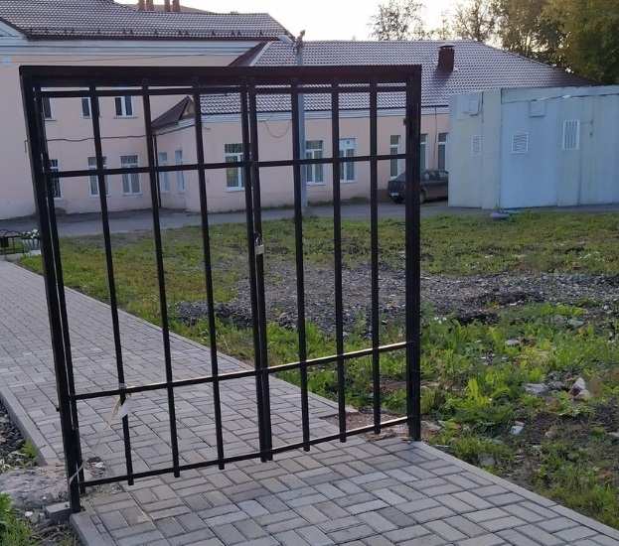
Why is Key Management Important?
In summary, why pick on the strongest link?

Slide 158
Useful Information:
Recommendation for Key Management: Part 1 - General (nist.gov)
Notes:
Resources & Notes:
https://nvlpubs.nist.gov/nistpubs/SpecialPublications/NIST.SP.800-57pt1r5.pdf

Slide 159
Useful Information:
Key Management - OWASP Cheat Sheet Series
Notes:
Resources & Notes:
https://cheatsheetseries.owasp.org/cheatsheets/Key_Management_Cheat_Sheet.html

Slide 160
Lab (30 Mins):
Research different types of Key Management Systems
Select a Key Management based upon a predefined set of your requirements i.e. consider what keys are you trying to manage??
Install a Key Management System
Consider both benefits and implementation and operational challenges as previously discussed in this section
Notes:
References:

Slide 161
Cryptography
Week 2
Intro
Monday
01
02
Wednesday
03
04
Tuesday
05
06
Thursday
Friday

Slide 162
Syllabus – Week 2
Monday
Secure Hash
Digital Signing, Certificate Authorities
Tuesday
Public Key Ciphers – Examples & Analysis
Block Ciphers – Examples & Analysis – Covered Previously
Wednesday
How cryptographic techniques are applied and to what end and their limitations
Thursday
Examples of badly applied or implemented cryptographic techniques
Friday
Review, Q&A

Slide 163
Cryptographic Techniques and their Limitations

Slide 164
GSM - (Global System for Mobile communication)
GSM is a digital mobile network that is widely used by mobile phone users in Europe and other parts of the world
GSM uses a variation of time division multiple access (TDMA) and is the most widely used of the three digital wireless telephony technologies: TDMA, GSM and code-division multiple access (CDMA)
GSM digitizes and compresses data, then sends it down a channel with two other streams of user data, each in its own time slot
It operates at either the 900 megahertz (MHz) or 1,800 MHz frequency band

Slide 165
GSM Encryption Standards
A5/0 – No encryption used. Just for the sake of completeness.
A5/1 – A5/1 is a stream cipher used to provide over-the-air communication privacy in the GSM cellular telephone standard. It is one of seven algorithms which were specified for GSM use. It was initially kept secret, but became public knowledge through leaks and reverse engineering. A number of serious weaknesses in the cipher have been identified.
A5/2 – A5/2 is a stream cipher used to provide voice privacy in the GSM cellular telephone protocol. It was used for export instead of the relatively stronger (but still weak) A5/1. It is one of seven A5 ciphering algorithms which have been defined for GSM use.
A5/3 (Kasumi) – KASUMI is a block cipher used in UMTS, GSM, and GPRS mobile communications systems. In UMTS, KASUMI is used in the confidentiality and integrity algorithms with names UEA1 and UIA1, respectively. In GSM, KASUMI is used in the A5/3 key stream generator and in GPRS in the GEA3 key stream generator

Slide 166
Chip and PIN
Chip and PIN (also known as EMV - Europay, Mastercard, and Visa) is the name for the process of paying by credit or debit card through a card payment terminal (also known as a PDQ machine or card reader)
To help combat the insecure magnetic card swipe, Chip and PIN technology was introduced
Designed to make card transactions more secure, annual counterfeit card fraud losses decreased by £81.9 million between 2004 and 2014
Security is provided by the customer being asked to enter the 4-digit PIN code that their bank would have provided them with
The use of a PIN and cryptographic algorithms such as Triple DES, RSA and SHA provide authentication of the card to the processing terminal and the card issuer's host system

Slide 167
Common hard disk encryption - FDE
Full-Disk Encryption (FDE) or “whole disk” encryption methods encrypt every file stored on the drive (or drives), including the operating system/file system
This is usually done on a sector-by-sector basis
A filter driver that is loaded into memory at boot encrypts every file as it is written to disk and decrypts any file that is moved off of the disk
This happens transparently to the end user or the application generating the files.

Slide 168
FDE - Advantages
Everything on the drive (or drives) is encrypted, including temporary files and swap space, increasing security of all your data, not just card data. If deployed on all in-scope systems, the card data would be guaranteed encrypted
Encryption of data is forced on end user, alleviating decisions on what or what not to encrypt
Encryption/decryption is transparent. When information needs to be accessed, it can be saved off the system and is automatically decrypted. If a processing application is installed on the system, the use of encrypted data is also easy
Since all data on the drive is encrypted, even if an alternative boot medium is used against an encrypted system, the data on the drive is unreadable and therefore useless to the thief

Slide 169
FDE - Disadvantages
Some FDE programs can cause an increase in data access times. Slight delays in writing and reading data can occur, especially with very large files and high transaction volumes
System password management and key management processes have to be defined and put into place. If a user loses his password that grants access to the encrypted system, he has no access to his data at all
For data centers, this technology is largely useless for security (as opposed to laptops that may be stolen or lost in the field) since most data centers have significant physical controls keeping their hardware safe
FDE does not necessarily protect data on a laptop if the system is compromised while in use. It primarily helps to prevent data disclosure resulting from physical theft

Slide 170
Disk encryption vs. filesystem-level encryption
Disk encryption does not replace file encryption in all situations
Disk encryption is sometimes used in conjunction with filesystem-level encryption with the intention of providing a more secure implementation
Since disk encryption generally uses the same key for encrypting the whole drive, all data is decryptable when the system runs
However, some disk encryption solutions use multiple keys for encrypting different volumes

Slide 171
Disk encryption vs. filesystem-level encryption
If an attacker gains access to the computer at run-time, the attacker has access to all files
Conventional file and folder encryption instead allows different keys for different portions of the disk
Thus an attacker cannot extract information from still-encrypted files and folders.
Unlike disk encryption, filesystem-level encryption does not typically encrypt filesystem metadata, such as the directory structure, file names, modification timestamps or sizes

Slide 172
Filesystem Encryption v FDE

Slide 173
Trusted Platform Module
Trusted Platform Module(TPM) is a secure cryptoprocessor embedded in the motherboard that can be used to authenticate a hardware device
Since each TPM chip is unique to a particular device, it is capable of performing platform authentication
It can be used to verify that the system seeking the access is the expected system

Slide 174
Trusted Platform Module
A limited number of disk encryption solutions have support for TPM
These implementations can wrap the decryption key using the TPM, thus tying the hard disk drive (HDD) to a particular device
If the HDD is removed from that particular device and placed in another, the decryption process will fail
Recovery is possible with the decryption password or token

Slide 175
TPM

Slide 176
TLS
TLS is a cryptographic protocol that provides end-to-end communications security over networks and is widely used for internet communications and online transactions
It is an IETF standard intended to prevent eavesdropping, tampering and message forgery
TLS is more efficient and secure than SSL as it has stronger message authentication, key-material generation and other encryption algorithms
TLS suffered from the Heartbleed Breech and others
Should only be using TLS1.3

Slide 177
TLS1.3
Makes use of the following algorithms:
RC4 Stream cipher
DES
3DES
RSA Key transport
SHA-1 hashing
CBC Mode ciphers
MD5
Diffie-Hellman groups
EXPORT ciphers
TLS 1.3 is lighter weight than its predecessor and uses fewer resources
This means its more efficient, consumes fewer CPU cycles and reduces latency, which leads to better performance

Slide 178
SSL
SSL (Secure Sockets Layer) is the standard security technology for establishing an encrypted link between a web server and a browser
This link ensures that all data passed between the web server and browsers remain private and integral
An SSL authentication encrypts the link between the server and the user, making it that much harder for unauthorized entities to gain access to sensitive information
SSL also includes different validation levels, like:
Extended validation certificates
Organization validated certificates
Domain validated certificates
A SSL certificate may be obtained from a Certification Authority (or CA)

Slide 179
Certificate Authority
In cryptography, a certificate authority or certification authority (CA) is an entity that issues digital certificates
A digital certificate certifies the ownership of a public key by the named subject of the certificate
A CA acts as a trusted third party—trusted both by the subject (owner) of the certificate and by the party relying upon the certificate
The format of these certificates is specified by the X.509 standard

Slide 180
Privacy enforcing technology - VPN Tunnelling

Slide 181
Privacy enforcing technology - VPN Tunnelling
The term VPN tunneling describes a process whereby data is securely transported from one device or network to another through a non-secure environment (such as the internet) without compromising privacy
Tunneling involves protecting data by repackaging it into a different form
In reality, no physical tunnel exists, of course; the data has to travel through the same wires as any other data passing through the public network
VPN tunneling employs the concepts known as data encapsulation and encryption to safely carry data traffic through the non-secure environment

Slide 182
Protection of “Data at Rest”
& “Data In Transit”

Slide 183
Secure Internet transaction technologies
There are several ways to help ensure safe transactions on the Internet, and more are becoming possible all the time
Some of these include:
Stored-value cards (cards that you can buy with specified, loaded dollar amounts)
Smart cards (cards that can act as credit cards, debit cards and/or stored-value cards)
Point-of-sale (POS) devices (like your PDA or mobile phone)
Digital cash
E-wallets
Online payment services like PayPal

Slide 184
Secure Internet transaction technologies
STT (Secure Transaction Technology) is a protocol provided by Microsoft and Visa International to the financial and technical communities for review and comment
STT is designed to handle secure payment with bank cards over insecure data transports like the Internet
The protocol requires only reliable message transport, such as TCP
It features strong, export-approved DES encryption of financial information, direct RSA (TM) encryption of bank card account numbers, and mandatory authentication of all participants, including clients, for reduced financial risk

Slide 185
Secure Internet transaction technologies
SSL (Secure Sockets Layer) is a standard security technology for establishing an encrypted link between a server and a client—typically a web server (website) and a browser; or a mail server and a mail client
It makes use of asymmetric and symmetric keys and encryption, working together to create an SSL-encrypted connection
Asymmetric uses 1024 or 2048 bit keys
2048-bit keys have enough unique encryption codes that we won’t write out the number here (it’s 617 digits) and could take up to 14 billion years to break
Symmetric keys are typically 128 or 256 bits
For example, a 128-bit key has 340,282,366,920,938,463,463,374,607,431,768,211,456 encryption code possibilities
SSL Certificates do not dictate what key size is used

Slide 186
SSL
Makes use of:
RSA
RSA is based on the presumed difficulty of factoring large integers (integer factorization). Full decryption of an RSA ciphertext is thought to be infeasible on the assumption that no efficient algorithm exists for integer factorization
ECC
Elliptic curve cryptography (ECC) relies on the algebraic structure of elliptic curves over finite fields. It is assumed that discovering the discrete logarithm of a random elliptic curve element in connection to a publicly known base point is impractical
Pre-Shared Key Encryption Algorithms
Pre-shared key encryption (symmetric) uses algorithms like Twofish, AES, or Blowfish, to create keys—AES currently being the most popular
All of these encryption algorithms fall into two types: stream ciphers and block ciphers

Slide 187
Secure Internet transaction Standard
When you’re processing payments on your website, compliance with the PCI standard is essential
The Payment Card Industry Data Security Standards (PCI DSS) provides mandatory requirements for merchants that tell them what they need to do in order to secure sensitive payment processing data
The number of security controls and level of assurance that needs to be achieved is dependent upon PCI Merchant Level, and scope of the PCI environment in which cards are processed
Options are available to outsource aspects of payment card processing, however the merchant still has the ultimate responsibility of ensuring that robust controls are in place to protect payment card information collected / processed / stored on its behalf
Certain data fields relating to payment cards must be encrypted
The PAN (Primary Account Number) and/or the CVV can neither be stored in full, or as plaintext

Slide 188
Tokenization
You should never store your customers’ credit and debit card information on your server
When choosing a payment processing solution, ideally the customers’ data doesn’t even touch your servers
More importantly, it’s encrypted before it is ever stored on database servers
Tokenization is used to replace sensitive data with a randomly generated string of characters, so it reduces the risk associated with data breach

Slide 189
Tokenization
One of the best protection methods is using a token that represents a real credit card number
When the transaction is authorized, the data is sent to the centralized server and stored securely
At the same time, a merchant’s system receives a unique number
The token is then used in place of the customers card data to complete current and future transactions e.g. one-click payments

Slide 190
3D Secure
3D Secure is an additional security layer that helps with fraud prevention in debit and credit card transactions
In short, when an online shopper wants to buy something, he/she creates a secure password for the credit card he/she uses to pay
At that time, every transaction will be confirmed with the password in order to add extra protection

Slide 191
Anti-fraud tools
With fraud prevention tools, every transaction is scanned and monitored (automatically or manually), so it’s easier to prevent and eliminate all suspected fraudulent activities
Moreover, when you seek out a payment gateway, choose one with great customer support
It’s extremely important for your business because you need to be sure that you can contact the payment provider easily for transaction queries and troubleshooting

Slide 192
Data at rest
“Data at Rest” is a term that is sometimes used to refer to all data in computer storage while excluding data that is traversing a network or temporarily residing in computer memory to be read or updated
By encrypting data at rest, you're essentially converting your customer's sensitive data into another form of data
This usually happens through an algorithm that can't be understood by a user who does not have an encryption key to decode it

Slide 193
Open vs closed source
With closed source software (also known as proprietary software), the public is not given access to the source code, so they can’t see or modify it in any way
But with open source software, the source code is publicly available to anyone who wants it, and programmers can read or change that code if they desire
Keep in mind that you don’t have to read or modify any code in order to use an open source product

Slide 194
Cryptography in Open and Closed Source
Keys are what makes the system secure – not the algorithm
Algorithms should be visible and available for scrutiny

Slide 195
Microsoft Active Directory
X.500 is the basis for its hierarchical structure
Lightweight Directory Access Protocol (LDAP) is based on the X.500 Directory Access Protocol
Uses the more efficient TCP/IP protocol
Integrating other OSs, such as Linux and UNIX into an Active Directory network requires using LDAP
Windows Active Directory was first used in Windows 2000 Server

Slide 196
Windows Active Directory
Active Directory offers the following features:
Hierarchical organization
Centralized but distributed database
Scalability
Security
Flexibility
Policy-based administration

Slide 197
Overview of the Active Directory Structure
Physical structure
Consists of sites and servers configured as domain controllers
Logical structure
Makes it possible to pattern the directory service’s look and feel after the organization in which it runs

Slide 198
Active Directory’s Physical Structure
An Active Directory site is simply a physical location in which domain controllers communicate and replicate information regularly
Each domain controller contains a full replica of the objects that make up the domain and is responsible for:
Storing a copy of the domain data and replicating changes to that data to all other domain controllers in the domain
Providing data search and retrieval functions for users attempting to locate objects in the directory
Providing authentication and authorization services for users who log on to the domain and attempt to access network resources

Slide 199
Active Directory’s Logical Structure
Four organizing components of Active Directory:
Organizational Units (OUs)
Domains
Trees
Forests
The organizational unit (OU) is an Active Directory container used to organize a network’s users and resources into logical administrative units

Slide 200
Active Directory’s Logical Structure
An OU contains Active Directory objects, such as:
User accounts
Groups
Computer accounts
Printers
Shared folders
Applications
Servers
Domain controllers

Slide 201
Active Directory’s Logical Structure
Domain - The core structural unit of an Active Directory
Contains OUs and represents administrative, security, and policy boundaries
Small to medium companies usually have one domain; larger companies may have several domains to separate geographical regions or administrative responsibilities

Slide 202
Kerberos Authentication
Kerberos is an authentication protocol that is used to verify the identity of a user or host
The Windows Server operating systems implement the Kerberos version 5 authentication protocol and extensions for public key authentication, transporting authorization data, and delegation
The Kerberos authentication client is implemented as a security support provider (SSP), and it can be accessed through the Security Support Provider Interface (SSPI)

Slide 203
Kerberos Authentication
Initial user authentication is integrated with the Winlogon single sign-on architecture
The Kerberos Key Distribution Center (KDC) is integrated with other Windows Server security services running on the domain controller
The KDC uses the domain's Active Directory service database as its account database
An Active Directory server is required for default Kerberos implementations

Slide 204
Practical applications of Kerberos
The benefits gained by using Kerberos for domain-based authentication are:
Delegated authentication
Single sign on
Interoperability
More efficient authentication to servers
Mutual authentication
Notes:
Mutual authentication.
By using the Kerberos protocol, a party at either end of a network connection can verify that the party on the other end is the entity it claims to be.
NTLM does not enable clients to verify a server's identity or enable one server to verify the identity of another.
NTLM authentication was designed for a network environment in which servers were assumed to be genuine. The Kerberos protocol makes no such assumption

Slide 205
Kerberos Authentication

Slide 206
Can Kerberos Be Hacked?
In short, Yes
Because it is one of the most widely used authentication protocols, hackers have developed several ways to crack into Kerberos
Most of these hacks take advantage of a vulnerability, weak passwords, or malware – sometimes a combination of all three

Slide 207
Can Kerberos Be Hacked?
Some of the more successful methods of hacking Kerberos include:
Pass-the-ticket: the process of forging a session key and presenting that forgery to the resource as credentials
Golden Ticket: A ticket that grants a user domain admin access
Silver Ticket: A forged ticket that grants access to a service
Credential stuffing/ Brute force: automated continued attempts to guess a password
Encryption downgrade with Skeleton Key Malware: A malware that can bypass Kerberos, but the attack must have Admin access
DCShadow attack: a new attack where attackers gain enough access inside a network to set up their own DC to use in further infiltration

Slide 208
LDAP
LDAP (Lightweight Directory Access Protocol) is a software protocol for enabling anyone to locate organizations, individuals, and other resources such as files and devices in a network, whether on the public Internet or on a corporate intranet
An LDAP directory is organized in a simple "tree" hierarchy consisting of the following levels:
The root directory (starting place or the source of the tree), which branches out to
Countries, each of which branches out to
Organizations, which branch out to
Organizational units (divisions, departments, and so forth), which branches out to (includes an entry for)
Individuals (which includes people, files, and shared resources such as printers)

Slide 209
Important Considerations

Slide 210
Performance
Using encryption may cause performance issues!
Good site explaining this:
https://techbeacon.com/security/relax-good-encryption-practices-wont-affect-app-performance

Slide 211
Security Clearance of Crypto-Custodians
Custodian is a person who has responsibility for taking care of or protecting something
Crypto-Custodian has the responsibility for overseeing and ensure the cryptographic materials security and integrity
Custodians in UK require BPSS (Baseline Personnel) and DBS check
Depending upon sector, may also require NPPV3, SC or DV clearance
Carried out by the “United Kingdom Security Vetting unit” (UKSV)

Slide 212
Historical consideration of broken cryptographic systems
The use of a broken or risky cryptographic algorithm is an unnecessary risk that may result in the exposure of sensitive information
Scope | Impact
Confidentiality | Technical Impact: The confidentiality of sensitive data may be compromised by the use of a broken or risky cryptographic algorithm.
Integrity | Technical Impact: The integrity of sensitive data may be compromised by the use of a broken or risky cryptographic algorithm.
Accountability Non-Repudiation | Technical Impact: If the cryptographic algorithm is used to ensure the identity of the source of the data (such as digital signatures), then a broken algorithm will compromise this scheme and the source of the data cannot be proven.

Slide 213
Theoretical vs practical security
It is impossible to guarantee the security of a cipher system. Even if it is theoretically secure, it may be insecure in practice
It can be quite acceptable in practice to use cipher systems that are theoretically breakable
Every attempt should be made to formulate a notion of practical security for a given environment. This will inevitably involve trade-offs, estimates and evaluations of what levels of risk to accept. Formulating this notion will be difficult
Regardless of whether a cipher system offers theoretical or practical security, the most likely way in which it will be “broken” is through bad key management processes

Slide 214
Kerckhoffs’s principle
Kerckhoffs's principle (also called Kerckhoffs's desideratum, assumption, axiom, doctrine or law) of cryptography was stated by Netherlands born cryptographer Auguste Kerckhoffs in the 19th century
A cryptosystem should be secure even if everything about the system, except the key, is public knowledge
Kerckhoffs's principle was reformulated (or possibly independently formulated) by American mathematician Claude Shannon as "the enemy knows the system", i.e., "one ought to design systems under the assumption that the enemy will immediately gain full familiarity with them“ - In that form, it is called Shannon's maxim
This concept is widely embraced by cryptographers, in contrast to "security through obscurity"

Slide 215
Kerckhoffs’s principle
Kerckhoff stated six design principles for military ciphers:
The system must be practically, if not mathematically, indecipherable
It should not require secrecy, and it should not be a problem if it falls into enemy hands
It must be possible to communicate and remember the key without using written notes, and correspondents must be able to change or modify it at will
It must be applicable to telegraph communications
It must be portable, and should not require several persons to handle or operate
Given the circumstances in which it is to be used, the system must be easy to use and should not be stressful to use or require its users to know and comply with a long list of rules
NOTE:
Some are no longer as relevant given the ability of computers to easily perform complex encryption, but his second axiom, now known as Kerckhoffs's principle, is still critically important!

Slide 216
Lab (20 Mins Research / 10 Mins discussion):
Look into where cryptography is used…
Can you find any techniques / real-world applications not discussed?
If so, how is cryptography being used?
What Ciphers are being used, and why?
Discuss findings as a group

Slide 217
Vulnerability Management

Slide 218
Vulnerability analysis
The existence of a weakness, design or implementation error that can lead to an unexpected event compromising the security of a system
A concept which describes factors or constraints of an economic, social, physical or geographical nature, which reduce the ability to prepare for and cope with the impact of hazards
A vulnerability assessment is the process of:
Defining, identifying, classifying and prioritizing vulnerabilities in computer systems, applications and network infrastructures
Completing risk assessments with the necessary knowledge, awareness and context to understand the threats to its environment and react appropriately

Slide 219
Vulnerability analysis
Vulnerability Assessment Scanning Tools
Comodo HackerProof
OpenVAS - software framework of several services and tools offering vulnerability scanning and vulnerability management (all free)
Nexpose Community - Nexpose offers real-time, on-premises vulnerability scanning
Nikto - will scan web servers and networks for matches with a database of over 6400 threats. Although the network protection software itself has not been updated in some time, it is still up to date

Slide 220
Vulnerability analysis
Vulnerability Assessment Scanning Tools
Nessus Professional - identifies and repairs detected vulnerabilities, including missing or incomplete patches; software bugs; or other general misconfigurations throughout applications, devices, and operating systems
Retina CS Community - Use it to scan servers, desktops - any networked device - for security flaws, and learn how to fix them
Microsoft Baseline Security Analyzer (MBSA) - used to verify patch compliance. MBSA also performed several other security checks for Windows, IIS, and SQL Server. Unfortunately, the logic behind these additional checks had not been actively maintained since Windows XP and Windows Server 2003

Slide 221
Vulnerability analysis
Vulnerability Assessment Scanning Tools
BurpSuite - a real-time network security scanner designed to identify critical weaknesses. Burp Suite will determine how cybersecurity threats might invade a network via a simulated attack
Nmap - This establishes what ports are open and services running on a particular system

Slide 222
Vulnerability analysis
Vulnerability Assessment Scanning Tools
Tripwire IP360 - offers protocol, application, and vulnerability detection with low false positive rates
Wireshark - a network protocol analyzer. It lets you capture and interactively browse the traffic running on a computer network
Aircrack or Aircrack-ng - a complete suite of tools to assess WiFi network security

Slide 223
Vulnerability Intelligence Sources
Mitre CVE (Common Vulnerabilities and Exposures):
https://cve.mitre.org/index.html
NIST NVD (National Vulnerability Database):
https://nvd.nist.gov/
SecurityFocus BugTraq:
https://www.securityfocus.com/bid
OWASP Top10 (Open Web Application Security Project):
https://owasp.org/www-project-top-ten/

Slide 224
Patch Management

Slide 225
Patch Management Process & Testing
Patching is more important than ever!
National Cyber Security Centre advise that 80+% of all Cyber Security related issues can be mitigated by robust and thorough patching
Patched should be applied to both systems and applications to ensure they have the most up-to-date features, run smoothly and are secure
Unpatched machines make them more vulnerable to cyber attacks

Slide 226
Patch Management Process
10 step process
Discovery
Categorisation
Patch management policy creation
Monitor for new patches and vulnerabilities
Patch testing
Configuration management
Roll out
Auditing
Reporting
Review, improve, and repeat

Slide 227
Patch Management – (1)Discovery
Ensure you have a comprehensive network inventory
At the most basic level, this includes understanding the types of devices, operating systems, OS versions, and third party applications
Many breaches originate because there are neglected or forgotten systems that IT has lost track of

Slide 228
Patch Management – (2)Categorization
Segment managed systems and/or users according to risk and priority
Examples could be by machine type (server, laptop, etc.), OS, OS version, user role, etc.
This will allow you to create more granular patching policies instead of taking a one-policy-fits-all approach

Slide 229
Patch Management – (3)Policy Creation
Create patching criteria by establishing what will be patched and when, under what conditions
For example, you may want to ensure some systems/users are patched more frequently and automatically than others (the patching schedule for laptop end users may be weekly while patching for servers may be less frequent and more manual)

Slide 230
Patch Management – (4)Monitoring
Understand vendor patch release schedules and models, and identify reliable sources for timely vulnerability disclosures
Create a process for evaluating and applying emergency patches

Slide 231
Patch Management – (5)Testing
Create a testing environment, or at the very least a testing segment to avoid being caught off guard by unintended impacts to production systems
That should include creating backups for easy rollback if necessary
Validate successful deployment and monitor for incompatibility or performance issues

Slide 232
Patch Management – (6)Config. Management
Document any configuration changes about to be made via patching
This will come in handy should you run into any issues with patch deployment beyond the initial test segment or environment

Slide 233
Patch Management – (7)Roll out
Follow your established patch management policies you created in step 3

Slide 234
Patch Management – (8)Auditing
Conduct a patch management audit to identify any failed or pending patches, and be sure to continue monitoring for any unexpected incompatibility or performance issues
It’s also a good idea to maintain contact with end users in both less critical (as part of the early testing phases) and business critical departments, who can help by providing timely feedback on whether or not patches are impacting their department

Slide 235
Patch Management – (9)Reporting
Produce a patch compliance report you can share with your clients to gain visibility into your work
Reporting provides assurance that patches are being applied without unduly impacting the business
In the event that an exploit is identified in a system or application, timely reporting is crucial in order to advise senior management of the level of exposure the company may have in relation to a particular threat

Slide 236
Patch Management – (10) Review, improve, and repeat
Establish a cadence for repeating and optimizing steps 1-9
This should include phasing out or isolating any outdated or unsupported machines, reviewing your policies, and revisiting exceptions to verify whether they still apply or are necessary

Slide 237
Threats to Key Generation Algorithms

Slide 238
Lab (20 Mins Research / 10 Mins discussion):
Look into the following types of attack to Key Generation Algorithms…
What do they do?
How are they used, can you find any live examples?
Discuss findings as a group

Slide 239
Threats To Key Generation Algorithms
Birthday
Replay
Side channel
Traffic analysis

Slide 240
Birthday
A birthday attack is a type of cryptographic attack that exploits the mathematics behind the birthday problem in probability theory
This attack can be used to abuse communication between two or more parties
The attack depends on the higher likelihood of collisions found between random attack attempts and a fixed degree of permutations (pigeonholes)
Notes:
With a birthday attack, it is possible to find a collision of a hash function in √(2^𝑛 )= 2^□(64&𝑛/2) with 2^𝑛 being the classical pre-image resistance security
A preimage attack on cryptographic hash functions tries to find a message that has a specific hash value. A cryptographic hash function should resist attacks on its preimage (set of possible inputs). In the context of attack, there are two types of preimage resistance:
preimage resistance: for essentially all pre-specified outputs, it is computationally infeasible to find any input that hashes to that output, i.e., given y, it is difficult to find an x such that h(x) = y
second-preimage resistance: it is computationally infeasible to find any second input which has the same output as that of a specified input, i.e., given x, it is difficult to find a second preimage x′ ≠ x such that h(x) = h(x′)

Slide 241
Replay
In this attack an adversary records a communication session and replays the entire session, or a portion thereof, at some later point in time
A replay attack (also known as playback attack) is a form of network attack in which a valid data transmission is maliciously or fraudulently repeated or delayed
A replay attack occurs when a cybercriminal eavesdrops on a secure network communication, intercepts it, and then fraudulently delays or resends it to misdirect the receiver into doing what the hacker wants
The added danger of replay attacks is that a hacker doesn't even need advanced skills to decrypt a message after capturing it from the network
The attack could be successful simply by resending the whole thing

Slide 242
Side Channel
A side-channel attack (SCA) is a security exploit that involves collecting information about what a computing device does when it is performing cryptographic operations and using that information to reverse engineer the device's cryptography system
Side channel attacks can reveal secrets during program execution, or change the behaviour of a program
Without profound knowledge of these attacks it is hard to defend code effectively
Whereas traditional secure programming methods focus mostly on input validation and output control, side channel security requires pervasive protection throughout the code

Slide 243
Side Channel Attack

Slide 244
Traffic Analysis
Traffic analysis is the process of intercepting and examining messages in order to deduce information from patterns in communication, which can be performed even when the messages are encrypted

Slide 245
Cryptography
Week 2
Intro
Monday
01
02
Wednesday
03
04
Tuesday
05
06
Thursday
Friday

Slide 246
Syllabus – Week 2
Monday
Secure Hash
Digital Signing, Certificate Authorities
Tuesday
Public Key Ciphers – Examples & Analysis
Block Ciphers – Examples & Analysis – Covered Previously
Wednesday
How cryptographic techniques are applied and to what end and their limitations
Thursday
Examples of badly applied or implemented cryptographic techniques
Friday
Review, Q&A

Slide 247
Module - recap

Slide 248
Module Recap
Modern Ciphers
Security Principles
Additional Cryptography Principles
Confusion?
Diffusion?
Tokenisation?
Key Management Lifecycle?
Threats to Key Generation algorithms
Notes:
Resources & Notes:
Confusion
Confusion means that each binary digit (bit) of the ciphertext should depend on several parts of the key, obscuring the connections between the two.[2]
The property of confusion hides the relationship between the ciphertext and the key.
Diffusion
Diffusion means that if we change a single bit of the plaintext, then about half of the bits in the ciphertext should change, and similarly, if we change one bit of the ciphertext, then about half of the plaintext bits should change
Threats to Key Generation algorithms
Birthday
Replay
Side channel
Traffic analysis

Slide 249
Modern Encryption Ciphers
Modern Ciphers
Symmetric Ciphers
Asymmetric Ciphers
Block Ciphers
Stream Ciphers
RSA
DSA
Diffie-Hellman
AES
DES
3DES
IDEA
Blowfish
RC 5 / 6
ISAAC
Quad
Fish
RC4
Seal

Slide 250
Key Management Lifecycle

Slide 251
Encryption Strength
Strong Crypto Vs Weak Crypto - It's all relative
Practically everything can be brute forced in time
Is the Cypher itself secure?
If we can find an algorithm that hasn’t had any crypto vulnerabilities it is considered strong

Slide 252
Encryption Strength
WEP has vulnerabilities and is therefore considered Weak
WEP - Design Flaw
DES - 56 Key - easily brute forced!!
Weak keys can be made stronger, by using the weak key several times (called key strengthening or key stretching)
e.g. Hash of a password, Hash a Hash of the Password, and Hash a Hash of a Hash of a password

Slide 253
Encryption Strength
Cryptographic Keys
Do not rely on security by obscurity
Algorithm is normally publicly available
The only thing that is not known to the attacker is the "Key"

Slide 254
Encryption Strength
The Key determines the output
Encrypted Data
Hash Value
Dig Signature
Key is protecting your data, so keep it secure!!

Slide 255
Encryption Strength
Size of the key is important, larger Keys tend to be more secure
The larger the key the more possible key combinations there are for an attacker to brute force
However as computing power grows, it becomes easier to brute force so we need to make keys larger keys i.e. 128bit or 256 bit keys
Symmetric Encryption - 128bit keys and larger
Asymmetric Encryption - 3072bit and larger

Slide 256
Badly applied or implemented Cryptographic Techniques

Slide 257
Cryptography - Challenges & Problems
ECB mode
Collision attacks
Algorithm problems
Key management problems
Identify vulnerabilities of encryption algorithms
Identify the block cipher ECB mode and the common problems associated with it
Describe the use of random number generation and specifically PRNG generator
Explain the phases of cryptographic key management lifecycle o generate; o distribute; o deploy; o archive; o destroy
Explain construct of the most common attacks: o version spoofing attack; o backtrack attack; o reverse protocol attack; version rollback attack

Slide 258
ECB Mode
In cryptography, a block cipher mode of operation is an algorithm that uses a block cipher to provide information security such as confidentiality or authenticity
The simplest of the encryption modes is the Electronic Codebook (ECB) mode (named after conventional physical codebooks)
The message is divided into blocks, and each block is encrypted separately

Slide 259
ECB Mode

Slide 260
ECB Mode – Common Problems
The disadvantage of this method is a lack of diffusion
Diffusion means that if we change a single bit of the plaintext, then (statistically) half of the bits in the ciphertext should change, and similarly, if we change one bit of the ciphertext, then approximately one half of the plaintext bits should change
Since a bit can have only two states, when they are all re-evaluated and changed from one seemingly random position to another, half of the bits will have changed state
The idea of diffusion is to hide the relationship between the ciphertext and the plain text
This will make it hard for an attacker who tries to find out the plain text and it increases the redundancy of plain text by spreading it across the rows and columns; it is achieved through transposition of algorithm and it is used by block cipher only
Notes:
Not to be substituted for CONFUSION
Confusion means that each binary digit (bit) of the ciphertext should depend on several parts of the key, obscuring the connections between the two.
The property of confusion hides the relationship between the ciphertext and the key.
This property makes it difficult to find the key from the ciphertext and if a single bit in a key is changed, most or all the bits in the ciphertext will be affected.
Confusion increases the ambiguity of ciphertext and it is used by both block and stream cipher.
AES has both excellent confusion and diffusion

Slide 261
ECB Mode – Common Problems
Because ECB encrypts identical plaintext blocks into identical ciphertext blocks, it does not hide data patterns well
In some senses, it doesn't provide serious message confidentiality, and it is not recommended for use in cryptographic protocols at all
ECB mode can also make protocols without integrity protection even more susceptible to replay attacks, since each block gets decrypted in exactly the same way

Slide 262
Collision Attacks
A collision attack on a cryptographic hash tries to find two inputs producing the same hash value, i.e. a hash collision
This is in contrast to a preimage attack where a specific target hash value is specified
Is an attempt to find two input strings of a hash function that produce the same hash result

Slide 263
Collision Attacks
Because hash functions have infinite input length and a predefined output length, there is inevitably going to be the possibility of two different inputs that produce the same output hash
If two separate inputs produce the same hash output, it is called a collision
This collision can then be exploited by any application that compares two hashes together – such as password hashes, file integrity checks, etc.

Slide 264
Random Number Generation
To generate “true” random numbers, random number generators gather “entropy,” or seemingly random data from the physical world around them
For random numbers that don't really need to be random, they may just use an algorithm and a seed value

Slide 265
PRNG
A Random Number Generator is a technology designed to generate a sequence that does not have any pattern, therefore appear to be random
Can be software or hardware based

Slide 266
Software Based
Software random generators (PRNG):
Software RNGs use mathematical algorithms to generate random numbers, initializing the algorithm with a "seed" value derived from some repetitive operation in the computer, such as keystrokes, running processes, the computer's clock, or mouse movements
However, it is extremely difficult to come up with a completely random seed value, since most such operations only provide seeds with a small range of values

Slide 267
Hardware Based
Hardware random generators (TRNG):
Hardware RNGs do not require seeds because hardware random numbers are not computed values; they are not derived through a repeatable algorithm
Rather, hardware-generated random numbers are digitized snapshots of naturally occurring noise
Because there is no algorithm and no repeating sequences of numbers, even if a hacker could determine one number, he would not be able to use it to predict any future numbers
For this reason, hardware RNGs are known as Truly Random Number Generators, or TRNGs

Slide 268
PRNG Generator
Pseudo Random Number Generator
What is the period?
What is the distribution?

Slide 269
PRNG - Period
The state is updated after each output
If the state has n bits after at least 2^n outputs the internal state must repeat which means that the PRNG produces the same sequence of outputs
Roughly speaking, the number of outputs until the internal state repeats is the period of a PRNG

Slide 270
PRNG - Distribution
Good Distribution
Low Bias
High Bias
< --------------------------------------------------------- Other Bias Patterns ------------------------------------------------------ >
Notes:
Resources & Notes:
https://www.youtube.com/watch?v=4sYawx70iP4

Slide 271
PRNG Algorithms
The very first software algorithm to generate random numbers, was supposedly written in 1946 by John von Neumann, and is called the Middle Square Method
It's crazy simple
Enough so, you could execute it with a pencil, paper, and basic calculator

Slide 272
PRNG Algorithms - Middle square
The algorithm is to start with an n-digit seed
The seed is squared, producing a 2n-digit result, zero-padded as necessary. The middle n-digits are then extracted from the result for the next seed
See? Simple
Let's look at an example…

Slide 273
PRNG Algorithms - Middle square
Suppose we start with a seed of 81 (2 digits)
81 squared is 6561 (4 digits)
We then take the middle two digits out of the result, which is 56
We continue the process:
81² = 6561
56² = 3136
13² = 0169
16² = 0256
25² = 0625
62² = 3844
84² = 7056
5² = 0025
2² = 0004
0² = 0000

Slide 274
PRNG Algorithms - Middle square

Slide 275
Middle Square Problem
And we've reached the core problem with the middle square method- it has a tendency to converge, most likely to zero, but other numbers are possible, and in some cases a short loop
Of course, John von Neumann was aware of this problem, but he also preferred it that way
When the middle square method fails, it's immediately noticeable
But, it's also horribly biased and fails most statistical tests for randomness

Slide 276
Middle Square Weyl Sequence
A modern approach to an old problem is known as the Middle Square Weyl Sequence, from Hermann Weyl
Basically, a number is added to the square, then the middle bits are extracted from the result for the next seed
Video: How Pseudo Random Number Generators Works? | Middle Square Weyl Sequence RNG Explained - YouTube
Notes:
Resources & Notes:
https://www.youtube.com/watch?v=Q63LpPAbDmU
https://www.youtube.com/watch?v=4sYawx70iP4

Slide 277
Algorithm Problems
In practice, the output from many common PRNGs exhibit artefacts that cause them to fail statistical pattern-detection tests
These include:
Shorter than expected periods for some seed states (such seed states may be called 'weak' in this context)
Lack of uniformity of distribution for large quantities of generated numbers;
Correlation of successive values
Poor dimensional distribution of the output sequence
The distances between where certain values occur are distributed differently from those in a random sequence distribution
Defects exhibited by flawed PRNGs range from unnoticeable (and unknown) to very obvious

Slide 278
Algorithm Problems
The first PRNG to avoid major problems and still run fairly quickly was the Mersenne Twister, which was published in 1998
Other high-quality PRNGs have since been developed
See: Cloudflare lava lamp

Slide 279
Lab (20 Mins Research / 10 Mins discussion):
Look into the following types of cryptographic attacks…
What do they do?
How are they used, can you find any live examples?
Discuss findings as a group

Slide 280
Cryptographic Attacks
Version spoofing attack
Backtrack attack
Reverse protocol attack
Version rollback attack

Slide 281
Crypto & Spoofing
SUMMARY
Feb. 7 (21:00 UTC) Update: Updated Trend Micro Microsoft Windows CryptoAPI Spoofing Vulnerability Assessment Tool
On January 14, 2020, Microsoft released its first monthly “Patch Tuesday” set of security updates of the new year for the Microsoft Windows operating system.
One very notable bug that was disclosed was CVE-2020-0601 (also known as "Curveball") - a Windows CryptoAPI Spoofing vulnerability in the way Elliptic Curve Cryptography (ECC) certificates are validated. Exploitation of this could allow an attacker to sign a malicious executable using a spoofed code-signing certificate (appearing legitimate), leading to a man-in-the-middle (MITM) attack and decryption of confidential information.
Other than the severity, the other reason it is notable is that it was the first Windows bug publicly attributed to the National Security Agency (NSA) in the United States.
In addition to the Microsoft Security Bulletin, the NSA also put out a comprehensive analysis document that goes into the vulnerability in more detail.
Notes:
Resources & Notes:
https://success.trendmicro.com/solution/000237289-SECURITY-ALERT-Windows-CryptoAPI-Spoofing-Vulnerability-CVE-2020-0601

Slide 282
Crypto & Backtracking
Backtracking is a general algorithm for finding solutions to some computational problems, notably constraint satisfaction problems, that incrementally builds candidates to the solutions, and abandons a candidate ("backtracks") as soon as it determines that the candidate cannot possibly be completed to a valid solution
The classic textbook example of the use of backtracking is the eight queens puzzle, that asks for all arrangements of eight chess queens on a standard chessboard so that no queen attacks any other. In the common backtracking approach, the partial candidates are arrangements of k queens in the first k rows of the board, all in different rows and columns. Any partial solution that contains two mutually attacking queens can be abandoned
Notes:
Resources & Notes:
https://en.wikipedia.org/wiki/Backtracking

Slide 283
Reverse Protocol
…

Slide 284
Version Rollback
A downgrade attack or version rollback attack is a form of cryptographic attack on a computer system or communications protocol that makes it abandon a high-quality mode of operation (e.g. an encrypted connection) in favor of an older, lower-quality mode of operation (e.g. cleartext) that is typically provided for backward compatibility with older systems

Slide 285
Key Management
Key management refers to management of cryptographic keys in a cryptosystem
This includes dealing with the generation, exchange, storage, use, crypto-shredding (destruction) and replacement of keys
It includes cryptographic protocol design, key servers, user procedures, and other relevant protocols
Key management concerns keys at the user level, either between users or systems
This is in contrast to key scheduling, which typically refers to the internal handling of keys within the operation of a cipher
Successful key management is critical to the security of a cryptosystem
It is the more challenging side of cryptography in a sense that it involves aspects of social engineering such as system policy, user training, organizational and departmental interactions, and coordination between all of these elements, in contrast to pure mathematical practices that can be automated

Slide 286
Cryptographic Key Management Lifecycle
The task of key management is the complete set of operations necessary to create, maintain, protect, and control the use of cryptographic keys
Keys have a life cycle; they’re “born,” live useful lives, and are retired
The typical encryption key lifecycle likely includes the following phases:
Key generation
Key registration
Key storage
Key distribution and installation
Key use
Key rotation
Key backup
Key recovery
Key revocation
Key suspension
Key destruction
See Key Management Lifecycle document on the Wiki

Slide 287
Entropy, its significance & associated problems

Slide 288
Entropy
Entropy is the randomness collected by an operating system or application for use in cryptography or other uses that require random data
This randomness is often collected from hardware sources (variance in fan noise or HDD), either pre-existing ones such as mouse movements or specially provided randomness generators
A lack of entropy can have a negative impact on performance and security
Entropy is a measure of how unpredictable something is
In cryptography this is an important issue for two reasons
high entropy in keys makes them hard to guess
high entropy in messages makes it hard to know when your guess is correct

Slide 289
Entropy
Entropy Sources
Plaintext
a b c d e f g h
i j k l m n o p q
r s t u v w x y z
0123456789
Ciphertext
89 B3 EC 0D F3 8F 49 5F 9D DA 47 76 AF 7D 0C 62 10 A7 AE DB D0 54 7C 35 16 EF 46 DC B8 B1 A4 A9 09 50 5C D8 8F 94 1A D3 BC 65 BA 03 95 9C 8B 6E F0 09
Random & Secret Keys
Encryption Algorithm

Slide 290
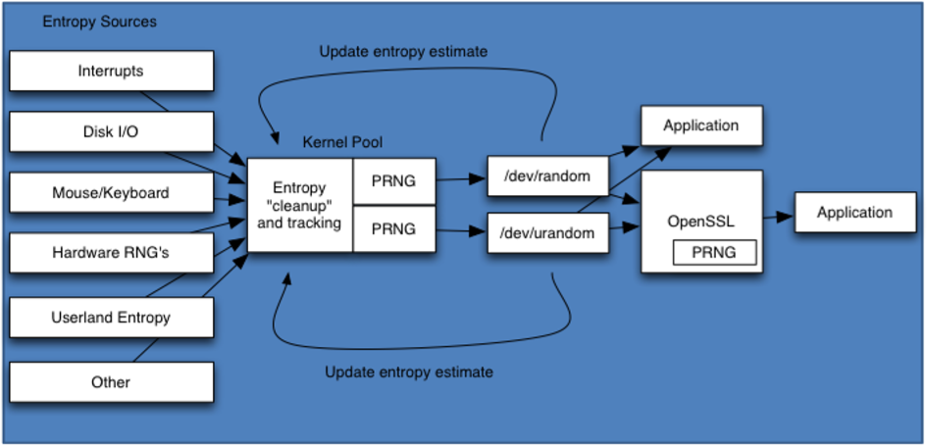
Entropy
Notes:
Resources & Notes:
entropy = sum over messages of (probability of message * - log (probability of message) )

Slide 291
Concept of low entropy and its significance
If the internal state or seed of a PRNG is very limited, it could be more susceptible to brute force attacks!

Slide 292
Importance of Entropy in Microsoft OS
Understand the importance of entropy in Microsoft OS and the role of entropy in security situations
Uses CryptoAPI to gather entropy
Windows's CryptoAPI uses the binary registry key HKEY_LOCAL_MACHINE\SOFTWARE\Microsoft\Cryptography\RNG\Seed to store a seeded value from all of its entropy sources
CryptoAPI is closed-source
For example, GnuPG, as of version 1.06, uses a variety of sources such as the number of free bytes in memory that combined with a random seed generates desired randomness it needs

Slide 293
Importance of Entropy In Microsoft OS
Newer version of Windows are able to use a variety of entropy sources:
TPM if available and enabled on motherboard
Entropy from UEFI interface (if booted from UEFI)[16]
RdRand CPU instruction if available
Hardware system clock (RTC)
OEM0 ACPI table content

Slide 294
Most common cryptographic tools
LastPass
Probably one of the most popular password manager tools out there, LastPass can be used for free with limited features, but will still secure your passwords and personal data
Using an encryption software tool like this one, you’ll no longer have to remember or note a password in a notebook or any other physical place
Bitlocker
While there are many encryption tools available you can use to encrypt your data locally, most users prefer to use Microsoft’s BitLocker software
You can either use it to encrypt a particular disk partition or the entire hard disk
BitLocker is a full-disk encryption tool built-in in the latest Windows operating systems (Windows 10), which uses AES (128 and 256-bit) encryption to encrypt data on the drives

Slide 295
Most common cryptographic tools
VeraCrypt
Another free encryption software tool you can use which is available for Windows, OS X and Linux operating systems
Works similar to Bitlocker and supports AES
FileVault 2
Looking to encrypt your data stored on devices featuring macOS and Mac hardware? FileVault 2 is a free encryption software tool worth checking out
Just like BitLocker and VeraCrypt tools, FileVault 2 (FileVault full-disk encryption) uses XTS-AES-128 encryption with a 256-bit key “to help prevent unauthorized access to the information on your startup disk”

Slide 296
Most common cryptographic tools
DiskCryptor
Yet another open-source and free encryption software you can use to secure your internal and external drive, including system partition, and even ISO images, or USB flash drives or any other storage devices
7-Zip
Many users are not interested in encrypting the entire hard disk, but only specific files and documents that store sensitive information
It’s a free and open source encryption software, as well as a lightweight solution known for its simplicity
This software tool is capable of extracting most archives and features strong AES-256 encryption.

Slide 297
Most common cryptographic tools
AxCrypt
Similar to 7-Zip, AxCrypt is an open source file encryption tool offering both a free solution and a premium version for Windows, macOS, Android, and iOS
It features AES-256 file encryption and can efficiently encrypt one file, an entire folder or a group of files with a simple right-click
Files can be encrypted for a specific period of time or can be auto-decrypted later on when that file reaches the destination
HTTPS Everywhere
Encrypting your files is not enough
To be one step ahead of cybercriminals, you need to enhance online protection, you need to make sure no one can eavesdrop on your communication over the Internet

Slide 298
Most common cryptographic tools
Tor Browser
If you want to access the Internet anonymously, Tor browser can be a great option to encrypt your online traffic and keep your browsing activities from prying eyes
Tor Browser will block popular browser plugins such as Flash, RealPlayer, Quicktime, and others which can be manipulated into finding out your IP address
CyberGhost
Another way to hide your online identity is to use a VPN (Virtual Private Network) which can encrypt your communication and keep it safe from constant interception attempts
This private network is able to spread across the normal Internet space, using its resources to create an encrypted channel and protect your data from hackers or the prying eyes of others

Slide 299
Cryptography
Week 2
Intro
Monday
01
02
Wednesday
03
04
Tuesday
05
06
Thursday
Friday

Slide 300
Syllabus – Week 2
Monday
Secure Hash
Digital Signing, Certificate Authorities
Tuesday
Public Key Ciphers – Examples & Analysis
Block Ciphers – Examples & Analysis – Covered Previously
Wednesday
How cryptographic techniques are applied and to what end and their limitations
Thursday
Examples of badly applied or implemented cryptographic techniques
Friday
Review, Q&A

Slide 301
Module - recap

Slide 302
Module Recap
What is Entropy?
What types of Random Number Generator are there?
What does PRNG?
Whats is TRNG?
What is the PRNG period?
What is the PRNG distribution?
Hash?
Digital Signature?
Public Key Cryptography?
Notes:
Resources & Notes:
Entropy
In computing, entropy is the randomness collected by an operating system or application for use in cryptography or other uses that require random data
Random Number Generator Types
Software and Hardware
PRNG – Pseudo Random Number Generator
Software RNGs use mathematical algorithms to generate random numbers, initializing the algorithm with a "seed" value derived from some repetitive operation in the computer, such as keystrokes, running processes, the computer's clock, or mouse movements
PRNG Period
Roughly speaking, the number of outputs until the internal state repeats is the period of a PRNG
PRNG Distribution
Distribution of the output
TRNG – Truly Random Number Generator
Hardware random generators (TRNG):
Hardware RNGs do not require seeds because hardware random numbers are not computed values; they are not derived through a repeatable algorithm
Name some cryptographic attacks
Version spoofing attack
Backtrack attack
Reverse protocol attack
Version rollback attack

Slide 303
PRNG - Distribution
Good Distribution
Low Bias
High Bias
< --------------------------------------------------------- Other Bias Patterns ------------------------------------------------------ >
Notes:
Resources & Notes:
https://www.youtube.com/watch?v=4sYawx70iP4

Slide 304
Module Recap
Modern Ciphers
Security Principles
Additional Cryptography Principles
Confusion?
Diffusion?
Tokenisation?
Key Management Lifecycle?
Threats to Key Generation algorithms
Notes:
Resources & Notes:
Confusion
Confusion means that each binary digit (bit) of the ciphertext should depend on several parts of the key, obscuring the connections between the two.[2]
The property of confusion hides the relationship between the ciphertext and the key.
Diffusion
Diffusion means that if we change a single bit of the plaintext, then about half of the bits in the ciphertext should change, and similarly, if we change one bit of the ciphertext, then about half of the plaintext bits should change
Threats to Key Generation algorithms
Birthday
Replay
Side channel
Traffic analysis

Slide 305
Modern Encryption Ciphers
Modern Ciphers
Symmetric Ciphers
Asymmetric Ciphers
Block Ciphers
Stream Ciphers
RSA
DSA
Diffie-Hellman
AES
DES
3DES
IDEA
Blowfish
RC 5 / 6
ISAAC
Quad
Fish
RC4
Seal

Slide 306
Key Management Lifecycle

Slide 307
Module Recap
Walkthrough of Assessment 1
Any questions / clarification required on Assessment 1?
Afternoon to start Assessment 1

Slide 308
Cryptography
Week 2
Intro
Monday
01
02
Wednesday
03
04
Tuesday
05
06
Thursday
Friday

Slide 309
Syllabus – Week 3
Monday
Assignment 1 due – Presentation
Note: Slides must be submitted no later than 23:59 the previous day
Tuesday
Self study time
Wednesday
Self study time
Thursday
Self study time
Friday
Issue Assignment 2

Slide 310
Any final questions?

