Slide 1
BCS Level 3 Certificate in Programming
QAN 603/1192/7

Slide 2
Syllabus
For each top-level area of the syllabus a percentage and K level is identified. The percentage shown relates to the proportion of the exam given to that area.
The K level identifies the maximum knowledge level that may be tested for that area.

Slide 3
Syllabus
Implementing software code following a logical approach (17.5%, K3)
How code integrates into the wider project (10%, K2)
Developing software against a set of functional and non-functional requirements (15%, K2)
The end user context for software development (7
Connecting code to data sources (5%, K2).5%, K2)
Database normalisation (5%, K3)
Following good coding practices (12.5%, K2)
Principles of good interface design (10%, K2)
Building in security software (17.5%, K2)

Slide 4
Implementing software code following a logical approach (17.5%, K3)
Fundamentals of programming
Constructs
Algorithms
Data structures
Problem solving
Test driven development (TDD)

Slide 5
Learning outcomes
Understand how to implement code, following a logical approach (17.5%, K3)
1.1. Fundamentals of Programming
1.2. Core constructs used when writing code

Slide 6
Procedural vs. object-oriented vs. functional programming
Programs are made up of modules
Are parts of a program that can be coded and tested separately
Assembled to form a co
The design method used in procedural programming is called Top Down Design (TDD)

Slide 7
Procedural vs. object-oriented vs. functional programming
An alternative to procedural programming is object oriented programming.
Object oriented programming is meant to address the difficulties with procedural programming.
In object oriented programming, the main modules in a program are classes, rather than procedures.
The object-oriented approach lets you create classes and objects that model real world objects.

Slide 8
Procedural vs. object-oriented vs. functional programming
Object-oriented Programming uses data fields where Procedural Programming uses procedures
Procedural | Object-oriented
Procedure | Method
Record | Object
Module | Class
Procedure call | Message

Slide 9
Procedural vs. object-oriented vs. functional programming
Functional programming languages are specially designed to handle symbolic computation and list processing applications
Based on mathematical functions
Popular functional programming languages include: Lisp, Python, Erlang, Haskell, Clojure, etc.
Two categories:
Pure functional languages
support only the functional paradigms - Haskell
Impure functional languages
support the functional paradigms and imperative style programming - Lisp

Slide 10
Procedural vs. object-oriented vs. functional programming
Functional Programming | OOP
Uses Immutable data. | Uses Mutable data.
Follows Declarative Programming Model. | Follows Imperative Programming Model.
Focus is on: “What you are doing” | Focus is on “How you are doing”
Supports Parallel Programming | Not suitable for Parallel Programming
Its functions have no-side effects | Its methods can produce serious side effects.
Flow Control is done using function calls & function calls with recursion | Flow control is done using loops and conditional statements.
It uses "Recursion" concept to iterate Collection Data. | It uses "Loop" concept to iterate Collection Data. For example: For-each loop in Java
Execution order of statements is not so important. | Execution order of statements is very important.
Supports both "Abstraction over Data" and "Abstraction over Behavior". | Supports only "Abstraction over Data".

Slide 11
Compiled vs. interpreted
COMPILED
A compiled language is one where the program, once compiled, is expressed in the instructions of the target machine.
E.G. an addition "+" operation in your source code could be translated directly to the "ADD" instruction in machine code.
INTERPRETED
An interpreted language is one where the instructions are not directly executed by the target machine, but instead read and executed by some other program

Slide 12
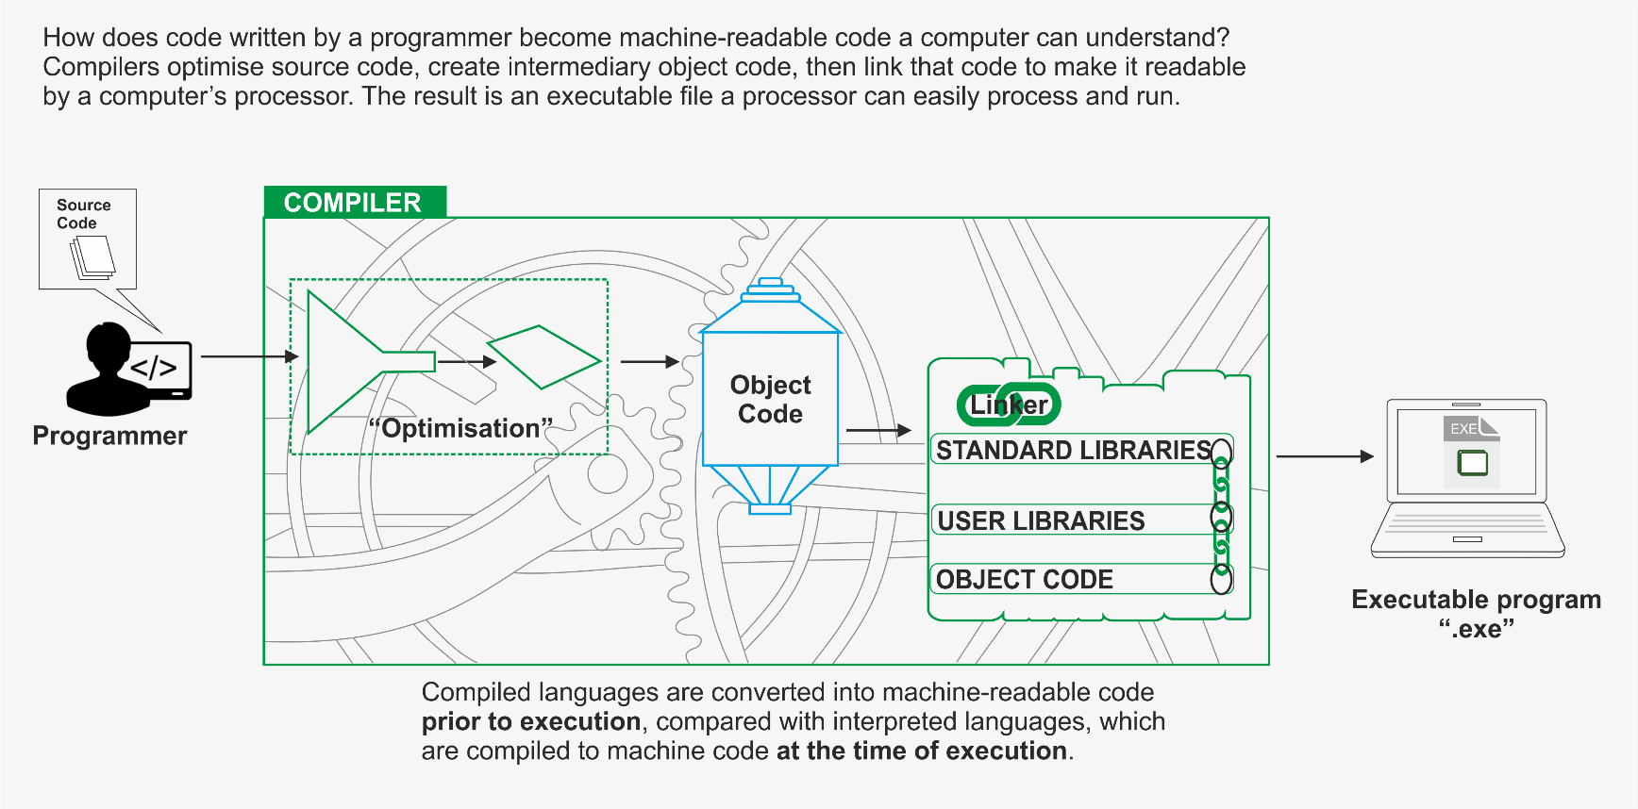
Compiled vs. interpreted

Slide 13
Compiled Languages
C
C++
C# - to bytecode (CIL)
Erlang – to bytecode
Objective-C
Java – to bytecode
Pascal
Scala
Swift
Smalltalk
TypeScript
AppleScript – to bytecode

Slide 14
Interpreted Languages
JavaScript
Python
PHP
Perl
Excel
VBScript
Matlab
PowerShell

Slide 15
Core constructs
Classes
Objects
Methods
Variables
Logic operators

Slide 16
Classes
A class describes data
It defines the abstract characteristics of an object very much like a blueprint
A class is an entity that defines how an object will behave and what the object will contain when the object is constructed, or instantiated
Things it can do – Methods
Attributes - Properties and fields

Slide 17
Objects
An object can be a variable, a data structure, a function, or a method, and as such, is a value in memory referenced by an identifier.
In the class-based object-oriented programming paradigm, object refers to a particular instance of a class, where the object can be a combination of variables, functions, and data structures.

Slide 18
Methods
A method in object-oriented programming is a procedure associated with a class
A method defines the behaviour of the objects that are created from the class
Another way to say this is that a method is an action that an object is able to perform
The association between method and class is called binding

Slide 19
Variables
In OOP there are two types of variables:
class variables
a variable defined in a class of which a single copy exists, regardless of how many instances of the class exist
static variables
a variable that has been allocated "statically", meaning that its lifetime (or "extent") is the entire run of the program

Slide 20
Logic Operators
Computers make use of logic gates to perform operations.
While there are only three logic operators to consider when programming, there are others that could be used programmatically.

Slide 21
Logic Gates

Slide 22
Logic Operators
Logic operators allow a program to make a decision based on multiple conditions
Each operand is considered a condition that can be evaluated to a true or false value
Logic operators have precedence in the same way as normal mathematical operators

Slide 23
Logic Operators
 | Function | Java | C# | VB.net
AND | Performs a logical AND operation: A && B | && | && | AND
OR | Performs a logical AND operation: A || B | || | || | OR
NOT | Performs a logical NOT operation: A != B | ! | ! | NOT

Slide 24
Control structures
Flow of control through any given function is implemented with three basic types of control structures:
Sequential: default mode.
Selection: used for decisions, branching - choosing between 2 or more alternative paths.
Repetition: used for looping, i.e. repeating a piece of code multiple times in a row.

Slide 25
Sequential
Each statement in the source code will be executed one by one in a sequential order
It is written for a single thread
This is the default mode of execution
Dim ctr1, ctr2 As Integer
For ctr2 = 1 to 5
'Display first 10 multiples
For ctr1 = 1 to 10
System.Console.WriteLine(1 & "*" & ctr1 & "+" & (1 * ctr1)
Next
Next
End Sub

Slide 26
Selection
The selection control structure is used for making decisions and branching statements
The following are the basic selection statements in the programming language:
If
If-else
Switch case

Slide 27
IF Statements
Used to make decisions in your programming code.
Good for complicated tests
Comparisons
Logic checks
Multiple checks
Nested checks ?
etc

Slide 28
If Statements
Example
Test if x = 5 or x = 10
If variableA = variableA
If x > 5
If x <> 22
And so on
The If is called a selection statement since it can select alternative paths through the program.

Slide 29
IF Else Statements
A decision statement such as if can choose to take one path else take another.
Example:
If x > 10 then
'Statements
Else
'do something else
End If

Slide 30
IF … IfElse…Else statements
A decision statement such as if can choose to take one path else take another, but you have situations where a number of conditions need to be checked to decide which statements to run.
Example:
if x > 10 then
'Statements
elseIf x > 5 then
'do these
elseif x > 3 Then
'do these
else
'do these
end If

Slide 31
Programming Task
Create a new GUI program using Visual Studio.
We are going to use a new feature for this program called the message box.
The Message box is called a dialogue window since it displays in a small window allow the user to respond to the message.
Let’s try this out.
Once you have a blank form showing, double click on the form to go to the form load code stub, we are not adding controls to this program.

Slide 32
Programming Task
In the Form1_load code stub enter this code then run it.
Dim Mark as Integer
Mark = InputBox(“Enter an exam mark from 0 to 100”)
If Mark >= 60 then
MessageBox.Show(“Merit”)
ElseIf Mark >= 40 Then
MessageBox.Show(“Pass”)
Else
MessageBox.Show(“A mark of “ + Mark.tostring + “ is a fail”)
End if

Slide 33
IF … IfElse…Else Statements
Many If else statements can make your code look messy and perform poorly.
Is there a better way?
You will be pleased to know that there is.

Slide 34
The Select Case Statement
The select case statement makes it easy to code for multiple ElseIf statements in a more readable and maintainable way.
Select Case x
Case 19
Do statements
Case 15
Do statements
Case Else
Do statements
End Select

Slide 35
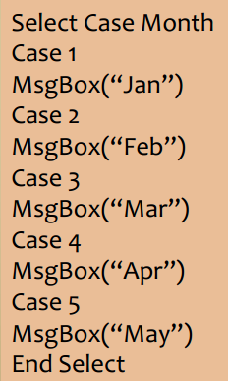
Select Case Construct
Select . . Case construct allows a large number of results.
This is the equivalent of multiple If..ElseIf constructs.

Slide 36
Program Challenge
Can you change your program you created earlier to use the Select Case statements rather than the If Elseif statements.

Slide 37
Iteration or Repetition
The iterative control structures are used for repetitively executing a block of code multiple times
The following are the basic iterative control structures:
For
While
Do-while

Slide 38
For …. Next loops
Loop continues for specified number of repetitions.
These are fixed loops

Slide 39
Do …. While loops
Loop continues while condition is TRUE
This is a pre-check loop, it checks the condition at the start so the code within it may never run
Here the condition is at end of loop, the loop body executes at least once. This is a post check loop

Slide 40
Do …. Until Loops
Loop continues until condition is true.

Slide 41
End of Session

