Slide 1
Operating Systems and Architecture
^{<assembler>}
(UFCFCU-30-1)

Slide 2
^{<snake part 2>}
In this section you will:
Detect hitting the edge and declare game over
Detect the snake crossing itself and declare game over
Create an apple in a random position
Make the snake grow when an apple is eaten
Optionally you can
Add an option to play again
Randomise the start position and direction of the snake
Add an option to change the speed
Increase the speed as apples are eaten
Create multiple apples
Notes:
This is the last section

Slide 3
^{<debugging>}
As well as highlighting assembler errors when submitting you can insert break points in the code
Clicking on a line number will turn it red to indicate it is a break point
Click on the red to remove the break point
Hovering over a register will show its current value
Hovering over a subroutine name or the target of a branch will show the memory address
Notes:
They should try this

Slide 4
^{<structure>}
Your code should have this layout
 | Define registers
 | Setup interrupts #update #keypress
 | Initialise game
 | Main loop
update: keypress: | Interrupt routines
Notes:
Make sure this is working before they carry on.

Slide 5
^{<edge detection>}
The best place to detect an edge is in the update routines for right, down, up and left
For down we can compare the value in R4 with 12284 (the last pixel) and branch to game over if it is greater
What would the equivalent comparison for up be?
Add the code for down and up
gameOver can be placed at the end of the current code
Check edge detection for up and down
down: ADD R4,R4,#256 //+64*4 moves down one row
MOV R0, #12284 //One past the last pixel
CMP R4, R0
BGT gameOver
B reDraw
gameOver:
MOV R0, #over STR R0,.WriteString HALT //To stop program execution
over: .ASCIZ " Game Over!\n"
Notes:
Up compare is 0,

Slide 6
^{<edge detection>}
right and left are handled differently
If the value of R4 is 255, ie at the right hand edge, then the AND with 255 will be 0
For the left hand edge, the comparison is with 252
Add these changes and test they work
right:ADD R4,R4,#4 //+4 (bytes) moves right one pixel
AND R0,R4,#255
CMP R0,#0
BEQ gameOver
B reDraw
left: SUB R4,R4,#4 //-4 moves left one pixel
AND R0,R4,#255
CMP R0,#252
BEQ gameOver
Notes:
Trust me, this works

Slide 7
^{<crossover>}
There is a very simple way to tell if the snake is crossing over itself
Can you work out what it is?
It only takes 3 lines of code
Notes:
See if the pixel the snake is moving to is green

Slide 8
^{<crossover>}
Read the the value of the next pixel (where is this value?) into R1
Compare R1 with the snake colour in R11
If it is equal, branch to game over
Insert the 3 lines of code at the start of the redraw
Test that crossing over triggers game over
Notes:
LDR R1, [R10+R4] CMP R1,R11 BEQ gameOver

Slide 9
^{<apple>}
The random number generator is used to position an apple
.Random generates a 32 bit random number
We only need a number divisible by 4 in the range 0-12280
If we AND the random number with 0x355c the range is cut to 0-16380 – 14 bits
Demonstrate this is correct
This number is compared to 12284. If it is bigger then a new random number is obtained
Otherwise the apple is drawn if the chosen pixel isn’t green
All this is done in a subroutine called in the initialisation sequence

Slide 10
^{<apple>}
Define registers New subroutine, place before gameOver
Add the BL createApple before the STR R0, .InterruptRegister in the initialisation
//Define registers ...
MOV R8, #0 //Score of apples eaten // Constants: MOV R12, #.red //Colour of apple
createApple: push {R0,R1, LR} newRandom: LDR R1,.Random // gets a random 32 bit pattern
MOV R0, #0x3ffc // Limit random to 14 bits
AND R1,R1,R0
MOV R0, #12284 //Max pixel number
CMP R1,R0
BGT newRandom //'Throw again' LDR R0, [R10+R1] //Get intended pixel CMP R0,R11 //Compare pixel to snake colour
BEQ newRandom STR R12, [R10+R1] //Draw apple POP {R0,R1,LR} RET
BL createApple
STR R0, .InterruptRegister

Slide 11
^{<apple>}
After entering that code check that an apple appears in a random position each time the game is run
To check if the snake has eaten the apple we add a test in the redraw routine
If the apple is eaten, we create another one and add 1 to the score
At gameOver, the score is written to the console

Slide 12
^{<apple>}
The code is similar to that used for crossover
The apple colour is in R12
If the comparison is not equal, then skip to the RFE
If it is equal, then increment the score by adding 1 to R8
The BL to createApple
For writing out the score use similar code to writing Game Over! With a message of “Your score: “ followed by writing R8 as a signed number.
You should be able to write this code yourself

Slide 13
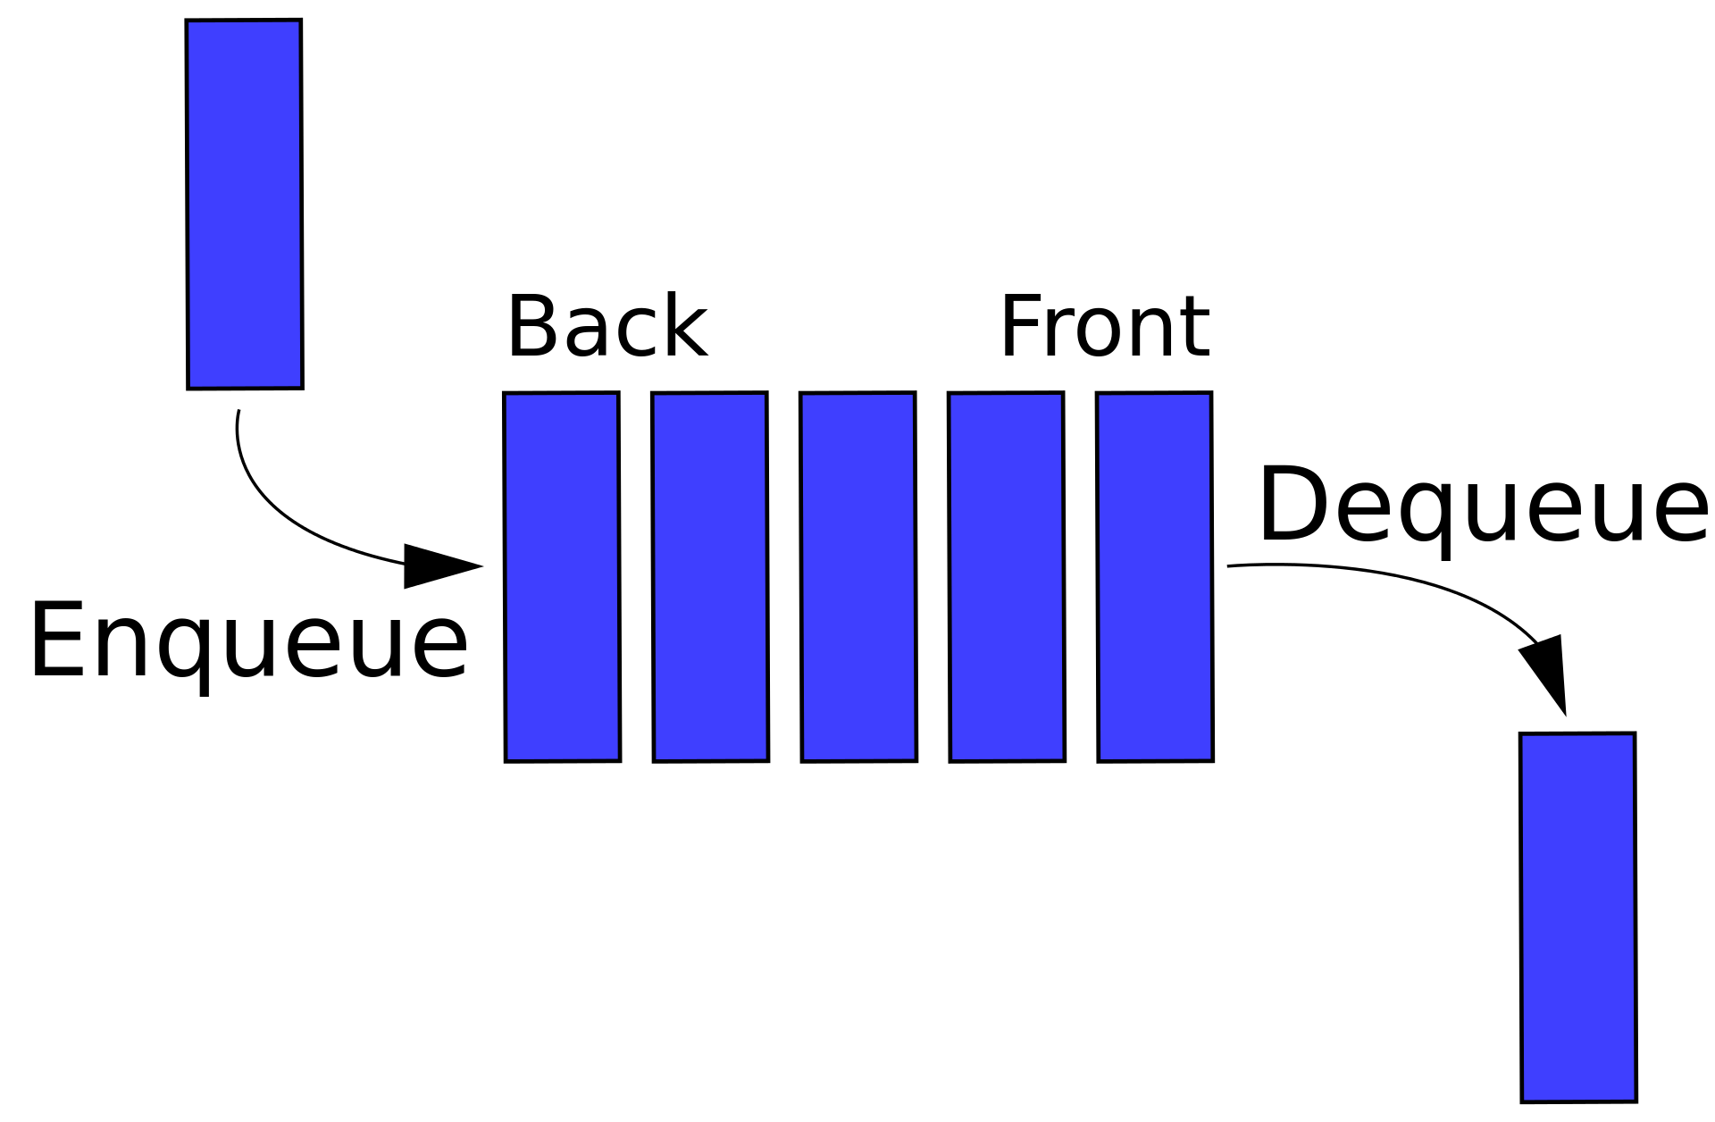
^{<growth>}
The snake grows continuously
It should only grow when it eats an apple
Code is required which tracks both the head, the tail and the path it has taken
We do this with a queue
This is a FIFO, first in, first out
As the head moves we “enqueue” its new address at the end of the queue
As the tail moves we dequeue it from the front

Slide 14
^{<growth>}
The queue is defined with a label (aligned to 256 so that is on a word boundary) at the end of the code
We need two registers to be pointers to the front and back of the queue
The pointers need to be set up. Add this to the initialisation section between STR R11,[R10+R4] and MOV R0, #1
over: .ASCIZ " Game Over!\n"
score: .ASCIZ "Your score: ”
.ALIGN 256
body: //The queue of body segments
//Define registers
...
// R5 Front (address of tail)
// R6 Back (address of head)
MOV R5, #body // Point to front of Q
ADD R6,R5,#4 // Point to head, 1 after tail
STR R3, [R5] // Points to tail address
STR R4, [R6] // Points to head address

Slide 15
^{<growth>}
The redraw code needs to be modified to:
Increment the back of the queue pointer by 4 (1 word)
Store the new head pixel number at the back of the queue
Change the tail pixel to white (unless an apple has been eaten)
Increment the front of queue pointer
Get the pixel number for the new tail
This is the new redraw code
reDraw:
//First check if the snake would be crossing itself LDR R1,[R10+R4] // read, from screen, contents of next pixel CMP R1,R11 //If it is snake colour... BEQ gameOver
ADD R6,R6,#4 //Increment back of Q pointer
STR R4, [R6] // Store new head pixel number at back of Q
CMP R1, R12 // Check if pixel is an apple
BEQ eat //Skip deleting tail pixel if apple
MOV R1, #.white
STR R1, [R10+R3] //Turn tail pixel white
ADD R5,R5,#4 //Increment front of Q pointer
LDR R3, [R5] // Get new tail pixel number
B .+3 //Skip to RFE
eat: ADD R8,R8, #1 //Increment score
BL createApple
STR R11, [R10+R4] //Draw new head
RFE

Slide 16
^{<growth>}
The game is complete
Check that it operates as expected
These are improvements you may wish to make
Add an option to play again
Randomise the start position and direction of the snake
Add an option to change the speed
Increase the speed as apples are eaten
Create multiple apples
There is a problem with this version – memory leaks

Slide 17
^{<memory leaks>}
The trail of pixels remains in memory and continues to grow as the snake moves
Even if you play for hours and don’t eat an apple it is unlikely you would fill memory (ARMlite has 1MB)
But this is bad practice
It is fixed by making the queue circular
After reaching a certain size, the pointers wrap around the end to start at the beginning of allocated memory again
How big does the queue need to be?
Change the code at the end, where nnnn is the queue size
.ALIGN 256
body: .BLOCK nnnn
limit: //1 past the end of the Q data
Notes:
64 x 48 pixels = 3072

Slide 18
^{<memory leaks>}
reDraw:
//First check if the snake would be crossing itself LDR R1,[R10+R4] // read, from screen, contents of next pixel CMP R1,R11 //If it is snake colour... BEQ gameOver
ADD R6,R6,#4 //Increment back of Q pointer
CMP R6, #limit //Check pointer within end of Q data area
BLT .+2
MOV R6, #body //If not loop pointer back to start
STR R4, [R6] // Store new head pixel number at back of Q
CMP R1, R12 // Check if pixel is an apple
BEQ eat //Skip deleting tail pixel if apple
MOV R1, #.white
STR R1, [R10+R3] //Turn tail pixel white
ADD R5,R5,#4 //Increment front of Q pointer
CMP R5,#limit // Check pointer within end of Q data area
BLT .+2
MOV R5, #body //If not loop pointer back to start
LDR R3, [R5] // Get new tail pixel number
B .+3 //Skip to RFE
eat: ADD R8,R8, #1 //Increment score
BL createApple
STR R11, [R10+R4] //Draw new head
RFE

Slide 19
^{<conclusion>}
You have successfully coded a working game using a variety of techniques
You have seen how efficient assembler is. Snake takes 121 lines of code.
This is important when memory and storage is limited
You have also seen why third generation languages were developed as coding in assembler is not simple and error prone
Constructs such as if…then..else or do until are not available
You will compare different languages with assembler in the programming module
Notes:
So say goodbye to assembler for now

