Slide 1
Operating Systems and Architecture
^{<computer architecture>}
(UFCFCU-30-1)

Slide 2
^{<outcomes>}
After completing this section of the module you will be able to:
Describe and explain computer architecture, digital logic and machine level representation of data (number systems)
Fetch – execute
ALU
Registers
Buses
Control unit

Slide 3
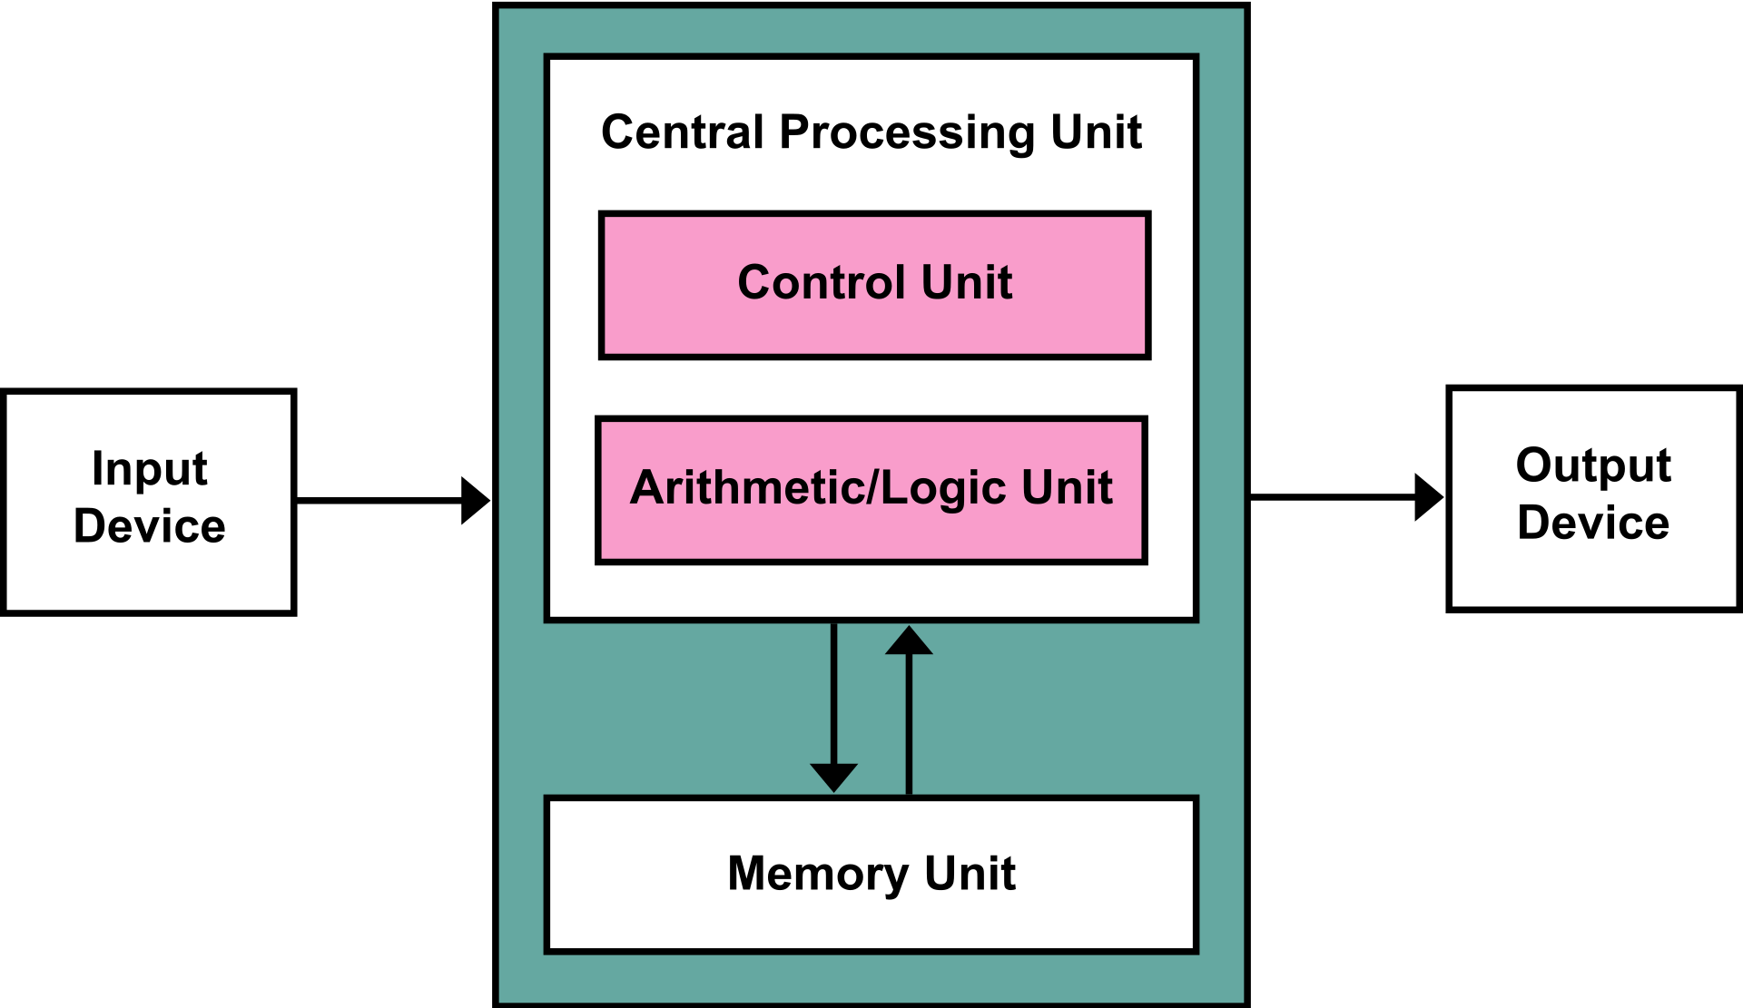
^{<stored program computer>}
von Neumann architecture (1945)
A stored program computer has:
A processing unit with registers and an ALU
A control unit with an instruction register and program counter
Memory that stores data and instructions
External mass storage
Input and output mechanisms
This architecture is still used today for general purpose computing
Notes:
Nothing new in computer architecture.
The ALU and memory are connected by buses

Slide 4
^{<fetch – decode -execute>}
So far we have described how the ALU and memory are connected by a bus
We now need to see how this is implemented in practice and how the operation is controlled
All CPU operations begin with:
Fetch an instruction from memory
Then
Decode the instruction in the control unit
Then
Execute the instruction in the ALU
Then repeat or halt

Slide 5
^{<MAR and MDR>}
There are 2 internal registers which:
Contain the address in memory to be read or written to, the memory address register (MAR)
Store the data to be written, or the data read, from memory, the memory data register (MDR)
There are two buses connecting the registers to memory
The address bus
The data bus

Slide 6
^{<MAR and MDR>}
Register 0
Register 1
Register n
Memory address register
Memory data register
Memory
Address bus
 | 0 | 1 | 2 | 3 | 4 | 5 | 6 | 7
0
1
2
3
etc
Data bus
Notes:
MAR – Memory address register
MDR – Memory data register

Slide 7
^{<program counter>}
Where does the MAR get its value from?
The program counter (PC) – another internal register
This register holds the address in memory of the next instruction
Where does the first value in the program counter come from when a CPU is first powered up?
Notes:
ROM chip that is accessed by the BIOS.

Slide 8
^{<program counter>}
Program counter
Register 0
Register 1
Register n
Memory address register
Memory data register
 | 0 | 1 | 2 | 3 | 4 | 5 | 6 | 7
0
1
2
3
etc

Slide 9
^{<fetch>}
Breakdown of the fetch phase
T₁ a valid address from the MAR is on the address bus
T₂ the contents of the memory location are put on the data bus
T₃ the data is transferred to the MDR
T₄ the instruction in the MDR is loaded into the instruction register (IR)
The program counter (PC) is incremented by 1
The fetch takes 4 clock cycles

Slide 10
^{<instruction register>}
Program counter
Register 0
Register 1
Register n
Memory address register
Memory data register
 | 0 | 1 | 2 | 3 | 4 | 5 | 6 | 7
0
1
2
3
etc
Instruction register
Control unit

Slide 11
^{<decode>}
The decode phase
T₁ (of the execute cycle in the diagram) - the instruction is decoded in the control unit
Either in hardware or microcode, the control unit sends appropriate signals to the ALU (e.g. the Control 0 and control 1 lines from our ALU logic diagram)

Slide 12
^{<execute>}
The execute phase
T₂ and T₃ (of the execute cycle in the diagram) - the ALU performs the instruction
The complete cycle for a simple instruction takes 7 clock cycles
If a CPU clocked at 3GHz takes 7 cycles to perform an instruction, how long is that in nanoseconds?

Slide 13
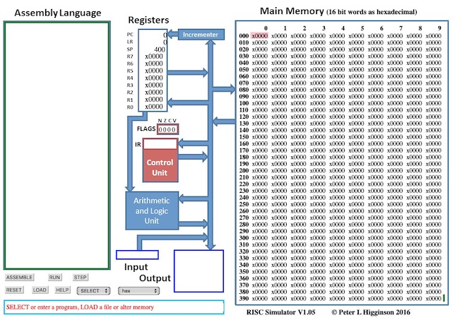
^{<simulation>}
We will illustrate the CPU and its operation using a RISC simulator (based on an ARM processor) http://www.peterhigginson.co.uk/RISC/
Program counter
Instruction register
Notes:
We are going to use this a lot. Probably a good idea to demo how you can load a program, step it or run it at various speeds, stop, before they try it themselves on the next slide.
LR is the link register used to hold the return address for a function cell
SP Stack pointer is used to hold “automatic” variables context/parameters across function calls.
Conceptually you can think of the "stack" as a place where you "pile" your data.
You keep "stacking" one piece of data over the other and the stack pointer tells you how "high" your "stack" of data is. You can remove data from the "top" of the "stack" and make it shorter.

Slide 14
^{<add>}
Select hex
Select the add program
The memory is populated
Press STEP once for 1 instruction cycle
What has happened?
Decode the instruction x7102
What are the addresses of the I/O devices?
Modify the program to write the result back to location 090 instead of register 2.
http://www.peterhigginson.co.uk/RISC/instruction_set.pdf
Notes:
You can edit the program by clicking in the Assembly Language window, making the changes and then pressing submit. You may want to show them around the instruction set before the tackle the decode and rewrite tasks.

Slide 15
^{<sequence>}
Step though the remainder of the program
This is an example of the programming construct – sequence
There are two other programming constructs:
Selection
Iteration
The next example contains both

Slide 16
^{<loop>}
What does this program do?
(A paper exercise – do not use the simulator)
Where does selection occur?
Where does iteration occur?
What operations occur in the ALU?
 | 0 | 1 | 2 | 3 | 4 | 6 | 6 | 7
000 | x2a20 | x71a7 | x1201 | x227f | x9801 | x2a0a | x71a7 | x0000
Notes:
Take them away from the screens!

Slide 17
^{<stack>}
A stack is an area of memory for storing items on a last in – first out basis (LIFO)
A data item is pushed onto the stack (PSH)
A data item is popped from the stack (POP)
The address of the top of the stack is held in the stack pointer
Stack pointer
0 | 0 | 0 | 0 | 0 | 0 | 0 | 0
PSH 65
Stack pointer
0 | 0 | 0 | 0 | 0 | 0 | 0 | 65
Notes:
You could get them to use the whiteboard on this slide to show what happens when you PSH and POP more than one thing.

Slide 18
^{<stack>}
Click in the Assembly Language window
Enter the program shown
Click Submit
Run the program
Why does the stack pointer start at 400?
When does the stack pointer get decremented and incremented?
Modify the program to push 5 items onto the stack, then retrieve them into their original locations
Notes:
If they are smart, they will see there is an instruction to PSH several registers at once. Get them to copy this code into a txt file as it may be useful later.

Slide 19
^{<stack>}
What use is a stack?
Saving the position and status of a program when jumping to a subroutine, then restoring them when the subroutine finishes
Passing values (parameters, variable) from one part of a program to another (e.g. functions)
What are potential cyber problems with stacks?

Slide 20
^{<subroutine>}
When an operation needs to be repeated in a program, rather than coding it each time it is required, code it as a subroutine
A JMS instruction will “jump” the program to a new address
A RET instruction will “return” the program to where it was
Main program
JMS |  | Subroutine
Main program continues |  | RET

Slide 21
^{<subroutine>}
Enter the program shown
Run the program
What is the function of LR and what is it?
What is LAB1?
Explain the opcode x9e05
Explain what submit has done
Write a program to save and restore the values of 2 registers before and after a subroutine
Notes:
Could start with the saved txt file

Slide 22
^{<flags>}
A flag is a status bit used to indicate the result of an operation
The simulator has 4 flags showing the result of the last ALU operation
N negative
Z zero
C carry
V overflow
Run this program
What flag does it set and why?
Write programs that set the other three flags
Notes:
They may need help with this.

Slide 23
^{<summary>}
You should now be able to explain the architecture of the RISC simulator
Address and data buses and registers
The instruction cycle
The specialised registers
Program counter
Stack pointer
Instruction register
PSH and POP
JMS and RET
Flags

Slide 24
^{<interrupts>}
Apart from subroutines, the programs have been linear sequences
The output device (address 4 and 7) was instantaneous
In real implementations, output devices are not instantaneous
Suppose a program needs to write to a hard disk
It rotates at 7,200 rpm. A half track rotation time is 4mS
Given our 3GHz example earlier, how many instructions could be run while waiting for 4mS?
In the dark ages (1981) of DOS 1.0, the PC would be unable to do anything else if it was printing
The solution to these issues are interrupts

Slide 25
^{<interrupts>}
Without interrupts
The preparation, I/O command and completion take a few instructions
Writing takes the time
User program |  | I/O Program
Code
Write
Wait |  | Preparation
Wait |  | I/O command
Wait |  | Writing
Wait |  | Completion
Code
Notes:
The CPU is hung up for a long time, ss the previous calculation

Slide 26
^{<interrupts>}
Interrupt mechanism
The CPU can be interrupted by an interrupt signal that can be sent by a device
Control is then passed to an interrupt handler which deals with the interrupt request
The fetch execute cycle is modified
Start
Fetch
Execute
Check/handle interrupts
Interrupts disabled
Interrupts enabled
Notes:
You could ask then to speculate on why you may want to disable interrupts? The answer comes up later on.

Slide 27
^{<interrupts>}
With interrupts
User program |  | I/O Program
Code
Write
Wait |  | Preparation
Code |  | I/O command
Code |  | Writing
Code |  | Completion
Code |  | Raise interrupt
Service interrupt
Code |  | Interrupt handler
 |  | Code
 |  | Return
Notes:
The wait is now very short

Slide 28
^{<interrupts>}
The interrupt request can be to indicate completion, or request more data to be read or written
Interrupts can occur at any point in a program’s execution
On receiving an execution request:
The current instruction is completed
Acknowledge the interrupt (device removes request)
Push the current status, register contents etc and program counter onto the stack
Program counter pointed to relevant interrupt service routine
Process the interrupt
On completion pop the status, register contents etc and program counter
Continue execution of interrupted program
Notes:
Now we see why we explained the stack. Key here is that the interrupted program has no need to know anything about what the interrupt is, or do anything about it.

Slide 29
^{<multiple interrupts>}
What happens if an interrupt occurs during an interrupt?
Interrupts can be disabled during interrupt handling
Second or subsequent interrupts held in a pending state
Serviced in sequence
What are the problems with this?
Consider three devices:
Printer
Hard disk
Comms adapter

Slide 30
^{<multiple interrupts>}
Consider three devices:
Printer – very slow
Hard disk - slow
Comms adapter - fast
If interrupts from the comms adapter are disabled while handling the hard disk or printer, then data may be lost or a buffer overflowed
The solution is to have interrupt priorities
Comms has highest priority
Then hard disk
Then printer
Then interrupts can be interrupted

Slide 31
^{<multiple interrupts>}
User program |  | Printer |  | Comms |  | Disk
User program interrupted by printer
Printer interrupted by comms
Comms returns to printer
Disk interrupts printer
Disk returns to printer
Printer returns to user program

Slide 32
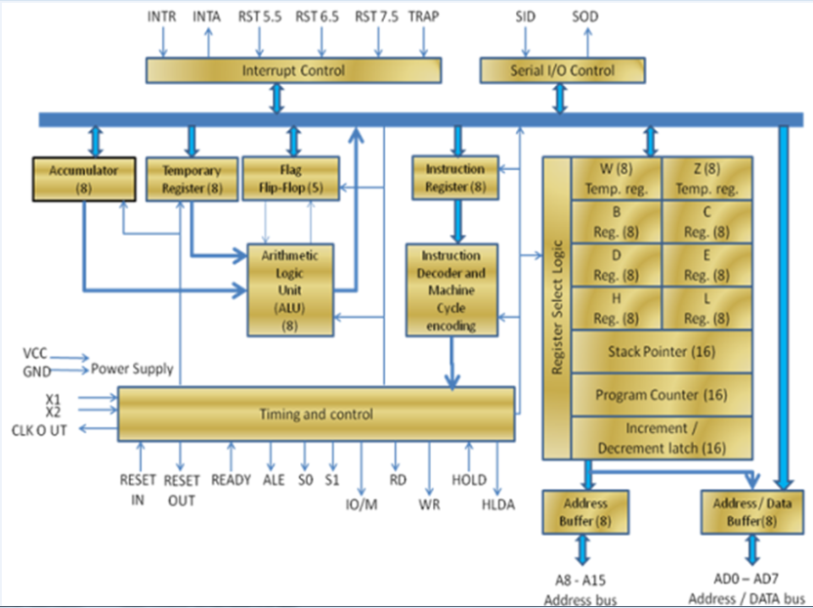
^{<8085 8—bit microprocessor>}
What are the features of the 8085 that you understand and can explain?
Notes:
A task for a couple of groups? Come back and present to this slide .There are items we haven’t covered so brownie points for explaining them.

Slide 33
^{<conclusion>}
We have covered:
The essential components of the CPU
How the CPU is architected
How the individual components operate
I/O systems will be covered on day 5

