Slide 1
Week 1 – Day 4
Cyber Threats
UFCFFU-30-1

Slide 2
Cyber Threats
Week 1
Introduction
Monday
01
02
03
Network-based attacks
Eavesdropping/sniffing
man-in-the-middle
Spoofing
session hijacking
denial of service
traffic redirection
routing attacks
traffic analysis
Wednesday
04
Tuesday
05
06
Thursday
Friday

Slide 3
Syllabus – Week 1
Foundations of cyber security, its significance, concepts, threats, vulnerabilities and assurance
Application of cyber security concepts to IT infrastructure
Fundamental building blocks and typical architectures of IT infrastructure
Common vulnerabilities in networks and systems
Vulnerabilities in computer networks, applications and systems (e.g., Insecure coding and unprotected networks) and how they can be exploited
Network-based attacks e.g.: Eavesdropping/sniffing, man-in-the-middle, spoofing, session hijacking, denial of service, traffic redirection, routing attacks, traffic analysis
Impact of vulnerabilities in an organisational context
Human dimension of cyber security and adversarial thinking applied to system development
How an employee may enable a successful attack chain without realising it

Slide 4
Week 1 - Thursday
Network-based attacks e.g.: Eavesdropping/sniffing, man-in-the-middle, spoofing, session hijacking, denial of service, traffic redirection, routing attacks, traffic analysis

Slide 5
Network-based attacks
Eavesdropping/sniffing
Man-in-the-middle
Spoofing
Session hijacking
Denial of service
Traffic redirection
Routing attacks
Traffic analysis

Slide 6
Network-based attacks
Eavesdropping/sniffing
Man-in-the-middle
Spoofing
Session hijacking
Denial of service
Traffic redirection
Routing attacks
Traffic analysis

Slide 7
Eavesdropping/sniffing
Network eavesdropping, also known as eavesdropping attack, sniffing attack, or snooping attack, is a method that retrieves user information through the internet
Happens on electronic devices like computers and smartphones
Typically happens under the usage of unsecured networks, such as public wi-fi connections or shared electronic devices
Eavesdropping attacks through the network is considered one of the most urgent threats in industries that rely on collecting and storing data

Slide 8
Man-in-the-middle
A man-in-the-middle attack is a type of cyber attack where a malicious actor inserts him/herself into a conversation between two parties, impersonates both parties and gains access to information that the two parties were trying to send to each other
A man-in-the-middle attack allows a malicious actor to intercept, send and receive data meant for someone else, or not meant to be sent at all, without either outside party knowing until it is too late

Slide 9
Man-in-the-middle
Man-in-the-middle is a type of eavesdropping attack that occurs when a malicious actor inserts himself as a relay/proxy into a communication session between people or systems.
A MITM attack exploits the real-time processing of transactions, conversations or transfer of other data.
Man-in-the-middle attacks allow attackers to intercept, send and receive data never meant to be for them without either outside party knowing until it is too late

Slide 10
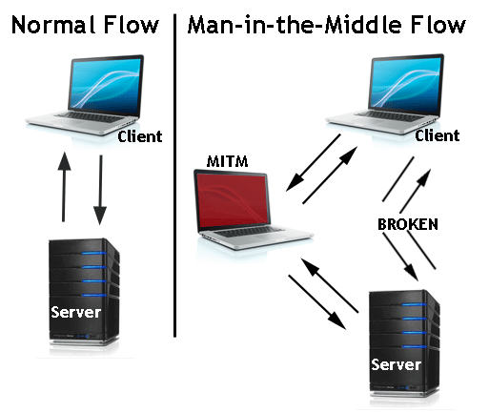
MitM Attack

Slide 11
Spoofing
A spoofing attack is when a malicious party impersonates another device or user on a network in order to launch attacks against network hosts, steal data, spread malware or bypass access controls
There are several different types of spoofing attacks that malicious parties can use to accomplish this
Some of the most common methods include:
IP address spoofing attacks
ARP spoofing attacks
DNS server spoofing attacks

Slide 12
Task
Find out more about each of these spoofing attacks

Slide 13
Session hijacking
The Session Hijacking attack consists of the exploitation of the web session control mechanism, which is normally managed for a session token
Because http communication uses many different TCP connections, the web server needs a method to recognize every user’s connections
The most useful method depends on a token that the Web Server sends to the client browser after a successful client authentication
A session token is normally composed of a string of variable width and it could be used in different ways, like in the URL, in the header of the http requisition as a cookie, in other parts of the header of the http request, or yet in the body of the http requisition
The Session Hijacking attack compromises the session token by stealing or predicting a valid session token to gain unauthorized access to the Web Serve

Slide 14
Session hijacking
The session token could be compromised in different ways; the most common are:
Predictable session token
Session Sniffing
Client-side attacks (XSS, malicious JavaScript Codes, Trojans, etc)
Man-in-the-middle attack
Man-in-the-browser attack

Slide 15
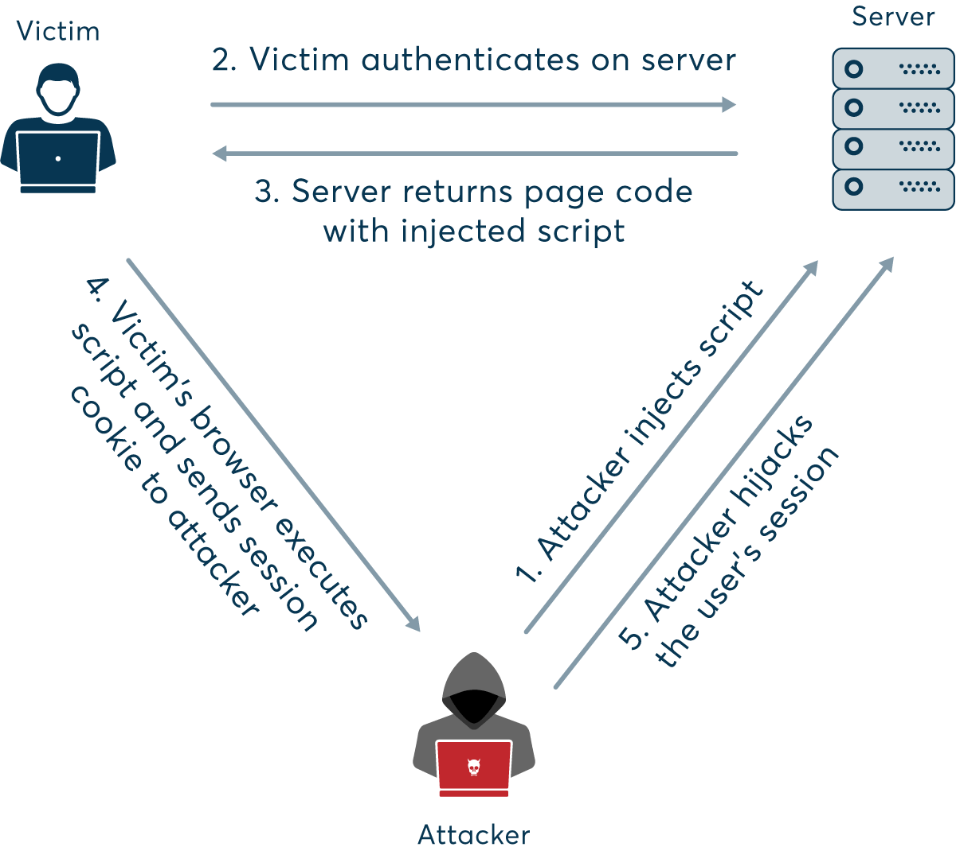
Session hijacking

Slide 16
Denial of service
A Denial-of-Service (DoS) attack is an attack meant to shut down a machine or network, making it inaccessible to its intended users
DoS attacks accomplish this by flooding the target with traffic, or sending it information that triggers a crash
In both instances, the DoS attack deprives legitimate users (i.e. employees, members, or account holders) of the service or resource they expected

Slide 17
Denial of service
There are two general methods of DoS attacks: flooding services or crashing services
Flood attacks occur when the system receives too much traffic for the server to buffer, causing them to slow down and eventually stop
Popular flood attacks include:
Buffer overflow attacks
ICMP flood
SYN flood

Slide 18
Task
Find out more about each of these flood attacks

Slide 19
Traffic redirection
DNS spoofing is an attack in which traffic is redirected from a legitimate website such as www.google.com, to a malicious website such as google.attacker.com
For example, attackers can compromise a DNS server, and in this way “spoof” legitimate websites and redirect users to malicious ones

Slide 20
Routing attacks
Internet routing protocols such as the Border Gateway Protocol (BGP) govern how our communications are routed over a series of autonomous systems to form an end-to-end communication channel between a sender and receiver
Unfortunately, Internet routing protocols were not designed with security in mind
The insecurity in the BGP protocol allows potential adversaries to manipulate how routing on the Internet occurs

Slide 21
Routing Protocol Attacks
The area most open to attack is often not the Internet's BGP tables but the routing systems within your own enterprise network
Because of some of the sniffing-based attacks, an enterprise routing infrastructure can easily be attacked with man-in-the-middle and other attacks designed to corrupt or change the routing tables with the following results:
Traffic redirection - In this attack, the adversary is able to redirect traffic, enabling the attacker to modify traffic in transit or simply sniff packets.
Traffic sent to a routing black hole - Here the attacker is able to send specific routes to null0, effectively kicking IP addresses off of the network.
Router denial-of-service (DoS) - Attacking the routing process can result in a crash of the router or a severe degradation of service.
Routing protocol DoS - Similar to the attack previously described against a whole router, a routing protocol attack could be launched to stop the routing process from functioning properly.
Unauthorized route prefix origination - This attack aims to introduce a new prefix into the route table that shouldn't be there. The attacker might do this to get a covert attack network to be routable throughout the victim network

Slide 22
Traffic analysis
Traffic analysis is the process of intercepting and examining messages in order to deduce information from patterns in communication, which can be performed even when the messages are encrypted
Generally, the greater the number of messages observed, or even intercepted and stored, the more can be inferred from the traffic
Traffic analysis can be performed in the context of military intelligence, counter-intelligence, or pattern-of-life analysis, and is a concern in computer security
Traffic analysis tasks may be supported by dedicated computer software programs
Advanced traffic analysis techniques may include various forms of social network analysis

Slide 23
Cyber Threats
Week 1
Introduction
Monday
01
02
Wednesday
03
Tuesday
04
05
06
Thursday
Friday

