Slide 1
Programming
<Cyber Security Technical Professional Integrated Degree>
Introduction
Lesson 1

Slide 2
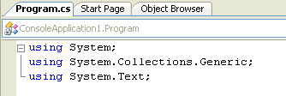
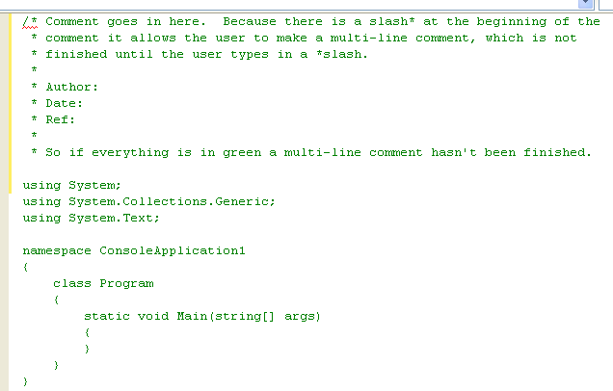
Programming Structure
Although the program begins with the default
It is actually expected that a program will begin with a comment (describing the program)

Slide 3
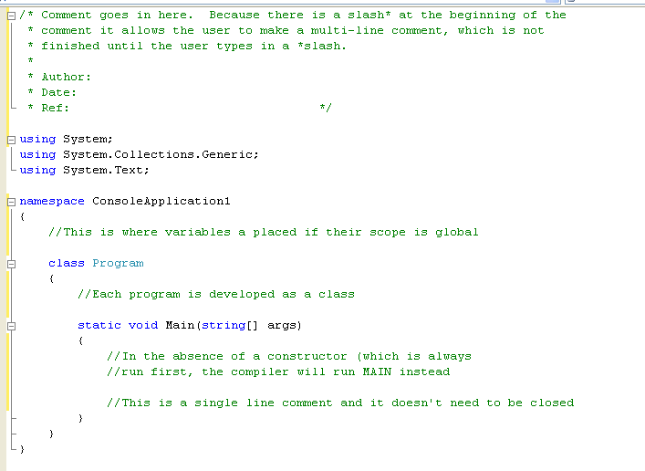
Program Structure
Notice the indentation –
known as program alignment
This is the industry standard

Slide 4
What about interacting with a user?
The basic Hello World program merely has an output to screen
But programs that interact with the user are more useful!
In a non-GUI program interaction is facilitated through keyboard presses
Each keypress or sequence of keypresses has to be handled by the program
These keypresses are stored in variables, which have to be declared and typed appropriately

Slide 5
Creating a String Variable
If you are going to ask the user for something, you must have a place ready to catch it. Computers store all information in memory cells. Computer languages call these cells “Variables”. There are many types of variables. In programming we refer to variables that deal with text String Variables.
The line
String sUserName;
is simply setting up a chunk of memory so that it is ready to store text data. The term sUserName refers to the name that this piece of memory has been given. Follow these guidelines when naming your variables:
It is good practice to begin the name of a string variable with an “s”.
A variable name must not contain spaces or punctuation.
Always use descriptive names so that when you come back to a program at a later date it is clear what you are using the variable for.
Resist using long names because misspelling them is too easy, which could cause problems later.
C# is a case sensitive language. Most programmers use mainly lowercase letters in their variable names, reserving uppercase letters for differentiating words (such as the capital U and N in sUserName).

Slide 6
Getting input from the user – Exercise 1
Create the program as shown and give it a suitable name.
Then add to the code to allow the user to input a forename, an initial and a surname.

Slide 7
Console.Readline()
Getting a Value with the Console.Readline() Method
Now that you have somewhere to hold a string value you need to get that value from the user. Console.Readline() waits for the user to type something on the screen and as soon as it encounters the Enter key, returns whatever was typed.
SUserName = Console.Readline(); this is an example of an assignment statement. This means that some sort of value is being copied from one thing to another. Think of “=” as meaning “gets”.

Slide 8
Variable as Outputs
Incorporating a Variable in Output
The next step is to print out the value that was input as part of a customised greeting.
Different Methods used……..
Console.Writeline(“Hi there, {0}!”, SUserName);
Console.Writeline(“Hi there “ + SUserName);
Console.Writeline(“Hi there “ + SFirstName + “ “ + SLastName);
The computer places the user’s name in place of the {0}. Computers start counting at zero so sUserName is variable number zero.

Slide 9
Declaring and using variables
We are going to write a program in c # that adds two integers together!
What variables do we need?
One integer to store the first number
One integer to store the second number
One integer to store the result when it’s calculated and before it’s output

Slide 10
Variables - possible data types
Real (float, double)
14.5 (for small number)
1358984.984198 (for large numbers)
Integer (sbyte, short, int, long, byte, ushort, uint, ulong)
See handout
Char (single character)
A, a, *, £
String (array of characters)
John Smith
Bool (boolean)
true, false
There are others!

Slide 11
Arithmetic operators
We also need a relevant arithmetic operator to use in our calculation:
+ = Add
- = Subtract
* = Multiply
/ = Divide (when this is used on a float it will divide as usual, when used on an integer it will return the whole number of times one number goes in to the other only)
% = Modulus (integer division, the whole number left over returned)
Task . Research what is Modulus ?

Slide 12
Add two numbers – Exercise 1
Note how the readline is used!
Readline is designed to get string inputs – in this case you want an integer!
You will see this over and over again!
We now need to code the
solution:
Prepare to code this solution!
C# is different to python – pay attention to the syntax

Slide 13
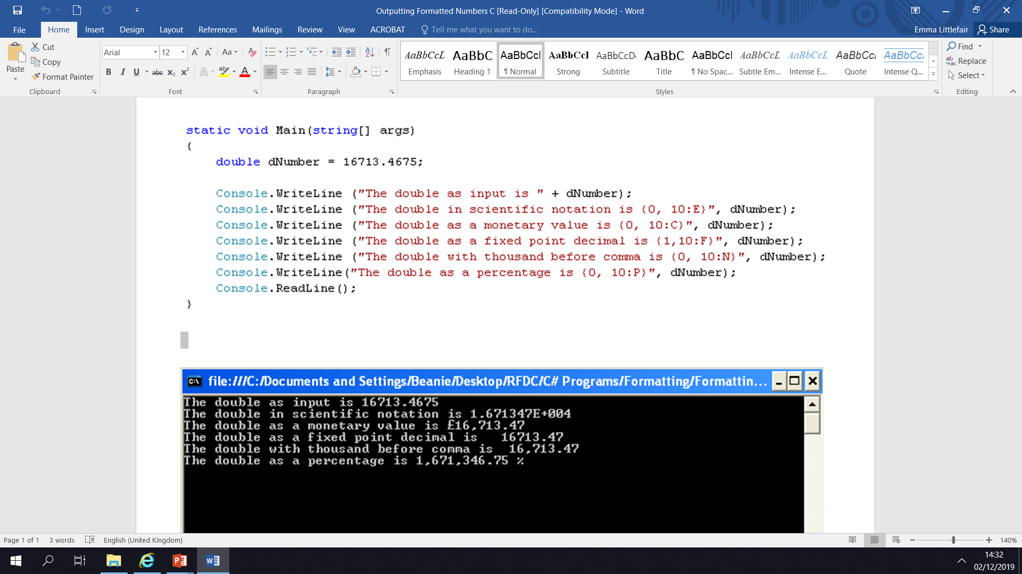
Formating Numbers – Exercise 2

Slide 14
C# Numbers Practice – Exercise 3
Write a program to convert temperatures in Fahrenheit to Celsius. (Subtract 32, multiply by 5 and divide by nine). Test your answer with boiling point (212F and freezing point (32F). Format your answer to 2 decimal places.
Write a program to calculate the average speed. Ask the user for the number of miles travelled and the time taken to travel in minutes. The average speed calculation is “number of miles/time taken in minutes * 60”.

Slide 15
The Problem With Vat! – Exercise 4
You are working for a computer supplies company and they have asked you to create a small invoicing system for their main product...... Memory usb sticks! The 1gb usb’s are sold in boxes of 10 and cost £45 per box. VAT is charged on top! You need to write a program that will ask for the customer’s personal details, e.g. name, address etc. You then need to ask how many boxes of usb’s he/she wants to buy.
Calculate the total (number of boxes multiplied by the cost per box).
Calculate the VAT (total multiplied by 0.2 – this is 20% VAT!)
Calculate the Gross amount (add total and VAT together).
These should be output on a cleared screen

Slide 16
Don’t forget to format your numbers (remember the syntax in c#)
Mr John Smith
9 The Road
The Area
GL1 1AA
10 boxes of 1gb USB’s ordered.
Cost £19.80
VAT £3.96
Total Cost £23.76

