Slide 1
BCS Level 4 Diploma in Software Development Methodologies Syllabus
QAN 603/0543/5

Slide 2
1. Life Cycle of Systems Development Concepts (50%, K3)
1.1 Role and function of the software development lifecycle
1.2 Seven generic stages of the software development lifecycle
1.3 Main activities in each stage of the software development lifecycle
1.4 High-level deliverables from each stage of the software development lifecycle

Slide 3
1.1 Explain the role and function of the system development lifecycle
Recognise that there are several ways to represent the terminology and stages of the SDLC.
Describe the role of the SDLC in the context of developing of IT systems and services, and operational software end-products.
Explain the purpose of the SDLC as a means to facilitate the creation of effective software

Slide 4
Representing the terminology and stages of the SDLC
Feasibility Study
Requirements
Analysis
Design
Design may change if application does not work as expected
Code Development
Testing
Deployment/
Implementation
Maintenance

Slide 5
Role of the SDLC
World accepted and standardized software development methodologies which are utilized during the software development life cycle, also known as 'Software Development Process Models‘
This fixed model follows specific steps to ensure the success in the software development project

Slide 6
Purpose of SDLC
An SDLC model maps the software development process from its initial planning through maintenance and eventual retirement of the completed application
An important goal of SDLC is to quickly and efficiently produce high-quality software in a series of phases that are called steps or phases
For this module, there are 7 steps

Slide 7
1.2 Relate the seven generic stages of the software development lifecycle.
Explain the purpose, objectives and scope of each stage of the SDLC
Describe inputs and outputs of each stage of the SDLC
Explain the main interfaces between the stages of the SDLC
Most of this is covered in Section 1.3

Slide 8
1.2 Relate the seven generic stages of the software development lifecycle.
Feasibility Study
Requirements Analysis
Design
Development
Testing
Implementation
Maintenance

Slide 9
1.3 Illustrate the main activities in each stage of the software development lifecycle
Feasibility Study
Requirements analysis
Design
Code Development
Testing
Deployment / Implementation
Maintenance

Slide 10
Feasibility Study
How software development is initiated when a need or an opportunity is identified
Purpose and main activities of a feasibility study
Importance of planning software development
Purpose of a business case
Potential tangible and intangible benefits that can be achieved using operational software
Simple cost benefit analysis for a given case

Slide 11
What is it?
A feasibility study is a short, focused study that should take place early in the requirements gathering process.
It should answer three key questions:
(1) Does the system contribute to the overall objectives of the organization?
(2) Can the system be implemented within schedule and budget using current technology?
(3) Can the system be integrated with other systems that are used?
If the answer to any of these questions is no, you should probably not go ahead with the project
Identifies new opportunities
Narrows the business alternatives
Provides valuable information for a “go/no go ” decision
Provides documentation that the idea was thoroughly investigated

Slide 12
How software development is initiated when a need or an opportunity is identified
An assessment of the practicality of a proposed plan or method
A feasibility study is an analysis that takes all of a project's relevant factors into account
Economic
Technical
Legal
Considerations
Ascertain the likelihood of completing the project successfully
Project managers use feasibility studies to discern the pros and cons of undertaking a project before they invest a lot of time and money into it
Feasibility studies also can provide a company's management with crucial information that could prevent the company from entering blindly into risky businesses

Slide 13
Purpose and main activities of a feasibility study
Technical feasibility
Financial feasibility
Collection of information
Assessment of risks and implications
Consideration of alternatives
Feasibility report writing

Slide 14
Technical feasibility
Technical feasibility assesses the current resources (such as hardware and software) and technology, which are required to accomplish user requirements in the software within the allocated time and budget
For this, the software development team ascertains whether the current resources and technology can be upgraded or added in the software to accomplish specified user requirements
Technical feasibility also performs the following tasks.
Analyses the technical skills and capabilities of the software development team members.
Determines whether the relevant technology is stable and established.
Ascertains that the technology chosen for software development has a large number of users so that they can be consulted when problems arise or improvements are required

Slide 15
Technical Feasibility
Ability to construct the system
Greater returns from riskier projects – manage risk
Fail to attain benefits
cost-/time overruns
Inadequate system performance levels
Unable to integrate with existing hardware or software

Slide 16
Financial feasibility
Economic evaluation is a vital part of investment appraisal, dealing with factors that can be quantified, measured, and compared in monetary terms
For any system if the expected benefits equal or exceed the expected costs, the system can be judged to be economically feasible
In economic feasibility, cost benefit analysis is done in which expected costs and benefits are evaluated
Economic analysis is used for evaluating the effectiveness of the proposed system.
As the name suggests, it is an analysis of the costs to be incurred in the system and benefits derivable out of the system
Cost-benefit analysis
estimating the strengths and weaknesses of alternatives used to determine options which provide the best approach to achieving benefits while preserving savings

Slide 17
Collection of Information
The challenge of collecting software engineering data is to make sure that the collected data can provide useful information for project, process, and quality management and, at the same time, that the data collection process will not be a burden on development teams
Must be based on well-defined metrics and models, which are used to drive improvements
Set collection goals early
Can be expensive

Slide 18
Assessment of risks and implications
Identify sources of project risk and to estimate the consequences of those risks
Risks might arise from the use of new technology, prospective users’ resistance to change, availability of critical resources, competitive reactions or changes in regulatory actions due to the construction of a system, or team member inexperience with technology or the business area
You should continually try to identify and assess project risk

Slide 19
Consideration of alternatives
Investigate a variety of ways of organising the business and positioning your product in the marketplace
It is like an exploratory journey and you may take several paths before you reach your destination
Just because the initial analysis is negative does not mean that the proposal does not have merit
Sometimes limitations or flaws in the proposal can be corrected.

Slide 20
Operational Feasibility
Useful for identifying operational problems to be solved
The ‘PIECES’ framework
Performance
Information
Economy
Control
Efficiency
Information
Services

Slide 21
Market Feasibility
Determine facility needs
Suitability of production technology
Availability and suitability of the site
Raw materials
Other inputs

Slide 22
Environmental Feasibility
Environmental impact and their assessment

Slide 23
Legal Feasibility
Is the project legally feasible?
Legal requirements

Slide 24
Feasibility report writing
Consists of definitive sections
Introduction/Executive Summary
Background
Outline of project
Methodology/method of analysis
Overview of alternatives
Conclusion
Recommendation

Slide 25
Importance of planning software development
Planning is one of the important activity which plays an important role in the successful delivery of the project
If proper planning is not done, then the entire project might be at risk
A good plan helps to manage time, cost, quality, potential risks and to focus on the project goals

Slide 26
Purpose of a business case
The business case captures the reasoning for initiating a project or task. It is the information needed for authorisation of the project
The purpose of the business case is to document the justification for the undertaking of a project usually based on the estimated cost of development and implementation against the risks and the anticipated business benefits and savings to be gained
Business case development is a step that companies often use for project selection
It analyses how fulfilling the business case for the project will implement the corporate strategy and sustain the competitive advantage of the company

Slide 27
Potential tangible and intangible benefits that can be achieved using operational software
Cost savings
Productivity gains
Risk reduction
Time savings
Increased income

Slide 28
Simple cost benefit analysis for a given case
A cost benefit analysis (also known as a benefit cost analysis) is a process by which organizations can analyse decisions, systems or projects, or determine a value for intangibles
The model is built by identifying the benefits of an action as well as the associated costs, and subtracting the costs from benefits
Organizations rely on cost benefit analysis to support decision making because it provides an agnostic, evidence-based view of the issue being evaluated—without the influences of opinion, politics, or bias

Slide 30
Requirements Analysis
Distinguish the role of the customer and the user in defining requirements
Describe how user research can facilitate understanding of the customer and enduser
Explain the difference between functional and non-functional requirements
Distinguish non-functional requirements, including
Recognise common ways in which software requirements can be expressed
Describe the qualities of good requirements and the impact of poor requirements
Explain how a data dictionary / glossary of terms can be used
List and describe techniques and tools used in requirements analysis, including

Slide 31
The role of the customer and the user in defining requirements
Requirements help communicate and define customer needs and problems
Through requirements gathering, stakeholders can establish a consensus on what is needed for customers' problems to be solved
The process also can provide a basis for estimates, timelines, and, if used effectively, help prevent failures

Slide 32
The role of the customer and the user in defining requirements
It is very important that the analyst work with the users to determine how the current system functions and what the users want from the new system
It is also important that future users are involved in the process early on so that their views of the system are taken into consideration
Requirements do not necessarily describe what and how reality is, rather, they model reality as it should be

Slide 33
How user research can facilitate understanding of the customer and end-user
who they are
the problem they are faced with
and how
Once the user requirements have been defined, a confirmation is necessary to ensure that they mirror the needs evolving from both the user’s work context and the use of the system
There must be user buy in before moving to the next phase

Slide 34
How user research can facilitate understanding of the customer and end-user
This is the opportunity for the analyst to get the user to commit to the scope of the project
One of the main goals of the requirements process is to get agreement on the views of the involved users, use cases are a good way to elicit requirements from the user’s point of view
Use cases reduce the risk on software projects by putting an early focus on the validity of user requirements, so as to build more usable systems they are currently dealing with the problem

Slide 35
How are they currently dealing with the problem
Questionnaires
User interviews
Contextual enquiry
Focus groups
Personas
Customer journey mapping

Slide 36
Personas
The aspect of someone's character that is presented to or perceived by others
Personas are fictional characters, which you create based upon your research in order to represent the different user types that might use your service, product, site, or brand in a similar way
Creating personas will help you to understand your users’ needs, experiences, behaviours and goals
Creating personas can help you step out of yourself
It can help you to recognise that different people have different needs and expectations, and it can also help you to identify with the user you’re designing for

Slide 38
Customer journey mapping
A customer journey map is a visual representation of every experience your customers have with you
It helps to tell the story of a customer's experience with your brand from original engagement and into hopefully a long-term relationship
Consists of 7 steps
Nail down your user persona
The first step in creating a journey map is understanding who your customers are
Understand your user's goals
Map out user touchpoints
Identify customer pain points
Prioritize and Fix Roadblocks
Update and Improve

Slide 39
Customer Journey

Slide 40
Differences between functional and non-functional requirements
The software developer establishes functional and non-functional requirements prior to software development
The functional requirements are those requirements that represent the core functionality provided by the system
Non-functional requirements are the additional requirements such as restriction on time, performance, availability, scalability, reliability, etc.

Slide 41
Common ways in which software requirements can be expressed
Security
Availability
Reliability
Performance
Capacity
Continuity
Supportability
Maintainability
Scalability

Slide 42
Security
Security, as part of the software development process, is an ongoing process involving people and practices, and ensures application confidentiality, integrity, and availability
Secure software is the result of security aware software development processes where security is built in and thus software is developed with security in mind
Security is most effective if planned and managed throughout every stage of software development life cycle (SDLC), especially in critical applications or those that process sensitive information
The solution to software development security is more than just the technology

Slide 43
Availability
Availability is defined as the probability that the system is operating properly when it is requested for use
In other words, availability is the probability that a system is not failed or undergoing a repair action when it needs to be used

Slide 44
Reliability
Reliability represents the probability of components, parts and systems to perform their required functions for a desired period of time without failure in specified environments with a desired confidence
Reliability, in itself, does not account for any repair actions that may take place
Reliability accounts for the time that it will take the component, part or system to fail while it is operating
It does not reflect how long it will take to get the unit under repair back into working condition

Slide 45
Performance
Performance requirements define what the system or item must do and how well it must do those things
Precursors of performance requirements take the form of function statements or functional requirements (quantified function statements)
These should be determined as a result of a functional analysis process that decomposes the customer need

Slide 46
Capacity
Traditionally you needed to estimate to know what you can deliver for a certain price, time or effort
Process capacity is a measurable property of a process to the specification
Number of stories - future v past
Number of sprints - future v past
Performance Requirements Analysis is a set of activities performed during the requirements gathering phase of a program to identify the Performance Engineering related objectives for the solution being delivered

Slide 47
Continuity
What you require to continue operating
Collects information on the resources required to resume activities and support the organisation or services objectives
How long the software will run without crashing

Slide 48
Supportability
The capability of supporting a software system over its whole product life
The degree to which system design characteristics and planned logistics resources meet system requirements
Supportability is the capability of a total system design to support operations and readiness needs throughout the life-cycle of a system at an affordable cost

Slide 49
Maintainability (Serviceability)
Serviceability is an expression of the ease with which a component, device or system can be maintained and repaired
Early detection of potential problems is critical in this respect
Some systems have the ability to correct problems automatically before serious trouble occurs

Slide 50
Scalability
Scalability is the capability of a system or process to handle an enhanced level of operations without constraints or structural bottlenecks
Every business model gives paramount importance to business generation, which leads to higher transactional volume and its consequential surge in operational activity
Scaling up the operations to handle increased business activity is inherent and built into the system design
Scalability can be classified into two categories:
Physical
Intangible

Slide 51
Physical
Refers to the parameters, which are critical to ensure that the organisation is equipped to handle scaled-up operations
It implies physical sustainability
This specifies the availability of the factors required in terms of the physical components of the process (i.e., data storage, network bandwidth, hardware, etc.) to qualify as sustainable

Slide 52
Intangible
Refers to the inherent ability to support non-physical growth
Business growth is critical to maintaining the market stake and competitiveness
Growth can be both intrinsic and extrinsic based upon the drivers and strategies adopted
Examples:
New products to be hosted on same platform/solution
Additional brands (for multi-brand organizations)
Additional business processes

Slide 53
Qualities of good requirements and the impact of poor requirements
Good requirements:
Unambiguous
Testable (verifiable)
Clear (concise, terse, simple, precise)
Correct
Understandable
Feasible (realistic, possible)
Independent
Atomic
Necessary
Implementation-free (abstract)

Slide 54
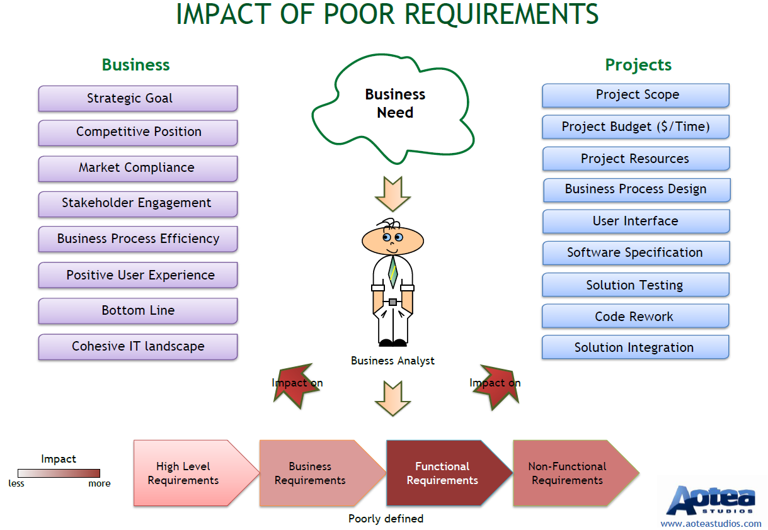
Impact of poor requirements

Slide 55
Data dictionary / glossary of terms
A data dictionary is a file or a set of files that contains a database's metadata
The data dictionary contains records about other objects in the database, such as data ownership, data relationships to other objects, and other data

Slide 56
Data dictionary / glossary of terms
A data dictionary is critical to making your research more reproducible because it allows others to understand your data
The purpose of a data dictionary is to explain what all the variable names and values in your spreadsheet really mean
Variable names
Readable variable name
Measurement units
Allowed values
Definition of the variable
Synonyms for the variable name (optional)
Description of the variable (optional)
Other resources

Slide 57
Techniques and tools used in requirements analysis
Functional decomposition
Use case diagrams
Context diagram
UML (unified modelling language) tool
Activity diagrams

Slide 58
Functional decomposition
Functional decomposition is a way of breaking down the complex problem into simpler problems based on the tasks that need to be performed rather than the data relationships
A functional requirements document (FD) is basically a textual representation of functional decomposition
For instance, think about using an ATM. You could decompose the process into:
Walk up to the ATM
Insert your bank card
Enter your pin
Think of the software running that ATM:
Code for reading the card
PIN verification
Transfer Processing

Slide 59
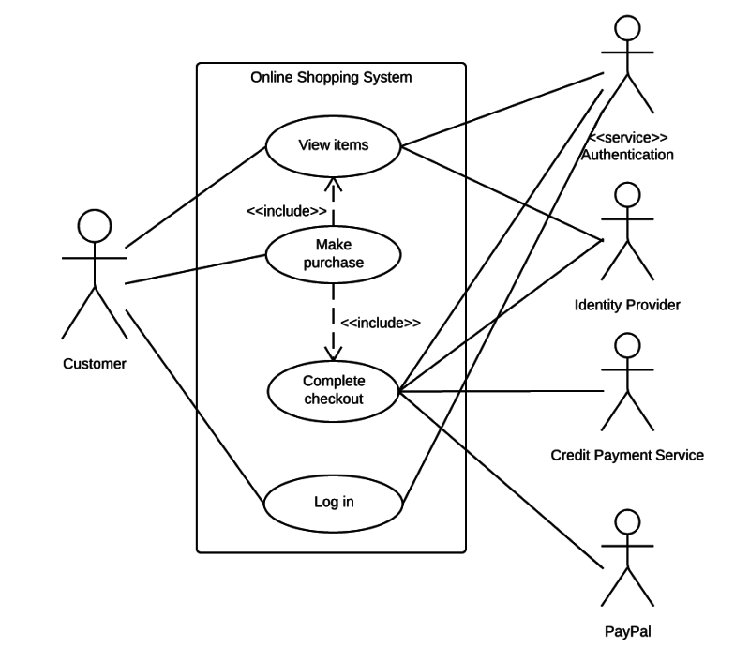
Use case diagrams
A use case diagram is a dynamic or behaviour diagram in UML
Use case diagrams model the functionality of a system using actors and use cases
Use cases are a set of actions, services, and functions that the system needs to perform

Slide 60
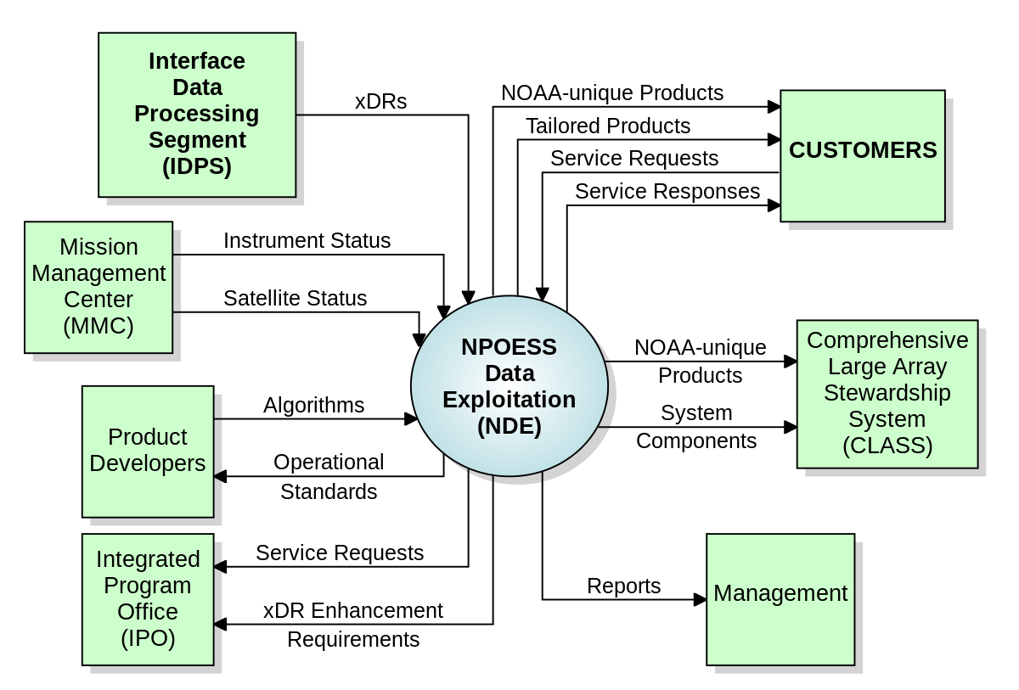
Context diagram
A system context diagram (SCD) in engineering is a diagram that defines the boundary between the system, or part of a system, and its environment, showing the entities that interact with it

Slide 61
UML (unified modelling language) tool
Unified Modelling Language specifies 14 diagram types that represent the structure, behaviour, and interactions of a system
Unified Modelling Language (UML) abstracts and visualises systems of object-orientated programming

Slide 62
ERD Diagram

Slide 63
Sequence Diagram

Slide 64
Activity diagrams
Activity diagram is another important diagram in UML to describe the dynamic aspects of the system
Activity diagram is basically a flowchart to represent the flow from one activity to another activity
The activity can be described as an operation of the system
The control flow is drawn from one operation to another

Slide 65
Activity Diagram

Slide 66
Design
Purpose and scope of design
Difference between functional design that aims to make the software fit for purpose according to functional requirements and non-functional design that aims to make the software fit for use according to non-functional requirements
How functional and non-functional requirements impact software design
Identify the system components that need to be considered when designing software
Explain why human computer interaction is an important consideration for design of software
Explain why good design leads to better operational software, and why the quality of design can have a direct impact on operational cost as well as quality
Explain how prototyping and modelling can be used to aid analysis and design

Slide 67
Purpose and scope of design
The purpose of the Software Design Document is to provide a description of the design of a system fully enough to allow for software development to proceed with an understanding of what is to be built and how it is expected to built
Performed in two stages:
Preliminary design in which the overall system architecture and data architecture is defined
In the detailed design stage more detailed data structures are defined and algorithms are developed for the defined architecture

Slide 68
Functional design v non-functional design
Difference between functional design that aims to make the software fit for purpose according to functional requirements and non-functional design that aims to make the software fit for use according to non-functional requirements
Functional design takes a look at the logical flow of systems, its inputs and outputs, its data organisation, the applicable business and processing rules and how it will appear to users
Non-functional design looks at the quality aspects of the system

Slide 69
How functional and non-functional requirements impact software design
A functional requirement defines a system or its component
A non-functional requirement defines the performance attribute of a software system.
Functional requirements along with requirement analysis help identify missing requirements
The advantage of Non-functional requirement is that it helps you to ensure good user experience and ease of operating the software
Transaction corrections, adjustments, and cancellations, Business Rules, Certification Requirements, Reporting Requirements, Administrative functions, Authorization levels, Audit Tracking, External Interfaces, Historical Data management, Legal or Regulatory Requirements are various types of functional requirements
Types of Non-functional requirement are Scalability Capacity, Availability, Reliability, Recoverability, Data Integrity, etc.
Functional Requirement is a verb while Non-Functional Requirement is an attribute

Slide 70
System components that need consideration
Software architecture
User interface
User ergonomics
Infrastructure / platform components
Tools
Operational processes
Measures and metrics

Slide 71
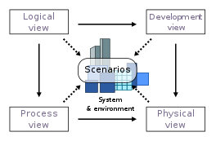
Software architecture
Refers to the fundamental structures of a software system and the discipline of creating such structures and systems
Each structure comprises software elements, relations among them, and properties of both elements and relations

Slide 72
User interface
The means by which the user and a computer system interact, in particular the use of input devices and software

Slide 73
User ergonomics
Software ergonomics is a subcategory of ergonomics that concerns the software design, rather than the hardware design, of systems
Software ergonomics includes the determination of user needs, interface design, user support and usability testing
A user-centered approach to the development of interactive systems

Slide 74
Infrastructure / platform components
A component is a software object, intended to interact with other components, encapsulating certain functionality or a set of functionalities
It has an obviously defined interface and conforms to a recommended behaviour common to all components within an architecture
Has a separation of concerns
Checkout
CardProcessing

Slide 75
Tools
UML software
Rational
Umbrello
Flowcharting software
Visio
Pencil and paper

Slide 76
Operational processes
Software development processes may be grouped into two process areas
lifecycle processes (analogous to core business processes)
cross-lifecycle processes (analogous to supporting business processes)

Slide 77
Primary lifecycle processes
Primary lifecycle processes in software organizations might be described as follows:
Discovering requirements
Designing solutions
Constructing solutions
Validating solutions
Implementing (or deploying) solutions
Supporting deployed solutions (including defect repairs, minor enhancements, changes dictated by evolution of underlying technologies)

Slide 78
Primary cross-lifecycle processes
Primary cross-lifecycle processes typically include:
Planning projects
Estimating (or forecasting) effort, duration, delivered quality
Tracking and reporting status
Defining processes and standards
Measuring and monitoring process performance
Training
Controlling versions and releases of software work products (configuration management)

Slide 79
Measures and metrics
A software metric is a measure of software characteristics which are quantifiable or countable
Software metrics are important for many reasons, including measuring software performance, planning work items, measuring productivity, and many other uses

Slide 80
Metrics
Software metrics should have several important characteristics
They should be:
Simple and computable
Consistent and unambiguous (objective)
Use consistent units of measurement
Independent of programming languages
Easy to calibrate and adaptable
Easy and cost-effective to obtain
Able to be validated for accuracy and reliability
Relevant to the development of high-quality software products

Slide 81
Scope of metrics
Software metrics contains many activities which include the following:
Cost and effort estimation
Productivity measures and model
Data collection
Quantity models and measures
Reliability models
Performance and evaluation models
Structural and complexity metrics
Capability – maturity assessment
Management by metrics
Evaluation of methods and tools

Slide 82
Human Computer Interaction (HCI)
HCI (human-computer interaction) is the study of how people interact with computers and to what extent computers are or are not developed for successful interaction with human beings
As its name implies, HCI consists of three parts:
the user
the computer itself
the ways they work together

Slide 83
Why good design leads to better operational software
Software design is the most important phase of the software development cycle
Good design keeps users happy
Good design makes products more competitive
A strong brand identity encourages customers to trust existing products
Simply/well designed software could mean better interactivity

Slide 84
How prototyping and modelling can be used to aid analysis and design
Prototyping is the process of building a model of a system
In terms of an information system, prototypes are employed to help system designers build an information system that is intuitive and easy to manipulate for end users
Prototyping is an iterative process that is part of the analysis phase of the systems development life cycle

Slide 85
Advantages
Reduces development time
Reduces development costs
Requires user involvement
Developers receive quantifiable user feedback
Facilitates system implementation since users know what to expect
Results in higher user satisfaction
Exposes developers to potential future system enhancements

Slide 86
Disadvantages
Can lead to insufficient analysis
Users expect the performance of the ultimate system to be the same as the prototype
Developers can become too attached to their prototypes
Can cause systems to be left unfinished and/or implemented before they are ready
Sometimes leads to incomplete documentation
If sophisticated software prototypes (4th GL or CASE Tools) are employed, the time saving benefit of prototyping can be lost

Slide 87
Code Development
Summarise the main features and benefits of version control for the development of code, including:
Demonstrate how version control, in conjunction with configuration and release management, can be used for software that is being developed for use on multiple platforms
Explain the importance of using coding guidelines and standards
Explain the purpose of a range of programming tools, including:
Explain the purpose and benefit of peer reviews and retrospectives in the development process

Slide 88
Main features and benefits of version control
Change history
Concurrent working
Tracking and preventing conflicts
Traceability
Security

Slide 89
Change history
Software change management is the process of selecting which changes to encourage, which to allow, and which to prevent, according to project criteria such as schedule and cost
The process identifies the changes' origin, defines critical project decision points, and establishes project roles and responsibilities

Slide 90
Concurrent working
Not to be confused with parallelism, concurrency is when multiple sequences of operations are run in overlapping periods of time
In the realm of programming, concurrency is a pretty complex subject
Dealing with constructs such as threads and locks and avoiding issues like race conditions and deadlocks can be quite cumbersome, making concurrent programs difficult to write
Through concurrency, programs can be designed as independent processes working together in a specific composition

Slide 91
Concurrent working
Where a team of people may concurrently make changes to the same files
A CVS is used to this end
Concurrent Versioning System (CVS), is a free client-server revision control system in the field of software development.
A version control system keeps track of all work and all changes in a set of files, and allows several developers (potentially widely separated in space and time) to collaborate
Several developers may work on the same project concurrently, each one editing files within their own "working copy" of the project, and sending (or checking in) their modifications to the server

Slide 92
Concurrency Models (not in syllabus)
Shared Mutable State Model
Actor model
https://www.toptal.com/software/introduction-to-concurrent-programming

Slide 93
Tracking
Tracking allows flexibility
Many tools available
The tools support the project by helping the team identify the requirements and split them into a number of smaller tasks

Slide 94
Tools
Source control tools
Git
Mercurial
Subverion
CVS
Continuous integration tools
Hudson
Jenkins
Team management
Jenkins
Git
Bamboo
Eclipse
Active Collab
Jira
Version One

Slide 95
Preventing Conflicts
Conflicts do occur and it is natural
Could be constructive or destructive
Destructiveness can be costly
Usually due to inattentive project planning
Clear roles and goals could largely eliminate conflict

Slide 96
Traceability
The ability to trace something
Could be mandated by government
Traceability in software engineering is the ability to trace work items across the development lifecycle
It’s used to keep track of what’s going on in the development lifecycle — and show what’s happened
Achieving regulatory compliance is a common purpose for traceability in software engineering
Traceability works by linking two or more work items in application development
This link indicates a dependency between the items
Requirements and test cases are often traced

Slide 97
Security
Security, as part of the software development process, is an ongoing process involving people and practices, and ensures application confidentiality, integrity, and availability
Secure software is the result of security aware software development processes where security is built in and thus software is developed with security in mind

Slide 98
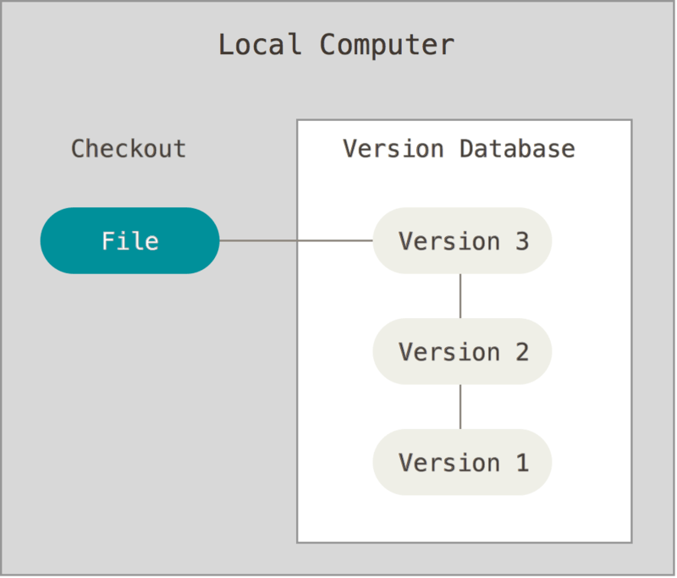
Using Version Control

Slide 99
Benefits of Version Control
Version control systems allow you to compare files, identify differences, and merge the changes if needed prior to committing any code
Versioning is also a great way to keep track of application builds by being able to identify which version is currently in development, QA, and production
When new developers join a team, they can easily download the current version of the application to their local environment using the version control system and are able to keep track of the version they’re currently running
During development, you can also have entirely independent code versions if you prefer to keep different development efforts separate
When ready, you can merge the files to create a final working version
Another great use for versioning is when troubleshooting an issue, you are able to easily compare different versions of files to track differences
You can compare the last working file with the faulty file, decreasing the time spent identifying the cause of an issue
If the user decides to roll back the changes, you can implement the last working file by using the correct version

Slide 100
Main Features of Version Control
A version control system is mostly based around one concept, tracking changes that happen within directories or files
The set of files or directories that are under version control are more commonly called a repository
Repositories may be cloned (also called checking out)
In version control, modifying, deleting files and/or directories, moving files or anything that can alter the state of a file is known as a commit
When a commit is made, the changes are recorded as a changeset and given a unique revision
A changeset will include a reference to the person who made the commit

Slide 101
Change history
As files are updated, you can leave messages explaining why the change happened (stored in the VCS, not the file). This makes it easy to see how a file is evolving over time, and why

Slide 102
Security
One of the fundamental pieces of version control is a revision history
Copies of the repository, which has all the files and their history, can be stored on multiple computers
Version control also allows you to create markers that reference the state of the files at a specific point in time
These are often used to denote major changes, such as a new version
Version control forces every file change to be attributed to a user, which introduces accountability

Slide 103
Importance of using coding guidelines and standards
Coding rules and guidelines ensure that software is:
Safe: It can be used without causing harm
Secure: It can’t be hacked
Reliable: It functions as it should, every time
Testable: It can be tested at the code level
Maintainable: It can be maintained, even as your codebase grows
Portable: It works the same in every environment
Coding standards are important for safety, security, and reliability.
Every development team should use a coding standard. Even the most experienced developer could introduce a coding defect — without realizing it. And that one defect could lead to a minor glitch. Or worse, a serious security breach

Slide 104
Importance of using coding guidelines and standards
There are four main drivers for using a coding standard:
Compliance with industry standards (e.g., ISO).
Consistent code quality — no matter who writes the code.
Software security from the start.
Reduced development costs and accelerated time to market

Slide 105
Purpose of a range of programming tools
Compilers
Interpreters
Debuggers
GUI designers

Slide 106
Compilers
A compiler is a special program that processes statements written in a particular programming language and turns them into machine language or "code" that a computer's processor uses
Typically, a programmer writes language statements in a language such as C# or VB.Net
The file that is created contains what are called the source statements
The programmer then runs the appropriate language compiler, specifying the name of the file that contains the source statements or C one line at a time using an editor

Slide 107
Interpreters
An interpreter is a computer program that directly executes instructions written in a programming or scripting language, without requiring them previously to have been compiled into a machine language program
An interpreter generally uses one of the following strategies for program execution:
Parse the source code and perform its behaviour directly
Translate source code into some efficient intermediate representation and immediately execute this
Explicitly execute stored precompiled code made by a compiler which is part of the interpreter system

Slide 108
Debuggers
A computer program that assists in the detection and correction of errors in other computer programs
Typically, debuggers offer a query processor, a symbol resolver, an expression interpreter, and a debug support interface at its top level
Debuggers also offer more sophisticated functions such as running a program step by step (single-stepping or program animation), stopping (breaking) (pausing the program to examine the current state) at some event or specified instruction by means of a breakpoint, and tracking the values of variables
Some debuggers have the ability to modify program state while it is running. It may also be possible to continue execution at a different location in the program to bypass a crash or logical error

Slide 109
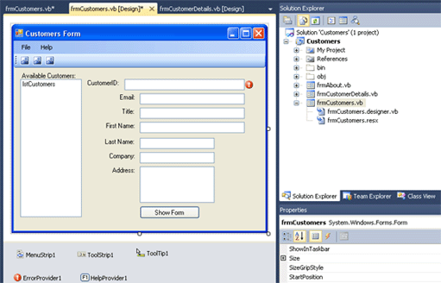
GUI designers
A graphical user interface builder (or GUI builder), also known as GUI designer
Software development tool that simplifies the creation of GUIs by allowing the designer to arrange graphical control elements (often called widgets) using a drag-and-drop WYSIWYG editor

Slide 110
Purpose and benefit of peer reviews and retrospectives
The purpose of a peer review is to provide "a disciplined engineering practice for detecting and correcting defects in software artifacts, and preventing their leakage into field operations“
Benefits:
Finding bugs early, when they are cheap to fix
Coding standards compliance
Teaching and sharing knowledge
Consistent design and implementation
Higher software security
Team cohesion
Confidence of stakeholders
An Agile retrospective is a meeting that's held at the end of an iteration in Agile software development (ASD )
During the retrospective, the team reflects on what happened in the iteration and identifies actions for improvement going forward

Slide 111
Testing
Why testing is necessary
How to determine the correct types of test coverage based on a requirement
Summarise the different levels of testing, their purposes and the generic test process that supports them
Different types and techniques for software testing and why they would be used, including
Functional and non-functional categories of tests for a given case
Recognise that different organisations apply different approaches to testing depending on development methodologies used and organisational preferences
Advantages and disadvantages of using independent software testing teams as opposed to using testers who have been involved in other aspects of development
The use of equivalence classes and use cases in testing code
How to efficiently and effectively debug code

Slide 112
Why testing is necessary
The principles of early testing
Risk reduction
Conformance to functional and non-functional requirements
Finding defects
Differentiating testing from debugging

Slide 113
Why Early Testing?
A defect can be found throughout all the phases of software development Life Cycle
It is better to start early testing in the software development life cycle so as to minimize defects in the later stages
It can be design review, unit testing or regression testing
Design phase comes early in Software Development Life Cycle
Design Testing is done at this phase.

Slide 114
Risk reduction
Risk: A factor that could result in future negative consequences; usually expressed as impact and likelihood - ISTQB Glossary
A risk-based approach to testing provides proactive opportunities to reduce the levels of product risk, starting in the initial stages of a project
It involves the identification of product risks and their use in guiding test planning and control, specification, preparation and execution of tests
In a risk-based approach, the risks identified may be used to:
Determine the test techniques to be employed
Determine the extent of testing to be carried out
Prioritise testing in an attempt to find the critical defects as early as possible
Determine whether any non-testing activities could be employed to reduce risk

Slide 115
Conformance to functional and non-functional requirements
Conformation is the degree of adherence to pre-set expectations
The degree to which a product meets its pre-specified criteria is termed as conformance in the context of software engineering
Software Developer establishes functional and non-functional requirements prior to software development
The functional requirements are those requirements that represent the core functionality provided by the system
Non-functional requirements are the additional requirements such as restriction on time, performance, availability, scalability, reliability, etc.
The degree of adherence of the software to its functional requirements is the conformance of the software to its requirements

Slide 116
Finding defects
Reviewers (aka Checkers or Inspectors) are responsible for finding defects in the product under review
Developers see finding defects as a negative process which causes delays
Testers know that software contains bugs
All defects start with a human error (for example a typo, misunderstanding, lack of capacity planning etc.)
The tester's job is to expose the defect by causing a failure before the software gets to production

Slide 117
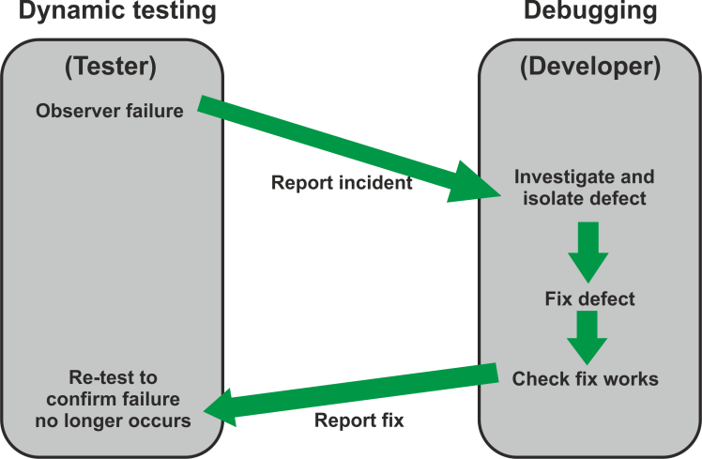
Differentiating testing from debugging
Debugging and testing are different
Testing can show failures that are caused by defects
Debugging is the development activity that identifies the cause of a defect, repairs the code and checks that the defect has been fixed correctly
Subsequent re-testing by a tester ensures that the fix does indeed resolve the failure

Slide 118
How to determine the correct types of test coverage based
Explain how to determine the correct types of test coverage based on a requirement

Slide 119
The different levels of testing
Summarise, the different levels of testing their purposes and the generic test process that supports them:
Unit testing
Integration testing
System testing
Acceptance testing

Slide 120
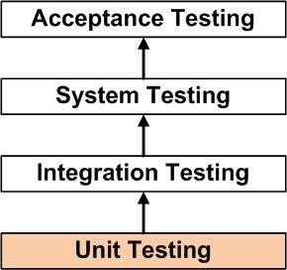
Unit Testing
Unit testing is a level of software testing where individual units/ components of a software are tested
The purpose is to validate that each unit of the software performs as designed. A unit is the smallest testable part of any software
It usually has one or a few inputs and usually a single output

Slide 121
Integration Testing
Integration testing is a level of software testing where individual units are combined and tested as a group
The purpose of this level of testing is to expose faults in the interaction between integrated units
Test drivers and test stubs are used to assist in Integration Testing

Slide 122
System Testing
System testing is a level of software testing where a complete and integrated software is tested
The purpose of this test is to evaluate the system's compliance with the specified requirements - definition by ISTQB

Slide 123
Acceptance Testing
The purpose of acceptance testing is to establish confidence in the system or specific characteristics of the system
The main focus is ensuring the system is fit for purpose, not finding defects. It may assess the system's readiness for deployment and use
The aim should literally be to 'accept' and therefore should be a test of the system under typical usage
Acceptance testing is a level of software testing where a system is tested for acceptability. The purpose of this test is to evaluate the system's compliance with the business requirements and assess whether it is acceptable for delivery - definition by ISTQB.

Slide 124
Different types and techniques for software testing
Describe different types and techniques for software testing and why they would be used, including:
Functional and non-functional testing
Regression testing
White box and black box testing
Experience-based testing

Slide 125
Functional Testing
Functional testing is concerned with WHAT the system must do to achieve its objectives, as defined in business requirements, functional specifications, Use Cases, business process models, etc.
It considers the external behaviour of the software, so is black-box testing

Slide 126
Non-Functional Testing
Non-functional testing tests the attributes of a system that do not relate to functionality. It is concerned with HOW WELL a system works
Non-functional requirements are often constraints on the functionality, e.g. constraint on how, how often, who, when or where a function can take place
Has the following parameters:
Security - The parameter defines how system is safeguarded against deliberate and sudden attacks from internal and external sources. This is tested via Security Testing
Performance - type of testing perform to determine the performance of system to major the measure, validate or verify quality attributes of the system like responsiveness, speed, scalability, stability under variety of load conditions
Usability - The ease with which the user can learn, operate, prepare inputs and outputs through interaction with a system. This is checked by Usability Testing
Reliability - The extent to which any software system continuously performs the specified functions without failure. This is tested by Reliability Testing

Slide 127
Regression testing
Testing of a previously tested program following modification, to ensure that defects have not been introduced or uncovered in unchanged areas of the software as a result of the changes made. ISQTB Glossary

Slide 128
Black Box testing (Specification-based)
Black-box test design techniques are a way to derive and select test conditions, test cases, or test data based on an analysis of the test basis documentation
This includes both functional and non-functional testing.
Black-box testing takes an external view of the software and does not use any information regarding the internal structure of the component or system to be tested

Slide 129
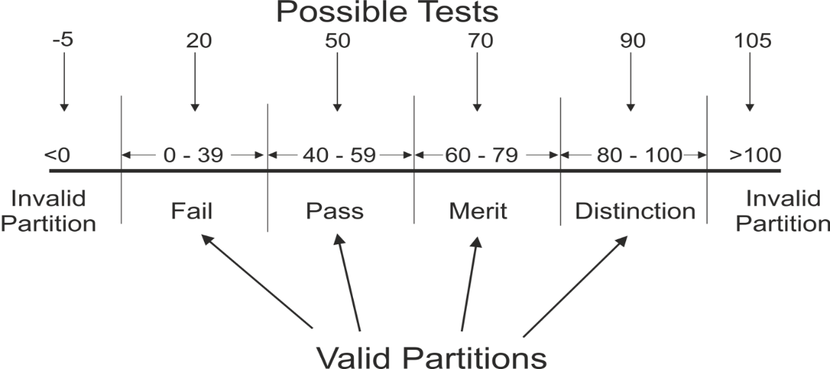
Black Box – Equivalence Partitioning
Equivalence partitioning
In equivalence partitioning, inputs to the software or system are divided into groups or ranges of values that are expected to exhibit similar behaviour, so they are likely to be processed in the same way, i.e. have the same output.
Instead of testing every value in the partition, one value can be chosen to represent all, and used to test the whole partition

Slide 130
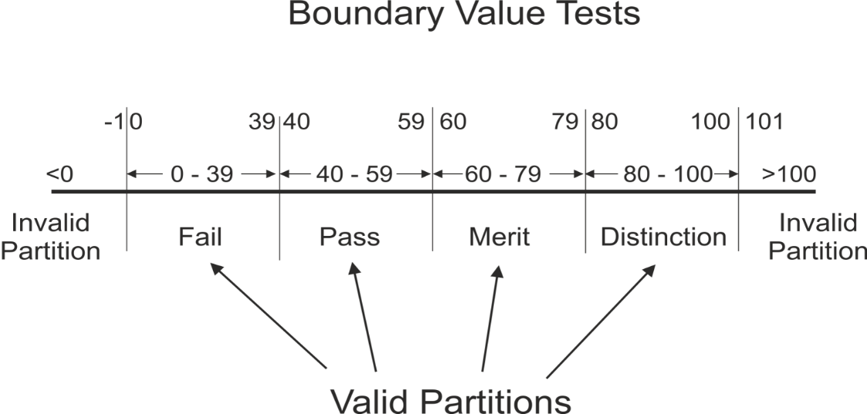
Black Box – Boundary Value Analysis
Boundary value analysis
Boundaries are the dividing lines between equivalence partitions
Behaviour at the edge of a partition is more likely to be incorrect than behaviour within the partition, so boundaries are an area where testing is likely to yield defects
The minimum and maximum values of a partition are its boundary values

Slide 131
Black box – Decision Tables
Decision tables
Decision Tables represent the behaviour of a system that depends on the outcome of multiple decisions
They may be used to record complex business rules that a system is to implement
The table specifies the possible combination of conditions and the resulting actions, according the business rules
Each column of the table corresponds to a business rule that defines a unique combination of conditions and which result in the execution of the actions associated with that rule
Conditions are usually stated in Boolean form (True/False or Yes/No)

Slide 132
Black box – Decision Tables

Slide 133
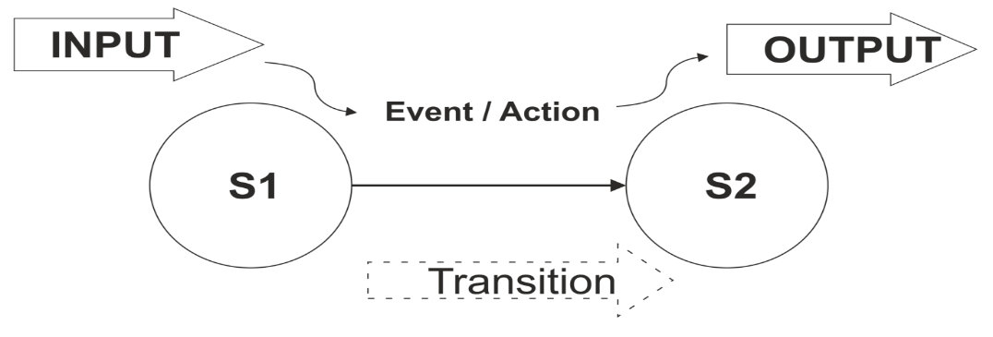
Black box - State transition diagrams
State transition diagrams
Some systems can be described in terms of 'states' or modes that the system can assume, the transition from one state to another because of some input condition, which leads to an event and results in an action which will finally give an output
These systems can be represented by a state diagram showing:
The states a component or system may be in
The transitions or changes form one state to another
The events or circumstances that cause transitions
The actions as a result from the transition, for example an error message

Slide 134
Experience-based testing
Experience-based testing is where tests are derived from the tester's skill or intuition, and their experience of similar applications and technologies
It is not based on analysis of specifications or structure
It is generally less thorough than systematic techniques (black-box and white-box), but it can be more effective if there is a lack of testing time or resources, and it can identify special tests not easily captured by formal techniques
Testers use their expertise to identify key areas to test, such as:
Critical or most-used functions
Areas most likely to fail (e.g. defect clusters or complex code)

Slide 135
Functional and non-functional categories of tests
Functional
Unit Testing
Smoke testing
Sanity testing
Integration Testing
Interface Testing
System Testing
Regression Testing
UAT
Non-Functional
Availability Testing
Baseline testing
Compatibility testing
Compliance testing
Configuration Testing
Documentation testing
Endurance testing
Ergonomics Testing
Interoperability Testing
Installation Testing
Load testing
Localization testing and Internationalization testing
Maintainability Testing
Operational Readiness Testing
Performance testing
Recovery testing
Reliability Testing
Resilience testing
Security testing
Scalability testing
Stress testing
Usability testing
Volume testing

Slide 136
Different approaches to testing
There are many strategies that a project can adopt depending on the context and some of them are:
Dynamic and heuristic approaches
Consultative approaches
Model-based approach that uses statistical information about failure rates.
Approaches based on risk-based testing where the entire development takes place based on the risk
Methodical approach, which is based on failures
Standard-compliant approach specified by industry-specific standards

Slide 137
Advantages and disadvantages of using independent software testing teams
Independent testing corresponds to an independent team, who involve in testing activities other than developer to avoid author bias and is often more effective at finding defects and failures
Benefits:
The tester sees each defect in a neutral perspective
The tester is totally unbiased
The tester sees what has been built rather than what the developer thought
The tester makes no assumptions regarding quality
Disadvantages:
Isolation from the development team can sometimes lead to outdated documentation reference
The independent test execution is normally the last stage and affected by any delays earlier in the process
Developers might be irresponsible for quality as they might assume that independent testing team is there to find the issues within the system
Independent testing can sometimes act as a hindrance to communication

Slide 138
Use of equivalence classes and use cases in testing code
Equivalence partitioning or equivalence class partitioning (ECP) is a software testing technique that divides the input data of a software unit into partitions of equivalent data from which test cases can be derived
In principle, test cases are designed to cover each partition at least once

Slide 139
Black Box – Equivalence Partitioning
Equivalence partitioning
In equivalence partitioning, inputs to the software or system are divided into groups or ranges of values that are expected to exhibit similar behaviour, so they are likely to be processed in the same way, i.e. have the same output.
Instead of testing every value in the partition, one value can be chosen to represent all, and used to test the whole partition

Slide 140
Use case testing
Use Case Testing is defined as a software testing technique, that helps identify test cases that cover the entire system, on a transaction by transaction basis from start to the finishing point

Slide 141
How to efficiently and effectively debug code
Types of error
Exception handling
Reproduction
Elimination
Logging
Test coverage

Slide 142
Types of error
We distinguish between the following types of errors:
Syntax errors: errors due to the fact that the syntax of the language is not respected
Semantic errors: errors due to an improper use of program statements
Logical errors: errors due to the fact that the specification is not respected
From the point of view of when errors are detected, we distinguish:
Compile time errors: syntax errors and static semantic errors indicated by the compiler
Runtime errors: dynamic semantic errors, and logical errors, that cannot be detected by the compiler (debugging)

Slide 143
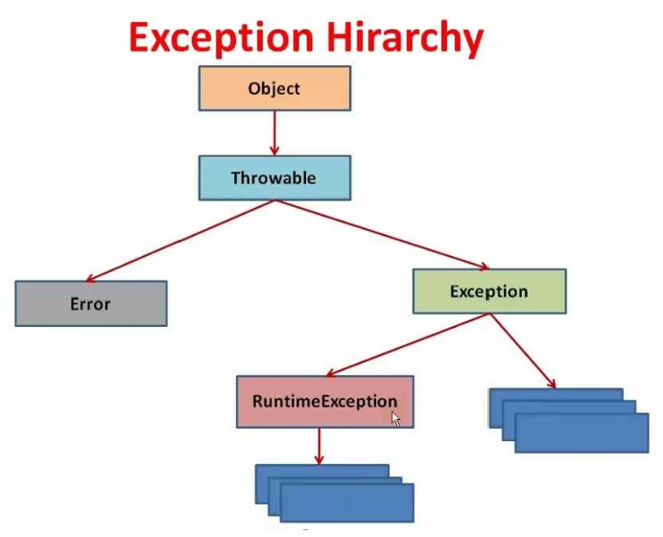
Exception handling
Process of responding to the occurrence, during computation, of exceptions – anomalous or exceptional conditions requiring special processing – often disrupting the normal flow of program execution
It is provided by specialized programming language constructs, computer hardware mechanisms like interrupts or operating system IPC facilities like signals

Slide 144
Reproduction
When a bug occurs, users will it into a tracking system with detailed information on how to reproduce it.
A developer walks through the given steps to reproduce the issue, finds the problem, and submits a fix
Reproducibility (often confused with replication) is the question of whether or not your answers can be reached via different means
This is considered a holy grail of the science process: if other people can get the same result without using an identical process, then the result is more likely to be correct

Slide 145
Elimination
Concept of eliminating bugs before they are coded
Bugs are discovered as software is created, then eliminated

Slide 146
Logging
Defect logging, a process of finding defects in the application under test or product by testing or recording feedback from customers and making new versions of the product that fix the defects or the clients feedback

Slide 147
Logging
Defects are tracked based on various parameters such as:
Defect Id - Lists each defect uniquely
Priority - Assigning priority to a defect on the basis of the degree of risk involved
Severity - Determines to what extent the defect can affect the system
Created By - The name of the person who has detected the defect
Created Date - The date on which the defect was captured
Assigned to - The person to whom the defect is reported for resolving it
Resolved Date - The date on which the defect is resolved
Resolved By - The team/person who resolved the defect
Status - Defect fixed or postponed (based on the severity of the defect)

Slide 148
Test coverage
Test coverage is defined as a metric in Software Testing that measures the amount of testing performed by a set of test
It will include gathering information about which parts of a program are executed when running the test suite to determine which branches of conditional statements have been taken
Structural or white box
Coverage expressed as apercentage

Slide 149
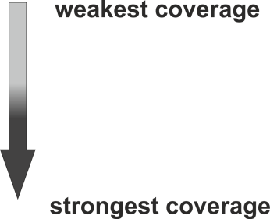
Test coverage
There are different coverage measures of software code structure:
Statement coverage
Decision coverage
Condition coverage
Multiple condition coverage
All Paths coverage

Slide 150
Deployment / Implementation
Activities undertaken during release and deployment of an IT service
Configuration management techniques are used to control and manage the different software development artefacts through the stages of the SDLC and into live operation
Explain the relative advantages and disadvantages of ‘phased deployment’ versus ‘big bang’ deployment of software
Relate phased deployment and big bang deployment to waterfall and agile methods of development
Explain the role of software developers in ‘early life support’ for operational software
Explain the concepts of ‘release packages’
Produce an appropriate version numbering system for software releases in a given case
Explain the concept of software licensing, and describe the types of licence that can be deployed

Slide 151
Activities undertaken during release and deployment of an IT service
Implementation planning
Training users and operations
User documentation
Build software release
Deploy software

Slide 152
Implementation planning
A thorough implementation plan usually covers at least five elements:
the work plan
resources and budget
Stakeholders
risk assessment
quality control

Slide 153
Training users and operations
User documentation
Build software release
Deploy software

Slide 154
User documentation
User documentation refers to the documentation for a product or service provided to the end users
The user documentation is designed to assist end users to use the product or service
This is often referred to as user assistance
Types of user documentation
Instructional material
Training material

Slide 155
Build software release
A “build” is a developed application for the customers that is given by development team to the software testing team
A “release” is an official launch of the application for the customers
A build when tested and certified by the software testing team is provided to the customers as “release”

Slide 156
Deploy software
Software deployment includes all the process required for preparing a software application to run and operate in a specific environment
It involves installation, configuration, testing and making changes to optimize the performance of the software

Slide 157
How Configuration Management Techniques Are Used
Configuration management (CM) is a systems engineering process for establishing and maintaining consistency of a product's performance, functional, and physical attributes with its requirements, design, and operational information throughout its life
Applied over the life cycle of a system provides visibility and control of its performance, functional, and physical attributes
CM verifies that a system performs as intended, and is identified and documented in sufficient detail to support its projected life cycle
The CM process facilitates orderly management of system information and system changes for such beneficial purposes as:
to revise capability
improve performance, reliability, or maintainability
extend life
reduce cost
reduce risk and liability
correct defects

Slide 158
Configuration Management

Slide 159
Relative advantages and disadvantages of ‘phased deployment’ versus ‘big bang’ deployment
The 3 main implementation strategies:
Parallel Run
Big Bang
Phased Approach
Parallel Run: Using this strategy you as the client will use your new system alongside your legacy application
Big Bang: Using this strategy the complete implementation happens in one single instance and all legacy application (if any) are cut out and all users move to the new system on an agreed upon day
Phased Approach: The cutover and adoption of the new application happens in phases over an extended period of time and all users are migrated to the new system in an orchestrated series of steps

Slide 160
Phased deployment and big bang deployment
A ‘big bang’ implementation is typically used to describe a go-live or cutover scenario where a business switches from their old system to their new system at a single point in time
In contrast, a ‘phased’ approach describes a scenario where elements or modules of the system are introduced in a planned sequence, replacing the old systems gradually
Difficult to implement a phased approach using the waterfall method

Slide 161
Role of software developers in ‘early life support’
Based on ITIL, early life support provided for a new or changed IT service for a period of time after it is released
During early life support the IT service provider may review the KPIs, service levels and monitoring thresholds, and provide additional resources for incident and problem management
SD is instrumental in identifying specific incidents and determine the necessary course of action

Slide 162
Release packages
Alpha and beta releases
Major and minor releases
Software upgrades

Slide 163
Alpha and beta releases
The alpha phase of the release life cycle is the first phase to begin software testing (alpha is the first letter of the Greek alphabet, used as the number
In this phase, developers generally test the software using white-box techniques
Additional validation is then performed using black-box or grey-box techniques, by another testing team
Moving to black-box testing inside the organization is known as alpha release
Beta is the software development phase following alpha
Software in the beta stage is also known as betaware
Beta phase generally begins when the software is feature complete but likely to contain a number of known or unknown bugs
Software in the beta phase will generally have many more bugs in it than completed software, speed or performance issues, and may still cause crashes or data loss
The focus of beta testing is reducing impacts to users, often incorporating usability testing

Slide 164
Major and minor releases
Software upgrade versioning is the process of assigning either unique version names or unique version numbers to unique states of computer software
Within a given version number category (major, minor), these numbers are generally assigned in increasing order and correspond to new developments in the software

Slide 165
Software upgrades
When referring to software, a software upgrade refers to any major upgrade to the software that adds significant or completely new changes to the program
An example of a software upgrade is upgrading your version of Windows
Instead of building on your existing program, a software upgrade is a new version of the software product entirely
A software upgrade, then, supersedes the old product
Upgrades are used for significant changes and major improvements to your current version of the program
It might have an overhauled user interface, or an exciting set of new features, or key structural changes

Slide 166
Version numbering system
Usual method of versioning is in the form of X.Y.Z
Corresponds to major.minor.patch
Major version numbers change whenever there is some significant change being introduced
For example, a large or potentially backward-incompatible change to a software package.
Minor version numbers change when a new, minor feature is introduced or when a set of smaller features is rolled out
Patch numbers change when a new build of the software is released to customers. This is normally for small bug-fixes or the like

Slide 167
Concept of software licensing
Explain the concept of software licensing and describe the types of licence that can be deployed, including
proprietary licence
end-user licence
enterprise licence
site licence
workstation licence
perpetual licence
open-source licence

Slide 168
Proprietary licence
Proprietary software consists of software that is licensed by the copyright holder under very specific conditions
Typically, you are not allowed to modify or distribute the software
Some propriety software is commercial, and you have to pay for a license, but other proprietary software is free

Slide 169
End-user licence
Usually an agreement to use the software
An End User License Agreement (EULA) is a legal contract between a software application author or publisher and the user of that application
The user can refuse to enter into the agreement by returning the software product for a refund or clicking "I do not accept" when prompted to accept the EULA during an install

Slide 170
Enterprise licence
A software site license that is issued to a large company
It typically allows unlimited use of the program throughout the organization, although there may be restrictions and limitations
Similar to a volume license

Slide 171
Site licence
A site license is a type of software license that allows the user to install a software package in several computers simultaneously, such as at a particular site (facility) or across a corporation

Slide 172
Workstation licence
Workstation license is a license that may be used on a single computer, where the host application (3ds Max, Cinema 4D, ...) is running in "full" mode - with graphical user interface, material editor, and all other features enabled, as opposed to node license

Slide 173
Perpetual licence
A perpetual software license is a type of software license that authorizes an individual to use a program indefinitely
Generally, outside of termination, a perpetual software license allows the holder to use a specific version of a given software program continually with payment of a single fee

Slide 174
Open-source licence
An open-source license is a type of license for computer software and other products that allows the source code, blueprint or design to be used, modified and/or shared under defined terms and conditions
This allows end users and commercial companies to review and modify the source code, blueprint or design for their own customization, curiosity or troubleshooting needs
Open-source licensed software is mostly available free of charge, though this does not necessarily have to be the case

Slide 175
Maintenance
The activities that take place in the maintenance stage
Reasons and drivers for changes to software
The purpose of a service level agreement for operational software
A typical process for reporting, logging, and dealing with incidents and problems in operational software, and explain the terms ‘first-line support’ and ‘second-line support’ in this context
Problem-solving techniques
The importance of managing and controlling changes to operational software
Typical process for the control of changes to live software

Slide 176
Maintenance
Maintenance activities can be categorised into four classes:
Adaptive – modifying the system to cope with changes in the software environment (DBMS, OS)
Perfective – implementing new or changed user requirements which concern functional enhancements to the software
Corrective – diagnosing and fixing errors, possibly ones found by users
Preventive – increasing software maintainability or reliability to prevent problems in the future

Slide 177
Activities that take place in the maintenance stage
Describe the activities that take place in the maintenance stage, including:
Minor enhancement
Major enhancement
Error correction
Temporary workaround / bug fix
Performance improvement
Routine updates and upgrades

Slide 178
Minor enhancement
Minor enhancement means a revision to the System that provides moderate new functionality features and improvements without changing the direction/scope of the System
A minor enhancement is designated by a change in the number to the right of the decimal point (e.g., a move from Version 3.1 to Version 3.2)

Slide 179
Major enhancement
Major enhancement means a revision to the System that provides radically new functionality features and improvements while possiblyt changing the direction/scope of the system

Slide 180
Error correction
Maintenance phase could be used for error correction
This will be where a module or component is proving to be challenging from a security point of view
Errors and omissions in the original software requirements are discovered and need to be rectified to make the software remain useful

Slide 181
Temporary workaround / bug fix
A workaround is a bypass of a recognized problem or limitation in a system
A workaround is typically a temporary fix
Implies that a genuine solution to the problem is needed
A patch or change that fixes the unwanted behaviour exhibited by a bug

Slide 182
Performance improvement
Performance improvements could include parameters such as:
buffer space
disk file allocation
main memory partition
I/O priority
Performance testing is concerned both with demonstrating that the system meets its requirements and discovering problems and defects in the system
To test whether performance requirements are being achieved, you may have to construct an operational profile

Slide 183
Routine updates and upgrades
Software Update
A software update, which is sometimes called a software patch, is a free download for an application, operating system, or software suite that provides fixes for features that aren't working as intended or adds minor software enhancements and compatibility
Software updates are released to address security issues when they occur, to address minor bugs discovered in the software, to improve the operation of hardware or peripherals, and to add support for new models of equipment
These small, incremental updates improve the operation of your software

Slide 184
Routine updates and upgrades
The Importance of Software Updates
Although they are typically small and free, software updates play important roles often related to solving or preventing a problem:
Protect against new-found security risks
Introduce new features in your software
Improve battery depletion rate or performance speed
Extend your equipment's usable life by allowing its maximum productivity
Fix bugs in the software and improve functionality

Slide 185
Routine updates and upgrades
Software Upgrade
A software upgrade is a new version of the software that offers a significant change or major improvement over your current version
In many cases, a software upgrade requires the purchase of the new version of the software, sometimes at a discounted price if you own an older version of the software

Slide 186
Reasons and drivers for changes to software
Explain the reasons and drivers for changes to software including
Changed user requirement
Problem or incident identified
Regulatory or other mandatory change
Infrastructure / platform change

Slide 187
Changed user requirement
Things WILL change
Welcome change (it says so in the Agile Manifesto)
Why does it happen?
Patterns over time
Processes change (you are a developer, not a process consultant)

Slide 188
Problem or incident identified
Incidents differ from both problems and requests
An incident interrupts normal service
A problem is a condition identified through a series of multiple incidents with the same symptoms

Slide 189
Regulatory or other mandatory change
Regulation and compliance (following the rules) applies to the sociotechnical system as a whole and not simply the software element of that system
National and international regulators require detailed evidence that the system is safe
This evidence might include:
The specification of the system that has been developed and records of the checks made on that specification
Evidence of the verification and validation processes that have been carried out and the results of the system verification and validation
Evidence that the organizations developing the system have defined and dependable software processes that include safety assurance reviews. There must also be records showing that these processes have been properly enacted

Slide 190
Infrastructure / platform change
This could be a hardware or a software change
Windows to Linux
Hardware to cloud
Addition of API’s
Addition or change of database system

Slide 191
Purpose of a service level agreement for operational software
A service-level agreement is an agreement between two or more parties, where one is the customer and the others are service providers
Defines the level of service you expect from a vendor, laying out the metrics by which service is measured, as well as remedies or penalties should agreed-on service levels not be achieved
It is a critical component of any technology vendor contract
NOT a legal contract

Slide 192
Typical processes
Reporting
Logging
Dealing with incidents and problems in operational software
First-line support
Second-line support

Slide 193
Problem-solving techniques
Brainstorming
Fault tree analysis
Kepner-tregoe root cause analysis
Ishakawa diagrams (fishbone diagrams)
Decomposition

Slide 194
Fault tree analysis
Fault tree analysis is a top-down approach to identify all potential causes leading to a defect
Each cause is further broken down into least possible events or faults
The analysis begins with a major defect
All the potential events – individual or in combination – that may cause the defect are identified
Potential events are further traced down in a similar way to the lowest possible level

Slide 195
Fault tree analysis

Slide 196
Kepner-Tregoe root cause analysis
Also known as KT methodology
Developed by Charles Kepner and Benjamin Tregoe
Is a problem analysis model in which the “problem” is disconnected from the “decision”
An English synonym for this problem-solving method is Problem Solving and Decision Making (PSDM)
When solving problems people search for the answer to the following four questions:
What happened?
Why did it happen?
How should we act?
What will be the (future) result?

Slide 198
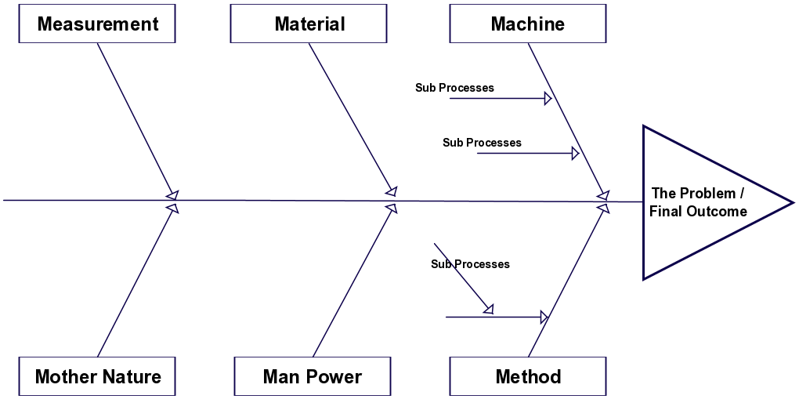
Ishakawa diagrams
A fishbone diagram, also called a cause and effect diagram or Ishikawa diagram, is a visualization tool for categorizing the potential causes of a problem in order to identify its root causes

Slide 199
Decomposition
Decomposition is the process of breaking down a system into its smaller components
These components may themselves be systems (subsystems) and can be broken down into their components as well
Decomposition is a technique that allows the systems analyst to:
Break a system into small, manageable, and understandable subsystems
Focus attention on one area (subsystem) at a time, without interference from other areas
Concentrate on the part of the system pertinent to a particular group of users, without confusing users with unnecessary details
Build different parts of the system at independent times and have the help of different analysts

Slide 200
Importance of managing and controlling changes
Change is a fact of life for large software systems
Organisational needs and requirements change during the lifetime of a system, bugs have to be repaired, and systems have to adapt to changes in their environment
Change management is intended to ensure that the evolution of the system is controlled, and that the most urgent and cost-effective changes are prioritised
Change management is the process of analysing the costs and benefits of proposed changes, approving those changes that are cost-effective, and tracking which components in the system have been changed

Slide 201
Change Process Flow
The change management process flow looks something like this:
Request for Change. Request For Change (RFC) is submitted to the change management team for validation and approval
An RFC template is used to record the change
Change Assessment and Planning
Change approvals
Change implementation

Slide 202
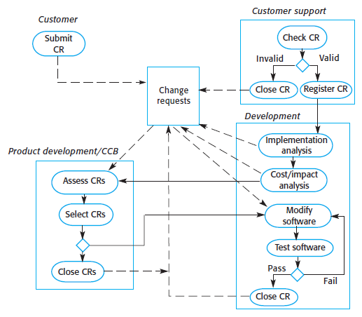
Typical process for the control of changes to live software
Describe in outline a typical process for the control of changes to live software

Slide 204
1.4 Demonstrate the high-level deliverables from each stage of the software development lifecycle
Organise deliverables according to the stage of the SDLC from which they are delivered
Main elements of a software development plan for a given case
Return on investment for a given simple set of costs and tangible benefits
Purpose of a requirements traceability matrix in relation to the stages of the SDLC
Main elements of a deployment / implementation plan for a given software deployment

Slide 205
Organising deliverables
Requirements gathering and analysis:
Business Requirement Documentation (BRD)
Software Requirement Specifications (SRS)
Technical Requirement Specifications documents
Design:
System design specification
Use case Diagram
Class Diagram
Entity-Relationship (ER) Diagram
Component Diagram
Workflow diagram
Activity Diagram
Test strategy
Detailed Design Specifications
Coding:
Working software

Slide 206
Organising deliverables
Testing:
Test Summary Report
Test results
QA plan
Revised bugs list
User Acceptance test
Deployment:
Deployed software
Customer’s review
Live Production environment
Data
Maintenance:
Updated version of the product
Code maintenance
Live system

Slide 207
Main elements of a software development plan
The Software Development Plan is a comprehensive, composite artefact that gathers all information required to manage the project
It encloses a number of artefacts developed during the Inception phase and is maintained throughout the project

Slide 208
Main elements of a software development plan
12 Core components
Scope Statement
Critical Success Factors
Deliverables
Work Breakdown Structure
Schedule
Budget
Quality
Human Resources Plan
Stakeholder List
Communication
Risk Register
Procurement Plan

Slide 209
Return on investment
ROI is a very valuable financial measurement to determine how a company's resources will be used to deliver maximum profit
The goal of software development is to generate more revenue than it cost to develop the product, or at the very least recoup the investment made into the custom piece of software
The basic ROI calculation is the ratio of present value (PV) of expected benefits over the present value of expected costs, or:
ROI = (PV OF EXPECTED BENEFITS / PV OF EXPECTED COST) * 100

Slide 210
Requirements traceability matrix
A Traceability Matrix is a document that co-relates any two-baseline documents that require a many-to-many relationship to check the completeness of the relationship
It is used to track the requirements and to check the current project requirements are met

Slide 211
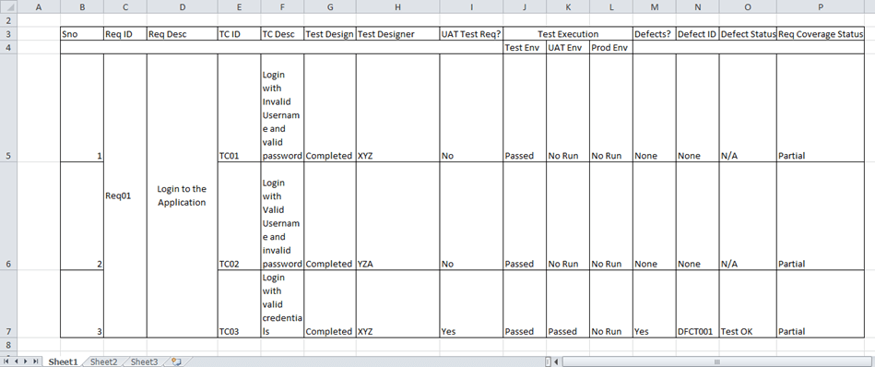

Slide 212
Types of Requirements Traceability Matrix
Forward Traceability
This type of RTM is used to make sure that the project progresses according to plan
It makes sure that the project has all the appropriate requirements applied to it going forward, and that each requirement is adequately tested
Backward Traceability
This type of RTM is used to ensure that the project stays on track
It provides traceability to the original requirements to mitigate scope-creep and that unnecessary additional code, features and tests aren’t added to the project
Bi-Directional Traceability
This RTM is a combination of both the Forward and Backward Traceability matrix
It tracks and ensures test coverage of all requirements
It is also used to determine the impact of changes in associated project requirements

Slide 213
Main elements of a deployment / implementation plan
The deployment plan outlines the scope, approach and execution planned for the deployment of the project deliverables
The plan includes, where relevant:
Information about system support
Issue tracking
Escalation processes
Roles and responsibilities before, during, and after deployment

Slide 214
2. Software Development Methodologies (20%, K3)
2.1 Differences between the waterfall and agile software development methods
2.2 Strengths and weaknesses of each of the waterfall and agile software development methods
2.3 Selection criteria for using either the waterfall or agile software development method.

Slide 215
2.1 Differences between the waterfall and agile software development methods
Recognise that there are a number of different methodologies used for software
Describe the main attributes and features of waterfall software development methods
Describe the main attributes and features of agile software development
Identify the main points of the Agile Manifesto
Describe the primary similarities and differences between waterfall and agile software development methods
Outline different agile software development methodologies
Outline different software development methods and approaches including Unified Process (UP)

Slide 216
Different methodologies used for software development
Recognise that there are a number of different methodologies used for software development that can broadly be categorised as sequential or iterative / incremental, and that some of these are waterfall or agile methods

Slide 217
Software Methodologies
There are the following methodologies:
Agile Software Development
Crystal Methods
Dynamic Systems Development Model (DSDM)
Extreme Programming (XP)
Feature Driven Development (FDD)
Joint Application Development (JAD)
Lean Development (LD)
Rapid Application Development (RAD)
Rational Unified Process (RUP) Methodology
Scrum Methodology
Spiral Methodology
Systems Development Life Cycle (SDLC) Methodology
Waterfall (a.k.a. Traditional) Methodology
Notes:
Pause here and get learner to research

Slide 218
Software Methodologies
There are the following methodologies:
Agile Software Development - Iterative
Crystal Methods - Iterative
Dynamic Systems Development Model (DSDM) – Agile therefore Iterative
Extreme Programming (XP) - Iterative
Feature Driven Development (FDD) – Iterative AND Sequential
Joint Application Development (JAD) - Iterative
Lean Development (LD) - Iterative
Rapid Application Development (RAD) - Iterative
Rational Unified Process (RUP) Methodology – almost Sequential
Scrum Methodology - Iterative
Spiral Methodology – Iterative AND Sequential
Systems Development Life Cycle (SDLC) Methodology – Iterative AND Sequential
Waterfall (a.k.a. Traditional) Methodology - Sequential

Slide 219
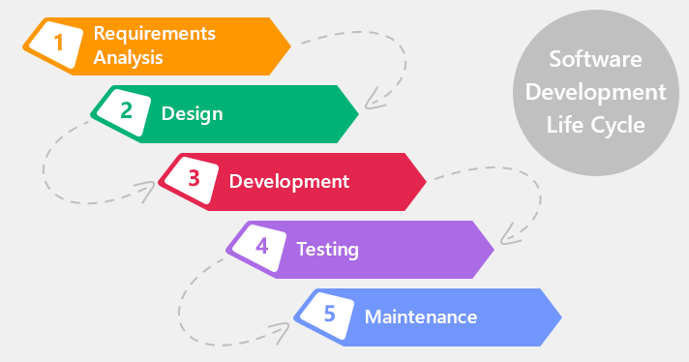
Main attributes and features of waterfall software development methods
Waterfall methodology is a sequential design process
This means that as each of the stages are completed, the developers move on to the next step

Slide 220
Main attributes and features of agile software development
Agile came about as a “solution” to the disadvantages of the waterfall methodology
Instead of a sequential design process, the Agile methodology follows an incremental approach
Developers start off with a simplistic project design, and then begin to work on small modules
The work on these modules is done in weekly or monthly sprints, and at the end of each sprint, project priorities are evaluated and tests are run
These sprints allow for bugs to be discovered, and customer feedback to be incorporated into the design before the next sprint is run
The process, with its lack of initial design and steps, is often criticized for its collaborative nature that focuses on principles rather than process

Slide 221
Main points of the Agile Manifesto
Individuals and interactions over processes and tools
Working software over comprehensive documentation
Customer collaboration over contract negotiation
Responding to change over following a plan

Slide 222
Similarities and differences between waterfall and agile
Go here:
https://www.guru99.com/waterfall-vs-agile.html

Slide 223
Different agile software development methodologies
Scrum
Kanban
Extreme Programming (XP)
Test Driven Development (TDD)

Slide 224
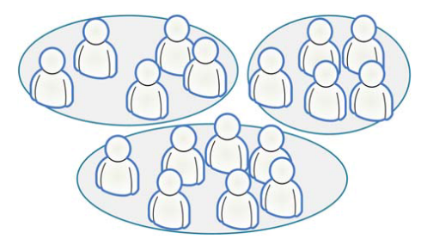
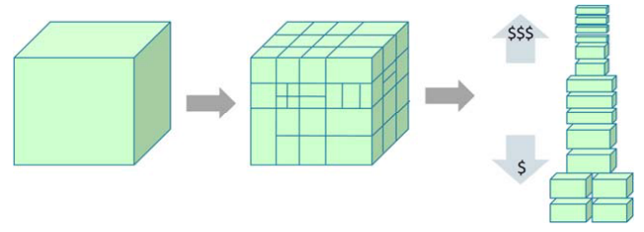
Scrum
A process tool
Split your organization into small, cross-functional, self-organizing teams
Split your work into a list of small, concrete deliverables. Sort the list by priority and estimate the relative effort of each item
Split time into short fixed-length iterations (usually 1 – 4 weeks), with potentially shippable code demonstrated after each iteration
Optimize the release plan and update priorities in collaboration with the customer, based on insights gained by inspecting the release after each iteration
Optimize the process by having a retrospective after each iteration

Slide 225
Kanban
A process tool
Literally, Kanban is a Japanese word that means “visual card”
Visualize the workflow
Split the work into pieces, write each item on a card and put on the wall
Use named columns to illustrate where each item is in the workflow
Limit Work In Progress (WIP) – assign explicit limits to how many items may be in progress at each workflow state
Measure the lead time (average time to complete one item, sometimes called “cycle time”), optimize the process to make lead time as small and predictable as possible
We collect useful Kanban links at: http://www.crisp.se/kanban

Slide 226
Kanban

Slide 227
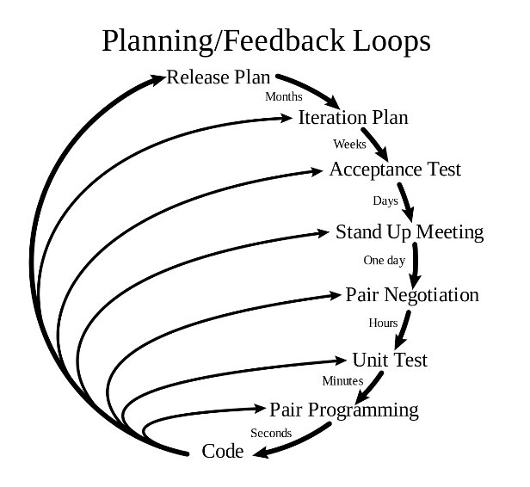
Extreme Programming (XP)
A software development methodology which is intended to improve software quality and responsiveness to changing customer requirements
A type of agile software development
Advocates frequent "releases" in short development cycles

Slide 228
Test Driven Development (TDD)
Test-driven development (TDD) is a software development process that relies on the repetition of a very short development cycle
The following sequence of steps is generally followed:
Add a test
Run all tests and see if the new one fails
Write some code
Run tests
Refactor code
Repeat

Slide 229
Different software development methods and approaches
Unified Process (UP)
V-model
Spiral
Lean
DevOps

Slide 230
Unified Process (UP)
The Unified Software Development Process or Unified Process is an iterative and incremental software development process framework
The best-known and extensively documented refinement of the Unified Process is the Rational Unified Process (RUP)
The Unified Process Model (UPM) is an iterative, incremental, architecture-centric and use-case driven approach to software development

Slide 231
Unified Process Phases
Inception :
The inception phase is similar to the 'Requirements Collection and Analysis' stage of the Waterfall Model of software development. In this phase, you'd collect requirements from the customer, analyse the project's feasibility, it's cost, risks and profits.
Elaboration :
In this phase, you'd be expanding upon the activities undertaken in the inception phase. The major goals of this phase include creating fully functional requirements (use cases) and creating a detailed architecture for fulfilment of the requirements. You'd also prepare a business case document for the customer.
Construction :
In this phase, you'd be writing actual code and implementing the features for each iteration. You'd be rolling out the first iteration of the software depending on the key use cases that make up the core functionalities of the software system.
Transition :
In this phase, you'd be rolling out the next iterations to the customer and fixing bugs for previous releases. You would also deploy 'builds' of the software to the customer.

Slide 232
V-model

Slide 233
Spiral
This is a risk methodology

Slide 234
Lean
Lean software development is a translation of lean manufacturing principles and practices to the software development domain
Adapted from the Toyota Production System it is emerging with the support of a pro-lean subculture within the Agile community
Lean offers a solid conceptual framework, values and principles, as well as good practices, derived from experience, that support agile organizations

Slide 235
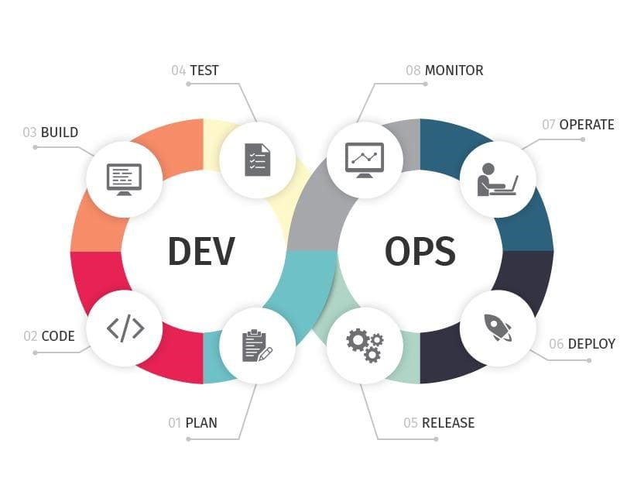
DevOps
DevOps is a set of software development practices that combines software development (Dev) and information technology operations (Ops) to shorten the systems development life cycle while delivering features, fixes, and updates frequently in close alignment with business objectives

Slide 236
2.2 Strengths and weaknesses of each of the waterfall and agile software development methods
Main principles of a waterfall approach to software development
Main principles of an agile approach to software development
Main differences between waterfall and agile methods
Compare and contrast waterfall or agile methods depending on attributes of an approach
Demonstrate the SDLC for waterfall and agile methods of software development

Slide 237
Main principles of a waterfall approach
Three main principles:
low customer involvement
strong documentation
sequential structure

Slide 238
Main principles of an agile approach
Done already

Slide 239
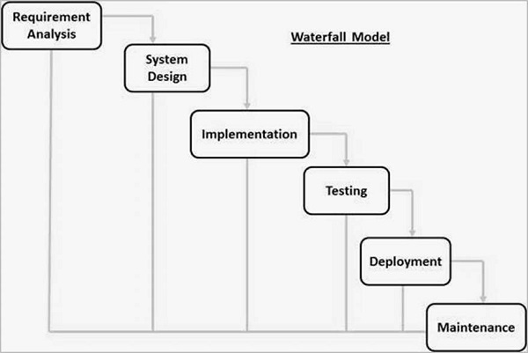
SDLC for waterfall

Slide 240
SDLC for Agile

Slide 241
2.3 Selection criteria for using either the waterfall or agile software development method
Recognise that business, market and information needs may lead to the development of very different software, whilst using similar software development methodologies
Explain the different business and market contexts that lead to different approaches to software development, including:
Distinguish advantages and disadvantages of using either waterfall or agile software development methods based on the factors listed above in a given scenario

Slide 242
Business, market and information needs

Slide 243
Different business and market contexts
Explain the different business and market contexts that lead to different approaches to software development, including:
Characteristics of market sectors and segments
Business drivers and desired outcomes
Market risk
Operational risk
Legal and regulatory requirements

Slide 244
Characteristics of market sectors and segments
A market segment is a group of people who share one or more common characteristics, lumped together for marketing purposes
Each market segment is unique, and marketers use various criteria to create a target market for their product or service
Marketing professionals approach each segment differently, after fully understanding the needs, lifestyles, demographics and personality of the target consumer

Slide 245
Business drivers and desired outcomes
Drivers are catalysts: they make things happen
Outcomes are an end result

Slide 246
Market risk
Market risk is the risk of losses in positions arising from movements in market prices

Slide 247
Operational risk
Operational risk is the prospect of loss resulting from inadequate or failed procedures, systems or policies

Slide 248
Legal and regulatory requirements
Regulatory compliance is an organization's adherence to laws, regulations, guidelines and specifications relevant to its business processes
Violations of regulatory compliance regulations often result in legal punishment including fines

Slide 249
Advantages and disadvantages of using either waterfall or agile
Pros | Cons
Agile promotes some of the best practices found in development environments. Some of the risk in a project should be reduced as the output of developers is reviewed early and constantly during development. | Agile is simple to understand in principle but hard to do well in practice. It requires real commitment and first attempts are not likely to go very well.
When projects are genuinely new they usually require creativity. Requirements can then emerge as understanding matures and grows. | It is less predictable what will be delivered at the end.
Flexibility can be higher than traditional methods - although this is not guaranteed. Changes (e.g. in prioritisation) can be introduced at almost any stage. | Agile requires high levels of collaboration and very regular communication between developers and users (e.g. Product Owner). This is always desirable but may not always be feasible and requires continual commitment and time from the business and developers.
Agile encourages or requires frequent communication between developers and those who will ultimately accept and use the deliverable. This should pay major dividends when effective. For example, feedback can be incorporated into future iterations as increments are delivered and reviewed by users or a Product Owner or both. False assumptions made by developers can be recognised very early reducing impact. Agile gives us continual opportunities to learn via this feedback. | Agile is very intensive for both developers and users. There can be reasons that may prevent this for example if developers work on multiple projects at one time. The only downside to the opportunities to learn is that people have got to be prepared to.
It should reduce the 'silos' that too often exist within project 'teams' - something that always damages projects (as it should result in a collaborative style of working). | There can be less of a blueprint of what the final deliverable will be. This can make it harder to gain commitment to the project by stakeholders at the early stage.
It should result in far less re-work on projects as issues and changes should be picked up much earlier. | Agile can be challenging when there is a supplier-customer relationship. Customers typically want to know what they are getting for their money as early as possible. It can be far harder to estimate timescales and costs as there is less 'definition' to base estimates on.
Collaboration is usually much higher with Agile. Although not guaranteed, this can result in more successful development environments, in terms of product quality (i.e. fit for purpose). | Agile can be very challenging on much larger projects or where co-location is not possible (between developers and the business).
With the common use of visuals, (boards, charts, Kanban etc) it can be easy to see what is going on (literally) what is done and what is yet to do, assuming the visuals are well organised, presented and up-to-date. This in itself can be a major benefit. | In Agile there can be a great reluctance (by some) to adopt or accept deadlines. Projects don't exist in isolation so when this happens it can be a real issue. Agile methods typically only address the product development and large-scale projects can be made up of many other elements.
 | Other obvious examples where Agile methods are not typically strong: dealing with lead times and major dependencies.

Slide 250
Advantages and disadvantages of using either waterfall or agile
Pros | Cons
On well managed projects Waterfall may provide more confidence of what will finally be delivered earlier in the life-cycle. | Many organisations and people really don't find defining requirements (up front) easy to do - especially early in some types of projects. The assumptions upon which early stage plans are based may be very flawed and too often are taken as being based on certainty.
Project team members don't need to be co-located although the risks associated with this must be managed carefully. | Communication can be a far higher risk - especially when there is limited early review of outputs and deliverables or when one-way methods of communication are used to convey requirements.
Where large-scale design or analysis is required, or the impact of downstream changes to design is very high, this is likely to be a far more suitable approach. | Risk in general can be far higher with Waterfall, for example as the scope for invalid assumptions is unlimited. If you add this to the high cost of making changes later in a Waterfall project, it is easy to see why some are very expensive, over budget and late. Too often, assurance of products being fit-for-purpose is demonstrated very late in Waterfall projects.
Where there are many interfaces and dependencies outside of the basic product development, waterfall projects tend to have the tools to model and manage these. | Waterfall projects don't have to be but tend to be made up of 'teams within teams'. This can be a major disadvantage to any project.

Slide 251
3. Data Roles and Responsibilities (30%, K3)
3.1 Roles and responsibilities within software development and implementation
3.2 Structure of a software development team within an organisation
3.3 Responsibilities of project managers in software development and the difference between project life cycles and software development life cycles
3.4 Team working aspects required to ensure effective delivery of software projects

Slide 252
3.1 Roles and responsibilities within software development and implementation
Describe the roles and responsibilities within software development teams
Describe the roles and responsibilities used in agile software development
List the skills required by each of the roles listed above
Explain the generic skills required within software development teams
Describe the main roles external to the software development team that interface with the software development team
Explain how the different roles within a software development team relate to each other in terms of typical interfaces and accountabilities

Slide 253
Roles and responsibilities within software development teams
Requirements engineer
Business analyst
Software designer
Programmer / coder
Software tester
Software release engineer; technical architect
Domain expert
Independent tester

Slide 254
Requirements Engineer
The requirements engineer is charged with working with the project stakeholders and end users to elicit, understand, analyse, and document the requirements for a system in order to solve a given business problem
Used interchangeably with the IT Business Analyst though many people see this role as being limited to requirements gathering and documentation
Other common titles for this role are: Requirements Analyst, Functional Architect, Business Systems Analyst, Business Analyst

Slide 255
Business Analyst
Someone who analyses an organization or business domain (real or hypothetical) and documents its business or processes or systems, assessing the business model or its integration with technology
Developing technical solutions to business problems
To advance a company's sales efforts, begins with defining, analysing and documenting requirements
Helping to manage, change and plan for the future in line with their goals
Communicating between internal departments and external parties, acting as a 'translator' where necessary to convey how information technology can support the organisation's needs

Slide 256
Software Designer
A software designer works as part of a collaborate development team to help create software that meets the management's or client's needs, and in an effective and cost-efficient manner
Involved at the requirements and design stages of the SDLC

Slide 257
Programmer / coder
A coder
Develops software solutions
May be called a systems/software/database/web programmer, engineer or developer, depending on the system you're developing
Responsible for using the technical requirements from the Technical Lead to create cost and timeline estimates

Slide 258
Software Tester
Ensures that the software solution meets the business requirements and that it is free of bugs, errors and defects
Tasks such as functional testing, customer scenario testing, stress testing, performance testing, scalability testing and international testing are common
Involved in identifying test conditions and creating test designs, test cases, test procedure specifications and test data, and may automate or help to automate the tests
Involved in all stages of the SDLC

Slide 259
Software Tester
Some of the Software Testers duties can include:
They often set up the test environments or assist system administration and network management staff in doing so
As test execution begins, the number of testers often increases, starting with the work required to implement tests in the test environment
Testers execute and log the tests, evaluate the results and document problems found
They monitor the testing and the test environment, often using tools for this task, and often gather performance metrics
Throughout the software testing life cycle, they review each other’s work, including test specifications, defect reports and test results

Slide 260
Software Project Manager
Has the overall responsibility for the successful initiation, planning, design, execution, monitoring, controlling and closure of a project
Must have a combination of skills including an ability to ask penetrating questions, detect unstated assumptions and resolve conflicts, as well as more general management skills

Slide 261
The role of the project manager encompasses many activities including:
Planning and Defining Scope
Activity Planning and Sequencing
Resource Planning
Developing Schedules
Time Estimating
Cost Estimating
Developing a Budget
Documentation
Creating Charts and Schedules
Risk Analysis
Managing Risks and Issues
Monitoring and Reporting Progress
Team Leadership
Strategic Influencing
Business Partnering
Working with Vendors
Scalability, Interoperability and Portability Analysis
Controlling Quality
Benefits Realisation

Slide 262
Software Release Engineer
A release engineer is an individual who is concerned with the mechanics of the development and processing of software products
Is involved in the final stages of the software
Oversee and control the proper placement and deployment of the source code
They ensure that each code is entered in the software code repository and is ready for media duplication and distribution

Slide 263
Technical architect
Technical architects are also known as IT systems architects and act as the link between a company, its managers and the specialist designers and developers who built the IT system
Technical architect jobs often involve working with large organisations, planning or redesigning IT systems to ensure they function correctly and operate as expected
Key responsibilities include ensuring that every aspect of the IT system works as planned, that the organisation’s requirements are completely satisfied and that the system meets the needs of those who will be using it

Slide 264
Domain expert
A person who is an authority in a particular area or topic
The term domain expert is frequently used in expert systems software development, and there the term always refers to the domain other than the software domain
A domain expert is a person with special knowledge or skills in a particular area of endeavour

Slide 265
Independent tester
Person, or company that tests products, materials, software, etc. according to agreed requirements
The test organization can be affiliated with the government or universities or can be an independent testing laboratory
They are independent because they are not affiliated with the producer nor the user of the item being tested: no commercial bias is present
These "contract testing" facilities are sometimes called "third party" testing or evaluation facilities

Slide 266
Independent tester
Roles of an independent tester:
Determine if, or verify that, the requirements of a specification, regulation, or contract are met
Decide if a new product development program is on track: Demonstrate proof of concept
Provide standard data for other scientific, engineering, and quality assurance functions
Validate suitability for end-use
Provide a basis for technical communication
Provide a technical means of comparison of several options
Provide evidence in legal proceedings: forensics, product liability, patents, product claims, etc.
Help solve problems with current products or services
Help identify potential cost savings in products or services

Slide 267
Roles and responsibilities used in agile software development
Product owner
Scrum master
Sprint leader

Slide 268
Product owner
The Scrum product owner is typically a project's key stakeholder
Part of the product owner responsibilities is to have a vision of what he or she wishes to build, and convey that vision to the scrum team
This is key to successfully starting any agile software development project

Slide 269
Scrum master
A scrum master is the facilitator for an agile development team
Scrum is a methodology that allows a team to self-organize and make changes quickly, in accordance with agile principles
The scrum master manages the process for how information is exchanged

Slide 270
Sprint leader
The leader of a sprint is responsible for designing and running the sprint
The leader must choose/describe the tickets in the sprint and completes (or at least coordinates) reviewing of the code submitted during the sprint

Slide 271
Generic skills required within software development teams
Leadership
Communication skills
Analytical skill
Creativity
Attention to detail
Team working skills

Slide 272
Leadership
Develops and uses effective strategies, change management and interpersonal skills to influence others toward the accomplishment of identified objectives
Leaders help themselves and others to do the right things
They set direction, build an inspiring vision, and create something new
Leadership is about mapping out where you need to go to "win" as a team or an organization; and it is dynamic, exciting, and inspiring.
Yet, while leaders set the direction, they must also use management skills to guide their people to the right destination, in a smooth and efficient way

Slide 273
Communication skills
Being able to communicate effectively is perhaps the most important of all life skills
It is what enables us to pass information to other people, and to understand what is said to us
Good communication skills can improve the way that you operate through life, smoothing your way in your relationships with others.
Poor communication skills, on the other hand, can sour relationships from business to personal, and make your life significantly harder

Slide 274
Analytical skill
Analytical skills refer to the ability to collect and analyze information, problem-solve, and make decisions
These strengths can help solve a company’s problems and improve upon its overall productivity and success

Slide 275
Creativity
Generates novel and valuable ideas, using these ideas to development new or improved processes, methods, systems, or services or products
The use of imagination or original ideas to create something
Inventiveness
involves transforming your ideas, imagination, and dreams into reality
When you’re being creative, you can see the hidden patterns, make connections between things that aren’t normally related, and come up with new ideas
Creative ability depends on creative thinking which is part hard work but largely creative problem-solving

Slide 276
Attention to detail
Attention to detail is the ability to achieve thoroughness and accuracy when accomplishing a task
The ability to manipulate small pieces of data with accuracy and focus is a crucial skill in a broad range of job fields

Slide 277
Team working skills
Willingly cooperates and works collaboratively toward solutions that generally benefit all involved parties and accomplish group objectives
Behavioural Indicators
Asks for the input of group members and encourages the participation of all
Gives credit and recognition to those who have contributed
Demonstrates interest in helping others solve problems and accomplish work objectives
Follows up on inquiries and requests from peers and co-workers
Participates actively in accomplishing group goals, doing his or her share willingly
Shares information and own expertise with others to enable them to accomplish group goals
Works to develop consensus in pursuit of group goals
Acknowledges and works through conflict in a productive way; shares concerns and differing opinions in a constructive, positive way
Respects and is tolerant of differing opinions and those who hold them
Obtains cooperation of others for whom one has no direct supervisory responsibility

Slide 278
Main roles external to the software development team
Customers
Users
Operations
Service Management and the generic term ‘stakeholders’

Slide 279
Customers
Customers make buying decisions
May or may not be users

Slide 280
Users
People who use the software
May be a customer

Slide 281
Operations
The operations department of a company is responsible for smooth and profitable production
Running efficiently
Ensuring quality
Timeliness of delivery
Management of resources
Goal setting
Communications

Slide 282
Service Management
IT service management (ITSM) refers to the entirety of activities
directed by policies, organized and structured in processes and supporting procedures
that are performed by an organization to design, plan, deliver, operate and control information technology (IT) services offered to customers

Slide 283
Customers
Customers make buying decisions
May or may not be users

Slide 284
Users
People who use the software
May be a customer

Slide 285
Operations
The operations department of a company is responsible for smooth and profitable production
Running efficiently
Ensuring quality
Timeliness of delivery
Management of resources
Goal setting
Communications

Slide 286
Stakeholders
A stakeholder is anyone who has a vested in any part of the software development project

Slide 287
Relationships between roles
Explain how the different roles within a software development team relate to each other in terms of typical interfaces and accountabilities

Slide 288
3.2 Structure of a software development team within an organisation
Recognise that software development teams may be structured in different ways, depending on organisational considerations
Distinguish at a high-level between a functional structure, a project structure and a matrix structure
Describe the roles and responsibilities of the main functions that typically interface with software development teams, recognising that different organisations may use different titles and different combinations of functions
Describe the structure of a typical software development team
Explain how the main roles and functions external to the software development team (listed above) interface with the software development team and at which stages of the SDLC these interactions occur

Slide 289
How software dev teams are structured
Recognise that software development teams may be structured in different ways, depending on organisational considerations
Structure a team
Choose team type
Generalists
A generalist is someone who possesses a wide range of knowledge and skills and is able to apply their competence across a vast range of areas within their expertise. Generalists can utilize a variety of different resources, perform different tasks and often have stronger communication skills and the ability to quickly acquire new knowledge
Hire a team of generalists (the term "generalist" usually refers to "full-stack developers" in IT industry) if the product you are developing requires a variety of different skills to be completed successfully.
Specialists
In comparison, a specialist has a specific set of skills and techniques or a preferred single methodology. A specialist possesses a high level of expertise and the ability to use this methodology while solving complicated business problems in areas where greater attention is demanded.
While working with software development teams, it is better to assemble a team of specialists, who are focused on a particular part of development, namely database specialists - for a database, Automation QA Engineer - for automation test suite, Manual QA - for manual testing etc.
Hybrid
In a nutshell, it is a mix of both. This kind of team will focus specifically on areas where your project needs the most work and will handle additional tasks if the need arises

Slide 290
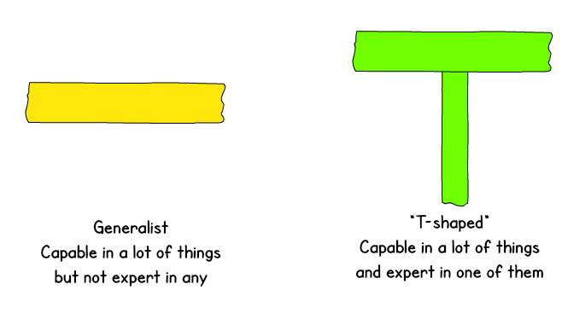
For software development teams, create a blend of specialists and generalists with a 3 to 1 or 75% to 25% ratio
Takeaway:
Hiring T-shaped employees is the best option
The long vertical line of the “T” indicates the general knowledge of the developers, while the horizontal line - the depth of their additional skills
For example, back-end developers, who write code on PHP (main expertise) can have a general understanding of JavaScript, databases (additional expertise)
Such employees aren’t considered to be complete generalists who can do everything, but rather team members that are able to work with other specializations if necessary

Slide 291
Team Structures - Functional Structure
A functional structure is one of the most common organizational structures
Under this structure, the organization groups employees according to a specialized or similar set of roles or tasks

Slide 292
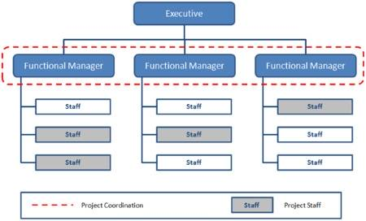
Team Structures - Project Structure
Project structure means the combination of all identifier structures used in the project for objects, pages, devices, and functions
All objects in a project (pages, devices, and functions) must be identified and placed in a hierarchical structure within the project

Slide 293
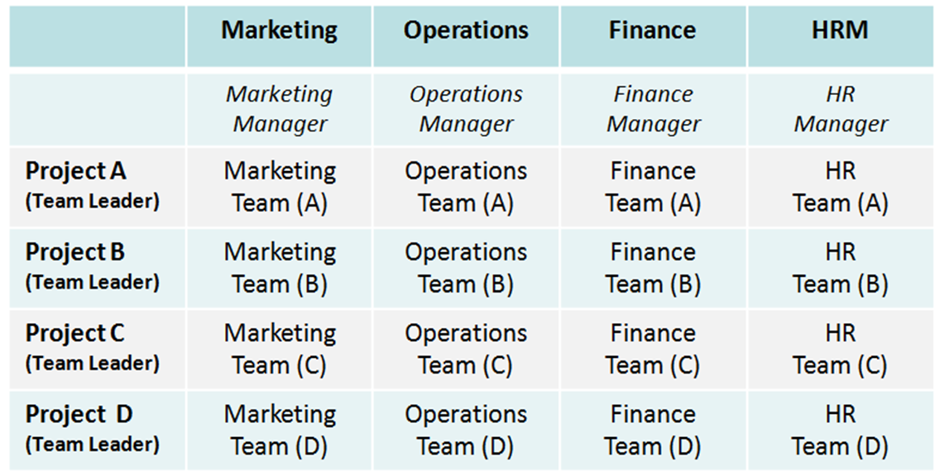
Team Structures - Matrix Structure
A matrix organizational structure is a company structure in which the reporting relationships are set up as a grid, or matrix, rather than in the traditional hierarchy
In other words, employees have dual reporting relationships - generally to both a functional manager and a product manager

Slide 294
Roles and responsibilities of the main functions
Describe the roles and responsibilities of the main functions that typically interface with software development teams, including
Customer Business Units
Operations
Service Management
Service Desk
Application Support
Technical Support
Recognise that different organisations may use different titles and different combinations of functions

Slide 295
Customer Business Units
The customer business unit refers to the people and roles that define and/or represent the voice and expectations of the primary consumers of the deliverables produced throughout the course of a project
Product managers, sales, marketing, executives and end-user customers are all examples of roles and titles that often comprise the customer business unit
In agile projects, the customer business unit is typically responsible for setting the vision, project charter and road map, creating and maintaining product backlog requirements and priorities, defining user acceptance criteria and communicating with the developer unit

Slide 296
Operations
The action of functioning or the fact of being active or in effect
Operations management is the administration of business practices to create the highest level of efficiency possible within an organization
It is concerned with converting materials and labour into goods and services as efficiently as possible to maximize the profit of an organisation

Slide 297
Service Management
IT service management (ITSM) refers to the entirety of activities – directed by policies, organized and structured in processes and supporting procedures – that are performed by an organization to design, plan, deliver, operate and control information technology (IT) services offered to customers

Slide 298
Service Desk
A service desk is a communications centre that provides a single point of contact (SPOC) between a company and its customers, employees and business partners
The purpose of a service desk is to ensure that users receive appropriate help in a timely manner
An evolution of the help desk, born out of the ITSM best practice framework ITIL (formerly known as the IT Infrastructure Library), and based on the underlying concept of “managing IT as a service.”
The ITIL definition of service desk is:
“The single point of contact between the service provider and the users. A typical service desk manages incidents and service requests, and also handles communication with the users.”

Slide 299
Application Support
It is a service
Application Maintenance and Support includes the skills and requirements for supporting application systems, including:
Troubleshooting
modifying, maintaining and enhancing legacy systems
Application Maintenance and Support also applies to applications running in a production environment

Slide 300
Technical Support
A service provided by a hardware or software company which provides registered users with help and advice about their products

Slide 301
3.3 Team working aspects required to ensure effective delivery of software projects
Recognise that software development is undertaken within governance and management frameworks that organisations use to control and manage projects, programmes and Operations
Explain the difference between the terms ‘programme’ and ‘project’ and the relationship between them, and how they relate to software development
Explain the role and responsibilities of a project manager in software development.
Describe in outline a generic project lifecycle and the purpose and scope of each stage of the lifecycle
Describe effective team-working and how this contributes to effective delivery of software projects
Explain the importance of working closely with the customer and users during requirements analysis
Explain the role of technical architects and domain experts during design
Explain the role of Operations and Service Management during design, in order to help ensure that the design of the software end product meets non-functional requirements
Explain ways in which team working is beneficial during code development
Explain why collaborative approaches are especially important for software development using agile and/or DevOps approaches

Slide 302
Governance and management frameworks
Recognise that software development is undertaken within governance and management frameworks that organisations use to control and manage projects, programmes and Operations

Slide 303
Terminology
Programme
The actual code that is being developed
Project
The overall task of creating the software

Slide 304
Role and responsibilities of a project manager
The Role of the Project Manager
A project manager is a person who has the overall responsibility for the successful initiation, planning, design, execution, monitoring, controlling and closure of a project
A project manager is a person who is responsible for making decisions, both large and small

Slide 305
Generic project lifecycle
Project management life cycle is usually broken down into four phases:
Initiation
Planning
Execution
closure
These make up the path that takes your project from the beginning to the end
Some methodologies also include a fifth phase, controlling or monitoring

Slide 306
Initiation
In the initiation phase of the project, you identify a business need, problem, or opportunity and brainstorm ways that your team can meet this need, solve this problem, or seize this opportunity
During this step, you figure out an objective for your project, determine whether the project is feasible, and identify the major deliverables for the project.
Project management steps for the initiation phase
Steps for the project initiation phase may include the following:
Undertaking a feasibility study – Identifying the primary problem your project will solve and whether your project will deliver a solution to that problem
Identifying scope – Defining the depth and breadth of the project
Identifying deliverables – Defining the product or service to provide
Identifying project stakeholders – Figuring out whom the project affects and what their needs may be
Developing a business case – Using the above criteria to compare the potential costs and benefits for the project to determine if it moves forward

Slide 307
Planning
Once the project is approved to move forward based on your business case, statement of work, or project initiation document, you move into the planning phase
In this phase, you break down the larger project into smaller tasks, build your team, and prepare a schedule for the completion of assignments
During this phase, you create smaller goals within the larger project, making sure each is achievable within the time frame
Smaller goals should have a high potential for success

Slide 308
Planning
Steps for the project planning phase may include the following:
Creating a project plan – Identifying the project timeline, including the phases of the project, the tasks to be performed, and possible constraints
Creating workflow documents or process maps – Visualizing the project timeline by diagramming key milestones
Estimating budget and creating a financial plan – Using cost estimates to determine how much to spend on the project to get the maximum return on investment
Gathering resources – Building your functional team from internal and external talent pools while making sure everyone has the necessary tools (software, hardware, etc.) to complete their tasks
Anticipating risks and potential quality roadblocks – Identifying issues that may cause your project to stall while planning to mitigate those risks and maintain the project’s quality and timeline

Slide 309
Execution
Once business approval has been received, and a plan has been developed, and your team is built it’s time to get to work
The execution phase turns your plan into action
The project manager’s job in this phase of the project management life cycle is to keep work on track, organize team members, manage timelines, and make sure the work is done according to the original plan

Slide 310
Execution
Steps for the project execution phase may include the following:
Creating tasks and organizing workflows – Assigning granular aspects of the projects to the appropriate team members, making sure team members are not overworked
Briefing team members on tasks – Explaining tasks to team members, providing necessary guidance on how they should be completed, and organizing process-related training if necessary
Communicating with team members, clients, and upper management – Providing updates to project stakeholders at all levels
Monitoring quality of work – Ensuring that team members are meeting their time and quality goals for tasks
Managing budget – Monitoring spending and keeping the project on track in terms of assets and resources

Slide 311
Execution

Slide 312
Closure
Once the team has completed work on a project, you enter the closure phase
In the closure phase, you provide final deliverables, release project resources, and determine the success of the project
Just because the major project work is over, that doesn’t mean the project manager’s job is done—there are still important things to do, including evaluating what did and did not work with the project

Slide 313
Closure
Steps for the project closure phase may include the following:
Analysing project performance
Determining whether the project's goals were met (tasks completed, on time and on budget) and the initial problem solved using a prepared checklist.
Analysing team performance
Evaluating how team members performed, including whether they met their goals along with timeliness and quality of work
Documenting project closure
Making sure that all aspects of the project are completed with no loose ends remaining and providing reports to key stakeholders
Conducting post implementation reviews
Conducting a final analysis of the project, taking into account lessons learned for similar projects in the future
Accounting for used and unused budget
Allocating remaining resources for future projects
By remaining on task even though the project’s work is completed, you will be prepared to take everything you’ve learned and implement it for your next project.

Slide 314
Effective team-working
Describe effective team-working and how this contributes to effective delivery of software projects, including
organisational behaviour theory
decision making
conflict resolution
Collaboration
communication

Slide 315
Team Working
Effective teamwork is an important aspect of any organisation's success
There are many benefits of teamwork, most notably, an increase in motivation from your employees
Motivation from your employees means more success for your company

Slide 316
Organisational behaviour theory
The study of human behaviour in organizational settings, the interface between human behaviour and the organization, and the organization itself“
Organisational behaviour research can be categorized in at least three ways:
individuals in organisations (micro-level)
work groups (meso-level)
how organisations behave (macro-level)

Slide 317
Decision making
Decision making is the selection of a procedure to weigh alternatives and find a solution to a problem
In addition, certain situations will require different approaches of decision making in order to be effective
Business decision making includes decisions that are made that determine business or organization outcomes.
Personal decision making has the decisions that determine who we are as individuals and the outcomes we create for ourselves and others with which we have relationships. This category includes what is sometimes referred to as life decisions.
Consumer decision making consists of choices that determine our effectiveness in purchase decisions that occur in either a personal or business context. In this case, the consumer (entity) can be an individual or a person within a business

Slide 318
Conflict resolution
Conflict resolution is a way for two or more parties to find a peaceful solution to a disagreement among them
The disagreement may be personal, financial, political, or emotional
When a dispute arises, often the best course of action is negotiation to resolve the disagreement

Slide 319
Collaboration
The action of working with someone to produce something
Similar to cooperation

Slide 320
Communication
The imparting or exchanging of information by speaking, writing, or using some other medium
Spoken or Verbal Communication
includes face-to-face, telephone, radio or television and other media
Non-Verbal Communication
covering body language, gestures, how we dress or act, where we stand, and even our scent
There are many subtle ways that we communicate (perhaps even unintentionally) with others
For example, the tone of voice can give clues to mood or emotional state, whilst hand signals or gestures can add to a spoken message.
Written Communication
includes letters, e-mails, social media, books, magazines, the Internet and other media
Until recent times, a relatively small number of writers and publishers were very powerful when it came to communicating the written word
Today, we can all write and publish our ideas online, which has led to an explosion of information and communication possibilities.
Visualizations
graphs and charts, maps, logos and other visualizations can all communicate messages

Slide 321
Working closely
Explain the importance of working closely with the customer and users during requirements analysis
Already covered this

Slide 322
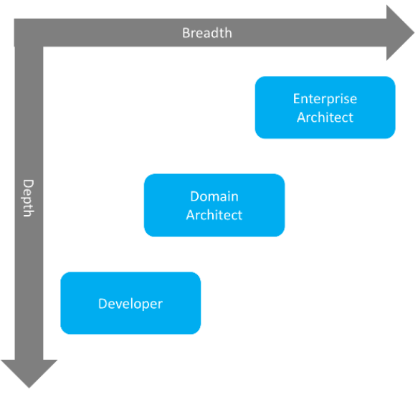
Role of technical architects and domain experts
Explain the Role of technical architects and domain experts during design
Already covered this

Slide 323
Beneficial team working
Learning from others
Reviewing each others’ work
Aiding communication
Sharing the workload
Utilising strengths and weaknesses of team members
Providing motivation and support
Contributing to retrospectives

Slide 324
Learning from others
Humans are better than any other animals at learning from one another
Take advantage of this superpower and learn from as many people as you can. At least, learn the good things and not the bad stuff
You can learn from others both directly and indirectly.
Direct learning takes place when you ask people how they do something, listen to their answer, and try to imitate what they did. A good example is asking colleagues how they are going to find the time to do all the reading for a development project
Indirect learning is when you observe someone doing something and imitate the procedure the person follows. Imitate other’s habits

Slide 325
Reviewing each others’ work
Informal pair (buddy) reviews

Slide 326
Aiding communication
Informal discussions
Clarification of work items
Creativity

Slide 327
Sharing the workload
Recognise overload
Assistance
Cover

Slide 328
Utilising strengths and weaknesses of team members
Mentoring
Distribution of work
Training

Slide 329
Providing motivation and support
Encouragement

Slide 330
Contributing to retrospectives
Improve efficiency
Team building
Honest reflection
Energising
Own decisions

Slide 331
Collaborative approaches
Explain why collaborative approaches are especially important for software development using agile and/or DevOps approaches
Input to non-functional requirements
Input to implementation and deployment plans
Assist in the creation of acceptance test data

