Slide 1
Cyber Security Technician
Level 3
Week 1

Slide 3
Introduction
Week 1
Intro
Monday
01
02
Wednesday
03
04
Tuesday
05
06
Thursday
Friday

Slide 4
Syllabus – Week 1
Monday
What is Cyber Security, History of Cyber Security, Role of Cyber Security
Managing Cyber Security, Implementing Cyber Security
Tuesday
Cyber Security Principles, Cyber Security Terminology
Access Control, Identity Access Management
Wednesday
Internet & Cyber Security Evolution, Threat Landscape,
Threat Actors, Threats / Attacks, Targets
Thursday
Legislation & Regulation
Friday
Legislation & Regulation Continued…
Security Policies, Data Ethics
Test

Slide 5
Cyber Security
What is cyber security?
Take 5 minutes
What does “Cyber Security” mean to you?
Prepare for a group discussion
Notes:
Notes & Information:
This group activity will enable us to understand the knowledge at the start of the course.

Slide 6
History of Cyber Security

Slide 7
Security
In the early days, security focussed largely on:
Policy Creation
Policy Compliance
Policy Enforcement

Slide 8
Security – Challenges / Issues
Focused mainly on governance
Doesn’t consider the needs of the business
Not proactively involved in business or IT change
Little visibility or concern with protection of organisational assets

Slide 9
IT Security
Focussed largely on:
Firewalls
Intrusion Detection / Protection
Internet Proxy Filtering

Slide 10
IT Security – Challenges / Issues
Focused mainly on the Technology
Doesn’t consider the needs of the business
Not proactively involved in business or IT change
Little visibility or concern with protection of organisational assets

Slide 11
Information Security
Focussed largely on:
Information / Data
Data Protection related legislation
Compliance & Audit

Slide 12
Information Security –Challenges & Issues
Focused mainly on Information Assets
Considers the needs of the business but within the scope of information only
Generally not proactively involved in IT change
Little visibility or concern with protection of organisational assets, outside of information

Slide 13
Cyber Security
Focusses on:
All aspects of Security, IT Security, Information Security
Protection of critical organisational assets (Intellectual Property, Services, Personal Information etc.)
Policies, People, Processes & Technology

Slide 14
Cyber Security - Benefits
Originally focussed on internet facing services, but now considers security in relation to all aspects of the business
Proactively involved in business change
Focuses on protecting what matters most to the business
Supports and enables the business

Slide 15
What is Cyber Security?
Cyber Security is practice of reducing the risk to individuals, organisations, governments and countries from cyber related attacks!
Cyber Security or “Good Cyber Hygiene” seeks to maintain and improve security controls in order to protect critical products, services and information.
Security controls include (but are not limited to) applying critical security patches to computers, building secure websites, implementing strong antivirus protection and following user best practice, for example being careful when opening emails from unknown users and not installing software from untrusted sources.

Slide 16
Role of a Cyber Security Professional

Slide 17
Cyber Security Professionals
People working in cybersecurity protect systems and networks from hackers and other threats and develop defenses against potential attacks
Creating a safe network, as well as developing a threat detection system and incident response is part and parcel of a cybersecurity professional's job
Cybersecurity careers tend to be very lucrative and offer excellent scope for progression and career development

Slide 18
Cyber Security Roles
How many Cyber Security Roles can you name?

Slide 19
Cyber Security Roles
Security Administrators
Security Engineer
Security Analyst
SOC Analyst (Tier 1-3)
Security Specialist
Security Risk Analyst
Security Architect
Ethical Hacker
Penetration Tester
Incident Responder
Incident Co-ordinator
Incident Investigator
Security Auditor
Security Consultant
IT Security Manager
Information Security Manager
Cyber Security Manager
Head of Cyber Security
CISO or CSO

Slide 20
Cyber Security Professionals
What departments / people do you think Cyber Security Professionals work with?

Slide 21
Who do Cyber Professionals work with?
Risk Team
HR
Service Desk
IT Ops & Support
CEO & Board Members
Information GovernanceTeam
Middle Managers
Senior Managers
Estates Team
Line Managers
Marketing Team
Dev Team
IT Architects
Network Team

Slide 22
Managing Cyber Security

Slide 23
Information Security Governance

Slide 24
Security Governance - Background
Security Governance… relates to how organisations control, direct and communicate their Cyber Security risk management activities
Security Governance is the means by which you control and direct your organisations approach to security
Just as security is the responsibility of everyone within an organisation, security decision making, happens at all levels
Security Governance is used by Senior Leadership to set out risks they are prepared for staff to take, and those they are not!
Notes:
Resources & Notes:
Ref: NCSC Security Governance - https://www.ncsc.gov.uk/collection/risk-management-collection/governance-cyber-risk/security-governance-introduction

Slide 25
Security Governance Objectives
At a minimum… Security Governance need to identify:
Security decisions that need to be made
People who will need to make them
Information required in order to make informed choices and decisions
Notes:
Resources & Notes:
Ref: NCSC Security Governance - https://www.ncsc.gov.uk/collection/risk-management-collection/governance-cyber-risk/security-governance-introduction

Slide 26
Establishing Security Governance
There is no “one size fits all” approach to security governance
It may be appropriate for organisations to take a more informal approach to Security Governance, but other may need to use a formalised security framework
Considerations to assist in ascertaining appropriate and proportionate Security Governance, include (but may not be limited to)…

Slide 27
Security Governance Considerations
Organisations Size & Complexity
What resources you have available to manage security governance
What your organisation does, and sector / industry it operates
External factors e.g. Contractual, Legislative, Regulatory

Slide 28
Security Governance Frameworks
Organisations use Security Governance Frameworks to help track and manage Security / Information Security
BSI - ISO/IEC 27001 ISMS (Information Security Management System)
NIST - Cyber Security Framework
UK GOV – SPF (Security Policy Framework)
CSA – Cloud Security Alliance STAR - mapping multiple frameworks
PCI DSS 3.2 – Payment Card Industry

Slide 29
Strategy

Slide 30
Business Strategy
What are the business strategy plans for the next 18 months…
New business lines / products
Business expansion i.e. new offices
Business growth i.e. national, international markets
Mergers / takeovers

Slide 31
IT Strategy
What are the IT strategy plans for the next 18 months…
On premise infrastructure
Adoption of Cloud infrastructure i.e. datacentre decommissioning
Increased use of SaaS (Software as a Service) i.e. Microsoft O365

Slide 32
Security Strategy
What are the Security strategy plans for the next 18 months…
Increased legislative / regulatory compliance requirements
Increased monitoring / filtering requirements
Security Awareness Campaigns
Adoption of security standards i.e. Cyber Essentials+, ISO27001, PCI

Slide 33
Other Business Factors

Slide 34
Business Culture
Understanding the organisations business culture is important
Culture heavily influences the way in which an organisation functions
The organisation may encourage a very agile way of working, for example:
Ability for an employee to install and use any software they want
Option for an employee to use personally owned devices
Option for an employee to work from home

Slide 35
Security Policies
Security Policies should closely align and support the Business Culture
Security Policies should provide clear guidance to employees on what is, and isn’t acceptable practice within the organisation
Security Policies are extremely important in terms of Cyber Security as they provide the scope and boundaries which Cyber Security will be expected to educate, monitor, uphold and enforce

Slide 36
Cyber Security – Enabler? or Blocker?
Implementing Cyber Security controls and following various sources of “Good Practice” and “Good Cyber Hygiene” can easily result in stopping the business from doing something it needs to do!
It is therefore critical that Cyber Security controls are implemented in a way which supports and enables the business
A business will not accept controls which are seen to block the business from what it needs to do!

Slide 37
Implementing Cyber Security

Slide 38
Understanding the Business
Prior to implementing Cyber Security in any organisation, key aspects must be considered to ensure the level of protection is appropriate and proportionate
If we don’t consider the needs of the business there is high likelihood that security will be perceived as a “Blocker”

Slide 39
Understanding the Business
Scenario: You are working as a Cyber Security Technician for a large Insurance Company.
Take 30 minutes
What Assets do you think they have, use, need?
What do you think are their most important Assets, which if compromised could impact the business?
What types of “Threats” would you worry about?
Notes:
Notes & Information:
This group activity will enable us to understand the knowledge at the start of the course.

Slide 40
Business Critical Assets

Slide 41
Business Assets
Business Assets include…
People
Products and services
Processes
Premises
Information

Slide 42
Business Critical Assets
Things that a business considers to be most important are normally considered to be business critical assets
Business critical assets can vary significantly based upon an organisations size, complexity, sector, industry and geographic location among other factors
In order to ensure that an appropriate level of protection is provided in the correct areas we need to first understand what aspects of the business are most important

Slide 43
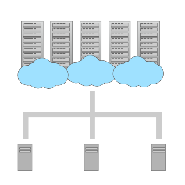
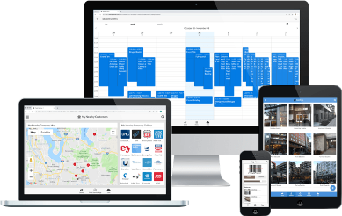
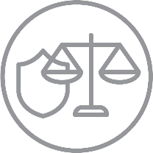
Business Critical Assets – Guess the Graphic?

Slide 44
Business Critical Assets – can include…
Externally facing Websites
Internal / External Production Applications
Intellectual Property i.e.
Product Design Patterns
Insurance Rating Tables
Pre-release Marketing Material
Commercially Sensitive Information i.e. pre-award bid information

Slide 45
Business Critical Assets – can include…
Employee Information i.e. Payroll Information
PII (Person Identifiable Information) i.e. Name, Address, Date of Birth, NI Number, IP Address etc.
Customer Information i.e. Orders, Purchasing / Account Information, Pricing etc.
Third Party (Supply Chain) i.e. Business Relationship, Connectivity etc.

Slide 46
Network Infrastructure – can include…
Firewalls, Switches, Routers, Hubs
IDS / IPS (Intrusion Detection / Prevention Systems)
VPN (Virtual Private Networks)
Internet Proxy / Internet Filtering

Slide 47
Technical Infrastructure – can include…
PC’s, Servers, Laptops, Tablets, Smartphones
Wifi Network (Corporate / Guest Access)
Client & Server Operating Systems
MS Windows
Linux
Android
Apple IOS

Slide 48
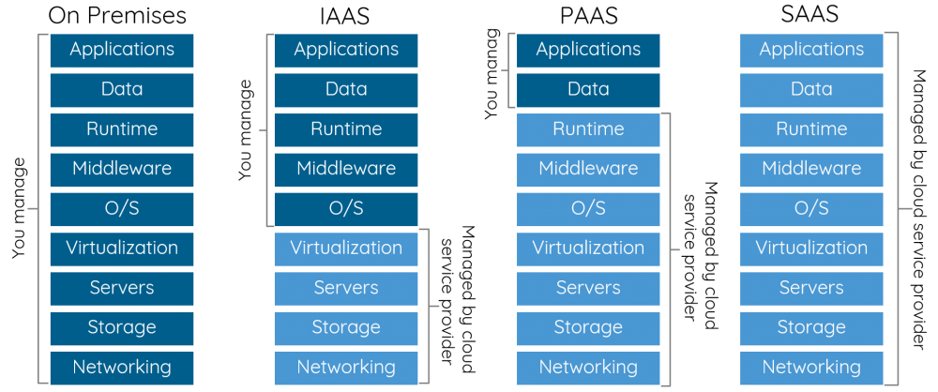
Cloud Infrastructure – can include…
On-Premise, Cloud and/or Hybrid Cloud Infrastructure

Slide 49
IOT Infrastructure – can include…
Medical Devices
CCTV
Multi-function Printers
Environ. Mgmt. Systems
IOT
(Internet of Things)
Physical Access Systems
Wearable Tech.
Smart Fridges
Smart TVs
Smart Lighting

Slide 50
Asset Management
Good “Asset Management” is critical to Cyber Security
You cannot manage the security relating to something if you don’t know it exists!
Assets must be tracked throughout their entire lifecycle…

Slide 51
Asset Management
Procurement
Deployment
Allocation
Delivery / Receipt

Slide 52
Asset Management Continued…
Monitoring & Maintenance
Decommissioning
Secure Disposal
Redeployment

Slide 53
Asset Management Continued…
Record Keeping
Reporting
Investigation
Auditing

Slide 54
Organisational Assets
What are your organisations Assets?
What Assets do you have, use, need?
What are the most important Assets, which if compromised could impact the business?
What types of “Threats” would you worry about?
Notes:
Notes & Information:
This group activity will enable us to understand the knowledge at the start of the course.

Slide 55
Introduction
Week 1
Intro
Monday
01
02
Wednesday
03
04
Tuesday
05
06
Thursday
Friday

Slide 56
Recap Session (15 Mins)
What is the role of a Cyber Security Professional?
What aspects need to be considered when implementing security well?
What do we mean by the term Assets?
What are the levels of Cloud services?
What are "Hybrid" Cloud services?
What IOT Devices can you name?

Slide 57
Syllabus – Week 1
Monday
What is Cyber Security, History of Cyber Security, Role of Cyber Security
Managing Cyber Security, Implementing Cyber Security
Tuesday
Cyber Security Principles, Cyber Security Terminology
Access Control, Identity Access Management
Wednesday
Internet & Cyber Security Evolution, Threat Landscape,
Threat Actors, Threats / Attacks, Targets
Thursday
Legislation & Regulation
Friday
Legislation & Regulation Continued…
Security Policies, Data Ethics

Slide 58
Cyber Security Terminology

Slide 59
Cyber Security Principles

Slide 60
What is the CIA Triad?

Slide 61
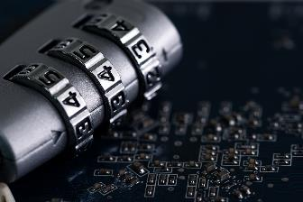
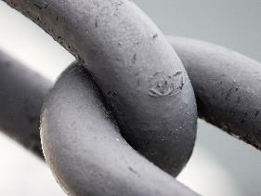
CIA Principles
Confidentiality Integrity Availability
Ensuring that the sensitive information is protected from unauthorized access
Ensuring the consistency, accuracy, completeness and general trustworthiness of data is maintained, “In Transit” and “At Rest”, and throughout its lifecycle
Ensuring that information is readily available and accessible for authorized parties with a legitimate need

Slide 62
CIA Principles
Confidentiality, Integrity and Availability
Could also be considered as…
“Ensuring that authorised individuals have access to accurate information in a timely manner”
Notes:
Phrase “Ensuring that authorised individuals have access to accurate information in a timely manner” – Copyright Martin Webley – introduce thinking in relation to legislative “control”.

Slide 63
Confidentiality
Threats
Capturing network traffic
Unauthorized access to network
Password dump stealing
Dumpster diving
Social engineering
Port scanning
Eavesdropping
Countermeasures
Encryption
VPN
Authentication to systems
Access control
Network traffic padding
Data classification
End-user training
Anything that needs to be protected
Safeguard against unauthorized access, notice, use
Protecting data at each stage (Collection, In-Transit, Processing & Storage)
Also known as: “secrecy” or “privacy”

Slide 64
Integrity
Threats
Malicious Code i.e. Virus
Logic bombs
Errors
Malicious modifications
Intentional replacement
System back door
Countermeasures
Activity logging
Access control
Authentication / permissions
Hashing
Encryption
IDS / IPS
Enforces Accuracy
Provides Assurance
Prevent unauthorized modifications
Prevent unauthorized modifications by authorized users
Maintain internal and external consistency of objects

Slide 65
Availability
Threats
Device failure
Software error
Natural calamity
Power
Human error / Oversight
Denial of Service (DOS / DDOS)
Countermeasures
RAID
Redundant systems
Clustering
Access control
BCP/DR
Fault tolerance
Battery Backup (UPS)
GEO-IP Filtering / DDOS Protection
Provision of un-interrupted and timely access to authorized subjects
Offers high level of assurance that data shall be available to authorized subjects
It includes
Usability
Accessibility
Timeliness

Slide 66
Cyber Security Terms

Slide 67
Identity
The fact of being who or what a person or thing is
Most commonly a user account
Identity must be unique

Slide 68
Credentials
Combination of unique information
At a minimum includes:
Username
Password

Slide 69
Passwords – Activity Part 1
Password Strength?
Take 15 minutes
Research what makes a strong password?
Think of a strong password?
Check your password at:
https://password.kaspersky.com/
Notes:
Resources & Notes:
Password Checkers:
https://www.passwordmonster.com/
https://password.kaspersky.com/
https://www.security.org/how-secure-is-my-password/

Slide 70
Passwords – Activity Part 2
What are the problems with passwords?
Take another 15 minutes
The number of systems we access are increasing exponentially!
Think about how we might be able to stay secure, without remembering long and complex passwords?
Notes:
Notes & Information:
This group activity will enable us to understand the knowledge at the start of the course.

Slide 71
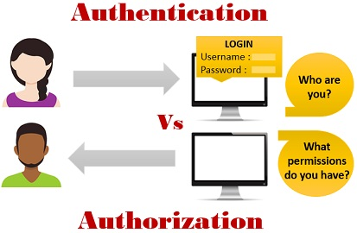
Authentication
Process or action of proving or showing something to be true, genuine, or valid
Process of determining whether someone or something is in fact who or what it declares itself to be
Process of recognising someone’s identity
Authentication process can be described in two distinct phases
Identification
Actual authentication

Slide 72
Authentication and Authorisation
These two parts of access control can be summarized as follows:
Authentication:
Are you who you say you are?
Authorization:
Are you allowed to do that?

Slide 73
Authorisation
The action of authorizing
The function of specifying access rights/privileges
Resources can include systems, servers, computers, folders and files

Slide 74
Accountability
Accountability means that people will be held responsible for their actions and for how they perform their duties
Accountability involves having control and verification systems in place, and, if necessary, the ability to reprimand, arrest, prosecute and convict offenders for illegal, or corrupt behaviour
All personnel must be held accountable

Slide 75
In summary… AAA
AAA stands for Authentication, Authorization and Accounting
Authentication is used to verify the identity of a person
Authorization is used to verify the persons has the correct permissions to access something
Accounting involves recording the persons access, by logging their activities

Slide 76
Access Control
Access control is a fundamental component of data security that defines who's allowed to access and use company information and resources.
Through authentication and authorization, access control policies make sure users are who they say they are and that they have appropriate access to company data.

Slide 77
Authenticity
What do we mean by Authenticity?
Authenticity is assurance that a message, transaction, or other exchange of information is from the source it claims to be from. Authenticity involves proof of identity.
We can verify authenticity through authentication. The process of authentication usually involves more than one “proof” of identity

Slide 78
Non-repudiation
Repudiation means to refuse to acknowledge a fact
Non-repudiation is the assurance that someone cannot deny something
Typically, non-repudiation refers to:
The ability to ensure that a party to a contract or a communication cannot deny the authenticity of their signature on a document
Or, the sending of a message that they originated

Slide 79
Reliability
Reliability is an attribute of any computer-related component (software, or hardware, or a network, for example) that consistently performs according to its specifications
It has long been considered one of three related attributes that must be considered when making, buying, or using a computer product or component

Slide 80
Threat
A cyber or cybersecurity threat…
Is a malicious act conducted by a “Threat Actor” that seeks to damage data, steal data, or disrupt digital life in general

Slide 81
Vulnerability
A vulnerability is a weakness in an IT system that can be exploited by an attacker to deliver a successful attack.
They can occur through flaws, features or user error, and attackers will look to exploit any of them, often combining one or more, to achieve their end goal.
Notes:
Resources & Notes:
Ref: NCSC
Link: https://www.ncsc.gov.uk/information/understanding-vulnerabilities

Slide 82
Vulnerability - Flaw
A flaw is unintended functionality. This may either be a result of poor design or through mistakes made during implementation.
Flaws may go undetected for a significant period of time.
Common attacks we see today exploit these types of vulnerabilities.
Between 2014 and 2015, nearly 8,000 unique and verified software vulnerabilities were disclosed in the US National Vulnerability Database (NVD).
Notes:
Resources & Notes:
Ref: NCSC
Link: https://www.ncsc.gov.uk/information/understanding-vulnerabilities

Slide 83
Vulnerability – Zero Day Vulnerabilities
Zero-days are frequently used in bespoke attacks by the more capable and resourced attackers.
Once the zero-days become publicly known, reusable attacks are developed and they quickly become a commodity capability.
This poses a risk to any computer or system that has not had the relevant patch applied or updated its antivirus software.
Notes:
Resources & Notes:
Ref: NCSC
Link: https://www.ncsc.gov.uk/information/understanding-vulnerabilities

Slide 84
Vulnerability – Feature
A feature is intended functionality which can be misused by an attacker to breach a system
Features may improve the user’s experience, help diagnose problems or improve management, but they can also be exploited by an attacker
When Microsoft introduced macros into their Office suite in the late 1990s, macros soon became the vulnerability of choice with the Melissa worm in 1999 being a prime example
Notes:
Resources & Notes:
Ref: NCSC
Link: https://www.ncsc.gov.uk/information/understanding-vulnerabilities

Slide 85
Vulnerability – User Error
A computer or system that has been carefully designed and implemented can minimise the vulnerabilities of exposure to the Internet.
Unfortunately, such efforts can be easily undone (for example by an inexperienced system administrator who enables vulnerable features, fails to fix a known flaw, or leaves default passwords unchanged).
More generally, users can be a significant source of vulnerabilities. They make mistakes, such as choosing a common or easily guessed password, or leave their laptop or mobile phone unattended.
Notes:
Resources & Notes:
Ref: NCSC
Link: https://www.ncsc.gov.uk/information/understanding-vulnerabilities

Slide 86
Risk
Risk is the probability (or “Likelihood”) of an organization being affected by a given Threat, resulting in a negative consequence (or “Impact”)
Negative consequences (or “Impact”) can include loss of critical assets and sensitive information, or reputational harm as a result of a cyber attack or breach within an organization’s network
Typically, “Impact” is considered in terms of the Confidentiality, Integrity and/or Availability of an Asset being negatively affected
Notes:
Resources & Notes:
NCSC “The Fundamentals of Risk”
Link: https://www.ncsc.gov.uk/collection/risk-management-collection/essential-topics/fundamentals

Slide 87
Risk Calculation
The significance of a Risk is generally calculated by the following equation:
Risk = Likelihood x Impact
Likelihood and Impact are assigned a number from 1 (being lowest) to 5 (being highest), prior to multiplying one with the other, giving you a maximum possible Risk Score of 25
Notes:
Resources & Notes:
NCSC “The Fundamentals of Risk”
Link: https://www.ncsc.gov.uk/collection/risk-management-collection/essential-topics/fundamentals

Slide 88
Risk Matrix
Once the Risk score has been calculated, the resultant Risk Score is mapped onto a Risk Matrix in order to communicate with senior stakeholders
Stakeholders may include:
Asset Owner, Security Manager, IT Manager, Risk Manager,
Information Governance Manager, Chief Information Risk Owner (CISO),
Finance Manager, Board Members, Partners

Slide 89
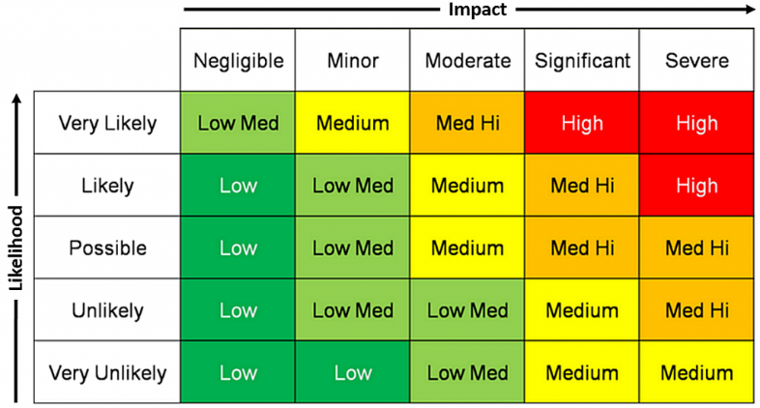
Risk Matrix - Qualitive
What do you notice?
Can you see any problems with this approach?

Slide 90
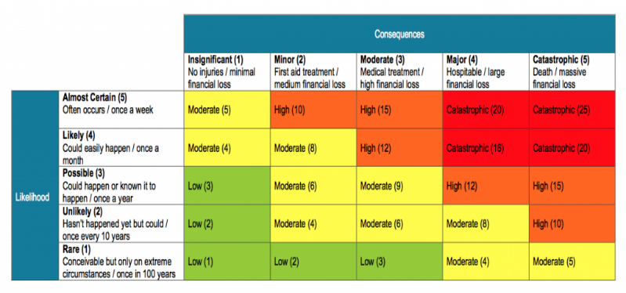
Risk Matrix - Quantitative
What do you notice?
Can you see any problems with this approach?

Slide 91
Risks and Hazards
The possibility of damage or harm, and the likelihood that damage or harm will be realized
A function of the likelihood of a given threat source exploiting a potential vulnerability, and the resulting impact of that adverse event on an organization
Hazards include physical and environmental hazards
Breaches
Moisture
Exposed cabling
Natural causes

Slide 92
Hazard
A hazard is any substance, phenomenon or situation, which has the potential to cause disruption or damage to people, their property, their services and their environment
Hazards can be:
Natural
Biological
Technological
Societal

Slide 93
Assurance
“Measure of confidence that the security features, practices, procedures, and architecture of an information system accurately mediates and enforces the security policy”
– Ref: NIST
Notes:
Resources & Notes:
Ref: NIST – National Institute of Standards and Technology

Slide 94
Access Control

Slide 95
Password Authentication
The most basic form of authentication
After a user enters his or her username, they need to type in a secret code to gain access to the network
To reduce this risk, users need to choose secure passwords with both letters and numbers, upper and lower case, special characters (such as $, %, or &), and no words found in the dictionary
Example:
j0hnW1c£@h! – john wick rich as hell!
Notes:
Anyone who uses the internet is familiar with passwords, the most basic form of authentication. After a user enters his or her username, they need to type in a secret code to gain access to the network. If each user keeps their password private, the theory goes, unauthorized access will be prevented. However, experience has shown that even secret passwords are vulnerable to hacking. Cybercriminals use programs that try thousands of potential passwords, gaining access when they guess the right one.
To reduce this risk, users need to choose secure passwords with both letters and numbers, upper and lower case, special characters (such as $, %, or &), and no words found in the dictionary. It’s also important to use long passwords of at least eight characters; each additional character makes it harder for a program to crack. Short, simple passwords such as “password” (one of the most common) and “12345” are barely better than no password at all. The most secure systems only allow users to create secure passwords, but even the strongest passwords can be at risk for hacking. Security experts have therefore developed more sophisticated authentication techniques to remedy the flaws of password-based systems.

Slide 96
Two-factor Authentication (2FA)
Passwords are historically bad, but are still in use!
Two-factor authentication builds on passwords to create a significantly more robust security solution
The principle of 2FA is that you have 2 out of the 3 following factors:
Something you have i.e. a mobile phone
Something you know i.e. a password
Or Something you are i.e. Fingerprint or Retina Scan (Biometrics)
Ref (The hacker who got hacked)
Notes:
Two-factor authentication builds on passwords to create a significantly more robust security solution. It requires both a password and possession of a specific physical object to gain access to a network—something you know and something you have. ATMs were an early system to use two-factor authentication. To use an ATM, customers need to remember a “password”—their PIN—plus insert a debit card. Neither one is enough by itself.
In computer security, 2FA follows the same principle. After entering their username and a password, users have to clear an additional hurdle to login: they need to input a one-time code from a particular physical device. The code may be sent to their cell phone via text message, or it may be generated using a mobile app. If a hacker guesses the password, they can’t proceed without the user’s cell phone; conversely, if they steal the mobile device, they still can’t get in without the password. 2FA is being implemented on an increasing number of banking, email, and social media websites. Whenever it’s an option, make sure to enable it for better security.

Slide 97
Two Factor Authentication Example
Example, using a mobile phone for the “Something you have”…
After entering their username and a password, users must clear an additional hurdle to login
They need to input a one-time code from their registered mobile phone
2FA is being implemented on an increasing number of banking, email, and social media websites

Slide 98
Two-factor Authentication (2FA)
Trust?
No
Yes
Username
Password
Notes:
Step 1 – Password
Step 2 – Proof
Step 3 - Access

Slide 99
Token authentication
Token authentication requires users to obtain a computer-generated code (or token) before they're granted network entry
Token authentication is typically used in conjunction with password authentication for an added layer of security
This is what we refer to as two-factor authentication (2FA)
Notes:
Some companies prefer not to rely on cell phones for their additional layer of authentication protection. They have instead turned to token authentication systems. Token systems use a purpose-built physical device for the 2FA. This may be a dongle inserted into the computer’s USB port, or a smart card containing a radio frequency identification or near-field communication chip. If you have a token-based system, keep careful track of the dongles or smart cards to ensure they don’t fall into the wrong hands. When a team member’s employment ends, for example, they must relinquish their token. These systems are more expensive since they require purchasing new devices, but they can provide an extra measure of security.

Slide 100
Token authentication
password
Client
Authorisation
server
token
password
User
token
Resource
server
resource
Notes:
The Token-Based Authentication works as Follows:
The user enters his credentials (i.e. the username and password) into the client (here client means the browser or mobile devices, etc).
The client then sends these credentials (i.e. username and password) to the Authorization Server.
Then the Authorization Server authenticates the client credentials (i.e. username and password) and generates and returns an access token. This Access Token contains enough information to identify a user and also contains the token expiry time.
The client application then includes the Access Token in the Authorization header of the HTTP request to access the restricted resources from the Resource Server until the token is expired.

Slide 101
Biometric Authentication
The cutting edge of computer authentication methods
Biometrics (meaning “measuring life”) rely on a user’s physical characteristics to identify them
Very secure as no two users have the same exact physical features
Have considerable downsides
They are expensive to install, requiring specialized equipment like fingerprint readers or eye scanners
They come with worrisome privacy concerns - users may balk at sharing their personal biometric data with a company or the government unless there is a good reason to do so
Notes:
Biometric systems are the cutting edge of computer authentication methods. Biometrics (meaning “measuring life”) rely on a user’s physical characteristics to identify them. The most widely available biometric systems use fingerprints, retinal or iris scans, voice recognition, and face detection (as in the latest iPhones). Since no two users have the same exact physical features, biometric authentication is extremely secure. It’s the only way to know precisely who is logging in to a system. It also has the advantage that users don’t have to bring a separate card, dongle, or cell phone, nor do they have to remember a password (though biometric authentication is more secure when paired with a password).
Despite their security advantages, biometric systems also have considerable downsides. First, they are expensive to install, requiring specialized equipment like fingerprint readers or eye scanners. Second, they come with worrisome privacy concerns. Users may balk at sharing their personal biometric data with a company or the government unless there is a good reason to do so. Thus biometric authentication makes the most sense in environments requiring the highest level of security, such as intelligence and defense contractors.

Slide 102
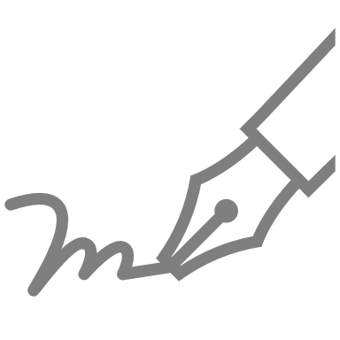
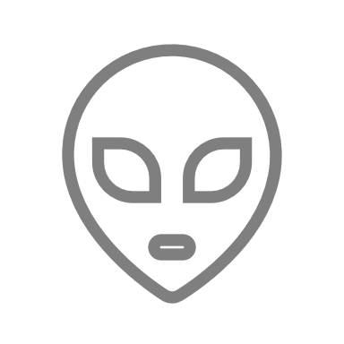
Biometric Authentication - Types
Signature Recognition
DNA Matching
Face Recognition
Fingerprint Recognition
Voice Recognition
Vein Pattern
Recognition
Notes:
Types of Biometric Authentication
Signature
DNA
Face
Fingerprint
Voice
Vein

Slide 103
Single Sign-on (SSO)
A useful feature to consider when deciding between device authentication methods
Enables a user to only enter their credentials once to gain access to multiple applications
Saves time and keeps users happy by avoiding repeatedly entering passwords
Can introduce security risks
an unauthorized user who gains access to one system can now penetrate others
Notes:
Single sign-on (SSO) is a useful feature to consider when deciding between device authentication methods. SSO enables a user to only enter their credentials once to gain access to multiple applications. Consider an employee who needs access to both email and cloud storage on separate websites. If the two sites are linked with SSO, the user will automatically have access to the cloud storage site after logging on to the email client. SSO saves time and keeps users happy by avoiding repeatedly entering passwords. Yet it can also introduce security risks; an unauthorized user who gains access to one system can now penetrate others. A related technology, single sign-off, logs users out of every application when they log out of a single one. This bolsters security by making certain that all open sessions are closed.

Slide 104
Single Sign-on
User
Single Sign-On
Username
Password
1
2
3
App 1
App 2
App 3

Slide 105
Access Control Systems
Discretionary Access Control (DAC)
DAC assigns access rights based on rules specified by users. Subjects can determine who has access to their objects. The DAC model takes advantage of using access control lists (ACLs) and capability tables.
Role Based Access Control (RBAC)
RBAC is used when system administrators need to assign rights based on organizational roles instead of individual user accounts. Addresses the principle of ‘least privilege’. This gives an individual only the access needed to do their job, since access is connected to their job.
Three main types of access control systems:
Mandatory Access Control (MAC)
Strictest of all levels of access control systems. Commonly used by the government. An hierarchical approach to control access to files/resources. Access to resource objects is controlled by the settings defined by a system administrator. It is not possible for users to change access control of a resource.
Notes:
DAC is a type of access control system that assigns access rights based on rules specified by users. The principle behind DAC is that subjects can determine who has access to their objects. The DAC model takes advantage of using access control lists (ACLs) and capability tables.
RBAC, also known as a non-discretionary access control, is used when system administrators need to assign rights based on organizational roles instead of individual user accounts within an organization. It presents an opportunity for the organization to address the principle of ‘least privilege’. This gives an individual only the access needed to do their job, since access is connected to their job.
Considered the strictest of all levels of access control systems. The design and implementation of MAC is commonly used by the government. It uses a hierarchical approach to control access to files/resources. Under a MAC environment, access to resource objects is controlled by the settings defined by a system administrator. This means access to resource objects is controlled by the operating system based on what the system administrator configured in the settings. It is not possible for users to change access control of a resource.

Slide 106
Identity Access Management

Slide 107
IAM?
Identity and access management (IAM) ensures that the right people and job roles in your organization (identities) can access the tools they need to do their jobs
Identity management and access systems enable your organization to manage employee apps without logging into each app as an administrator
Identity and access management systems enable your organization to manage a range of identities including people, software, and hardware like robotics and IoT devices
Notes:
Resources & Notes:
Ref: onelogin.com

Slide 108
IAM Benefits - Security
Traditional security often has one point of failure - the password
If a user's password is breached - or worse yet, the email address for their password recoveries - your organization becomes vulnerable to attack
IAM services narrow the points of failure and backstops them with tools to catch mistakes when they're made
Notes:
Resources & Notes:
Ref: onelogin.com

Slide 109
IAM Benefits - Productivity
Once you log on to your main IAM portal, your employee no longer has to worry about having the right password or right access level to perform their duties
Not only does every employee get access to the perfect suite of tools for their job, but their access can also be managed as a group or role instead of individually, reducing the workload on your IT professionals
Notes:
Resources & Notes:
Ref: onelogin.com

Slide 110
IAM Functionality
IAM generally performs two tasks:
IAM confirms that the user, software, or hardware is who they say they are by authenticating their credentials against a database
Identity access management systems grant only the appropriate level of access. Instead of a username and password allowing access to an entire software suite, IAM allows more granular access to be assigned
Notes:
Resources & Notes:
Ref: onelogin.com

Slide 111
IAM Authentication
Notes:
Resources & Notes:
Ref: onelogin.com

Slide 112
IAM Core Functions
TASK | TOOLS
Manage user identities | IAM systems can be the sole directory used to create, modify, and delete users, or it may integrate with one or more other directories and synchronize with them. Identity and access management can also create new identities for users who need a specialized type of access to an organization's tools.
Provisioning/deprovisioning users | Specifying which tools and access levels (editor, viewer, administrator) to grant a user is called provisioning. IAM tools allow IT departments to provision users by role, department, or other grouping in consultation with the managers of that department. Since it is time consuming to specify each individual’s access to every resource, identity management systems enable provisioning via policies defined based on role-based access control (RBAC). Users are assigned one or more roles, usually based on job function, and the RBAC IAM system automatically grants them access. Provisioning also works in reverse; to avoid security risks presented by ex-employees retaining access to systems, IAM allows your organization to quickly remove their access.
Authenticating users | IAM systems authenticate a user by confirming that they are who they say they are. Today, secure authentication means multi-factor authentication (MFA) and, preferably, adaptive authentication.
Authorizing users | Access management ensures a user is granted the exact level and type of access to a tool that they're entitled to. Users can also be portioned into groups or roles so large cohorts of users can be granted the same privileges.
Reporting | IAM tools generate reports after most actions taken on the platform (like login time, systems accessed, and type of authentication) to ensure compliance and assess security risks.
Notes:
Resources & Notes:
Ref: onelogin.com

Slide 113
Federated Identity Management

Slide 114
FIM?
Federated identity management (FIM) is an arrangement between multiple enterprises or domains that enables their users to use the same identification data (digital identity) to access all their networks.
These partners are also known as trust domains. A trust domain can be an organization, a business unit, a smaller subsidiary of a larger organization, etc.
Notes:
Resources & Notes:
Ref: https://www.techtarget.com/searchsecurity/definition/federated-identity-management

Slide 115
FIM – How does it work?
FIM is a system of single login, multiple access. For FIM to work effectively, all involved partners must have a sense of mutual trust
Each trust domain maintains its own identity management. However, all domains are interlinked through a third-party service that stores users' access credentials and provides the trust mechanism needed for FIM to work
This third service is known as the identity provider or identity broker
Notes:
Resources & Notes:
Ref: https://www.techtarget.com/searchsecurity/definition/federated-identity-management

Slide 116
FIM – How does it work?
This provider brokers access control among multiple service providers. The FIM arrangement is made between two, or even more identity brokers across organizations.
FIM links users' identities across multiple security domains. When two domains are federated, users only need to authenticate themselves to one domain.
That's because a second security domain and part of the FIM system trusts that the user's home domain authenticated the user and enables them to have unfettered access.

Slide 117
FIM Systems
Examples of FIM systems include:
OpenID
Open Authorization
Shibboleth, which is based on the Organization for the Advancement of Structured Information Standards' Security Assertion Markup Language (SAML)
Note: Organizations that implement SSO do not necessarily use FIM. However, FIM relies heavily on SSO technologies to authenticate users across domains.

Slide 118
FIM Process
Notes:
Resources & Notes:
Ref: Microsoft

Slide 119
FIM – Common Uses
New users added to the system after a merger or acquisition;
External vendors or distributors that require access to the organization's resources;
Users from commercial identity providers;
Users with credentials from a public organization;
Citizens using credentials from a national identity provider; and
Access to social websites, like Gmail, Facebook, Google, etc

Slide 120
Introduction
Week 1
Intro
Monday
01
02
Wednesday
03
04
Tuesday
05
06
Thursday
Friday

Slide 121
Recap Session (15 Mins)
What security principles are covered by CIA?
What are the principles of 2FA?
What two aspects (L x I) are considered when calculating Risk?
What are the three main types of Access Control System(DAC / RBAC / MAC), and how do they work?
What do we mean by the term Threat, and Vulnerability?
Notes:
Something you know
Something you have
Something you are

Slide 122
Syllabus – Week 1
Monday
What is Cyber Security, History of Cyber Security, Role of Cyber Security
Managing Cyber Security, Implementing Cyber Security
Tuesday
Cyber Security Principles, Cyber Security Terminology
Access Control, Identity Access Management
Wednesday
Internet & Cyber Security Evolution, Threat Landscape,
Threat Actors, Threats / Attacks, Targets
Thursday
Legislation & Regulation
Friday
Legislation & Regulation Continued…
Security Policies, Data Ethics

Slide 123
Internet & Cyber Security Evolution

Slide 124
Evolution of the Internet

Slide 125
Evolution of the Internet

Slide 126
Evolution of the Internet
Notes:
Resources & Notes:
Reference - Spencer Trask Institute

Slide 127
Evolution of Cyber Security – 1970s
1970s the first example of a computer programme which left behind a “breadcrumb” of valuable information where ever it went.
Called the “Creeper” and could move across ARPANET’s network
The inventor of email (Ray Tomlinson) created a programme called “Reaper” in response to “Creeper”
Reaper was designed to chase and delete Creeper
Very first example of antivirus / antimalware
Creeper was the very first-computer Worm (malware – Malicious Software).
Notes:
Resources & Notes:
Reference - https://cybermagazine.com/cyber-security/history-cybersecurity & Martin Webley

Slide 128
Evolution of Cyber Security – 1980s
1987 saw the birth of the first commercial antivirus
First Antivirus product was released for the Atari ST
“Ultimate Virus Killer” product released in 1987
NOD Antivirus also released in the same year
Notes:
Resources & Notes:
Reference - https://cybermagazine.com/cyber-security/history-cybersecurity & Martin Webley

Slide 129
Evolution of Cyber Security – 1990s
The world goes online…
People begin putting their Personal Information online
Criminal organisations saw and seized the opportunity
Mid-1990s exponential increase in network related threats
Notes:
RResources & Notes:
Reference - https://cybermagazine.com/cyber-security/history-cybersecurity & Martin Webley
ef

Slide 130
Evolution of Cyber Security – 2000s
Crime organisations begin to professionally fund Cyber Attacks
Governments began to clamp down on the criminality of “Hacking”
Legislation was updated to recognise and convict perpetrators of computer based crime
Information security continued to advance, but responded reactively to new methods of hacking and attacks
Notes:
Resources & Notes:
Reference - https://cybermagazine.com/cyber-security/history-cybersecurity & Martin Webley

Slide 131
Evolution of Cyber Security – 2021…
Cyber Security industry continues to grow
Ransomware is one of the common threats to an organisation
Email and social engineering are common attack vectors, however the down of IOT devices is expected to provide new options for hackers
Demand for Cyber Security professionals far exceeds skilled and experienced resources available
Notes:
Resources & Notes:
Reference - https://cybermagazine.com/cyber-security/history-cybersecurity & Martin Webley

Slide 132
Threat Landscape

Slide 133
Threat Landscape - Live
Notes:
Resources & Notes:
https://threatmap.checkpoint.com/
https://www.fireeye.com/cyber-map/threat-map.html

Slide 134
Threat Actors

Slide 135
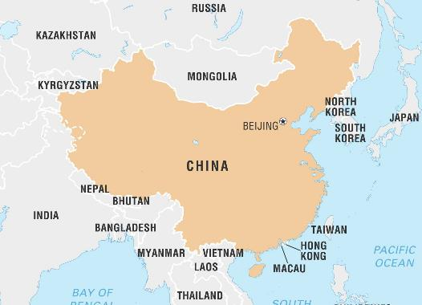
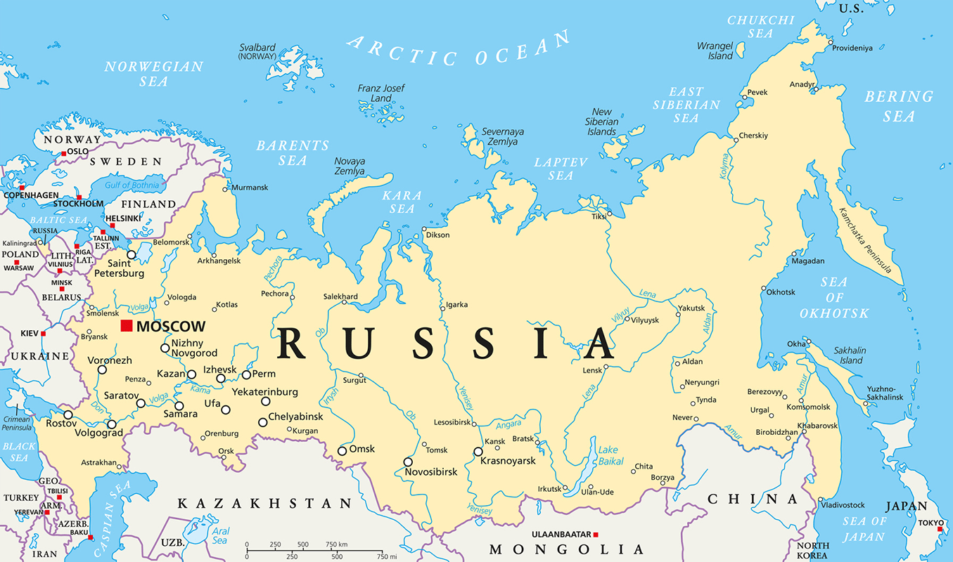
Threat Actors (2021 / 2022)
During 2021, the UK continued its work with global partners to detect and disrupt shared threats, the most consistent of these emanating from Russia and China
Notes:
Resources & Notes:
Ref: NCSC

Slide 136
Threat Actors (2021 / 2022)
Direct cyber security threats posed by the Russian state
Many organised crime gangs launched ransomware attacks against Western targets were based in Russia.
Notes:
Resources & Notes:
Ref: NCSC

Slide 137
Threat Actors (2021/2022)
China remains a highly sophisticated actor in cyberspace with increasing ambition to project its influence beyond its borders and a proven interest in the UK’s commercial secrets.
Notes:
Resources & Notes:
Ref: NCSC

Slide 138
Threat Actors (2021/2022)
How China evolves in the next decade will probably be the single biggest driver of the UK’s future cyber security.
Notes:
Resources & Notes:
Ref: NCSC

Slide 139
Threat Actors (2021/2022)
While less sophisticated than Russia and China, Iran and North Korea continued to use digital intrusions to achieve their objectives, including through theft and sabotage
Notes:
Resources & Notes:
Ref: NCSC Page 24 & 25 of National Cyber Strategy

Slide 140
Threats / Attacks

Slide 141
Threats / Attacks (2021 / 2022)
Ransomware
Strategic Vulnerabilities
Supply Chains
Notes:
Resources & Notes:
Ref: NCSC Page 24 & 25 of National Cyber Strategy

Slide 142
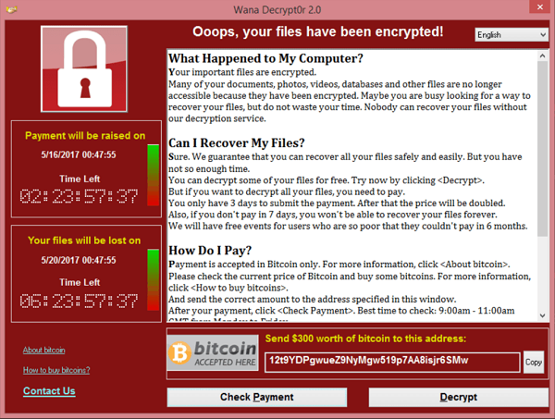
Ransomware
In May 2021, a ransomware attack against the Irish Health Service Executive (HSE) disrupted Irish healthcare IT networks and hospitals for over 10 days
The attack, caused real-world consequences to patients and their families. Some stolen patient data was also published online.
The HSE, which provides health and social care services in Ireland, shut down national and regional networks the same day to contain the incident.
Notes:
Resources & Notes:
Ref: NCSC Page 24 & 25 of National Cyber Strategy

Slide 143
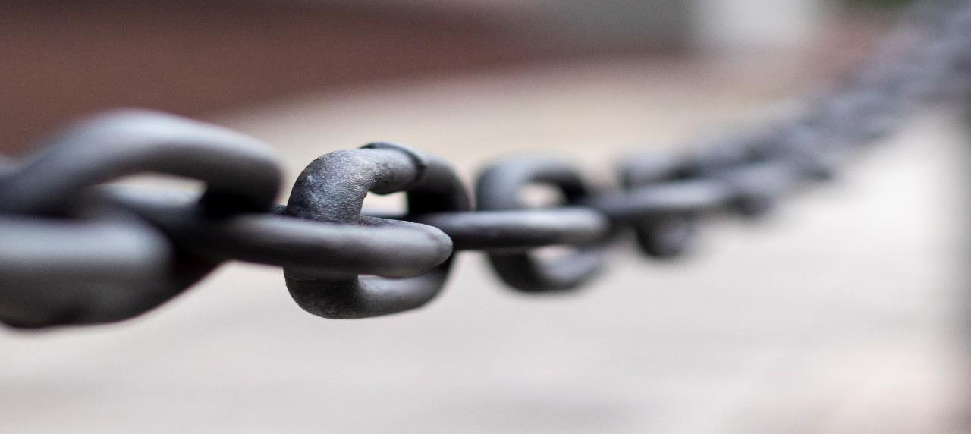
Strategic Vulnerabilities & Supply Chains
The compromise of the software company SolarWinds and the exploitation of Microsoft Exchange Servers highlighted the threat from supply chain attacks.
These sophisticated attacks, which saw actors target less-secure elements - such as managed service providers or commercial software platforms - in the supply chain of economic, government and national security institutions
These were two of the most serious cyber intrusions ever observed by the NCSC!

Slide 144
Strategic Vulnerabilities – Solar Winds
The actor was able to implant malicious code into an update file for the software, as far back as March 2020.
In April 2021 the NCSC, together with its security counterparts in the US, revealed for the first time that Russia’s Foreign Intelligence Service (the SVR) was behind this attack
One of the most serious cyber intrusions of recent times
SolarWinds confirmed 18,000 organisations affected across the world, including US Government departments

Slide 145
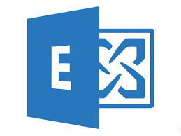
Strategic Vulnerabilities – Microsoft
On 2 March 2021, Microsoft made public that sophisticated actors had attacked a number of Microsoft Exchange servers, which are used by organisations worldwide to manage their email, scheduling and collaboration
Microsoft assessed that the initial intrusions commenced as early as January 2021 and were Chinese state sponsored
In response to this they released multiple security updates for affected servers

Slide 146
Strategic Vulnerabilities – Microsoft
In July 2021, the UK joined like-minded partners to confirm that Chinese state-backed actors were responsible for the attacks that affected over a quarter of a million servers worldwide
The attack was highly likely to enable large-scale espionage, including acquiring personally identifiable information and intellectual property

Slide 147
Targets

Slide 148
Targets

Slide 149
Introduction
Week 1
Intro
Monday
01
02
Wednesday
03
04
Tuesday
05
06
Thursday
Friday

Slide 150
Recap Session (15 Mins)
What was the foundation system of the Internet called?
What does the Threat Landscape mean, and which countries are currently the biggest threats?
What are the three main Threats / Attacks for 2021 / 2022?
Name three types of Target in the UK?
What does the money from Cybercrime fund?
Notes:
Critical National Infrastructure

Slide 151
Syllabus – Week 1
Monday
What is Cyber Security, History of Cyber Security, Role of Cyber Security
Managing Cyber Security, Implementing Cyber Security
Tuesday
Cyber Security Principles, Cyber Security Terminology
Access Control, Identity Access Management
Wednesday
Internet & Cyber Security Evolution, Threat Landscape,
Threat Actors, Threats / Attacks, Targets
Thursday
Legislation & Regulation
Friday
Legislation & Regulation Continued…
Security Policies, Data Ethics

Slide 152
Legislation & Regulation

Slide 153
Legislation, Regulation, Policies & Standard
Legislation is an official instruction by a legislative body (Broad and general)
Regulation is specific and details how the legislation is being enforced and supplement Legislation
Policies can be a set of guidelines and rules set by an organisation for employees to comply.

Slide 154
Personal Data
Information of a living individual. Can include but not limited to:
Customer
Client
Employee
Partner
Business contact
Public official
Member of public

Slide 155
Personal Data
Any form of information which could identify someone can be personal data
Doesn’t necessarily mean ‘private information’
Public knowledge can also fall under personal data
Notes:
PII

Slide 156
Data Processing
Anything you do with data counts as processing, this includes:
Collecting
Recording
Storing
Using
Analysing
Combining
Disclosing
Deleting

Slide 157
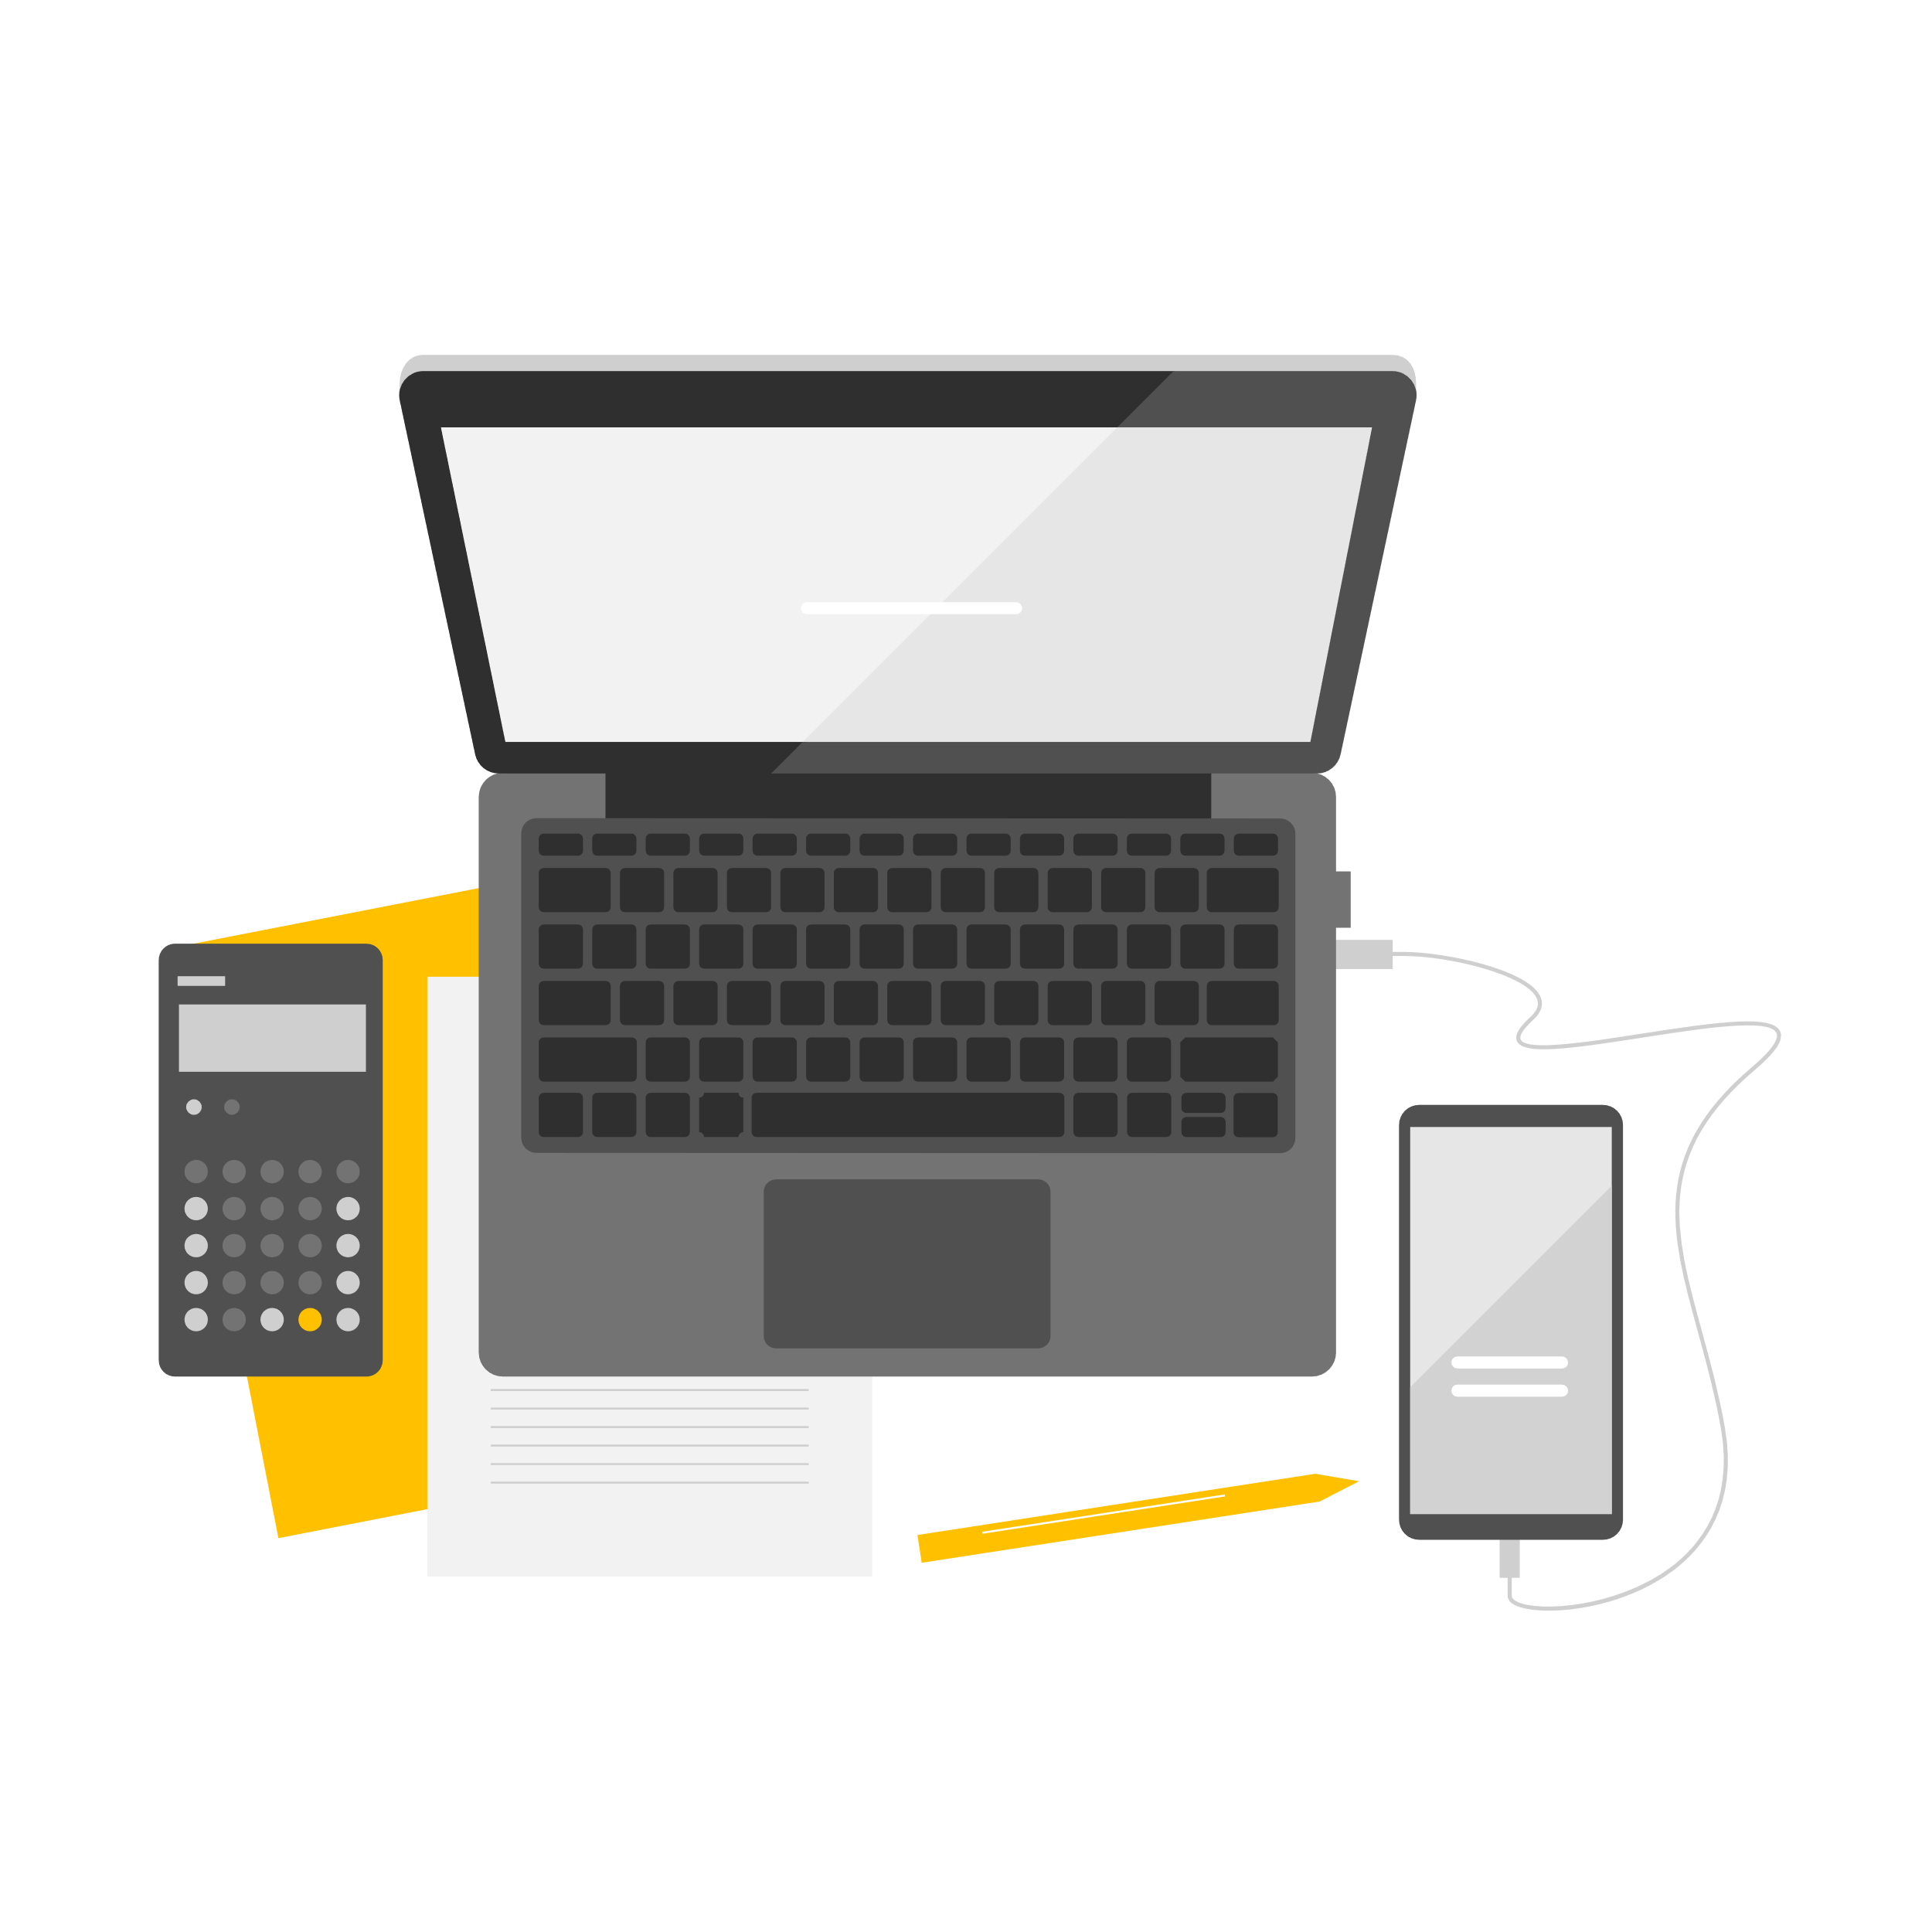
Data Controller
Controller is the person that decides how and why they go collect and use the data
Usually an organisation or individual
The ‘Controller’ must ensure the processing of data complies with data protection law

Slide 158
Data Processor
Third party or behalf of Controller
Similar to a Data Controller
The Data Subject’s data cannot be used for any other purpose than originally specified when the data controller collected it unless they seek further authorisationexplicitly from the Data Subject

Slide 159
Data Subject
Data subject is an individual who can be identified via personal data
This can be via an identifier such as an ID number, location data and many more factors.

Slide 160
Data Subject Rights
The right to be informed
The right of access
The right to rectification
The right to erasure
The right to restrict processing
The right to data portability
The right to object
Rights in relation to automated decision making and profiling

Slide 161
Data Protection Act

Slide 162
Data Protection Act (DPA)
Data Protection Act can be traced back to the 1970s
“Right to Privacy”
Data Protection Act has undergone multiple updates
UK has updated Data Protection (2018) in accordance with GDPR
GDPR is the General Data Protection Regulation

Slide 163
Data Protection Act
DPA is concerned with the processing of personal information and how it’s used by:
Organisations
Businesses
Government
Individuals
Personal Identifiable Information (Information which can identify a person)
Name
National Insurance Number
IP Address
Cookie Identifier
Many more…

Slide 164
Data Protection Act (DPA)
Anyone Responsible for personal data has to follow strict principles:
Used fairly, lawfully and transparently
Used for Specified, explicit purposes
Used in an adequate way, relevant and limited to what is necessary
Accurate and up to date
Kept for no longer than necessary
Ensuring appropriate security, protection against unlawful and unauthorised processing, access, loss, destruction or damage

Slide 165
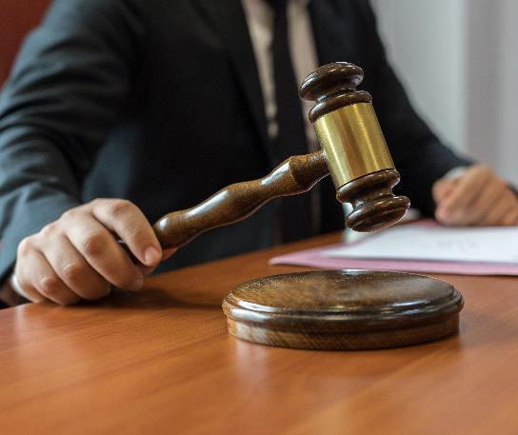
Data Protection Act (DPA)
Also includes stronger legal protection for the following sensitive information:
Race
Ethnic Background
Political opinions
Religious Beliefs
Trade union membership
Genetics
Biometrics (Identification)
Health
Sex life or orientation

Slide 166
Data Protection Breaches!
Take 15 minutes
Have a look at the ICO’s website for breaches and action taken
Pick an interesting breach to present to the rest of the group

Slide 167
General Data Protection Regulation (GDPR)

Slide 168
Geographical Scope
GDPR is an EU data privacy law which is to protect the data belonging to EU citizens and residents.
Covers any organisation worldwide that handle any personal data within the EU
DP is the UK’s implementation of GDPR, whether or not an organisation is based in the EU/UK, as long as they handle any data of citizens in those areas they will have to comply

Slide 169
General Data Protection Regulation (GDPR)
Falls in place with Data Protection Act as a Regulation
Seven key principles:
Lawfulness, fairness and transparency
Purpose limitation
Data minimisation
Accuracy
Storage limitation
Integrity and confidentiality (security)
Accountability

Slide 170
Lawfulness, fairness and transparency
1. User Consent
2. Required to form a Contract
3. Required to fulfil a Legal obligation
4. May be used as Protection of vital interests of a natural person
5. May be used as a Public task done in public interest
6. You can prove Legitimate use/interest and the subjects right aren’t overridden

Slide 171
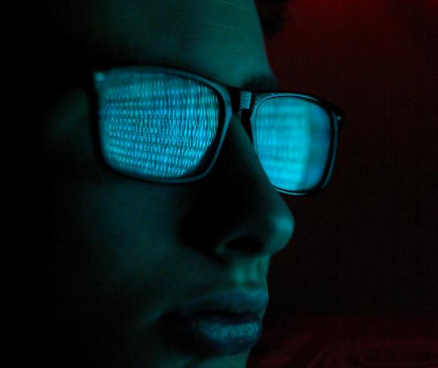
Purpose Limitation
This principle sets boundaries around using data only for specific use
“Collected for specified, explicit, and legitimate purposes”
Purposes for processing data must be detailed thoroughly while also clearly communicating via a privacy notice
Any change of intention with data which isn’t compatible with the original purpose, consent must be requested again!

Slide 172
Data Minimisation
This principle covers the amount of personal data being processed
Only collect what is required to complete the purpose.
An example would be signing users for a newsletter
What info would you require?

Slide 173
Accuracy
This principle ensures the accuracy of data
Tasks can include updating, erasing incomplete data or incorrect data
Regular audits to keep information up to date from Data Subjects.
Includes data which is collected and stored

Slide 174
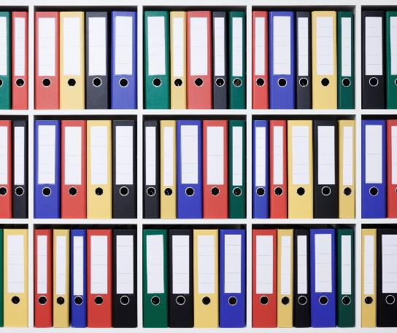
Storage Limitation
This principle covers the justification of time data is kept
Set data retention periods is an option to establish and meet storage limitation policies
Once “old” data is no longer needed, multiple options are available such as removal of data or anonymize the data.

Slide 175
Integrity and confidentiality
This principle covers the security of data from internal or external threats
Planning and persistent approach to maintain the security of data
What are we protecting data against?
Notes:
Unauthorised or unlawful processing
Accidental Loss
Destruction
Damage

Slide 176
Accountability
This principle covers the accountability of the Data Controller
An organisation can say they are following GDPR rules but how do you know?
This is where accountability comes in, appropriate measures and records to prove compliance
Creating an audit trail will prove responsibility with authorities

Slide 177
Conclusion
These seven principles form the GDPR and the best practices with data processing and handling.
It all forms around the Data Controller and processor
Do you remember what a Data controller and processor means?

Slide 178
Consequences of DPA & GDPR Violation
Covers any breach for European citizens and residents
UK GDPR & DPA combined
Maximum fine of 4% of annual global turnover

Slide 179
GDPR Individual Rights

Slide 180
The right to be informed
Individuals have to right to be informed
Collection and use of personal data
This is a key transparent requirement under GDPR

Slide 181
The right of access
Individuals have the right to access and receive a copy of their personal data
This is referred as Subject Access Request
How do you think you can request this from an organisation?
Notes:
Subject Access Request can be verbal or in writing, including social media
The organisation should perform a reasonable search for the requested information
Information in an accessible, concise and intelligible format
Information should be disclosed securely

Slide 182
The right to rectification
Individuals have the right to have inaccurate personal data rectified
This also includes incomplete person date being completed
Evidence for incorrect data may need to be supplied

Slide 183
The right to erasure
Individuals have the right to have personal data erased
Also known as the ‘right to be forgotten’
Think of some scenarios where you would want to be forgotten?
What scenarios can organisations deny the right to forget or erase your data?

Slide 184
The right to restrict processing
Individuals have the right to restrict the processing of their personal data
Limitation of use on personal data
Alternative to requesting the erasure of data

Slide 185
The right of data portability
Individuals have the right to receive personal data they have provided to a controller
Allows them to ‘migrate’ data to other third parties
Data must be in a structure, commonly used and machine readable format.
Notes:
NHS medical records migration to Private
Can be personal data which has also formed around you
Data cannot be in a proprietary format

Slide 186
The right to object
Individuals have the right to object to the processing of their personal data at any time*
The right to object only applies in certain circumstances
What reasons or organisations could disallow this?
Notes:
Digital Marketing

Slide 187
Rights in relation to automated decision making and profiling
Individuals have the right to object to decisions based solely on computer processing and to questions the decisions made about you by a computer (artificial intelligence)
You cannot object in certain automated decision making, including profiling
What do you think these are?
Notes:
it is required for a contract you have entered into
it is required by law, for example fraud or tax evasion monitoring or
you have given your explicit consent

Slide 188
Information Commissioner’s Office (ICO)
UK’s independent professional body setup to uphold information rights in the public interest, promoting openness by public bodies and data privacy for individuals
https://ico.org.uk/
Notes:
These are the watchdog’s

Slide 189
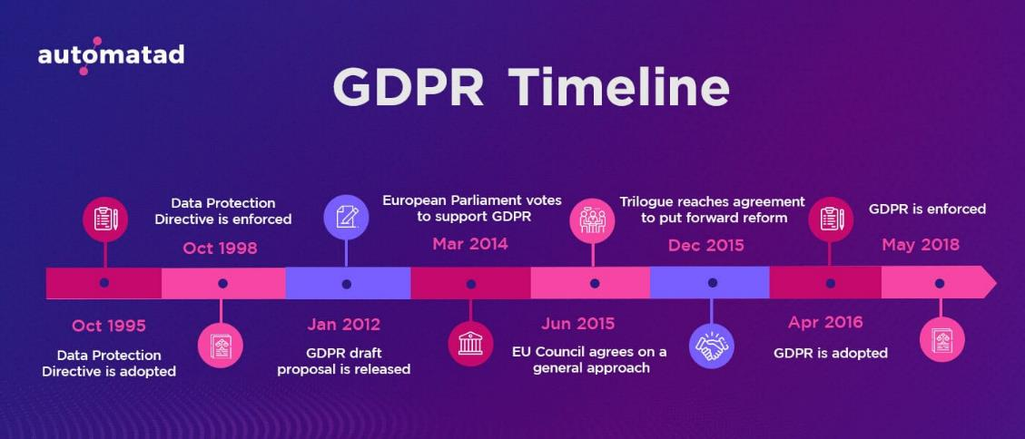

Slide 190
The Regulation of Investigatory Powers Act (RIPA)

Slide 191
Regulation of Investigatory Powers Act 2000 (RIPA)
RIPA governs the use of surveillance which isn’t openly acknowledged by public bodies.
What is surveillance?
A covert listening device (a bug or wire)
Video surveillance (CCTV)
Interceptions of private communications (Man-in-the-middle, SMS, phones, emails
Undercover government agents (secret intelligence)

Slide 192
Regulation of Investigatory Powers Act (RIPA)
RIPA applies to a wide range of investigations
How private information might be obtained for the purposes of evidence and investigation
Cases can include:
Terrorism
Crime
Public Safety
Emergency Services

Slide 193
Regulation of Investigatory Act 2000 (RIPA)
Introduced in 2000 which allowed certain groups the legal right for surveillance
Access to digital communication held by a person or organisation
RIPA covers a wide range of security services but let’s consider the relation to cyber

Slide 194
RIPA
Listed Public bodies who can access digital communication and or stored digital data in certain circumstances
Internet Service Providers (ISPs)
Organisations which facilitates digital communication and storage (what kind of organisations do you know, that may facilitate this?)
Individuals and employees of businesses using digital communication and storage
Notes:
The following groups would be relevant to RIPA context

Slide 195
Users and Employees
Contracts with ISPs or Mobile Operators are subject to RIPA
Browsing habits, digital communications monitoring
Accessed by security services and public bodies

Slide 196
Legal Implications
Increased amounts of computer technology
Increased needs for more legislation
Safeguard requirements for individuals and organisations

Slide 197
Human Rights Act

Slide 198
Humans Right Act
Protects the human rights from being taken away from the state
Public authorities have a legal obligation to uphold these rights
What is a public authority?

Slide 199
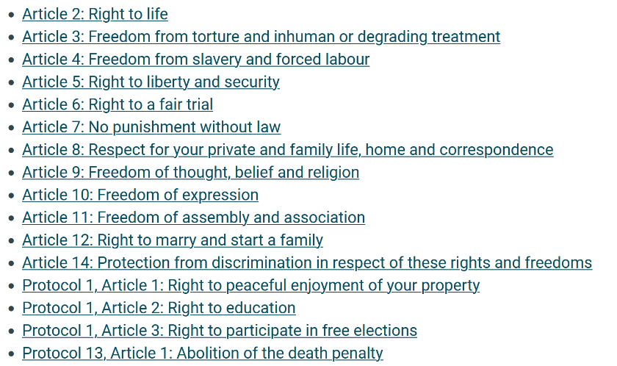
Humans Right Act

Slide 200
Computer Misuse Act

Slide 201
Computer Misuse Act (1990)
Protects from unauthorised access and modification to systems
The act covers the following things:
Unauthorised access to computer material. (Hacking)
Unauthorised access to computer material with intent to commit further crime (malware installation)
Unauthorised modification of data. (modifying or deleting data)
Making, supplying or obtaining anything which can be used in computer misuse offences

Slide 202
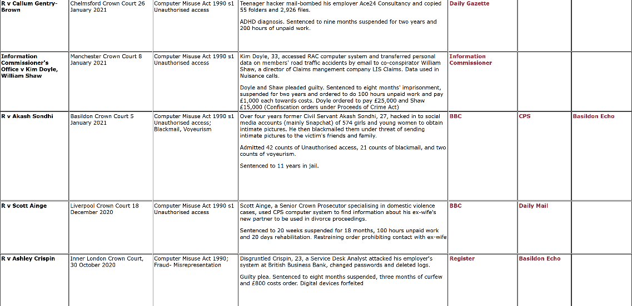

Slide 203
Freedom of Information Act

Slide 204
Freedom of Information Act 2000
This act provides public access to information held by public authorities
This is covered in the following ways:
Public authorities are obliged to disclose certain information on their activities
Public are entitled to request information from public authorities

Slide 205
Official Secrets Act

Slide 206
Official Secrets Act 1911 (OSA)
A law which protects the states secrets
Protection against disclosure of information without lawful authority
Protects against espionage
Espionage – the use of spies for to gather secret information
Cover’s you for life

Slide 207
Protected Information
There are six categories of protected information
Security and Intelligence
Defence
International Relations
Information which might lead to the commission of crime
Foreign confidence
The special investigation powers under the Interception of Communications Act and the Security Services Act 1989

Slide 208
Security and Intelligence
It is a criminal offence for security and intelligence services to release information about security and intelligence without permission

Slide 209
Defence
It is a criminal offence to release information that damages the armed forces. The Act sets criteria that define what is ‘damaging’ and require the Attorney General to prove that a disclosure is damaging

Slide 210
International Relations
This means relations between two states, for example America and the UK or between state and an international organisation.
It is a criminal offence to release information that endangers the interests of the UK abroad or endangers British citizens abroad.

Slide 211
Information which might lead to the commission of crime
It is a criminal offence to release information in relation to an ongoing crime.
So, it is a criminal offence to release information if it results in an offence, allows an escape of someone in legal custody, or stops or prevents the prosecution of someone who is suspected of an offence.

Slide 212
Introduction
Week 1
Intro
Monday
01
02
Wednesday
03
04
Tuesday
05
06
Thursday
Friday

Slide 213
Recap Session (15 Mins)
What do the GDPR and DPA have in common?
Name some of the key principles for GDPR?
Name some examples of individuals rights under GDPR?
What Legislation would be used to convict someone of “Hacking”?
What Legislation gives the right to specific government departments to investigate individuals computer activity?
Notes:
GDPR – Seven Key Principles: Lawfulness, fairness and transparency, Purpose limitation, Data minimization, Accuracy, Storage limitation, Integrity and confidentiality (security),
Accountability

Slide 214
Syllabus – Week 1
Monday
What is Cyber Security, History of Cyber Security, Role of Cyber Security
Managing Cyber Security, Implementing Cyber Security
Tuesday
Cyber Security Principles, Cyber Security Terminology
Access Control, Identity Access Management
Wednesday
Internet & Cyber Security Evolution, Threat Landscape,
Threat Actors, Threats / Attacks, Targets
Thursday
Legislation & Regulation
Friday
Legislation & Regulation Continued…
Security Policies, Data Ethics

Slide 215
Payment Card Industry Data Security Standard (PCI-DSS)

Slide 216
Payment Card Industry Data Security Standard (PCI-DSS)
Set of security standards designed to ensure companies that accept, process, store or transmit credit card information maintain a secure environment
Applies to any organisation , regardless of size or number of transactions that handle any cardholder data.
Notes:
Primary Account Number (Last 4 digits)
Storing of information

Slide 217
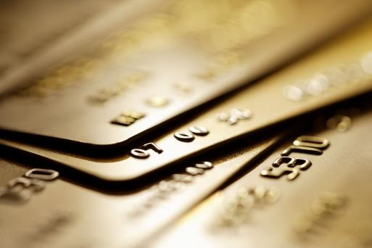
PCI-DSS
PCI compliance is mandated by credit/debit card companies to help ensure the security of transactions in the payment card industry
Requirements are set forth are operational and technical, core focus to protect cardholder data
Merchant bank has the right to remove the organisations capacity to process payment cards

Slide 218
PCI-DSS 12 Requirements
Protect system with firewall
Configure passwords and settings
Protect stored cardholder data
Encrypt transmission of cardholder data across open, public networks
Use and regularly update anti-virus software
Regularly update and patch systems
Restrict access to cardholder data by business need to know
Assign a unique ID to each person with computer access
Restrict physical access to cardholder data
Track and monitor all access to network resources and cardholder data
Regularly test security systems and processes
Maintain a policy that addresses information security for all personnel

Slide 219
Firewall Protection
Systems which store cardholder data must be properly configured with firewalls
Hardware and software firewalls are recommended
Firewall will restrict incoming and outgoing network traffic

Slide 220
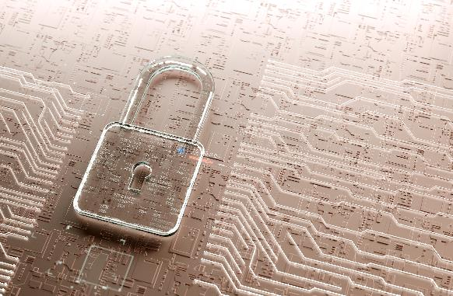
Password and Settings Configuration
Update default passwords which vendor supply from the start
Default passwords can be easy to guess
New devices introduced to the infrastructure must undergo configuration/hardening procedures

Slide 221
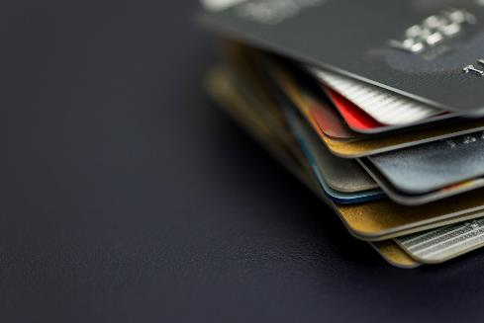
Protection of stored cardholder data
Encryption must be used when storing cardholder data
Merchants don’t realise they store PAN numbers as cleartext
Cardholder may be found in log files, databases, spreadsheets, etc.

Slide 222
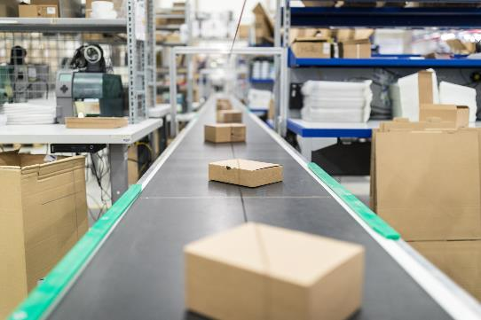
Transmission Encryption
Cardholder data must be encrypted during transmission
Transmission may be over open or public network
Cybercriminals can access cardholder data when transmission is done over public networks

Slide 223
Anti-virus maintenance
Protection against all types of malware
Regular scans and updates of anti-virus is a must
Prevention is better than cure

Slide 224
Patching and updating
Vulnerabilities are usually exploited on unpatched/outdated systems
All systems in the card data environment must be patched and updated to latest software

Slide 225
Access restriction to cardholder data
Service providers must be able to allow or deny access to cardholder data
Dependent on role, an access control must be in place
Reasons for use must only be on a need-to-know basis

Slide 226
Personnel Unique ID
Every authorised user must have a unique identifier, passwords must be complex
Ensures any user which access to cardholder information can be traced
Accountability can be maintained with Unique ID

Slide 227
Physical Access restriction
Physical access controls must be put into place to stop unauthorised persons gaining access.
Monitoring of CCTV for entry and exit doors, logs of personnel movement must be held for minimum 90 days
Removeable media containing cardholder data must be physically protected

Slide 228
Logging management
Tracking and monitoring in necessary for any access to network resources and cardholder data
Systems must have correct audit policy and send logs to a centralised server
These logs must be reviewed at least daily for any suspicious activity
SIEM Tools

Slide 229
Vulnerability & Penetration
Systems and processes must be tested on a frequent basis
Security must be maintained, this can be done through vulnerability scans and penetration testing
Periodic assessments must be undertaken, such as internal vulnerability scans and all external Ips and domains must go through penetration testing

Slide 230
Assessment and Documentation
Implementation and maintaining of an information security policy
Annual risk assessments, identifying critical assets, threats and vulnerabilities
User awareness training, employee background checks and incident management

Slide 231
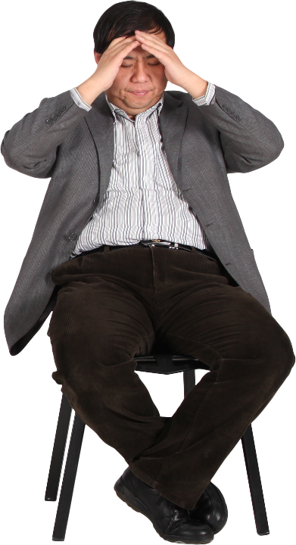
Penalty
Lose their right to process payments via credit cards
Whilst non-compliant, organisations face a monthly fine based upon number of transactions processed per month

Slide 232
Wireless Telegraphy Act

Slide 233
Wireless Telegraphy Act
Regulation of radio communication in the United Kingdom
“The sending of electro-magnetic energy over paths not provided by a material substance”
Requires organisations to hold a licence for wireless telegraphy

Slide 234
Wireless Telegraphy Act

Slide 235
Security Policies

Slide 236
What a good policy looks like
Specific, relevant and applicable to the organisation
Plain and understandable language that is easy to read
Clearly define scope regarding what the audience can and can’t do
Well structured and consistent, easy to manage and implement
Clear, un-ambiguous
Avoid statements like “reasonable”, “choice”, which can be subject to interpretation

Slide 237
Non Compliance of Policies
The consequences of non compliance can lead to disciplinary process, this may lead to the termination or suspension of employees contract
Risk of facing individual liability to lawsuits or even criminal charges depending on the breach of policy/legislation
Non compliance can be down to negligence or intended wrongdoing

Slide 238
Benefits of a Good Policy
Can save organisations time and money
Promote and improve appropriate behaviour
Achieve consistency and efficiency
Avoids:
Damaging reputation
Breaking laws
Avoiding fines
Organisational risk

Slide 239
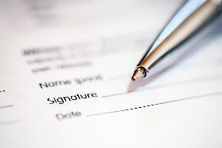
Acceptable Use Policies
AUP is a mandated policy which employees must follow regardless of their role or seniority in the organisation
AUP is an important document that can demonstrate due diligence with regards to the IT security within an organisation
AUP involves relevant stakeholders such as Human Resources, Finance, Legal, IT and Security.

Slide 240
AUP - Supporting Processes
Understand what data is vital to the survival of the organisation and internal and external forces that can affect them
Policy would be created for business assets, processes and employee access to files and data
Evaluate security measures and potential solutions
Monitoring and enforcement of security technology and human oversight
Train employees to recognise risks and refrain from insecure behaviours

Slide 241
Incident Management Policies
To provide guidance to employees with an efficient response and timely reporting of computer security related incidents
Aids the early detection and mitigation of security incidents
Reduce risks, decrease costs of security events and reduces the time to restore critical business functions

Slide 242
Incident Management Requirements
Requirements should include the due diligence response to incidents which may include but not limited to computer viruses, unauthorised user activity and suspicious of compromised data
The record keeping of incidents to mitigation similar occurrences in the future
Prevention and actions that must be taken in order to prevent further damage
Gathering of evidence in a maintained form that will withstand internal and external scrutiny

Slide 243
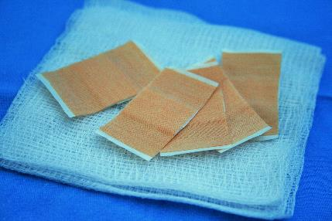
Patching Policies
Sets of steps and procedures aimed towards managing and mitigating vulnerabilities through a patching process
All phases of patching should be well documented: Testing, deploying, and documenting the security patches applied
When vulnerabilities are discovered they may be publicly disclosed or not, merchants would then release a patch
Must apply critical updates as soon as they can be scheduled

Slide 244
Patching Policy Requirements
The following items are what a good patching policy would include:
Asset inventory
Assigning Patch Management roles
Choosing the right patch management software
Testing Patches
Creating a Patching schedule
Document the patching process
Automation of patching management systems will install patches periodically
Notes:
INTEL CPU Vulnerability

Slide 245
Anti-virus Policies
Describe requirements for Preventing & Addressing computer viruses, worms, spyware, malware, and other types of malicious software.
Appointing the role of IT personnel who is trained in the use of security solutions
Awareness of end users and enforcement of security policies on workstations, removeable media, mobile devices etc…

Slide 246
Anti-Virus Requirements
Anti-virus policies are in place to guard against malicious software or scripts by blocking or quarantining
Enterprise level anti-virus solutions should be installed on systems and devices, deployment can be done via the network for new devices (BYOD)
Periodic scans must be performed, may include boot scans and continuous file and browser scanning
Centralised reporting to identify initial outbreaks and spread infection

Slide 247
Bring Your Own Device (BYOD) Policies
BYOD is the concept of employees using their personal devices on corporate network for work related purposes, this brings some vulnerability, so policies are set in place for mitigation of any risks associated
BYOD Policies are in place to make sure systems and data are used appropriately, legally and securely

Slide 248
BYOD Policy Importance
BYOD brings it’s own challenges which can include:
Ensuring employees comply with company policies and procedures
Support may be required for a wider range of device types and operating systems (could introduce vulnerabilities)
Protecting corporate data and infrastructure
Protecting personal privacy of end user
Ensuring legal compliance and meeting obligations within contract
Regulations and Legislation such as GDPR should be taken into consideration
Notes:
Cannot monitor personal devices, only network related access, no unique ID for
Reduced costs of company devices
No Personal Identifiable
Unique Identifier MAC address, MDM Solution
Virtual Workspace, Corporate Environment
Thin Client

Slide 249
Access Control Policies
Provides rules and guidelines structuring who can access data and resources in an organisation
Adapted to dynamically respond to evolving risk factors
Users may have role-based access control with least privileges deemed necessary for their role.
Notes:
The implementation of CIA Triad
Access control is critical to organisations, sophisticated policies can be adapted to dynamically respond to evolving risk factors enabling an organisation to isolate relevant employees and data resources in a breach
Role based access controls are common to give the least privileges necessary. Users can only attempt to access data that’s deemed necessary for their role
Starters, movers, leavers process
Internal and external, management of leaving employees
ACP needs to include the process on new employees joining an organisation, or leaving the organisation

Slide 250
Access Control Policy Importance
Regulate users and system security hardening
Least amount of privileges that is deemed necessary. Why?
Minimise potential exposure on unauthorised use of resources
Preserve Confidentiality, Integrity and availability
Not to breach Regulation and Legislation such as CMA
Notes:
Need-to-know principle dictates that users should only have access to resources they need to perform their job. If someone doesn’t need access to a category of sensitive data, they shouldn’t be allowed to access it.

Slide 251
Social Media Policies
Documentation that outlines how organisation’s and it’s employees should conduct themselves online
Important to maintain a good image and mitigate damaging reputation
Facilitate inclusion and diversity
Combination of other policies such as Acceptable Use can mitigate security breaches: phishing, hacking, and imposter accounts

Slide 252
Social Media Policy Importance
Prevention of security breach
Prevent a PR crisis with clear social media policies
Respond quickly if a crisis or breach does happen
Employee clarification of social media roles & responsibilities
Encourage good moral's from employees online
Notes:
Includes personal and organisational accounts
Roles and responsibilities
Security Protocols
A plan of action for security breaches or PR crisis
Complying with regulations and legislation
Guidance for employees especially when representing an organisation

Slide 253
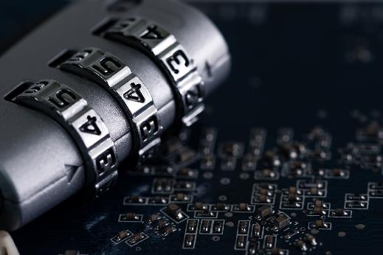
Password Policies
Set of rules created to improve computer security by advising users to create strong, dependable passwords while also storing them safely
May involve enforcement of strong passwords*
Regular interval password changes
Notes:
For example, policy may include minimum characters, number of special characters etc..

Slide 254
Password Policies Importance
Preventing unauthorised access, passwords are first line of defence
Encouraging good security culture
Security Breach, or breach of GDPR, with sensitive data being accessed by unauthorised users.
Encourage using different passwords. Why?
Methods of storing passwords, such as Password Managers, instead of sticky notes

Slide 255
Data Classification Policies
Enables organisations to apply the appropriate level of security to data
Protect information from accidental or deliberate compromise = consequences
Subsequently classification is determined by data risk and then put into categories
Sensitive Data, Public Data, Confidential or Personal Data*
Notes:
Data must be classified first in order to know how the handle the data.
*Different organisations will use different schemes of categories, such as Government organisations or

Slide 256
OLD
NEW
TOP SECRET
TOP SECRET
SECRET
OFFICIAL SENSITIVE & OFFICIAL
SECRET
CONFIDENTIAL
RESTRICTED
PROTECT
UNCLASSIFIED
Notes:
Government scheme of Data Classification

Slide 257
Data Handling Policy
Depending on the classification of data, the data handling policy is documentation explaining how data should be handled.
Guidelines to meet legal, ethical obligations (GDPR)
Promote good practice in relation to information handling
Confidentiality, Integrity and Availability

Slide 258
IT Asset Disposal Policies
Documentation on rules and guidelines when disposing of IT assets.
Disposal procedure and handling and destroying of IT asset
Third party companies offer asset disposal services, important to check their security measures. Organisation may be responsible for data breaches.
The two common data destruction standards HMG information assurance standard 5
DOD5220.22-M
Notes:
Data is most important thing in Cyber.

Slide 259
IT Asset Disposal Policy Importance
Asset inventory of all items, that belong to the organisation with unique ID (serial numbers, etc.)
Provide a framework for the disposal of IT assets and disposal methods, including decommissioning
Eliminate assets from account records, known as derecognition
Notes:
DOD
NIST

Slide 260
Ethical Data Use

Slide 261
Can you list data which may be used in an organisation? (think about supply chain)

Slide 262
Data in Organisations
Customer Data
Organisation Data
Supply Chain Data

Slide 263
Big Data
Large, diverse sets of information that grows at substantial rates, typically collected from big retailers, Amazon, etc.
Just because you can collect it, doesn’t mean you can use it
Retrieved from data mining, volume of information, velocity of creation and variety of data.
Just because you can collect it, doesn’t mean you can use it

Slide 264
Data Collection
Cookies: Files which collect data on user’s, collect usernames and passwords, etc.
Used to improve web browsing experience
Vulnerability to privacy
User needs to accept use of cookies to access sites

Slide 265
What is Data Ethics?
The ethical use of data use encompassed the moral obligations of gathering, protecting, and using personally identifiable information
Are you doing the right thing with data?
Can you improve?
What rights are you upholding?
Confidence from the data subject

Slide 266
Principles of Data Ethics
1. Ownership
2. Transparency
3. Privacy
4. Intention
Principles are in place to know the data subject’s safety and rights are intact

Slide 267
Ownership
An individual has ownership over their own personal information
Consent must be obtained (written agreements, digital privacy policies, terms and conditions, website cookie pop ups)
Data subjects can opt out any time!
It’s unlawful and unethical to collect personal data without consent

Slide 268
Transparency
Data subjects also have the right to know how an organisation may do the following:
Collect data
Store data
Use data
Dispose data
Third party
Withholding or lying about your company’s methods or intentions is deception and both unlawful and unfair to your data subjects
Notes:
**Activity behind the tracking of cookies

Slide 269
Privacy
Privacy is a huge ethical responsibility that ensures data subjects privacy.
Even with consent from the data subject to collect, store, and analyse their personally identifiable information (PII), doesn’t mean they want it publicly available
What is PII?
Notes:
Full name
Birthdate
Street address
Phone number
NHS number
Credit card information
Bank account information
Passport number.

Slide 270
Intention
With ethics in mind, when collecting data from data subjects, questions need to be asked:
Why you need it?
What you will gain from it?
If intentions are malicious or to cause harm, it’s not ethical to collect the data

Slide 271
Data Algorithms Ethics
Data collection is mostly automated, with the aid of algorithms and machine learning
Algorithms learn based on data they are provided with, can easily violate data ethics
The outcome of algorithms can be bias and cause disparate impact.
Notes:
Data lake , GDPR individual rights in regards to computer processing of personal data

Slide 272
Data Ethics – Your data?
Discuss
Take 15 minutes
Think of who you may have given data to?
Think of who they may have been shared with?
Think of how they might use that data?
If it provides some benefit to you, are you comfortable with organisations building a current and updated profile on your activity
Notes:
15 minutes
Think of who you have given data to?
Think of who they may have shared that with?
Think of how they might use that data?
If it provides some benefit to you, are you comfortable with organisations building a current and updated profile on your activity
Discuss

Slide 273
Security Culture

Slide 274
Security Culture – What are the indicators?

Slide 275
Indicators of poor security culture
No Visitor badges (poor visitor management)
Non segmented buildings
No CCTV
Tailgating
Entrances & Exits not monitored or secured
Insecure Endpoints (Laptops, PCs)
Non-compliance of policy (Staff not wearing ID, etc.)
Work desks not being clear
Sensitive printed waste, unsecure bin (how often emptying is done)
Passwords written down (post-it notes)
And more…..

Slide 276
Impact of poor security culture
Risk of security breach
Increase risk of internal security incidents
Risk of non compliance of policies, regulations, legislations
Employees will be less engaged with security awareness and issues
Loss of reputation with stakeholders

Slide 277
Organisational Structures
Divisional
Hierarchical
Line
Flat
Tall
Functional
Research the different organisational structures, and discuss what security challenges these can introduce?
Notes:
Research and what security challenges will you might face?
Flat structure (no one to take responsibility)
Hierarchical (Can take time for management, authorisation etc.)

Slide 278
Organisations Structure Cultures
Organisational structure: the way a business is run
Different structures will require different security needs, such as designated roles and responsibilities
Can be a collection of values, expectations, and practises that guide and inform the actions of all team members

Slide 279
Importance of maintaining privacy and confidentiality
Reduce risk of unauthorised exposure to confidential and person information
Mitigate risks and harden security culture, prevention is better than cure
Avoid breaching regulations and legislation such as Data protection, and Computer Misuse

Slide 280
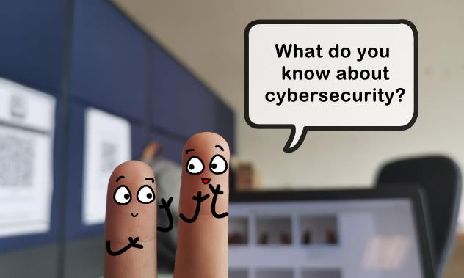
Security Awareness
Investment in the education of employees about IT security and good practice
Helps employees in their personal life and organisation
“Security isn’t just a work thing” – Martin Webley

Slide 282
Any final questions?

Slide 283
Introduction
Week 1
Intro
Monday
01
02
Wednesday
03
04
Tuesday
05
06
Thursday
Friday

Slide 284
Recap Session (15 Mins)
Xxx
Xxx
Xxx
Xxx
Xxx

Slide 285
If you see a slide with this background…
Recap Session

Slide 286
If you see a slide with this background…
Exercises & Labs =

Slide 287
If you see a slide with this background…
Important Information =

