Slide 1
BCS Software Development and Methodologies K8 S7

Slide 2
Software Development Methodologies
In this topic, you will learn a broad range of methodologies, frameworks and how they can be applied to software development.

Slide 3
Software development methodologies Sequential & Iterative

Slide 4
Software Methodologies
There are the following methodologies:
Agile Software Development
Crystal Methods
Dynamic Systems Development Model (DSDM)
Extreme Programming (XP)
Feature Driven Development (FDD)
Joint Application Development (JAD)
Lean Development (LD)
Rapid Application Development (RAD)
Rational Unified Process (RUP) Methodology
Scrum Methodology
Spiral Methodology
Systems Development Life Cycle (SDLC) Methodology
Waterfall (a.k.a. Traditional) Methodology
Notes:
Pause here and get learner to research

Slide 5
Software Methodologies
There are the following methodologies:
Agile Software Development - Iterative
Crystal Methods - Iterative
Dynamic Systems Development Model (DSDM) – Agile therefore Iterative
Extreme Programming (XP) - Iterative
Feature Driven Development (FDD) – Iterative AND Sequential
Joint Application Development (JAD) - Iterative
Lean Development (LD) - Iterative
Rapid Application Development (RAD) - Iterative
Rational Unified Process (RUP) Methodology – almost Sequential
Scrum Methodology - Iterative
Spiral Methodology – Iterative AND Sequential
Systems Development Life Cycle (SDLC) Methodology – Iterative AND Sequential
Waterfall (a.k.a. Traditional) Methodology - Sequential

Slide 6
Waterfall
The waterfall model shows the steps in sequence where the customer requirements are progressively refined to the point where coding can take place. This type of model is often referred to as linear or sequential model. Each work product or activity is completed before moving on to the next.
In the waterfall model testing is carried out once the code has been fully developed. Once this is completed a decision can be made on whether the product can be released into the live environment.
This model for development shows how a fully tested product can be created but it has significant drawbacks, what happens if the product fails the tests.

Slide 7
Sequential Approach
It is very simple to understand and use. Each phase must be completed before the next phase can begin and there is no overlapping in the phases.
The waterfall model illustrates the software development process in a linear sequential flow. This means that any phase in the development process begins only if the previous phase is complete.

Slide 8
Iterative Approach
A design methodology based on a cyclic process of prototyping, testing, analyzing, and refining a product or process
Based on the results of testing the most recent iteration of a design, changes and refinements are made
This process is intended to ultimately improve the quality and functionality of a design
In iterative design, interaction with the designed system is used as a form of research for informing and evolving a project, as successive versions, or iterations of a design are implemented.
Incremental Approach
A method of software development where the model is designed, implemented and tested incrementally (a little more is added each time) until the product is finished
It involves both development and maintenance
The product is defined as finished when it satisfies all of its requirements

Slide 9
Agile
Agile Development is a different way of managing software development projects
The key principles, and how Agile Development fundamentally differs from a more traditional Waterfall approach to software development

Slide 10
Key Principles of Agile Software Development
Active user involvement is imperative
The team must be empowered to make decisions
Requirements evolve but the timescale is fixed
Capture requirements at a high level; lightweight &amp; visual
Develop small, incremental releases and iterate
Focus on frequent delivery of products
Complete each feature before moving on to the next
Apply the 80/20 rule
Testing is integrated throughout the project lifecycle – test early and often
A collaborative & cooperative approach between all stakeholders is essential

Slide 11
Four VALUES of Agile
Individuals and Interactions Over Processes and Tools
Working Software Over Comprehensive Documentation
Customer Collaboration Over Contract Negotiation
Responding to Change Over Following a Plan

Slide 12
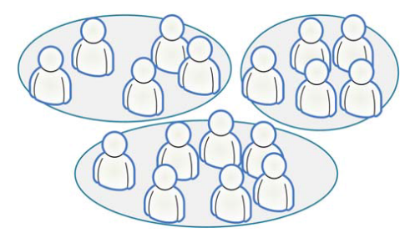
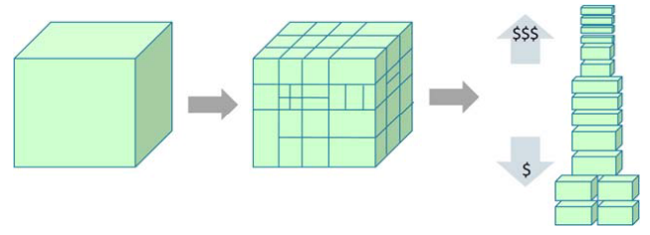
Scrum
A process tool
Split your organization into small, cross-functional, self-organizing teams
Split your work into a list of small, concrete deliverables. Sort the list by priority and estimate the relative effort of each item
Split time into short fixed-length iterations (usually 1 – 4 weeks), with potentially shippable code demonstrated after each iteration
Optimize the release plan and update priorities in collaboration with the customer, based on insights gained by inspecting the release after each iteration
Optimize the process by having a retrospective after each iteration

Slide 13
Kanban
A process tool
Literally, Kanban is a Japanese word that means “visual card”
Visualize the workflow
Split the work into pieces, write each item on a card and put on the wall
Use named columns to illustrate where each item is in the workflow
Limit Work In Progress (WIP) – assign explicit limits to how many items may be in progress at each workflow state
Measure the lead time (average time to complete one item, sometimes called “cycle time”), optimize the process to make lead time as small and predictable as possible
We collect useful Kanban links at: http://www.crisp.se/kanban

Slide 14
Kanban

Slide 15
Test Driven Development
Test-driven development (TDD) is a software development process that relies on the repetition of a very short development cycle
The following sequence of steps is generally followed:
Add a test
Run all tests and see if the new one fails
Write some code
Run tests
Refactor code
Repeat

Slide 16
TDD Vs. Traditional Testing
Traditional:
Write logic
Write tests
This is unit testing!!!!

Slide 17
TDD Vs. Traditional Testing
TDD:
Write tests
Write logic

Slide 18
Task -
Create a presentation describing the following
Waterfall model
Agile method
Ensure that you explain each stage of the model / what is involved
Also include an evaluation explaining key differences between the them.
Be prepared to present your work and create your own diagrams ( this will help you remember the steps and processes.)

Slide 19
Frameworks & methods that organisations use to control and manage projects, programmes and operations.

Slide 20
Governance
Oxford dictionary the meaning it has is:
the action or manner of governing a state, organization, etc.
rule, control
In software development life cycle we can think of governance as monitor, measure and management of software

Slide 21
Development Stage | What needs governance | How do we (or tools/techniques used for) govern?
Business Problem | The source of problem statement (real business case vs. developer’s wish) Project roadmap, timeline and resource constraints | Process exists to ensure right stakeholders are engaged, agreed upon project roadmap is defined, and resource pool, delivery timeline and risks are identified
Requirement Gathering | Use Case and Requirements Effort level and Risks | Requirement document reviewed and signed off from all major stakeholders (business, development and testing teams)
Architecture | Alignment with corporate IT Non FRs like Performance, Security | Architecture Review
Design | Design guidelines | Design review
Implementation | Code Quality Feature implementation | Code Review Code Coverage Feature Demo
Testing | Test Plan and Strategy Test Results and Coverage Score card on Non-FRs | Review of Test Plan, Strategy, Coverage, and Results Review of Non-FRs score card or compliance report
Documentation | Documents | Documentation Review
Deployment | Deployment Instructions | Deployment document review Deployment team’s feedback on ease of deployment and 1st few weeks report from production
Service / Maintenance | Ease of troubleshooting Number of Customer found defects New feature request | Tracking production defects and ensuring root cause analysis done on the same Assess and feed feature requests to next release’s project requirements Process to have regular feedback from service team’s

Slide 22
Management Frameworks
ITIL
(formerly an acronym for Information Technology Infrastructure Library) is a set of detailed practices for IT service management (ITSM) that focuses on aligning IT services with the needs of business
https://www.goodelearning.com/courses/it-service-management/itil-foundation/what-is-itil
TOGAF
The Open Group Architecture Framework (TOGAF) is a framework for enterprise architecture that provides an approach for designing, planning, implementing, and governing an enterprise information technology architecture
https://www.goodelearning.com/courses/enterprise-architecture/togaf-9-foundation/what-is-togaf

Slide 24
Agile
Agile processes allow for changing requirements throughout the development cycle and stress collaboration between software developers and customers and early product delivery
4 values of Agile
In Scrum, projects progress in a series of month-long iterations called sprints
Development teams meet with the client, or product owner, before each sprint to prioritize the work to be done and select the tasks the team can complete in the upcoming sprint
During the sprint, the team stays on track by holding brief daily meetings
At the end of each sprint, the team delivers a potentially shippable product increment

Slide 25
Phases of the SDLC (Software development lifecycle) Feasibility Study Requirements Analysis Design Code Development Testing Deployment/Implementation Maintenance

Slide 26
Software Development Cycle
Feasibility Study
Requirements
Analysis
Design
Design may change if application does not work as expected
Code Development
Testing
Deployment/
Implementation
Maintenance

Slide 27
Software Development Lifecycle
Development of a program forms part of a natural lifecycle. New solutions are designed due to:
A system failing
Users needs change over time

Slide 28
1
Determine the scope of the problem
2
8
Gathering requirements
Review and maintain
3
7
Writing the specification
Writing documentation
6
testing
4
Designing a solution
5
Coding the
design

Slide 29
Stage 1 – Determine the scope of the problem
What are the boundaries of the problem? (Scope). It is important to note what is and also what is not covered by the program, and who is affected by it.
Understanding all of these elements combined help understand the nature of the program.

Slide 30
Stage 2 – Gather requirements
What is wanted from the program off your stakeholders, so that it can specify what the program is going to do (looking at the function requirements)
A high number of commercial solutions fail because not enough research is done in this stage.
They are often collected describing individually how each task is going to be achieved.

Slide 31
Stage 3 – Writing the specification
Make a list of all the elements which cover:
Inputs and outputs
Processing
Storage
User interface
constraints

Slide 32
Stage 4: Designing the solution
Solution is built using suitable design tools (it shows a set of procedures)(pseudocode and flow diagrams)
Can be paper or electronic
Without correct planning and design a lot of time is wasted from mistakes made!

Slide 33
Stage 5 & 6 – coding & testing
Convert the design into code. It is important that stage 6 is mostly done simultaneously by the program being tested in smaller sections the same way as each broken down element is coded.
Testing is vital. Two main methods for testing are the black box and white box testing methods….

Slide 34
Stage 6 – Testing (Continued)
Black Box testing
Does it meet the list of its functional requirements?
Does it do what it is supposed to do?
e.g. Area = height * width
White Box Testing
Examines the performance of the code AFTER the functionality is working
Is there a better way to do the task?
Does it allow for flexibility?
Is it robust?
Is the use of language clear for the end user?
Is the solution displayed in a logical order?
ALL Boundaries should be tested thoroughly….

Slide 35
Stage 7 – Writing Documentation
There are three types of documentation
Internal documentation
Technical documentation
User documentation

Slide 36
Task
Explain the main activities of each of the phases of the SDLC (Software development lifecycle) in terms of inputs, activities and outputs

Slide 37
Internal Documentation
Use correct naming conventions especially when naming your variables!
Good use of comments, describing the purpose of the bits of code
Use a tidy layout, complete with indentation and blocking correctly

Slide 38
Technical Documentation
Written by developers for other developers to read
Often uses jargon and programming terminology, but it must also be backed up with a clear and concise explanation!
Should cover –
Requirements
Design
Flow charts
DFD
Data type list
Testing
Corrective actions for errors
Copy of documented code
Recommendations for future improvements/enhancements

Slide 39
User documentation
Technical terms and jargon are avoided!
Installation
How to use the program
Troubleshooting
Help
Examples of program working
This can be paper format, text files or screencast/video animations.

Slide 40
Stage 8 - Review and Maintain
Reviewing is reflective by comparing this to the original stakeholder requirements – does it do what you want it to do, how well does it work?
Maintenance is ongoing, fixing minor errors as they occur and making small adjustments as you feel they are necessary, adding extra features and extra functionality

Slide 41
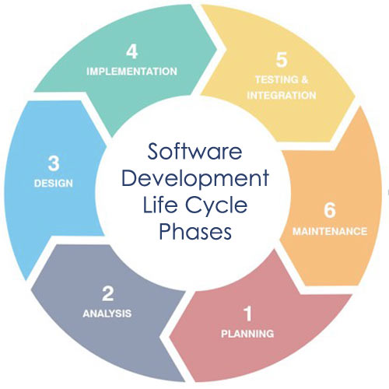
Summary of SLC
5.2 Summarise the phases of the SDLC. (Software development lifecycle)

Slide 42
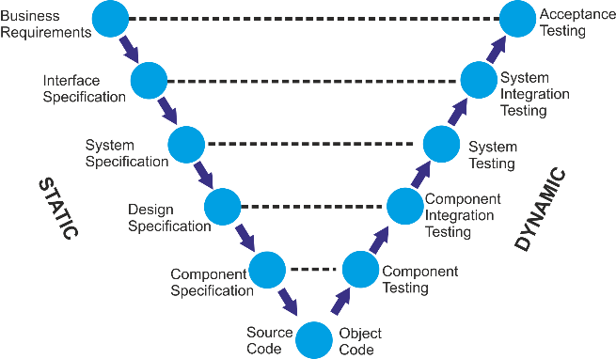
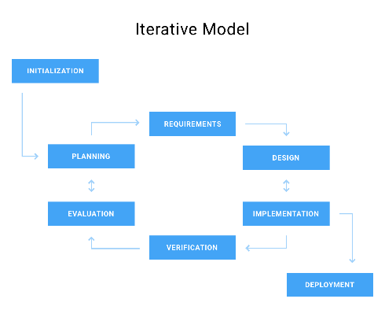
Using V-model
Using Waterfall
Using Iterative model

Slide 43
Software Testing

Slide 44
Why Early Testing?
A defect can be found throughout all the phases of software development Life Cycle
It is better to start early testing in the software development life cycle so as to minimize defects in the later stages
It can be design review, unit testing or regression testing
Design phase comes early in Software Development Life Cycle
Design Testing is done at this phase.

Slide 45
Risk reduction
Risk: A factor that could result in future negative consequences; usually expressed as impact and likelihood - ISTQB Glossary
A risk-based approach to testing provides proactive opportunities to reduce the levels of product risk, starting in the initial stages of a project
It involves the identification of product risks and their use in guiding test planning and control, specification, preparation and execution of tests
In a risk-based approach, the risks identified may be used to:
Determine the test techniques to be employed
Determine the extent of testing to be carried out
Prioritise testing in an attempt to find the critical defects as early as possible
Determine whether any non-testing activities could be employed to reduce risk

Slide 46
Conformance to functional and non-functional requirements
Conformation is the degree of adherence to pre-set expectations
The degree to which a product meets its pre-specified criteria is termed as conformance in the context of software engineering
Software Developer establishes functional and non-functional requirements prior to software development
The functional requirements are those requirements that represent the core functionality provided by the system
Non-functional requirements are the additional requirements such as restriction on time, performance, availability, scalability, reliability, etc.
The degree of adherence of the software to its functional requirements is the conformance of the software to its requirements

Slide 47
Finding defects
Reviewers (aka Checkers or Inspectors) are responsible for finding defects in the product under review
Developers see finding defects as a negative process which causes delays
Testers know that software contains bugs
All defects start with a human error (for example a typo, misunderstanding, lack of capacity planning etc.)
The tester's job is to expose the defect by causing a failure before the software gets to production

Slide 48
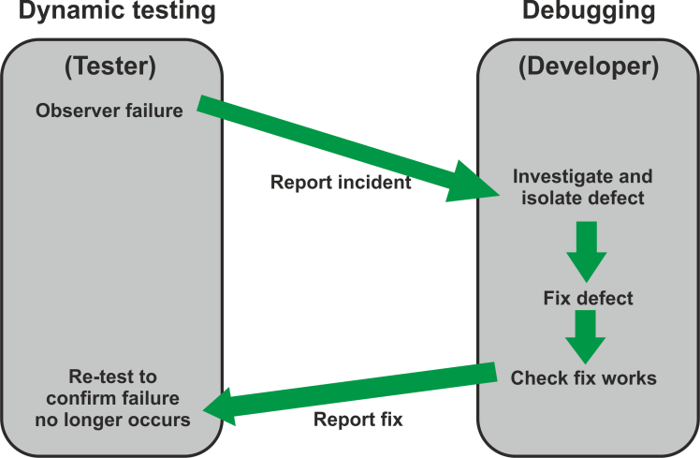
Differentiating testing from debugging
Debugging and testing are different
Testing can show failures that are caused by defects
Debugging is the development activity that identifies the cause of a defect, repairs the code and checks that the defect has been fixed correctly
Subsequent re-testing by a tester ensures that the fix does indeed resolve the failure

