Slide 1
Cyber Technician
Level 3
Cyber Threats

Slide 4
Week 1 - Recap Session (5 Mins)
In the context of an organisation, what are assets?
What is the weakest link in Cyber?
What is a threat, vulnerability & exploit?
Pick a legislation or regulation and briefly describe it
What does CIA stand for?
Which two countries are currently a threat to UK in terms of Cyber attacks?

Slide 5
Knowledge Competencies
K3 Types of physical, procedural and technical controls
K14 Categories of cyber security vulnerabilities and common vulnerability exposures –software misconfiguration, sensitive data exposure, injection vulnerabilities, using components with known vulnerabilities, insufficient logging and monitoring, broken access control and authentication, security misconfiguration, incorrect cross-site validation
K16 Threat sources and threat identification and network reconnaissance techniques and the impact that threats might have on an organisation
K17 Types of information security events – brute force attack, malware activity, suspicious user behavior, suspicious device behaviour, unauthorized system changes

Slide 6
K3
Candidates will be able to:
Describe the different types of security controls
Indicative Content
Physical
Building and door access
CCTV
Environment controls
Procedural(administrative)
Policies
Standards
Baselines
Procedures
Awareness and training
Technical
Access controls
Secure configuration
Network security
Encryption
Anti-malware
Patch management
Monitoring

Slide 7
K14
Candidates will be able to:
Recognise types of security vulnerabilities
Indicative Content
Software Misconfiguration
Sensitive Data Exposure
Injection Vulnerabilities
Using Components with Known Vulnerabilities
Insufficient Logging and Monitoring
Broken Access Control and Authentication
Security Misconfiguration
Incorrect Cross-Site Validation

Slide 8
K16
Scenario practical demonstrations:
Perform a cyber security operational task
Implement a cyber security control where cryptography is required
Modify a cyber security access control
Scope a cyber security vulnerability assessment
Evaluate the results of a cyber security vulnerability assessment
Monitor, identify and describe an information security event
Respond to and report upon an information security event
The business impact and mitigation(s) for the management of risk
Maintain a digital information asset inventory

Slide 9
K17
Security Event | Detective measure | Preventative measure
Brute force attack | System logs Multiple failed login attempts | Failed attempt lockouts Limiting simultaneous logins Multi-factor authentication Use of CAPTCHA technology
Malware activity Ransomware Worm Trojans Spyware | Systems log Networks logs Intrusion Detection Systems Security awareness training | Anti-malware software Firewalls Intrusion Prevention Systems Vulnerability/patch management
Suspicious user behaviour | Honeypots File Integrity Monitoring Behavioural analytics System logs Network logs CCTV | Firewalls Role-based access control Principle of least privilege Job rotation Door entry system Web proxy
Suspicious device behaviour | Intrusion Detection Systems System logs Network logs | Intrusion Prevention Systems Firewalls
Unauthorised system changes | System Integrity Monitoring File Integrity Monitoring | Role-based access control Principle of least privilege

Slide 10
Introduction
Week 2
Intro
Monday
01
02
Wednesday
03
04
Tuesday
05
06
Thursday
Friday

Slide 11
Syllabus – Week 2
Monday
Introduction to EPA
Networking Basics
Tuesday
Cyber Threats
Vulnerability sources
Wednesday
Security Controls
Security Vulnerabilities
Thursday
Common Vulnerability Exposures
Friday
Malware activity
Suspicious User Behaviour

Slide 12
EPA
End Point Assessment
for
Cyber Security Technicians

Slide 13
What is it?
The apprentice undertakes the required assessment methods for the apprenticeship standard, assessed by the BCS
Three components:
Scenario demonstrations with questioning
Professional discussion underpinned by portfolio
Knowledge test

Slide 14
KSBs – knowledge, skills, behaviours
There are:
30 knowledge criteria
22 skills criteria
7 behaviours
These are all assessed in EPA
KSBs are allocated to each assessment method, for example: K8, K9, K11, S2, S5, S6, S9, S10, B4, K15, S11, S12, K10, K19, S7, S16, S17, K12, K16, K27, S13, S14, S15 are only assessed in the scenarios

Slide 15
Coverage
Each assessment component tests selected knowledge, skills and behaviour criteria
Grading:
 | Discussion | Test | Overall grade
Fail | Any grade | Any grade | Fail
Any grade | Fail | Any grade | Fail
Any grade | Any grade | Fail | Fail
Pass | Pass | Pass | Pass
Pass | Distinction | Pass | Distinction
Fail | Pass | Fail | Fail

Slide 16
Work activities prior to EPA - 1
You should make sure you are competent in these activities and can perform them without recourse to manuals, search engines or video
Routine operations
Carries out agreed operational procedures associated with operating and controlling the installed (or virtual) hardware and software. This may include configuration and maintenance of multiple hardware or software platforms. Implements maintenance routines, utilising the appropriate tools and test equipment. Uses standard procedures and tools to carry out defined system backups, restoring data where necessary.

Slide 17
Work activities prior to EPA - 2
Violation investigation
Assists in the investigation and resolution of issues relating to access controls and security systems. Investigates and reconciles violation reports and logs generated by automated systems. Investigates any other minor security breaches, in accordance with established procedures and security standards. Integrates findings from other investigators, and compiles reports and recommendations for management follow-up. the appropriate tools and test equipment. Uses standard procedures and tools to carry out defined system backups, restoring data where necessary.

Slide 18
Work activities prior to EPA - 3
Auditable records
For all services and systems within identified remit, maintains auditable records and user documentation. Assists in the preparation and maintenance of evidence for use in internal and external audits, compliance or regulatory reporting, security accreditations, business recovery plans, particularly in the data collection and compilation/ production/ distribution phases of the exercise.
Security support and advice
Receives and responds to routine requests for security support. Maintains records and advises relevant persons of actions taken.

Slide 19
Work activities prior to EPA - 4
Access controls
Assists users in defining their needs for new access rights and privileges. Operates and administers physical and logical access controls relating to one or more platforms in order to provide continuous and secure access to information services and/or the infrastructure resources supporting them.
Procedures and controls
Applies and maintains specific procedures and security controls as required by organisational policy and local risk assessments to maintain confidentiality, integrity and availability of business information systems and infrastructure components.

Slide 20
Work activities prior to EPA - 5
Potential threats and vulnerabilities
Contributes to vulnerability assessments. Identifies potential threats to the confidentiality, integrity or availability of the system. Determines when security issues should be escalated to a higher level, to enhance resilience to unauthorised access
Risk assessment
Performs basic risk assessments for small information systems. Applies procedures to assess integrity of information in accordance with information security policies and standards.

Slide 21
Work activities prior to EPA - 6
Attacks/damage limitation
Investigates suspected attacks. Recognises when an IT network/ system has been attacked, e.g. by a remote host, or by malicious code, such as virus, worm or Trojan etc., or when a breach of security has occurred. Responds to security breaches in line with security policy and records the incidents and action taken. Takes immediate action to categorise and limit damage, according to the organisation’s security policy, which may include escalation to next level, and records the incident and action taken.

Slide 22
Scenario method
You will be given 4 scenarios for the demonstrations, previously unseen
Each one lasts 75 minutes
You will be provided with a scenario of no more than 250 words together with an Information Pack with supporting information (for example Screenshots, Data for analysis, Reports, Articles, Documentation)
The independent assessor can ask up to 5 questions during and after each scenario demonstration

Slide 23
Activities that must be observed
Perform a cyber security operational task
Implement a cyber security control where cryptography is required
Modify a cyber security access control
Scope a cyber security vulnerability assessment
Evaluate the results of a cyber security vulnerability assessment
Monitor, identify and describe an information security event
Respond to and report upon an information security event
Conduct an information security risk assessment
The business impact and mitigation(s) for the management of risk
Maintain a digital information asset inventory

Slide 24
Four scenarios
Implementing cyber security controls
Vulnerability management
Incident management
Risk management

Slide 25
Professional discussion underpinned by portfolio
Lasts 60 minutes
A minimum of 10 questions
Supported by a portfolio evidencing the specified knowledge, skills and behaviours (KSBs)
The portfolio must show:
What you did
How you did it
Who you worked with
The application of the knowledge you have gained
Ideally the evidence will be specific projects, incidents etc and not a box ticking exercise

Slide 26
Sample project
Got allocated a task to update the asset inventory priority to an audit (K12, K21, S10, S21)
Checked the relevant company policies (K20, S1)
Discovered there was no record of software levels on company issued smartphones (K10, S7)
Escalated this to technical manager (K28, S8, S21)
Researched mobile device management products and recommended one for installation (K23, B3)
Got approval to purchase and install recommended product (K8, S6, B1, B2, B4)
Used the product to update the asset inventory (S10)
Wrote a short report and recommended an update to the BYOD and Update policies (K12, K20, S17, S18)
This has covered 7 knowledge criteria, 8 skills criteria and 4 behaviours in one project.
You should now be looking out for opportunities to make some of your daily work a “project”. You might find it useful to discuss this with your manager/mentor so that they can support you.

Slide 27
Portfolio template
A template references the KSBs to the evidence
This is an example:
KSB | KSB | Evidence in the portfolio that fulfils this requirement | Portfolio Location
K6 | Principles of cyber security compliance and compliance monitoring techniques.
K21 | Cyber security audit requirements, procedures and plans, need to obtain and document evidence in an appropriate form for an internal or external auditor to review.
S19 | Perform cyber security compliance checks
S20 | Translate audit requirements and collate relevant information from log files, incident reports and other data sources.

Slide 28
Knowledge test
Covers these knowledge criteria:
K3 (17.5%) Types of physical, procedural and technical controls.
K4 (20%) Awareness of how current legislation relates to or impacts upon the occupation including Data Protection Act, Regulation of Investigatory Powers Act, Human Rights Act, Computer Misuse Act, Freedom of Information Act, Official Secrets Act, Payment Card Industry Data Security Standard (PCI-DSS), Wireless and Telegraphy Act, professional body codes of conduct, ethical use of information assets.
K7 (17.5%) Core terminology of cyber security – confidentiality, integrity, availability (the CIA triad), assurance, authenticity, identification, authentication, authorization, accountability, reliability, nonrepudiation, access control.

Slide 29
Knowledge test
K14 (17.5%) Categories of cyber security vulnerabilities and common vulnerability exposures – software misconfiguration, sensitive data exposure, injection vulnerabilities, using components with known vulnerabilities, insufficient logging and monitoring, broken access control and authentication, security misconfiguration, incorrect cross-site validation
K17 (17.5%) Types of information security events – brute force attack, malware activity, suspicious user behaviour, suspicious device behaviour, unauthorized system changes.
K18 (10%) Computer forensic principles – the importance of ensuring that evidence is not contaminated and maintaining the continuity of evidence without compromising it.

Slide 30
Knowledge test
Online examination
40 Multiple choice questions
Lasts 1 Hour.
An additional 25% will be allowed for apprentices sitting the examination in a language that is not their native / mother tongue.
Pass mark 26/40 (62.5%).
Calculators cannot be used during this examination

Slide 31
On program
Monthly checks on competency progress
Each month you will have to evidence specific skills (related to the knowledge you gained in class)
Assistance in developing portfolios
Sample knowledge tests
Full review of completed portfolio one month prior to EPA Gateway
Catch up review of criteria for knowledge test and sample exam in the exam week

Slide 32
Gateway entry requirement
Portfolio typically containing 8 discrete pieces of evidence, in the following sections (2 pieces of evidence per section)
Section 1 Application of Information Security Policies and Procedures
Section 2 Cyber security awareness and culture
Section 3 Maintaining professional knowledge of cyber security developments
Section 4 Information security governance practice
The completed:
Portfolio template
Gateway form (employer confirms readiness for EPA)

Slide 33
Introduction
Week 2
Intro
Monday
01
02
Wednesday
03
04
Tuesday
05
06
Thursday
Friday

Slide 34
Syllabus – Week 2
Monday
Introduction to EPA
Networking Basics
Tuesday
Cyber Threats
Vulnerability sources
Wednesday
Security Controls
Security Vulnerabilities
Thursday
Common Vulnerability Exposures
Friday
Malware activity
Suspicious User Behaviour

Slide 35
Week 1 - Recap Session (40 Mins)
Networking slides revise session
Complete Multiple Choice Networking exam

Slide 36
Cyber Security Technician Competency Reference: K16
Threats

Slide 37
What is a Cyber Threat?

Slide 38
Threat
A cyber or cybersecurity threat…
Is a malicious act conducted by a “Threat Actor” that seeks to damage data, steal data, or disrupt digital life in general

Slide 39
Threat Actors

Slide 40
What are Threat Actors?

Slide 41
Threat Actors
Criminal Groups
Hackers
Malicious Insiders
Corporate Spies
Nation States
Terrorist Groups
Hacktivists
Script Kiddies

Slide 42
Threats

Slide 43
Can you name some
Threat Types?

Slide 44
Activity – 15 Mins
- On your own
- Research up the 50 different types of Threats
- Pick a Threat to present to the group
- Explain at a high level what the threat is and how it might compromise the C, I or A of an asset
Notes:
Pass the Hash
Challenge to decrypt hash
Check what tools you could use to crack the password
Captcha deterrent, invalid attempts, lockouts

Slide 45
Cybersecurity Threat Types

Slide 46
Malware or Malicious Code
Malware or Malicious Code is a term used to describe malicious software, including spyware, ransomware, viruses, and worms
Malware breaches a network through a vulnerability, typically when a user clicks a dangerous link or email attachment that then installs risky software
Once inside the system, malware can do the following:
Blocks access to key components of the network (ransomware)
Installs malware or additional harmful software
Covertly obtains information by transmitting data from the hard drive (spyware)
Disrupts certain components and renders the system inoperable

Slide 47
Phishing
Phishing is the practice of sending fraudulent communications that appear to come from a reputable source, usually through email
The goal is to steal sensitive data like credit card and login information or to install malware on the victim’s machine

Slide 48
Man-in-the-Middle
Also known as eavesdropping attacks, occur when attackers insert themselves into a two-party transaction
Once the attackers interrupt the traffic, they can filter and steal data
Two common points of entry for MitM attacks:
On unsecure public Wi-Fi, attackers can insert themselves between a visitor’s device and the network. Without knowing, the visitor passes all information through the attacker
Once malware has breached a device, an attacker can install software to process all of the victim’s information

Slide 49
Denial-of-Service
Floods systems, servers, or networks with traffic to exhaust resources and bandwidth
The system is unable to fulfill legitimate requests
Attackers can also use multiple compromised devices to launch this attack
This is known as a distributed-denial-of-service (DDoS) attack

Slide 50
DoS vs DDoS

Slide 51
An Attack

Slide 52
SQL Injection
A Structured Query Language (SQL) injection occurs when an attacker inserts malicious code into a server that uses SQL and forces the server to reveal information it normally would not
An attacker could carry out a SQL injection simply by submitting malicious code into a vulnerable website search box
How SQL injection works

Slide 53
Zero-day Exploit
A zero-day exploit is when an attacker exploits a system or network vulnerability after it’s identified, but before a patch or interim solution or “mitigating control” is implemented
Attackers target the disclosed vulnerability during this window of opportunity
Zero-day vulnerability awareness requires IT and security professionals to maintain current and ongoing knowledge of potential threats and exploits!

Slide 54
Blended Threats
The term “Blended Threat” is used then an attacker uses a combination of threats in an attack, for example:
Phase 1 - Advanced persistent threat (APT)
Phase 2 - Information theft and ransomware
Phase 3 - Denial of service (DoS and DDoS)

Slide 55
Advanced persistent threat (APT)
APT’s are prolonged and targeted attacks whereby an intruder gains access to a network and remains undetected for an extended period of time
The intention of an APT attack is usually to monitor network activity and steal data rather than to cause damage to the network or organization
APT attacks typically target organizations in sectors such as national defense, manufacturing and the financial industry, as those companies deal with high-value information, including intellectual property, military plans, and other data from governments and enterprise organizations

Slide 56
APT Attack Profile

Slide 57
Ransomware
Malicious software that threatens to publish the victim's data or perpetually block access to it unless a ransom is paid
Most ransomware variants encrypt the files on the affected computer or file share, making them inaccessible
Some recent examples of ransomware attacks include by WannaCry, Petya, Cerber, Locky and CryptoLocker ransomware

Slide 58
Ransomware Infection
What would you do?
Reinstall the operating system?
Run an antivirus program from an external drive or bootable disc?
Do a System Restore and take Windows back to a time before the ransomware was loaded?
Notes:
Operations manual for instructions of what to do
Remove host from network

Slide 59
Threat Intelligence Sources

Slide 60
Threat Intelligence Types
Vendor / Subscription
Intelligence
OSINT
Open Source Intelligence

Slide 61
Threat Intelligence Sources
National Cyber Security Centre (NCSC)
Alien Vault Open Threat Exchange
Cisco Talos Intelligence
The Spamhaus Project
SANS: Internet Storm Centre
Virus Total
Microsoft
Symantec
Secureworks

Slide 62
Open Source Threat Intelligence
“Open source intelligence (OSINT) is the practice of collecting information from published or otherwise publicly available sources.
OSINT operations, whether practiced by IT security pros, malicious hackers, or state-sanctioned intelligence operatives, use advanced techniques to search through the vast haystack of visible data to find the needles they're looking for to achieve their goals—and learn information that many don't realize is public.”
Ref: CSO Online
Notes:
References & Notes:

Slide 63
OSINT - Open Source Intelligence Sources
Maltego
Mitaka
SpiderFoot
Spyse
BuiltWith
Intelligence X
DarkSearch.io
Grep.app
Recon-ng
theHarvester
Shodan
Metagoofil
Searchcode
SpiderFoot
Babel X

Slide 64
Threat Identification

Slide 65
Threat Identification
Cyber Security professionals use a number of sources of threat intelligence to make informed decisions on potential threats, taking into consideration many factors which include, but may not be limited to Asset Exposure, Org. Sector and Industry and Public Profile
In addition to assessing current / emerging / evolving threats to the organisation, Cyber Security professionals also undertake “Horizon Scanning” to anticipate future threats over the medium – longer term

Slide 66
Horizon Scanning
Horizon scanning is defined as ‘a systematic examination of information to identify potential threats, risks, emerging issues and opportunities’
Horizon scanning typically involves longer-term scenario planning
Involves a wide variety of sources, such as
the Internet
blogs
government ministries and agencies
non-governmental organisations
international organisations and companies
research communities
on-line and off-line databases and journals
hacker conferences
cyber security events

Slide 67
Horizon Scanning
Information can also be obtained from Government sponsored sources
The National Cyber Security Centre (NCSC)
https://www.ncsc.gov.uk/section/advice-guidance/all-topics?topics=active%20cyber%20defence
CiSP (Cyber Security Information Sharing Partnership)
https://www.ncsc.gov.uk/section/keep-up-to-date/cisp
CertUK (Computer Emergency Response Team)
https://www.gov.uk/government/news/uk-launches-first-national-cert

Slide 68
Network Reconnaissance Techniques

Slide 69
M.O.M
Method
Opportunity
Motive

Slide 70
Method
The skill, knowledge, tools and approach used to stage an attack

Slide 71
Opportunity
The level of access and timeframe required in order to accomplish the attack

Slide 72
Motive
The reason why an individual / group / country would want to perform this attack against a particular target
Motives could be:
Financial
Revenge
Power
Recognition
Random

Slide 73
MITRE ATT&CK Framework
MITRE ATT&CK® is a globally-accessible knowledge base of adversary tactics and techniques based on real-world observations
The ATT&CK knowledge base is used as a foundation for the development of specific threat models and methodologies in the private sector, in government, and in the cybersecurity product and service community
Notes:
Resources & Notes:
https://attack.mitre.org/

Slide 74
Cyber Kill Chain Framework
Developed by Lockheed Martin, the Cyber Kill Chain® framework is part of the Intelligence Driven Defense® model for identification and prevention of cyber intrusions activity. The model identifies what the adversaries must complete in order to achieve their objective
The seven steps of the Cyber Kill Chain® enhance visibility into an attack and enrich an analyst’s understanding of an adversary’s tactics, techniques and procedures
Notes:
Resources & Notes:
https://www.lockheedmartin.com/en-us/capabilities/cyber/cyber-kill-chain.html#
https://www.lockheedmartin.com/en-us/capabilities/cyber/intelligence-driven-defense.html

Slide 75
Mitre Att&ck & Kill Chain

Slide 76
Activity – 30 Mins
As a group, use these frameworks to:
- Research the various types of “Network Reconnaissance” techniques
- Individually present a chosen reconnaissance technique (Active Scanning)
- Explain what the technique is, and how it might be detected
Notes:
Pass the Hash
Challenge to decrypt hash
Check what tools you could use to crack the password
Captcha deterrent, invalid attempts, lockouts

Slide 77
Organisational Impact

Slide 78
Cyber Attack – Business Impact
Notes:
Resources & Notes:
Source: Deloite & Touche – Beneath the Surface of Cyber Attack

Slide 79
Introduction
Week 2
Intro
Monday
01
02
Wednesday
03
04
Tuesday
05
06
Thursday
Friday

Slide 80
Recap Session (15 Mins)
Revise the following:
Threat actors
Threat Vector
Malicious Code
Phishing
SQL Injection

Slide 81
Syllabus – Week 2
Monday
Introduction to EPA
Networking Basics
Tuesday
Cyber Threats
Vulnerability sources
Wednesday
Security Controls
Security Vulnerabilities
Thursday
Common Vulnerability Exposures
Friday
Malware activity
Suspicious User Behaviour

Slide 82
Cyber Security Technician Competency Reference: K3
Security Controls

Slide 83
Security Controls
Security control are used are used within organisations to:
Reduce the Likelihood of an Attack being successful
And / or
Reduce the Impact if an Attack was successful

Slide 84
Security Controls Types

Slide 85
Security Control Types - Physical
Physical controls are those controls which seek to prevent an attack through the use of something tangible
Examples of physical controls include mechanisms such as:
Walls, locks, security guards, security cameras, anti-climb fencing
Backup copies or real-time replication of data i.e. “Disk Mirroring”
Use of natural or man-made disaster-protection devices such as smoke alarms or fire extinguishers

Slide 86
Security Control Types - Procedural
Procedural and administrative controls are guidelines, agreements and supporting processes that require or advise people to act in certain ways with the goal of protecting organisational assets
Examples of procedural and administrative controls include mechanisms such as:
Laws and local regulations
Organizational policies, procedures, or guidelines
Methods of protecting intellectual property such as copyrights, patents, or trade secrets
Contracts or other documents that govern the relationship between two or more parties

Slide 87
Security Control Types - Technical
Technical controls are controls or countermeasures that use technology-based contrivances in order to protect organisational assets from harm
These can include mechanisms such as:
Passwords, access controls for operating systems
Application software programs, network protocols, firewalls
Intrusion detection systems, encryption technology

Slide 88
Security Controls Sub-Types

Slide 89
Preventative
Some of the best controls prevent fraud, theft, misstatements, or ineffective organizational functioning
For example, we saw previously the effectiveness of segregation of duties to prevent fraud
Preventive controls can be as simple as locks and access codes to sensitive areas of a building or passwords for confidential information

Slide 90
Detective
A security camera is a good example of a detective control
A store manager who notices a pattern of a cash drawer coming up short when attended by a particular clerk can easily look at video of the clerk’s actions throughout the day to detect potential theft
An access log and an alert system can quickly detect and notify management of attempts by employees or outsiders to access unauthorized information or parts of a building

Slide 91
Corrective
Coupled with preventive and detective controls, corrective controls help mitigate damage once a risk has materialized
An organization can document its policies and procedures, enforcing them by means of warnings and employee termination when appropriate
When managers wisely back up data they can restore a functioning system in the event of a crash
If a disaster strikes, business recovery can take place when effective Business Continuity and Disaster Recovery plans are in place and followed

Slide 92
Defence in Depth

Slide 93
Defence in Depth
The term “Defence in Depth” is used when a number of different controls are implemented to provide a combined and robust level of protection
The benefit of defence in depth is that if a particular control fails, other controls may still reduce the likelihood and/or impact of the attack
Another benefit is that when a number of controls are used, there is greater opportunity to be proportionate, thereby not overly restricting the organisation from it’s business objectives!

Slide 94
External Threats & Controls
Azure
AWS
Google
Data Centre (Backup)
Remote Workers
Site B
Computer Room
Site A
Computer Room
Homeworkers

Slide 95
Internal Threats & Controls
Site A
Execs & PA
Finance
HR
Computer Room
Marketing
Business Depts
Network Support
IT Support (1st / 2nd/ 3rd Line)
Help Desk / Service Desk
Cyber Security
Estates
Server Support
Post Room
Deliveries
Information Governance

Slide 96
Notes:
Resources & Notes:
Ref: Northrop Grumman Corporation

Slide 97
Security Vulnerabilities

Slide 98
Security Vulnerability
“A vulnerability is a weakness in an IT system that can be exploited by an attacker to deliver a successful attack.
They can occur through flaws, features or user error, and attackers will look to exploit any of them, often combining one or more, to achieve their end goal.”
Ref: National Cyber Security Centre
Notes:
Resources & Notes:
https://www.ncsc.gov.uk/information/understanding-vulnerabilities

Slide 99
Activity – 60 Mins
As a group, research:
- Categories of vulnerability
- Vulnerabilities in networks, systems, applications, websites etc.
- How vulnerabilities are assessed, scored and ranked to determine their severity
Notes:
Pass the Hash
Challenge to decrypt hash
Check what tools you could use to crack the password
Captcha deterrent, invalid attempts, lockouts

Slide 100
Additional Activity
Research:
- Enterprise solutions to help manage vulnerabilities in a large organisation
Notes:
Pass the Hash
Challenge to decrypt hash
Check what tools you could use to crack the password
Captcha deterrent, invalid attempts, lockouts

Slide 101
Vulnerability Categories

Slide 102
Vulnerability - Flaw
A flaw is unintended functionality. This may either be a result of poor design or through mistakes made during implementation.
Flaws may go undetected for a significant period of time.
Common attacks we see today exploit these types of vulnerabilities.
Between 2014 and 2015, nearly 8,000 unique and verified software vulnerabilities were disclosed in the US National Vulnerability Database (NVD).
Notes:
Resources & Notes:
Ref: NCSC
Link: https://www.ncsc.gov.uk/information/understanding-vulnerabilities

Slide 103
Vulnerability – Zero Day Vulnerabilities
Zero-days are frequently used in bespoke attacks by the more capable and resourced attackers.
Once the zero-days become publicly known, reusable attacks are developed and they quickly become a commodity capability.
This poses a risk to any computer or system that has not had the relevant patch applied or updated its antivirus software.
Notes:
Resources & Notes:
Ref: NCSC
Link: https://www.ncsc.gov.uk/information/understanding-vulnerabilities

Slide 104
Vulnerability – Feature
A feature is intended functionality which can be misused by an attacker to breach a system
Features may improve the user’s experience, help diagnose problems or improve management, but they can also be exploited by an attacker
When Microsoft introduced macros into their Office suite in the late 1990s, macros soon became the vulnerability of choice with the Melissa worm in 1999 being a prime example
Notes:
Resources & Notes:
Ref: NCSC
Link: https://www.ncsc.gov.uk/information/understanding-vulnerabilities

Slide 105
Vulnerability – User Error
A computer or system that has been carefully designed and implemented can minimise the vulnerabilities of exposure to the Internet.
Unfortunately, such efforts can be easily undone (for example by an inexperienced system administrator who enables vulnerable features, fails to fix a known flaw, or leaves default passwords unchanged).
More generally, users can be a significant source of vulnerabilities. They make mistakes, such as choosing a common or easily guessed password, or leave their laptop or mobile phone unattended.
Notes:
Resources & Notes:
Ref: NCSC
Link: https://www.ncsc.gov.uk/information/understanding-vulnerabilities

Slide 106
Common Vulnerability Exposures

Slide 107
Software Misconfiguration

Slide 108
Software Misconfiguration
An incorrect or suboptimal configuration of an information system or system component that may lead to vulnerabilities.
A setting within a computer program that violates a configuration policy or that permits or causes unintended behavior that impacts the security posture of a system
Notes:
Resources & Notes:
https://csrc.nist.gov/glossary
https://owasp.org/Top10/A05_2021-Security_Misconfiguration/

Slide 109
Sensitive Data Exposure

Slide 110
Sensitive Data Exposure
Rather than directly attacking crypto, attackers steal keys, execute man-in-the-middle attacks, or steal clear text data off the server, while in transit, or from the user’s client, e.g. browser.
A manual attack is generally required. Previously retrieved password databases could be brute forced by Graphics Processing Units (GPUs).
Notes:
Resources & Notes:
https://owasp.org/www-project-top-ten/2017/A3_2017-Sensitive_Data_Exposure

Slide 111
Using components with Known Vulnerabilities

Slide 112
Using components with known vulnerabilities
It is very common for web services to include a component with a known security vulnerability. When that happens it falls under this category, independently of what kind of component is vulnerable, making this a very frequent finding
The component with a known vulnerability could be the operating system itself, the CMS used, the web server, some plugin installed or even a library used by one of these plugins
Notes:
Resources & Notes:
https://owasp.org/www-project-top-ten/2017/A9_2017-Using_Components_with_Known_Vulnerabilities

Slide 113
Injection Vulnerabilities

Slide 114
Injection Vulnerabilities
An injection flaw is a vulnerability which allows an attacker to relay malicious code through an application to another system.
This can include compromising both backend systems as well as other clients connected to the vulnerable application, allowing an attacker to execute operating system calls on a target machine.
Notes:
Resources & Notes:
https://owasp.org/Top10/A03_2021-Injection/

Slide 115
Insufficient Logging & Monitoring

Slide 116
Insufficient logging and monitoring is, missing security critical information logs or lack of proper log format, context, storage, security and timely response to detect an incident or breach.
Organization may be blindsided to a breach which can go undetected with irreparable regulatory, financial and legal issues
Notes:
Resources & Notes:
https://owasp.org/www-project-top-ten/2017/A10_2017-Insufficient_Logging%2526Monitoring

Slide 117
Broken Access Control & Authentication

Slide 118
Broken Access Control & Authentication
Access control enforces policy such that users cannot act outside of their intended permissions.
Failures typically lead to unauthorized information disclosure, modification or destruction of all data, or performing a business function outside of the limits of the user.
Notes:
Resources & Notes:
https://owasp.org/Top10/A01_2021-Broken_Access_Control/
https://portswigger.net/web-security/access-control

Slide 119
Security Misconfiguration

Slide 120
Attackers will often attempt to exploit unpatched flaws or access default accounts, unused pages, unprotected files and directories, etc to gain unauthorized access or knowledge of the system
Such flaws frequently give attackers unauthorized access to some system data or functionality. Occasionally, such flaws result in a complete system compromise
Notes:
Resources & Notes:
https://owasp.org/www-project-top-ten/2017/A6_2017-Security_Misconfiguration

Slide 121
Incorrect Cross-site Validation

Slide 122
Incorrect Cross-site Validation
Cross-Site Scripting (XSS) attacks are a type of injection, in which malicious scripts are injected into otherwise benign and trusted websites
XSS attacks occur when an attacker uses a web application to send malicious code, generally in the form of a browser side script, to a different end user
Flaws that allow these attacks to succeed are quite widespread and occur anywhere a web application uses input from a user within the output it generates without validating or encoding it
Notes:
Resources & Notes:
https://portswigger.net/web-security/cross-site-scripting
https://owasp.org/www-community/attacks/xss/

Slide 123
Vulnerability Scoring & Ranking

Slide 124
Vulnerability Scoring & Ranking
The Common Vulnerability Scoring System (CVSS) provides a way to capture the principal characteristics of a vulnerability and produce a numerical score reflecting its severity
The numerical score can then be translated into a qualitative representation (such as low, medium, high, and critical) to help organizations properly assess and prioritize their vulnerability management processes

Slide 125
CVSS Score Metrics
Notes:
Resources & Notes:
https://www.first.org/cvss/calculator/3.1

Slide 126
Introduction
Week 2
Intro
Monday
01
02
Wednesday
03
04
Tuesday
05
06
Thursday
Friday

Slide 127
Recap Session (15 Mins)
Name the three different security controls
What are security controls used for?
What are the four different vulnerability categories?
Name a common vulnerability exposure

Slide 128
Syllabus – Week 2
Monday
xxx
xxx
Tuesday
xxx
xxx
Wednesday
xxx
xxx
Thursday
xxx
Friday
xxx
xxx

Slide 129
Information Security Events

Slide 130
Incident
Security event that has occurred and caused a negative impact on asset(s) in an organisation
This is reactive state, after an event has occurred

Slide 131
Near Miss
A security event that has almost happened but was narrowly avoided
This is a reactive approach to a security event which was close to happening

Slide 132
Observation
Is an observation by somebody of potential improvement to avoid a potential event
This is a Proactive approach and ongoing

Slide 133
Activity
Take 5 minutes
Research the following:
Indicators of Compromise
Prepare for group discussion

Slide 134
Brute Force

Slide 135
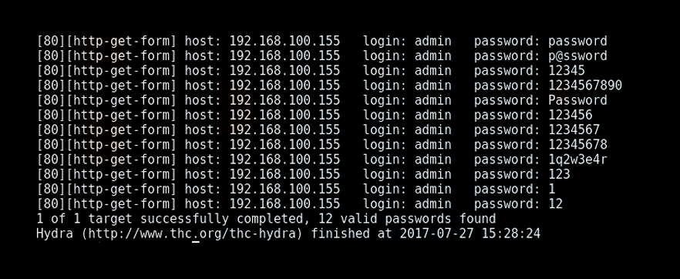
Method of using trial and error to crack passwords, credentials and encryption keys.
Work through possible combinations to guess correctly
Excessive forceful attempts to try and “force” their way in

Slide 136
Simple Brute force Attacks
Manually guessing login credentials without the use of software
Weak passwords can be compromised or poor password etiquette
Hackers may do minimal reconnaissance to crack potential passwords

Slide 137
Dictionary Attacks
Brute Force technique where it uses predefined list of passwords
Software based password spraying of multiple characters of either numbers, letters or special characters
Typically time consuming and low chances of success compared to other attacks

Slide 138
Hybrid Brute Force Attacks
Mixture of dictionary & simple brute forcing
Includes logical guesses and level of difficulty can be dependant on reconnaissance
Experiments with common words and letters such as “Cisco123”

Slide 139
Reverse Brute Force Attacks
Begins with a known password, which may have been discovered through a breach
Known password is used to search for a matching login credentials using a list of usernames
Attacks may use common passwords such as “Password1” to spray across various accounts

Slide 140
Credential Stuffing
Injection of stolen usernames and passwords
May be used across different sites
Typically found of the dark web, lists of compromised credentials

Slide 141
Brute Force Lab
Follow the video tutorial
Practise Brute Force lab & Password spraying
Notes:
NCSC Password Compromise List
Challenge to decrypt hash
Check what tools you could use to crack the password
Captcha deterrent, invalid attempts, lockouts

Slide 142
Password Spraying Lab
Follow the video tutorial
Practise Brute Force lab & Password spraying
Notes:
Pass the Hash
Challenge to decrypt hash
Check what tools you could use to crack the password
Captcha deterrent, invalid attempts, lockouts

Slide 143
Malware Activity

Slide 144
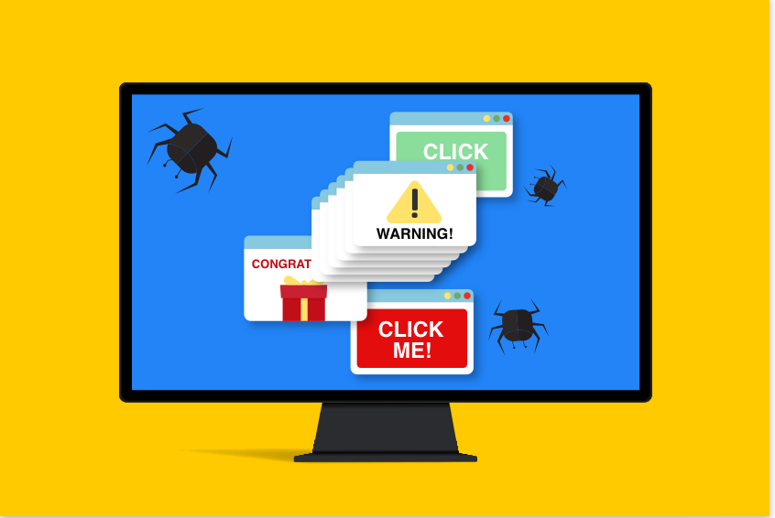
Adware
Unwanted or malicious advertising
Harmless but irritating and sometimes difficult to remove
These ads may lead to harmful sites/downloads, Important not to click on them
Typically found on websites

Slide 145
Adware
Adware isn’t known to spread but more of an annoyance
Can cause impacts to the device only if clicked on
Spread through software bundling typically

Slide 146
Adware Example
Fireball 2017
Israeli software company found more than 250 million computers infected
Browser hijacker which changes your search engine to a malicious one, obtrusive ads are then displayed and prevents you from modifying browser settings
Luckily no evidence of anything else, but the company Rafotech who created fireball could of launched a cyber attack with devastating consequences.

Slide 147
Fileless Malware
Malicious code which targets non-file objects like Office365 macros.
No executable file, anti virus will be difficult to protect against
Code my require admin rights - deterrent

Slide 148
Fileless Malware
Ability to self-replicate and laterally move across a network
Can spread across networks or email attachments however mostly remain undetected because its memory based, not file-based
A lot of malware can be deterred by using least privileges in organisations. This helps prevent cyber criminals from leveraging malware to gain employee credentials and access restricted data.
IT Admin can also disable PowerShell unless required to reduce malicious scripts from running

Slide 149
Fileless Malware Example
Operation Cobalt Kitty
OceanLotus Group infiltrated several corporations and conducted nearly six months of stealthy operations before being detected
Multi-phased attack which started with Fileless Malware injected via PowerShell Payloads

Slide 150
Viruses
Infect other programs and can spread across systems, as well as performing maliciousness
Attached to files and executed upon launch
Can encrypt, corrupt, delete or move your files
Can replicate themselves

Slide 151
Viruses
Can replicate and attach replicas of itself to other files and applications
Ability to spread via multiple ways such as removeable media, email attachments, unsafe download links
Mainly spread via the Internet

Slide 152
Virus Example
Take 5 minutes
Research some serious virus events which have occurred and how they affected organisations
Present to group

Slide 153
Worms
Target known exploits
Can spread across devices or systems but can’t infect programs
Latest patches & updates – deterrent
Firewalls and email filtering for suspected worm infections

Slide 154
Worms
Worms are self-replicating that enter networks allowing them to move from computer to computer
Worms require no interaction such as opening a file, and spread automatically

Slide 155
Worm Example
ILOVEYOU virus came within email attachments, which would target victims via lover letters
Once attachment is opened it is then re-sent to everyone
Reached 45 million users, in 10 days

Slide 156
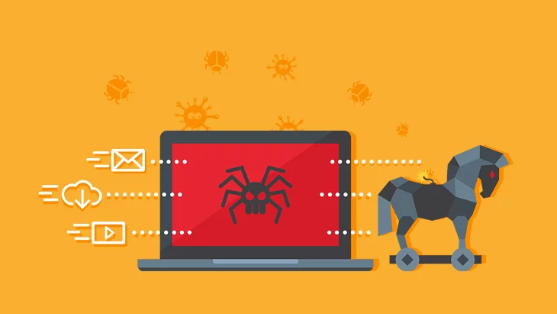
Trojans
Trojans programs pretends to be legitimate one, but actually malicious intent
Trojan would be executed via the victim, normally via C&C, backdoor, RAT
Always download from trusted sources and avoid unknown sources - detterent

Slide 157
Trojans
•Similar characteristics except a Trojan horse does not replicate. Worms commonly utilize network resources
•Trojans can spread across many methods similar to other information security events

Slide 158
Trojan Example
Emotet in 2018 most dangerous and destructive malware
Financial information theft, bank logins and cryptocurrencies
Spread via malicious emails as spam and phishing campaigns

Slide 159
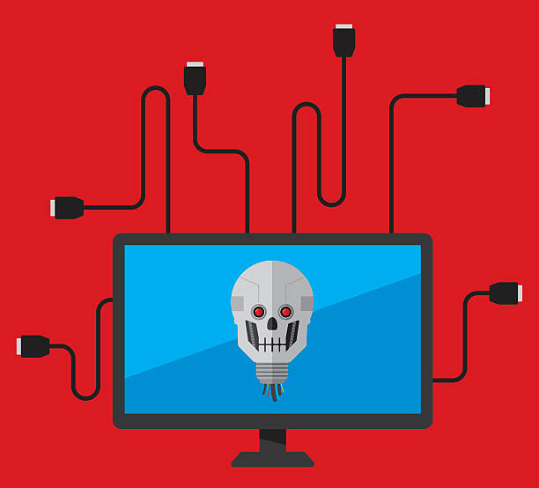
Bots
Software or program that performs automated tasks without interaction
What other malware performs an action which is predetermined conditions such as certain time or condition
An infected device can spread to other devices creating a botnet
What do you think can happen? (Refer back to C&C)

Slide 160
Bots
•Bots can self-replicate like worms or replicate upon request via C&C.
Can spread via other means of malware such as trojan
Bots have all sorts of purposes, spambots, malicious chatterbots, file-sharing bots, DDoS bots and many more

Slide 161
Botnet Example
Mirai was an example of DDoS botnet which was discovered in 2016
Targeted university DNS to disrupt services worldwide
Masterminded by students using IoT devices

Slide 162
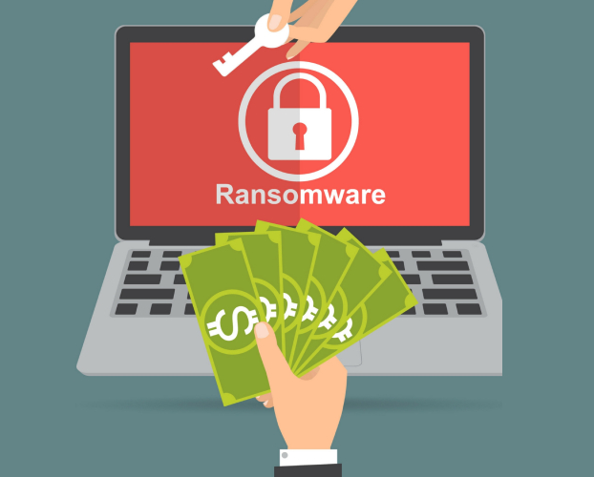
Ransomware
Encrypts the devices data and holds it ransom until the victim pays to release
Threats to delete the data by certain time/date if the ransom isn’t paid can occur
Typically in cryptocurrency form, as tracking a user down via wallet addresses isn’t easy

Slide 163
Ransomware
•Ransomware affects any device it is executed on; this doesn’t necessarily replicate itself but can encrypt a whole system
Ransomware can spread and infect devices across a network, important to isolate any devices from the network

Slide 164
Ransomware Example
Take 5 minutes
Research some serious ransomware events and how they affected organisations
Prepare for a group discussion

Slide 165
Spyware
Monitor the activity of targets on their systems
Can include screen grabs, keylogging, microphone and camera access as well as general logging
Spyware comes with software/programs from untrusted sources

Slide 166
Spyware
•Spyware can replicate via Trojan Horses which can also be controlled via RAT (Remote Admin Tools), which will allow you to control the zombie device
Spyware can spread but is normally alerted by anti virus/ windows defender. Depending on network & admin rights

Slide 167
Spyware Example
CoolWebSearch
Browser hijacker which has many variants that redirect you to coolwebsearch.com
Installs a lot of suspicious bookmarks, shortcuts, etc.
Uninstallation is complex and wont completely remove when done manually

Slide 168
National Institute of Standards and Technology

Slide 169
Malware Incident Handling
Prepare
Detection and Analysis
Containment
Eradication
Recovery
Post-Incident Activity

Slide 170
Preparation
Organisations should perform regular measures to ensure they can respond effectively to malware incidents. Some actions can include:
Building and maintain malware related skills within the incident response team
Facilitate communication and coordination throughout the organisation
Acquiring necessary tools and resources to assist in malware incident handling

Slide 171
Detection and Analysis
Organisations should strive to detect malware incidents to minimise the number of infected hosts and damage to the organisation. Some recommended actions include:
Identify infected hosts and prepare them for the next steps
Study the behaviour of malware by analysis either actively or forensically

Slide 172
Containment
In this part of the process there are two focuses: stop the spread of malware and prevent further damage to hosts. Organisations should have strategies and policies in place for containment related decisions.
Strategies may include isolating devices from organisation networks

Slide 173
Eradication
This is the process of removing malware from infected hosts. The potential damage of the malware may require different methods of eradication. This can include restoring infrastructure to a previous back up but this also impacts the business.

Slide 174
Recovery
Two parts of this stage include restoring functionality of infected hosts and removing any temporary containment measures.

Slide 175
Post-Incident Activity
Important for organisations to conduct robust assessment of previous experiences to learn from major malware incidents to prevent any similar occurrences. An important step to assist in preparation for future malware incidents.

Slide 176
Introduction
Week 2
Intro
Monday
01
02
Wednesday
03
04
Tuesday
05
06
Thursday
Friday

Slide 177
Recap Session (15 Mins)
xxx?
xxx?
xxx?
xxx?
xxx?
Notes:
Critical National Infrastructure

Slide 178
Syllabus – Week 2
Monday
xxx
xxx
Tuesday
xxx
xxx
Wednesday
xxx
xxx
Thursday
xxx
Friday
xxx
xxx

Slide 179
Suspicious user behaviour

Slide 180
Definition
Set of actions taken by a user (who may or may not be authenticated) that is out of the ordinary
Overcoming existing security controls
Depending on infrastructure actions can be labelled beforehand

Slide 181
Example
Administering video streaming service and have forbidden certain areas due to licensing reasons
Would it be suspicious if client traffic came from forbidden areas?
What could you implement to mitigate this issue?

Slide 182
Geographical Location
Impossible travel action
During a small window of time if the same user is performing actions from locations which would be impossible to travel, this could be suspicious
Having a predefine set of policies that match the organisations requirements is a defence mechanism for the organisation

Slide 183
Unusual Login
Examples of unusual login could be login attempts after hours such as the middle of the night, or someone connects to their workstation from abroad.

Slide 184
Benefits of Automation Handling
Provides many measurable benefits, such as saving time
Remediation measures that will improve workflow and minimise the risk of security breach
Allow the automation of detection and remediation and free up staff to focus on other security needs

Slide 185
Suspicious User Behaviour Case Study
User logged in from a new device
The system compared the device to a list of known devices and flagged it. MFA sent to Client
User Failed MFA
User tried logging in multiple times with different devices and Ips
Passwords were tried from rainbow tables of passwords that wouldn’t be allowed
User submitted a ticket on the platform to try gain access but didn’t provide sufficient identification or answer security questions

Slide 186
Case Study
With those steps mentioned in the previous slide, how would you design a system that could trigger automated rules and suspend credentials after a specific number of failed attempts?

Slide 187
Suspicious Device Behaviour

Slide 188
Exploring suspicious behaviour
An action which runs without the user’s knowledge
Malicious or irregular actions

Slide 189
Suspicious Behaviour Detection
Watches all system processes for signs of active malware
Examples of suspicious behaviour could be writing to registry or file copying.
Systems can be put in place to alert the administrator and/or block the process

Slide 190
IDS (Intrusion Detection System)
Vulnerability scanning & analyses activity on the network
Searches for patterns and indicators of compromise of known threats
Can only check and alert management or administrator. No action to avoid or prevent activity

Slide 191
IPS (Intrusion Prevention System)
Similar to IDS, however capable of taking action
Has the ability to block suspicious or malicious activity and PREVENT attacks.
Also referred as IDPS (Intrusion Detection Prevention System)

Slide 192
Indicators of Compromise IoCs
Symptoms of those events happen
Example: additional network traffic
Notes:
Security logs being cleared

Slide 193
Phishing
Main vector of receiving malware. So popular because of the weakness of humans

Slide 194
USB Peripherals
USB devices are another vector to receive malware and infect workstations
The method of leaving infected USB flash drives with malicious

Slide 195
Remote Desktop Protocols
Another invitation of possible vector is remote desktop software
File transfer, I/O control and many more option with remote desktop
Ransomware has been known to be targeted this way to innocent users who connect their desktops to third party “tech” companies.

Slide 196
Unauthorised System Changes

Slide 197
Unauthorised System Changes
Unauthorised changes on computers or networks can cause serious problems to arise
Altering the physical or logical nature of a computer and/or network without knowledge of the modification is reckless and negligent
Information systems require stability and upkeep performance to keep confidentiality, integrity and availability
Information security is based upon knowledge of how a system should perform.

Slide 198
Introduction
Week 1
Intro
Monday
01
02
Wednesday
03
04
Tuesday
05
06
Thursday
Friday

Slide 199
Recap Session (15 Mins)
xxx?
xxx?
xxx?
xxx?
xxx?
Notes:
Critical National Infrastructure

Slide 200
Syllabus – Week 2
Monday
xxx
xxx
Tuesday
xxx
xxx
Wednesday
xxx
xxx
Thursday
xxx
Friday
xxx
xxx

Slide 201
Introduction
Week 1
Intro
Monday
01
02
Wednesday
03
04
Tuesday
05
06
Thursday
Friday

Slide 202
Recap Session (15 Mins)
Xxx
Xxx
Xxx
Xxx
Xxx

Slide 203
If you see a slide with this background…
Recap Session

Slide 204
If you see a slide with this background…
Exercises & Labs =

Slide 205
If you see a slide with this background…
Important Information =

