Slide 1
BCS Level 3 Award in Mobile and Operating Systems Syllabus
QAN 603/0134/X
Version 2.0 September 2017

Slide 2
1 Operating System Software and Configuration(40%, K2)
In this topic, the apprentice will gain an understanding and working knowledge of current operating systems. The successful apprentice should be able to:
Describe different operating system platforms
List and order the basic process of building a PC
Describe the process for installing a software operating system
List and describe the order of tasks required for end-to-end testing of an operating system to ensure it works as intended (Windows, Linux)
Summarise the native applications for different operating systems
Explain the security principles when running an operating system running on a platform

Slide 3
1.1 Describe different operating system platforms

Slide 4
What is an Operating System?
Interface between hardware, applications, and the user
Standard environment for hardware and application developers
Utility programs for users
Kernel and device drivers
Command-line and Graphical User Interfaces (GUI)
Markets
Business client
Network Operating System (NOS)
Home client PCs
OR?
Smartphones and tablets...

Slide 5
Windows Server
A group of operating systems
Can support Enterprise-level management, data storage, applications and communications.
Windows Server focuses on Security, Networking, and stability.
WMI – Windows management Infrastructure
MI – Management instrumentation
OMI – Open Management Infrastructure
Active Directory (AD) - The Active Directory provider, also known as the Directory Services (DS) provider, maps Active Directory objects to WMI.
BitLocker Drive Encryption (BDE) - Provides configuration and management for an area of storage on a hard disk drive

Slide 6
Windows Desktop

Slide 7
Windows 7
Released 2009
netmarksetshare.com (2015) – about 56%
Desktop
Start menu

Slide 8
Taskbar
Manage windows
Show desktop / peek
Notification area
Start Menu & Taskbar Properties

Slide 9
Aero

Slide 10
Windows 7 Editions
Editions and markets
Starter (Netbooks)
Home Basic (“developing” countries only)
Home Premium
Business
Professional (retail)
Enterprise (volume licence)
Ultimate
x86 versus x64

Slide 11
Windows 8 / Windows 8.1
OS for PCs, laptops, and smartphones / tablets
Windows Apps versus Desktop Applications
Windows 8 Editions
“Core” or “Basic”
Professional
Enterprise
x86 versus x64

Slide 12
Using the Start Screen
Replaces Start menu with touch-oriented interface and live tiles
Windows 8.1 restored Start button and boot to desktop
Start+X

Slide 13
Windows Vista
Released 2007
netmarksetshare.com (2016) – about 1.6%
Editions
Home (Premium / Basic)
Professional (Business / Enterprise)
Ultimate
Compared to Windows 7
No pinned Taskbar items (Quick Launch toolbar instead)
Gadgets within Sidebar
Note gadgets should no longer be enabled due to security problems

Slide 14
Windows System Requirements
CPU
Cores / speed
x86 versus x64 (32 bit v 64 bit)
System memory
Official requirements often too conservative
Graphics adapter / graphics memory
Hard disk
Capacity not usually a problem with modern disks
Often represent a performance bottleneck though

Slide 15
Windows System Limits
Professional / enterprise editions support better hardware at the high end
Multiple physical processors
Maximum system memory
Professional / enterprise editions support enterprise networking
Home editions cannot join domains
DVD / Blu-ray playback limitations

Slide 16
Windows Upgrade Paths
Type of upgrade
In-place
Clean install (migration) -> better
In-place generally preferred for home / small office
In-place upgrade must be performed from a supported product

Slide 17
Native Apps and Operating Systems
Native Apps are applications that have been developed to be used with particular hardware and software.
This gives them an advantage as they can take full advantage of the hardware and software combined.
Windows has many native applications that can be used for a variety of different tasks.
Internet Explorer
Edge
Notepad
Paint
Command Prompt

Slide 18
Internet Explorer
First released in 1995.
Discontinued from windows 10 and above
Internet explorer is preinstalled with your Windows OS
IE had a great range of devices it was used on
Highly compatible with all windows operating systems
Great ease of access
Was/is considered simpler to use
IE was the first browser to allow you to open up tabs you closed
IE was not as fast as its competitors
It had limited customisation
Did not offer nearly the same amount of addons like chrome
Could not store a list of blocked websites
Security became a problem as it was the most common browser.

Slide 19
Edge
Edge was the browser that was supposed to replaced IE
Comes preinstalled on Windows like IE
PDF support built in to the browser
Fairly lightweight
Often is faster that other browsers
According to the Security Council of Certificate Authorities (CASC), the current Edge browser is in fact the fastest and more secure browser on the market
Uses Microsoft own search engines (Bing) that is not as good as competitors
Less browser extensions than others
Cannot search through history of the browser
Not 100% compatible with web standards

Slide 20
Notepad
Very lightweight
Can be used to modify program scripts and code
Based of MS-DOS
Included on all versions of windows from 1.0 onwards
Very simple – Maybe too simple
Harder to use that other IDE’s
Does not offer the same amount of flexibility to users than other text editors like WordPad or notepad++
Not very user friendly
Outdated

Slide 21
Paint
Microsoft Paint is a simple raster graphics editor that has been included with all versions of Microsoft Windows
In July 2017, Microsoft added Paint to the list of deprecated Windows features
Very basic feature set

Slide 22
Upgrade Advisor / Assistant
Why would this NOT be a good idea?

Slide 23
Linux servers
Open Source
Built off of UNIX
Linux is the most popular operating system on Servers – macOS Server and Windows both Cost.
If a problem persists in Windows or macOS they have to assign their teams to identify and resolve the problem.
If Linux has a problem it can be solved most of the time quicker as its open source millions of users can help.
This makes Linux Stable, Secure, and flexible
UBUNTU Server is a very common Linux Server

Slide 24
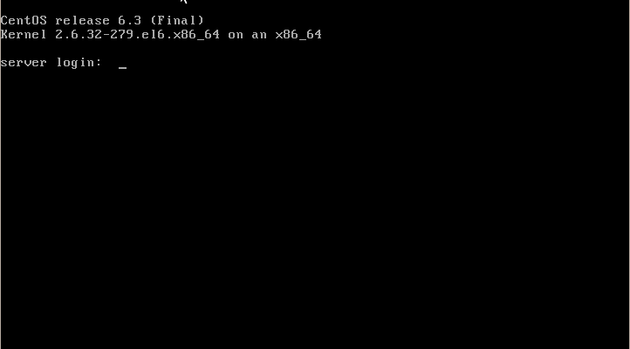
Linux Server
Highly reliable and powerful
Super efficient and scalable
Command line only
Need to know the commands to be able to use fully

Slide 25
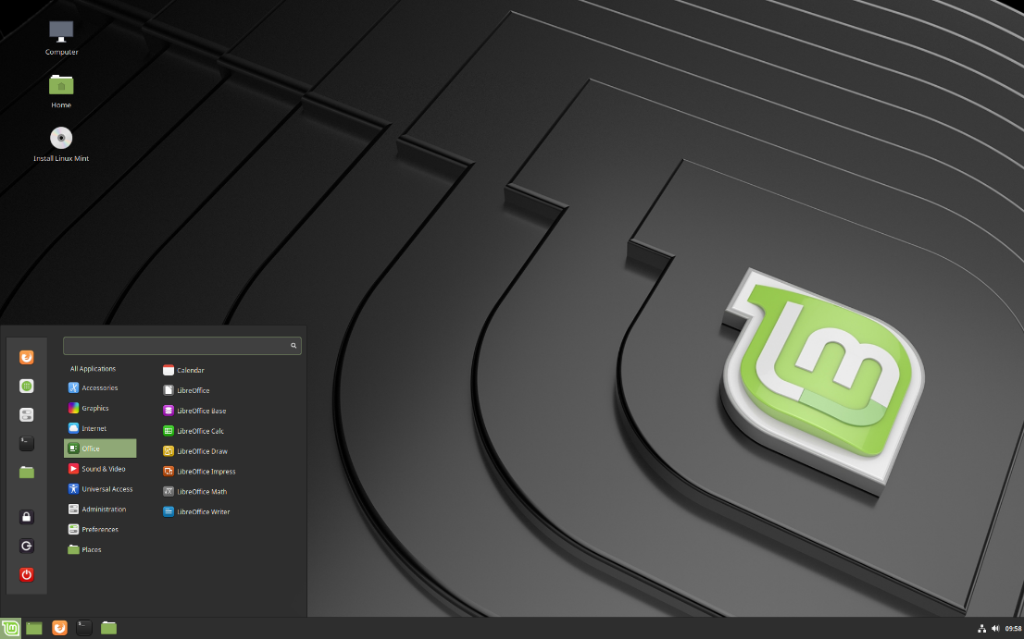
Linux Desktop
Many varieties, called distro’s
Linux has an interface similar to windows so it is not to difficult to use.
A lot of the commands are similar also:
Ipconfig (Windows)
Ifconfig (Linux)

Slide 26
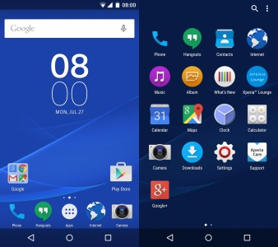
Android
Initially developed by Android Inc. and then bought by Google
Based off the Linux OS family and other open source software
Can be customized significantly more than Apple IOS
Can be distributed across a massive range of mobile devices (Tablets, phablets, and phones)
Apps can be installed from Google Play Store
Apps can also be installed from other sites like Amazon and also APKs
Primarily for touch devices

Slide 27
Android
The core Android source code is known as Android Open Source Project (AOSP), and is primarily licensed under the Apache License
Android is also associated with a suite of proprietary software developed by Google, called Google Mobile Services
Installed by default on Android devices
the Google Chrome web browser
Google Search
Gmail
The application store and digital distribution platform Google Play

Slide 28
Apple IOS
Based of OSX/UNIX OS family
Customization is limited unless jailbroken
Only available on Apple products such as iPod Touch, iPhone, and iPad
Applications can only be installed from Apple app store
In most cases more secure than Android

Slide 29
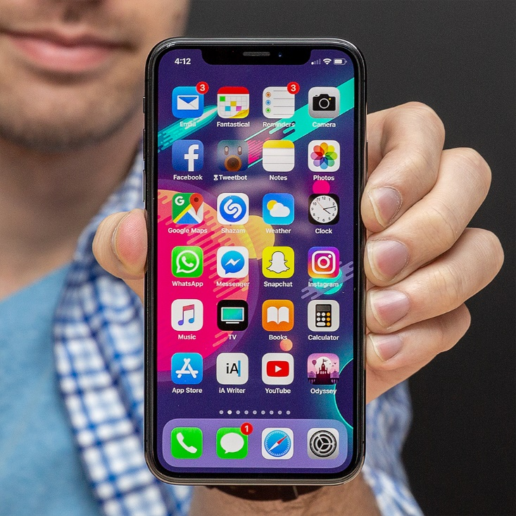
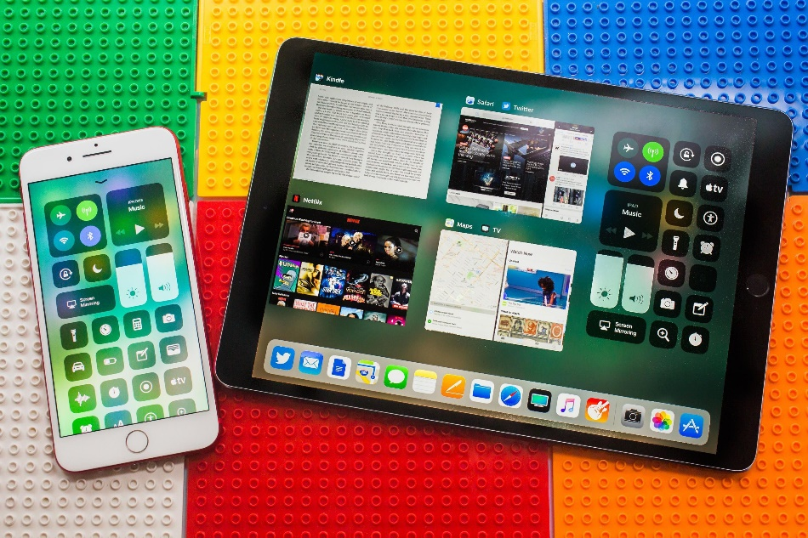
Apple iOS
iOS is a mobile operating system created and developed by Apple exclusively for its hardware
It is the operating system that presently powers many of the company's mobile devices, including the iPhone, iPad, and iPod Touch
It is the second most popular mobile operating system globally after Android

Slide 30
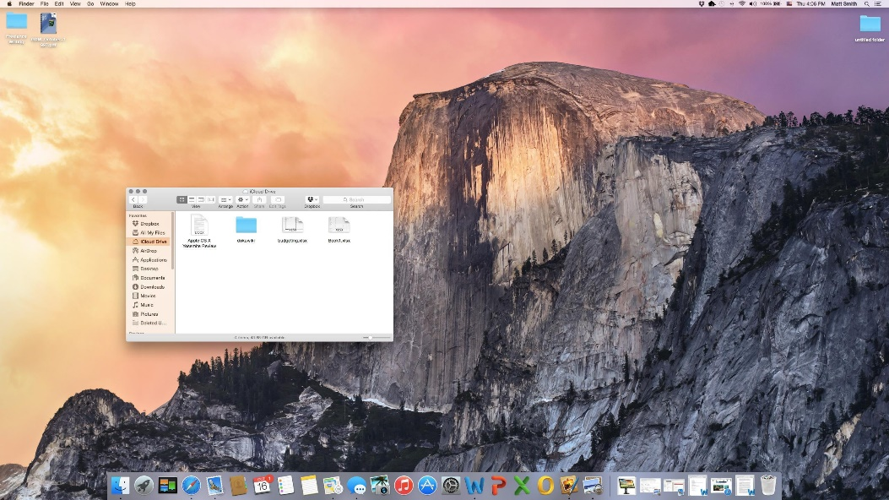
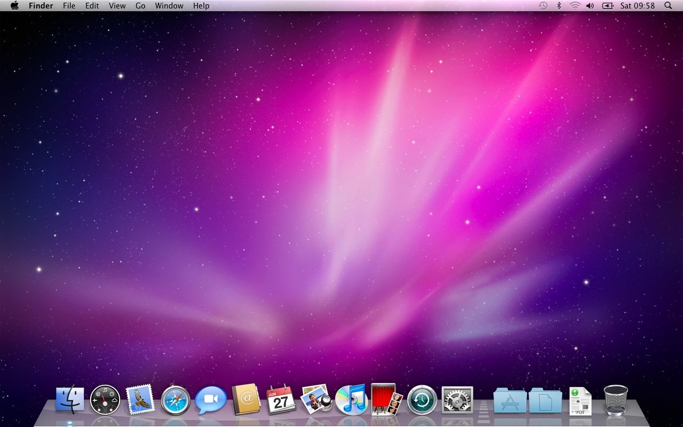
MacOS
macOS is a series of graphical operating systems developed and marketed by Apple Inc. since 2001
It is the primary operating system for Apple's Mac family of computers
Within the market of desktop, laptop and home computers, and by web usage, it is the second most widely used desktop OS, after Microsoft Windows

Slide 31
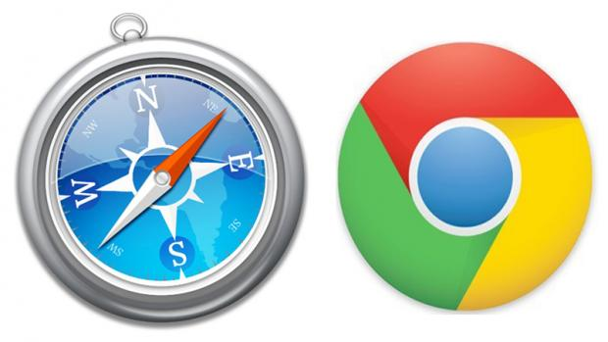
Safari
Safari is a Native app to IOS (you can get other apps that do the same job on IOS but they are not as efficient as the native)
Safari is quicker and has a more uniformed design with IOS than other apps.
Because it is designed with IOS in mind it can accomplish this.
IOS and safari ships with 2 apple products iPhone and iPad, Chrome for instance needs a browser that can work across a multitude of different devices, size, shape, notch, no notch, RAM, CPU, and so on.

Slide 32
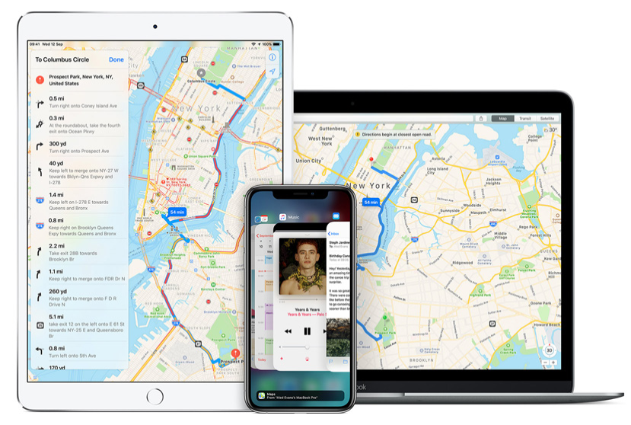
Apple Maps
Apple maps is native to apple devices alone
The point of Maps is to help people with apple products navigate and plan journeys or even days out.
Maps has a quick search function that will search for POIs (Points of Interest).
Has proactive suggestions such as the best time to leave for work on a weekday.
Can be used indoors at big shopping complexes to help people find what they are looking for.
Can use iCloud to save favorites form your other apple products and retrieve them later on a mobile device.

Slide 33
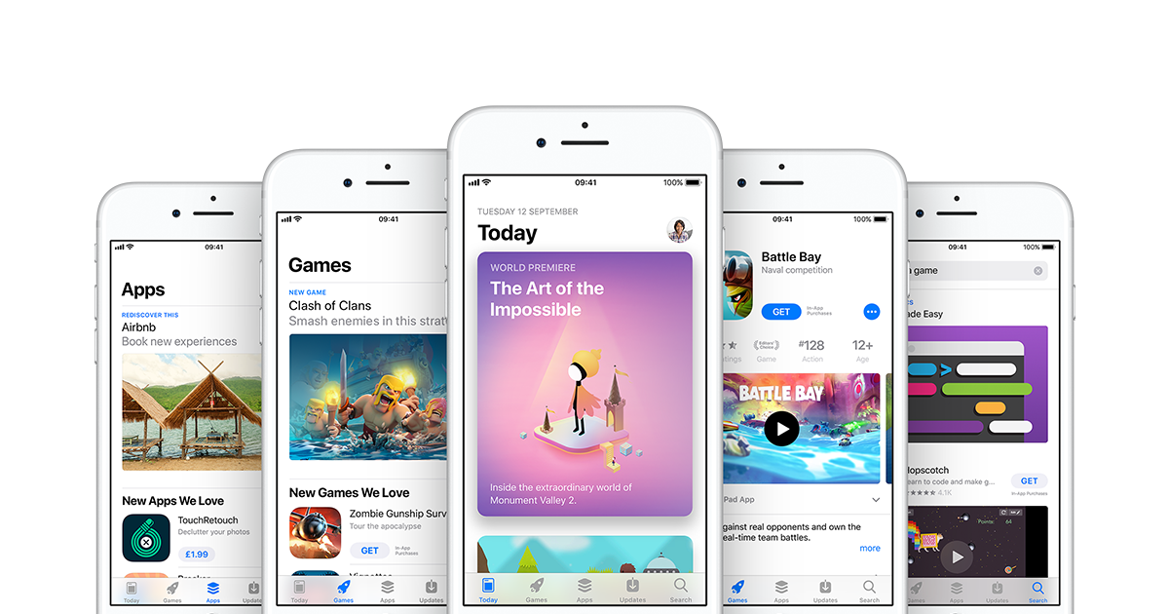
App Store
Apples application store – App store is in apples words designed for discovery.
The App store is only available on apple iOS
The App store allows users to download secure certified applications to their mobile devices.
Compared to Android apple doesn’t have as many apps
However Apple in the first half of 2018 outpaced google play store in revenue
$22.6 billion worldwide to $11.8 billion from google.
https://techcrunch.com/2018/07/16/apples-app-store-revenue-nearly-double-that-of-google-play-in-first-half-of-2018/?guccounter=1

Slide 34
1.2
List and order the basic process of building a PC

Slide 35
Component Selection
To build a complete PC you need the following components:
Motherboard
Processor
Memory
Hard drive
Graphics card
CPU cooler and fan
Power supply
Case
Monitor
Optical drive*

Slide 36
Order of Component Assembly
Motherboard
CPU cooler and fan
Memory
Case
Power supply
Hard drive
Optical drive
Graphics card
These are assembled outside of the case
then inserted into the case
The case is opened, stand-offs for the motherboard screwed in and then the motherboard is inserted
Connect to the motherboard via cables
Plugs into the motherboard

Slide 37
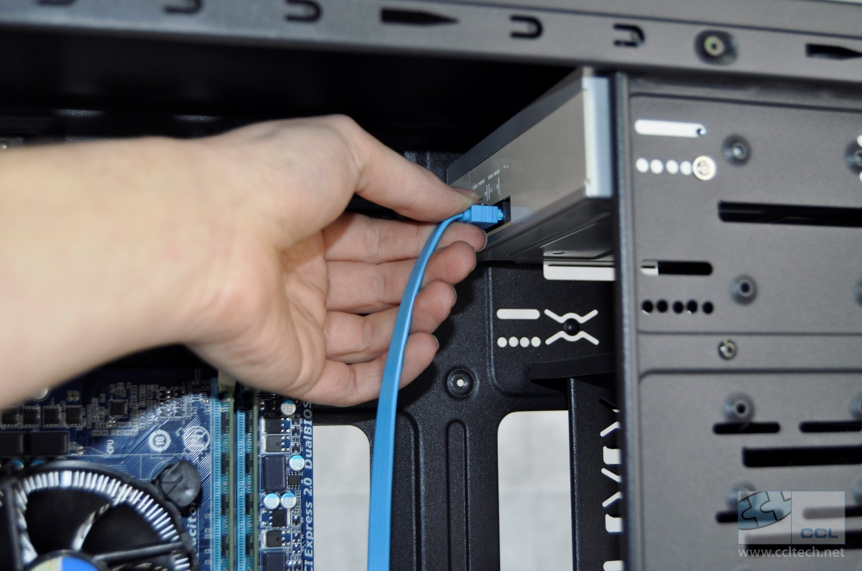
Assembly

Slide 38
Environment Precautions
Static is a major factor to consider
An electrostatic wristband and mat should be used when working with components
Ensure you have earthed yourself and the mat
Unplug the mains from all equipment before working on anything

Slide 39
1.3 Describe the process for installing a software operating system.

Slide 40
Obtaining Installation Media
Windows
Linux
Mac /IOS
Android

Slide 41
Windows
Download an ISO
Media creation tool
Write to CD, DVD or USB flash drive

Slide 42
Linux
Download a distro
Write to DVD or USB stick

Slide 44
MACOS and iOS
MacOS and iOS are installed via download when the machine is booted up
To install the latest version of macOS, the user needs at least maxOS Snowleopard on DVD

Slide 45
Android
A stock ROM can be downloaded from the manufacturers website
A modified ROM can be downloaded from various sites.
Modified ROMs do not have the Google or manufacturer’s bloatware installed
Can sometimes ‘brick’ your device

Slide 46
Identifying Suitable Hardware

Slide 47
Installing Software
Windows and Linux Desktop systems
There are two types of software to be installed on a desktop system:
The operating system
Application software
iOS platforms
Base system
Application software installed from the AppStore
Android systems
Base system
Application software installed from the PlayStore

Slide 48
OS Installation
In Windows you will need to create a Hyper-V virtual file for each of Windows 10 and Linux Mint

Slide 49
Windows Desktop
https://www.youtube.com/watch?v=SKbR6XT7fcA

Slide 50
Linux Desktop
We will use the Linux mint Distro
https://www.youtube.com/watch?v=G0AFuhVSvEk (this link has a very good description which can be copied and pasted into a word document)

Slide 51
Configuring for first use
Windows:
https://www.zdnet.com/article/how-to-set-up-a-new-windows-10-pc-perfectly-in-one-hour-or-less/
Linux mint: https://www.youtube.com/watch?v=RXV6FXVL6xI

Slide 52
Post-installation Tasks
Windows:
Check Device Manager for unknown devices
Check setup log files and verify no critical errors in System and Application logs
Use Programs and Features to install software applications
Optionally, restore user data / create user accounts
Update system documentation

Slide 53
1.4 List and describe the order of tasks required for end-to-end testing of an operating system to ensure it works as intended (Windows, Linux)

Slide 54
Perform a login as an Administrative User
Using the virtual machines you created, login in as the Administrator
To keep systems secure, we use a special account called the Administrator account
The Administrator account allows the user to perform very specialised functions only reserved for the Administrator
Windows:
If you are the first user, you are the Administrator, but you need to confirm this on many occasions by clicking the continue button. (*very secure*)
Alternatively, you could create an Administrator account purely for admin functions (much more secure)
Linux:
There are two types of users:
Root
General users

Slide 55
Linux Root
If a Linux system has been set up with a super user account, you will need to log in as root
You will need to know what the root password is
Unless you really, really know what you are doing, do not run any rm –rf commands
More here: https://www.howtogeek.com/125157/8-deadly-commands-you-should-never-run-on-linux/
If you have logged in as a standard user, you can gain super user privileges by using sudo
Example:
sudo apt-get update

Slide 56
Test Remote Management
WinRM (Windows Remote Management)
WinRM is the “server” component of this remote management application and WinRS (Windows Remote Shell) is the “client” for WinRM, which runs on the remote computer attempting to remotely manage the WinRM server
BOTH computers must have WinRM installed and enabled on them for WinRS to work and retrieve information from the remote system
While WinRM listens on port 80 by default, it doesn't mean traffic is unencrypted
Traffic by default is only accepted by WinRM when it is encrypted using the Negotiate or Kerberos SSP. WinRM uses HTTP (TCP 80) or HTTPS (TCP 443)
WinRM also includes helper code that lets the WinRM listener to share port 80 with IIS or any other application that may need to use that port

Slide 57
Test Remote Management
Create a second Hyper-V Windows machine
Install the client (WinRS) on one and the server (WinRM) on the other
Test that you can access the server machine
For example, if you want to perform a directory listing on the system drive on a remote machine, you can remotely launch ‘dir’ using this syntax:
winrs -r:machinename dir

Slide 58
Perform a Login as a Normal User
Using your virtual machines, log in as a standard user

Slide 59
Verify That a Normal User Cannot Use Admin Tools Requiring Elevated Permissions
In Windows, in a command terminal, run the following command:
net users administrator /active:yes
You should have received an “Access denied” message
If you run cmd as Administrator by right clicking, and the run the command again, it should provide you with access

Slide 60
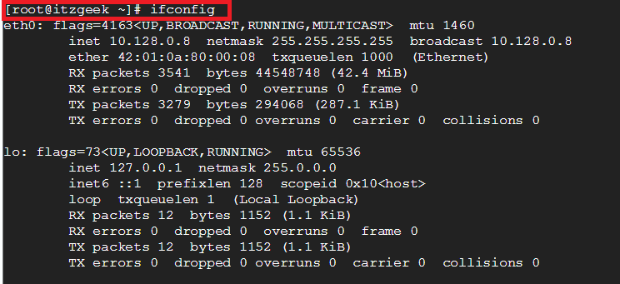
Verify That a Normal User Cannot Use Admin Tools Requiring Elevated Permissions
In Linux, in a terminal, run the following command:
ifconfig
In Linux, in a terminal, run the following command:
find -name *.sh
You should receive a message that you do not have the correct privileges
Now run the command again, but precede it with sudo
sudo find -name *.sh

Slide 61
Verify That Connectivity to Network Resources and Internet Services Works Correctly
Windows:
On your Windows machine with WinRM:
Create a folder called Shared in the C: drive
Give sharing permissions for everyone
On the Windows machine with WinRS:
See if you can access the shared drive
See if you can access the following website on both machines:
http://superglos.co.uk/appWiki

Slide 62
Verify That Connectivity to Network Resources and Internet Services Works Correctly
Linux:
See if you can access the shared drive on the Windows machine
See if you can access the following website:
http://superglos.co.uk/appWiki

Slide 63
1.5 Summarise the native applications for different operating systems

Slide 64
IOS
Safari
Maps
App Store

Slide 65
Safari
Safari is a Native app to IOS (you can get other apps that do the same job on IOS but they are not as efficient as the native)
Safari is quicker and has a more uniformed design with IOS than other apps.
Because it is designed with IOS in mind it can accomplish this.
IOS and safari ships with 2 apple products iPhone and iPad, Chrome for instance needs a browser that can work across a multitude of different devices, size, shape, notch, no notch, RAM, CPU, and so on.

Slide 66
Apple Maps
Apple maps is native to apple devices alone
The point of Maps is to help people with apple products navigate and plan journeys or even days out.
Maps has a quick search function that will search for POIs (Points of Interest).
Has proactive suggestions such as the best time to leave for work on a weekday.
Can be used indoors at big shopping complexes to help people find what they are looking for.
Can use iCloud to save favorites form your other apple products and retrieve them later on a mobile device.

Slide 67
App Store
Apples application store – App store is in apples words designed for discovery.
The App store is only available on apple iOS
The App store allows users to download secure certified applications to their mobile devices.
Compared to Android apple doesn’t have as many apps
However Apple in the first half of 2018 outpaced google play store in revenue
$22.6 billion worldwide to $11.8 billion from google.
https://techcrunch.com/2018/07/16/apples-app-store-revenue-nearly-double-that-of-google-play-in-first-half-of-2018/?guccounter=1

Slide 68
Windows
IE
Edge
Notepad
Paint
Command Prompt

Slide 69
Internet Explorer
First released in 1995.
Discontinued from windows 10 and above
Internet explorer is preinstalled with your Windows OS
IE had a great range of devices it was used on
Highly compatible with all windows operating systems
Great ease of access
Was/is considered simpler to use
IE was the first browser to allow you to open up tabs you closed
IE was not as fast as its competitors
It had limited customisation
Did not offer nearly the same amount of addons like chrome
Could not store a list of blocked websites
Security became a problem as it was the most common browser.

Slide 70
Edge
Edge was the browser that should have replaced IE
Comes preinstalled on Windows 10 like IE
PDF support built in to the browser.
Fairly lightweight (desktop app)
Often is faster that other browsers
According to the Security Council of Certificate Authorities (CASC), the current Edge browser is in fact the fastest and more secure browser on the market
Uses Microsoft owned search engines that are not as good as competitors (Bing)
Does not have an easy ecosystem
Less browser extensions than others
Can not search through history of the browser
Not 100% compatible with many web standards.

Slide 71
Notepad
Very lightweight
Can be used to modify program scripts and code
Based of MS-DOS
Included on all versions of windows from 1.0 onwards
Very simple – Maybe too simple
More difficult to use that other IDE’s
No formatting
Does not offer the same amount of flexibility to users than other text editors like Notepad++
Not very user friendly
Outdated look

Slide 72
Paint
Microsoft Paint is a simple raster graphics editor that has been included with all versions of Microsoft Windows
In July 2017, Microsoft added Paint to the list of deprecated Windows features
Very basic feature set

Slide 73
Linux
Nano
Terminal

Slide 74
Android

Slide 75
Chrome
Maps
Play Store

Slide 76
1.6 Explain the security principles when running an operating system running on a platform; with a focus on physical hardware, virtual servers and cloud services
secure configuration following recommended good practice;
• user access control;
• malware protection;
• patch management.

Slide 77
User Access Control
User Account Control (UAC) is a security component in Windows operating systems
UAC enables users to perform common tasks as non-administrators and as administrators without having to switch users, log off, or use Run As

Slide 78
Malware Protection
Malware is a term used to describe malicious software, including spyware, ransomware, viruses, and worms
Malware breaches a network through a vulnerability, typically when a user clicks a dangerous link or email attachment that then installs risky software
Once inside the system, malware can do the following:
Blocks access to key components of the network (ransomware)
Installs malware or additional harmful software
Covertly obtains information by transmitting data from the hard drive (spyware)
Disrupts certain components and renders the system inoperable

Slide 79
Patch Management
Patch management is an area of systems management that involves acquiring, testing, and installing multiple patches (code changes) to an administered computer system
Windows Server Update Services – WSUS
Update management is the process of controlling the deployment and maintenance of temporary software versions in a production environment. It can help you maintain operational efficiency, overcome security breaches as well as maintain your production environment’s stability.

Slide 80
2 Remote Systems Management (60%, K2)

Slide 81
In this topic area, the apprentice will understand the importance of disaster recovery, how a disaster recovery plan works and their role within it.
The successful apprentice should be able to:
2.1 Describe the top-level tasks required to deploy a VPN
2.2 Describe how HTTPS provides secure access to web applications.
2.3 Describe how VOIP provides voice communication over IP.
2.4 Describe how using encryption technologies can securely transport data across mobile or wireless networks
2.5 Describe the key features of mobility
2.6 Explain how tools can be used to remotely manage devices or provide assistance to remote users
2.7 Describe how each item in the list would help secure a mobile device.
2.8 Explain the top-level configuration
2.9 Identify the benefits of device encryption and a strong passcode on a user's mobile device

Slide 82
802.1x and standards

Slide 83
WIFI
IEEE 802.11 is a set of standards for implementing wireless local area networks
802.11a
802.11b
802.11c
802.11g
802.11n
802.11i

Slide 84
The 802.11 Protocols
The 802.11abgn specifications are collectively and individually referred to as Wi-Fi

Slide 85
802.11a
802.11a operates in the 5 GHz frequency band and utilizes OFDM (Orthogonal Frequency Division Multiplexing)
Modulation for up to 54 Mbps data rate.

Slide 86
802.11b
802.11b operates in the 2.4 GHz frequency band and utilizes DSSS (Direct Sequence Spread Spectrum)
Modulation for up to 11 Mbps data rate
Supported range of 150 feet (doesn't include occluding objects)
Devices that can cause interference include:
Microwave ovens
Bluetooth devices
Baby monitors
Cordless telephones
Amateur radio equipment

Slide 87
802.11c
This works in the 2.4 GHz band (like 802.11b), but uses the same OFDM based transmission scheme as 802.11a
Operates at a maximum physical layer bit rate of 54 Mbit/s exclusive of forward error correction codes, or about 22 Mbit/s average throughput
Fully backward compatible with 802.11b hardware
Experience interference from other products operating in the 2.4 GHz band

Slide 88
802.11g
802.11g operates in the 2.4 GHz frequency band and utilizes OFDM and DSSS modulation for up to 54 Mbps data rate
Can suffer from the same interference issues as 802.11b
802.11g hardware is fully backward compatible with 802.11b hardware

Slide 89
802.11i
Used for WPA2
Used to facilitate secure end-to-end communication for wireless local area networks (WLAN)

Slide 90
802.11n
IEE 802.11n sought to increase the achievable speeds of Wi-Fi networks beyond that achievable using 802.11g
802.11n is an amendment that improves upon the previous 802.11 standards by adding multiple-input multiple-output antennas (MIMO)
802.11n operates in both the 2.4 GHz and 5 GHz frequency bands
Utilizes OFDM modulation, and uses advanced technologies including MIMO (Multiple-Input Multiple-Output) spatial multiplexing to increase throughput and range

Slide 91
802.11n (Wi-Fi 4)
Supports a theoretical transfer rate of 300 Mbps, can achieve 450 Mbps when using 3 antennae
Uses MIMI (Multiple Input Multiple Output) allows for multiple transmitters/receivers to operate simultaneously
Support for 2.4 GHz and 5 GHz

Slide 92
802.11ac (Wi-Fi 5)
Speeds ranging from 433 Mbps up to several Gigabits per second
Only supports 5GHz
Uses MU-MIMO (Multi User MIMO) this doesn’t increase speeds but increase the data throughput

Slide 93
WiFi Security
WEP
WPA
WPA2
WPS

Slide 94
WEP
Wired Equivalent Privacy
When a client connects to a WEP-protected network, the WEP key is added to some data to create an “initialization vector,” or “IV” for short
When a client sends its request to the access point, the portion containing the IV is transmitted wirelessly in clear-text (not encrypted)
WEP is not the correct choice for securing your network

Slide 95
WPA
WiFi Protected Access (WPA
Ratified by the WiFi Alliance in 2003 as a response to the insecurities that were discovered in WEP
Uses a pre-shared key (PSK), referred to as WPA Personal, and the Temporal Key Integrity Protocol or TKIP
Included a new message integrity check nicknamed “Michael”
While Michael offered a great deal of improvement over the old way of securing networks, there was still some worry about some security issues with using a similar (though much stronger) implementation

Slide 96
WPA2
The concerns about Michael led to WPA2’s introduction in 2004
At the center of WPA2 is its use of a security protocol based on Advanced Encryption Standard (AES), the U.S. Government’s preferred choice of encryption
As it stands now, the only people who should still be using TKIP on a wireless network are those who are dealing with hardware that is rated for 802.11g only

Slide 97
WPS
WiFi Protected Setup
A user is able to add new devices to their network by simply pushing a button (within administration software or physically on the router) and then typing in an 8-digit PIN number on the client device

Slide 98
80
80
443
443
Ports
There are 65535 ports
Think of ports like a dock for boats.
Only the ports of 1 to 1023 have pre assigned boats that can dock there
The other ports are available to anyone to dock at and share
Boat and port diagram “ports” “Boats as Data”
Notes:
Certain ports like 443 will have a certain set or rules or instructions on how to communicate and share data “just like the boats and ports, port 443 will act differently to port 80. Port 443 might require proof you are who you say you are and 80 will not”

Slide 99
2.1 Describe the top-level tasks required to deploy a VPN
• configure VPN client settings
• receive IP
• configure WAN link
• connect to remote server
• encrypt traffic

Slide 100
What is a VPN?
Virtual Private Network
A connection method used to add security and privacy to private and public networks
Most often used by corporations to protect sensitive data
Privacy is increased with a Virtual Private Network because the user's initial IP address is replaced with one from the VPN provider

Slide 101
Why do I need a VPN?
Hide your IP address
Connecting to a Virtual Private Network often conceals your real IP address.
Change your IP address
Using a VPN will almost certainly result in getting a different IP address.
Encrypt data transfers
A Virtual Private Network will protect the data you transfer over public WiFi.
Mask your location
With a Virtual Private Network, users can choose the country of origin for their Internet connection.
Access blocked websites
Get around website blocked by governments with a VPN

Slide 102
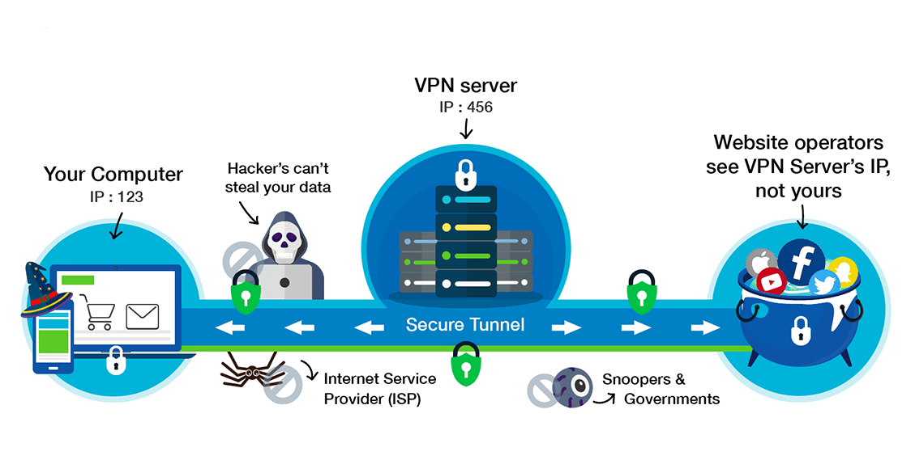
VPN – Virtual Private Network

Slide 103
Before Deploying a VPN
Plan for a software VPN solution that can scale and be easily upgraded
End-of-life hardware issues often cause you to extend platforms which can have detrimental effects on operations and security
Plan for a software VPN solution with integrated management of all VPN components such as servers, clients, users, certificates, etc.
Management is key to maintaining control and reducing time-consuming operations
Ensure all relevant client platforms are supported
This will be important for company-wide acceptance of the solution
Ensure the solution has a concept of rollout and client updates, as well as upgrades that do not require administrator intervention
Client and configuration updates should be configurable at any time and pushed out to the users automatically afterwards
Ensure the solution integrates with your user directories (LDAP/AD) and allows automated synchronization of identities between the user directory and VPN system
Every additional required manual configuration task increases the risk for incomplete user provisioning or de-provisioning
Pay particular attention to usability and user-friendly features and functions
These will effectively reduce support calls and enhance end-user satisfaction

Slide 104
Configure VPN Client Settings
Various VPN’s require different setup procedures
Windows has a built in VPN client

Slide 105
2.2 Describe how HTTPS provides secure access to web applications

Slide 106
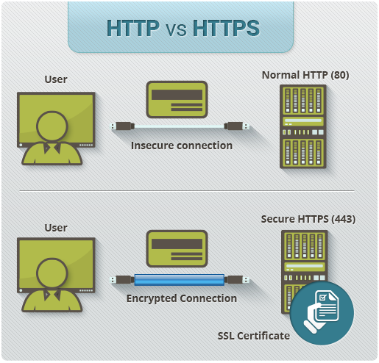
How HTTPS works
HTTPS works on port? 443 or 8080
Typically uses SSL or TLS
Secure Sockets Layer
Transport Layer Security – The new SSL

Slide 107
SSL/TLS
Secure Sockets Layer/ Transport Layer Security
SSL/TLS certificates are required for a secure HTTPS connection
SSL/TLS certificate require a key pair
These are known as a Public and Private Key
Every browser checks against the CA (Certificate Authority) to make sure the certificate is trusted.

Slide 108
SSL/TLS
1. Browser connects to a web server
2. Server sends a copy of its SSL/TLS certificate including the servers public key
3. Browser checks the certificate root against the list of trusted CAs and the certificate is valid and creates then encrypts and sends back a symmetric session key using the servers public key
4. Server decrypts the session key using its private key and then sends back an acknowledgment
5. Server and browser now encrypt all data

Slide 109
2.3 Describe how VOIP provides voice communication over IP

Slide 110
VOIP
VOIP or Voice Over Internet Protocol uses the existing network.
It converts the existing analog signals into network packets and travel like any other type of network data.
You need a ATA or analog telephone adapter to convert the signal or a IP Phone.

Slide 111
2.4 Describe how using encryption technologies can securely transport data across mobile or wireless networks.
• HTTPS
• VPN technologies
• Wireless

Slide 112
Encryption

Slide 113
Wireless Security
Wireless devices often connect via Wi-Fi
WEP – Wired Equivalent privacy
WPA – Wi-Fi protected access
WPA2 – Wi-Fi protected access 2, uses the AES (Advanced Encryption Standard)
WPA2 PSK – Ideal for home office and everyday households. Each device is authenticated with the same key.
WPA2 ENT – used by business and enterprises, it separates the user and routers password by creating a new key every time someone wants to join the network.

Slide 114
2.5 Describe the key features of mobility
• bring your own device
• extends the corporate network to mobile devices
• extends the implementation and enforcement of organisational security policies

Slide 115
BYOD
BYOD – Bring your own device
Company can save money as employees bring their own devices.
People like to use what they know and are comfortable with so increases happiness and satisfaction while also increasing productivity.
Most people will have more up to date technology too which offers better security

Slide 116
Device Encryption
When using a mobile device for work or home use you need to make sure it is secure.
You can encrypt your device so that all communications are sent via end to end encryption.
This helps to secure information on a device that is used on a free or public Wi-Fi hotspot for sensitive information

Slide 117
2.6 Explain how tools can be used to remotely manage devices or provide assistance to remote users
• Remote Desktop / Remote Assistance
• Secure Shell

Slide 118
Remote Desktop
Remote Desktop and Assistance can be used to allow users to access certain devices without actually being in front of them, a good example would be that you can remote desktop in to a server to configure it even though its stored in a server rack. You can also remote desktop in to a work computer and access all your work information without having to worry about transferring all the information to a personal PC.
Remote assistance is like virtual desktop but instead of taking control of the desktop you can assist another user. You both can see what is going on at the same time. This is often used for long distance support of devices.

Slide 119
Secure Shell SSH
SSH, also known as Secure Shell or Secure Socket Shell, is a network protocol that gives users, particularly system administrators, a secure way to access a computer over an unsecured network

Slide 120
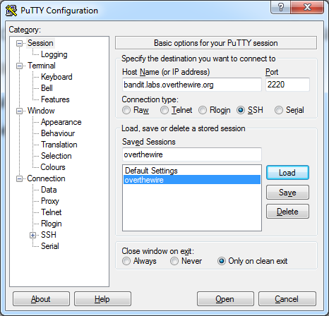
SSH on Windows Computers
Windows does not provide built-in SSH software
Uses open source of Open SSH
Client software:
Putty or Secure Shell for Workstations

Slide 121
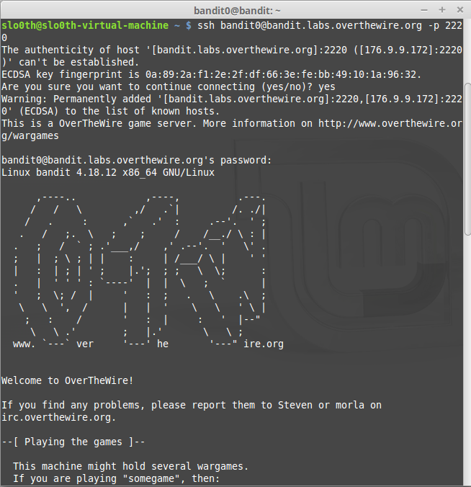
SSH on Linux & Mac OS Computers
Linux and Mac OS both have built-in, command-line SSH programs
To connect from one Linux or Mac OS computer to another, simply type ssh host at the Terminal prompt, where host is either the alphanumeric hostname or numeric Internet Protocol (IP) address
Example:
ssh bandit@bandit.labs.overthewire.org –p 2220

Slide 122
2.7 Describe how each item in the list would help secure a mobile device
• device encryption
• strong device passwords / biometric checks
• transport encryption such as HTTPS / VPN

Slide 123
Device Encryption
Most mobile devices require third party apps to fully implement encryption
Some devices use native encryption like 256-bit AES encryption to encrypt on-device data
Blackberry devices support full encryption including usb drive encryption

Slide 124
Strong passwords / Biometrics
It is important that on a mobile device you have a Strong password or pin code to unlock your device
This stops any random person being able to access the data
Biometrics is also a good solution for device security with many laptops and phones having some sort of fingerprint or facial detection to allow you to access the device.

Slide 125
What to do if lost or stolen
If a mobile device is stolen and it has sensitive information the best thing that can help from the start is a Strong passcode or biometrics.
It is also very useful to have some sort of remote wipe where the next time the devices connects to the internet its told to remove all sensitive information and make the phone useless

Slide 126
Transport Encryption such as HTTPS / VPN
Already discussed previously

Slide 127
2.8 Explain the top-level configuration required for:
• connections that support secure remotely LAN access
o https
o VPN
• mobility options supported by mobile device management software
o remote wipe
o system / software updates
o phone tracking
o data encryption
o security policy enforcement
• security of mobile devices
o mobile security policy enforcement
o encryption at rest and in transit (on the wire)

Slide 128
Many, if not all of these, have been covered in previous sections

Slide 129
2.9 Identify the benefits of device encryption and a strong passcode on a user's mobile device
• if a device is lost or stolen, the data is encrypted
• a strong passcode to help prevent unauthorised access to data

Slide 130
Benefits of Strong Passwords
Strong passwords are much, much harder to crack than weak passwords
Strong passwords are resistant to brute force attack
Confidentiality is maintained

