Slide 1
Hosting

Slide 2
Why would anyone (YOU!) want to publish?
You’re technologists, people (including potential employers) value your opinion – use this to your advantage.
Finding your voice, whether that is through Blogging, Tweeting, YouTubing, Discording, Twitching is incredibly empowering.
If you’re ambitious and wish to “reach the top” you will need to find a way to build your reputation. You can do this – I believe in you.

Slide 3
Why would anyone (YOU!) want to publish?
But don’t just take my word for it, listen to Scott:
https://www.hanselman.com/blog/your-blog-is-the-engine-of-community
https://www.hanselman.com/blog/your-words-are-wasted
Who is Scott and why should I listen to him, I hear your cry!

Slide 4
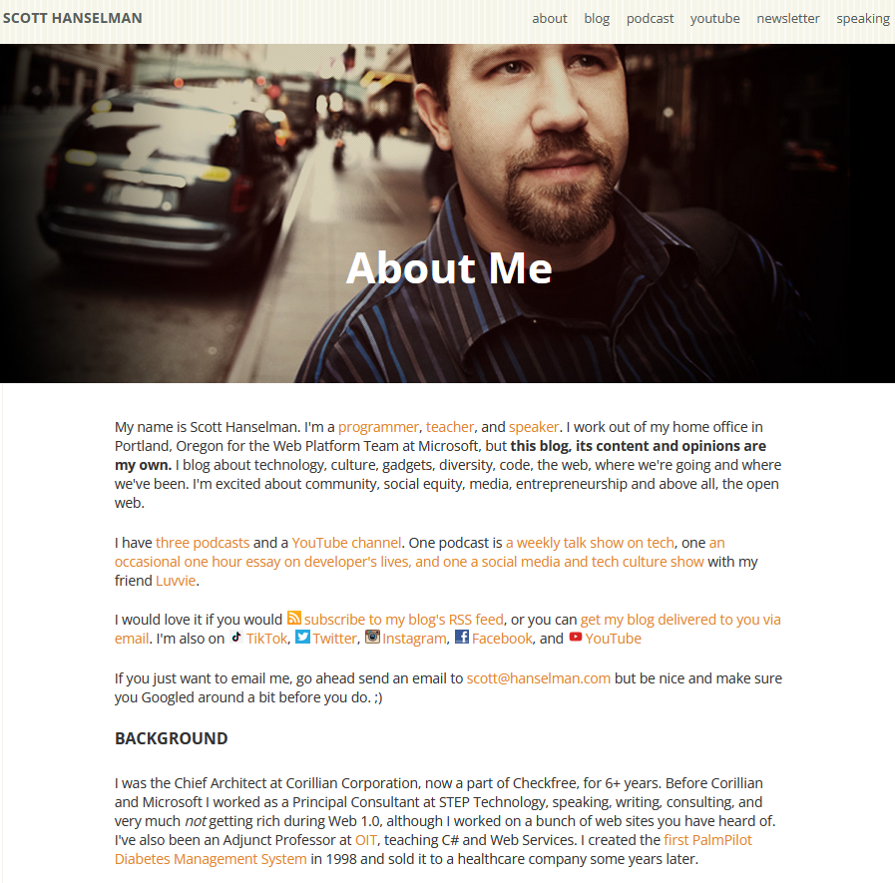
Listen to Scott, he’s a good guy
https://www.hanselman.com/about

Slide 5
Let’s talk about Hosting
Now I’ve convinced you to start blogging, and to own your own words and not use someone like Twitter, Substack, Medium, or even – heavens forbid, Facebook (full disclosure – I am on Facebook, Instagram and WhatsApp) - how do you go about it?
Let me show you one way…

Slide 6
You have options – lots of them
First, let’s be clear – “The Cloud” is just someone else’s computer.
Amazon’s AWS, Microsoft’s Azure and Google’s Cloud Platform folks would love you to think differently, that the Cloud is some super special technology but no - it’s true – The Cloud is just someone else’s computer.
So “Hosting in the Cloud” simply means paying someone to host your stuff – that’s it.

Slide 7
You have options – lots of them
We’ve mentioned AWS, Azure and GCP – they’re certainly the biggest and can be more expensive but for our purposes you really don’t need them.
AWS, Azure and GCP offer lots of tools to help develop, deploy, host, scale and update your sites and apps – this is where their business is.

Slide 8
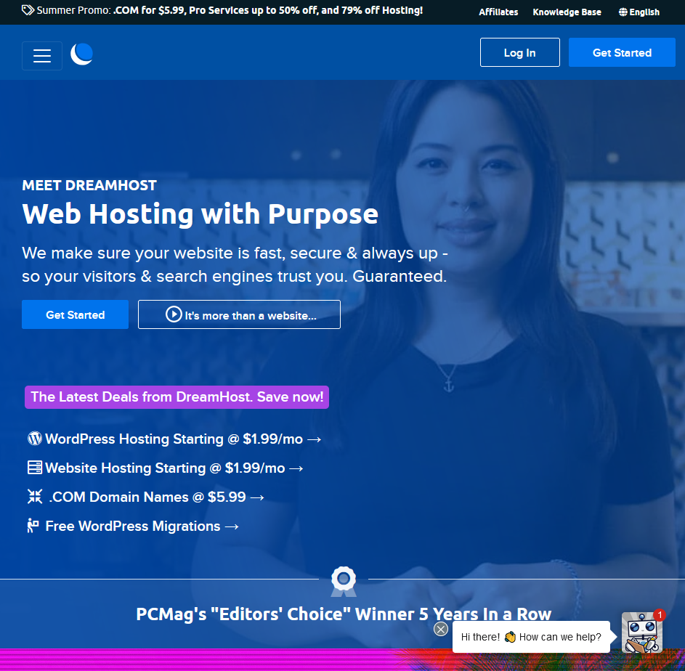
Shared Hosting
One of the easiest and cheapest ways to host your own site or app (like Wordpress) is to use something called Shared Hosting.
I use Shared Hosting provided by a company called Dreamhost but there are many others, notably Fasthosts here in Gloucester – I think Steve worked there?

Slide 9
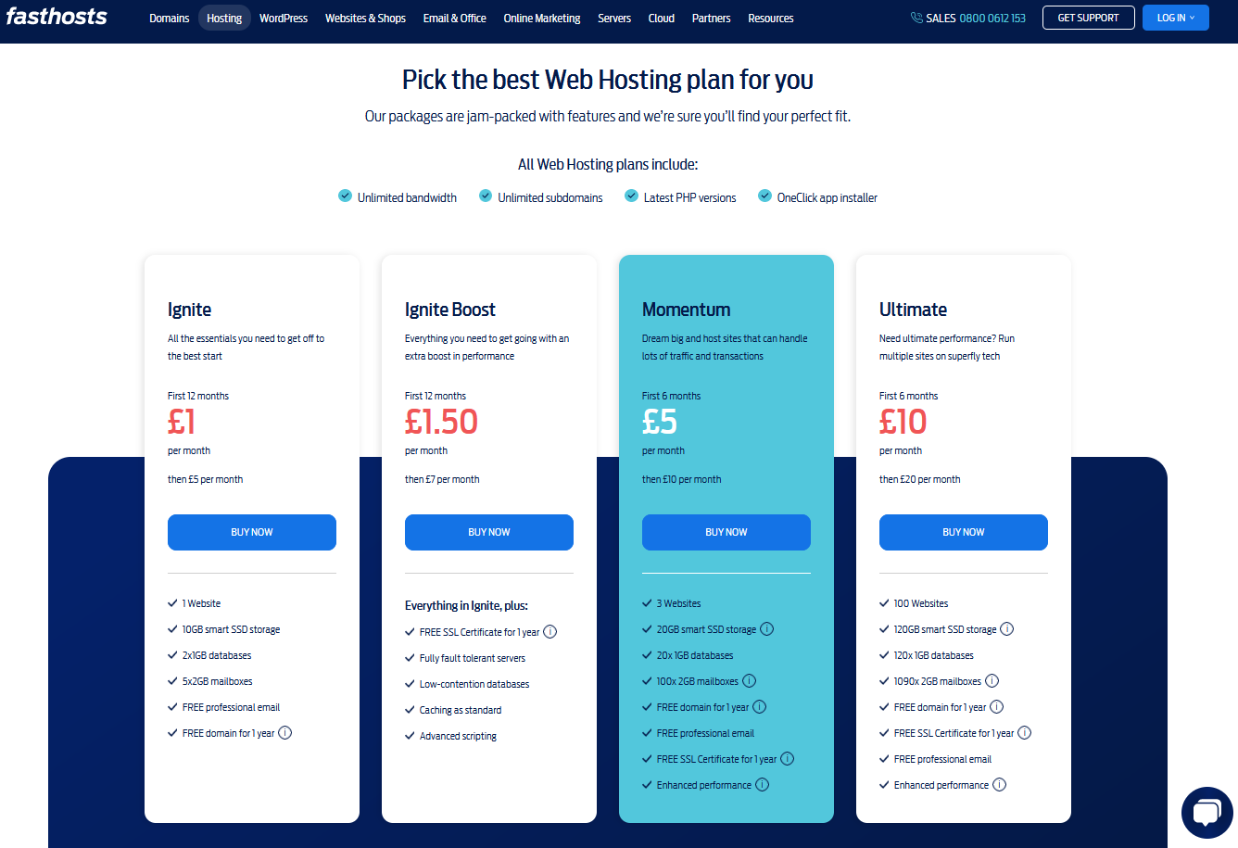
What you will need
A domain (the www.gloscol.ac.uk bit)
A host, like Dreamhost or fasthosts
Fasthosts look very reasonably priced…

Slide 10
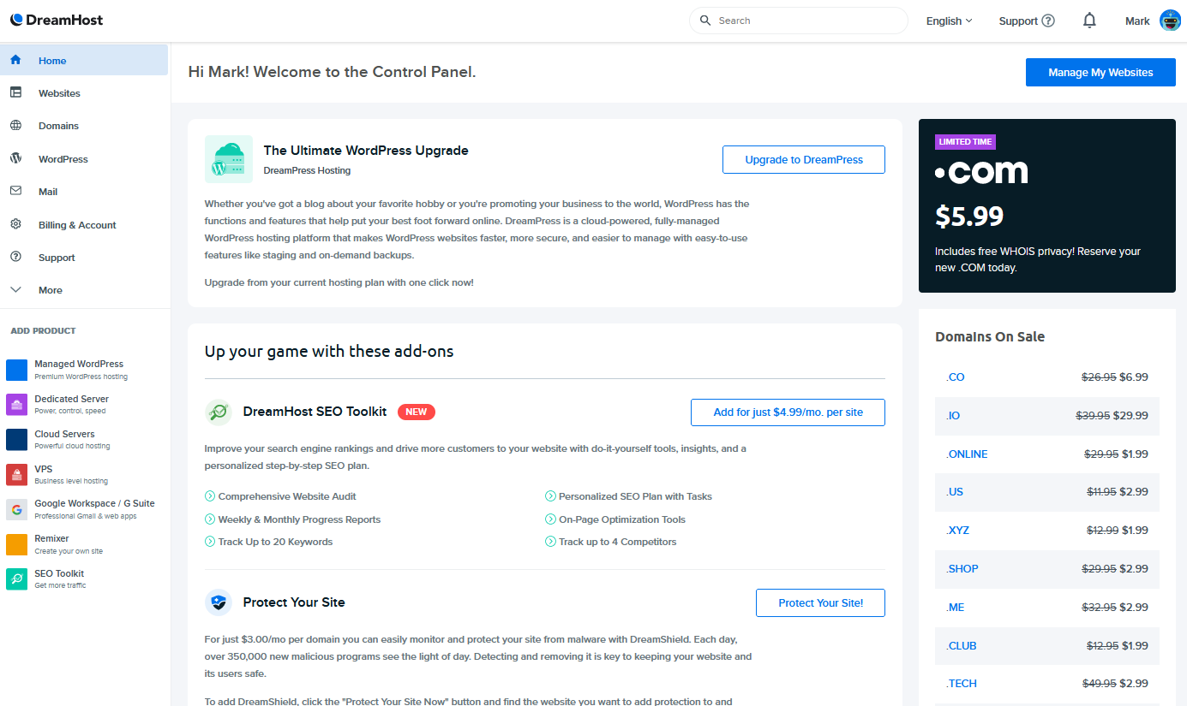
My dashboard
Here you can see my Dreamhost control panel or dashboard – I control my hosting through this portal
(I’m not getting paid for this!)

Slide 11
What else is on the panel
Let me show you with a quick demo of:
Manging websites
FTP Users
MySQL Databases
Secure Cert’s
Managing Domains
Registrations
Managing email

Slide 12
Hosting your app for your assignment
Using Dreamhost, you don’t even need to install a traditional FTP client – can you drag and drop to upload your files through the web interface.
Because I’m super nice, here’s a little series of tutorial videos on how to host with Dreamhost, setting up PHP and MySQL and even FTP’ing thrown in for good measure:
https://www.youtube.com/c/CalebTheVideoMaker2/search?query=dreamhost
Remember, other hosts are available!

Slide 13
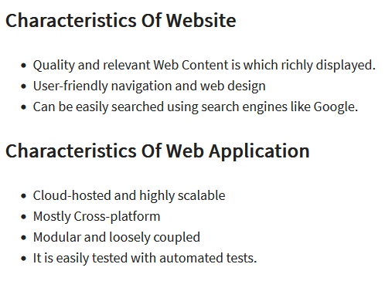
Hosting your application or website
What’s the difference between a web app and a web site?
This is not a straightforward question to answer – like many things in computing the line is blurry
For some good pointers, have a look at this site:
https://www.guru99.com/difference-web-application-website.html

