Slide 1
OS Security &
Defensive
Programming
Week 1
Intro
Monday
01
02
Wednesday
03
04
Tuesday
05
06
Thursday
Friday

Slide 2
Tuesday’s Agenda
Finishing off Monday’s slides
Writing Better Requirements
Requirements Engineering
Sources of secure programming practices
CyBOK
OWASP
CERT
Microsoft/Oracle*
Employer coding standards/guidelines

Slide 3
Writing better requirements
Requirements Engineering

Slide 4
Requirements Overview
Begin by eliciting requirements for our app/system from the stakeholders
Identifies
what the system/app should do
What the system/app shouldn’t do
What’s preventing the system/app from doing something
Requirements come in the form of:
Natural language requirements
Model based requirements
Graphs – e.g.: UML
Formulas – e.g.: mathematical representation
Code – pseudocode/prototype
Natural Language and Graphs are referred to as artifact based requirements

Slide 5
Requirements Overview
What is an artifact?
Anything written down/documentation
Goals
Other stakeholders
constraints
Good Requirements engineers act as communication hubs, connecting the stakeholders and implementers and any other interested parties

Slide 6
Requirements Process
The SDLC, like most models, are either incomplete, inaccurate or just plain wrong because they don’t exist in isolation.
What happens before the requirements stage?
Are we really starting from scratch in every project?
What happens after the release/maintenance phase?
This SDLC model, like most models are abstractions and by their very nature incomplete, inaccurate and/or out of date
Finally - this is not a linear process!

Slide 7
Requirements Process
Requirements engineering has four major phases
Requirements elicitation
Requirements analysis
Requirements documentation
Requirements verification & validation
1.
Requirements
elicitation
2. Requirements analysis
3.
Requirements documentation
4.
Requirements verification and
validation

Slide 8
Requirements Process
Requirements engineering has four major phases
There is a constant feedback process as you work through these phases, always needing the check and double check emerging requirements
1.
Requirements
elicitation
2. Requirements analysis
3.
Requirements documentation
4.
Requirements verification and
validation

Slide 9
Requirements Process – The Twin Peaks model
1.
Requirements
elicitation
2. Requirements analysis
3.
Requirements documentation
4.
Requirements verification and
validation
Let’s imagine we are designing an ICE system for JLR
We identify layers upon layers of subsystems
Each system and subsystem need to have a requirements engineered design
Or else we get the “Volvo issue”
In-Car-Entertainment System
4 Subsystems
1
2
3
4
Subsystem 3
Subsystem 4
1
2
1
2
3
4
3
4
Subsystem 1
Subsystem 4
1
2
1
2
3
4
3
4

Slide 10
Problems in R.E.
Incomplete or Hidden requirements
Different agendas from different stakeholders
Inconsistent requirements (contradictory)
Terminology
What is a ‘system’?
Unclear Responsibilities
Who’s requirements are more important?
Communication
Shock – some people are not good communicators!

Slide 11
Problems in R.E.
Moving targets
Last week you wanted X, but now you need Y, next week they’ll need Z
Limited time and budget
Baseline requirements must be set, along with penalty costs for changing requirements
Technically unfeasible requirements
I want an emissions free flying car for £10k
Stakeholders
Don’t know/understand requirements
Underspecified requirements
Unclear/unmeasurable non-functional requirements – the system should be fast…
Notes:
Stakeholders - Don’t know/understand requirements – Steve Jobs and previous solutions
Underspecified requirements - deleting blog posts

Slide 12
Generic Process Model
Using this process, you can develop almost anything
Software, Systems, Airplanes, Submarines, Aircraft Carriers etc
We need to consider several things in our process model
Roles and responsibilities
Tooling
Artifacts
Activities & Methods
Milestones
Process Model
Roles and responsibilities
Tooling
Artifacts
Activities & Methods
Milestones

Slide 13
Generic Process Model
This could also be drawn as
Roles and responsibilities
Artifacts
Process Model
Tools
Activities & Methods
Milestones
Notes:
Teams and their members (Roles and responsibilities) need to know which artifacts to develop (activities and methods) in which order (milestones) using what tooling.
When these questions have been answered then we have a good idea of what our process model will look like.

Slide 14
Generic Process Model – an example
Roles and responsibilities
Artifacts
Security Team
Process Model
Security team drafts security requirements
- security requirements are reviewed
- security requirements are signed off
Tools
Activities & Methods
Security team use some sort of DB
to capture and organise project
Requirements.
Could be a spreadsheet or a
dedicated tool
Milestones
Different frameworks and processes
are available
Work backwards from final delivery date
Identify milestones that need to be hit
Notes:
Teams and their members (Roles and responsibilities) need to know which artifacts to develop (activities and methods) in which order (milestones) using what tooling.
When these questions have been answered then we have a good idea of what our process model will look like.

Slide 15
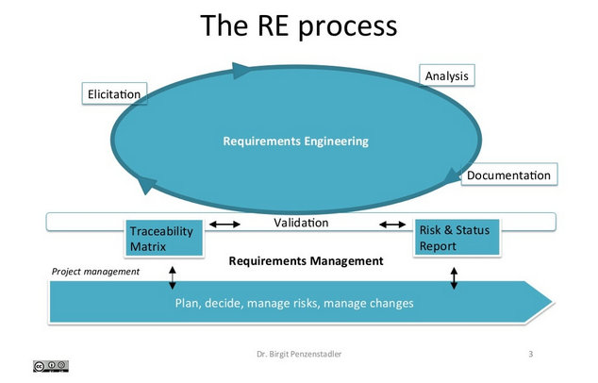
The Requirements Engineering process
A typical RE process is iterative, like almost everything else in software and systems engineering.
We begin by
identifying requirements (elicitation)
prioritizing them (analysis)
writing the up (documentation)
Checking them (validating)
Then refine them by iterating again.
Image copyright Dr. Birgit Penzenstadler

Slide 16
Who is involved?
Major roles in the RE Process
Requirements Engineer – person who carries out the task
Product Owner/Business Analyst/Entrepreneur
Domain Expert
Software or System Architect
Test Team
Any other stakeholders
Project teams are never this happy

Slide 17
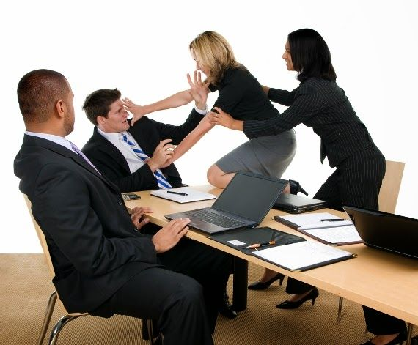
How is the outcome of the RE process used?
Outcomes of the RE Process are used:
Project accounting
Project planning
Stakeholder coordination
Contract negotiation
Product design, integrations
Verification and Acceptance testing
Documentation
Product evolution – what’s next?
Project teams are usually this happy

Slide 18
Requirements Process - elicitation
1.
Requirements
elicitation
Several methods are available to the Requirements Engineer to help capture requirements.
Here are a selection of popular methods – more are available
Surveys
Interview with Experts
Questionnaires
Creativity Techniques
Brainstorming
Change of perspective (wear 6 hats)
Analogy technique
Document-Centric
Systems archaeology
Perspective-based reading
Requirements reuse
(are we updating something?)
Business process
Observation techniques
Field observation
Apprenticing
Support Techniques
Mind-mapping
Workshops
CRC Cards
Audio/Video recordings
Use Case modelling
Prototypes

Slide 19
Requirements Elicitation
1.
Requirements
elicitation
Surveys
Interviews with the experts
Face-to-face, can go in-depth, good level of detail/deep dives
Can be difficult to arrange depending on staff scheduling- herding cats
Can be time consuming
Questionnaires
Can be initially quick to do, but will often need follow-ups/clarifications
Can be ambiguous- need for clarification

Slide 20
Requirements Elicitation - Surveys
1.
Requirements
elicitation
You can see the original here: https://youtu.be/3vsO0g0w1bg

Slide 21
Requirements Elicitation
1.
Requirements
elicitation
Creativity
Brainstorming
Brainstorming paradox
Analogy Paradox

Slide 22
Requirements Elicitation - Creativity
1.
Requirements
elicitation
You can see the original here: https://youtu.be/uL2ykbxaQ2o

Slide 23
Requirements Elicitation
1.
Requirements
elicitation
Document-Centric
System archaeology
Perspective-based reading
Requirements reuse
Business process

Slide 24
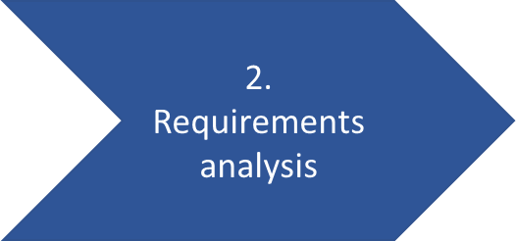
Requirements Process
Requirements analysis
https://www.guru99.com/learn-software-requirements-analysis-with-case-study.html
This is a really good resource for how to perform Requirements Analysis, let’s work through this example.

Slide 25
Requirements Process
Requirements analysis
Building on the previous example from Guru99, let’s look at how this organisation puts together an SRS
https://jelvix.com/blog/software-requirements-specification
They also offer a nice breakdown on the difference between Function and Non-Functional requirements
https://jelvix.com/blog/functional-vs-nonfunctional-requirements

Slide 26
Requirements Process
Requirements documentation
There is no hard and fast rule as to how you “do” requirements management – every organisation is different and will produce different requirements assets
Traditional “heavy” engineering firms tend to have a more thorough process that involves producing more assets to support their process.
You can’t be too careful – Boeing 737-Max

Slide 27
Requirements Process
Requirements verification and validation
Verification – check with the stakeholders – did we record what you said?
Validation – check with the stakeholders are we building the right thing?
These are two different things.
Very often, stakeholders do not fully understand what they are asking for.
It is the job of the requirements engineer to figure that out.

Slide 28
Requirements Process
Requirements verification and validation
Verification – am I building the system right?
Validation – am I building the right system?
These are two different things.
Very often, stakeholders do not fully understand what they are asking for.
It is the job of the requirements engineer to figure that out.

Slide 29
Agile requirements
When we come back in week 2, we will spend some time looking at ways Agile practitioners do their requirements management

Slide 30
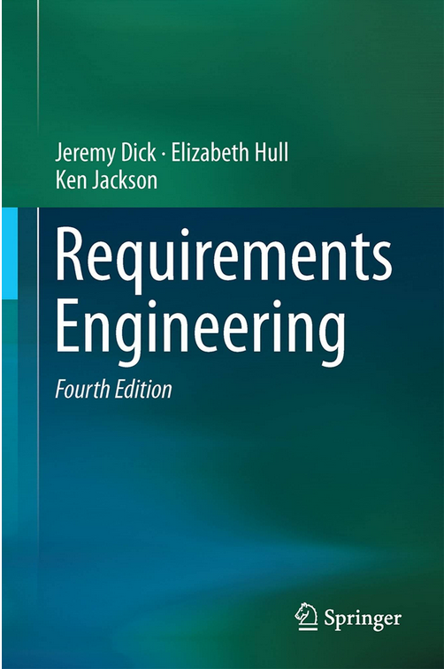
More information
Jeremy and Ken’s book:
Requirements Engineering by Jeremy Dick https://smile.amazon.co.uk/dp/B0754H3632/ref=cm_sw_r_tw_dp_XD68BYW59QECDC7314J1

Slide 31
Writing better requirements
Agile Methodologies

Slide 32
Sources of secure programming practice
Where to learn more

Slide 33
Sources of good practice
CyBOK
SEI
OWASP
CERT
Microsoft

Slide 34
CyBOK
All of CyBOK, but primarily chapters 15, 16 and 17
Chapter 15 – Software Security
Chapter 16 – Web & Mobile Security
Chapter 17 – Secure Software Algorithm

Slide 35
SEI
Carnegie Mellon University run the Software Engineering Institute (SEI)
“At the SEI, we research complex software engineering, cybersecurity, and AI engineering problems; create and test innovative technologies; and transition maturing solutions into practice.”
A list of their areas of interest:
https://www.sei.cmu.edu/our-work/all-topics/index.cfm
I could spend days on their site – so much interesting stuff to read about

Slide 36
SEI – Vulnerabilities database
The Vulnerability Notes Database provides information about software vulnerabilities. Vulnerability notes include summaries, technical details, remediation information, and lists of affected vendors. Most vulnerability notes are the result of private coordination and disclosure efforts.
https://www.kb.cert.org/vuls/

Slide 37
SEI – Technical Papers
The SEI Digital Library houses thousands of technical papers and other documents, ranging from SEI Technical Reports on groundbreaking research to conference proceedings, survey results, and source code.
https://www.sei.cmu.edu/publications/technical-papers/index.cfm

Slide 38
SEI – Tools
Access and download the software, tools, and methods that the SEI creates, tests, refines, and disseminates. Organizations and individuals worldwide use these technologies and management techniques to improve the results of software projects, the quality and behavior of software systems, and the security and survivability of networked systems.
https://www.sei.cmu.edu/publications/software-tools/index.cfm

Slide 39
OWASP
The Open Web Application Security Project (OWASP) have been a source of trusted advice for developers for many years
OWASP looks a bit old and out of date, and it is true many of their documents have not been updated in some time, that’s because they work.
Let’s have a look at a small number of the very many OWASP projects

Slide 40
OWASP – the infamous TOP 10
OWASP Top 10
https://owasp.org/www-project-top-ten/
https://owasp.org/Top10/ - dedicated 2021 site
“The OWASP Top 10 is a standard awareness document for developers and web application security. It represents a broad consensus about the most critical security risks to web applications.
Companies should adopt this document and start the process of ensuring that their web applications minimize these risks. Using the OWASP Top 10 is perhaps the most effective first step towards changing the software development culture within your organization into one that produces more secure code.”

Slide 41
OWASP – Web Security Testing Guide
OWASP Web Security Testing Guide:
https://owasp.org/www-project-web-security-testing-guide/
https://owasp.org/www-project-web-security-testing-guide/stable/
“The Web Security Testing Guide (WSTG) Project produces the premier cybersecurity testing resource for web application developers and security professionals.
The WSTG is a comprehensive guide to testing the security of web applications and web services. Created by the collaborative efforts of cybersecurity professionals and dedicated volunteers, the WSTG provides a framework of best practices used by penetration testers and organizations all over the world.”

Slide 42
OWASP – Cheat Sheets
OWASP Cheat Sheet Series
https://cheatsheetseries.owasp.org/index.html
“The OWASP Cheat Sheet Series was created to provide a concise collection of high value information on specific application security topics. These cheat sheets were created by various application security professionals who have expertise in specific topics.”

Slide 43
OWASP – Secure Coding Practices Guide
OWASP Secure Coding Practices Guide
https://owasp.org/www-project-secure-coding-practices-quick-reference-guide/migrated_content#
“The Secure Coding Practices Quick Reference Guide is a technology agnostic set of general software security coding practices, in a comprehensive checklist format, that can be integrated into the development lifecycle. At only 17 pages long, it is easy to read and digest.”

Slide 44
OWASP – Dependency-Check
OWASP Dependency-Check tool
https://owasp.org/www-project-dependency-check/
“Dependency-Check is a Software Composition Analysis (SCA) tool that attempts to detect publicly disclosed vulnerabilities contained within a project’s dependencies. It does this by determining if there is a Common Platform Enumeration (CPE) identifier for a given dependency. If found, it will generate a report linking to the associated CVE entries.”

Slide 45
OWASP – SAMM
OWASP Software Assurance Maturity Model
https://owasp.org/www-project-samm/
https://owaspsamm.org/model/
“Our mission is to provide an effective and measurable way for you to analyze and improve your secure development lifecycle. SAMM supports the complete software lifecycle and is technology and process agnostic. We built SAMM to be evolutive and risk-driven in nature, as there is no single recipe that works for all organizations.”

Slide 46
OWASP – Secure Coding Dojo
OWASP Secure Coding Dojo
https://owasp.org/www-project-secure-coding-dojo/
The Secure Coding Dojo is a training platform which can be customized to integrate with custom vulnerable websites and other CTF challenges. The project was initially developed at Trend Micro and was donated to OWASP in 2021.
Here are some of the features:
Integrates with Enterprise environments using Slack, Google and LDAP for authentication
It allows grouping of participants according to their development teams
It allows teams to track progress and compete with each other
Each lesson is built as an attack/defence pair. Developers can observe the software weaknesses by conducting the attack and after solving the challenge they learn about the associated software defenses
Predefined lessons are based on the MITRE most dangerous software errors (also known as SANS 25) so the focus is on software errors rather than attack techniques
The predefined hacking challenges are created for entry level and keep the developers engaged. Only a browser is needed.
With CTFs there is a puzzle aspect to the challenges which is great for pen-tester audiences but can make some developers lose interest. In the Secure Coding Dojo the focus is on demonstrating the vulnerability.
There are tips that help the developers as they are exploiting the issue to avoid getting stuc

Slide 47
OWASP – Join up
Want to know more? Join the local chapter - Bristol
https://owasp.org/www-chapter-bristol-uk/

Slide 48
CERT - Computer Emergency Response Team
The EU took the initiative and created CERT back in the early 2010’s
“After a pilot phase of one year and a successful assessment by its constituency and its peers, the EU Institutions have decided to set up a permanent Computer Emergency Response Team (CERT-EU) for the EU institutions, agencies and bodies on September 11th 2012. The team is made up of IT security experts from the main EU Institutions (European Commission, General Secretariat of the Council, European Parliament, Committee of the Regions, Economic and Social Committee). It cooperates closely with other CERTs in the Member States and beyond as well as with specialised IT security companies.”
https://cert.europa.eu/cert/filteredition/en/CERT-LatestNews.html
Good source of up to date news with a European perspective

Slide 49
Microsoft Security Engineering
Microsoft grasped the nettle in 2002 and challenged themselves and the industry to adopt a more secure operating model. It began with one of Bill Gates’ famous memos…
https://www.wired.com/2002/01/bill-gates-trustworthy-computing/
“The Microsoft SDL introduces security and privacy considerations throughout all phases of the development process, helping developers build highly secure software, address security compliance requirements, and reduce development costs. The guidance, best practices, tools, and processes in the Microsoft SDL are practices we use internally to build more secure products and services. Since first shared in 2008, we’ve updated the practices as a result of our growing experience with new scenarios, like the cloud, Internet of Things (IoT), and artificial intelligence (AI).”
https://www.microsoft.com/en-us/securityengineering/sdl

Slide 50
Microsoft Security Engineering
Framework Design Guidelines:
https://docs.microsoft.com/en-us/dotnet/standard/design-guidelines/
This section provides guidelines for designing libraries that extend and interact with the .NET Framework. The goal is to help library designers ensure API consistency and ease of use by providing a unified programming model that is independent of the programming language used for development. We recommend that you follow these design guidelines when developing classes and components that extend the .NET Framework. Inconsistent library design adversely affects developer productivity and discourages adoption.

