Slide 1
USMT

Slide 2
Migrate User Data
You need to know how to
Migrate from previous versions of windows
Migration strategies
Perform a user state migration

Slide 3
Migrate User Data
People don’t like change. Supplying a fresh OS can cause a loss in productivity
The level of user personalisation of the device can include the following.
Desktop appearance, sounds, themes and backgrounds
Start-menu customization
Icons and file associations
Files and folders stored locally
Device and power settings
Application settings, such as autotype and template locations

Slide 4
Migration strategies
Research the different Migration strategies
What method would be best for a new customer wanting an upgrade from Win 7 to Win 10?
A customer who wants a new Win 10 PC?

Slide 5
Migration Strategies
You can perform migration to Windows 10 when your users have new computers on which to install Windows 10 and you want to preserve the settings and data. During the process you can perform the following high-level procedures:
Verify that all existing required applications work on Windows 10.
Ensure that the appropriate edition of Windows 10 is installed on the user’s new computer.
On the new computer, install the required applications.
Back up the user’s data files and settings from the old computer using USMT (User State Migration Tool).
Restore the user’s data files and settings on the new computer using USMT.

Slide 6
Migration strategies
You can use either side by side or wipe and load
A side-by-side migration
In this scenario, the source and destination computers for the upgrade are different machines. You install a new computer with windows 10 and then migrate the data and most user settings from the earlier operating system to the new computer.
A wipe-and-load migration
In this scenario, the source and destination computer are the same. You back up the user data and settings to an external location and then install Windows 10 on the user’s existing computer. Afterward, you restore user data and settings.

Slide 7
Migration strategies
Side-by-side migration uses the following procedure
Either obtain a computer with Windows 10 preinstalled or install Windows 10 on a new computer. When Setup.exe prompts you, choose Custom (Advanced).This is the destination computer.
Install the same applications on the destination computer as are presently on the source computer.
Create an external intermediate storage location, such as a file server–shared folder or an external hard drive, for the storage of user data and settings. This storage must be accessible from both the source and destination computers.

Slide 8
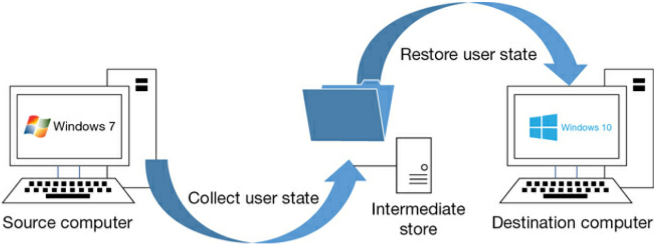
Migration strategies
Use the USMT to collect the user’s data and settings from the source computer and store them to the external intermediate store.
Use the USMT to collect the user’s data and settings from the external intermediate store and install them in the destination computer.

Slide 9
Migration strategies
Wipe-and-load migration strategy
Create an external storage location, such as a file server-shared folder or an external hard drive, for the storage of user data and settings.
Use the USMT to collect the user’s data and settings and store them in the external location.
Install Windows 10 on the existing computer. When Setup.exe prompts you, choose Custom (Advanced).
Reinstall the applications on the computer. Use the USMT to restore the user’s data and settings from the external location.

Slide 10
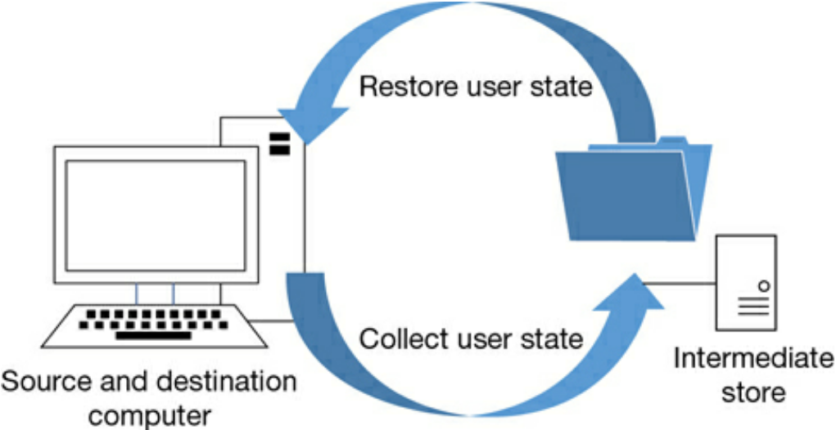
Migration strategies

Slide 11
Considerations for migration
When determining whether to use one of the two migration methods outlined to upgrade to Windows 10, consider the following factors.
You have an opportunity to create a clean installation, free from remnant files and settings.
You can reconfigure the existing disk partitions.
You can upgrade to any Windows 10 edition, irrespective of the earlier Windows edition.
Migration is a more complex process, and you must use migration tools such as User State Migration Tool (USMT) to migrate user data and settings.
You need to provide storage space for user settings and files to be migrated.
Applications are not retained, and you must manually reinstall these.

Slide 12
User State Migration
There are 2 Phases for state migration
Settings and data are captured (collected) from the source computer and stored in a secure migration store using the ScanState tool.
Captured settings and data are restored on the destination computer, using the LoadState tool.

Slide 13
User State Migration
USMT is a collection of three command-line tools that can be scripted to capture and migrate data efficiently and securely and is intended for performing large-scale automated deployments.
ScanState.exe
LoadState.exe
UsmtUtils.exe

Slide 14
User State Migration
You choose which data is captured, and these settings are stored in migration XML files as follows.
MigApp.xml
MigDocs.xml
MigUser.xml
Custom XML files that you can create The XML files provide the migration rules that USMT needs to process. You can also create a Config.xml file that is used to specify files or settings, which will be excluded from the migration.

Slide 15
Data types accessible by USMT
Data Type | Example | Description
User Data
Data Type
Operating system components
Supported applications settings
Using the empty table, research the data that is accessible using USMT and give examples of what type of data it might be migrating.
E.g. User Data – Documents, Any word documents or excel spreadsheets the customer doesn’t want to lose.

Slide 16
Data types accessible by USMT
Data Type | Example | Description
Operating system components
Supported applications settings

Slide 17
Data types accessible by USMT
Data Type | Example | Description
User Data | Documents, Video, Music, Pictures, Desktop Files, Start Menu, Quick Launch settings, and favourites | Folders from each user
 | Shared Documents, shared video, shared music, shared desktop files, shared pictures, shared start menu, and shared favourites | Folders from the public profiles
 | File | USMT searches fixed drives, collecting files that have any of the file name extensions that are defined in the configuration XML file.
 | Access control Lists (ACLs) | USMT can migrate the ACL for specified files and folders.

Slide 18
Data types accessible by USMT
Data Type | Example | Description
Operating system components | Mapped network drives, network printers, folder options, users’ personal certificates, and internet explorer settings | USMT migrates most standard operating system settings
Supported applications settings | Microsoft Office, Skype, Google Chrome, adobe acrobat reader, apple iTunes, and more | USMT will migrate settings for many applications which can be specified in the MigApp.xml file. Version of each application must match on the source and destination computers. With Microsoft Office, USMT allows migration of the settings from an earlier version of an Office application.

Slide 19
USMT
These following settings are not migrated when you use USMT
Local printers,
hardware-related settings
Device drivers
Passwords
Customized icons for shortcuts
Shared folder permissions Files and settings, if the operating systems have different languages installed

Slide 20
USMT
C:\Program Files (x86)\Windows Kits\10\Assessment and Deployment Kit\User State Migration Tool

